Slide 1

Design of Businessmen Forum Building
An-Najah National University
Faculty of Engineering & Information Technology
Department of Building Engineering
Graduation Project ll
Prepared by: Supervisor:
Raya Blawneh Dr. Narmin Al Barq
Wardah Bsharat

Slide 2
Contents of Presentation
Site Analysis
Architectural Design
Structural Design
Environmental Design
Electro – Mechanical Design
Quantity Surveying

Slide 3
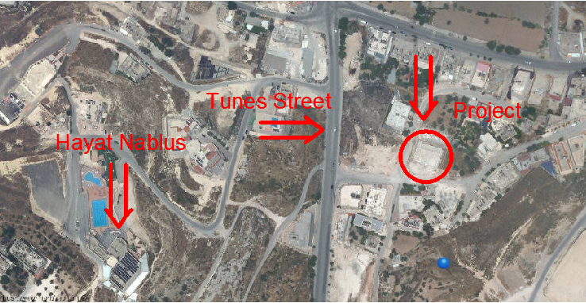
Site Analysis

Slide 4
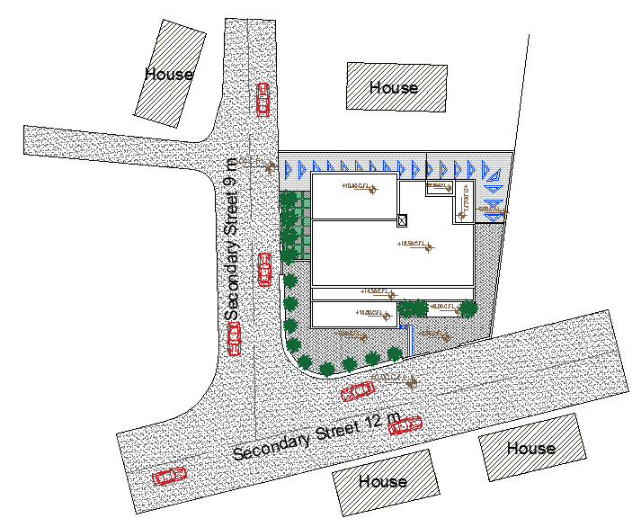
Site Analysis
Total site area = 1000 m²
Building area = 500 m²
Notes:
The site plan speaks for itself and it mainly shows how the building behaves with the surroundings. Total site land is approx. 2000 and the building area is 500
The basement garage ramp is shown here, building main entrance, parking spaces in front of the building.

Slide 5
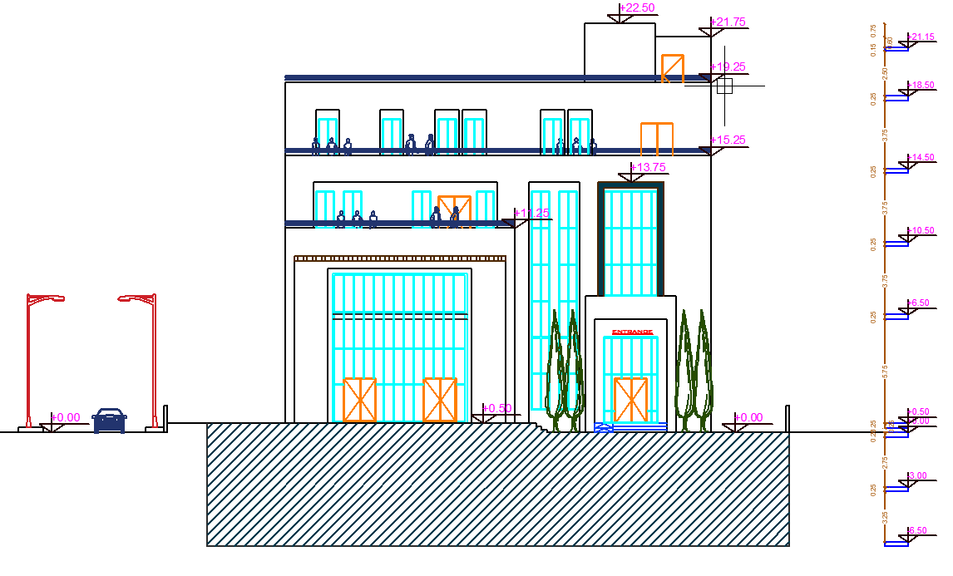
Architectural Design
Southern Elevation
Notes:
Moving on to the first design phase, this slide shows a 3D shot of the building entrance modelled by 3D Max

Slide 6
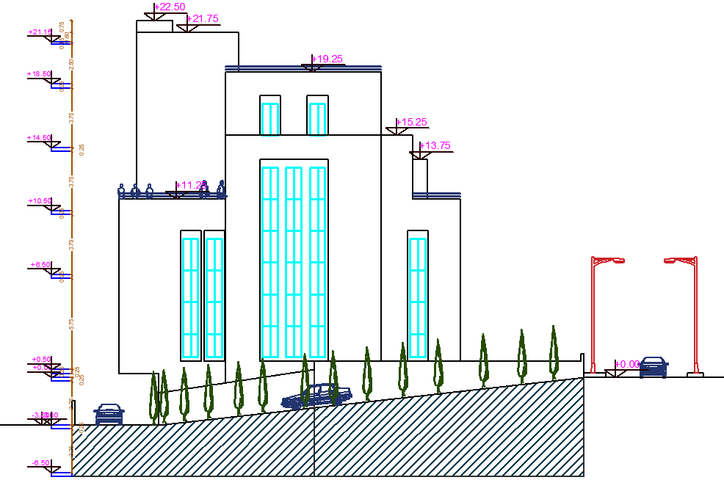
Architectural Design
Western Elevation
Notes:
The upcoming slides will present the main architectural drawings. This shows furnished basement floor plan

Slide 7
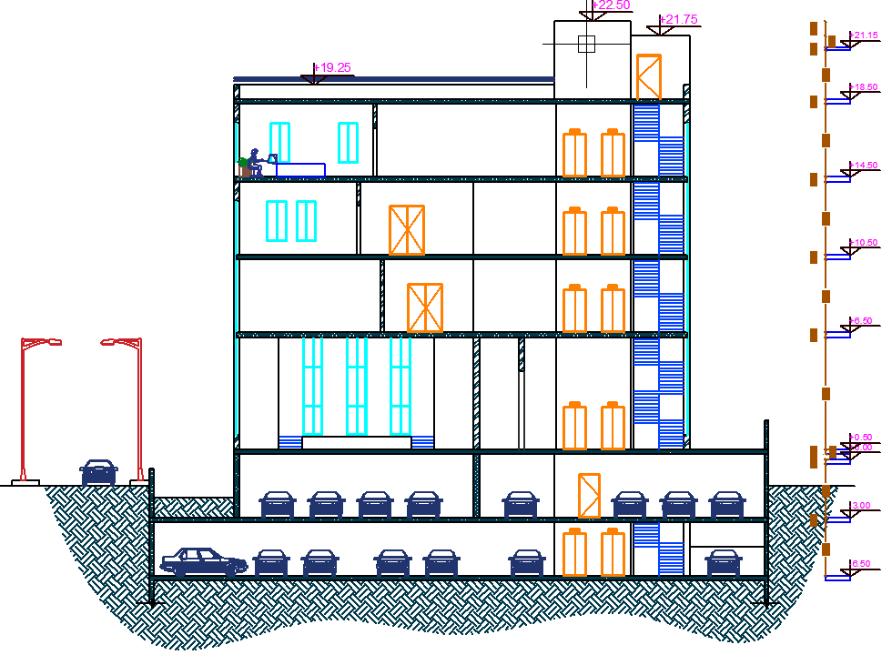
Architectural Design
Section A-A
Notes:
Ground floor plan

Slide 8
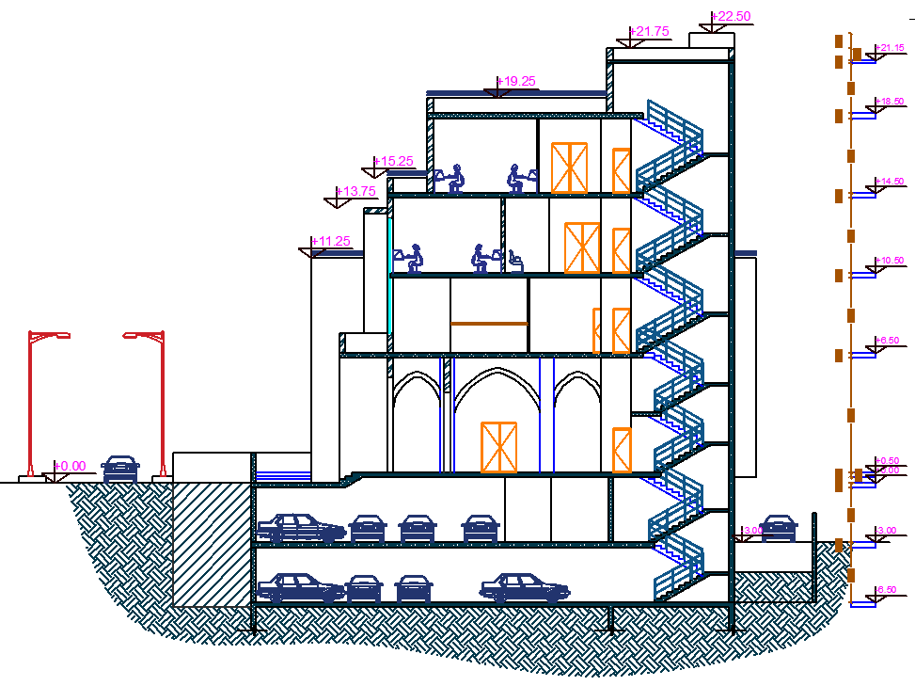
Architectural Design
Section B-B
Notes:
First floor plan. Section B-B is taken in the floor plans here

Slide 9
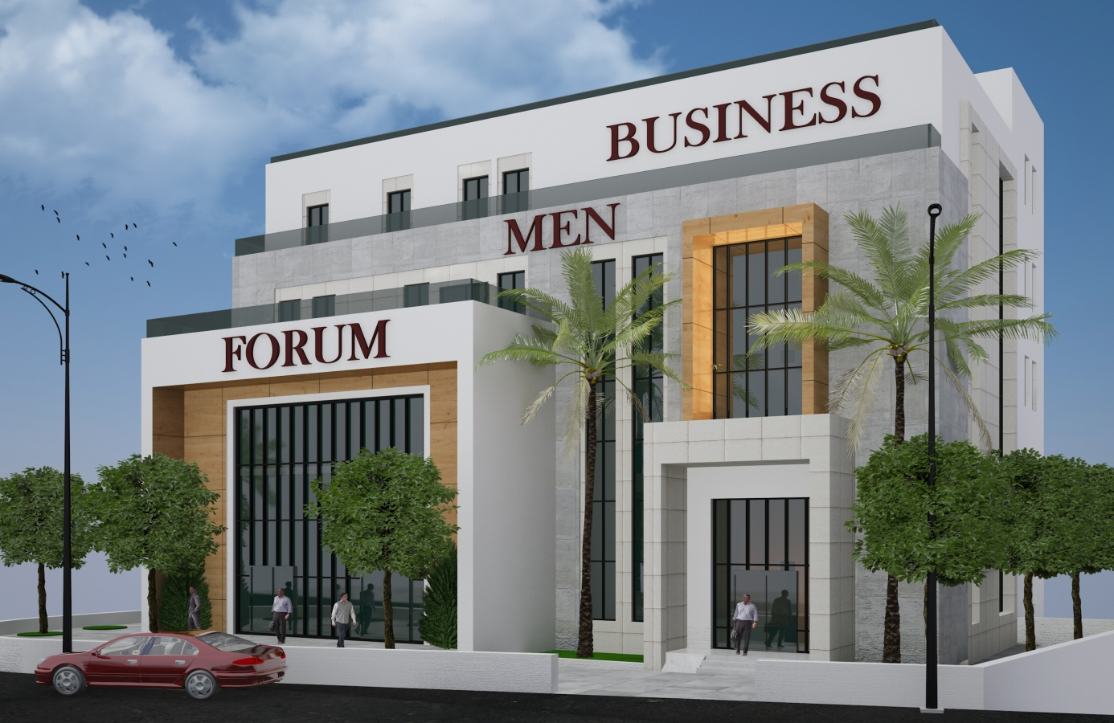
Architectural Design
3D Model
Notes:
Section b-b in

Slide 10
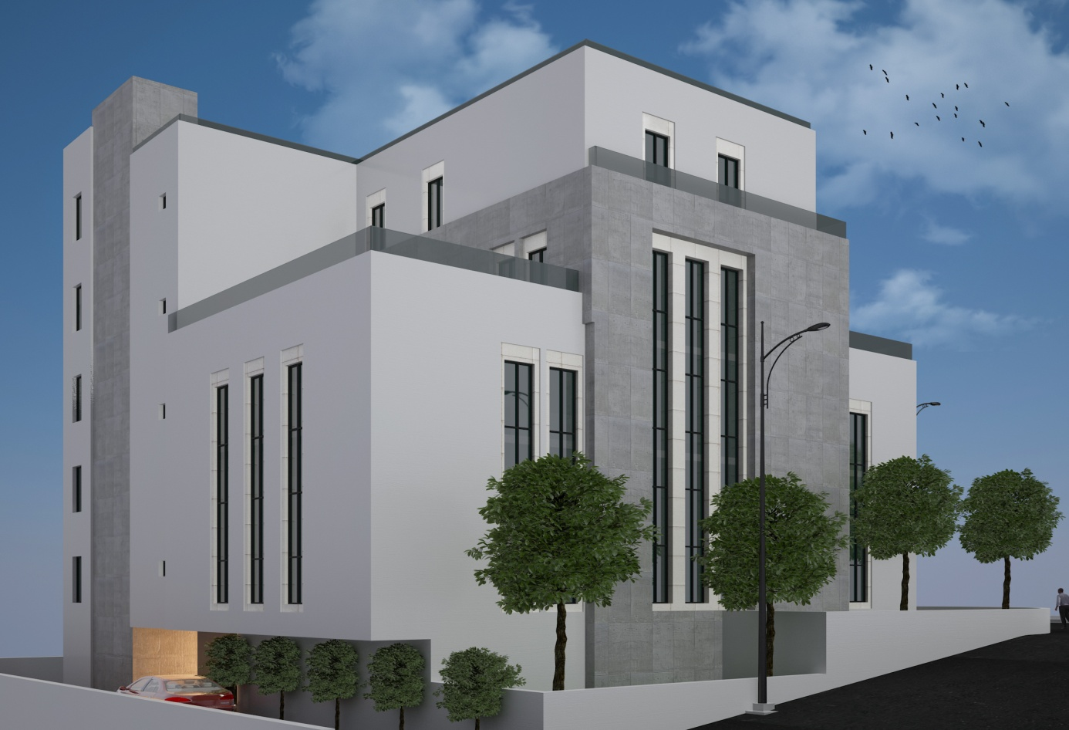
Architectural Design
3D Model
Notes:
SW Elevation

Slide 11
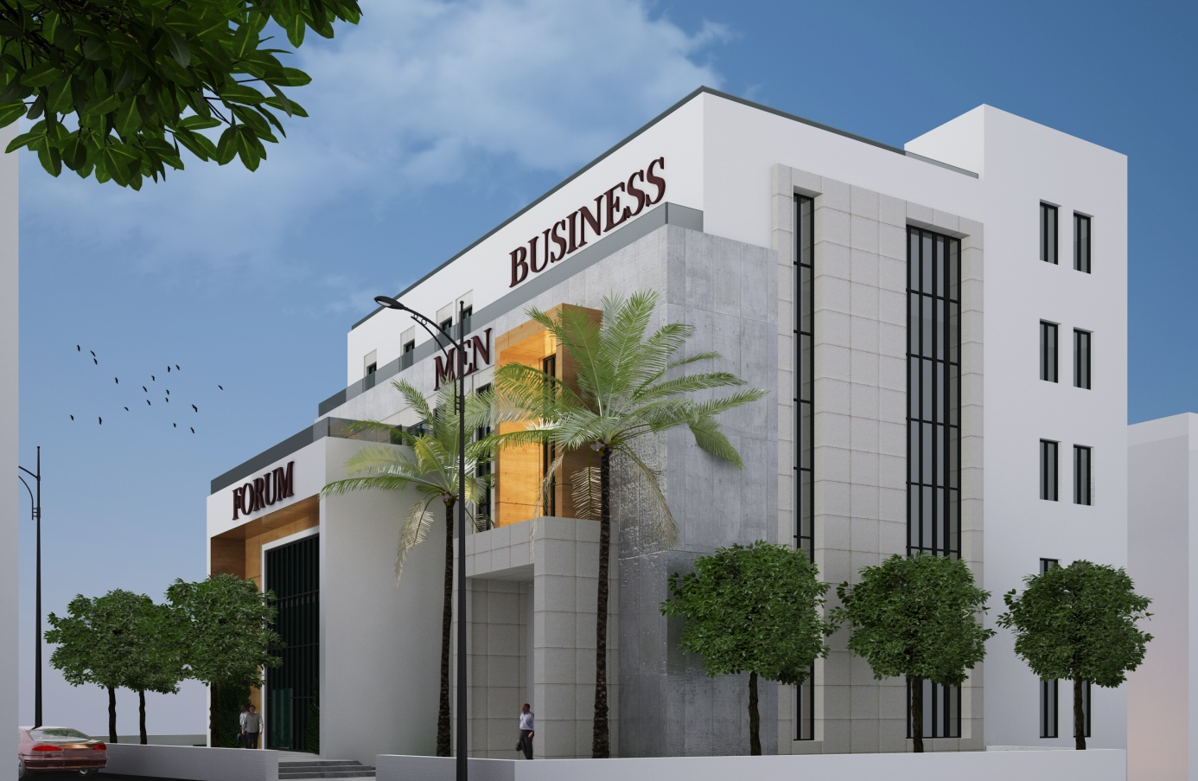
Architectural Design
3D Model
Notes:
NW Elevation

Slide 12
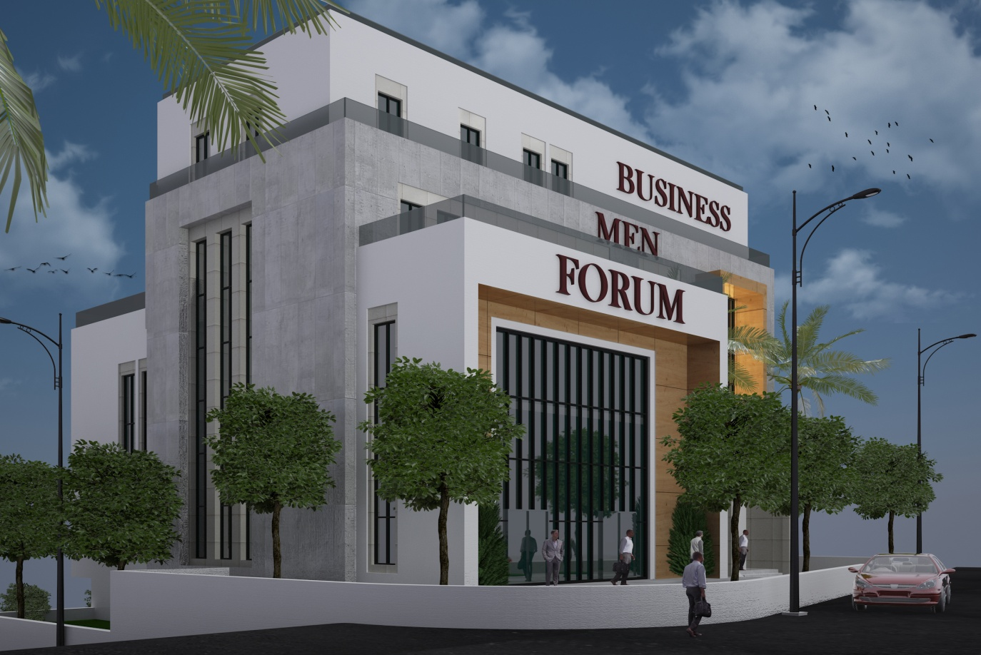
Architectural Design
3D Model
Notes:
NW Elevation

Slide 13
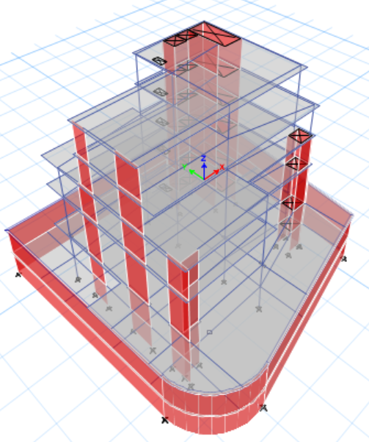
Structural Design
3D Structural Model
Notes:
The extruded 3D Model presented is taken from etabs

Slide 14
Structural Design
Design Codes
ACI -318-14 for Reinforced Concrete Structural Design
UBC -97 for Seismic Load Calculation Design
Design Data
Concrete B350 with fʹ_{c} = 28 MPa for All Structural Elements
Allowable Bearing Capacity of Soil = 250 KN/m²
Design Loads
Super Imposed Load = 4 KN/m²
Live Load = 5 KN/m²
Notes:
The design codes used in the design are 1 2 ..
Design data shows the used concrete in all structural elements which is the b350 with compressive strength of 28. Qall = 175
The SD load = 4 and the LL=3

Slide 15
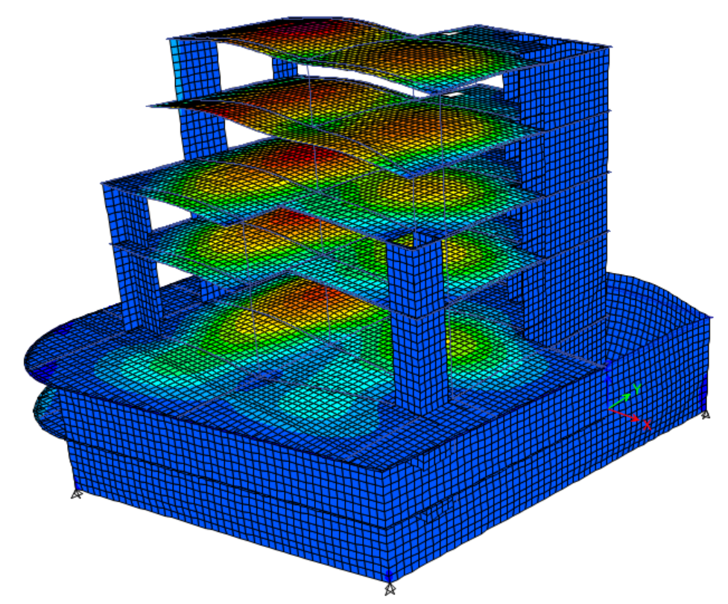
Structural Design
3D ETABs Deformed Model
Notes:
The building was structurally modelled using ETABs and This shows the structure’s deformed shape after running the model

Slide 16
Structural Design
Model Primary Checks
Model was checked and is valid for:
Compatibility
Equilibrium
Internal Stress-Strain Interaction
Notes:
Primary checks were conducted and the model is valid for compatibility, equil and the internal reactions are okay

Slide 17
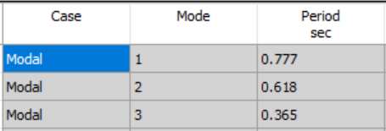
Structural Design
Model Dynamic Checks
Building Time Period Check
T_{manual} = 0.763 sec
T_{ETABs} = 0.777 sec
Notes:
The four main dynamic checks were also obtained. The time period and base shear check are shown as a sample here.

Slide 18
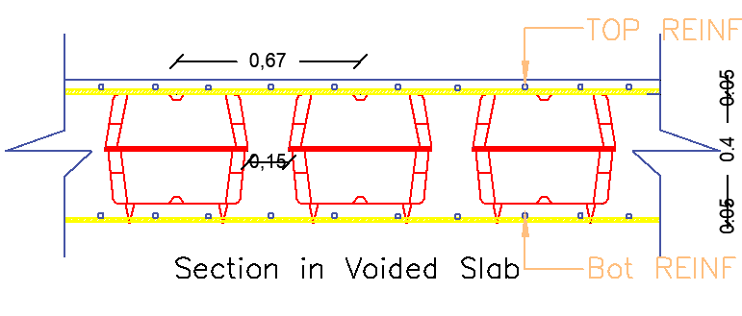
Structural Design
Results and Reinforcement
Slab Design
Voided Slab Thickness=50cm
U-boot height= 40cm
Notes:
Moving on to the final stage of the structural design, results and elements reinforcement. The slab design section is shown here.

Slide 19
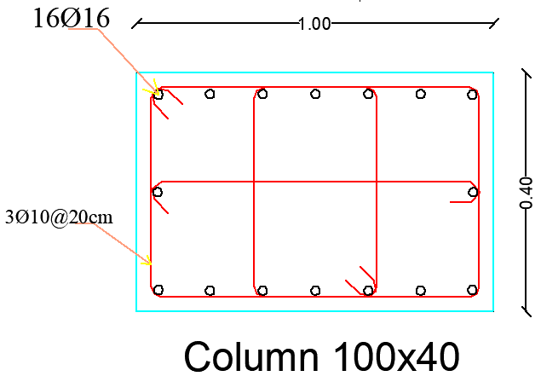
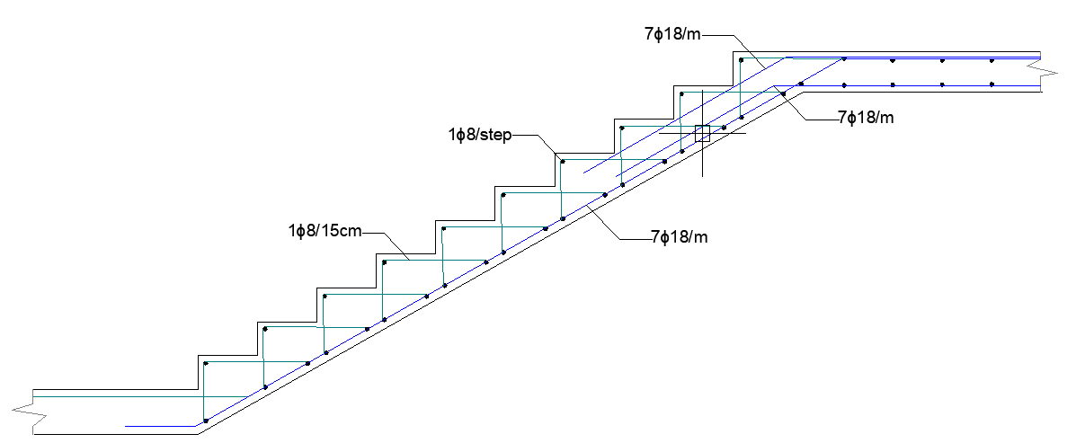
Structural Design
Results and Reinforcement
2. Column and Stair Design
Notes:
Sample footing section and detailing here

Slide 20
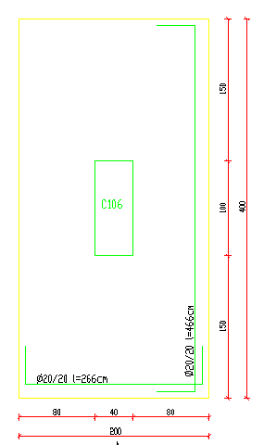
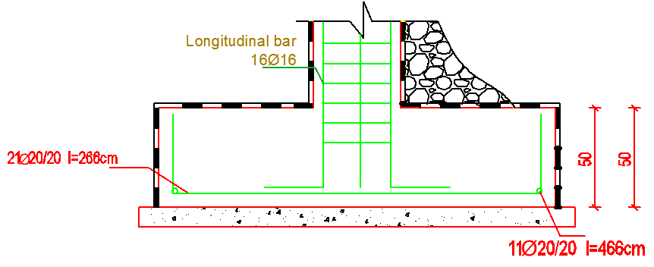
Structural Design
Results and Reinforcement
2. Footing Design
Notes:
Sample footing section and detailing here

Slide 21
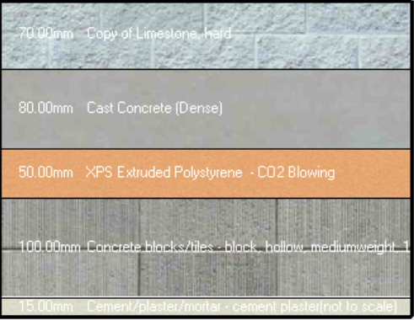
Environmental Design
External Wall
U-Value = 0.521 W/m².k

Slide 22
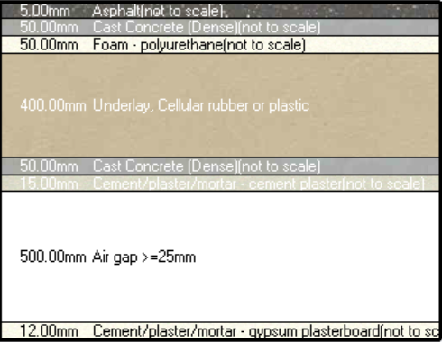
Environmental Design
Flat Slab
U-Value = 0.30 W/m².k

Slide 23
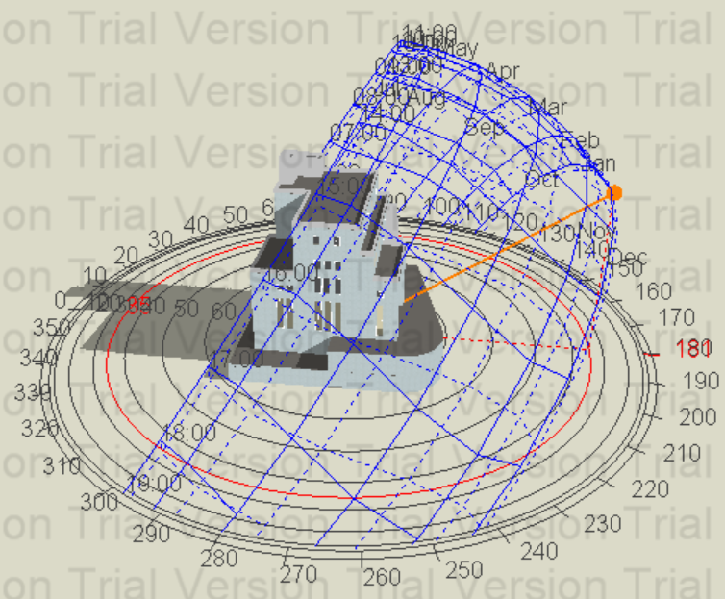
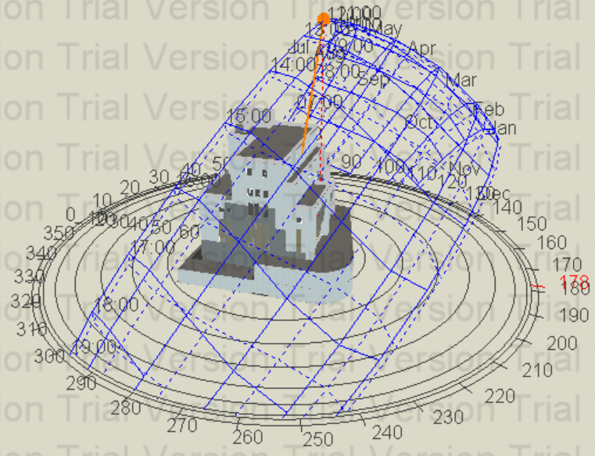
Environmental Design
3D Shot in Design Builder show shading on the building
21st Dec
12:00p.m
21st June
12:00 p.m.

Slide 24
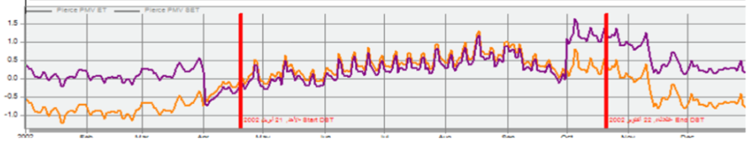
Environmental Design
Total heating load is 70 kWh
Total cooling load is 151.77kWh
Pierce PMV SET values nearly ranges within the limit (-0.5 and 0.5) throughout the year

Slide 25
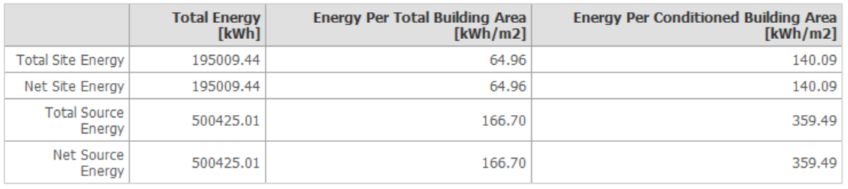
Environmental Design
Energy Consumption
The total energy consumption per meter square is equal
64.96 kWh/m²

Slide 26
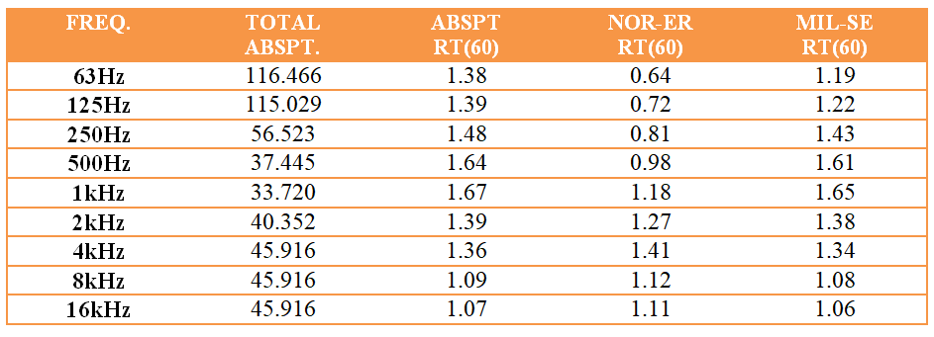
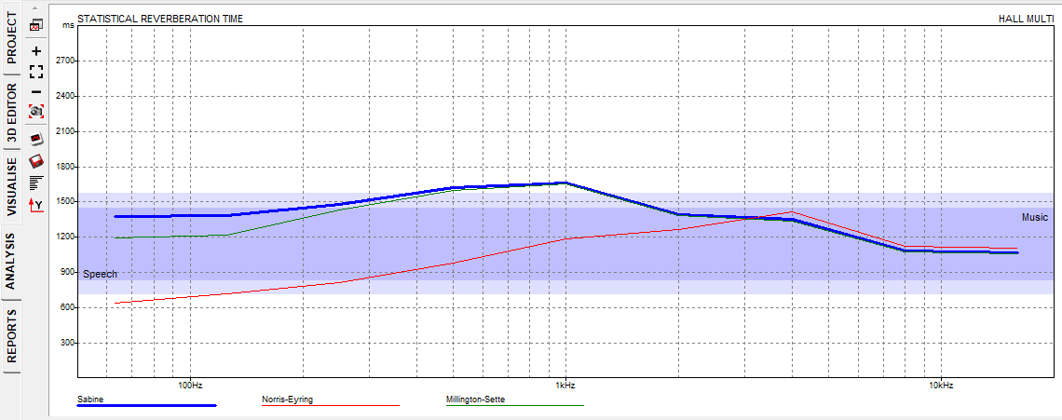
Environmental Design
Acoustical Design
Reverberation time (RT60)
RT60 Range Should be (1.4-1.9)
From table and figure, the RT60 of
Multipurpose hall between the range.

Slide 27
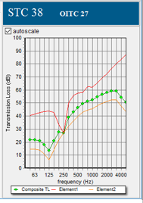
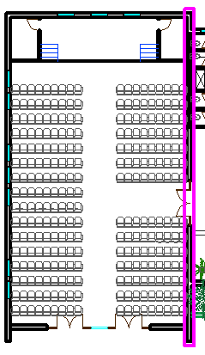

Environmental Design
Acoustical Design
Sound Transmission Class (STC)
For the internal partition
From Insul software, the
STC value between Multipurpose
Hall and interior equals 38 db is
Less than 40db

Slide 28
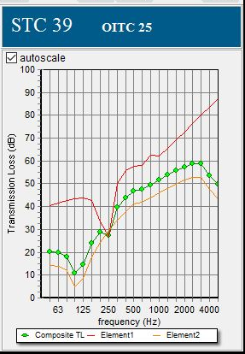
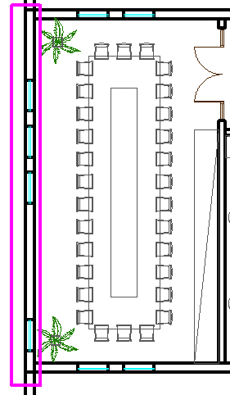

Environmental Design
Acoustical Design
Sound Transmission Class (STC)
For the exterior partition
From Insul software, the
STC value between Multipurpose
Hall and interior equals 39db is
more than 38db

Slide 29
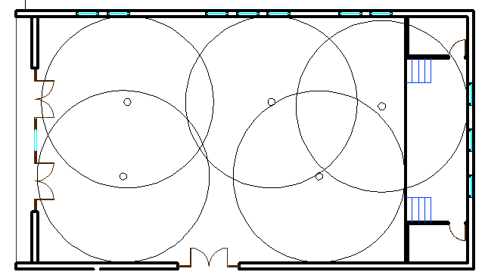
Environmental Design
Acoustical Design
Distribution of speakers
Number of speaker which was used equals 5 speaker.

Slide 30
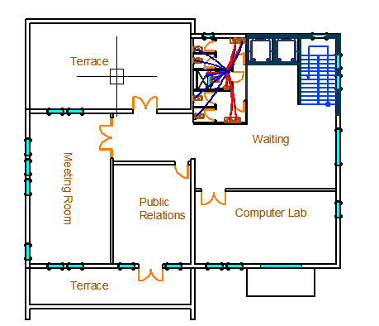
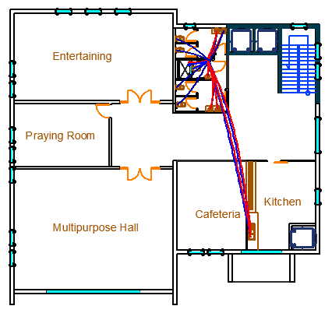
Electro-Mechanical Design
Water supply demand
Notes:
These plans show the water system in the building, and here are two samples of the water piping system in ground floor and basement.

Slide 31
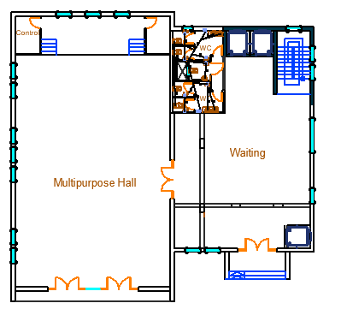
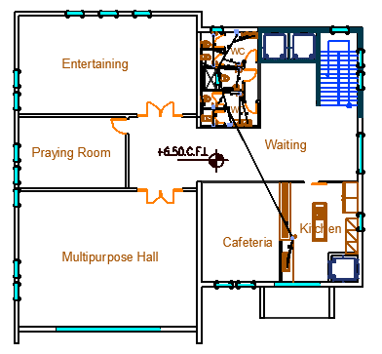
Electro-Mechanical Design
Sanitation System
Notes:
Moving to the sanitation system, These plans are showing a sample of the sanitation system of grey, black and storm water in the building.

Slide 32
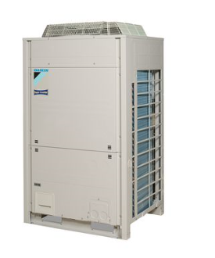
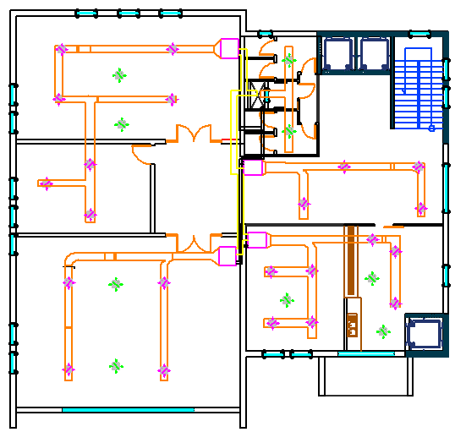
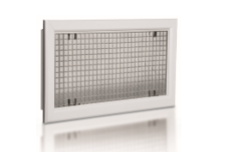
Electro-Mechanical Design
HVAC System
VRF with diffuser was used in the building.
Outdoor Unit
Diffuser
Notes:
Talking about the HVAC system used in our design, VRF with split units were used in our building, here is the split units distribution in the ground floor.

Slide 33
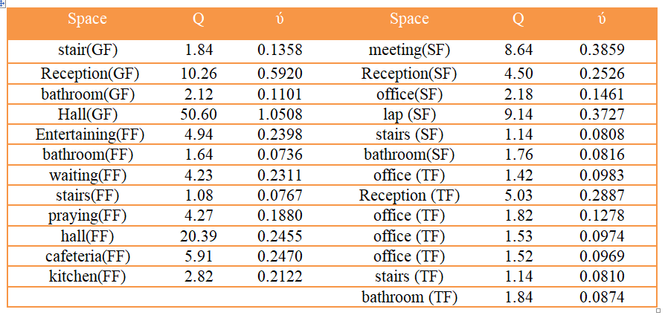
Electro-Mechanical Design
VRF System
Notes:
A sample of the capacities of indoor units for each zone in basement and ground floor displayed as shown.

Slide 34
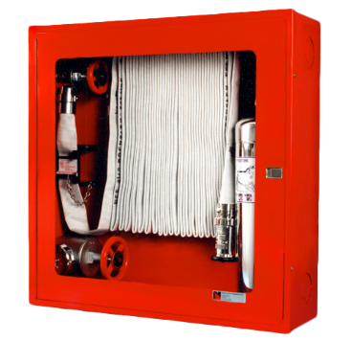
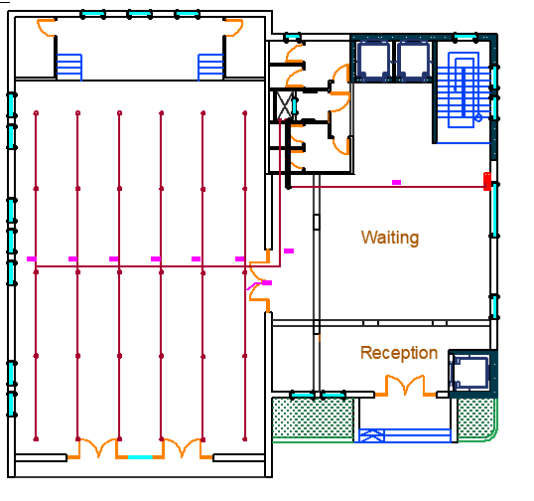
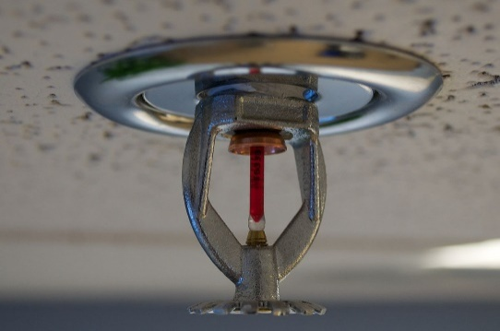
Electro-Mechanical Design
Fire Protection
Hose Station
Hose Station
Sprinkler
Notes:
The fire fighting system used in our design is a dry riser, it includes an inlet at street level on the outside face of the building that can be used by the fire department trucks and an outlet in each floor which helps in delivering water as quickly as possible in case of fire.

Slide 35
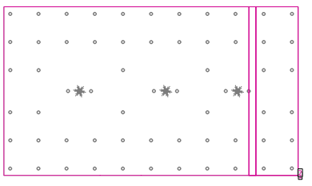
Electro-Mechanical Design
Artificial Lighting Design
Multipurpose hall Results
7 Concentric Recessed Lamps
Eavg = 566 lux
Emax = 696 lux
Emin = 408 lux
U = 72%
Notes:
Moving to the design of the artificial lighting, Dialux evo were used for these calculations
We have 3 rooms samples starting with the Kitchen results we used 7 concentric recessed lamps and we have got a 518 lux Illuminance and uniformity of 0.62 and the Max UGR = 14 and its all in its ranges and acceptable.

Slide 36
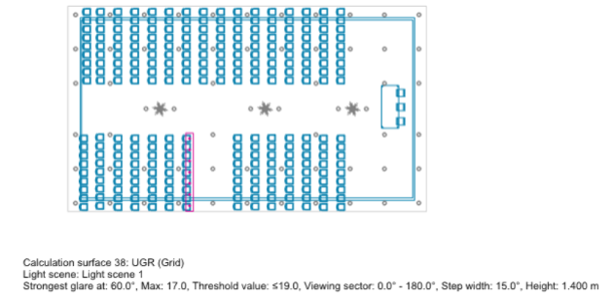
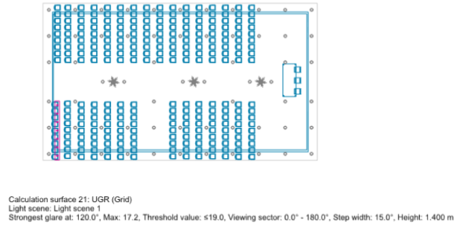
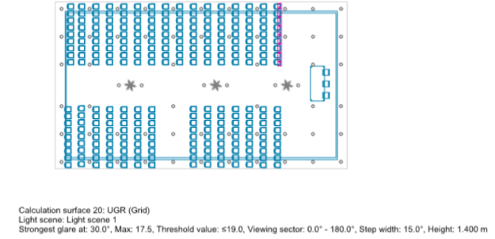
Electro-Mechanical Design
Notes:
Moving to the design of the artificial lighting, Dialux evo were used for these calculations
We have 3 rooms samples starting with the Kitchen results we used 7 concentric recessed lamps and we have got a 518 lux Illuminance and uniformity of 0.62 and the Max UGR = 14 and its all in its ranges and acceptable.

Slide 37
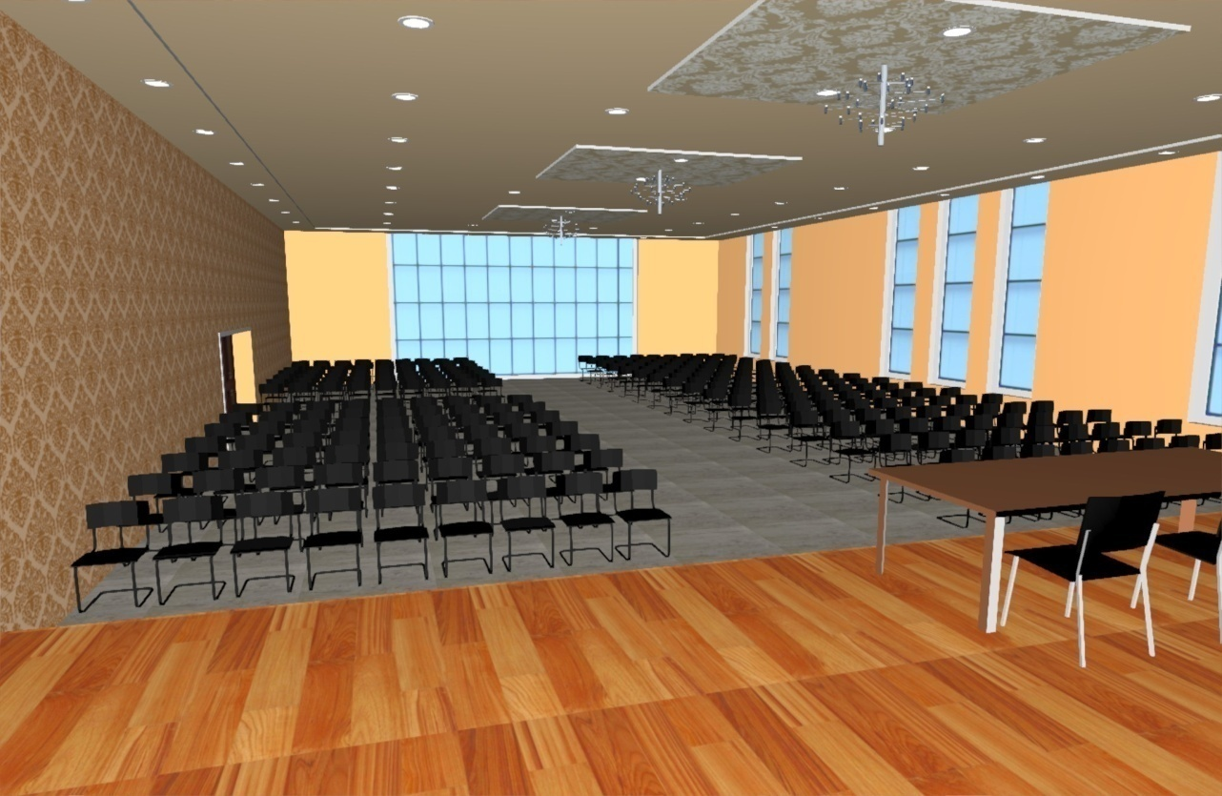
Electro-Mechanical Design
Notes:
Moving to the design of the artificial lighting, Dialux evo were used for these calculations
We have 3 rooms samples starting with the Kitchen results we used 7 concentric recessed lamps and we have got a 518 lux Illuminance and uniformity of 0.62 and the Max UGR = 14 and its all in its ranges and acceptable.

Slide 38
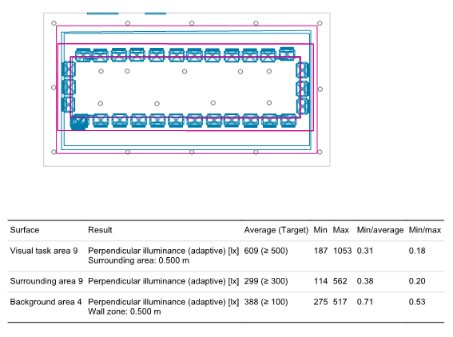
Electro-Mechanical Design
Artificial Lighting Design
Meeting room Results
Visual task= 609 lux
Surrounding area= 299 lux
Background = 388 lux
Notes:
Moving to the design of the artificial lighting, Dialux evo were used for these calculations
We have 3 rooms samples starting with the Kitchen results we used 7 concentric recessed lamps and we have got a 518 lux Illuminance and uniformity of 0.62 and the Max UGR = 14 and its all in its ranges and acceptable.

Slide 39
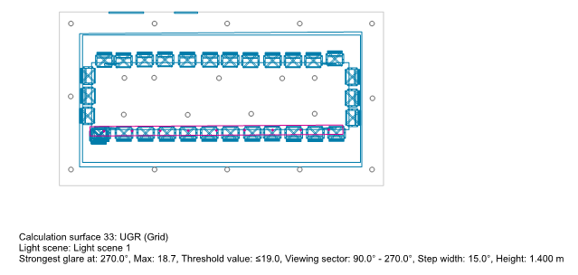
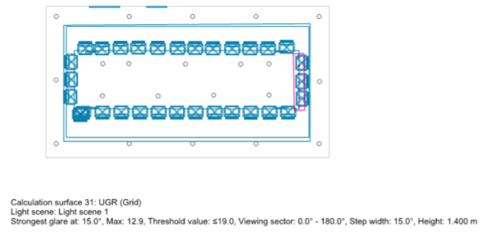
Electro-Mechanical Design
Artificial Lighting Design
Notes:
Moving to the design of the artificial lighting, Dialux evo were used for these calculations
We have 3 rooms samples starting with the Kitchen results we used 7 concentric recessed lamps and we have got a 518 lux Illuminance and uniformity of 0.62 and the Max UGR = 14 and its all in its ranges and acceptable.

Slide 40

Electro-Mechanical Design
Artificial Lighting Design
Notes:
Moving to the design of the artificial lighting, Dialux evo were used for these calculations
We have 3 rooms samples starting with the Kitchen results we used 7 concentric recessed lamps and we have got a 518 lux Illuminance and uniformity of 0.62 and the Max UGR = 14 and its all in its ranges and acceptable.

Slide 41

Electro-Mechanical Design
Luminaires Distribution Sample in second floor
Notes:
This photo shows the luminaires distribution and its wiring in GF

Slide 42

Electro-Mechanical Design
Sockets Distribution Sample in basement Floor
Notes:
Ending up with this photo showing the sockets distribution and its wiring in GF, and you can find all the other plans in the drawing sheets.

Slide 43
Electro-Mechanical Design
Total project cost= 4441046 NIS
Notes:
Ending up with this photo showing the sockets distribution and its wiring in GF, and you can find all the other plans in the drawing sheets.

