Slide 1

T1D (type 1 diabetes)
Prepared by:
Dania Shashtare
Rama AbuGhdeeb
Supervisor:
Dr. Emad Natsheh

Slide 2

INTRODUCTON
Type 1 Diabetes requires daily follow-up and continuous monitoring.
Patients often use separate tools for readings, meals, appointments, and communication.
Scattered information can lead to missed updates and harder medical follow-up.
Family members may not receive urgent alerts when abnormal glucose situations happen.

Slide 3
WHAT
IS
T1D?
T1D is a healthcare application
that helps Type 1 Diabetes patients
track glucose, manage daily care,
and communicate with doctors
and nutritionists in one platform.

Slide 4
TECHNOLOGICAL INNOVATIONS
Frontend
Tools
Database
Flutter + Dart
VS Code, Postman, GitHub, Android Emulator
MongoDB + Mongoose
Backend
Notifications
Node.js + Express.js
Firebase / Firestore

Slide 5
Patient Features:
Glucose tracking
meals
reports
water
activity
appointments
Support Features:
Chat
meal plans
family monitoring
Notifications
admin approval

Slide 6
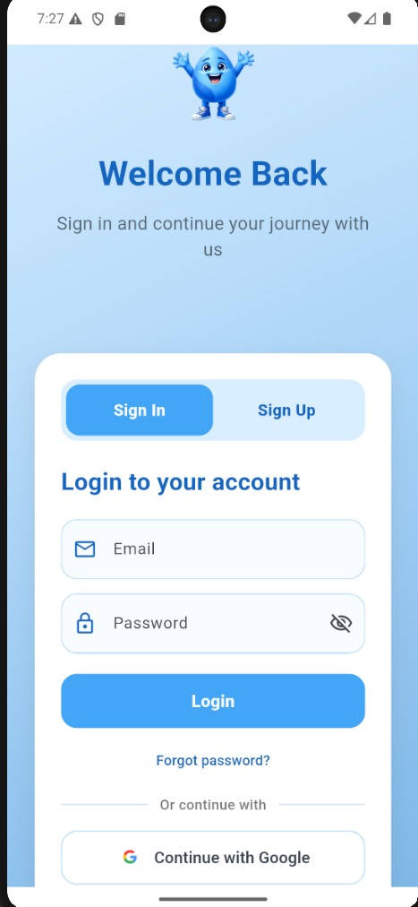
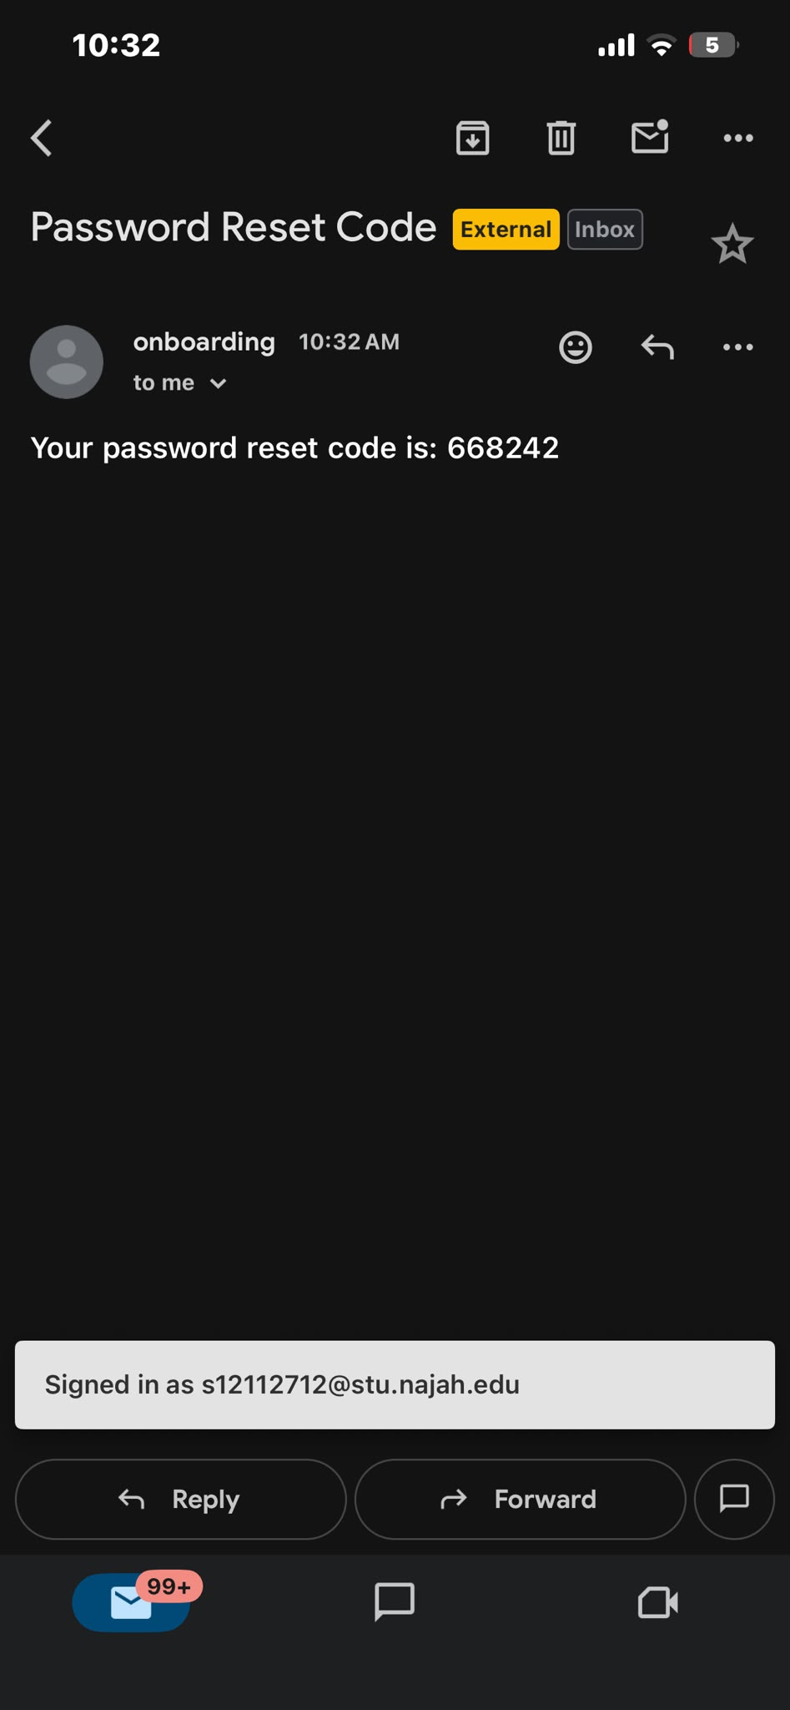
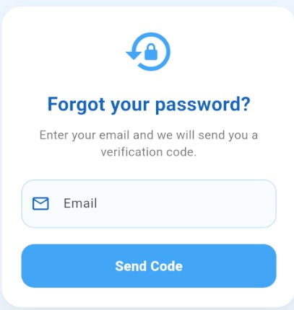
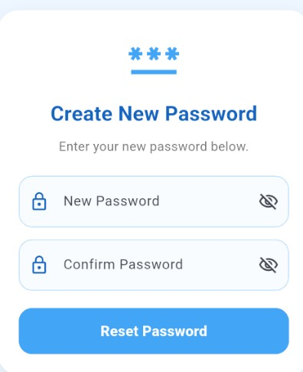
SIGN IN

Slide 7
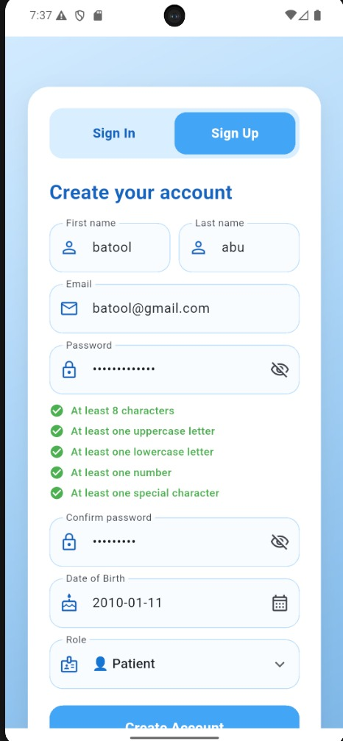
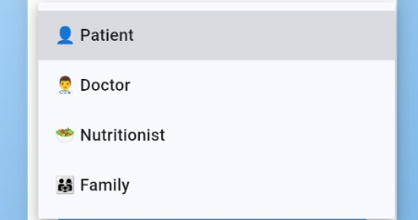
SIGN UP

Slide 8
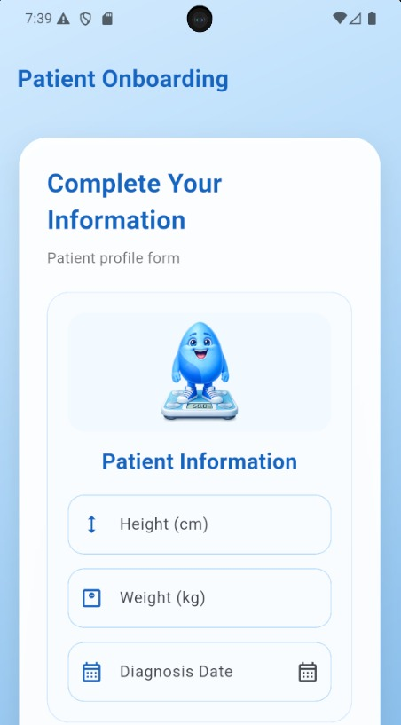
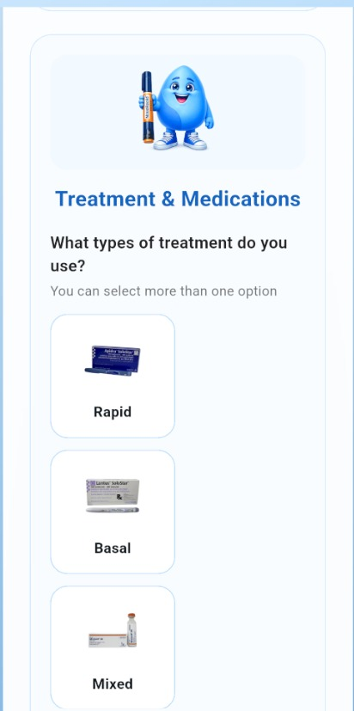
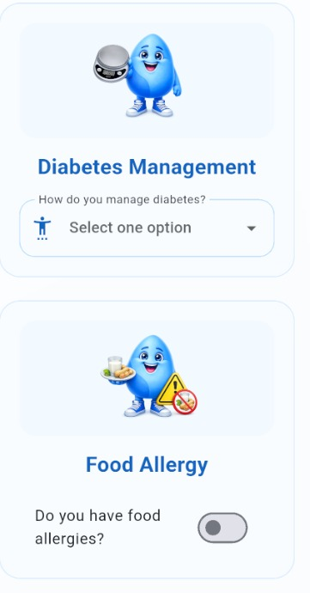
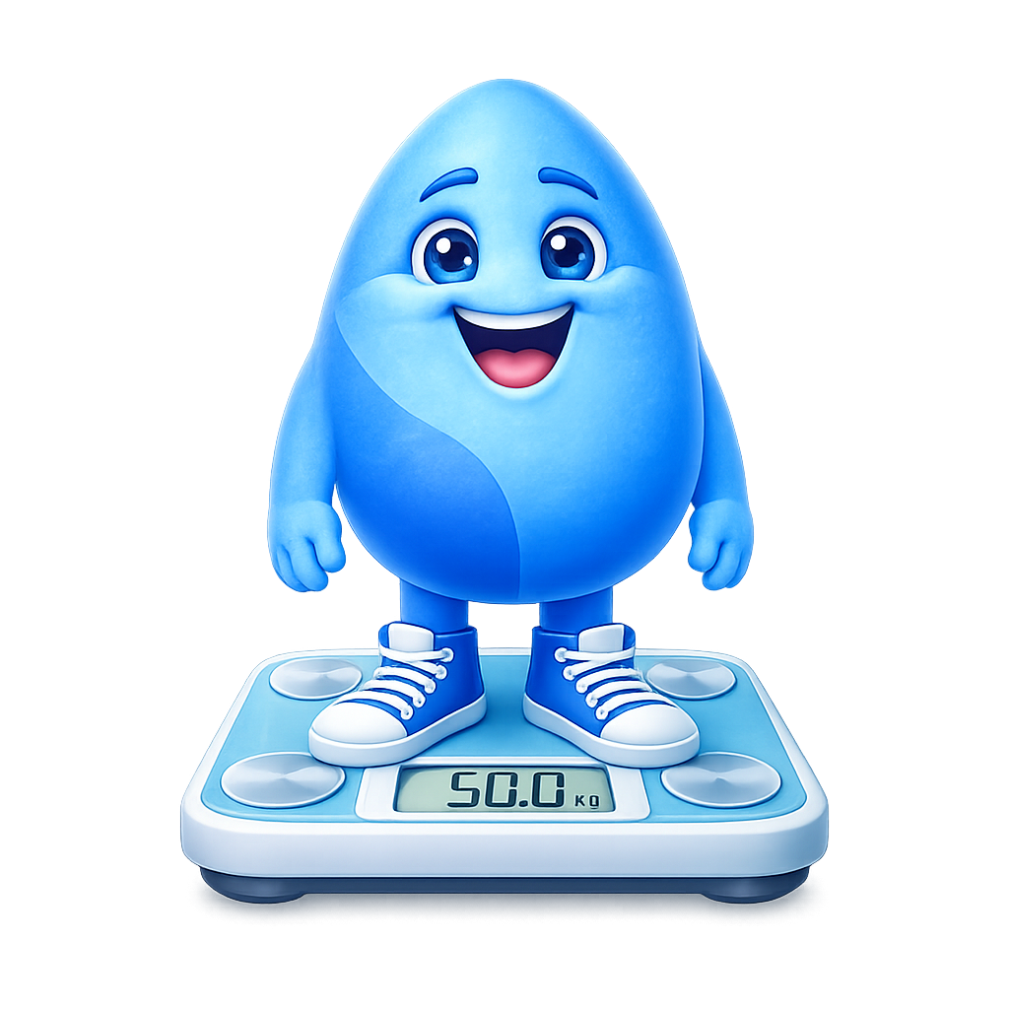
FORM PATIENT

Slide 9
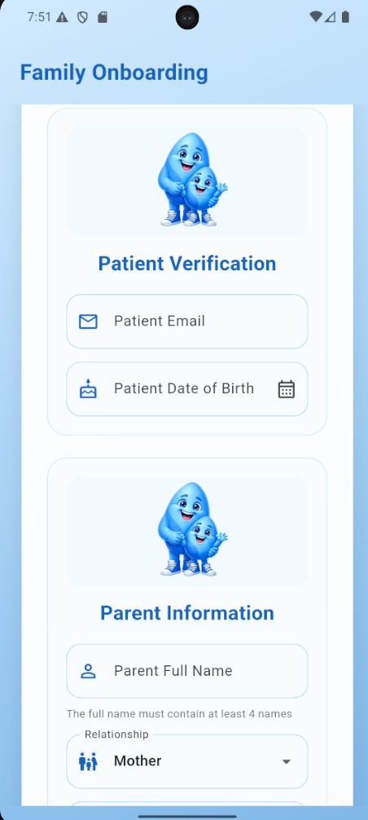
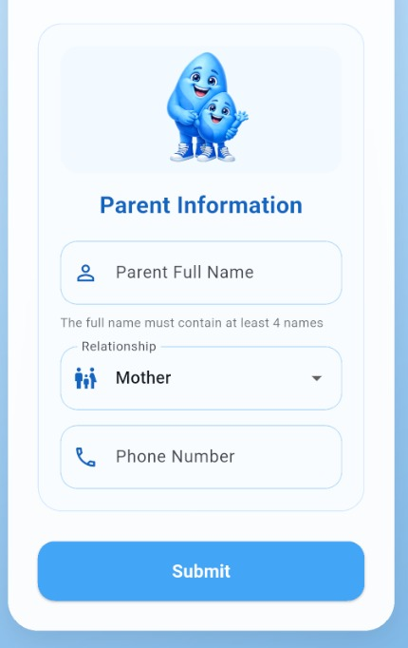

FORM PARENT

Slide 10
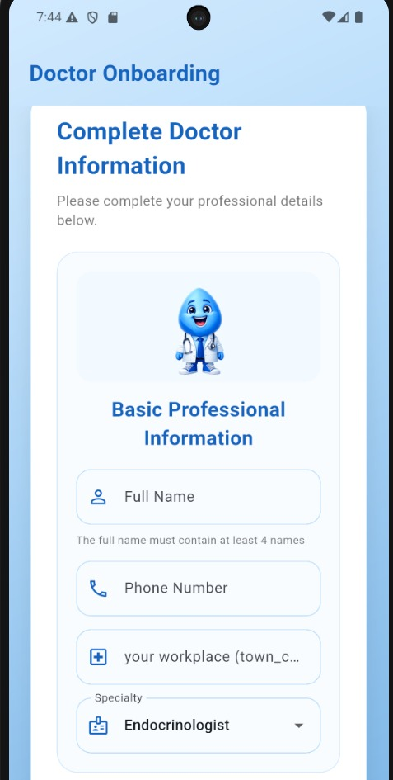
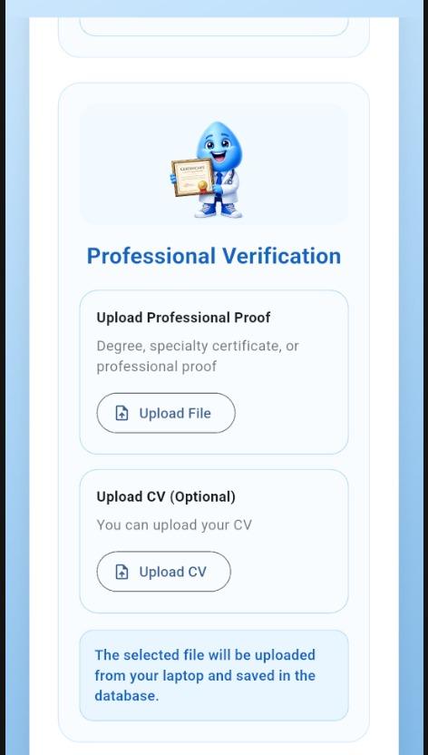
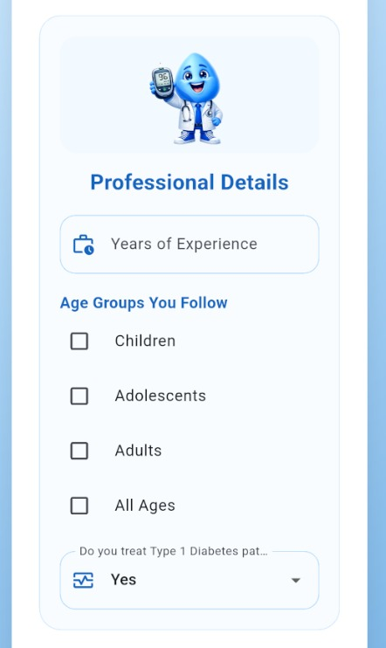

FORM DOCTOR

Slide 11
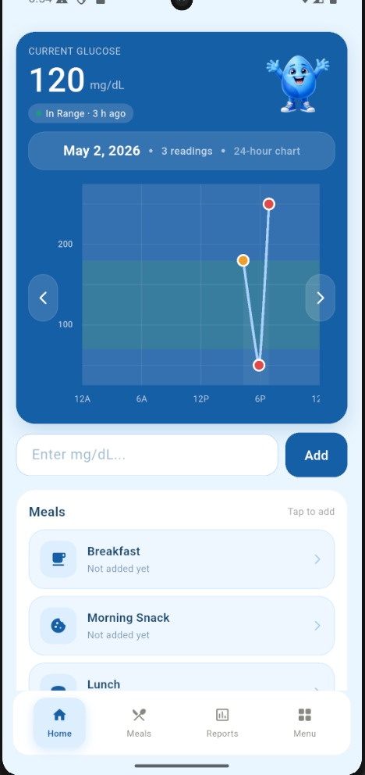
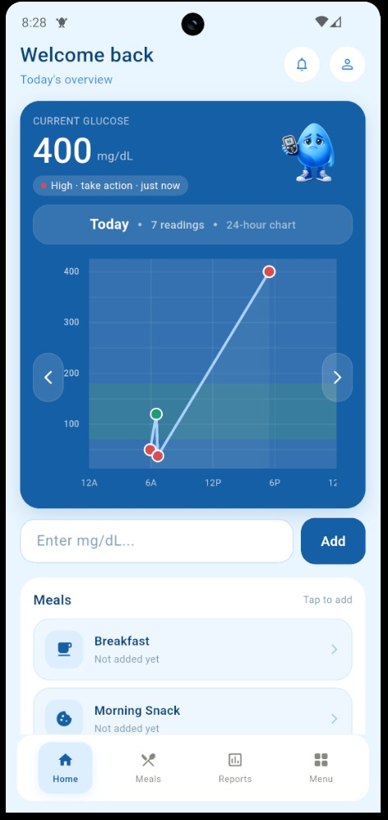
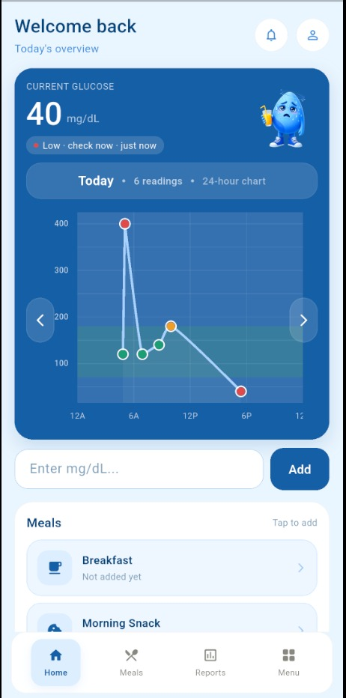
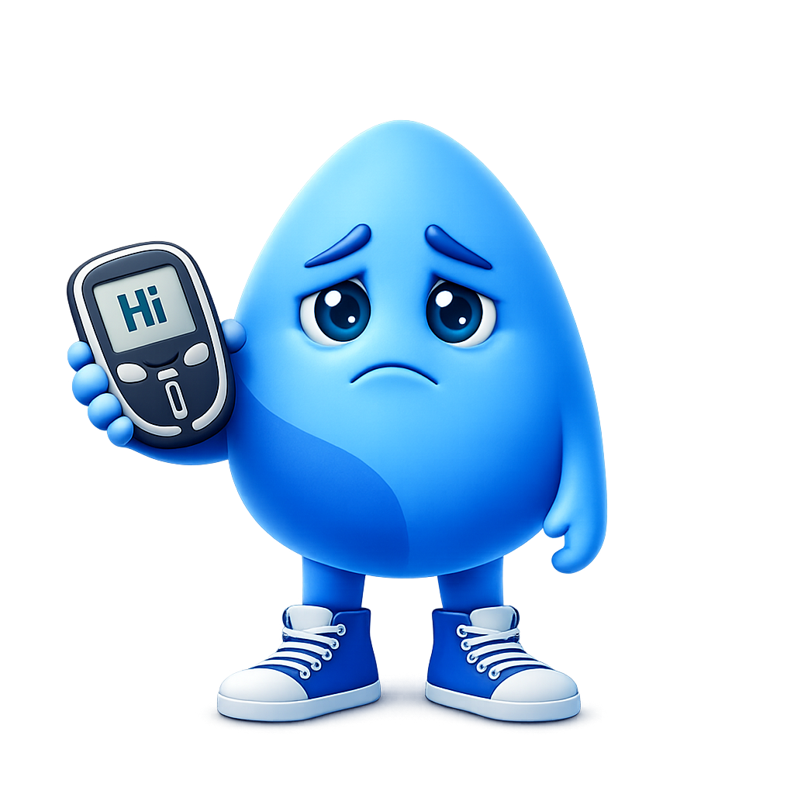

PATIANT PAGE

Slide 12
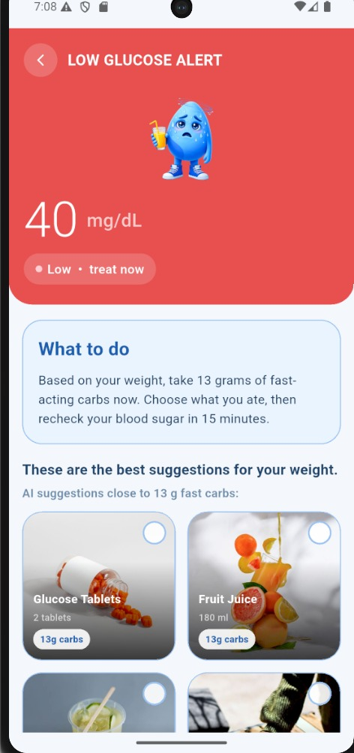
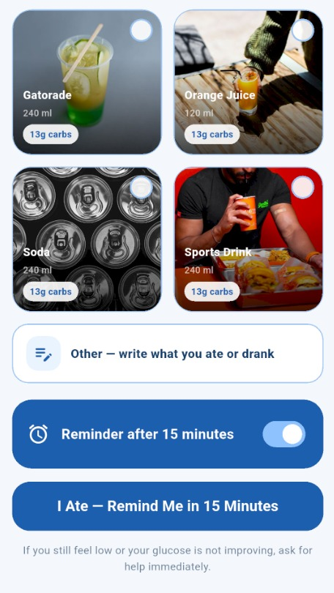
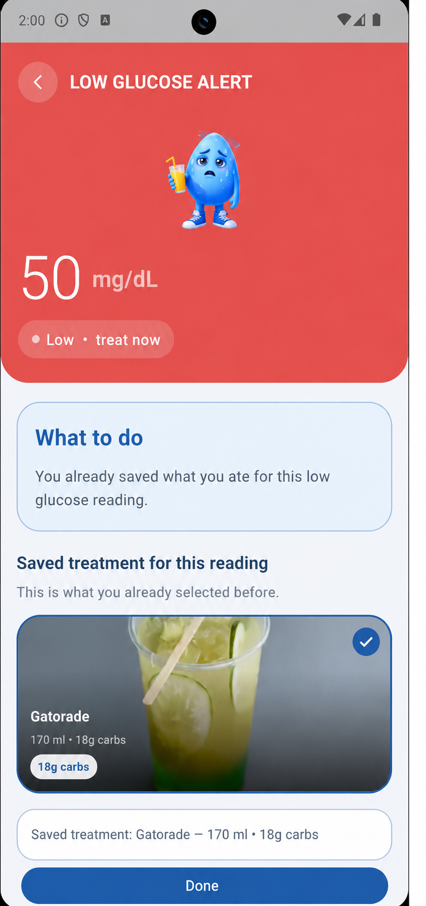
LOW GLUCOOSE

Slide 13
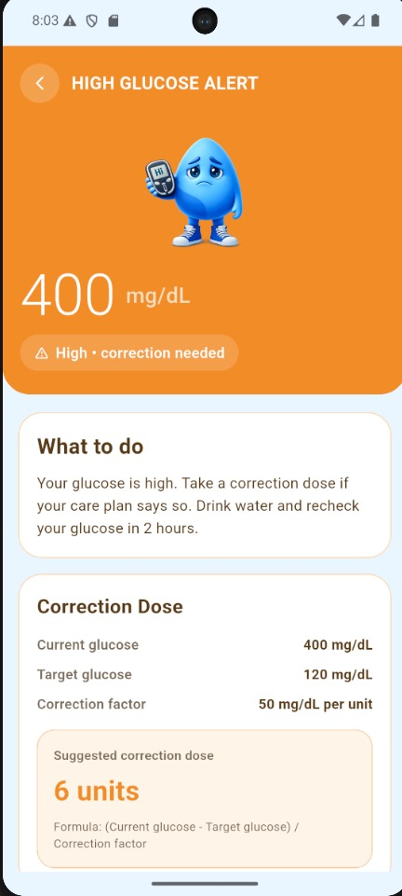
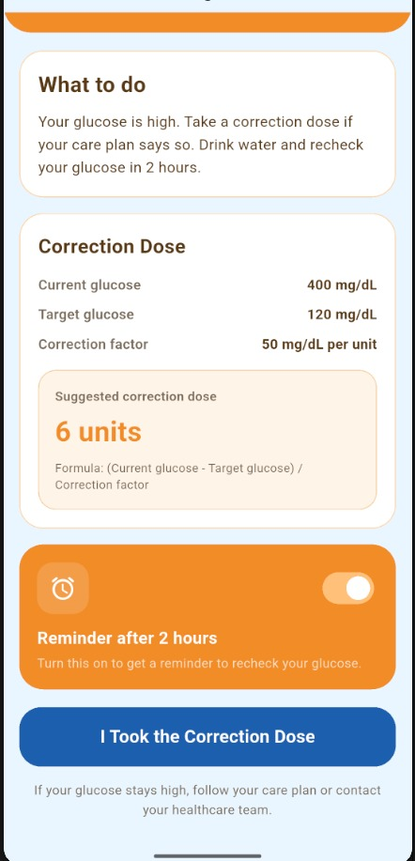
HIGH GLUCOOSE

Slide 14
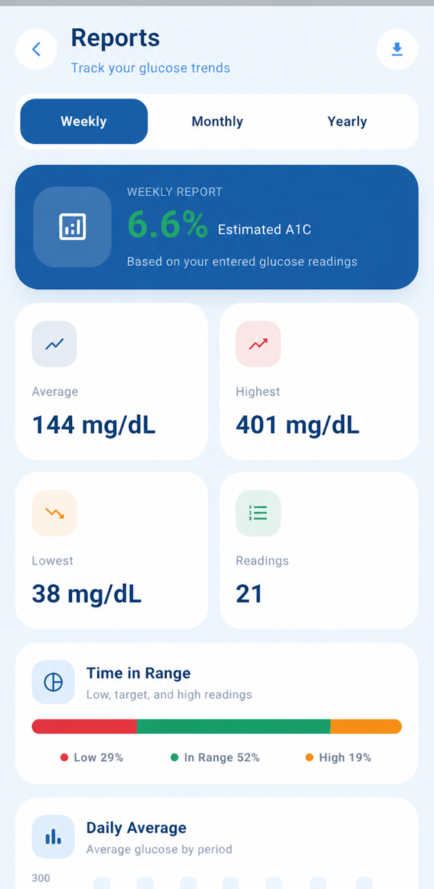
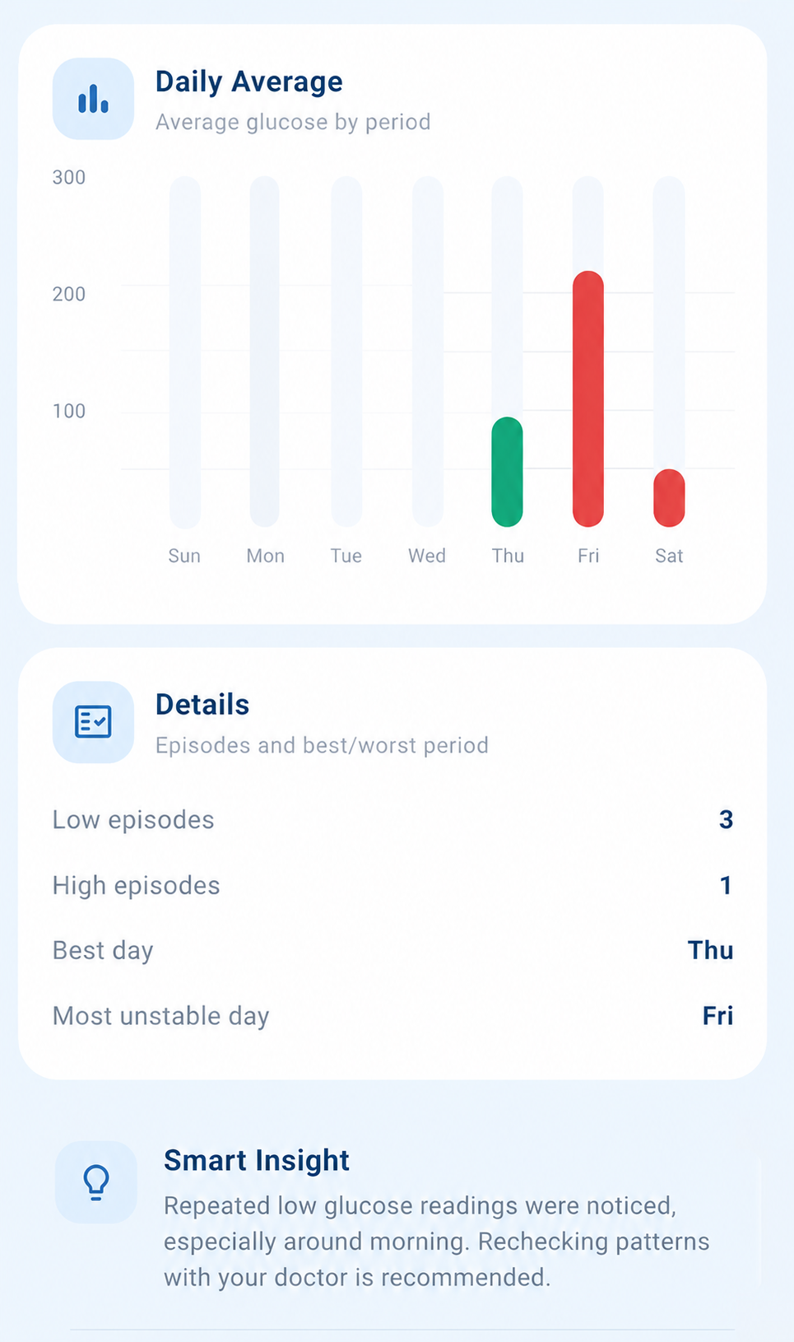
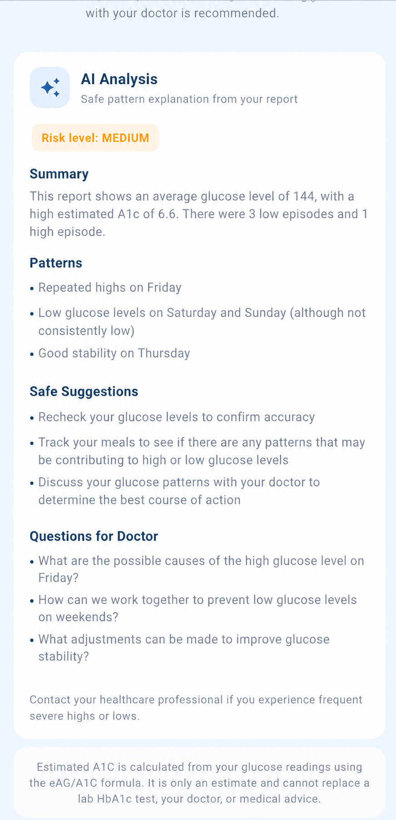
GLUGOOS
REPORT

Slide 15
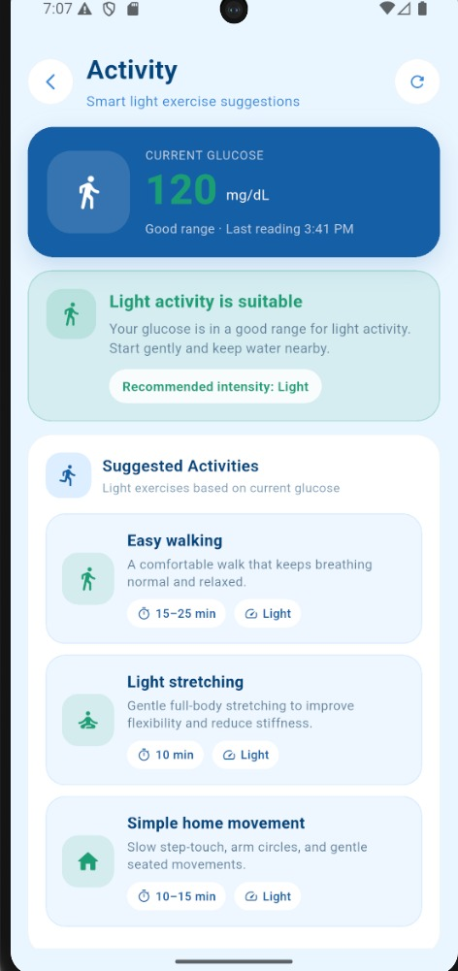
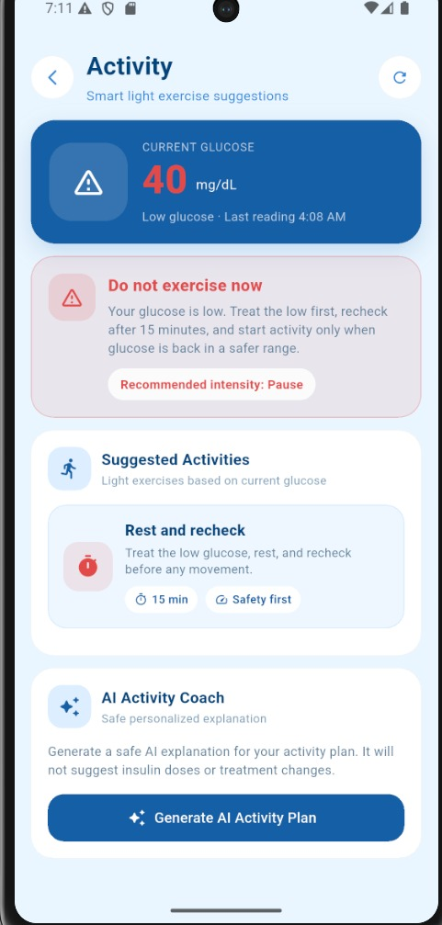
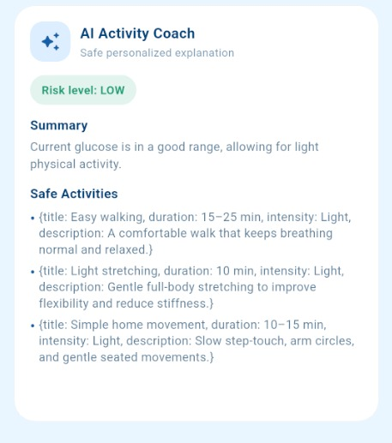
ACTIVETY

Slide 16
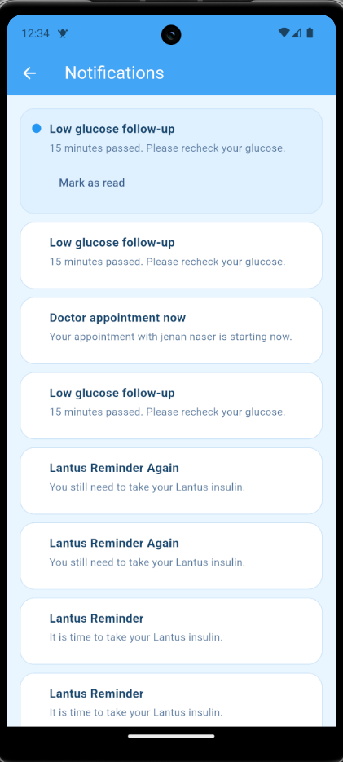
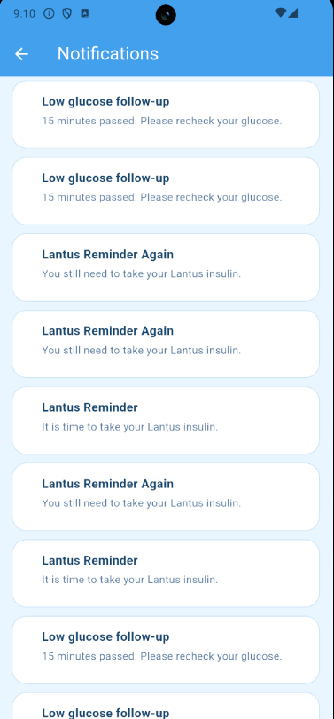
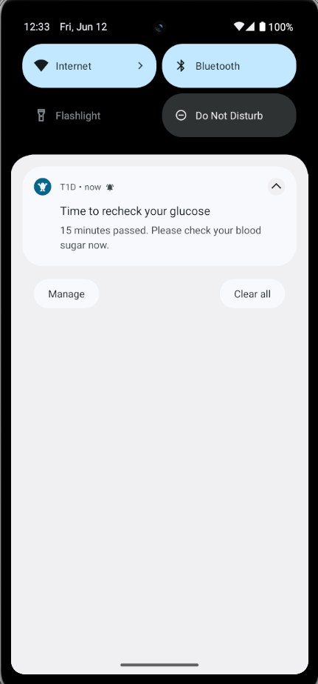
NOTIFICATION

Slide 17
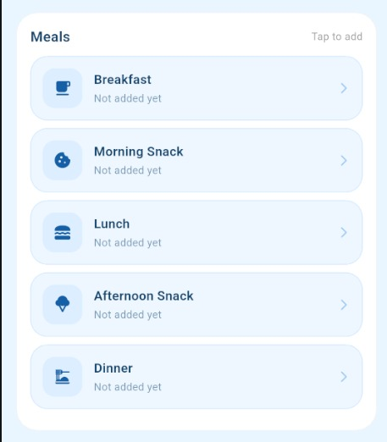
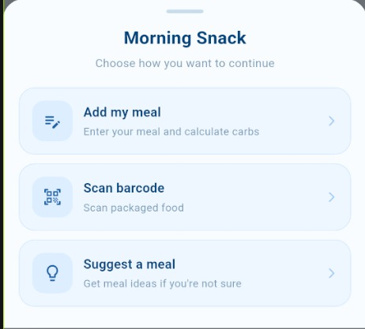
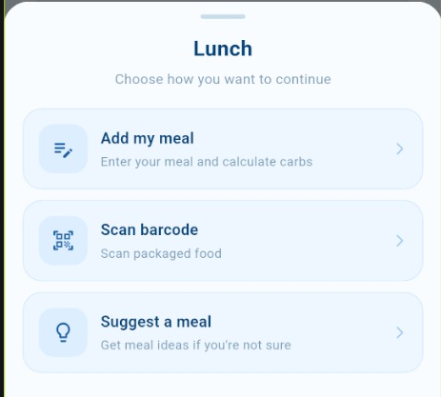
MEAL ENTRY

Slide 18
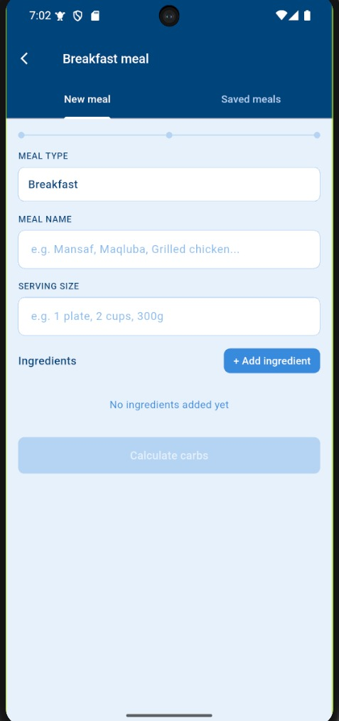
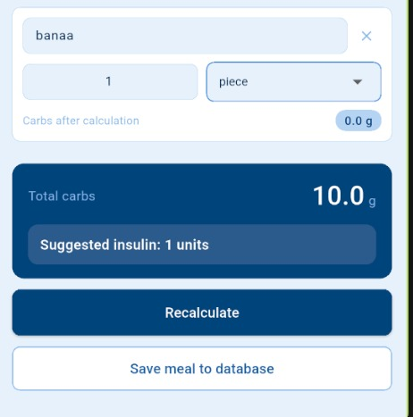
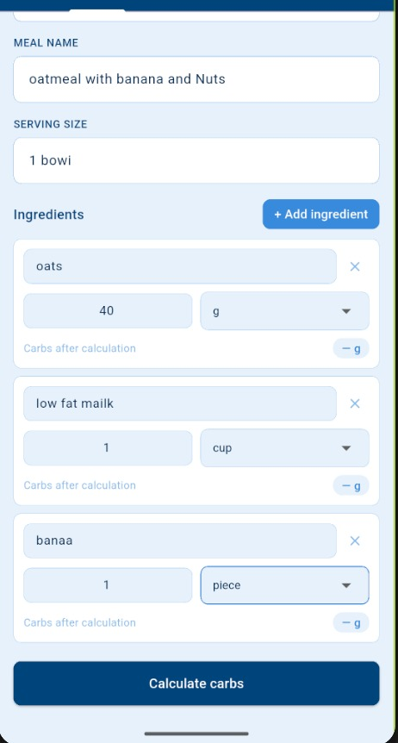
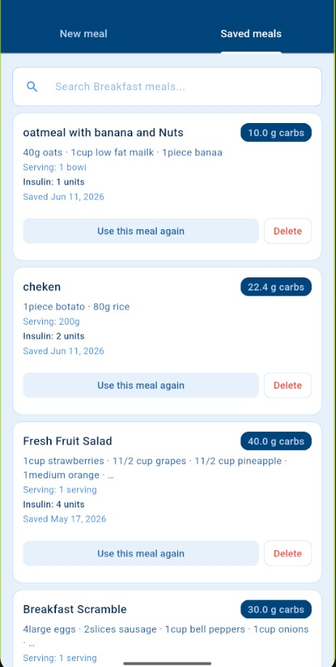
ADD MY MEAL

Slide 19
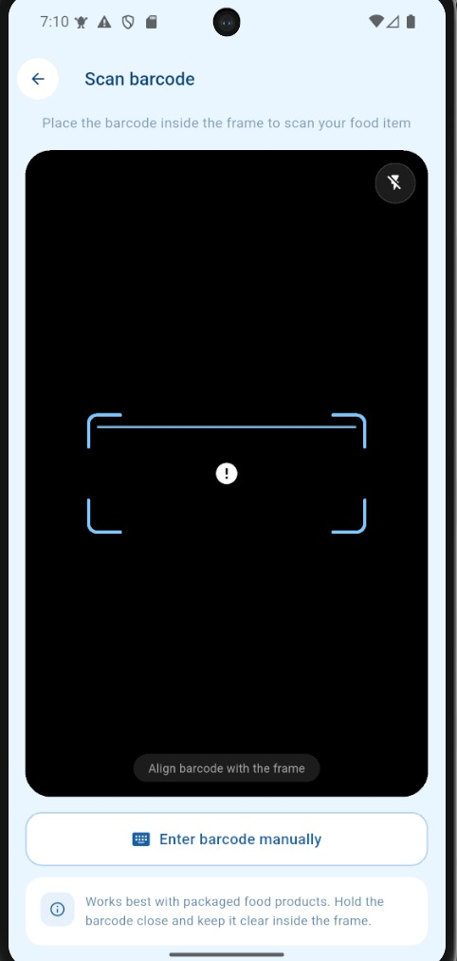
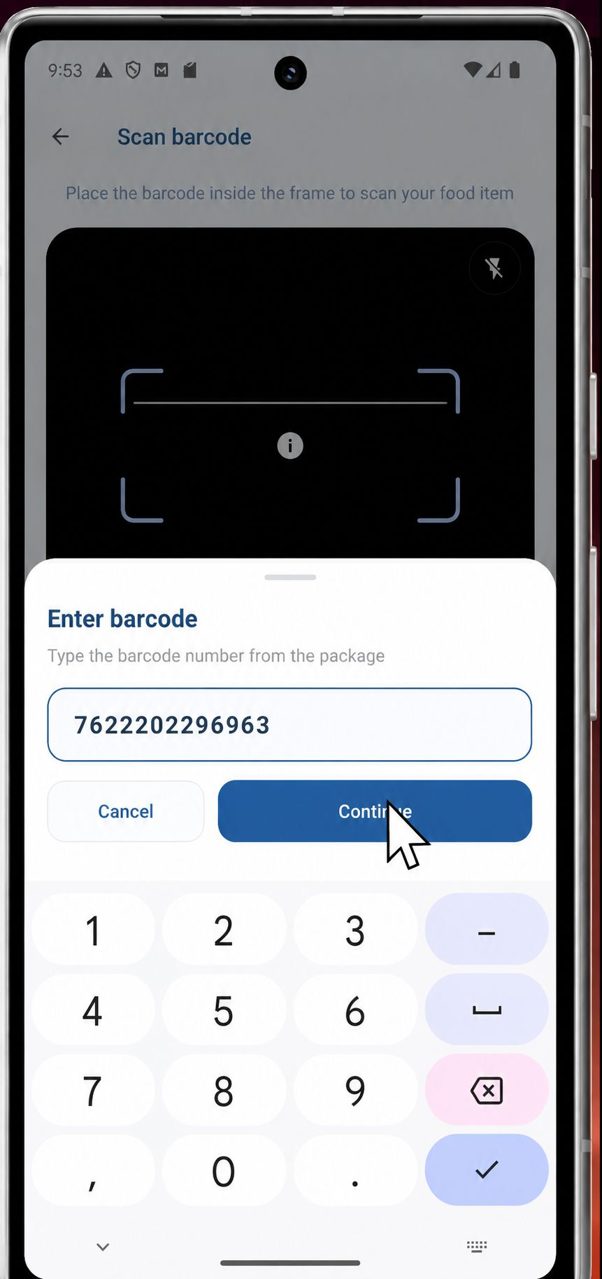
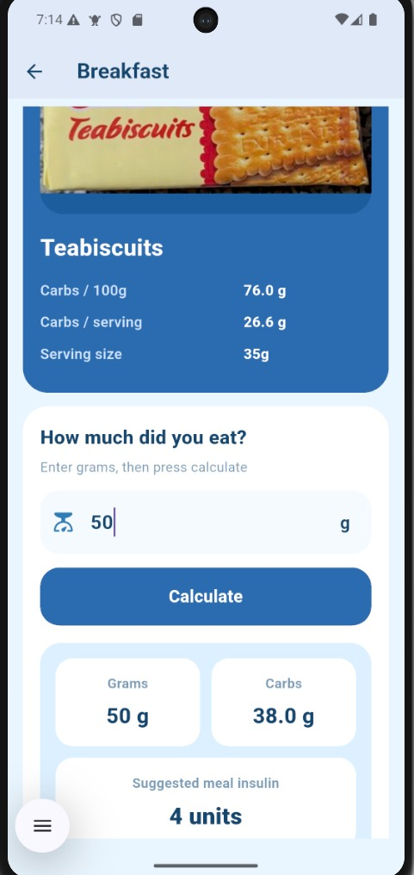
SCAN BARCODE

Slide 20
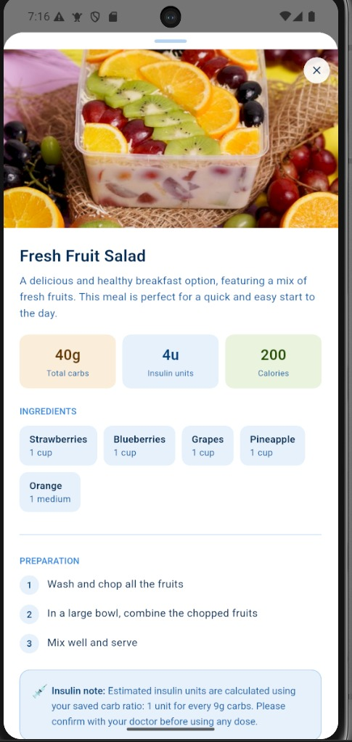
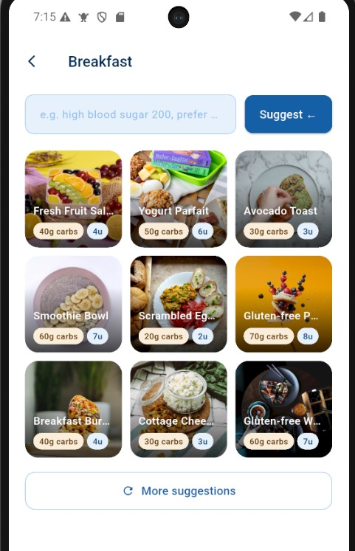
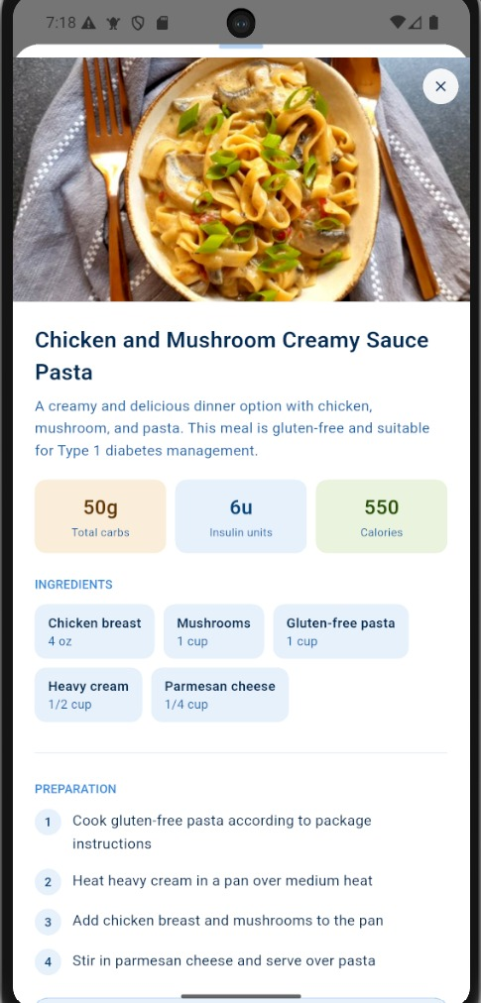
SUGGEST
MEAL

Slide 21
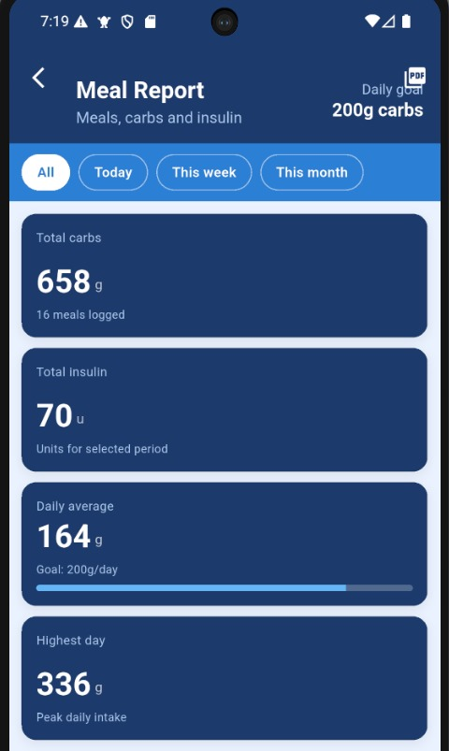
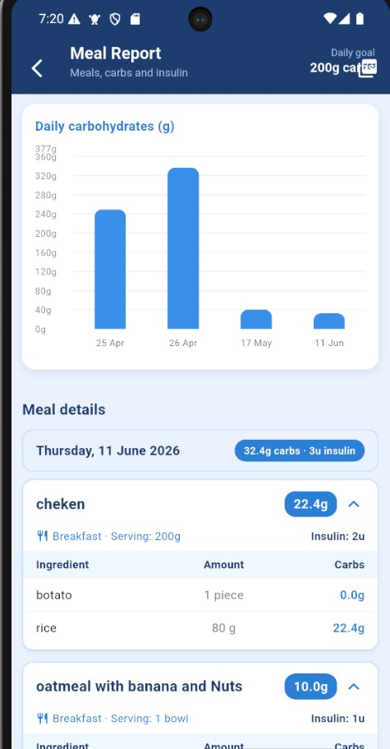
MEAL REPORT

Slide 22
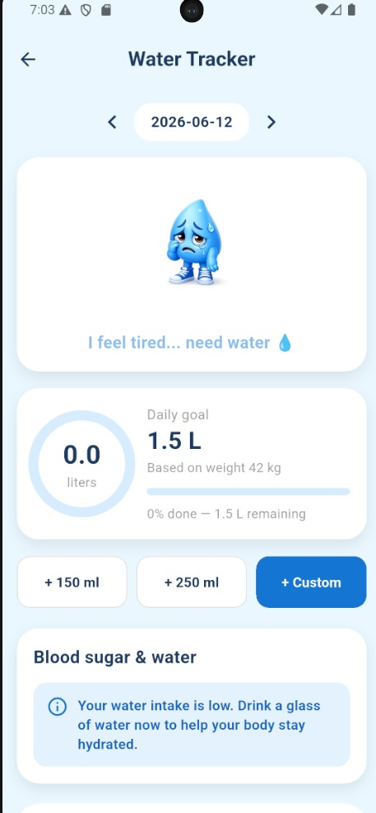
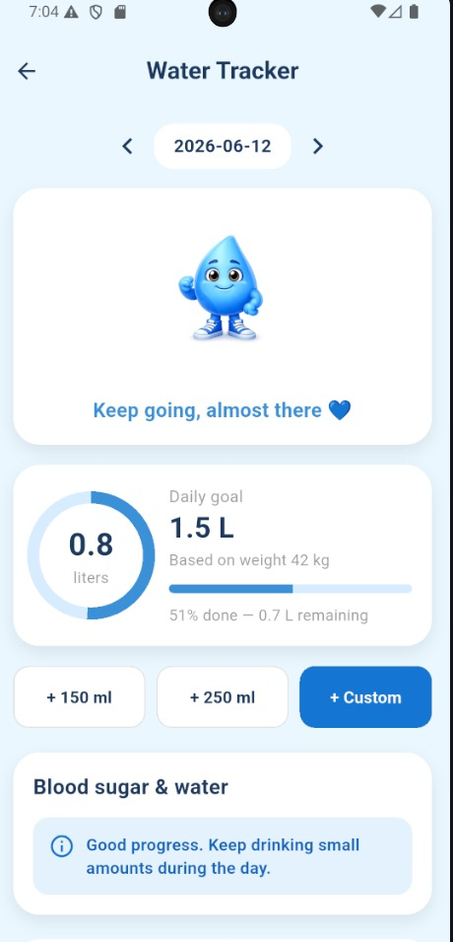


WATER
TRACKER

Slide 23



CHATS

Slide 24




APPOINTMENT

Slide 25



APPOINTMENT

Slide 26


MEAL PLAN

Slide 27


PROFILE

Slide 28



SETTING

Slide 29




FAMILY PAGE

Slide 30




ALERTS & PROFILE

Slide 31


NUTRITIONIST DASHBOARD

Slide 32

NUTRITIONIST DASHBOARD

Slide 33

NUTRITIONIST PATIENTS

Slide 34

NUTRITIONIST PATIENTS

Slide 35

NUTRITIONIST PATIENTS

Slide 36

NUTRITIONIST PATIENTS

Slide 37

NUTRITIONIST APPOINTMENTS

Slide 38

NUTRITIONIST APPOINTMENTS

Slide 39

NUTRITIONIST APPOINTMENTS

Slide 40

NUTRITIONIST MEAL PLANS

Slide 41

NUTRITIONIST MEAL PLANS

Slide 42

NUTRITIONIST MESSAGES

Slide 43

NUTRITIONIST PROFILE

Slide 44


DOCTOR DASHBOARD

Slide 45

DOCTOR DASHBOARD

Slide 46

DOCTOR MESSAGES

Slide 47

DOCTOR APPOINTMENTS

Slide 48

DOCTOR APPOINTMENTS

Slide 49

DOCTOR PATIENTS

Slide 50

DOCTOR PATIENTS

Slide 51

DOCTOR PATIENTS

Slide 52

DOCTOR PATIENTS

Slide 53

DOCTOR PATIENTS

Slide 54

DOCTOR PATIENTS

Slide 55

DOCTOR PROFILE

Slide 56

SEETING IN WEB

Slide 57

SEETING IN WEB

Slide 58

SEETING IN WEB

Slide 59

ADMIN DASHBORD

Slide 60

ADMIN DASHBORD

Slide 61

ADMIN DASHBORD

Slide 62

ADMIN DASHBORD

Slide 63

ADMIN DASHBORD

Slide 64

ADMIN DASHBORD

Slide 65




THANK
YOU

