Slide 1
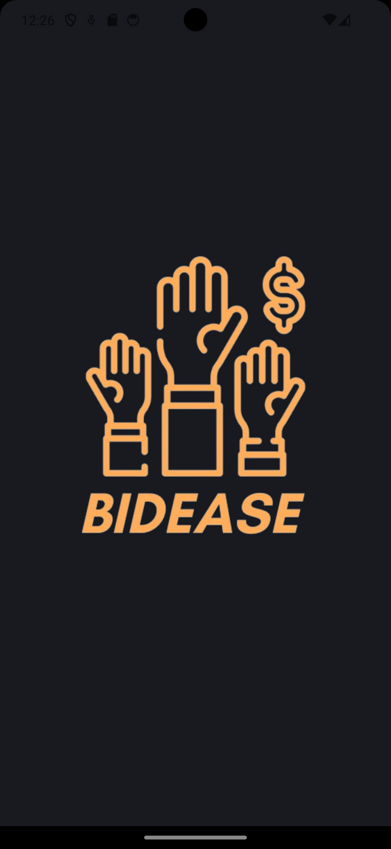
BidEase
Application
Proudly presented by:
Zain Awadeh Amal Dawod
12028410 12011229

Slide 2
Contents
  1
  4
Introduction & About The Application
Features & Added Values
  2
  5
Development Of The Project
Problems Faced & Future work

Slide 3
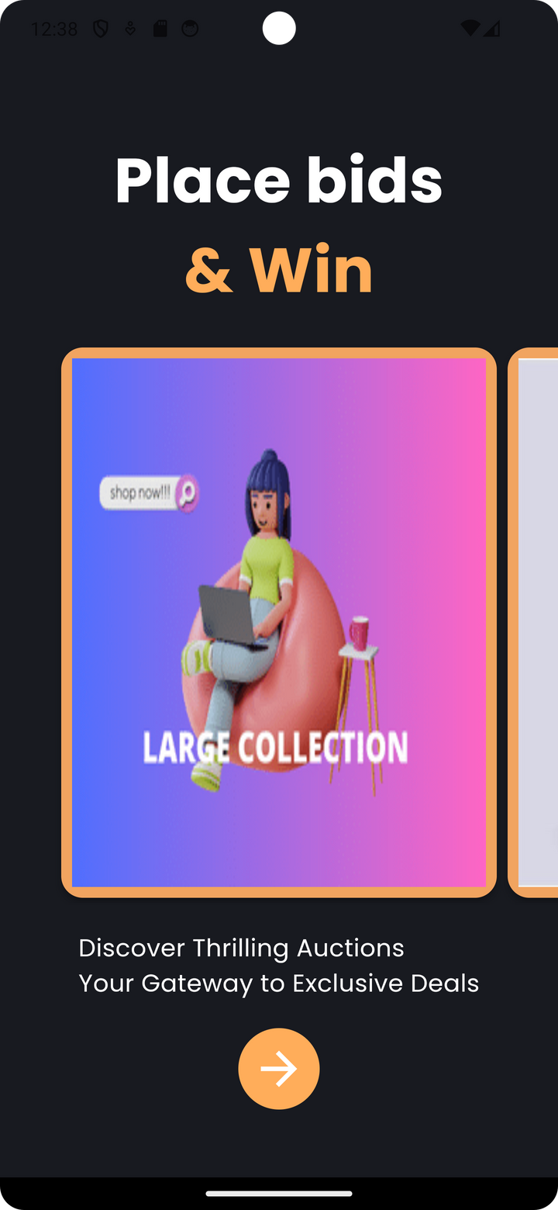
Introduction
Welcome to BidEase - the online auction platform where finding what you want and selling what you don't need is simple, eco-friendly, and budget-friendly

Slide 4
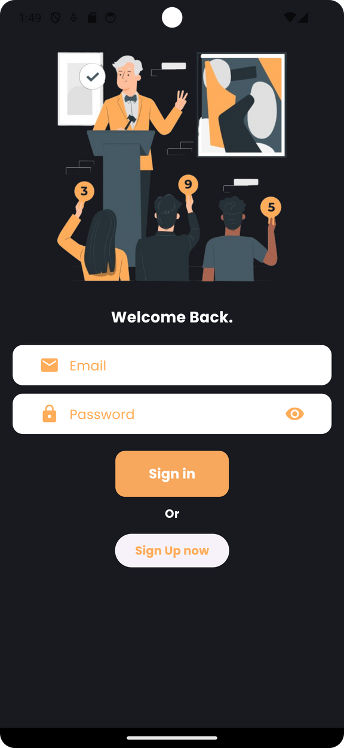
About BidEase
At BidEase, we believe in making online auctions accessible and enjoyable for everyone. Our platform is designed to be user-friendly, eco-conscious, and budget-conscious, ensuring a seamless experience for both buyers and sellers.

Slide 5



Development
Intro
  Our application was developed using the powerful combination of Flutter and Firebase, all within the Android Studio environment.
Flutter for Beautiful UI
  Flutter, Google's UI toolkit, enabled us to create stunning user interfaces that look and feel great on Android devices. Its fast rendering engine and customizable widgets made UI development a breeze.
Firebase for Backend Magic
  Firebase, Google's mobile and web application development platform, provided a range of backend services that we seamlessly integrated into our app. These services include authentication, real-time database, cloud storage, and more.

Slide 6



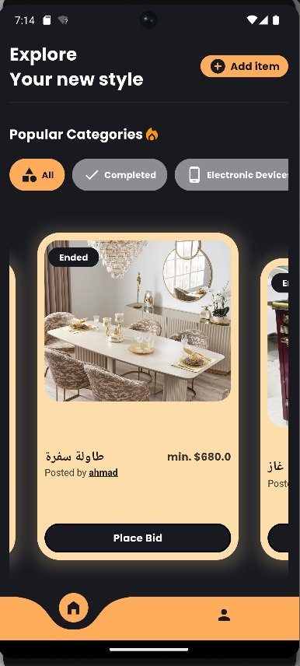
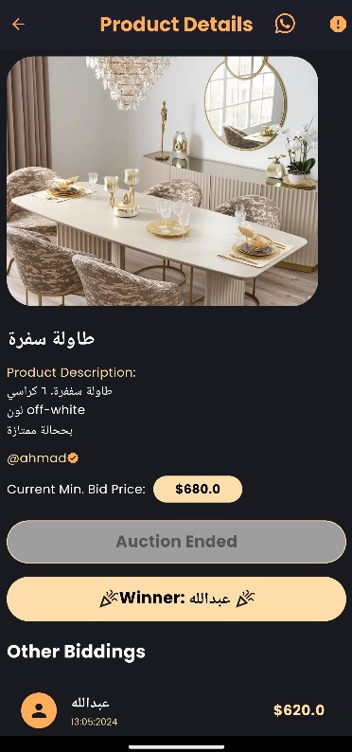
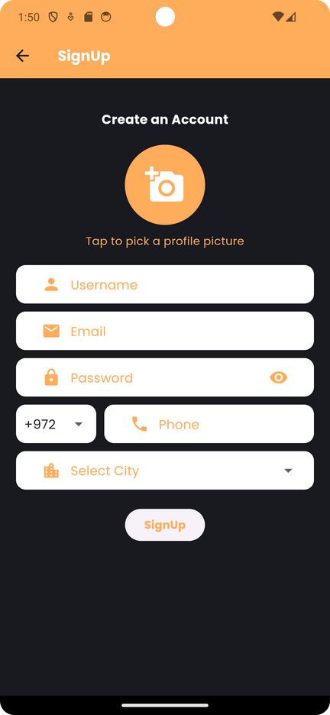


INTRODUCING
OUR FEATURES
EASY TO USE
SECURE
Simple and user friendly interface make the app very easy to use
Secure authentication via Firebase
WHATSAPP CHAT
GAMIFICAITON
Bid races with timed challenges
Instant messaging for easy communication via WhatsApp

Slide 7



Added Values
Time-Efficient Bidding:
Our app streamlines the bidding process, saving users time and effort while ensuring a dynamic auction experience.
Competitive Edge:
Participate in bid races and timed challenges, adding excitement and a competitive element to the auction process.
Transparent and Fair:
Our platform promotes transparency and fairness in bidding, ensuring a level playing field for all participants

Slide 8
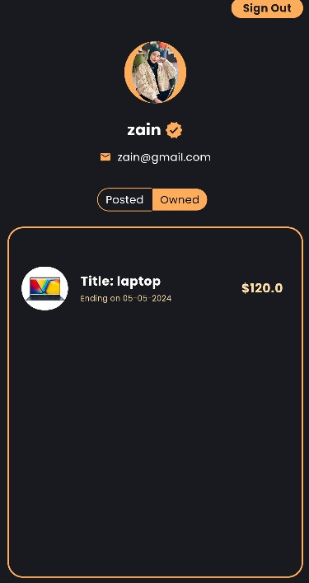
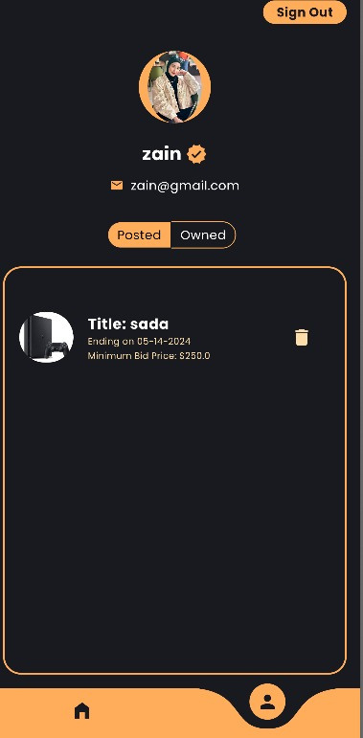
Now Hook-up for an amazing tour in our project

Slide 9




Problems Faced
Knowledge Limitations in Programming Languages and Databases
Limited expertise in programming languages and databases poses challenges in developing and maintaining the application effectively.
Lack of Financial Resource for Feature integration
Insufficient financial resources hinder the ability to purchase or activate certain features, limiting the app's functionality and competitiveness.
Difficulty in Designing an Appealing and User-Friendly Interface
Designing an attractive and user-friendly interface suitable for diverse users proves challenging, impacting user engagement and satisfaction.
Ensuring App Functionality and Error-Free Operation
Ensuring that the application functions correctly and without errors requires meticulous testing and debugging, consuming time and resources.

Slide 10
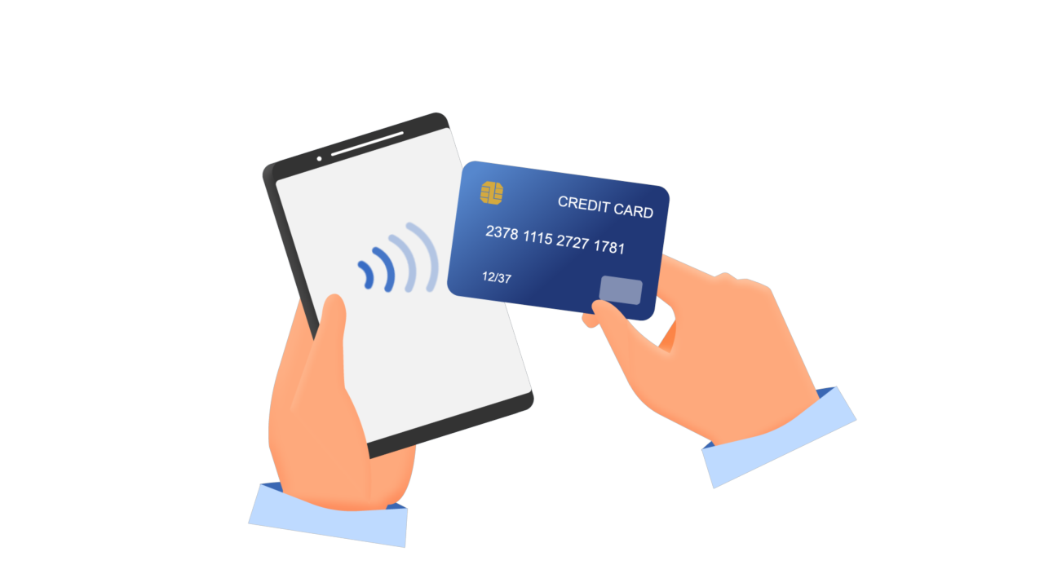

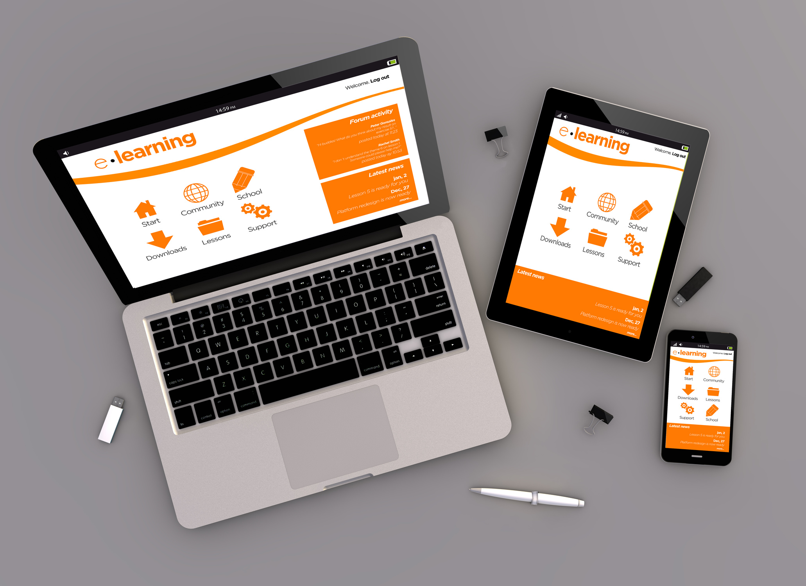
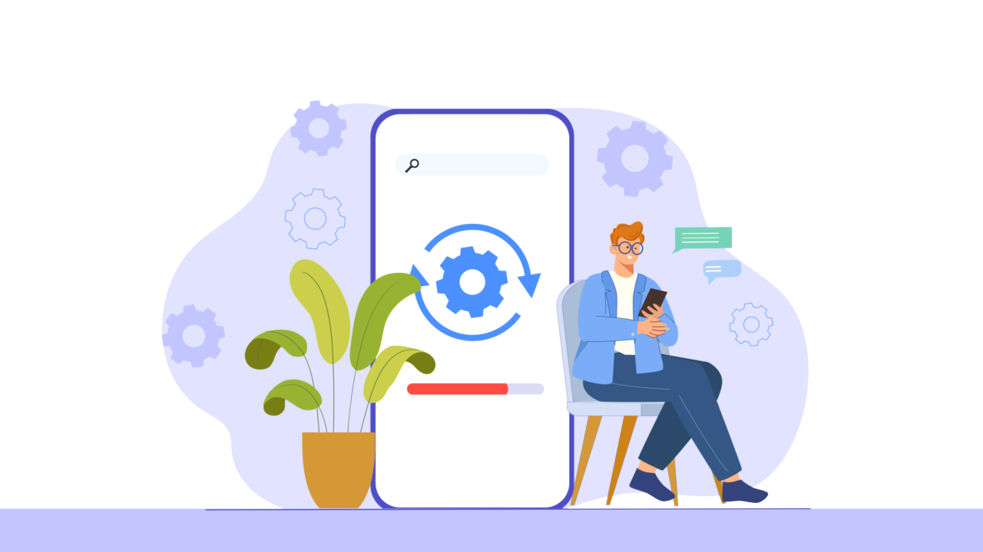
Future Work
01
Transactions using debit, credit and online payment methods
02
App notifications in-app and outside of it
03
Expansion to Other Platforms and reach a larger audience
04
Enhancements and Updates

Slide 11
Thanks for
your attention!!
We are ready for all your questions

