Slide 1
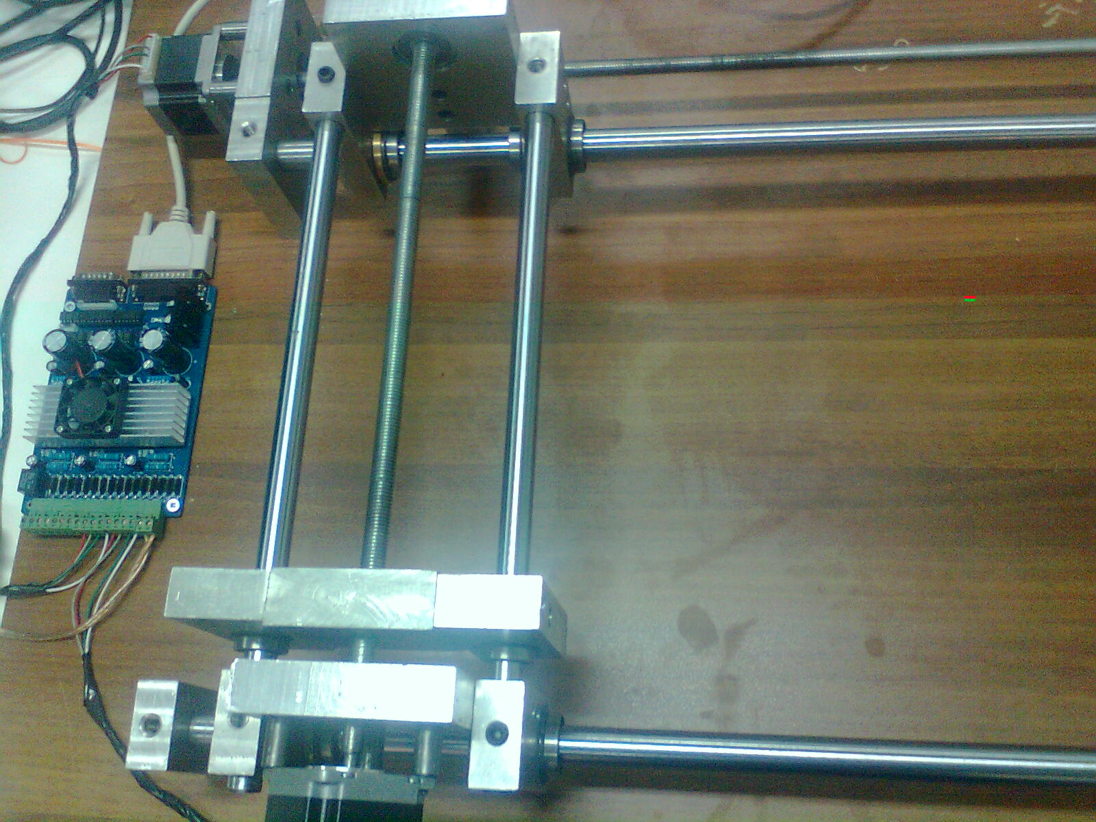
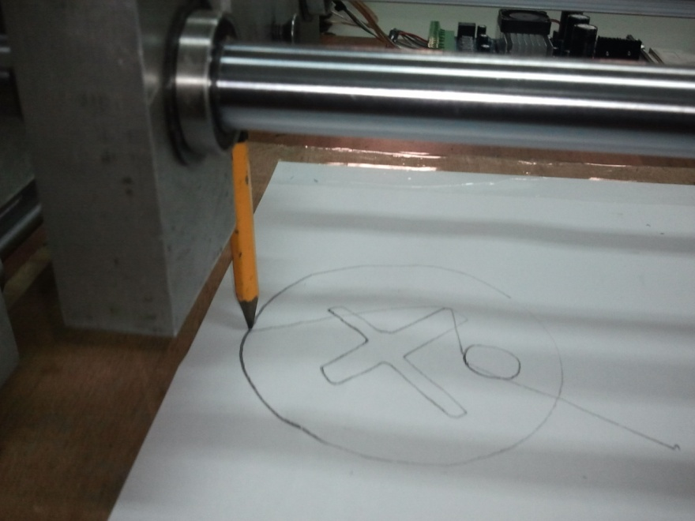
CNC DRAWING MACHINE
CNC DRAWING MACHINE

