Slide 1
APPLICANT TRACKING SYSTEM
Apply for your dream Job!

Slide 2
APPLICANT TRACKING SYSTEM
Our Amazing Team:
Marah I. Khader
Aseel B. Asia
Haifa’ A. Noubani
Supervisor: Dr. Mai Abu Sair
An-Najah National University 2020

Slide 3
Vertical Timeline
Idea Formation
Problem
Solution
Goals & Objectives
Competitors Features
&
Value Proposition
Jobs Palestine
Palestine Ta3mal

Slide 4
Vertical Timeline
Design
Adobe XD WireFrames
How we are doing this?
Take Information
Rates
Search & filter
Approved or Rejected
Development
PostgreSQL
Flask
Python
React

Slide 5
Vertical Timeline
Difficulties
&
Challenges
Future Works
Online Interviews
Chat Application
Performance

Slide 6
Ideal Formation
01
Problem
Solution
Goals & Objective

Slide 7
Problem
01
The large job application issue for vacancies, and the difficult manual hiring process.
02
The problem of searching for a job in more than one place with the appropriate skills, and the stressful traditional methods of applying for work.
Companies
Job Seekers

Slide 8
01. THE PRIMARY PURPOSE
02. For Companies
03. For Applicants
04. REDUCING TIME
Solution
Provide an easy way to find the right employee and recruit it to the company effortlessly and quickly.
Is to replace the old and traditional way of publishing a job, and applying for it, with a modern process that gave companies and job seekers a good experience in solving this problem that resulted mainly in increasing numbers of job applicants, and costly recruitment methods.
Find the best job suggestion automatically and apply for it online, which reduce time and effort.
Reduce the time lost in communication between companies and applicants

Slide 9
GOALS & OBJECTIVES
A
C
Unburden the Recruiter and create a better and healthier working environment by exponentially increasing the recruitment capacity.
Replace the traditional recruitment process with e-Recruitment.
B
D
Contribute to the environment by enabling almost completely paper-free recruitment.
Providing competitive services to companies and employees.

Slide 10
Competitors Features
&
Value
Proposition
02

Slide 11
Around The World
BairesDev
San Francisco, CA, US
Akhtaboot
Amman, Jordan
Careerjet
Malbourne, Australia

Slide 12
In Palestine
Search for job and show the best suggestion.
View the list of vacancies on the platform.
Post training courses.
Easy to contact with.
Jobs Palestine
Palestine Ta3mal

Slide 13
Value Proposition (ATS)
01
03
rate the applicant with his skills
provide services from our own platform
cover the need for the many job seekers and companies with efficient and easy-to-use search options
The form assigned to the applicant is to be relied upon instead of CV, but the cv is referred to if the company wants or in the event of equal opportunities
02
04

Slide 14
03
HOW WE ARE DOING THIS?

Slide 15
PROCESSES
Take needed Information
Approved or Rejected?
Search & Filter
Rates
And save it into the database
Rating the applicants
Easy and fast searching and filtering processes

Slide 16
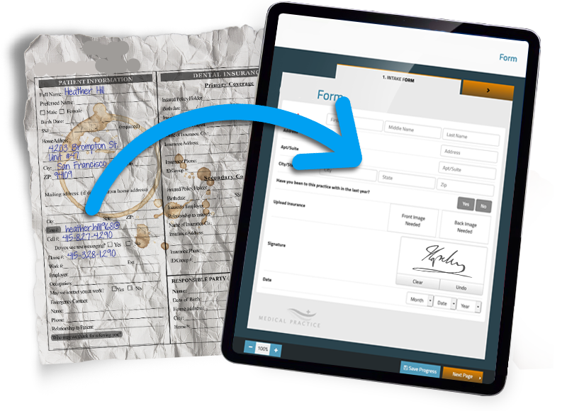
TAKE ALL NEEDED INFORMATION AT FIRST
Provide many online forms that receive user data, starting from the client or the company that has vacant jobs, then the applicants to these jobs, till the platform employees.
How to use?
1. User fills the required data in form.
2. The system sends these data to the database and keep it.

Slide 17
RATES
The rating process of the applicants is very useful in reaching the priority for obtaining the job. The current rating types are self-rate, and employee rate.
How to use?
1. Applicant rate his skills by his-self.
2. The system send his email to the pending list until an employee rate him, then he will be approved or rejected.

Slide 18
SEARCH & FILLTER
The job seeker searches for a job that suits him by choosing options that provide an easy search process by taking the job specifications he wants, then the system displays vacancies with the same specifications.
How to use?
1. User enter “Browse Job” page to choose the options of job specifications that he want.
2. The system takes these selections and search in the database.
3. the system displays vacancies to the user with the same specifications.

Slide 19

Provide Services
The system will provides efficient services for the system’s parties, and will be able to handle many services to take care of all customers in an effective manner.
How to use?
1. User enter “Services” page to choose the services he want.
2. The system takes the selected service and save its details in the database.
3. An Employee will get connected with the client to serve him and take more details.

Slide 20

SERVICES for Companies
01
02
03
Recruitment Service.
Staff Augmentation Service.
Outsourcing Service.
04
05
Training Service.
Consulting Service.

Slide 21
04
DESIGN

Slide 22
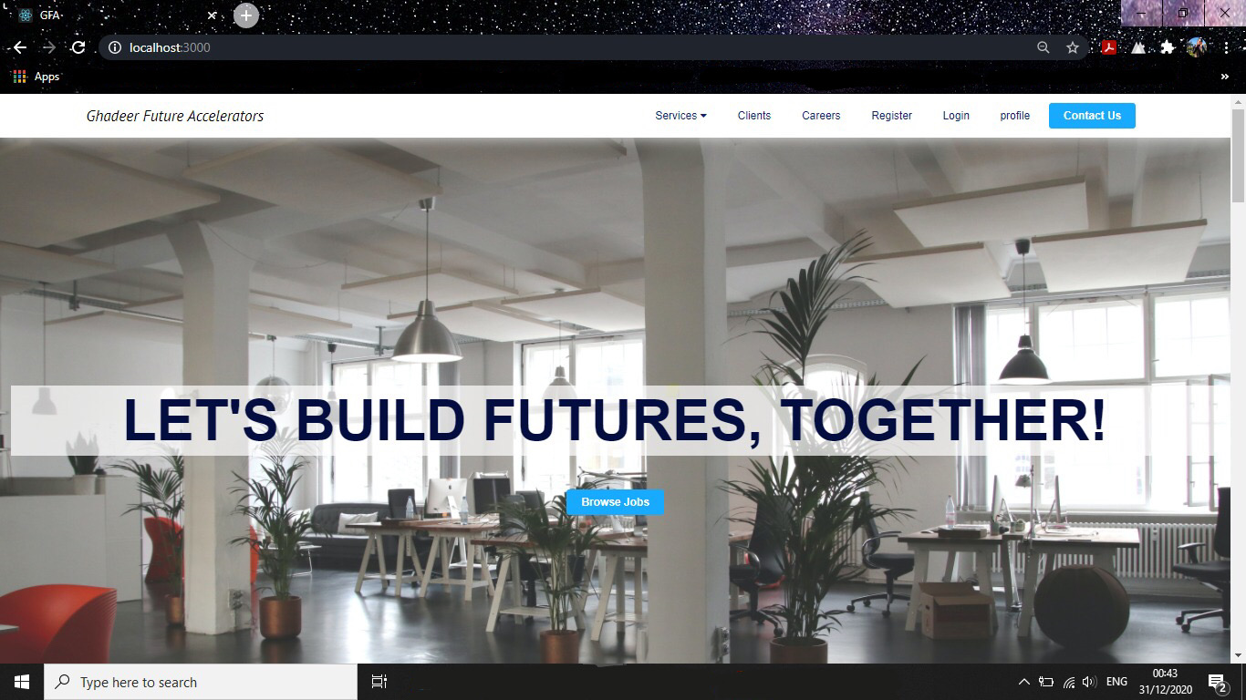
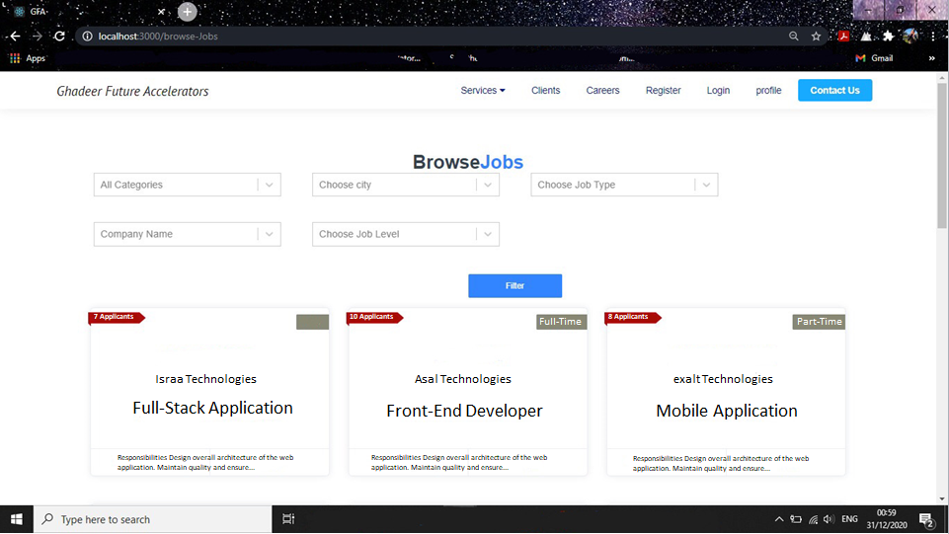
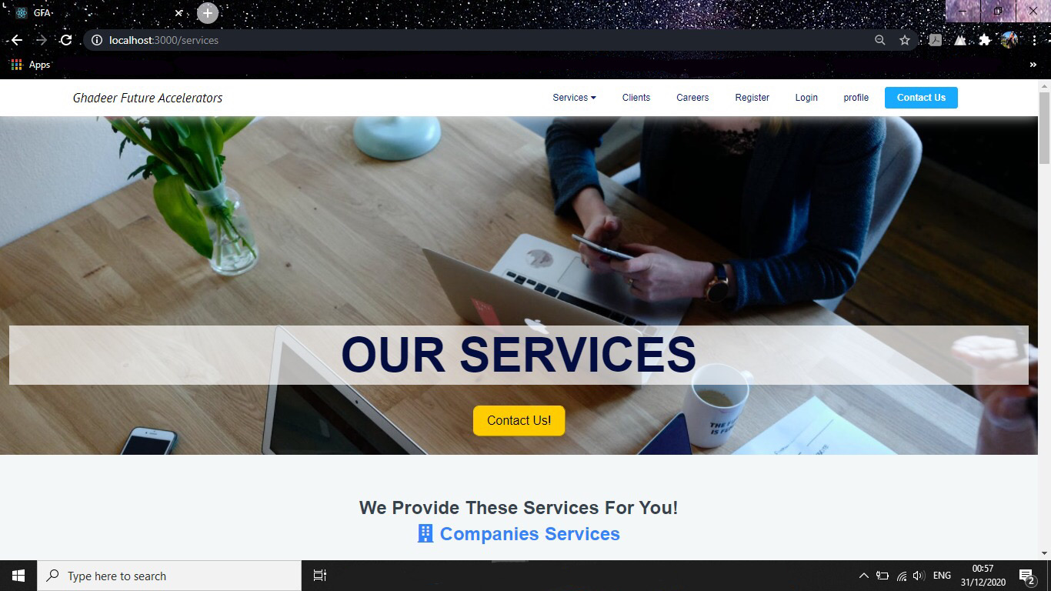
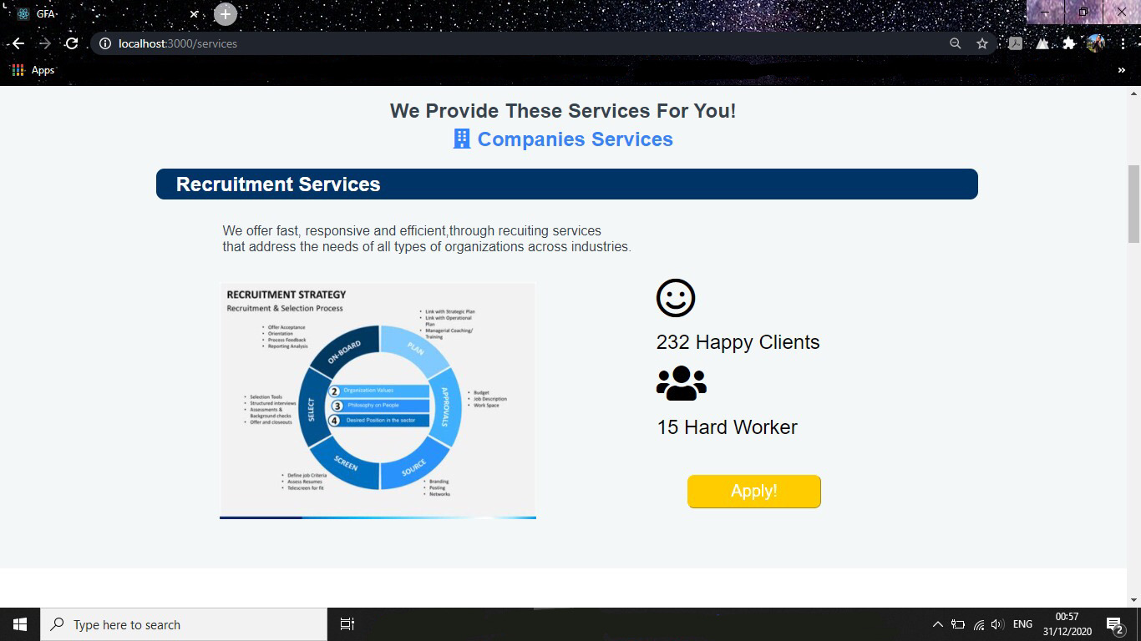
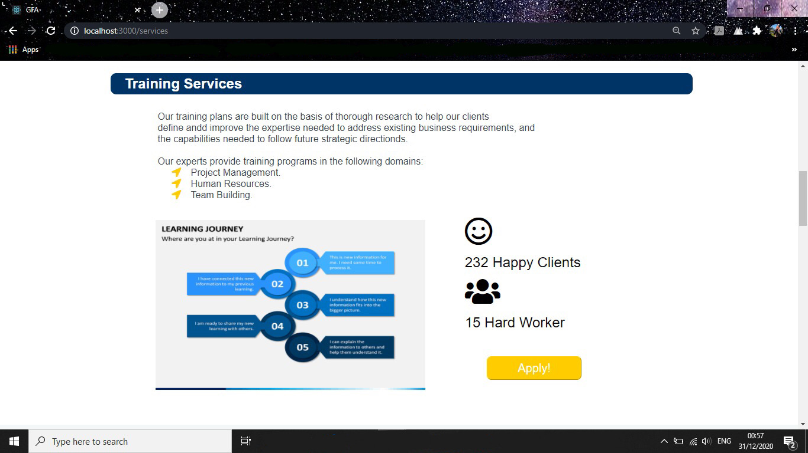
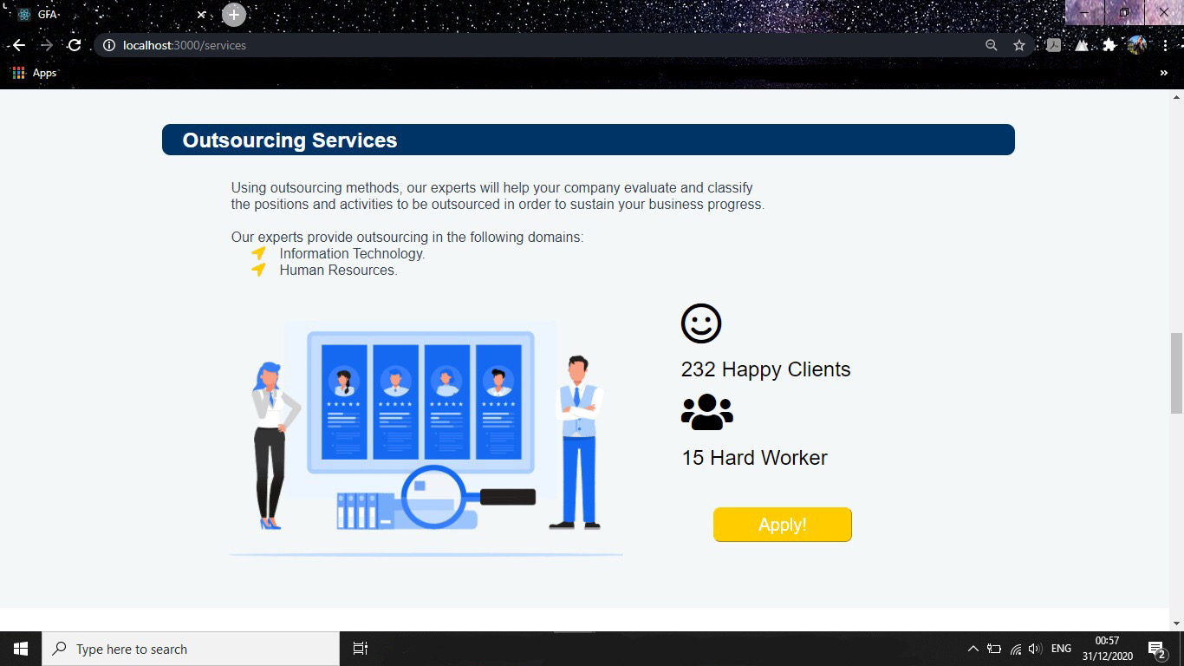
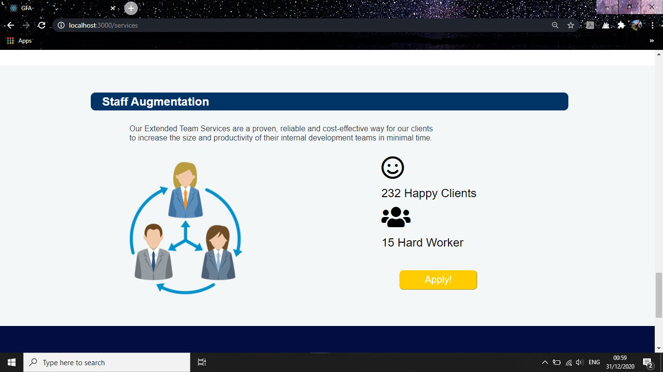
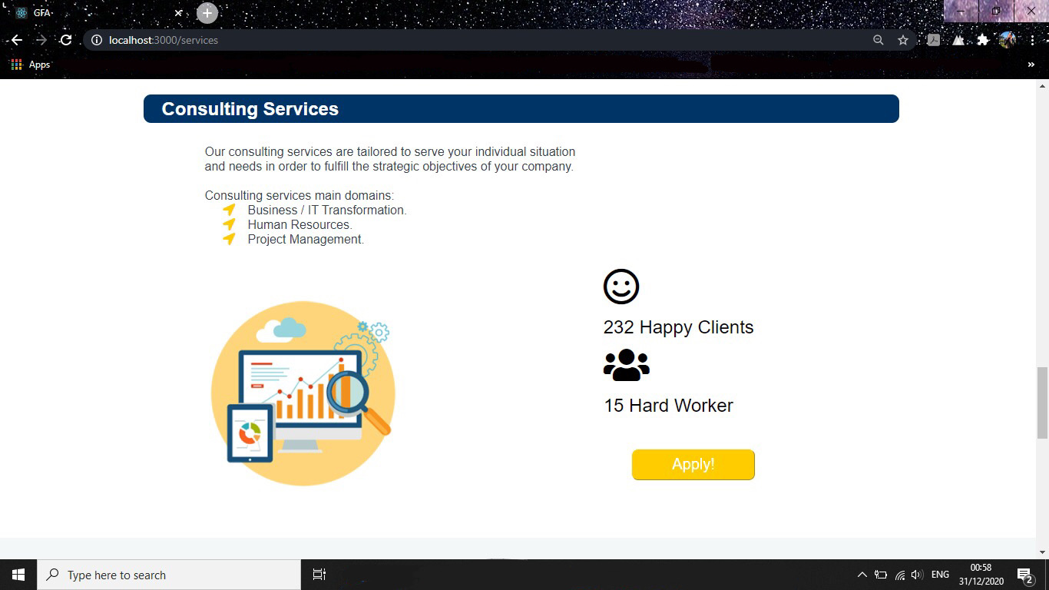

Slide 23
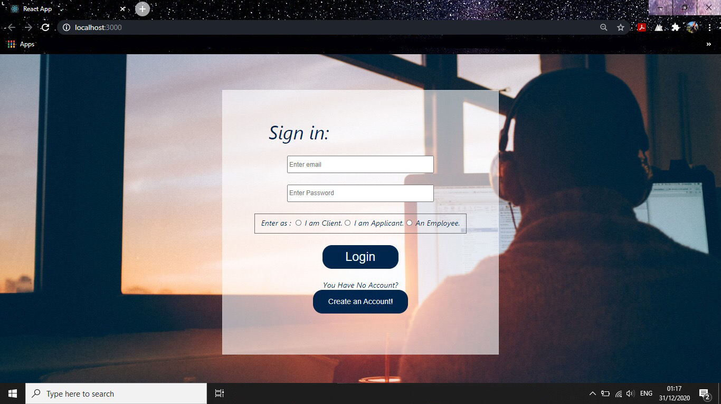
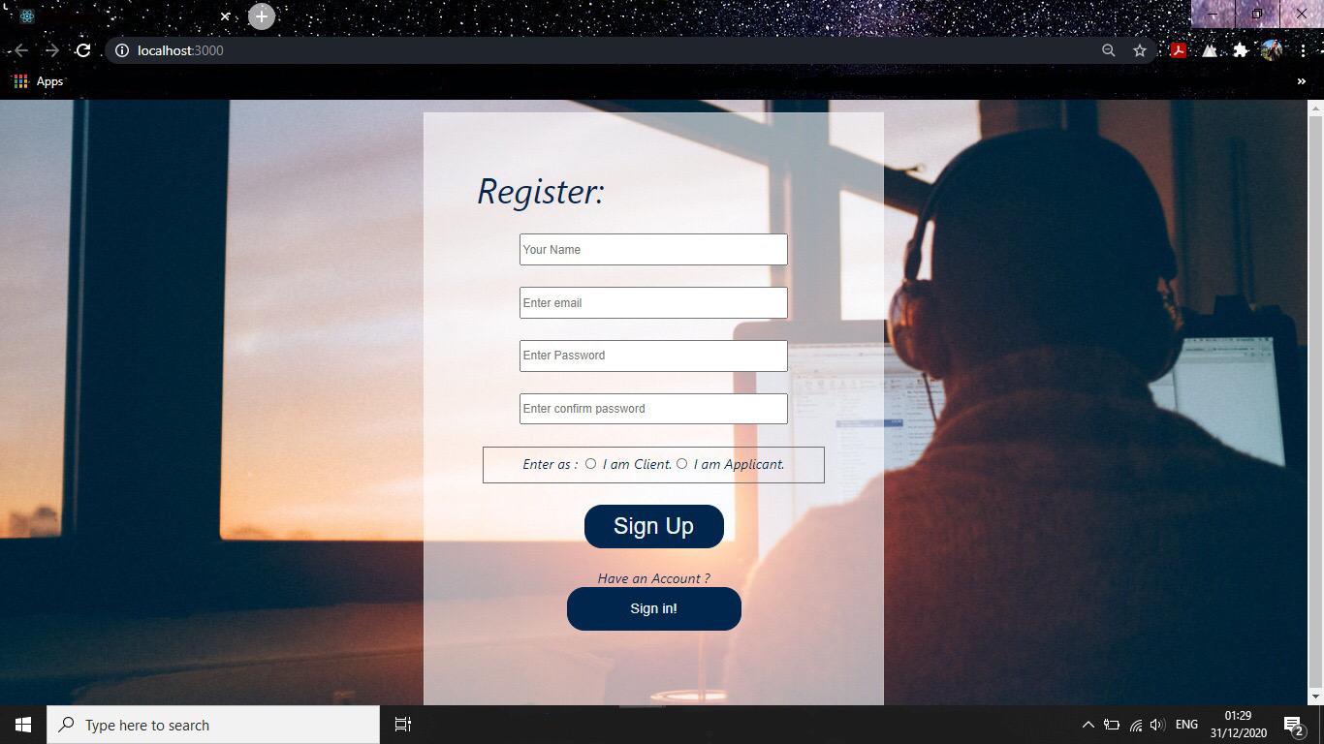
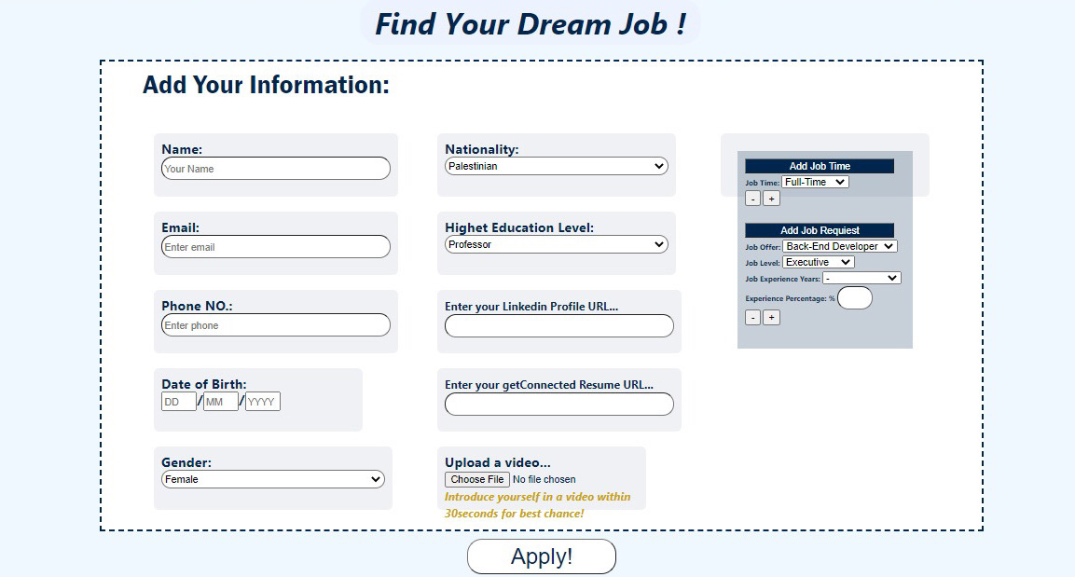
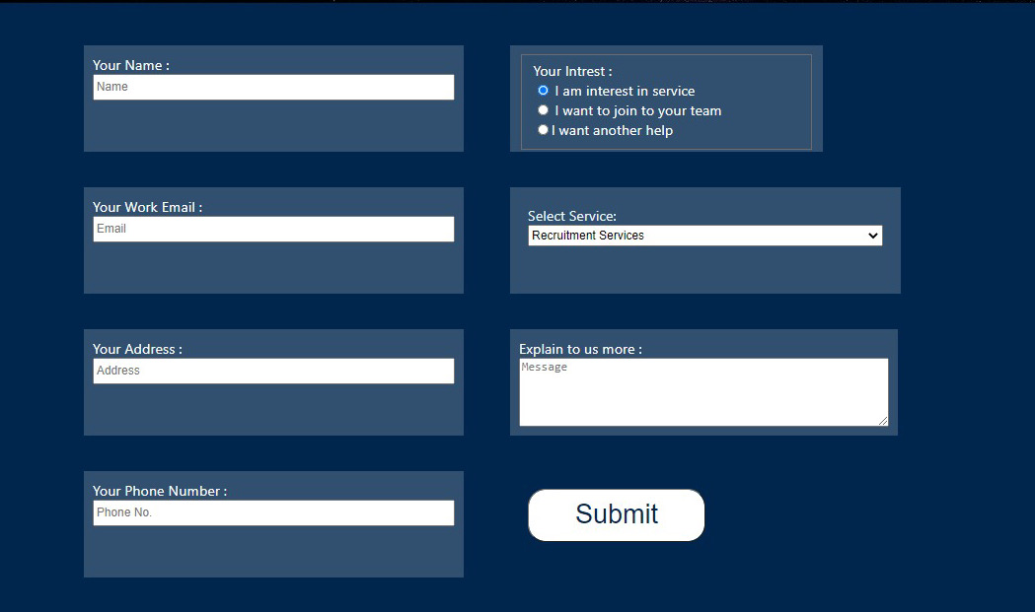
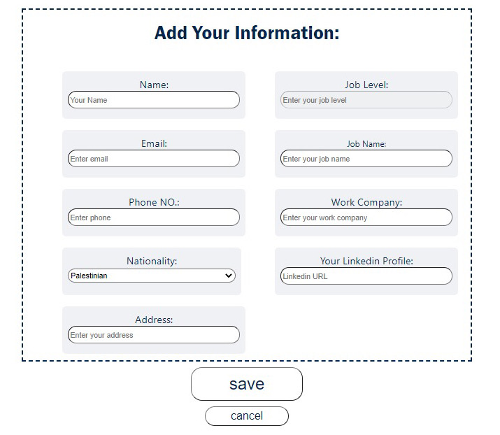
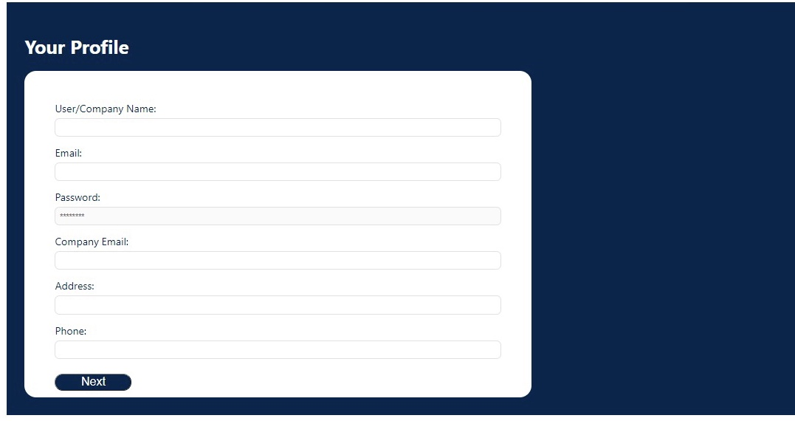
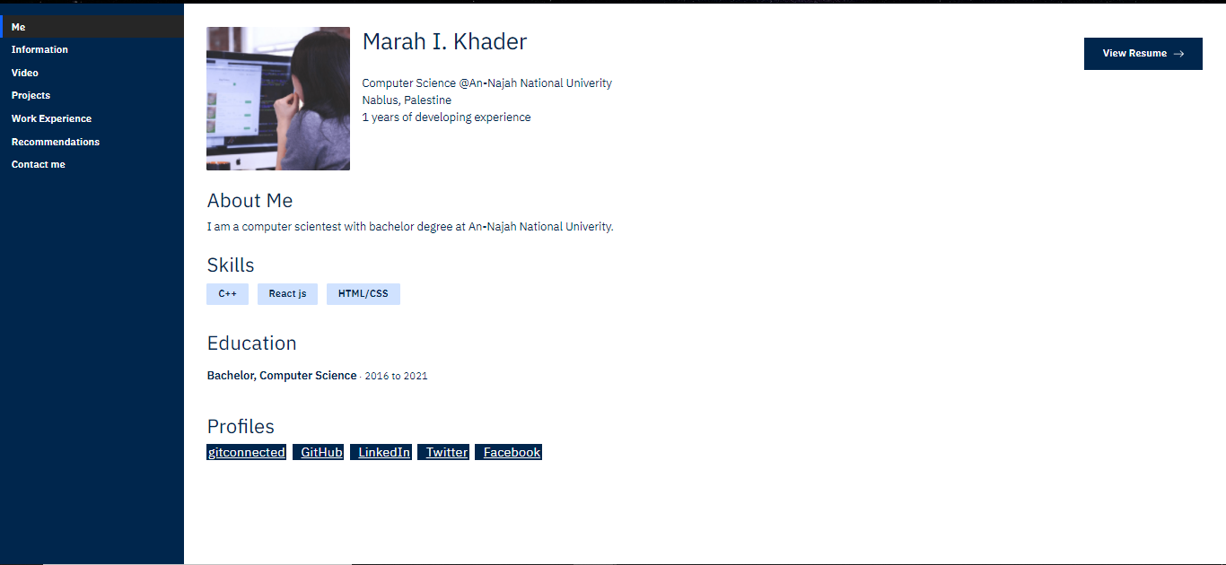
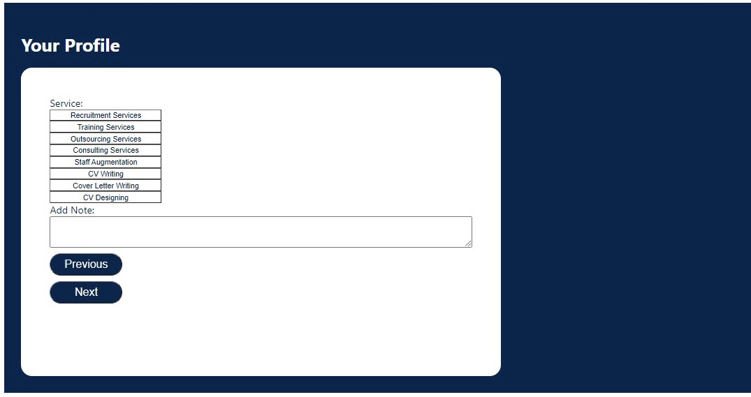

Forms

Slide 24
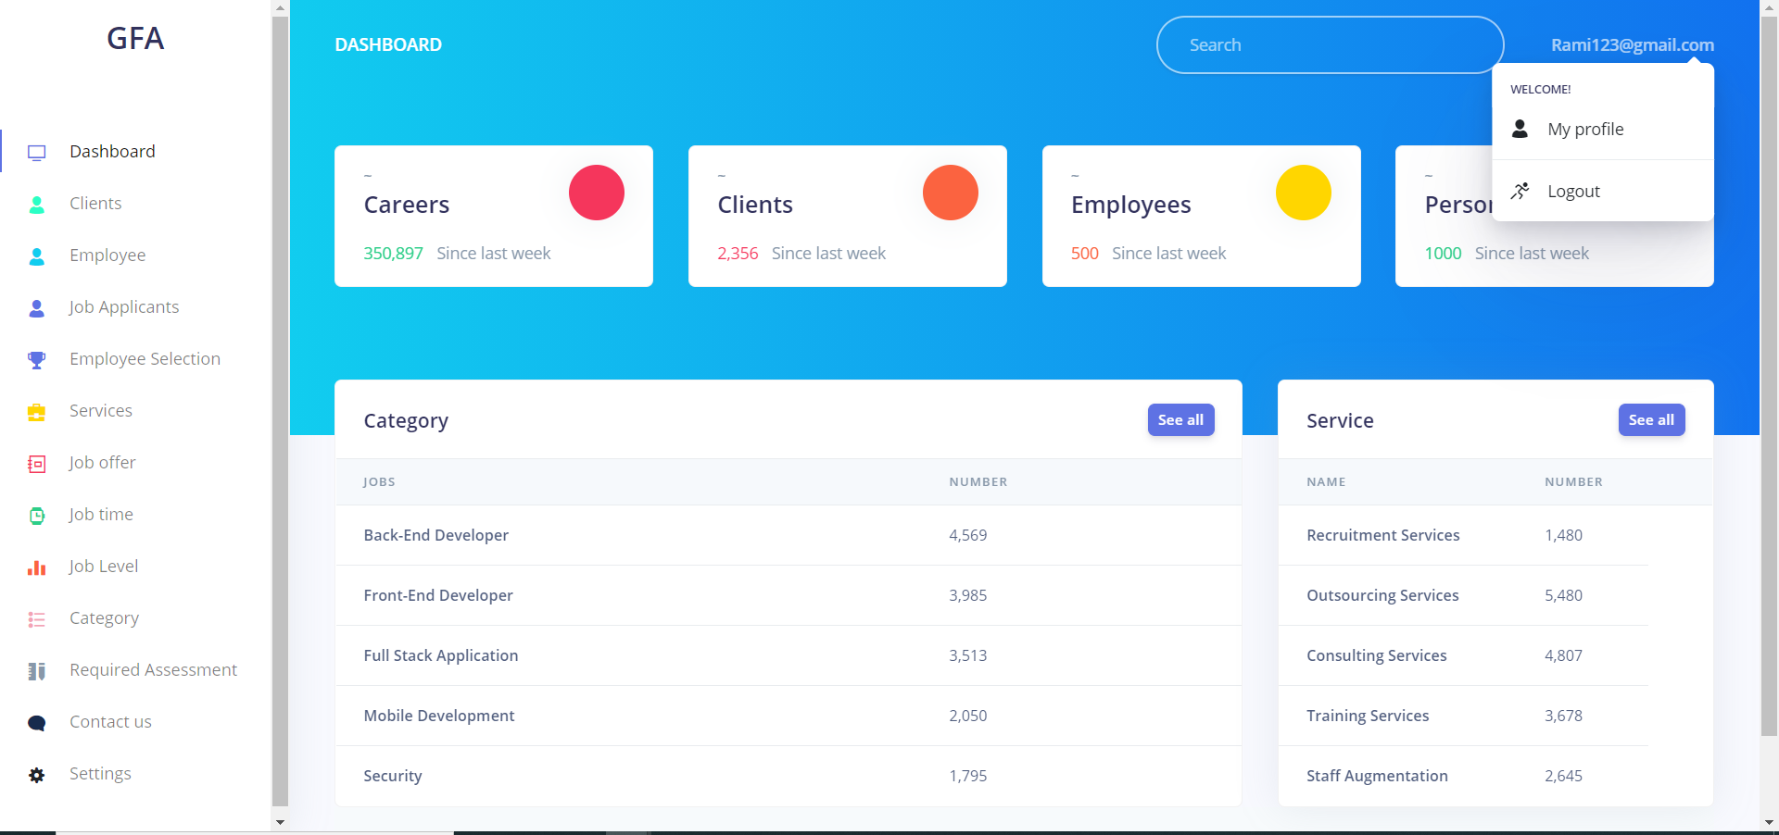
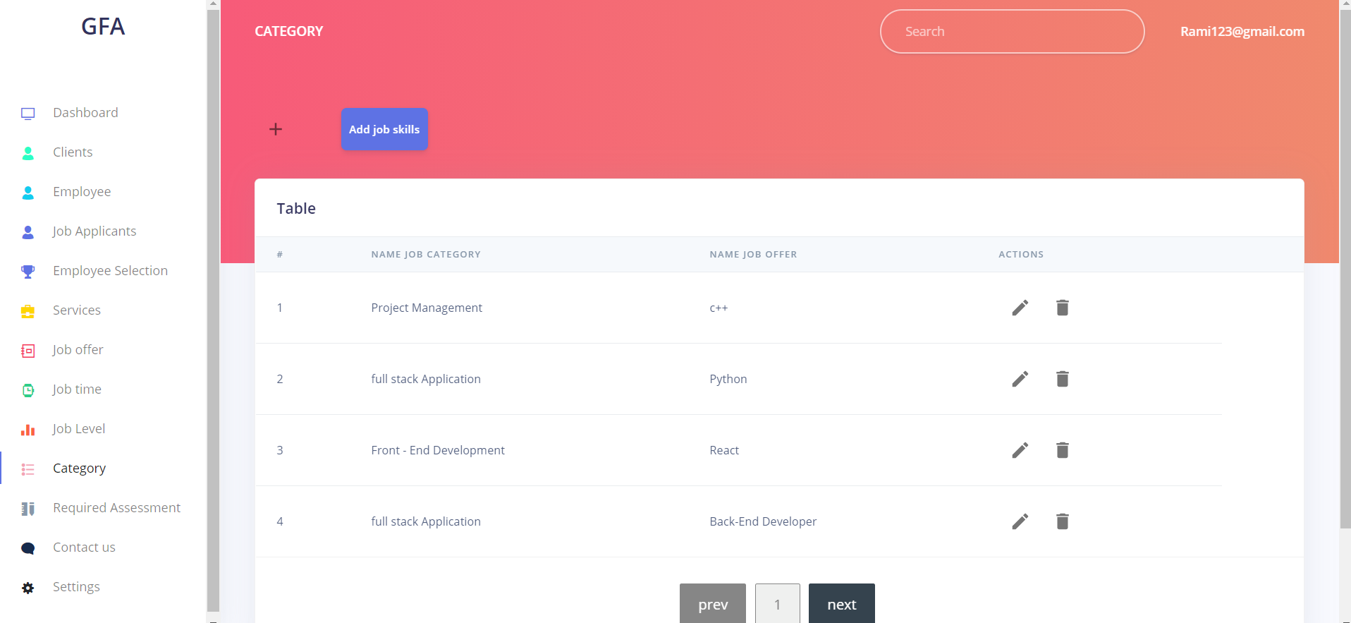
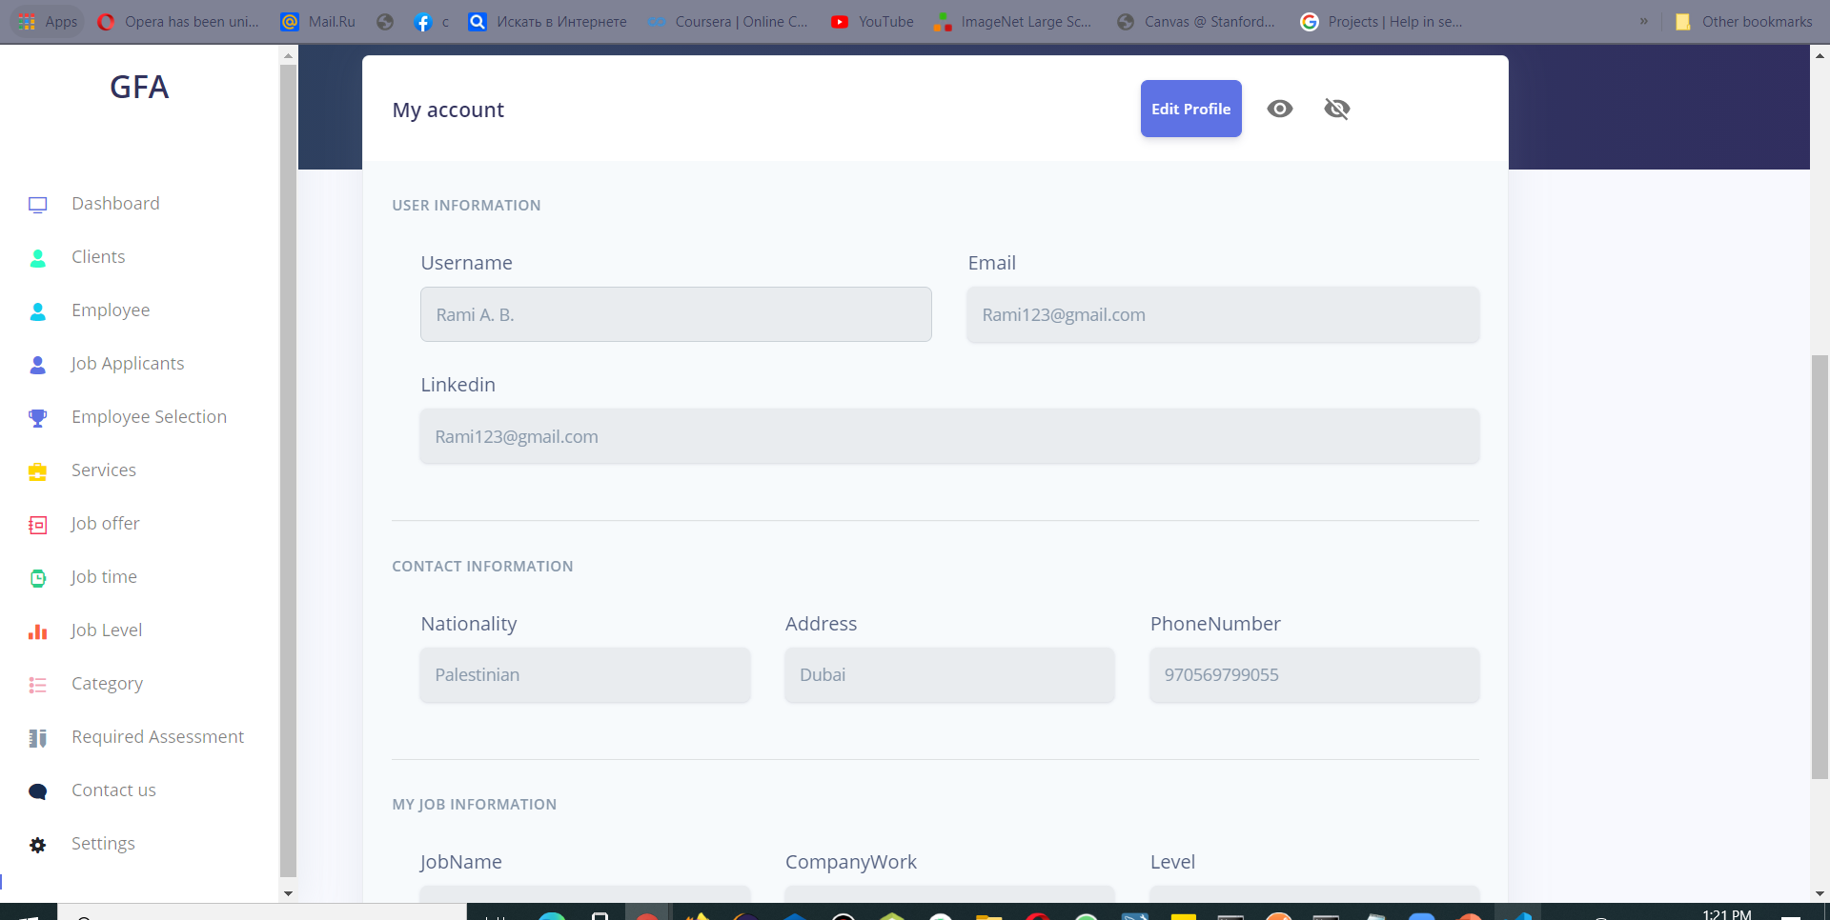
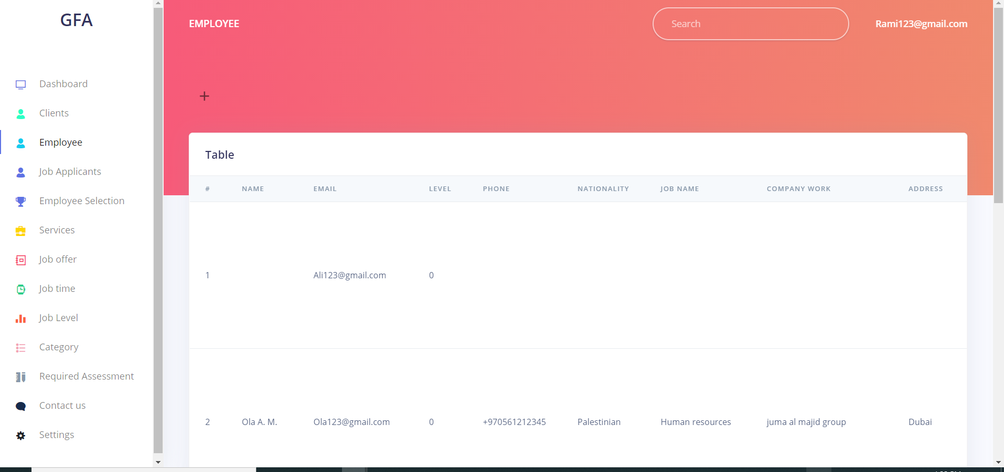
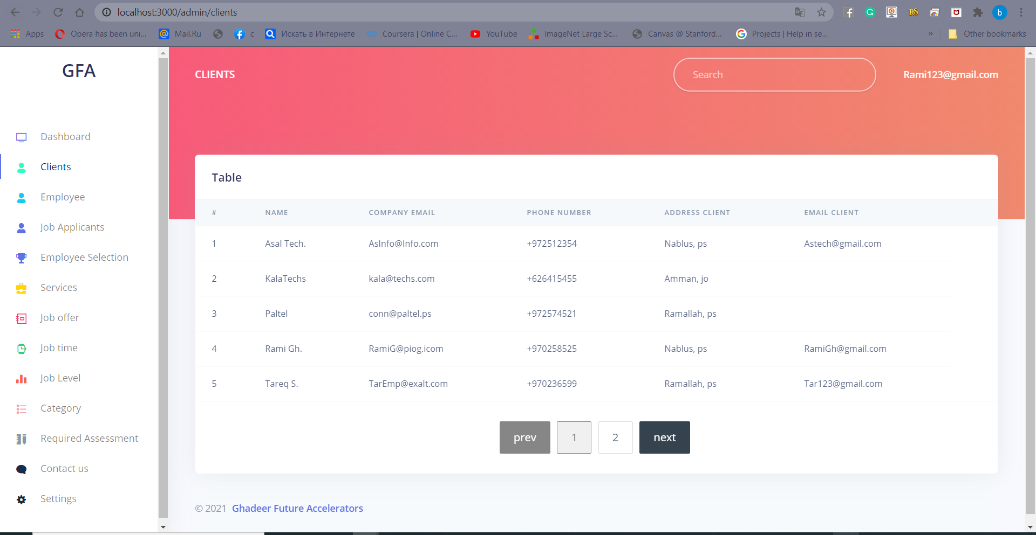
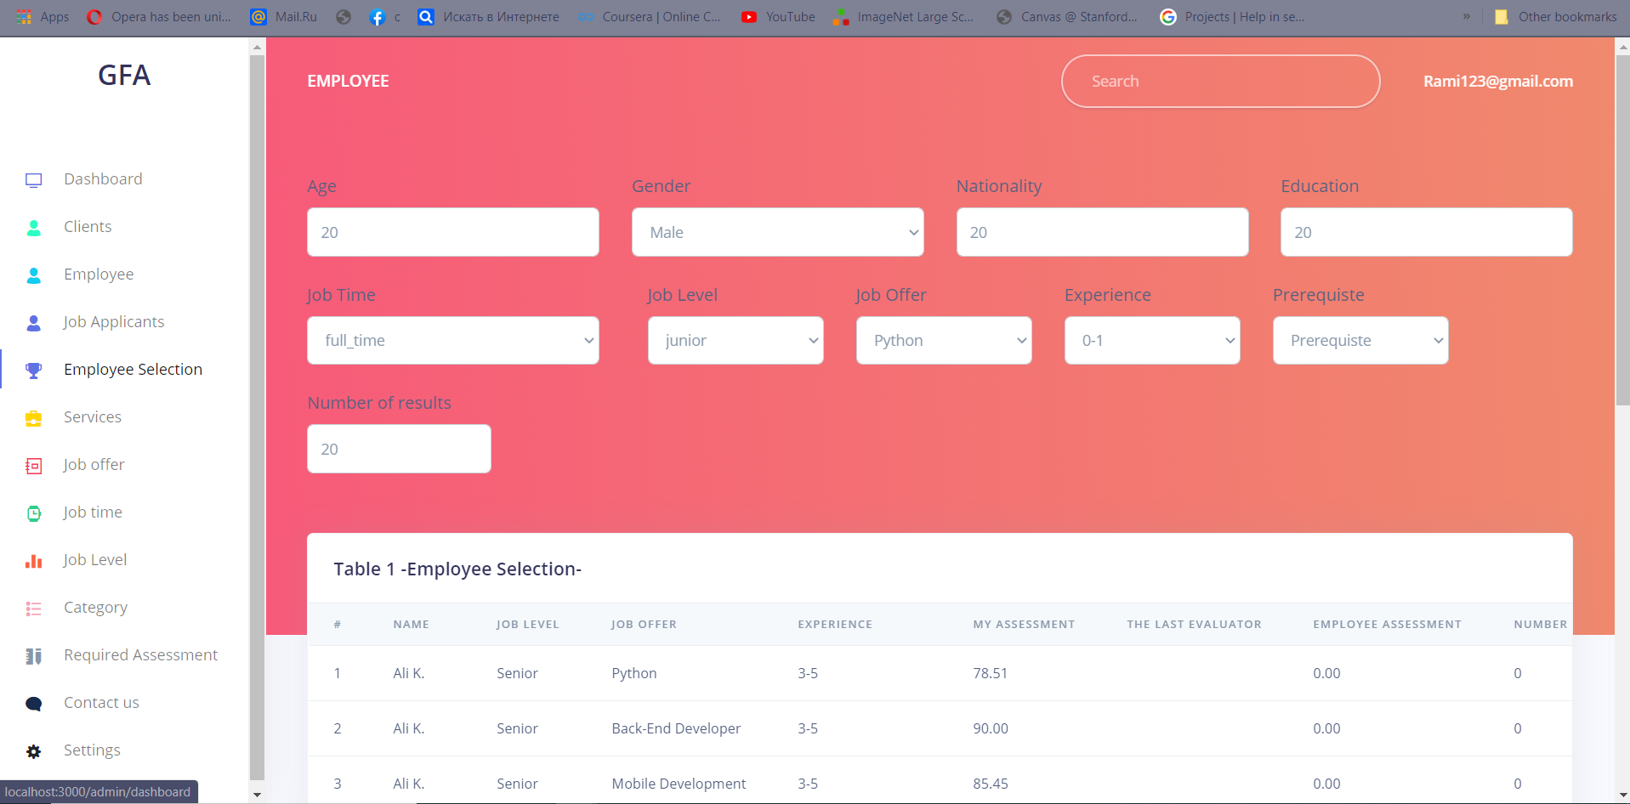
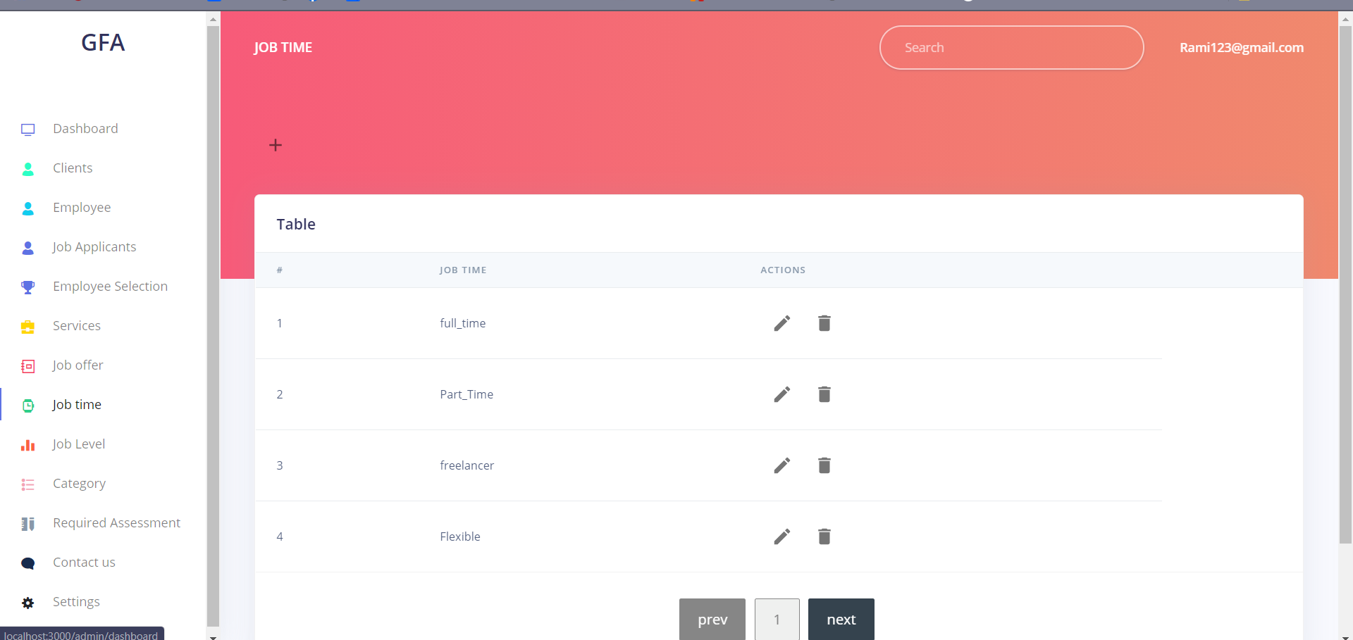

Slide 25

05
DEVELOPMENT

Slide 26




DEVELOPMENT
Front-End
Front-End & Back-End
React
Flask
Back-End
PostgreSQL
Python

Slide 27

React (Front-End)
What?
React is a declarative, efficient, and flexible JavaScript library for building user interfaces. It lets you compose complex UIs from small and isolated pieces of code called “components”.
Why?
1. Simplicity
2. Easy to handle
3. Data Binding
4. Testability
5. Performance

Slide 28

PostgreSQL (Back-End)
What?
Is a general purpose and object-relational database management system, the most advanced open source database system.
Why?
1. Protect data integrity.
2. Build fault-tolerant environments.
3. Free and open source.
4. Manage large dataset.

Slide 29

Python (Back-End)
What?
Python is an interpreted, object-oriented, high-level programming language with dynamic semantics.
Why?
1. Easy to use
2. Powerful
3. Flexible Language
4. Flexible Language

Slide 30
Flask (Front-End & Back-End)
What?
is a web framework. This means flask provides you with tools, libraries and technologies that allow you to build a web application.
Why?
1. simplicity control.
2. flexibility control.
3. fine-grained control.
4. lightweight web application.

Slide 31
06
Difficulties
& Challenges

Slide 32
DIFFICULTIES & CHALLENGES
Short Period of time for research, development, testing, ...etc.
Difficulty and time needed to learn and integrate new development tools like React.js ,UX/UI, Python and API.
The closing due to Covid-19. Inability to meet and get direct feedback from the companies and administrators due to the lockdown.
After designing our project and a month ago from now, all sites similar to the idea of our project developed into a shape and ideas similar to ours, so we had to make some changes, which led to delays in the rest of the work.

Slide 33

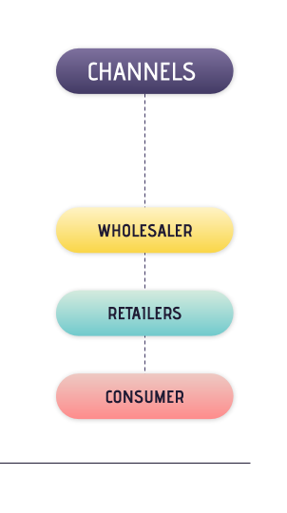
07
FUTURE WORK

Slide 34
01
02
03
04
05
Online Assessment
Using NLP
"Chat" application
Developing a job description
SMART ATS

Slide 35
THANKS!

