Slide 1
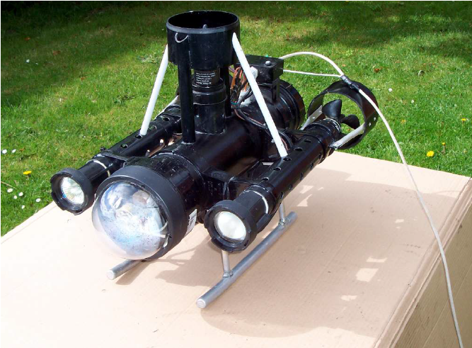
Remotely Operated underwater unmanned Vehicle (ROV)
Prepared by :
Diya Salman
Adham Owiesi
Supervised by :
Dr.Saed Tarapiah

Slide 2
What is ROV
An underwater remotely operated vehicle (ROV) is a mobile robot designed for aquatic work environments. Remote control is usually carried out through copper or fiber optic cables. A human operator sits in a shore-based station the operator can also maneuver the robot and watch the vehicle on the screens.

Slide 3
Why we choose this project
For help specialists explore the deep sea without endangering themselves and the search for the remains of the planes and ships that are falling in the seas.
Also as a game of entertainment.

Slide 4
The different thing in this project is the integration of several scientific branches related to electricity, communication and control to get out a practical robot in the scientific and exploratory field.
Chat Conversation End

Slide 5
bouyancy
Types of buoyancy:
Negative Buoyancy: The weight of the vehicle is higher than buoyancy as the difference between them increases the speed of the vehicle's descent to the bottom.
Positive Buoyancy :The buoyancy strength is greater than the weight of the vehicle, and the greater the difference between them, the faster the vehicle will raise
Neutral buoyancy: Is characterized by making the weight of the submarine zero inside the water.

Slide 6
why neutral buoyancy:
In this project neutral buoyancy Will be relied upon because of stability of the vehicle in the water and no need to use propellers to install it and this in turn Reduces energy losses.
How to make ROV in neutral buoyancy
Referring to the buoyancy law of Archimedes:
The weight of the removed liquid = the weight of ROV

Slide 7
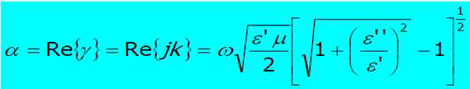
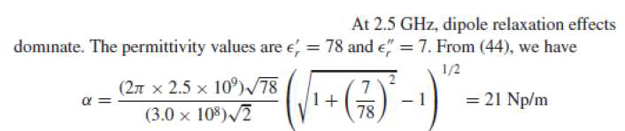

Why Wi-Fi signals does not used instead of Ethernet

Slide 8
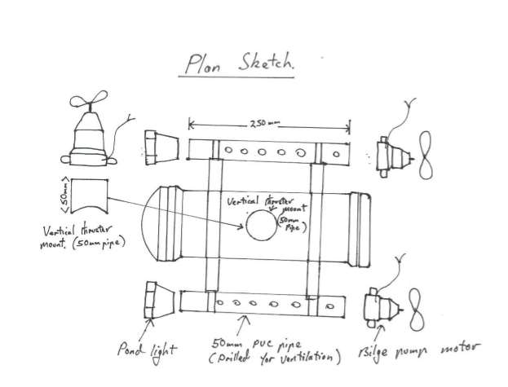
Plane ROV
android device

Slide 9
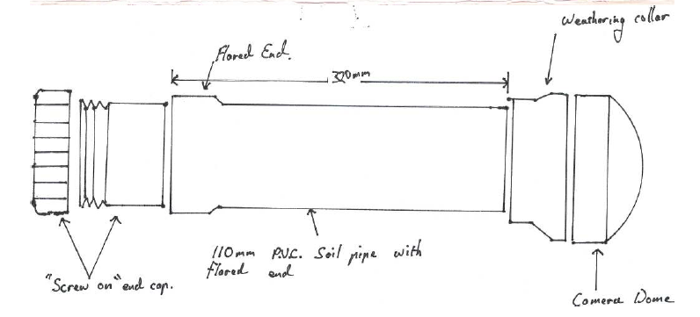

Slide 10
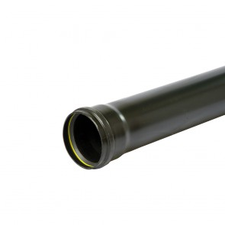
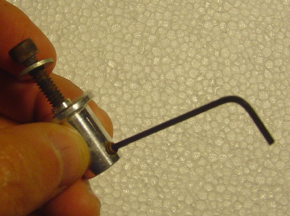
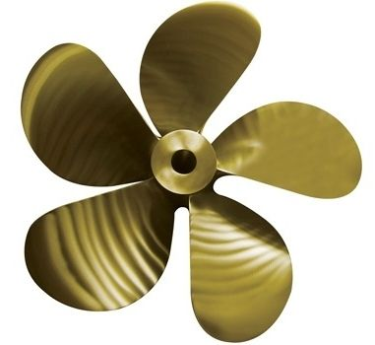
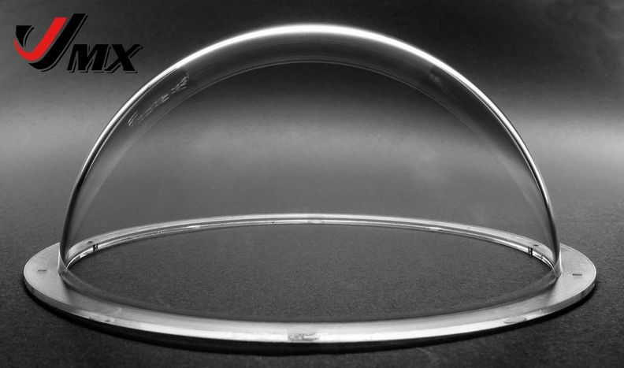
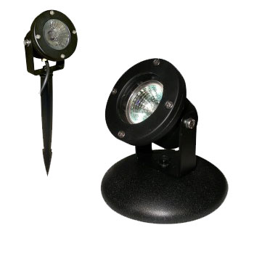
PVC SOIL PIPE
direct drive propeller adapter
PROPELLORS
Camera dome
POND LIGHTS
WEATHERING COLLAR

Slide 11
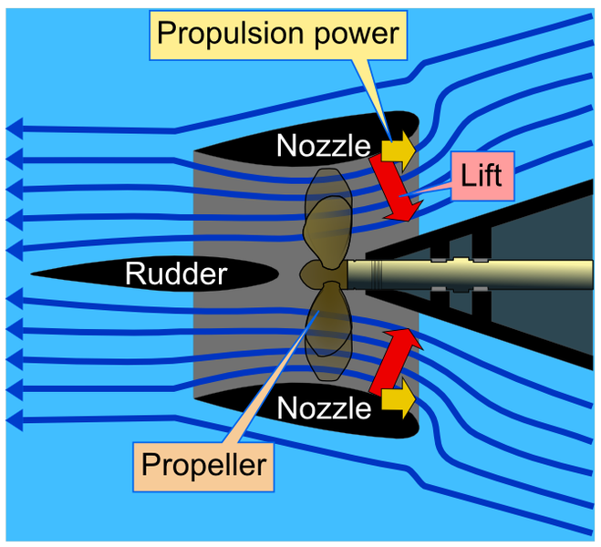

Slide 12
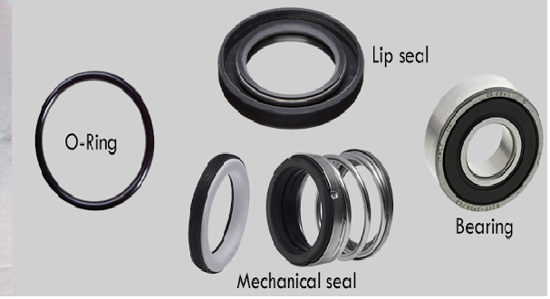
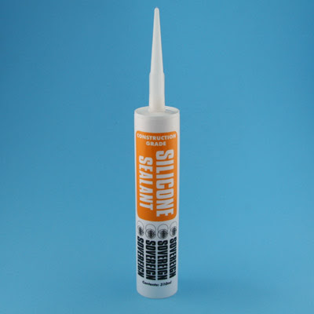
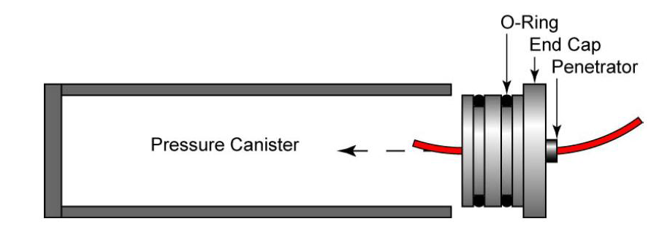
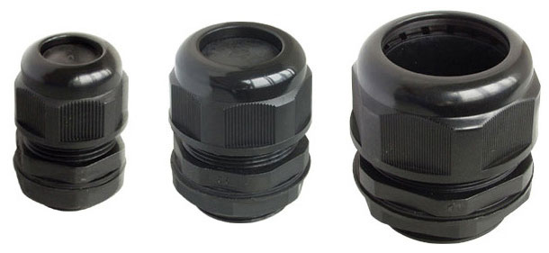
Materials insulating

Slide 13
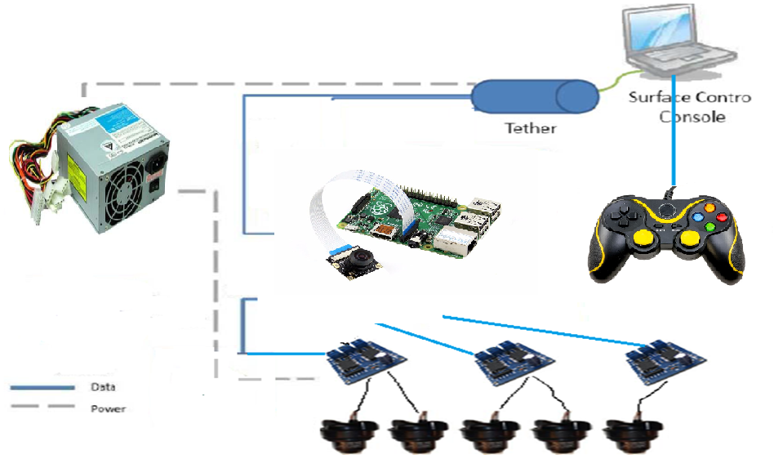
Electronic and control system for ROV
wd

Slide 14
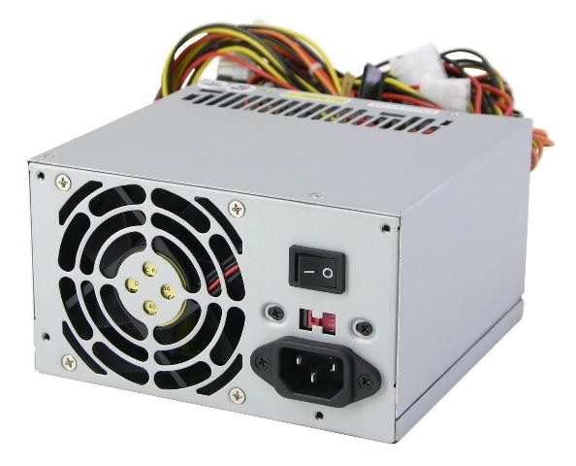
Power supply

Slide 15
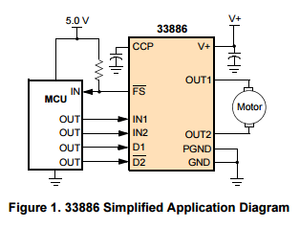
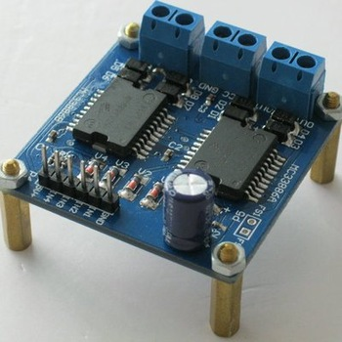
H-Bridge MC33886:

Slide 16
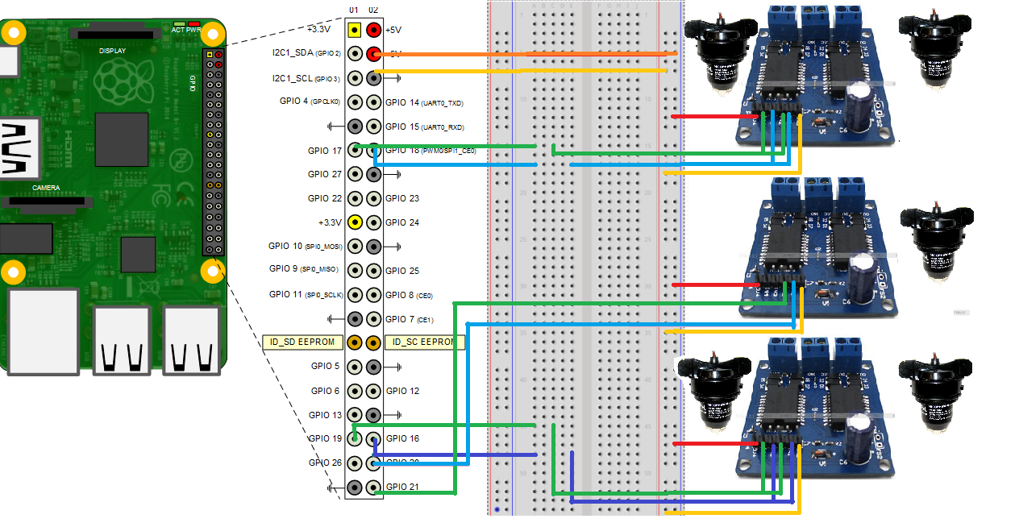

Slide 17
software
Software required:
Matlab R2016b or up
Computer vision system toolbox
Image processing tool box
Hardware support package :
Simulink support package for raspberry
2)VEX ARM Cortex Support from Simulink

Slide 18
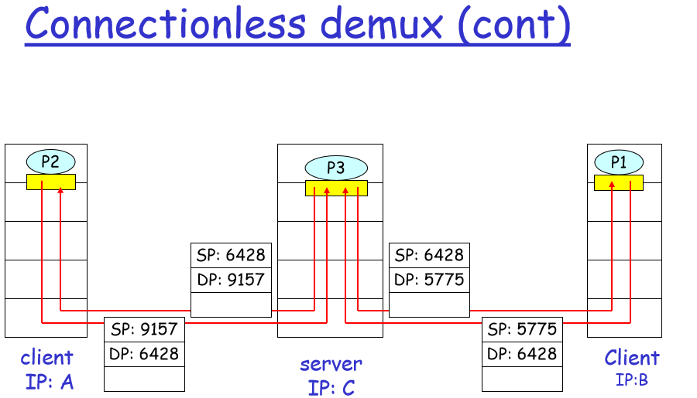

Slide 19
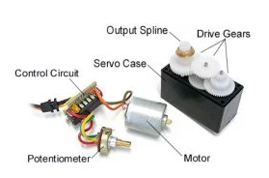
Servo motor

Slide 20
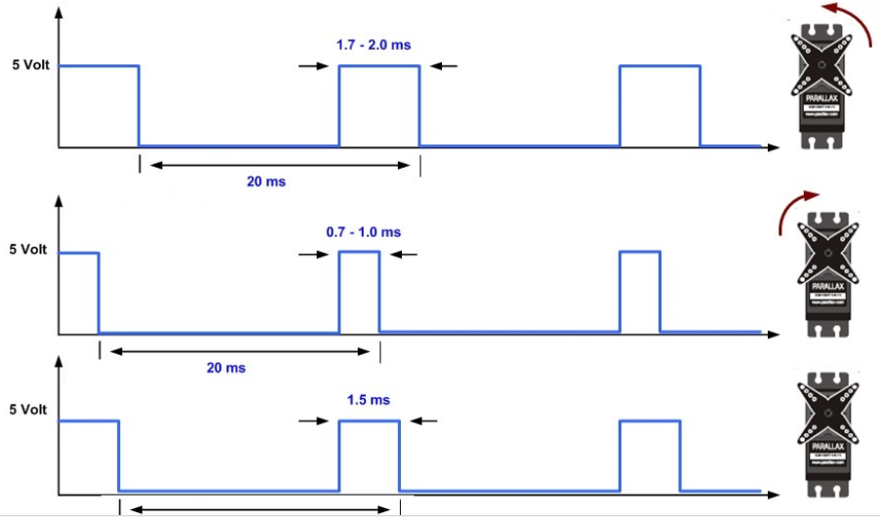

Slide 21
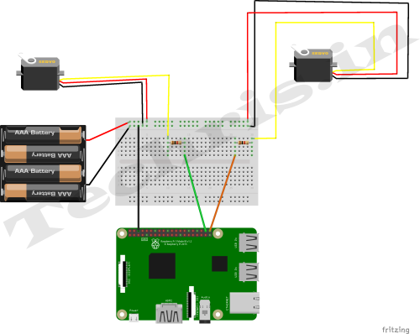

Slide 22
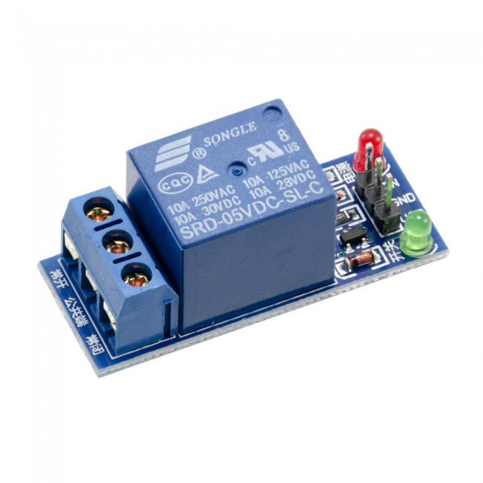
Relay module

Slide 23
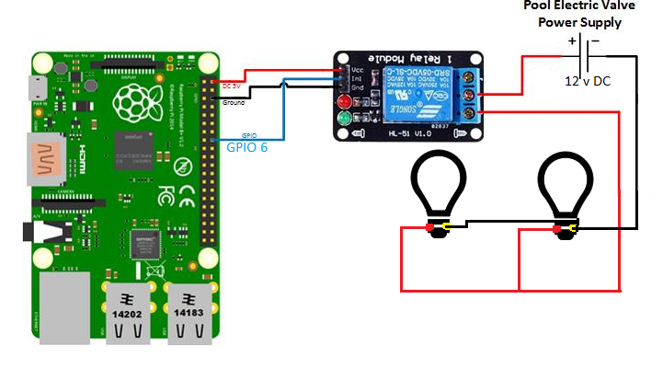

Slide 24
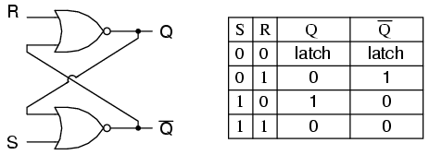
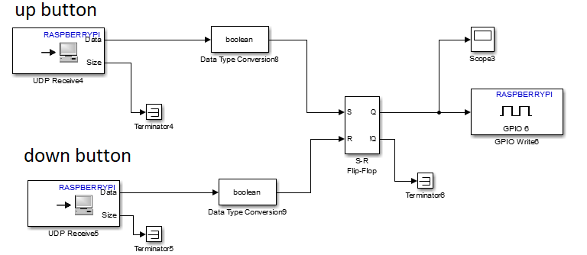

Slide 25
RTSP(real time streaming protocol)
RTSP is the control protocol for the delivery of multimedia content across IP networks.
very similar operation and syntax to HTTP. RTSP
is used by the client application to communicate to the server information such as the media file being requested, the type of application the client is using, the mechanism of delivery of the file (unicast or multicast, UDP or TCP), and other important control information commands such as DESCRIBE, SETUP, and PLAY. The actual multimedia content is not typically delivered over the RTSPconnection(s), although it can be interleaved if required. RTSP is analogous to the remote control of the streaming protocols.

Slide 26
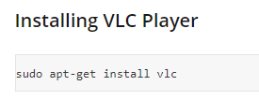
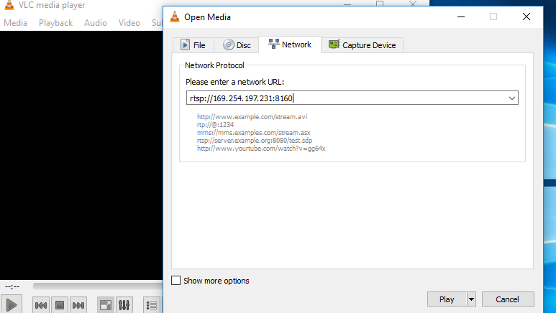
Streaming Video Using VLC Player

Slide 27
Hopefully the project has won your admiration.
Thank you

