Slide 1

“Redesign Cultural Center in Nablus City”
An-Najah National University
Faculty of Engineering & Information Technology
Department of Building Engineering
Prepared By:
Haitham Aker
Ahmad Awwad
Mahmoud Qawareq
Supervisor: Eng. Alaa Shaheen

Slide 2
Contents:
Site analysis
Architectural Design
Environmental Design
Structural system Design
Electro-Mechanical system Design
Safety design
Quantity Survey and Cost Estimation

Slide 3
Site Analysis

Slide 4
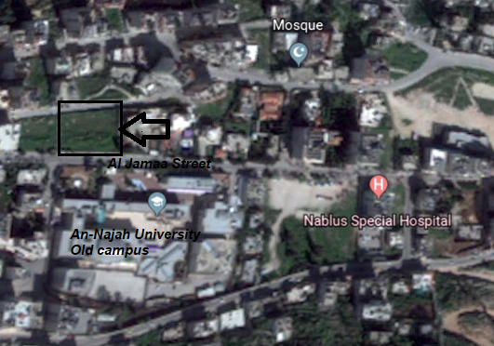
Site analysis
The site is located in Nablus city near the old campus of An-Najah National University, it’s in the Northern side of Al Jamaa street and rise about 597 m above sea level. Site has a total area of 2692 m2.

Slide 5
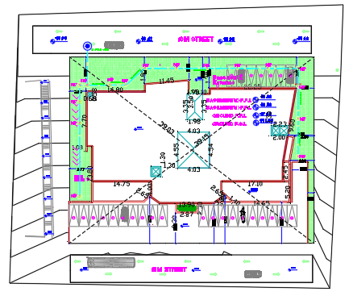
Site analysis
Building area = 1954 m²

Slide 6
Architectural Design

Slide 7
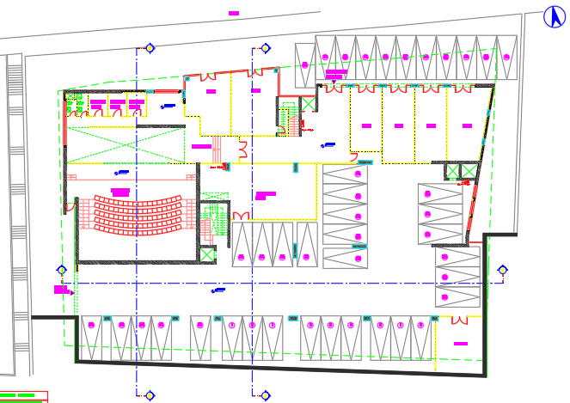
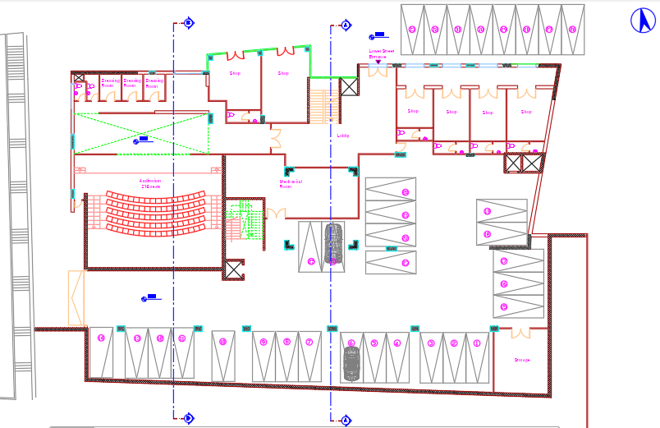
Basement 2
Old Basement 2 area = 1812 m²
New Basement 2 area = 1796 m²

Slide 8
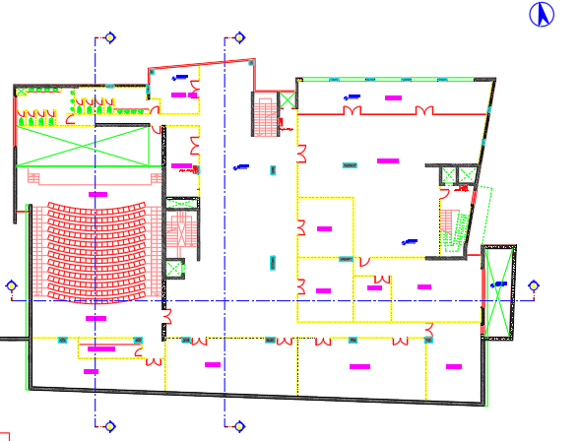
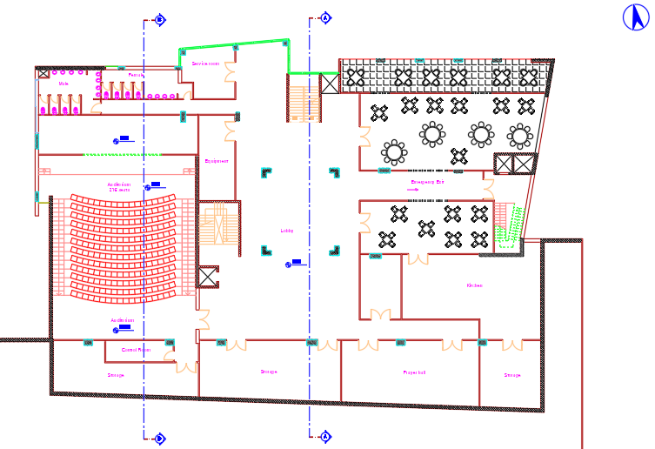
Basement 1
Old Basement 1 area = 1832 m²
New Basement 1 area = 1816 m²

Slide 9
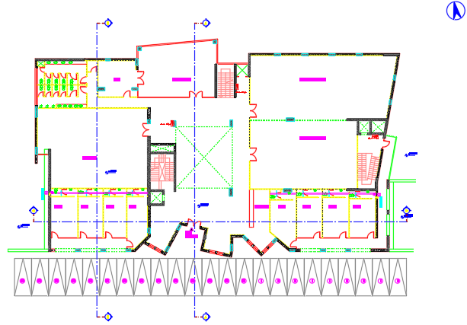
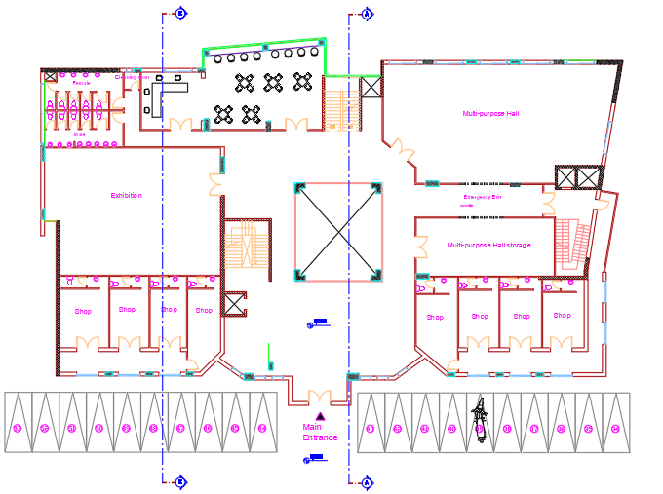
Ground Floor
Old Ground Floor area = 1484 m²
New Ground Floor area = 1508 m²

Slide 10
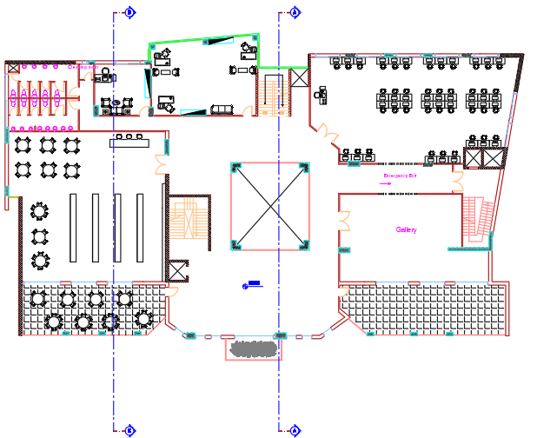
First Floor
First Floor area = 1508 m²

Slide 11
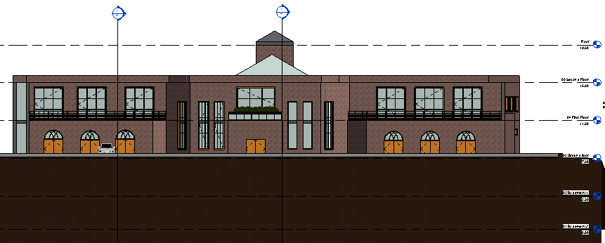
Southern Elevation

Slide 12
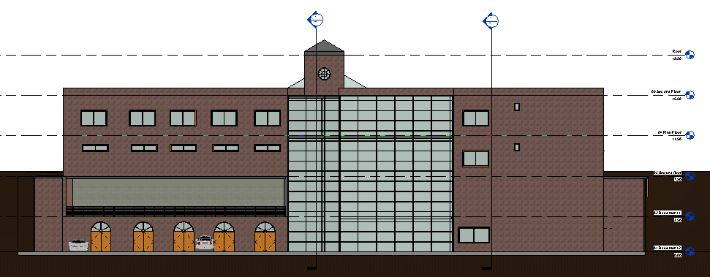
Northern Elevation

Slide 13
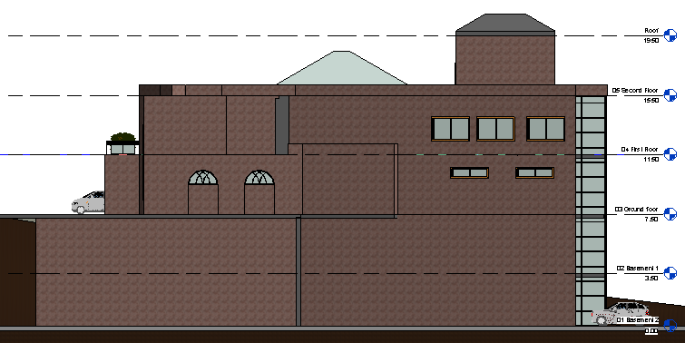
Eastern Elevation

Slide 14
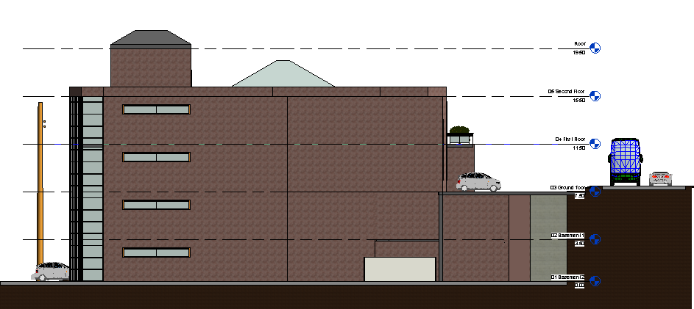
Western Elevation

Slide 15
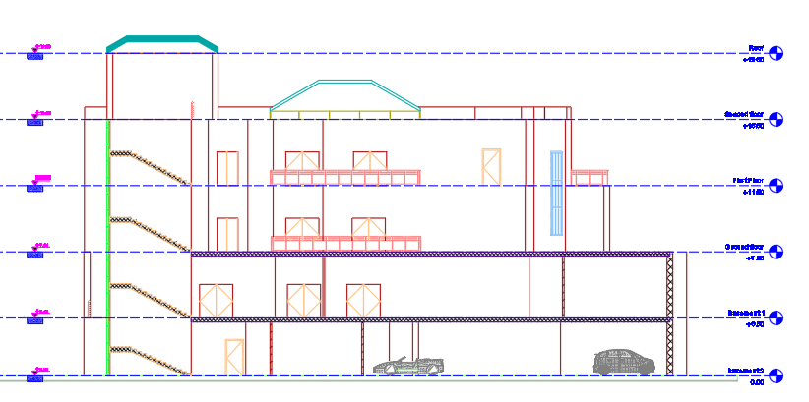
Section A-A

Slide 16
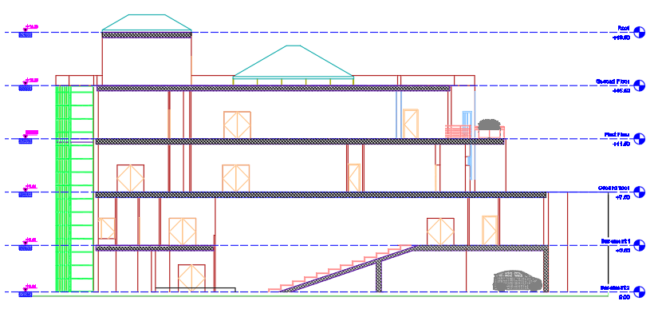
Section B-B

Slide 17
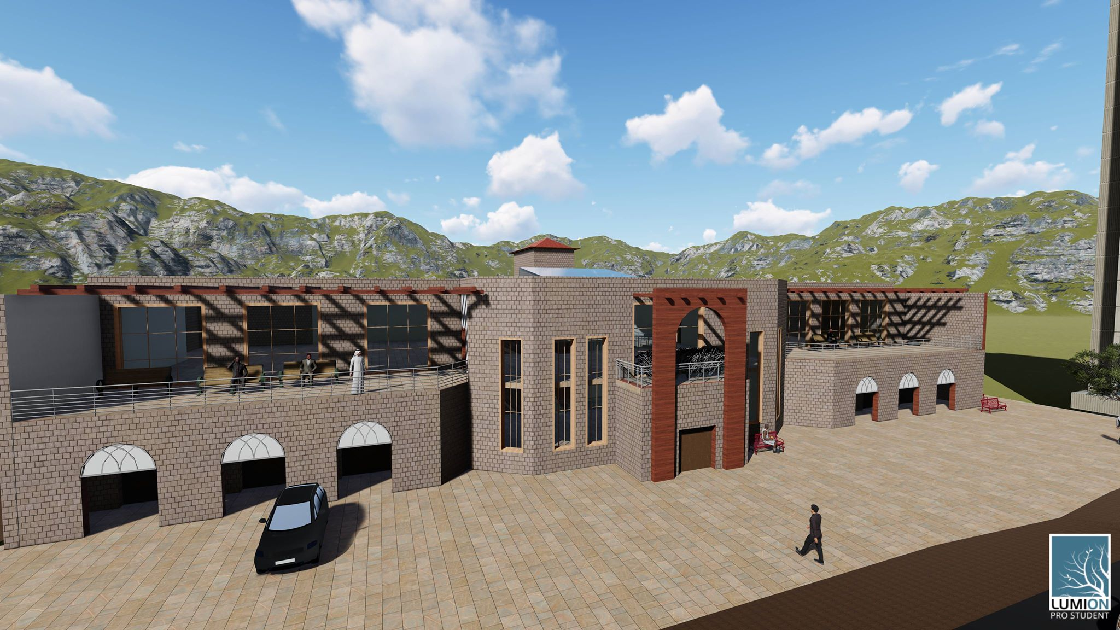
3D model

Slide 18
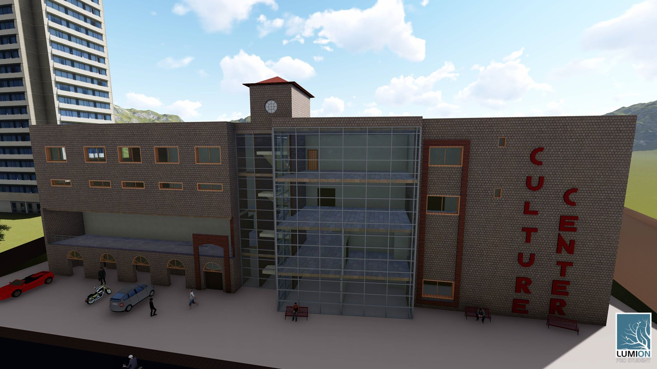
3D model

Slide 19
Environmental Design

Slide 20
Thermal Design
Old U value for building envelope
New U value for building envelope
Component | U-value (w/m²-k)
External Wall | 0.514
Partition Wall | 1.955
Floor | 0.513
Roof | 0.467
Windows (Double glass) | 2.665
Component | U-value (w/m²-k)
External Wall | 0.442
Partition Wall | 1.955
Floor | 0.487
Roof | 0.368
Windows (Double glass, low e, 6 mm) | 1.493

Slide 21
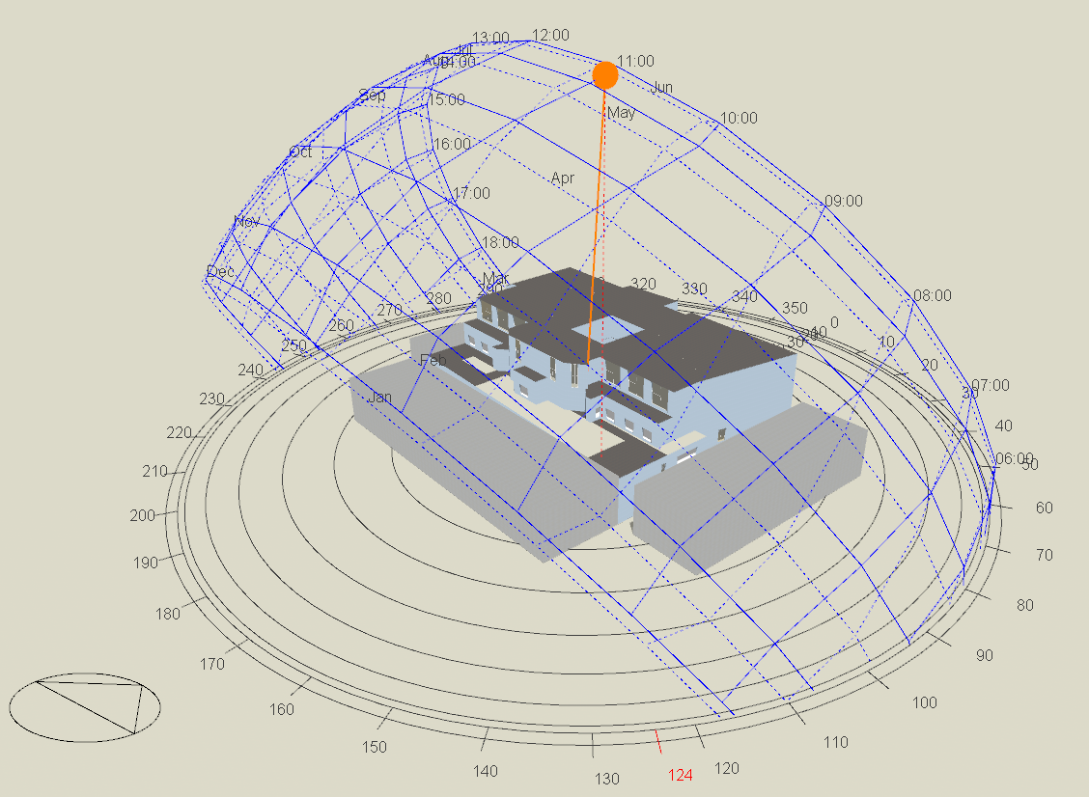
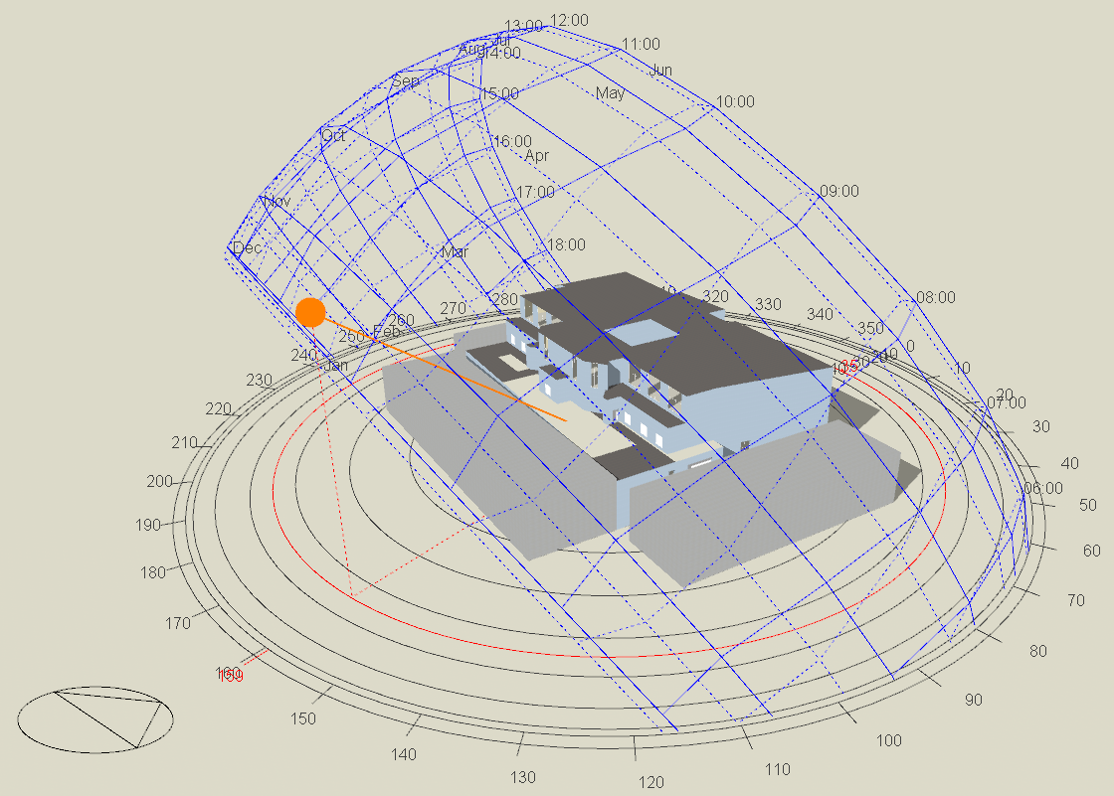
Shading
Design Builder program ( 3D Model )
Summer day (sun path 21/6 at 12:00 pm )
Winter day (sun path 21/1 at 8:00 am )

Slide 22
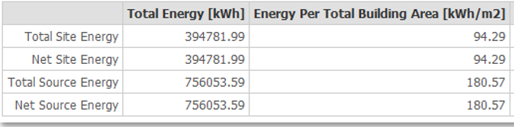
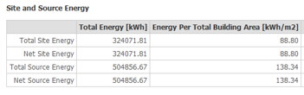
Thermal Design
Heating and cooling load
Heating load 194 kw
Cooling load 248 kw
Site and Source Energy
Old total site energy
New total site energy

Slide 23
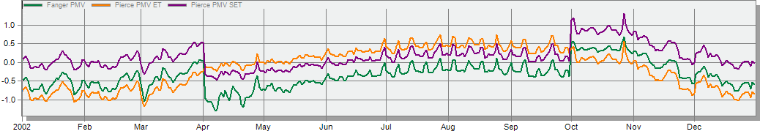
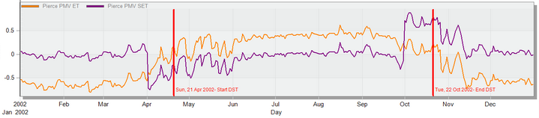
Comfort PMV-Set
Old PMV graph
New PMV graph

Slide 24
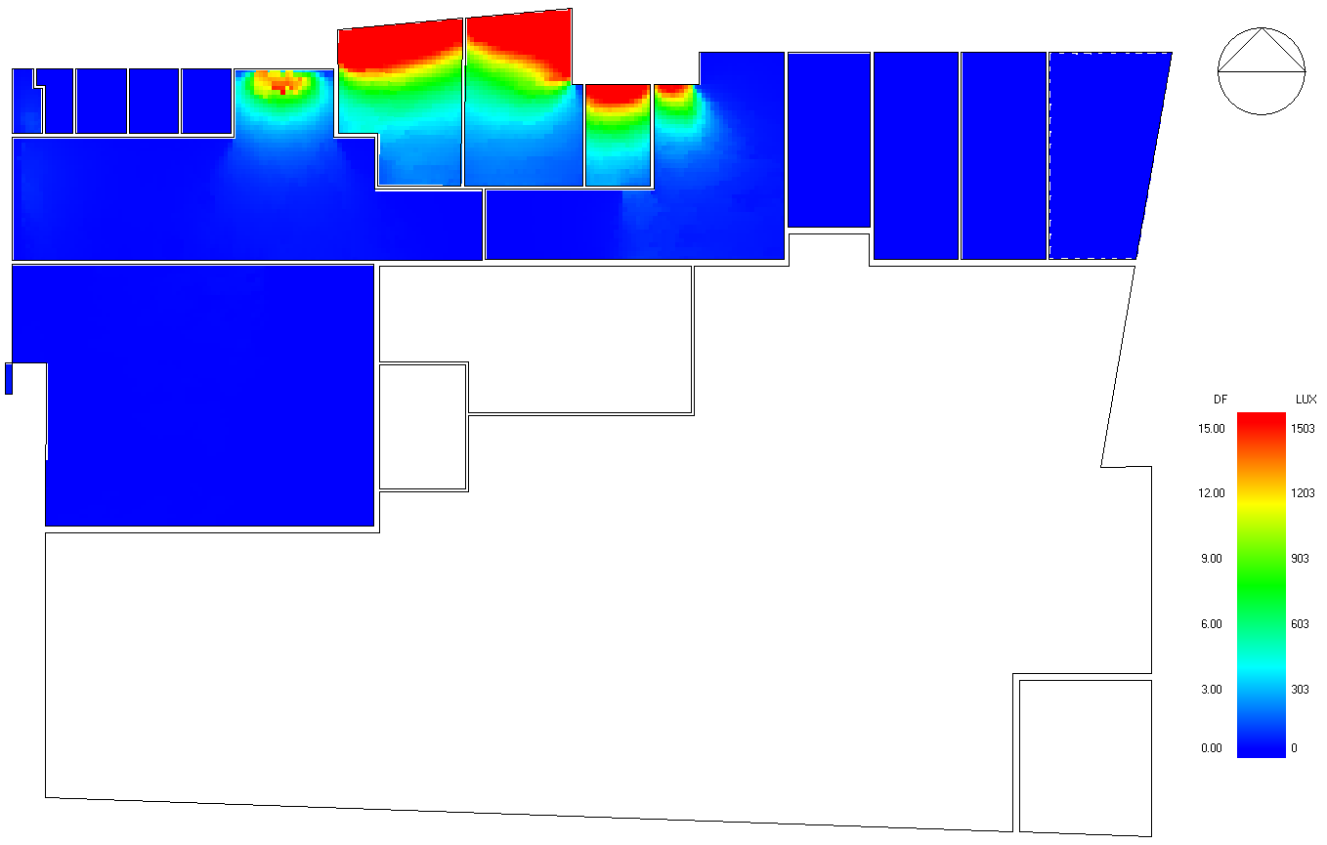
Daylight analysis
Overcast sky
D.F% | Floor
1.55 | Basement 2
1.75 | Basement 1
1.83 | Ground Floor
2.00 | First Floor

Slide 25
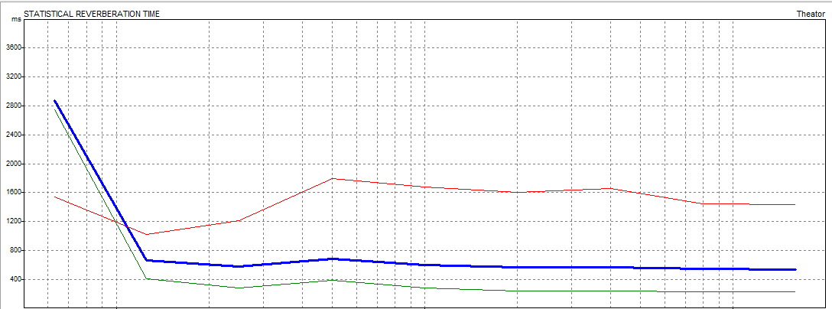
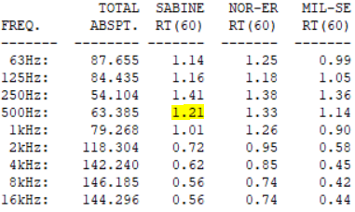
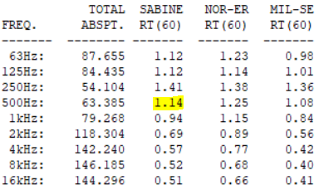
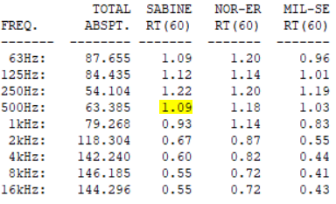
Acoustics Design
RT60 (Reverberation Time)
For Theater

Slide 26
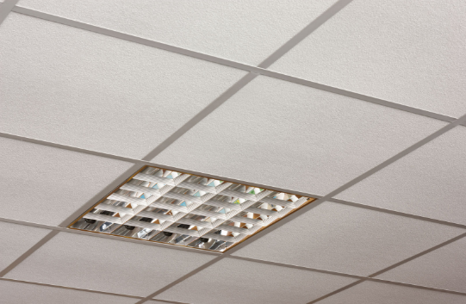
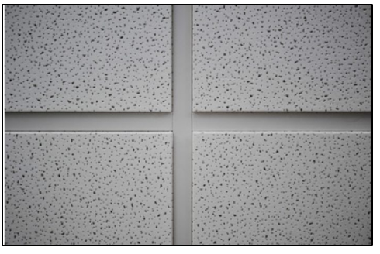
RT60 (Reverberation Time)
Element | Finish material | Absorption coefficient(α) at each frequency
 |  | 63_{HZ} | 125 _{HZ} | 250 _{HZ} | 500 _{HZ} | 1000 _{HZ} | 2000 _{HZ} | 4000 _{HZ} | 8000 _{HZ} | 16000_{HZ}
Ceiling | Acoustical Tile | 0.7 | 0.66 | 0.72 | 0.92 | 0.88 | 0.75 | 0.75 | 0.75 | 0.75

Slide 27
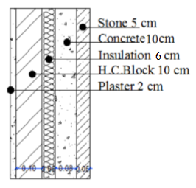
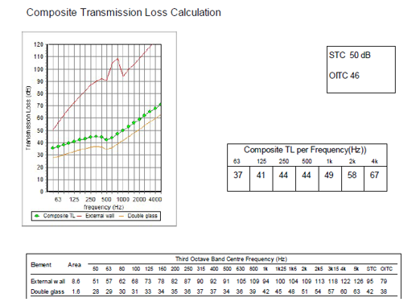
Sound Transmission Class(STC)
TL = 50 dB
External Wall

Slide 28
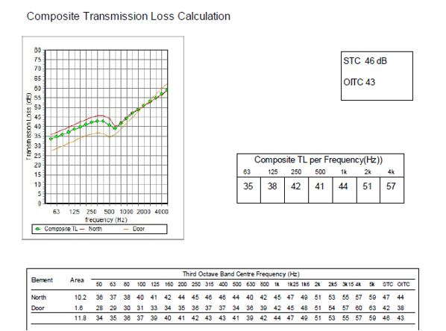
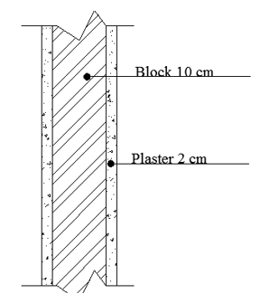
Sound Transmission Class(STC)
TL = 46 dB
Internal Wall

Slide 29
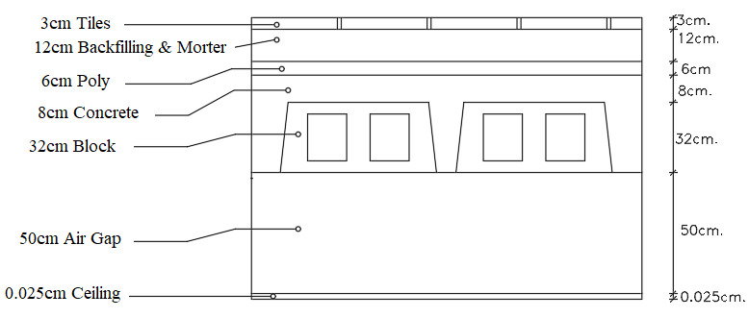
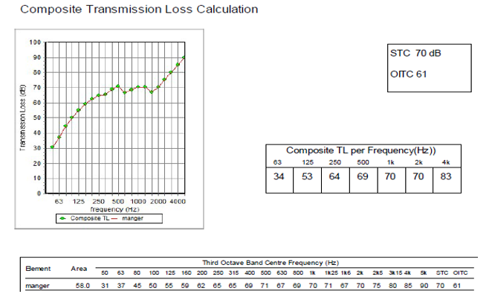
IIC For Ceiling
IIC = 70 dB

Slide 30
Structural Design

Slide 31
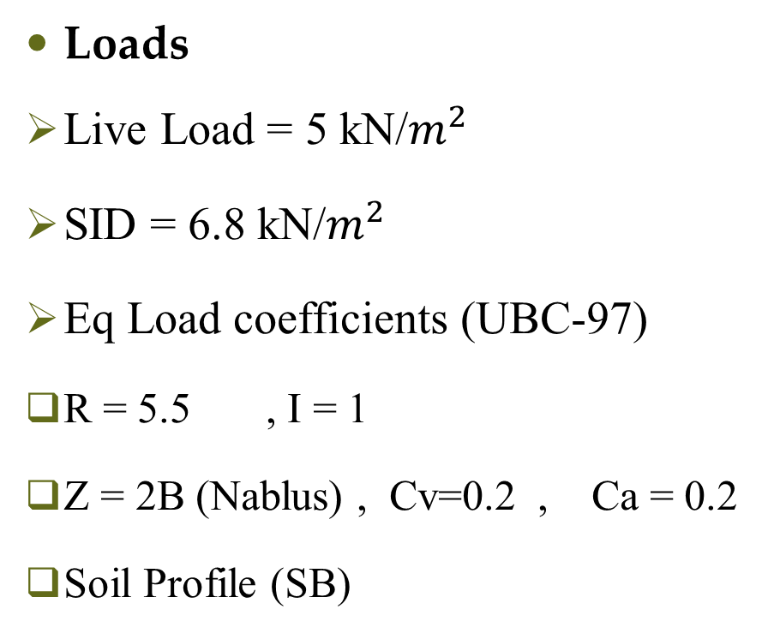
Codes and Loads
Structural design
Loads
Live Load = 5 kN/$m^{2}$
SID = 6.8 kN/$m^{2}$
Eq Load coefficients (UBC-97)
R = 5.5 , I = 1
Z = 2B (Nablus) , Cv=0.2 , Ca = 0.2
Soil Profile (SB)
Codes
UBC-97 for Earthquake design
ACI 318-14 for RC structure design

Slide 32
Structural system
Structural design
Materials
Concrete B350
Steel fy = 420 Mpa
Final Design Sections
Slab thickness 40 cm
Columns dimensions(50*50 & 90*60)cm and others
Beams dimensions ( 60* 90 & 60 * 70 ) cm and others
Structural System
One Way Ribbed Slab
With Drop Beams
Walls Thickness 30 cm

Slide 33
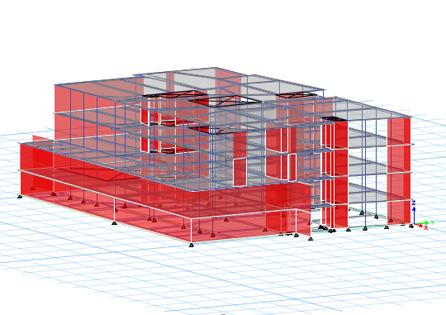
3D-Modeling
Structural design

Slide 34
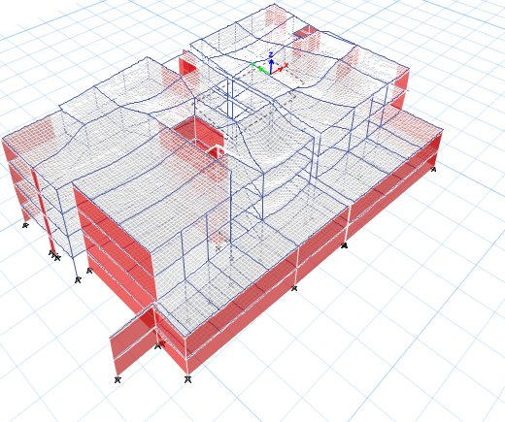
Model Checks
Structural design
Compatibility Check

Slide 35
Model Checks
Structural design
Equilibrium Check
Done for Dead, SID and Live load within difference less than 5 %.
Internal Forces Check
Done of all item slab, beams and columns within difference less than 10%

Slide 36
Model Checks
Structural design
Deflection Check
Period Check
Limit = L/240
= 27500/ 240 = 114mm
Uz from Etabs =55.9mm
Check is ok
Period from ETABS = 0.348 sec.
Period from hand calculation= 0.57
T from ETABS < 1.4 from hand calc.
0.348 sec.< 0.799 sec.

Slide 37
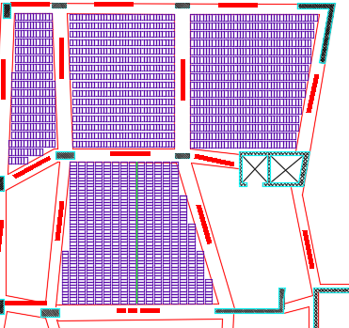
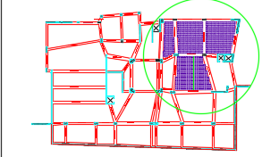
Slab Reinforcement layout
Structural design

Slide 38
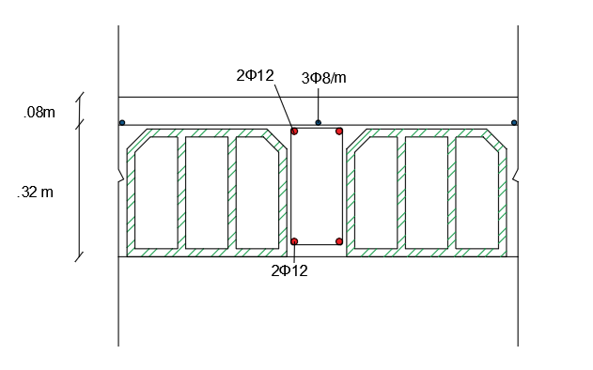
Slab Reinforcement
Structural design

Slide 39
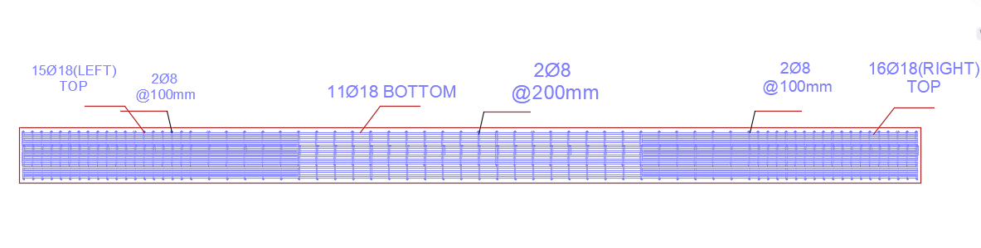
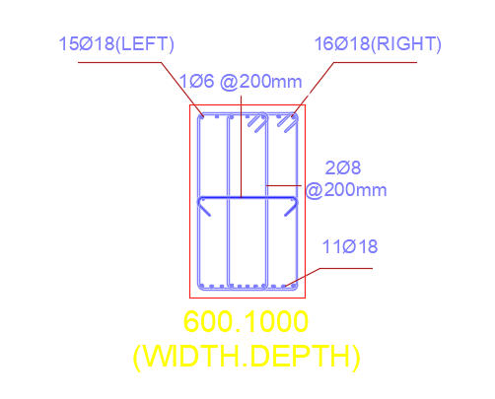
Structural design
Beams Reinforcement
One sample of beams that taken in detail: -

Slide 40
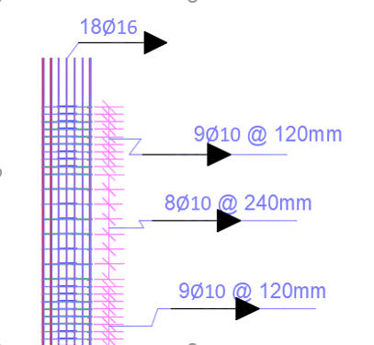
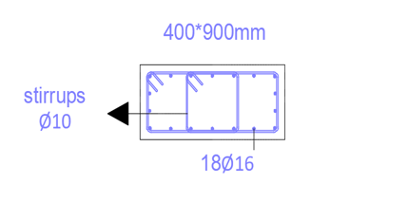
Structural design
Columns Reinforcement
One sample of columns that taken in detail: -

Slide 41
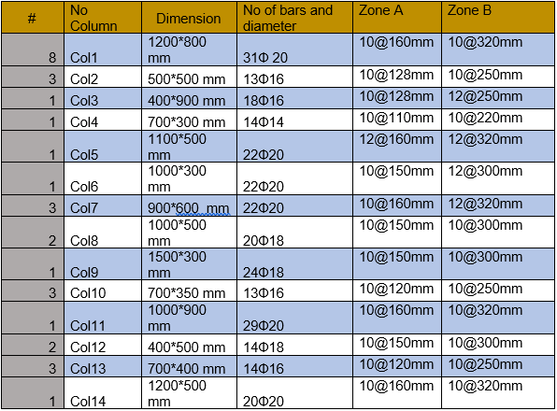
Structural design
Columns Reinforcement
Table of other columns reinforcement: -

Slide 42
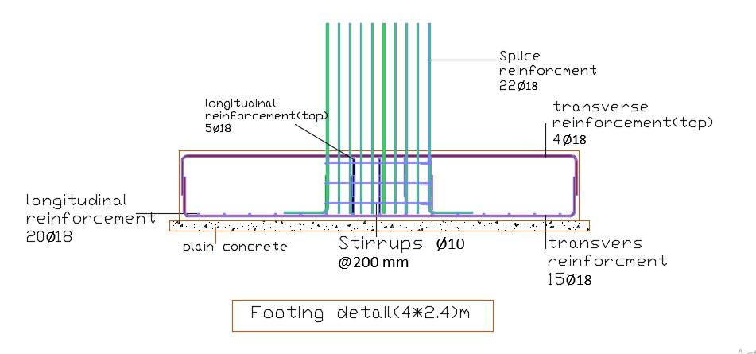
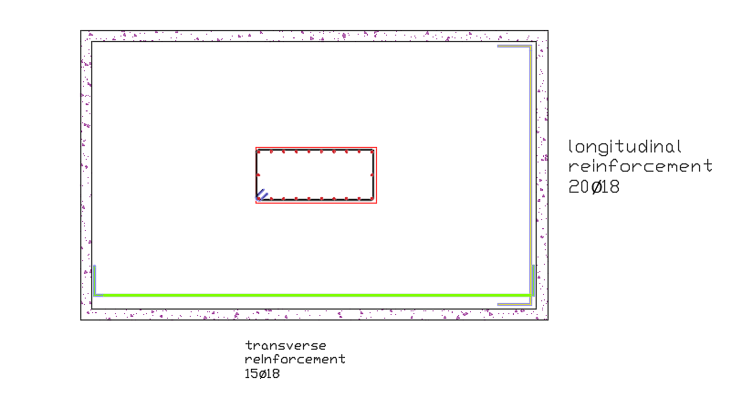
Footing Reinforcement
Structural design
One sample of isolated footing that taken in detail:-

Slide 43
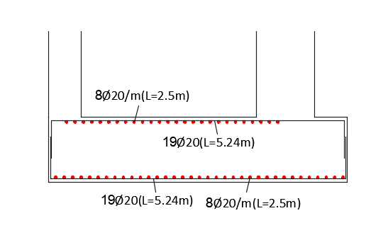

Footing Reinforcement
Structural design
One sample of combined footing that taken in detail:-

Slide 44

Footing layout
Structural design

Slide 45


Structural design
Shear Wall Reinforcement

Slide 46


Structural design
Water tank design
Base design
Wall design

Slide 47

Structural design
Water tank design
Roof design

Slide 48

Structural design
Stairs Reinforcement

Slide 49
Structural design
Past and New Design
Past
New Design
Not Designed For Seismic Load
No construction joint
Use the Hidden Beams.
There is no water tank design.
Earth quick Design Based
There a construction joint
all beams are Drop Beams.
There is water tank design.

Slide 50
Mechanical Design

Slide 51



Water demand = 30 $m^{3}$/day
Water Supply System

Slide 52


Water Supply System
fresh water
Gray water
sprinkler tank
Old number of tanks = 4
New number of tanks = 17

Slide 53


Drainage system

Slide 54

Drainage system

Slide 55

Rain Water Drainage
Storm Water Tank size = 340 m3

Slide 56

(HVAC (System
VRV system used
From Design builder
Total Cooling load 248 kw
Total Heating load 194 kw

Slide 57

(HVAC (System
VRV system
Outdoor unit Selected From Daikin company
Outdoor unit uses (RXQ30TANYM(E)

Slide 58


(HVAC (System
VRV system
indoor unit From Daikin company
depending on load capacity for each space.
Fan coil (FXZQ50MVE)
slim unit uses provided by Daikin

Slide 59

Ground floor HVAC system layout

Slide 60
Electrical Design

Slide 61

First Floor socket plan

Slide 62

First Floor Lighting Plan

Slide 63



Luminaires Layout

Slide 64


Sample of 3D Rendering model (Dialux)
Computer lab
Library

Slide 65
Firefighting and Safety Design

Slide 66

Emergency Fire Protection System
1. Sprinkler system

Slide 67

Emergency Fire Protection System
2. Fire extinguisher

Slide 68

Emergency Fire Protection System
3. Fire hose reel

Slide 69

Emergency Egress System
Escaping Plan for basement(1) Floor

Slide 70

Elevator System
(3) Elevator of (1.8m*1.8m) are calculated

Slide 71
Quantity Surveying and Cost Estimation

Slide 72
Cost Estimation
Unit Cost (NIS/m2) | Total Cost (NIS) | Item
 | 2,215,330 | Excavation Work
 | 3,687,560 | Structure Work
 | 1,761,327 | Finishing work
 | 301,914 | Mechanical Work
 | 363,266 | Electrical Work
 | 18,700 | Safety Work
1546 | 8,348,097 | Total
Unit Direct Cost = 8,348,097/5600 = 1546 NIS /m²
Unit Direct Cost = 430 $ /m²

Slide 73

Thank You

