Slide 1


Slide 2
Outline
Introduction.
Study Area
Population Analysis
Objectives
Conclusion
Methodology
and
Results

Slide 3
Background
Human life needs many requirements that maintain its survival and continuity. one of the most essential requirements is water.
Water supply to houses by a network that carry it. Most of the water becomes wastewater that has been collected in cesspits tanks, that affect the environment.
To avoid that we design a wastewater collection network that runs the wastewater to lowest level in the village where the treatment plant is situated.

Slide 4
Objectives
The main objectives are:
Design a water distribution network (WDN) system in Burin village by using WaterCAD computer program.
To design wastewater network in the village using SewerCad computer program.
Design wastewater treatment planet.

Slide 5
Study Area
Burin is village located 10 km south-west of the city of Nablus and 2 km away from the main road Nablus-Ramallah

Slide 6
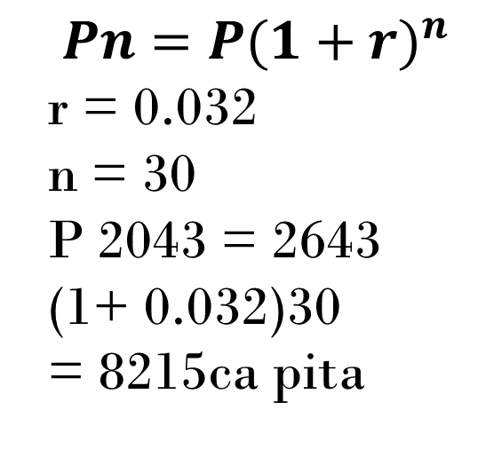
Population Analysis
$$Pn=P(1+{r)}^{n}$$
r = 0.032
n = 30
P 2043 = 2643 (1+ 0.032)30
= 8215ca pita

Slide 7
Methodology
Design Water Network System
Design Wastewater system
Design Treatment Plant

Slide 8
Water network distribution system
Total demand calculation:
To calculate the total demand in our project. We assume the maximum hourly factor equal 3.
Total Demand = Population*consumption capita per day* max. Hourly factor.
Total Demand = 8215*100*3/1000 =2464.5 m3/d.

Slide 9
Equation used
WaterCAD programme use Hazen-William equation to design and analyse the network .
ℎ𝑓=6.79𝐿𝐷1.16 (𝑉𝐶) 1.85
where:
hf : head loss (m, ft).
L : is the pipe length ( m, ft)
D : is the pipe diameter (m , ft)
V : is the velocity (m/s , ft/s)
C : Hazen-William friction factor
.

Slide 10
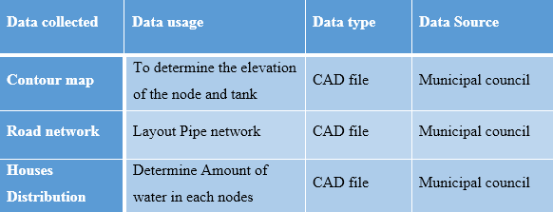
Collected data and sources

Slide 11
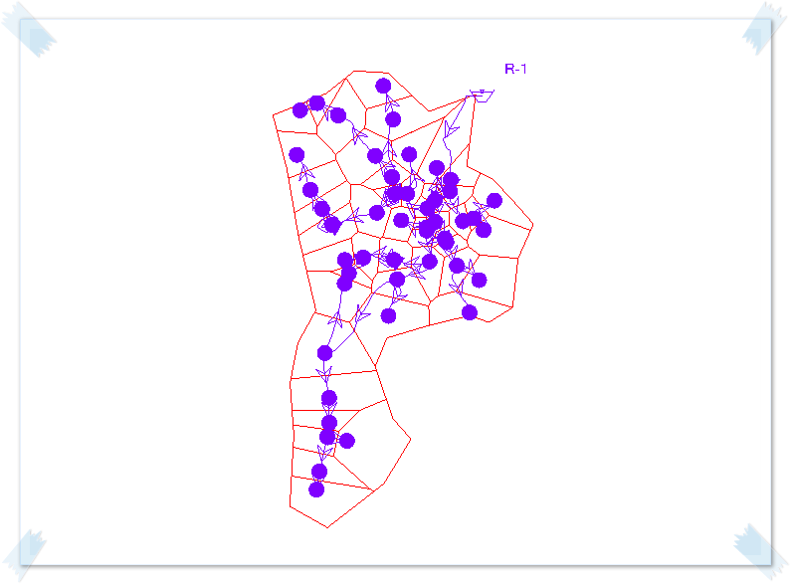
Design steps
Distribute the junction and tracing the pipes and give them approximate diameters and run the program.

Slide 12
Design steps
After run the model we change the diameters to achieve the velocities criteria.
And adding pressure reducing valve(PRV) to reduce high pressure junction.
Design criteria:
The pressure in the junctions among 20 and 100 m H2O.
The velocity in the pipes among 0.3 and 2 m/s.
Finally run the model and check that all result are matching criteria.

Slide 13
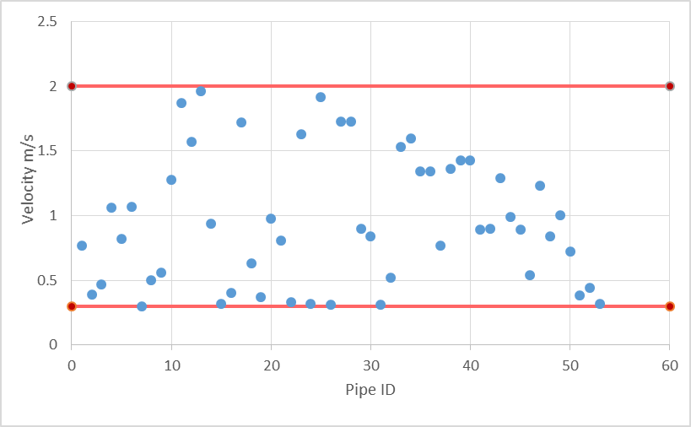
Result
The existing network velocities and pressure are given in the following figures:

Slide 14
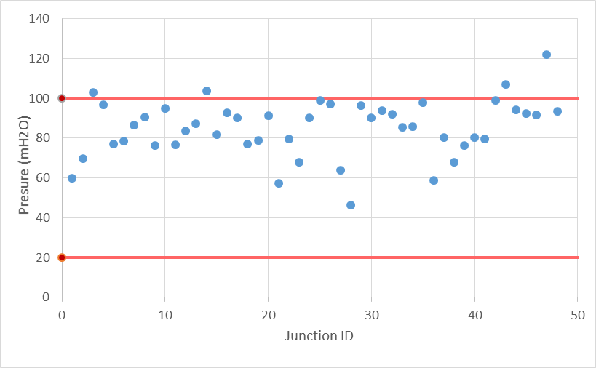
Result

Slide 15
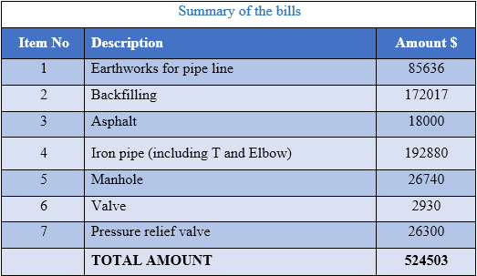
BOQ

Slide 16
Wastewater collection system
Total supply calculation:
Wastewater production factor is 80% of water used, the maximum hourly factor is 3 and the infiltration factor is 20%.
Wastewater supply = population * hourly factor * water consumption * production factor.
=8215 * 3 * 100 * 0.8 * 1.2 / 1000 = 1971.6 m3/d.
Infiltration rate = 0.2 *8215*100*0.8/1000 = 132 m3/d.
Total supply = 1971.6 + 131.4 = 2103 m3/d.

Slide 17
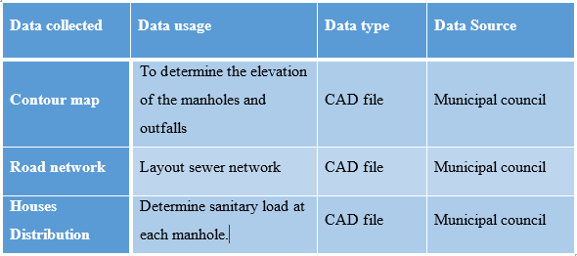
Collected data and sources

Slide 18
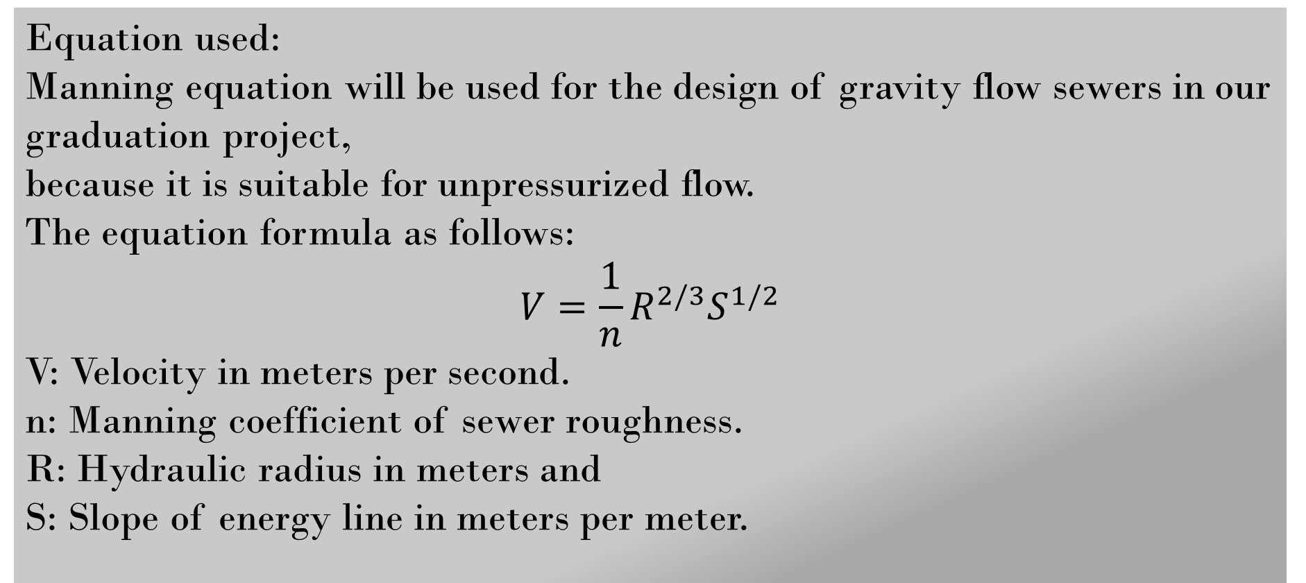
Collected data and sources
Equation used:
Manning equation will be used for the design of gravity flow sewers in our graduation project,
because it is suitable for unpressurized flow.
The equation formula as follows:
$$V=\frac{1}{n}R^{2/3}S^{1/2}$$
V: Velocity in meters per second.
n: Manning coefficient of sewer roughness.
R: Hydraulic radius in meters and
S: Slope of energy line in meters per meter.

Slide 19
Design criteria
Minimum and maximum velocity:
Minimum velocity criteria is set to allow cleaning the sewer network, while maximum velocity criteria is set to prevent corrosion of the sewers or manholes. Therefore, flow velocity should be between 0.4 - 3.0 m/s.
      Minimum and maximum slope:
The design criteria for minimum and maximum slope of the pipes should be between 1% and 15%.

Slide 20
Design criteria
      Manholes:
Manhole should be used in start of each pipe, and at the change in the direction, diameter, and slope.
The manhole in the sewer network must be designed according to the following criteria:
The maximum distance between manholes should not exceed 30m.
Circular manhole are used with diameter equals 36`` (90cm).
Manhole cover depends on the load in the manhole.

Slide 21
Collected data and sources
      Minimum and maximum cover:
The minimum cover depth is 1 m to avoid damage of the pipe but should not greater than 5 m to decrease the pressure on the pipes.

Slide 22
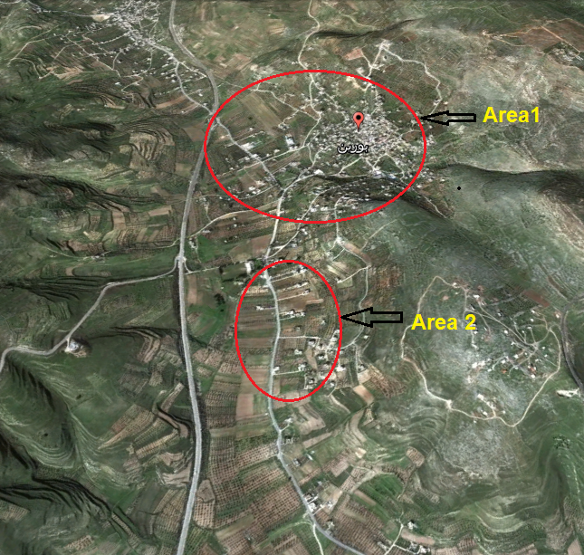
Design steps
After selection of the study area in the village we classified to two networks.

Slide 23
Design steps
Select the pathway of the sewers by using the Google earth and Civil 3d Programs.
Draw and drag the manhole and conduit without pass through the houses as possible and without making any loops.

Slide 24
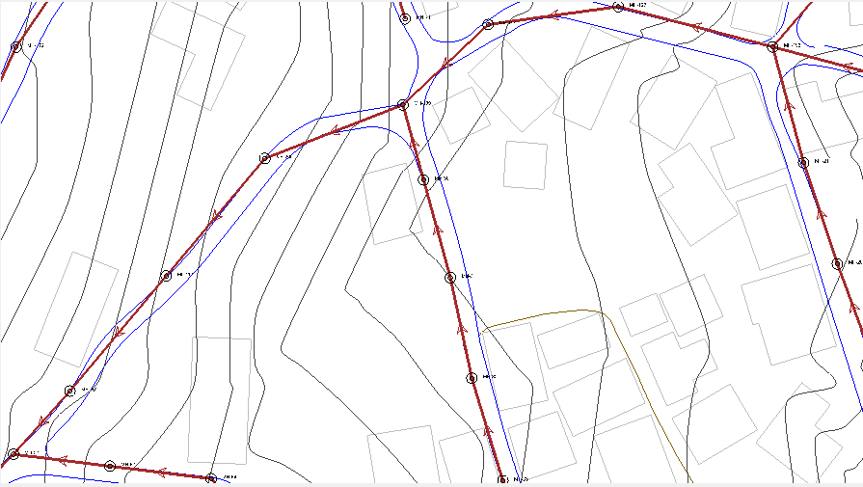
Design steps

Slide 25
Design steps
Input design criteria in SewerCAD.
Input data for manholes:
For every pipe we entered the required data for design.
Determine the elevation of each manhole and outfall using the contour map.
Finally run the model, and check for the design criteria.

Slide 26
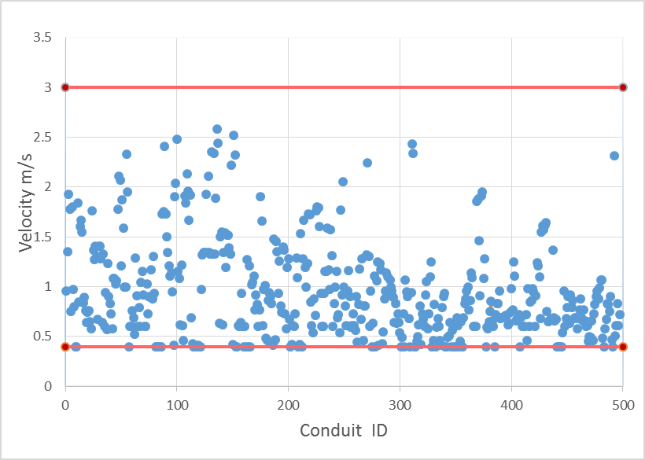
Result
The existing network velocities and cover are given in the following figures:

Slide 27
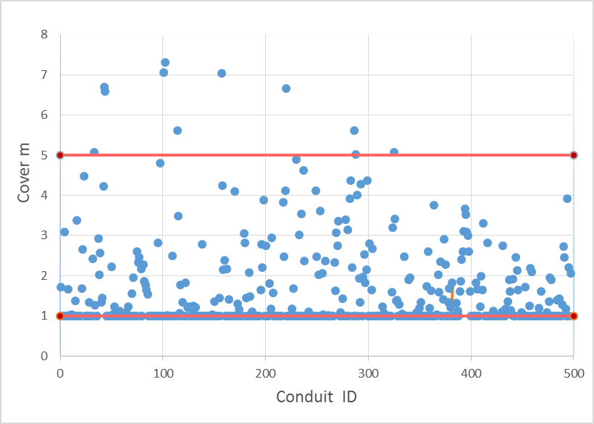
Result

Slide 28
BOQ
Item no | Description | Total cost ($) | % From Total Cost
1 | excavation | 355080 | 0.27
2 | manhole | 262180 | 0.20
3 | conduit | 153868 | 0.12
4 | backfilling | 388455 | 0.30
5 | pavement | 148000 | 0.11
 | total cost | 1307583

Slide 29
Treatment Plant
The main objective of wastewater treatment to reduce the spread of communicable diseases causes by pathogens organism is sewage and to prevent the population of surface and ground water. The BOD initial is equal 600 we need to reduce to 60 to reuse the wastewater treatment to irrigation the olives trees.

Slide 30
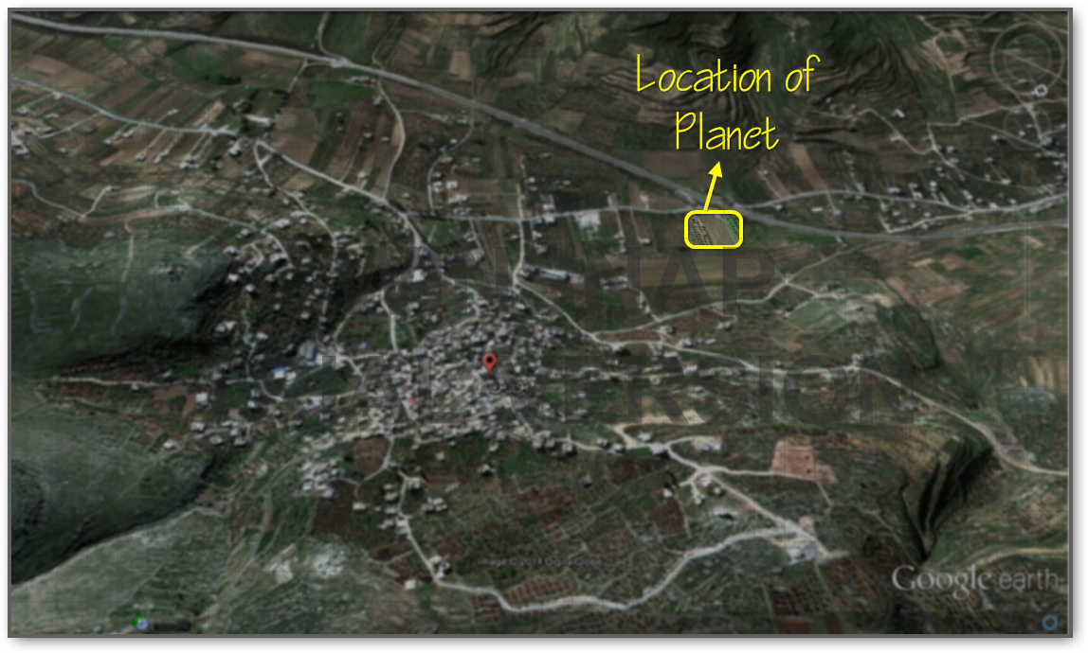
Location of the plant

Slide 31
Thank you

