Slide 1

Seismic Design For “Ladadweh” Residential Building
- Muneeb A. Atwan
By: - Abdullah I. Natsheh
- Marwan M. Zaidan
- Mutasim M. Atrash

Slide 2
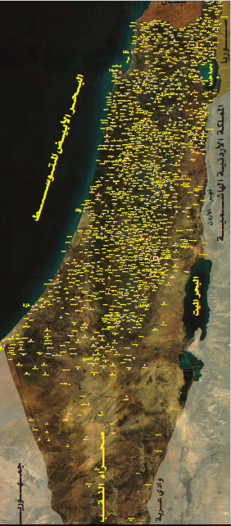
خريطة فلسطين كما ترسخت في عقولنا منذ الصغر

Slide 3
Outline
Introduction
Seismic Analysis Approach
3D Structural Analysis
Structural Design

Slide 4
Introduction
Al-ladadweh building consists of 9 floors; including 2 basement (parking), one ground floor and 6 residential floors. The area for each floor is 665 meters square.
This building is designed to resist the expected earthquake may be occur in this geological site, the width of the building is around 14.5 meters and the length is 57 meters so we divide the building to three separated buildings

Slide 5
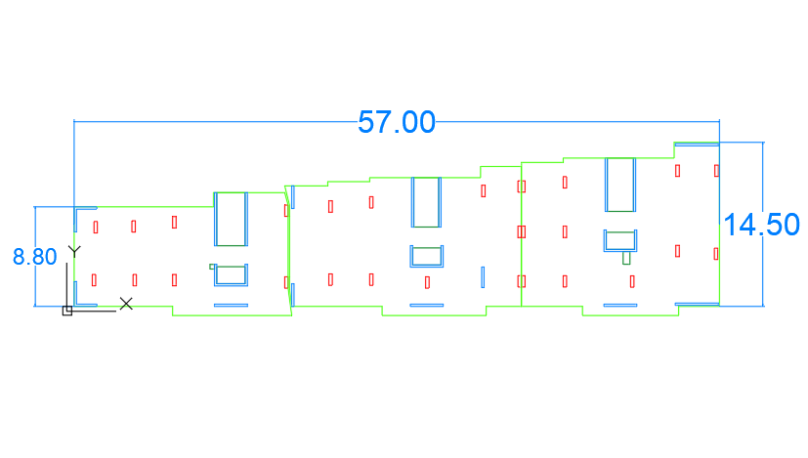
Building dimensions and joints location

Slide 6
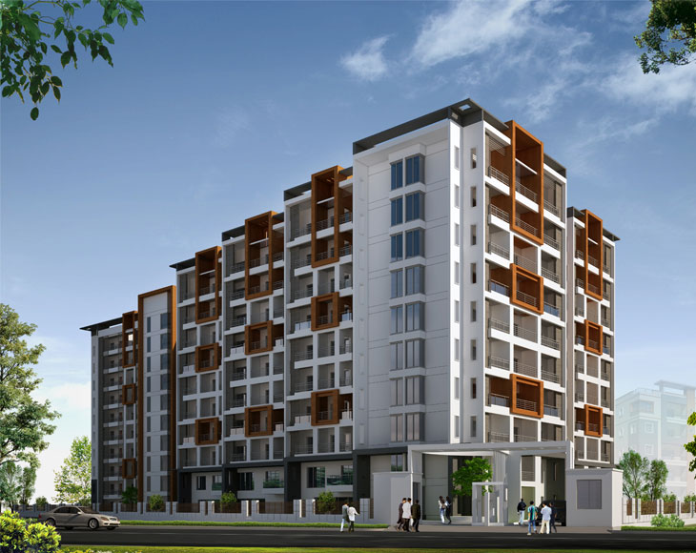
Project Description
This building is located at bier-zait town in Ramallah city, each story have 6 departments, and designed to be a reinforced concrete structure .

Slide 7

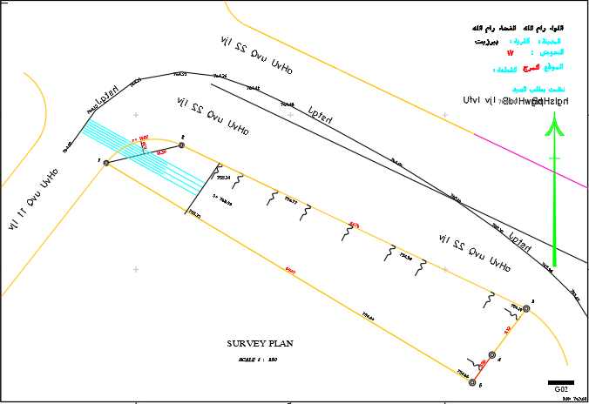
Project Location
Site: Ramallah city
Year: 2017

Slide 8
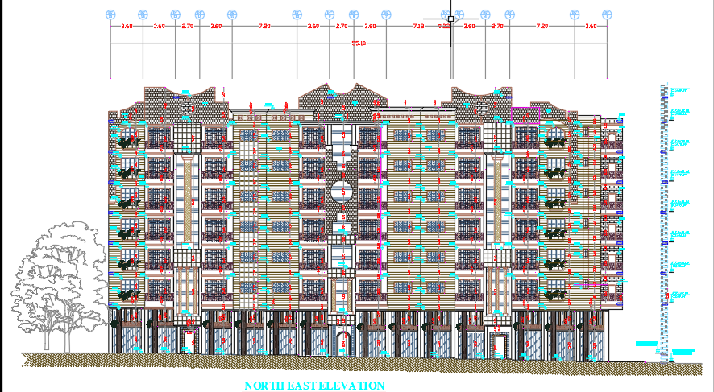
Architectural Information

Slide 9
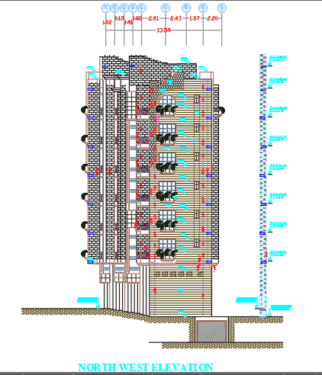
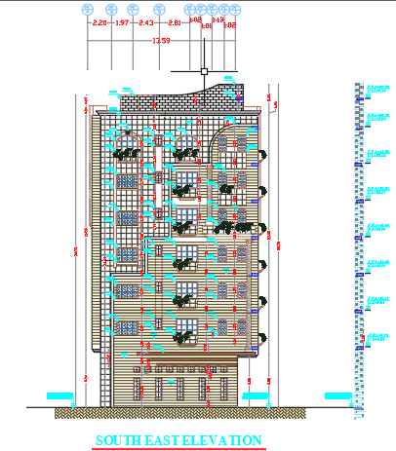
Architectural Information

Slide 10
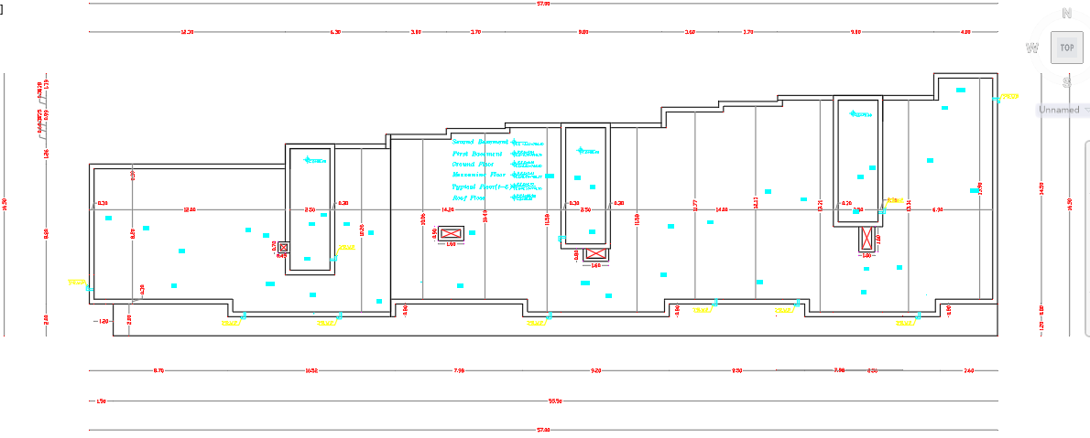
Architectural Information

Slide 11
Methodology
LOADS
E-TABS
CHECKS
Design
Structure

Slide 12
Required Data
Data
Loads
Structural system
Materials

Slide 13
Loading
Loads
Dead
Live
(5 KN\m² )
Earthquake
(Response spectrum )
Wind
(neglected)

Slide 14
Dead Load
-Own weight (OW)
4.2 KN/m²
Dead(D)
Wall Load = 20 KN/m
Superimposed (SID)
6.44 KN/m²

Slide 15
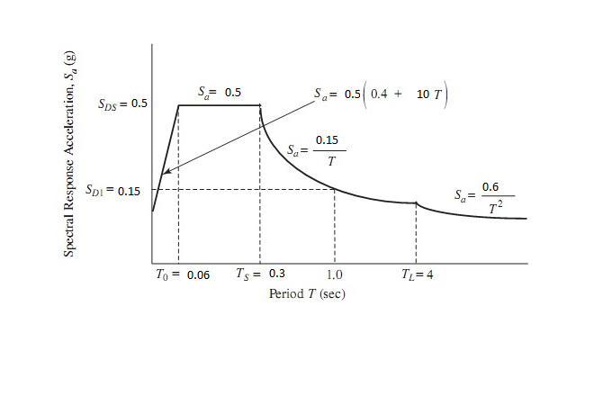
Earthquake Loads
According to IBC we use response spectrum curve to identify the earthquake loads

Slide 16
Load Combinations
According to ASCE-10 with seismic design these combinations must be considered
1) 1.4D
2) 1.2D+1.6L
3) 1.3D+1L+1.3EQ_{x}+0.39EQ_{y}
4) 1.3D+1L+1.3EQ_{y}+0.39EQ_{x}
5) 0.8D+1.3EQ_{x}+0.39EQ_{y}
6) 0.8D+1.3EQ_{y}+0.39EQ_{x}
7) 1.07D+0.7EQ_{x}+0.21EQ_{y}
8) 1.07D+0.7EQ_{y}+0.21EQ_{x}
9) 1.053D+0.75L+0.525EQ_{x}+0.158EQ_{y}
10) 1.053D+0.75L+0.525EQ_{y}+0158EQ_{x}
11) 0.53D+0.7EQ_{x}+0.21EQ_{y}
12) 0.53D+0.7EQ_{y}+0.21EQ_{x}
13) D
14) D+L

Slide 17
Materials
Materials
Concrete
Steel
Non-structural material
Blocks
Filling material
masonry stones
glass
Tile
Mortar

Slide 18
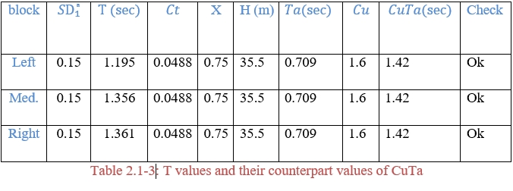
Seismic Analysis Approach
Period limits check

Slide 19
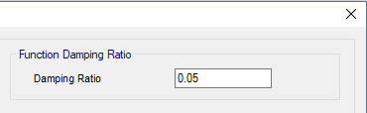
Seismic Analysis Approach
Damping ratio must be less than 10%

Slide 20
Seismic Analysis Approach
Ground motion input parameters
Exceedance probability 5%
In 50 years
S_{S}=0.65
S₁=0.14

Slide 21
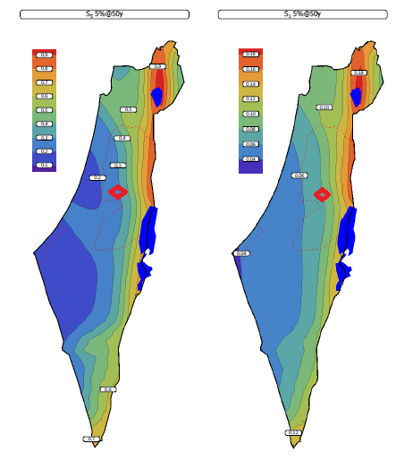
Seismic Analysis Approach

Slide 22
Seismic Analysis Approach
Seismic Parameters
Seismic Parameters | Value | Table # on ASCE 2010
Risk Catigory | Ⅱ | 1.5-1
Importence Factor | 1 | 1.5-2
SS | 0.65 | Israeli Code
S1 | 0.14 | Israeli Code
Site Class | C | 20.3-1
Fa | 1.14 | 11.4-1
F_{v} | 1.66 | 11.4-2
S_{MS} | 0.74 | Eqs 11.4-1
S_{M1} | 0.23 | Eqs 11.4-2
S_{DS} | 0.5 | Eqs 11.4-3
S_{D1} | 0.15 | Eqs 11.4-4
SDC | D | 11.6-1

Slide 23
Seismic Analysis Approach
Diaphragm Rigidity
The length to width ratio of the diaphragms in each block is less than 3 as shown in the table :
Block | Width | Length | Ratio (width/length) | Check
Left | 31.3 | 11.1 | 2.81 | Ok
Middle | 20.1 | 12.95 | 1.55 | Ok
Right | 17.33 | 14.7 | 1.17 | Ok

Slide 24
Seismic Analysis Approach
Response Spectrum function :

Slide 25
Seismic Analysis Approach
Seismic Base Shear
 |  | T | Cu*T | governing value of T | V | V_{Min} | governing V | V_{Etabs} | 85%of V | New scale factor
Left | X | 1.165 | 1.15 | 1.15 | 790.5846 | 800.0717 | 800.0716552 | 664.3733 | 680.0609 | 1673.035148
 | y | 1.065 | 1.15 | 1.065 | 853.6829 | 800.0717 | 853.6829441 | 599.5895 | 725.6305 | 1978.021176
Mid | x | 1.179 | 1.15 | 1.15 | 928.6618 | 939.8057 | 939.8057 | 751.545 | 798.8348 | 1737.286
 | y | 1.356 | 1.15 | 1.15 | 928.6618 | 939.8057 | 939.8057 | 640.9171 | 798.8348 | 2037.157
Right | x | 1.019 | 1.15 | 1.019 | 1086.065 | 973.8962 | 1086.065 | 4360.653 | 923.1552 | 346.0132
 | y | 1.361 | 1.15 | 1.15 | 962.348 | 973.8962 | 973.8962 | 3350.792 | 827.8118 | 403.7881

Slide 26
Seismic Analysis Approach
Drift Check :
For left block

Slide 27
Seismic Analysis Approach
For middle block :

Slide 28
Seismic Analysis Approach
For Right block :

Slide 29
Seismic Analysis Approach
Second order effect
Left
Middle
Right
story | Story height (mm) | ∆_{x} (mm) | ∆_{y} (mm) | Axial force (KN) | Shear force-x (KN) | Shear force-y (KN) | θ_{x} | θ_{y} | Check
0 | 3000 | 0 | 0
1 | 3700 | 0.485 | 2 | 54864.23 | 1082.18 | 1069.12 | 0.0066 | 0.0277 | Ok
story | Story height (mm) | ∆_{x} (mm) | ∆_{y} (mm) | Axial force (KN) | Shear force-x (KN) | Shear force-y (KN) | θ_{x} | θ_{y} | check
0 | 300 | 0 | 0 |  |  |  | `
1 | 3700 | 0.475 | 2.68 | 63072 | 1201 | 1159 | 0.0013 | 0.0078 | Ok
story | Story height (mm) | ∆_{x} (mm) | ∆_{y} (mm) | Axial force (KN) | Shear force-x (KN) | Shear force-y (KN) | θ_{x} | θ_{y} | check
0 | 300 | 0 | 0
1 | 3700 | 0.375 | 1.29 | 65300 | 1406 | 1219 | 0.0009 | 0.0037 | Ok

Slide 30
Seismic Analysis Approach
Irregularity Checks
We have 13 checks in ASCE-10 for irregularity
Vertical irregularity checks
Horizontal irregularity checks

Slide 31
3D Structural Analysis
The used structural system is building frame system (slab-beam-column) system.
The slab system used in the building is one way ribbed slab.

Slide 32

Software Program

Slide 33
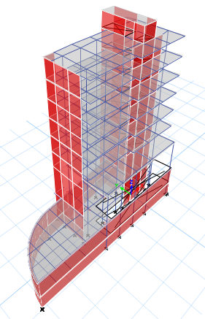
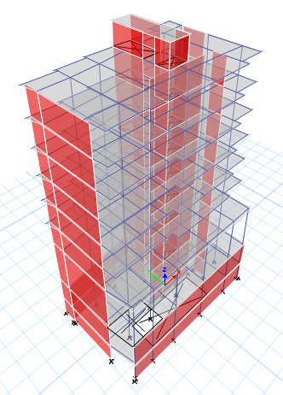
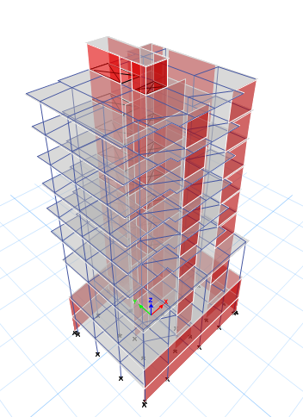
3D Modeling

Slide 34
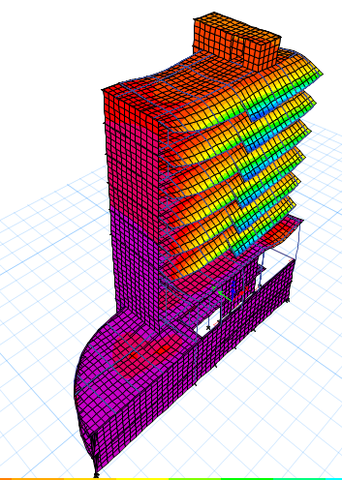
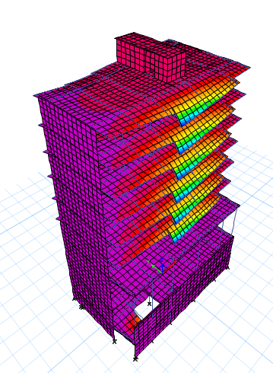
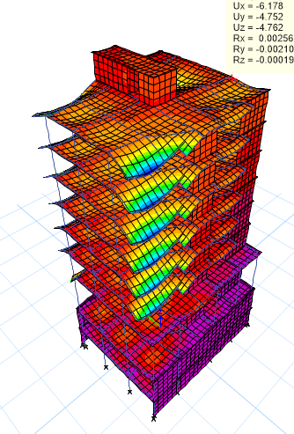
Compatibility Check
ETABS Modification
According to the
period for the
structure it’s
Compatible as
shown

Slide 35
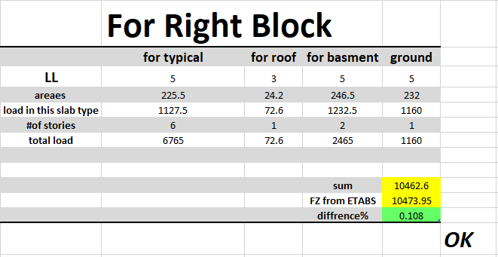
Equilibrium Check
Difference between manual calculations and ETABS results < 5%

Slide 36
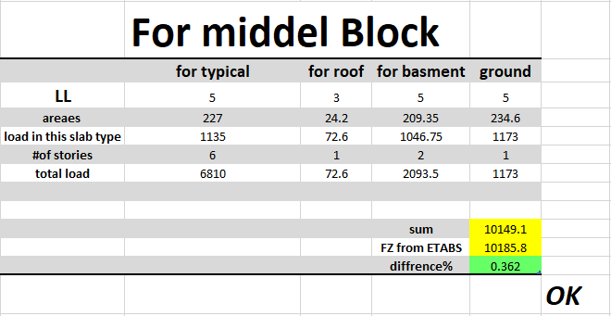
Equilibrium Check

Slide 37
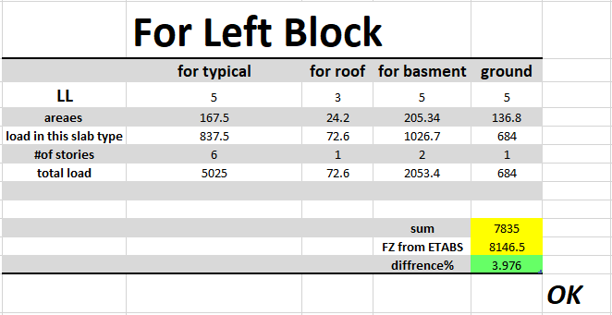
Equilibrium Check

Slide 38
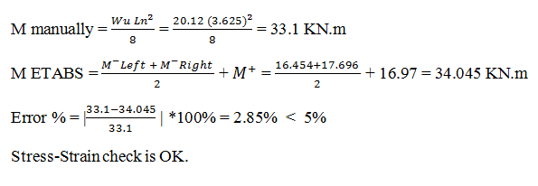
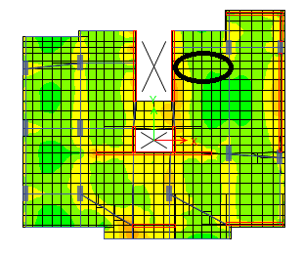
Stress-Strain Check

Slide 39
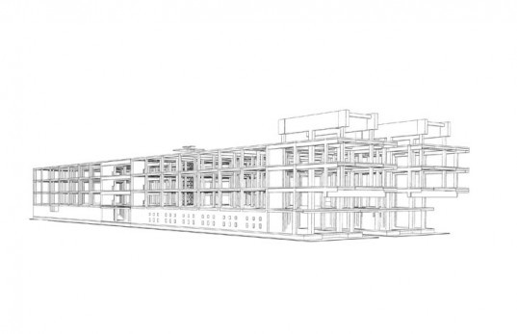
Design
All the structural elements are to be designed in project:
.Slabs
.Beams
.Columns
.Shear walls
.Footings

Slide 40
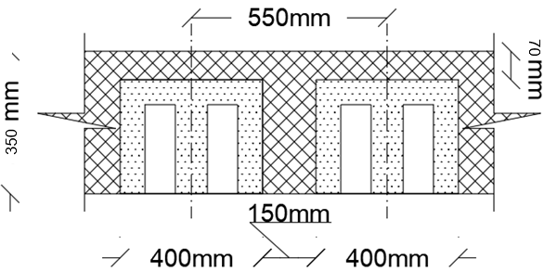
Slab Design
The structural system for slabs is one way ribbed slab of 350 mm thickness .
.Slab Thickness = 350 mm
.Web width = 150 mm
.Flange Thickness= 70 mm

Slide 41
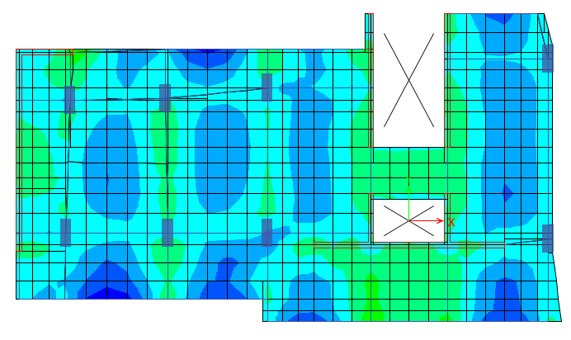
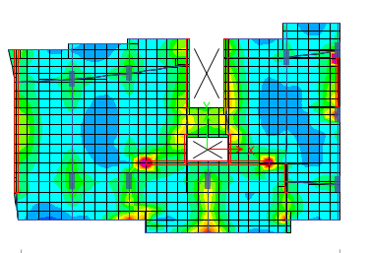
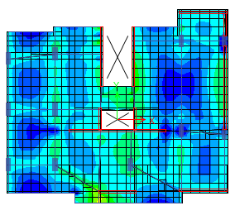
Slabs Moment Values
ØMn +ve = 121.42 KN.m / m ØMn –ve = 34.45 KN.m / m

Slide 42
Slabs Flexure
M-ve E-Tabs < ØMn-ve for Green and Yellow areas
ρ _{min} = 0.0033
As _{min} = 174.825 mm²/rip → bottom steel 2Ф12/rip
M_{max}-ve E-Tabs = 40 KN.m > ØMn-ve for Blue areas
ρ = 0.0093
As = 402.65 mm²/rip → 3ϕ14/rip
M_{max}+ve E-Tabs < ØMn+ve for All Slabs
ρ = 0.0033
As = 653.23 mm²/550mm → ϕ12/110mm

Slide 43
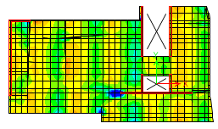
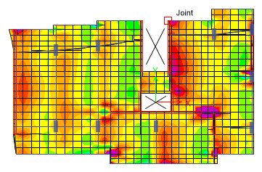
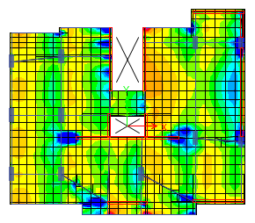
Slabs Shear Values
ØVc = 57.55 KN

Slide 44

Slabs Tie Stirrups
ØVc = Ø bw d * 1.1= 57.55 KN
Although the slabs does not need shear stirrups. Stirrups must be used to hold the bottom bars.
Stirrups 1ϕ10 / 300mm
ØVc > Ultimate Shear in Slabs

Slide 45
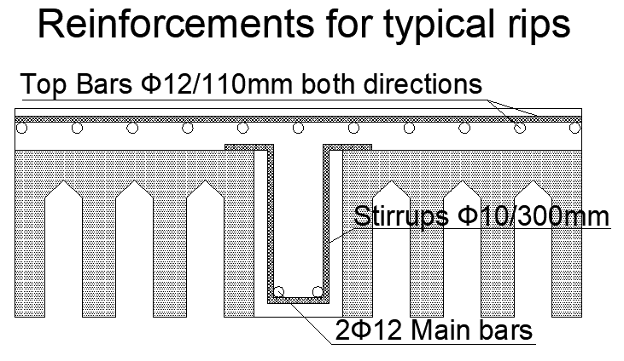
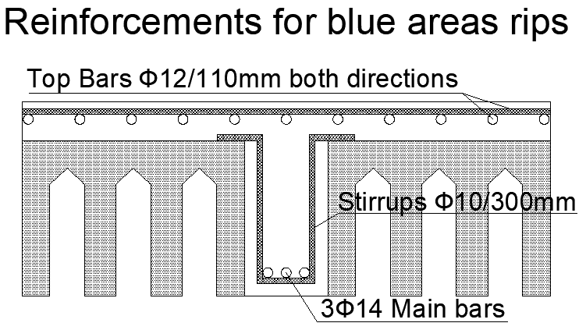
Slabs Sections

Slide 46
Beams Design Systems
Two types of beams were used in this project:
Hidden beams with several dimension
Drop beams of 500mm width and 900mm depth
Depth (mm) | Width (mm) | Type | Beam
350 | 700 | Hidden beam | B 70*35
350 | 400 | Hidden beam | B 40*35
350 | 1000 | Hidden beam | B 100*35
900 | 500 | Drop beam | B 50*90

Slide 47
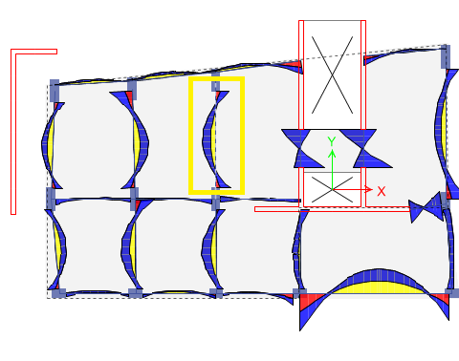
Beam “B5”
Hidden Beam “B5” in the 3rd story was chosen to check reinforcements. Beams width and depth are 70cm and 35cm respectively.

Slide 48



Beam “B5” Internal Forces
)
Mu +ve manually = 122.3 kN.m
Mu -ve manually = 80.8 kN.m
Vu = 164.7KN
Tu = 0.063N.m
s

Slide 49
Beam “B5” Reinforcement
+ve As = 1185 mm² > As min = 670 mm² → Top Bars 7ϕ16
-ve As = 771.4 mm² > As min = 670 mm² → Bottom Bars 5ϕ16
T_{th} = 8.8 KN.m > Tu → No need for tensional reinforcement
ØVc = 124.3 KN < Vu → closed stirrups 2Ф10/145mm

Slide 50
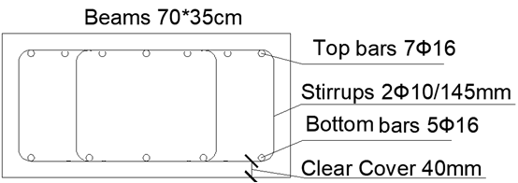
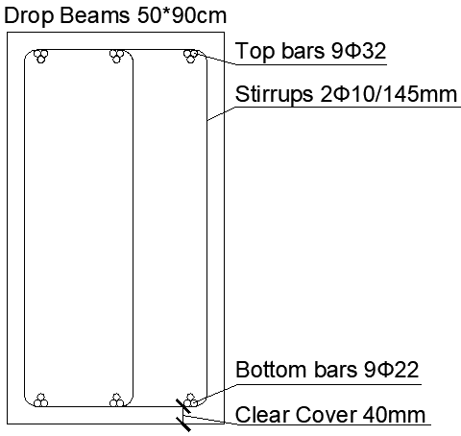
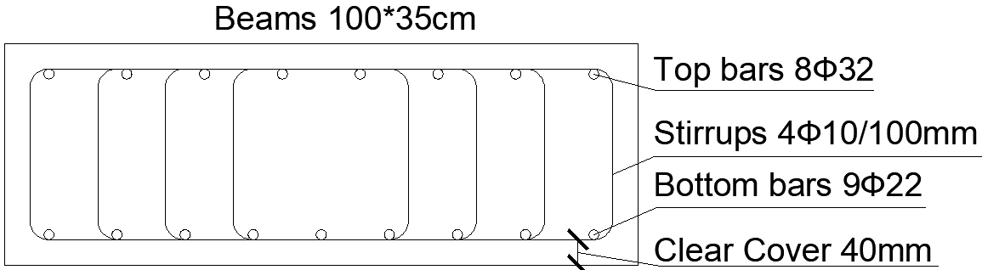
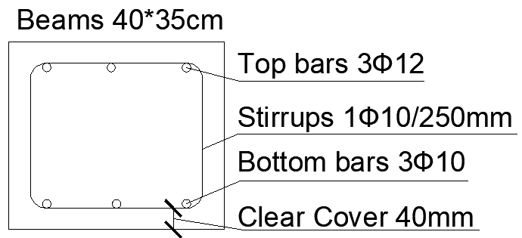
Beams Sections

Slide 51
Columns Design
Two columns in the project differs in dimensions and lengths:
Type | Length
Typical stories | 3.3m
ground floor story | 6.3m
1st basement story | 3.7m
2nd basement story | 3m
Dimensions:
Columns of cross section 1000mm*400mm
Columns of cross section 600mm*400mm

Slide 52
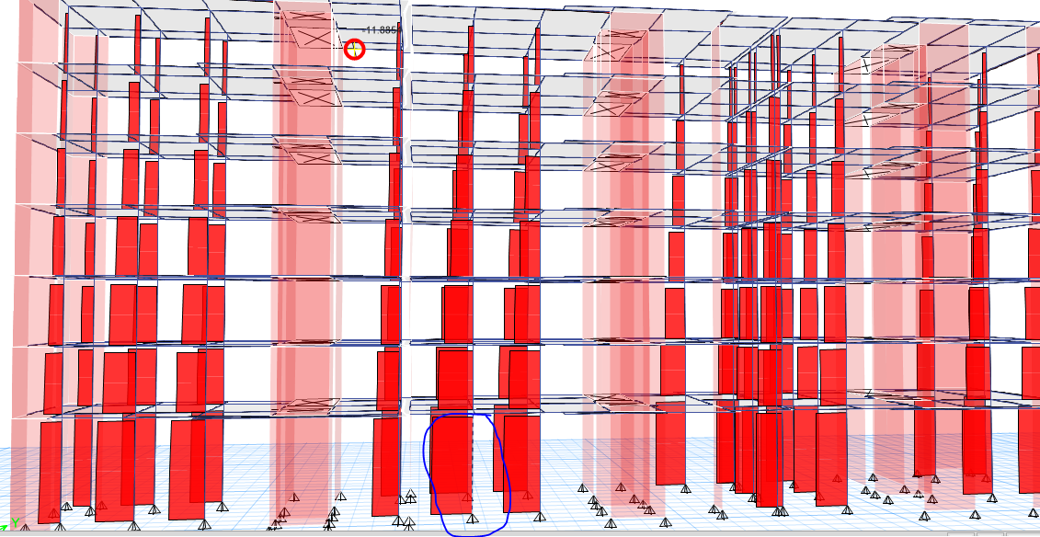
Columns 100cm*40cm
Column “C6” which has the max. compression load was chosen to check reinforcement in the basement.

Slide 53
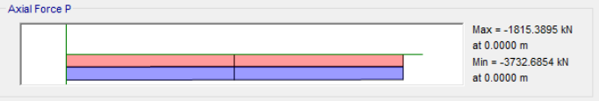
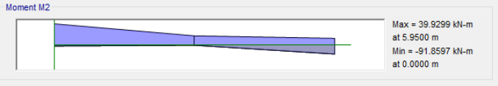
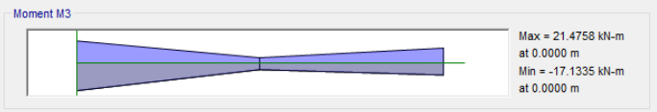
1st Basement Column “C6” Internal forces
Pu =3732.7 KN
M1 = 21.5 KN.m
M2 = 93.9 KN.m

Slide 54
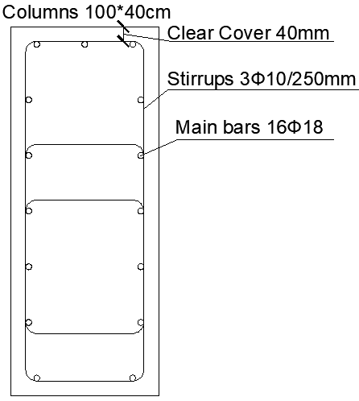
Columns 100cm*40cm Design
Slenderness ratio = 6.3 < 34 – 12 M1/M2=27.5 < 40
Slenderness can be neglected.
Ag = 400,000 mm²
ρ _{min} = 0.01
As min = 4000 mm²
ØPn = 8883.84 KN > Pu

Slide 55
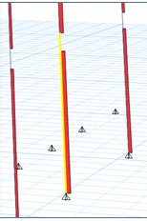
Columns 60cm*40cm
Column “C25” which has the max. compression load was chosen to check reinforcement in the basement.

Slide 56



^{2st} Basement Column “C25” Internal forces
Pu =467.7 KN
M1 = 12.2 KN.m
M2 = 24.3 KN.m

Slide 57
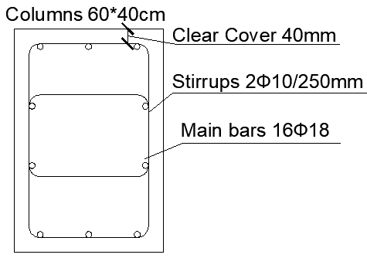
Columns 60cm*40cm Design
Slenderness ratio = 10.5< 34 – 12 M1/M2=28 < 40
Slenderness can be neglected.
Ag = 240,000 mm²
ρ _{min} = 0.01
As min = 2400 mm²
ØPn = 3464.7 KN > Pu

Slide 58

Foundations Design
The used foundation system is mat Foundation.
Safe software program was used to design the foundations.

Slide 59
Foundations’ Thicknesses
The allowable bearing capacity for soil in the location of the building is 320 KN/m².
Thickness of each foundation was chosen based on wide beam shear and punching shear.
Foundation | Thickness
Right building | 1200mm
Middle building | 1200mm
Left building | 900mm
Left matt foundation was selected to represent the required chicks.

Slide 60
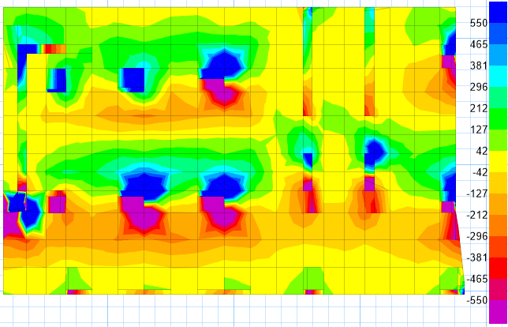
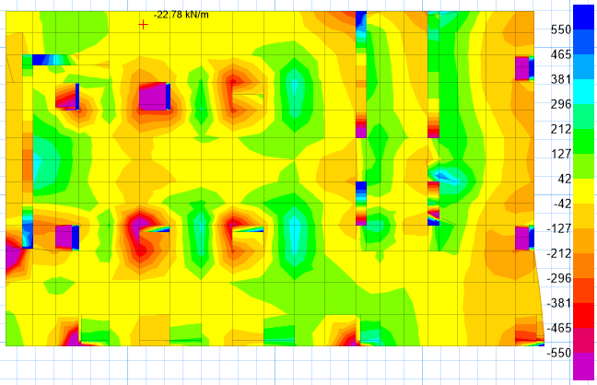
Wide Beam Shear Chick
Ø Vc = 550 KN

Slide 61
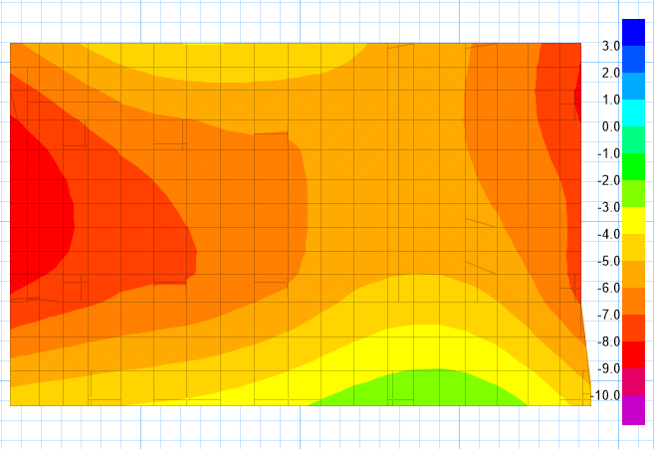
Deflection Chick
The maximum allowable deflection for foundation equals 10mm

Slide 62
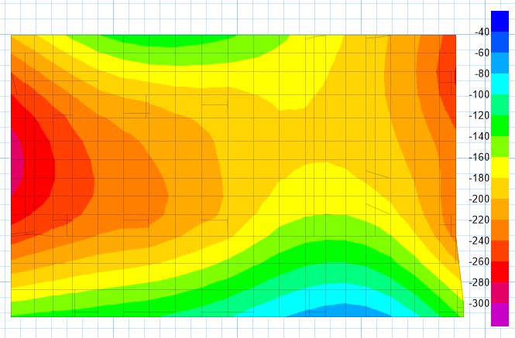
Stresses Chick
Allowable bearing capacity of the soil = 320 KN/m²

Slide 63
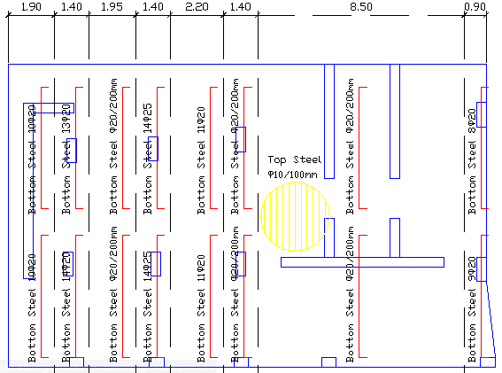
Flexure in Y direction

Slide 64

Flexure in X direction

Slide 65

Middle building Flexure
Y direction

Slide 66

Middle building Flexure
X direction

Slide 67

Right building Flexure
Y direction

Slide 68

Right building Flexure
X direction

Slide 69
Walls Design
Two types of walls in this project
Building Bearing walls
Basement Shear walls

Slide 70


Bearing Walls Design
Thickness = 200mm
ØPn = 1485 KN/m
Wall 9 Pu = 3478.5 KN/m

Slide 71


Bearing Walls Reinforcement

Slide 72

Shear Walls Design
Wall thickness = 200mm
γ soil = 20 KN / m³
Ka = 0.27
f’c = 24 MPa
fy = 420 Mpa
Max +ve Moment = 36.18 KN.m
Max -ve Moment = 23.3 KN.m
ØVc = 92.6 KN
Maximum shear force = 54 KN

Slide 73

Shear Reinforcement

Slide 74

Questions Part

