Slide 1
RF components Design for the Internet Over TV Band Adaptor
Prepared by:
Esam Ahmad
Supervised by:
Dr. Ahmed Masri

Slide 2
Contents
Introduction
Previous Work
Our Previous Work
The Mixer
The Bandpass Filters
The Low Noise Amplifier
The Duplexer
Future Work

Slide 3

Introduction
IoTV is a project that aims to transmit Internet wirelessly over TV band using Cognitive Radio, and utilizing the white space. In order to cover rural and remote areas.

Slide 4
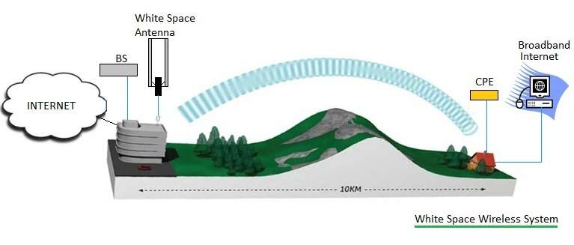
Introduction
White Space refers to the unused broadcasting frequencies in the wireless spectrum
White Space broadband can travel up to 10 kilometers “Super Wi-Fi”
White Space spectrum ranges from 470 MHz to 790 MHz

Slide 5
Applications for the project
increasing wireless range

Slide 6
Applications for the project
Connecting two remote users distant from each other

Slide 7
Applications for the project
Commercially as an ISP

Slide 8
Previous Work
Effort that has been done by our fellow colleagues:
Form a reliable database containing field data measurements
Designing a (1.6-2) GHz oscillator, along with two antennas with different directivities.
Result: The spectrum is mostly free

Slide 9
The Adaptor Block Diagram

Slide 10
Our Previous Work
High power amplifier in ADS software

Slide 11
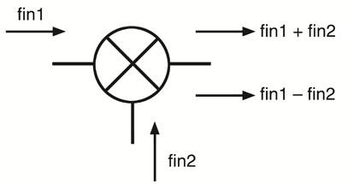
RF Component:
The Mixer

Slide 12
RF Component: The Mixer
When designing the mixer, we kept in mind:
Which type of mixer
Input frequency
Input power (LO drive power required)
Coupling factor (ideal DBM = -3dB)
Conversion gain (typical value = -6dB)

Slide 13
RF Component: The Mixer
The design for the mixer was chosen to be a double balanced mixer, with ring diodes in the middle

Slide 14
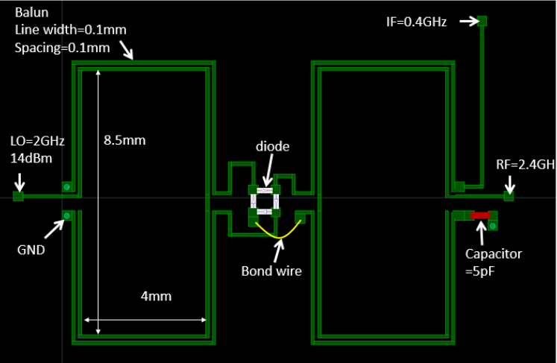
RF Component: The Mixer
The double-balanced mixer layout:

Slide 15

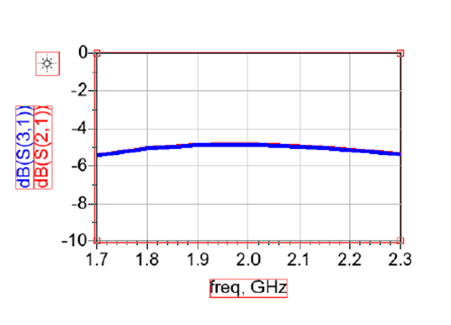
RF Component: The Mixer
Coupling factor magnitude (dB) results of double balanced mixer:

Slide 16
RF Component: The Mixer
simulated results for conversion gain (dB) vs Lofreq:

Slide 17

RF Component:
The Bandpass Filters

Slide 18
RF Component: The Bandpass Filters
Wi-Fi frequency band pass filter circuit:

Slide 19
RF Component: The Bandpass Filters
Wi-Fi frequency band pass filter simulation:

Slide 20
RF Component: The Bandpass Filters
TV frequency band pass filter circuit:

Slide 21
RF Component: The Bandpass Filters
TV frequency band pass filter simulation:

Slide 22
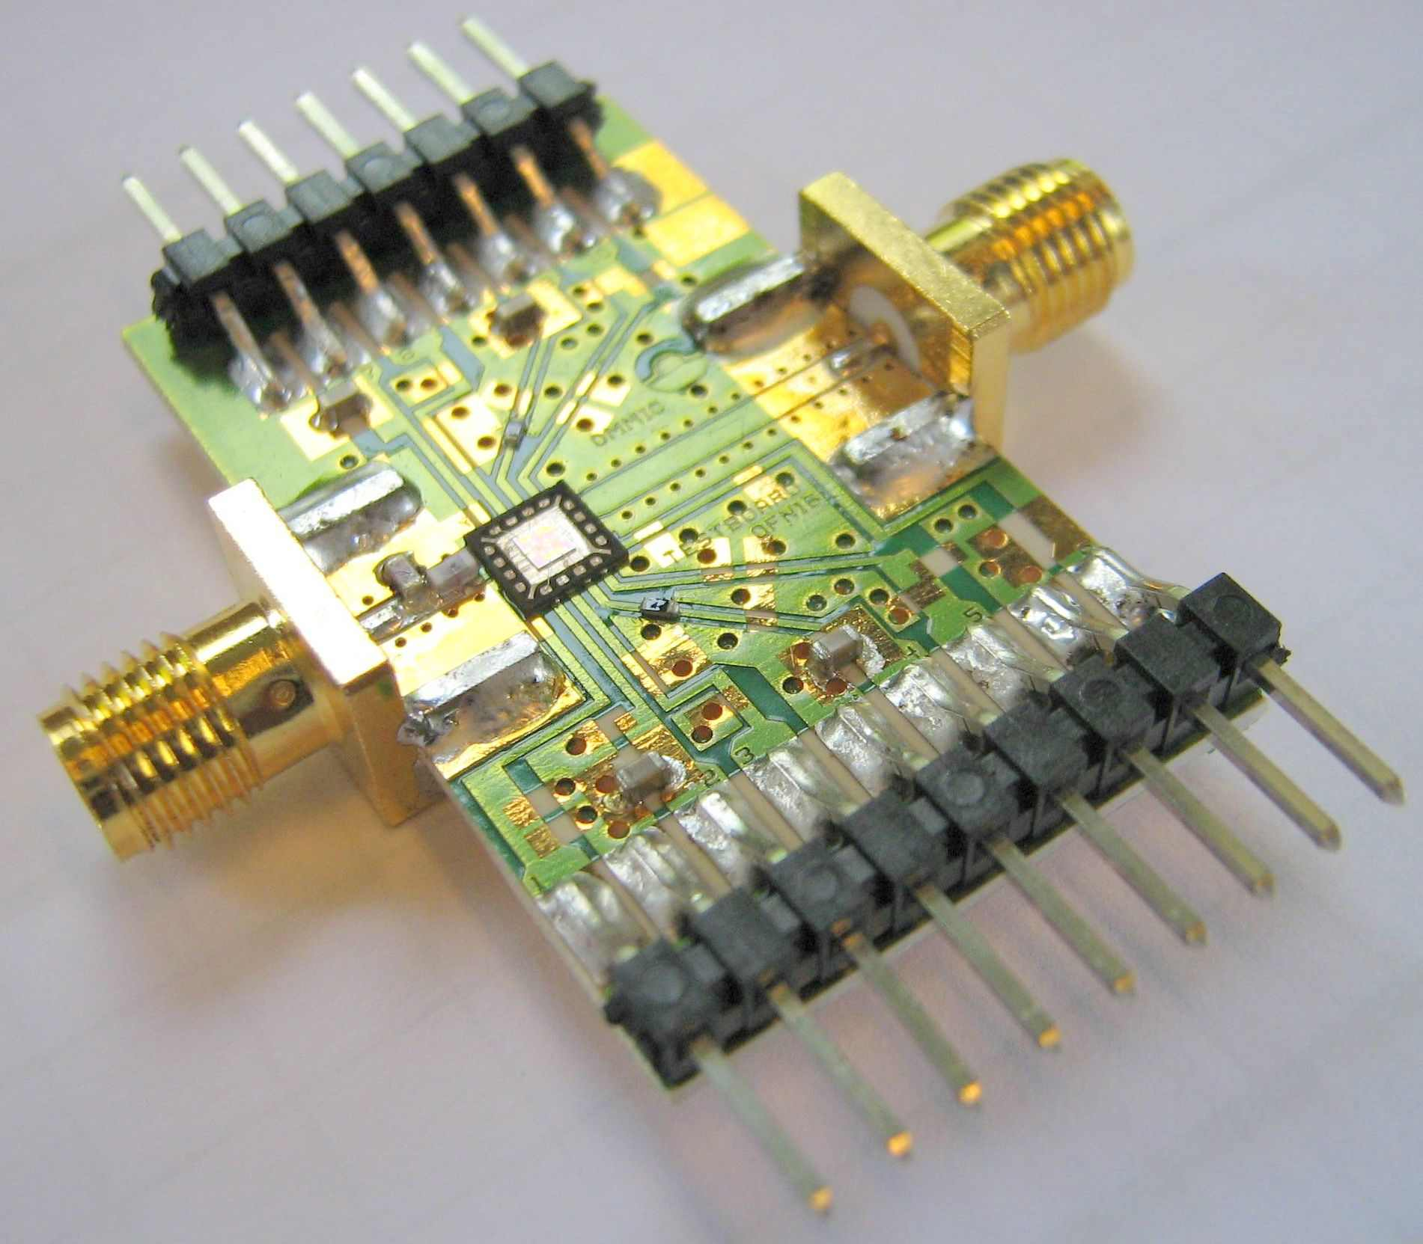
RF Component:
The Low Noise Amplifier

Slide 23
RF Component: The Low Noise Amplifier
When designing the mixer, we kept in mind:
Operating Frequency
Linearity
Power gain (typical value = 20dB)
Noise figure (max. of 2dB, IEEE standard)
Impedance matching

Slide 24
RF Component: The Low Noise Amplifier
Low noise amplifier circuit in ADS software

Slide 25
RF Component: The Low Noise Amplifier
Output Voltage Waveform having sin signal as input:

Slide 26
RF Component: The Low Noise Amplifier
Output spectrum having sin signal as input:
Harmonics | Power (dBm)
signal | 16.724
1st | -23.595
2nd | -38.363
3rd | -42.070
4th | -57.112

Slide 27
RF Component: The Low Noise Amplifier
The noise figure for the required frequencies

Slide 28
RF Component: The Low Noise Amplifier
The S-parameters for the require frequencies

Slide 29
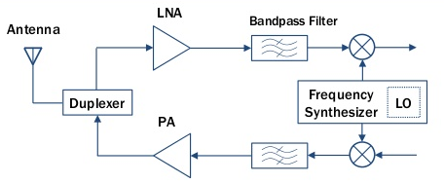
An Important Aspect: The Duplexer
The duplexer is an electronic device that allows bi-directional (duplex) communication over a single path.

Slide 30
An Important Aspect: The Duplexer
Types of Duplexeres:
Transmit-receive switch: a transmit/receive (TR) switch alternately connects the transmitter and receiver to a shared antenna.
Frequency domain: the transmitted and received signals can occupy different frequency bands,
Important properties of a duplexer are: Low loss between transmitter and antenna (less than 1 dB), Low loss between antenna and receiver (less than 1 dB), High isolation from transmitter to receiver (as much as 80 dB)

Slide 31
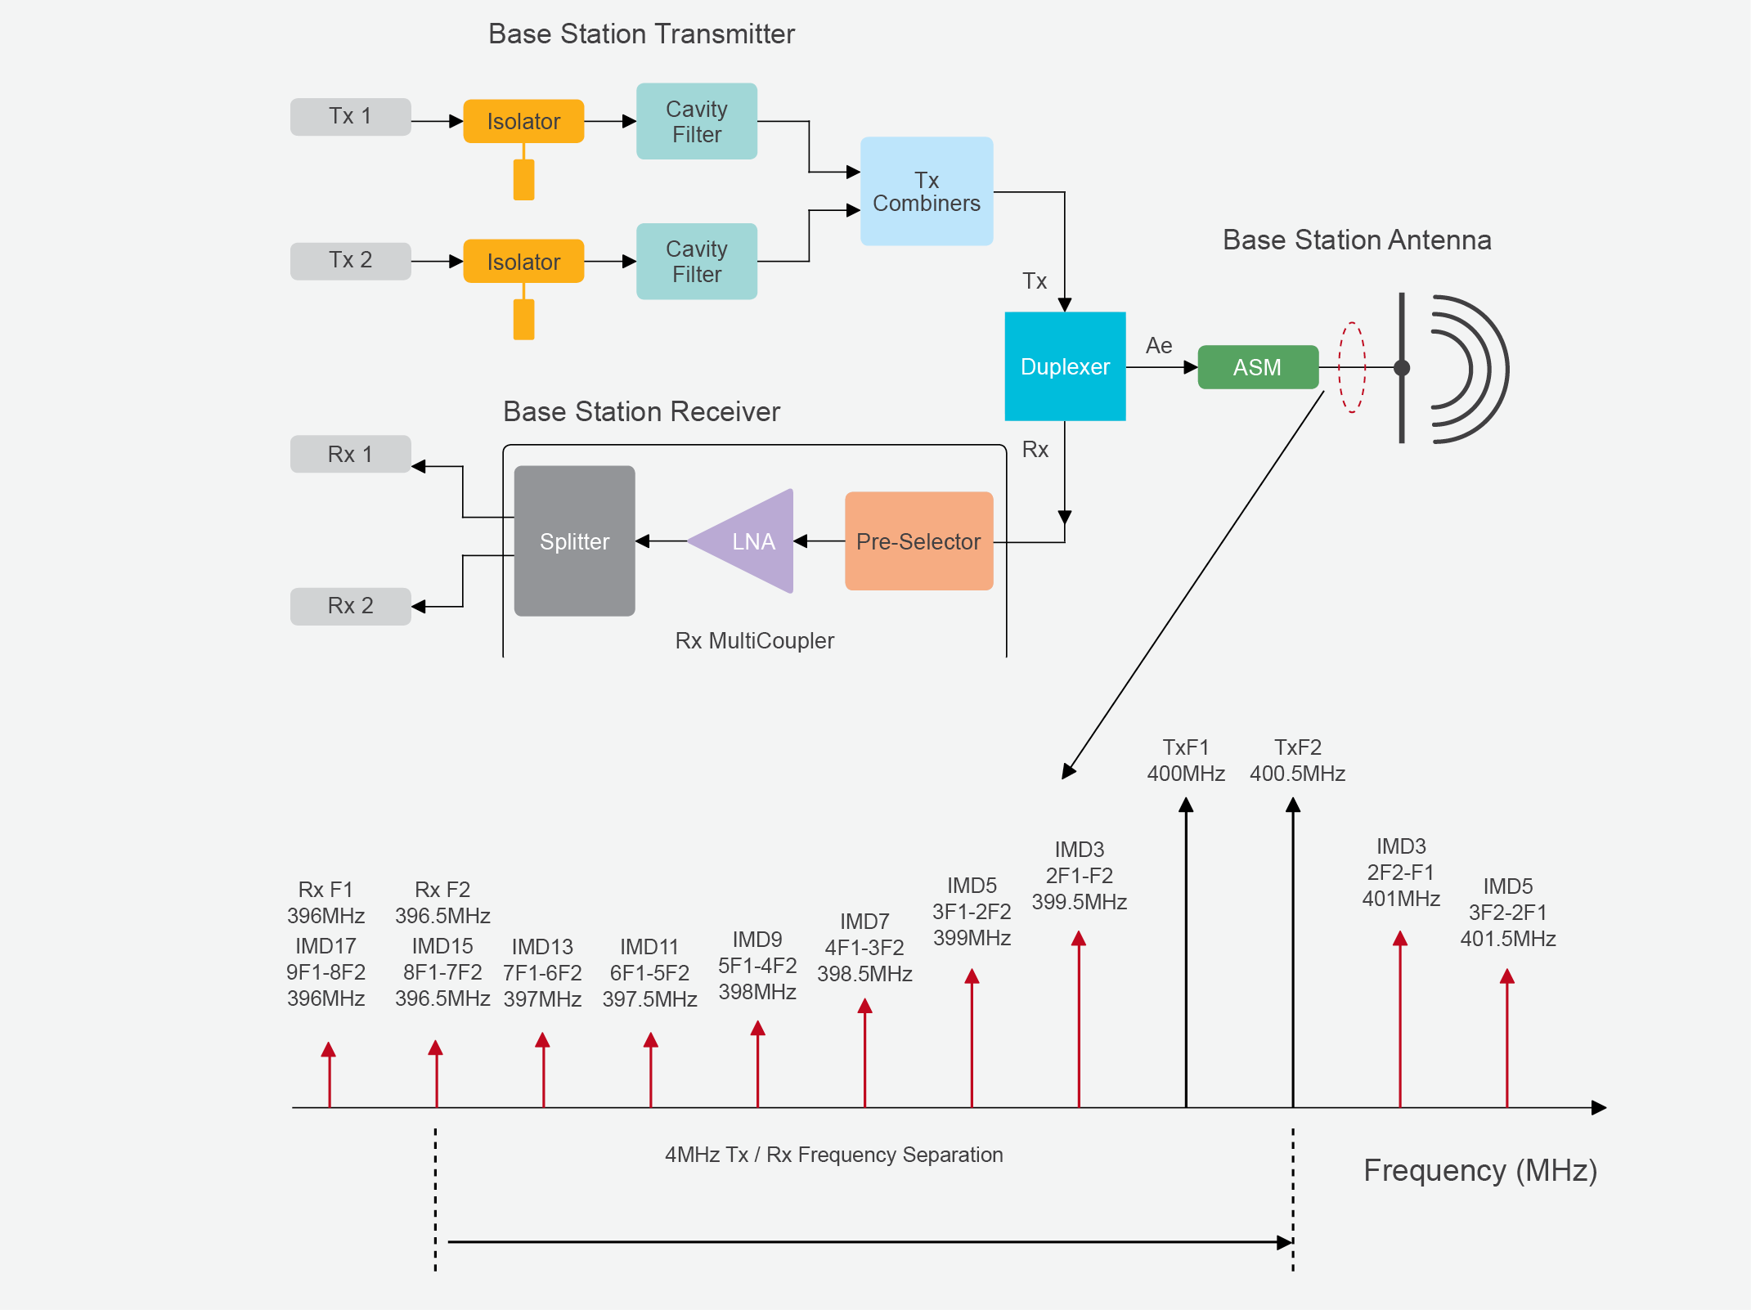
Should We Use a Duplexer ?
using a duplexer to reduce the number of antennas required by the system sounds like a great idea. But, as usual with RF, it is never quite that simple.

Slide 32

Future Work
We strongly advise in implementing the components on a printed circuit board and having them ready for testing
Making a decision regarding which type of duplexer should be used
Come up with a cool name and a logo in case it gets manufactured as a product

Slide 33


Slide 34


