Slide 1
Tank-filling lorry
Ethar Abu Sarah Dr.Luai Malhis
Baidaa Al Bzoor

Slide 2
Outlines:
What is “Tank-filling lorry”.
Objectives and main idea.
Materials and methods.
Problems.
Future work.

Slide 3
What is “Tank-filling lorry”?
A robot car (Self controlling).
Receives an RF (Radio Frequency ) signal.
Follow pre-determined path toward the specific tank.
Tank (Water, oil or any chemical liquid material).
With collision avoidance principle.

Slide 4
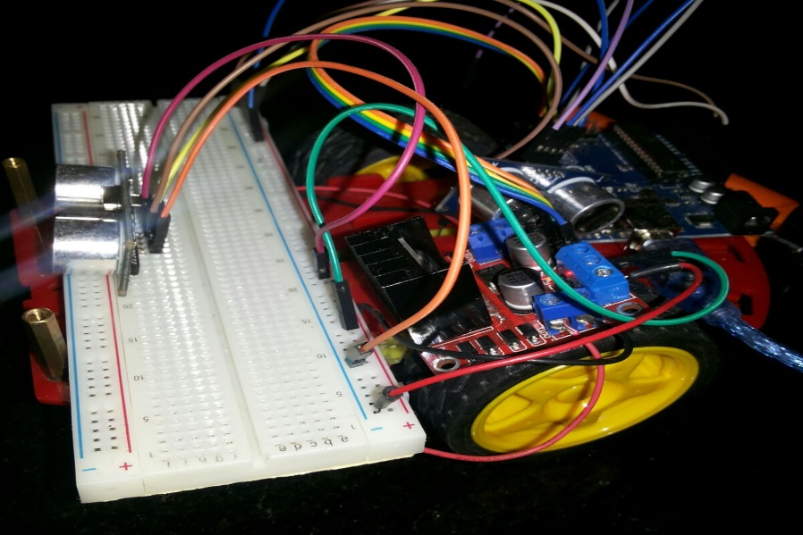
Car-object

Slide 5
Motivations and objectives:
Water level and distribution problem.
Try to build a self controlling tank-filling machine.
Controlling the water pumping process.

Slide 6
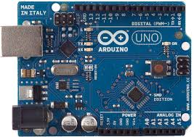
Materials and Methods.
1. Arduino Uno.

Slide 7
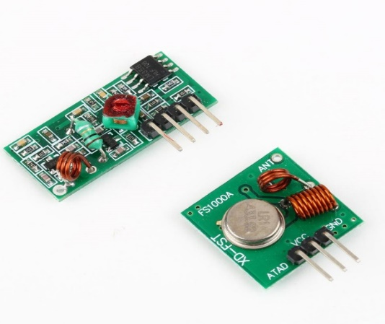
Materials and Methods
RF (Radio Frequency) communication.
Transmitter
Receiver

Slide 8
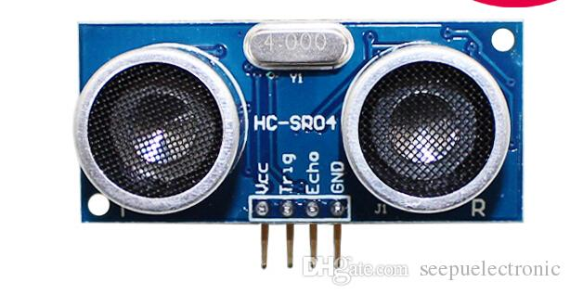
Materials and Methods
Ultrasonic

Slide 9
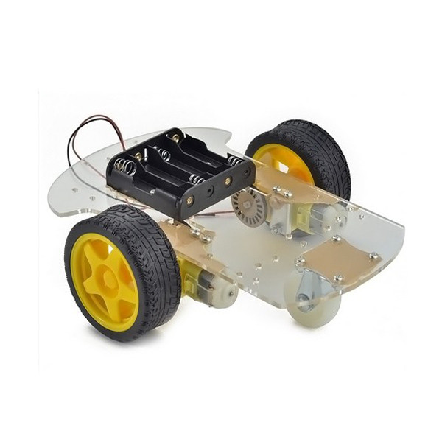
Materials and Methods
Robot Car Chassis Kit

Slide 10
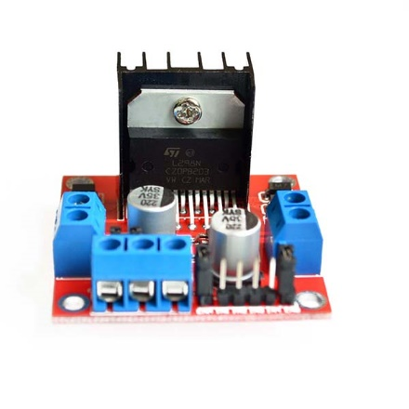
Materials
Dual H-Bridge Motor Drive

Slide 11
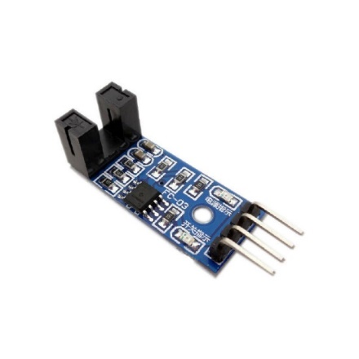
Materials
Optical Coupling Module (Speed Measuring Sensor)

Slide 12
Methods (Software implementations)
Speed sensor and decoder.
Ultrasonic code for water level detection.
RF code.
Car paths and obstacles avoiding codes.

Slide 13
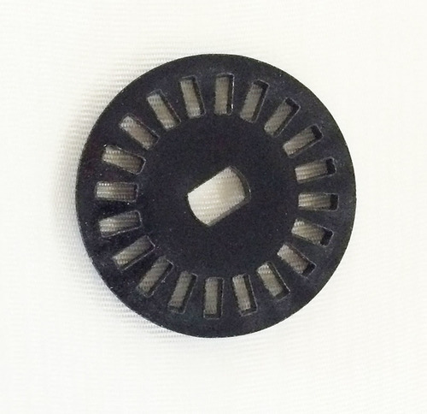
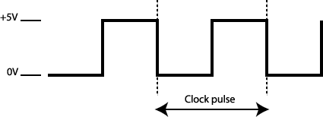
Speed Sensor and decoder

Slide 14
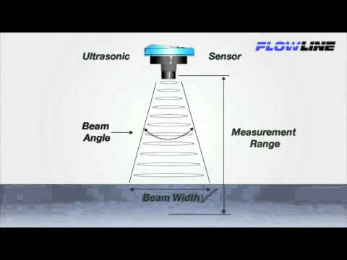
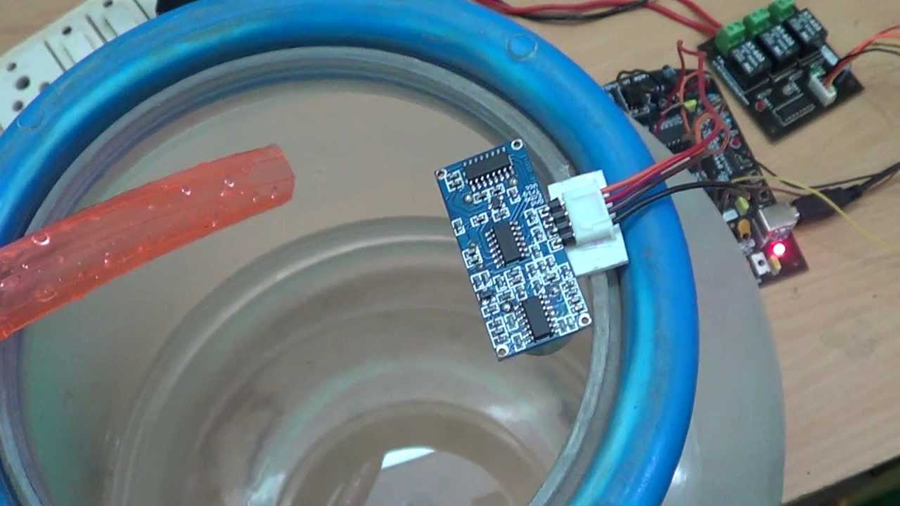
Water level detection(Ultrasonic)

Slide 15
RF:
Transmitter
Receiver

Slide 16
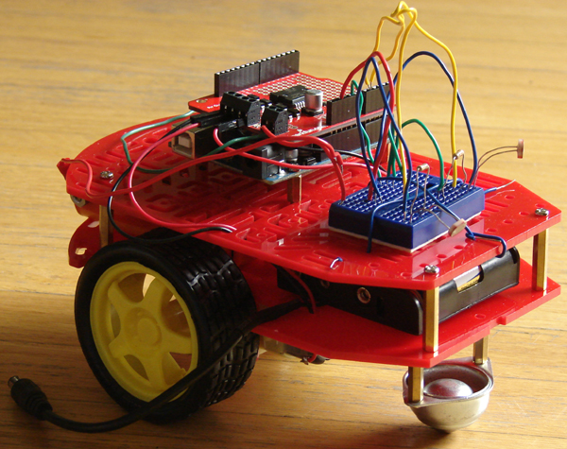
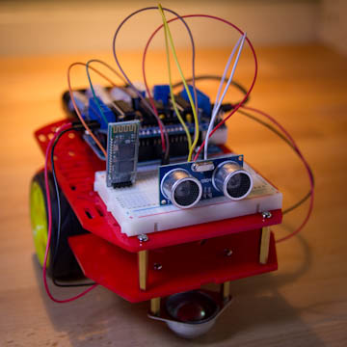
Car path and obstacle avoidance

Slide 17
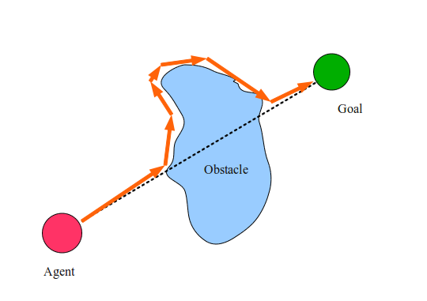
Obstacle avoidance

Slide 18
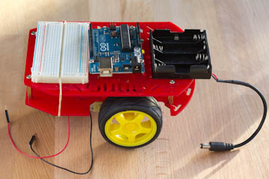
Problems
Car Motion controlling
(different RPS)
Solving:
PWM
Increase the Voltage

Slide 19
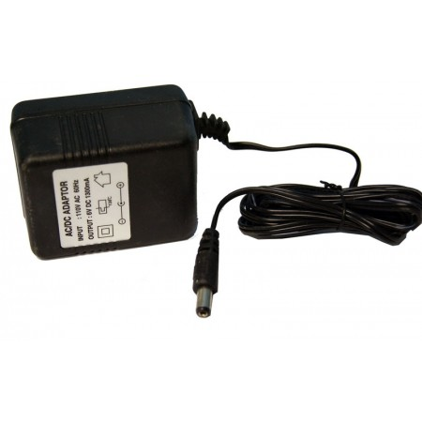
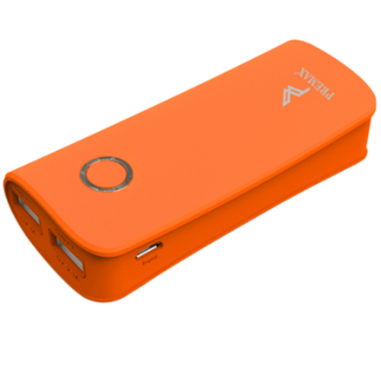
Power Supply

Slide 20
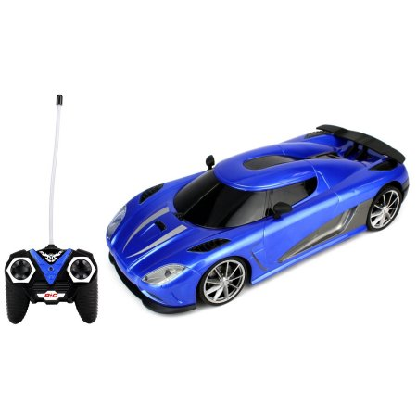
Static Paths
Its hard to make a self automated car that is self controlled
Instead of using remote controlling.

Slide 21
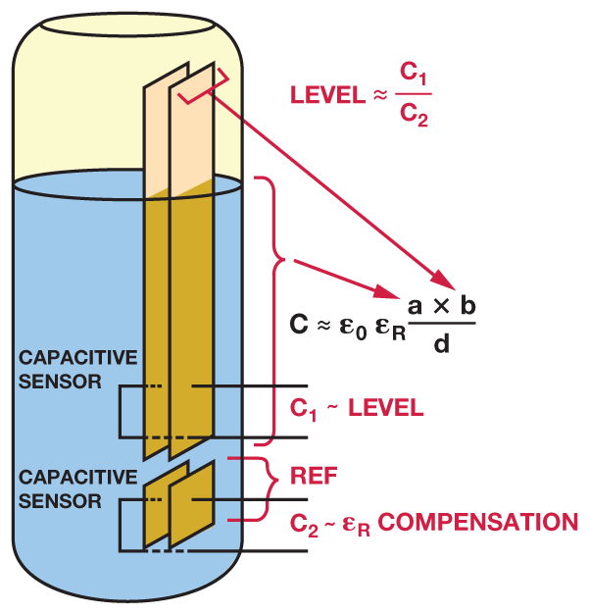
Future Work
Automated self-moving car
Can work in any environment
(high coverage area, different terrain )
3. Improve the water detection technique.

Slide 22
Demo ☺

