Slide 1
Design of Wastewater collection network for Amman Street, Nablus
By: Izz Ad-Din Jamal Dweikat (11716459)
Sa’eb Shaker Dweikat (11716814) under supervisio of: Dr. Mohammad N.Almasri

Slide 2
OUTLINE
01
02
03
04
Introduction
Case Study
Methodolgy
05
06
Limitations
Data Calculation
Design
07
08
09
Results
Cost Estimation
Recommendations

Slide 3
Introduction
1
About the study area:
Amman street is located 2Km to the east from the center of Nablus.
With 1.2Km length, Amman street is one of the most important streets in the city.
High traffic volume.
Combined system for drainage.

Slide 4
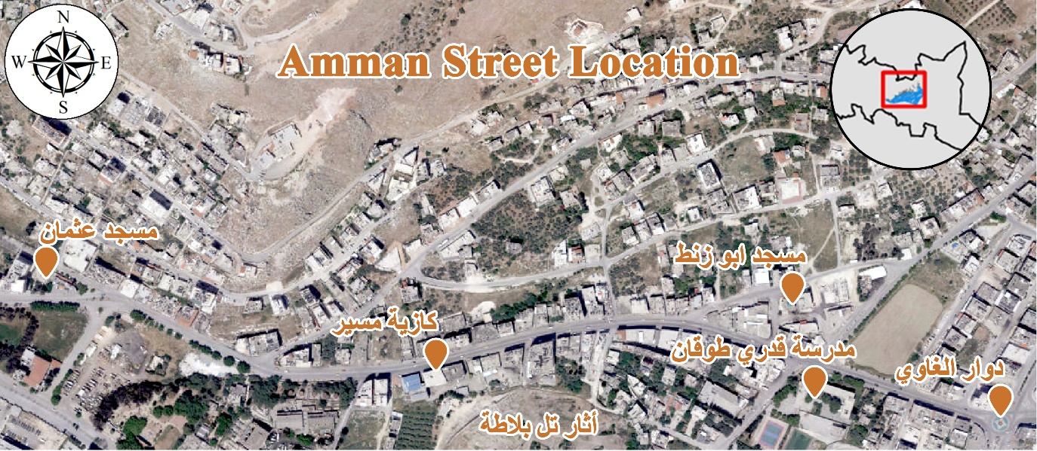
Study Area
Location:

Slide 5
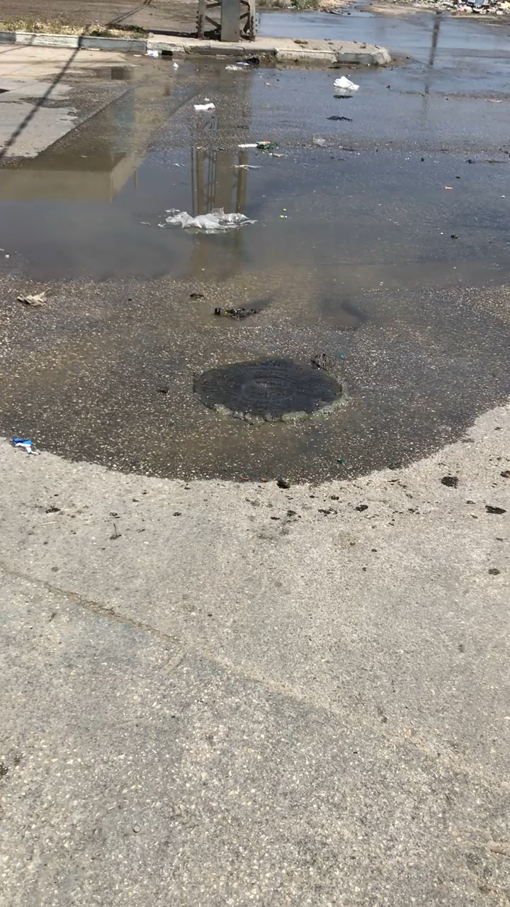
Case Study
2
Problems in the wastewater collection network:

Slide 6
Project Objectives
Study the drainage system in Amman Street Area.
To Redesign the combined wastewater collection network for this area using SewerCAD.
To estimate the cost of the redesigned network.

Slide 7
Methodology
3
1. Determination of the project Idea.
2. Obtaining all the required drawings from Nablus Municipality.
4. Selection of the study area using GIS maps.
5. Computing of the hydraulic loads
7. Analysis the current network
6. Data input/entry to network using SewerCAD
3.making a couple of meetings with different
Municipal Engineers.
8. Redesign the network and calculate the cost

Slide 8
Limitations
4
Topographic Nature is a big challenge.
Lack of important data such as:
The precise population in the area.
The water consumption rate.
A 1-meter contour map will give better details about the elevation.

Slide 9
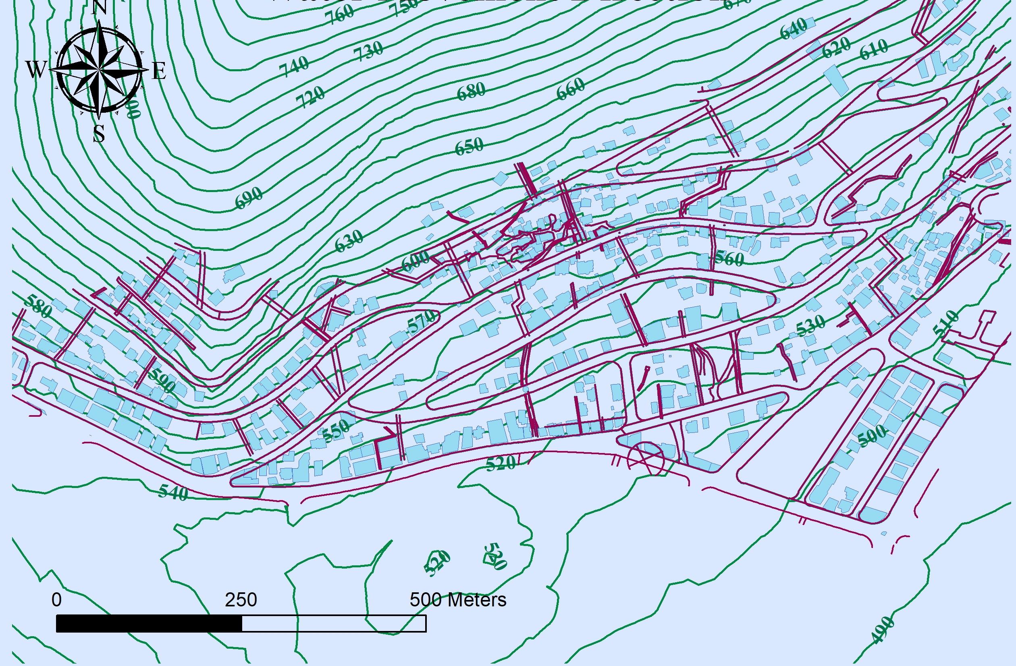

Slide 10
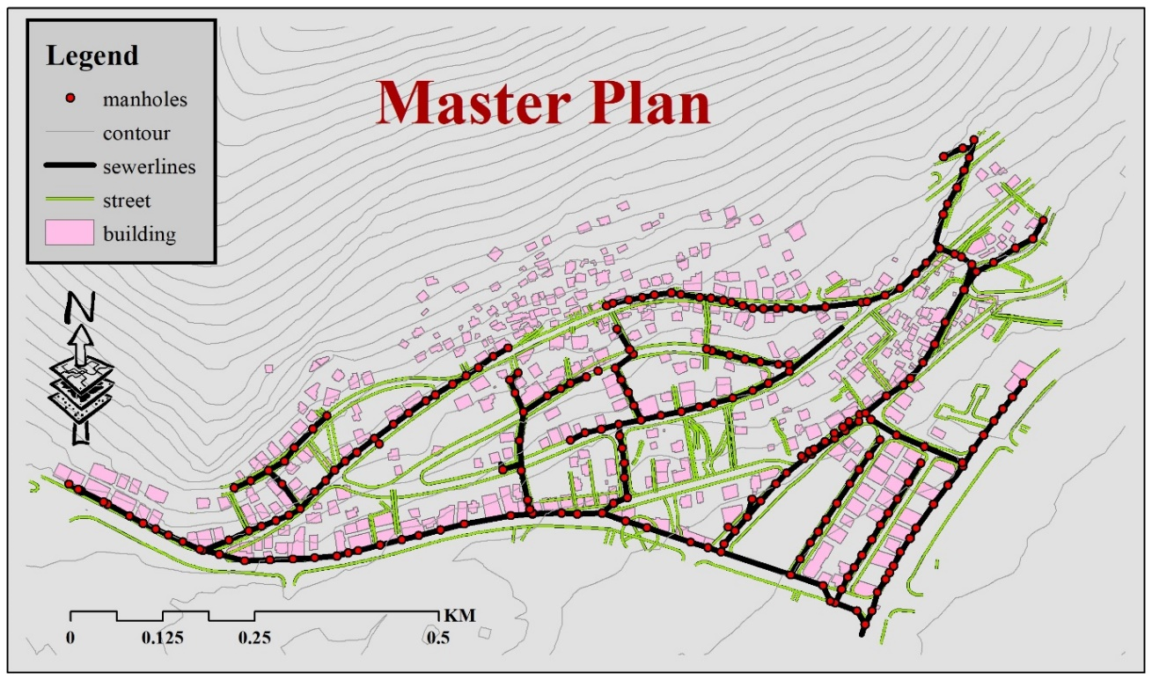
Data Calculation
5

Slide 11
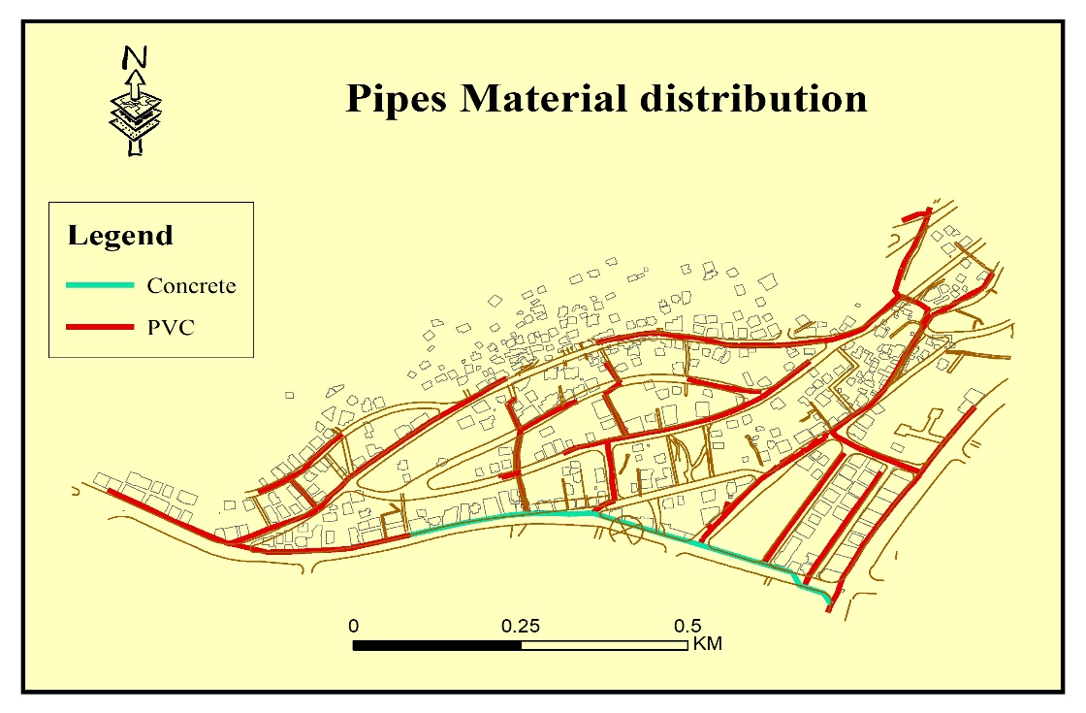
Data Calculation

Slide 12

Data Calculation
The Population is determined using approximate method that use the number of buildings in the count:
466
3
2
5

Slide 13
13,980
Persons

Slide 14
Year
Nablus
2017
155545
2018
158557
r = 1.89%
2019
161630
2020
164758
P₂₀₂₂ = 13980 persons
2021
167931
2022
171150
2023
174387
P₂₀₅₂ = 24516 persons
2024
177638
2025
180897
2026
184152

Slide 15
Manhloe Load Calculation:
Total Load = Population x W.C/c-d x W/WW% x PHF x (1+infiltration)
Current =
13980
86/100
80%
4
1+0.05
Future
(30Years) =
24516
86/100
80%
4
1+0.05

Slide 16
Manhloe Load Calculation:
Total Loads:
Current
Future (30 Years)
4039.6 m³/day
7084.14 m³/day
Number of Manholes = 243
Manhole load
Current
Future (30 Years)
16.6 m³/day
29.15 m³/day

Slide 17
Design Constrains
6
Velocity: 0.6m – 3.5m
Slope: 1% - 12%
Cover depth: 1.0m – 4.0m

Slide 18
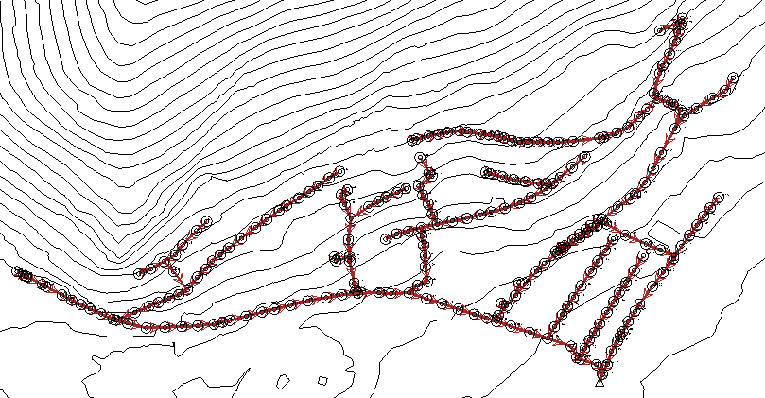
SewerCAD Model

Slide 19
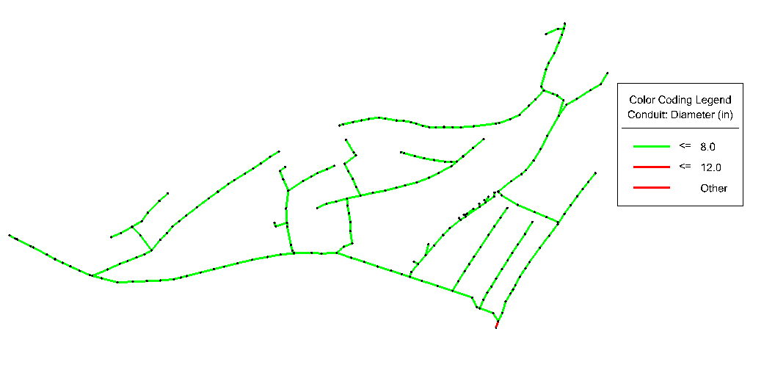
Results
7
Current Design

Slide 20
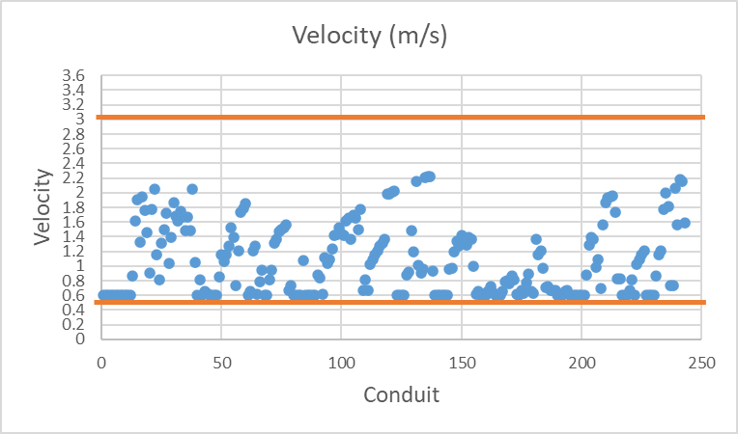
Results
Current Design

Slide 21
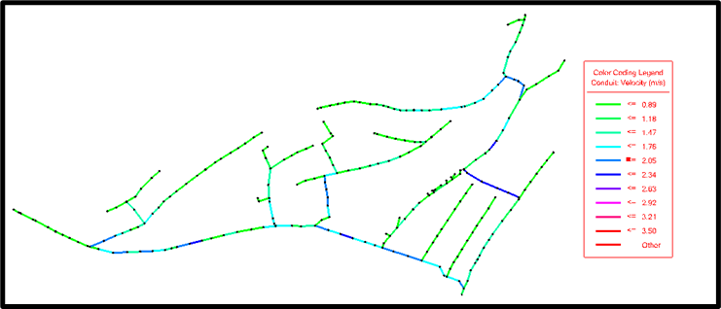
Results
Current Design

Slide 22
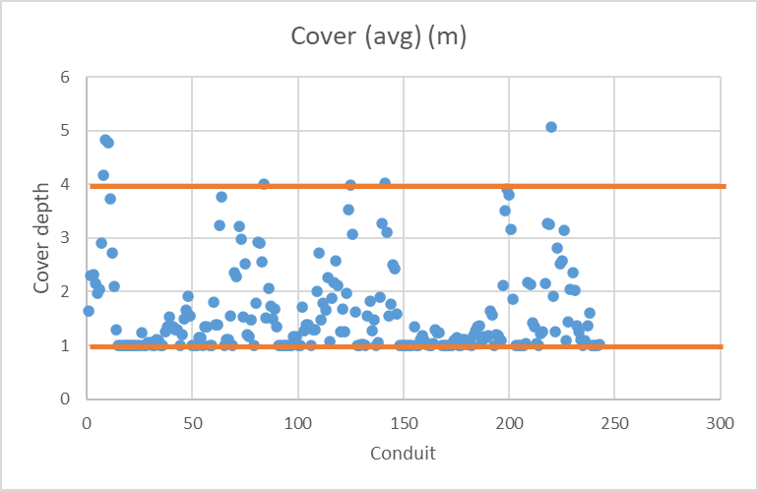
Results
Current Design

Slide 23
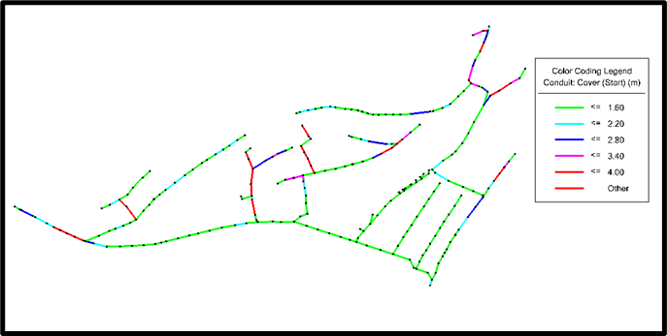
Results
Current Design

Slide 24
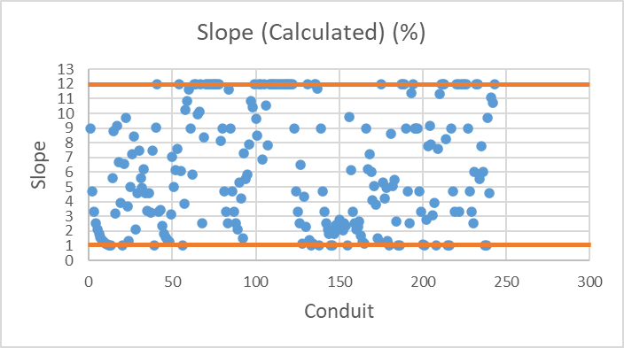
Results
Current Design

Slide 25
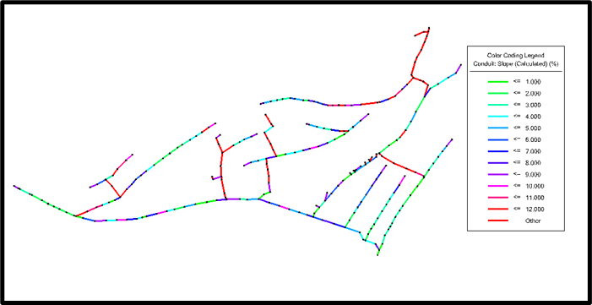
Results
Current Design

Slide 26
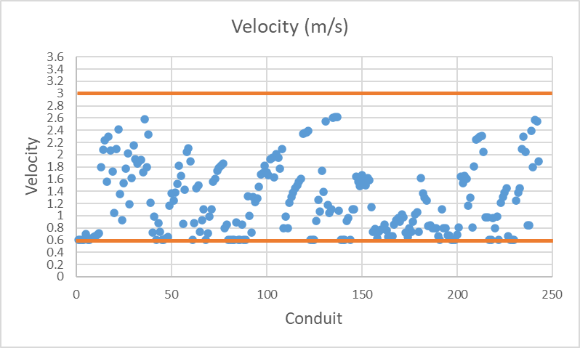
Results
Future Design

Slide 27
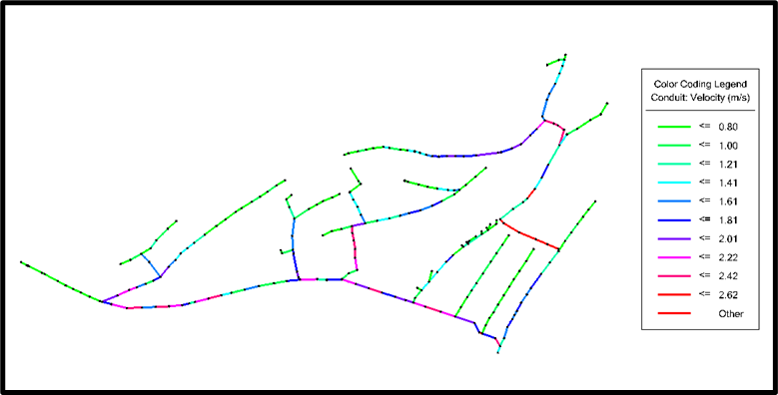
Results
Future Design

Slide 28
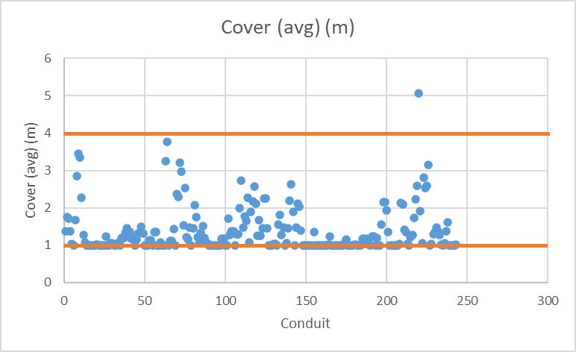
Results
Future Design

Slide 29
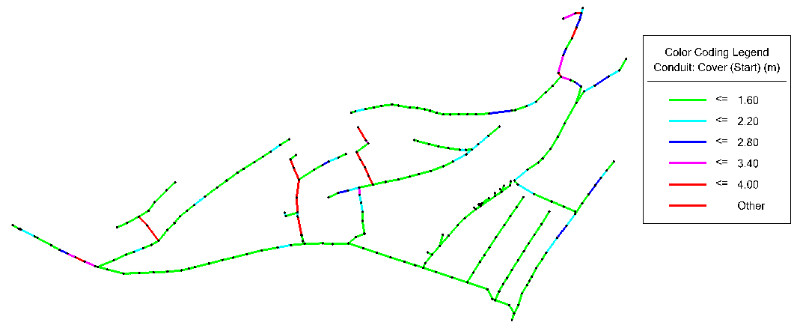
Results
Future Design

Slide 30
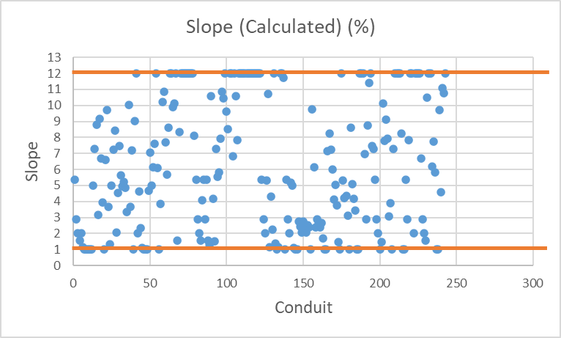
Results
Future Design

Slide 31
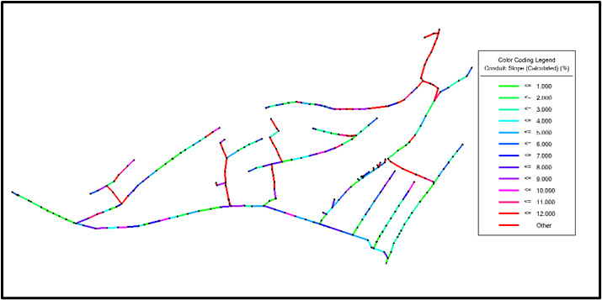
Results
Future Design

Slide 32
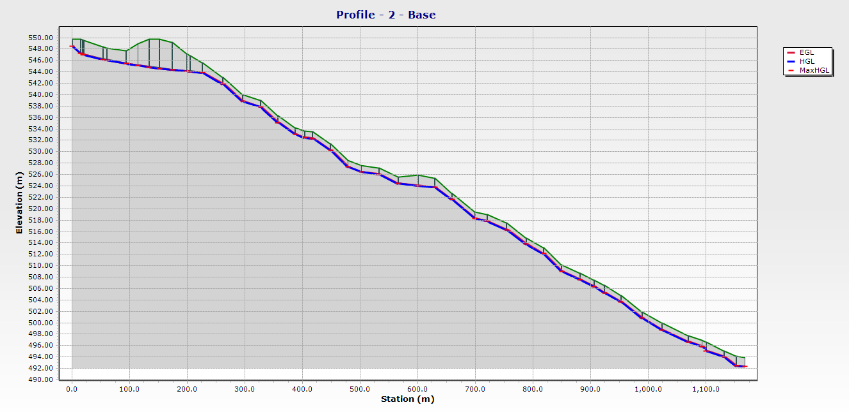
Results
Profile

Slide 33
Cost Estimation
8
Sewer
Pipes
31,109$
Excavation Cost
258,313$
Sewer
.
86,265$
Re-paving
.
206,090$
Labor Cost
.
94,690$
Total Cost = 676,467$
Cost/KM = 121,448$

Slide 34
Recommendations
9
Precise Survey about this area.
Another area must be checked.

Slide 35
Thanks
GG WP

