Slide 1
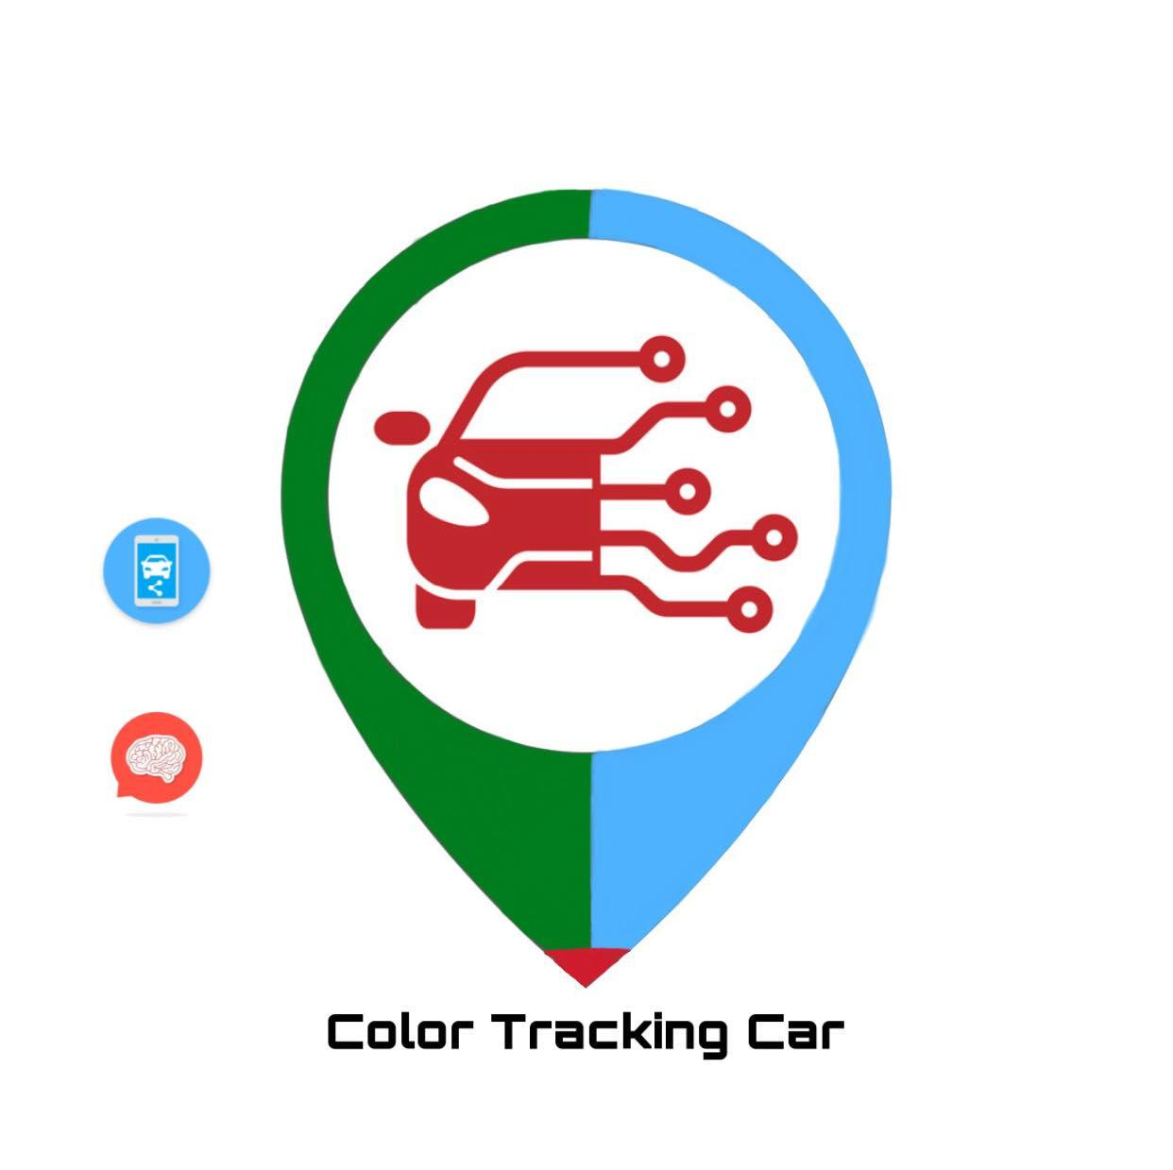
Color Tracking Car
SUPERVISOR: DR. LUAI MALHIS
STUDENTS :
SHAIMA YAMIEN
AMANI HAJ ALI

Slide 2
Outlines:
* Introduction
1. problem
2. Project Description
3. Objectives and Importance
* Literature Review
* Used Tools and Hardware components.
* Project Sections
1. Mechanical part
2. Software part
* Results and Discussion
* Constraints
* Conclusion and Future work.

Slide 3
1. Problem
With the continuous development of computer technology, network technology, we will need inventions that will save our time and effort; our car will follow a colored street of the basic colors (Red, Green and Blue).
The car also avoid the obstacles that will be on its way using the ultrasonic sensor that will detect if there is an object on the street.

Slide 4
2. Project Description
The robot car avoids obstacles while simultaneously moving on the colored streets (using the color
sensors). After finding the object, it will go back and turn it’s way in the opposite direction. Finally, the car
will wait another command from the mobile application to move on another colored street.

Slide 5
3. Objectives and Importance
With modern industrial production develops toward the high speed and automatic direction, color recognition has been widely used in various industrial detection and automatic control field.

Slide 6
Literature Review
The other projects were line following cars on black streets using IR sensors, but our robot car moves on the colored streets when it receives a command form a mobile application through the Bluetooth.

Slide 7
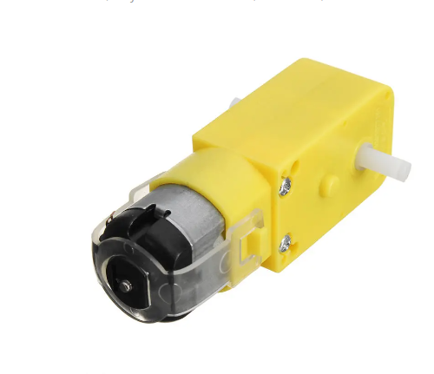
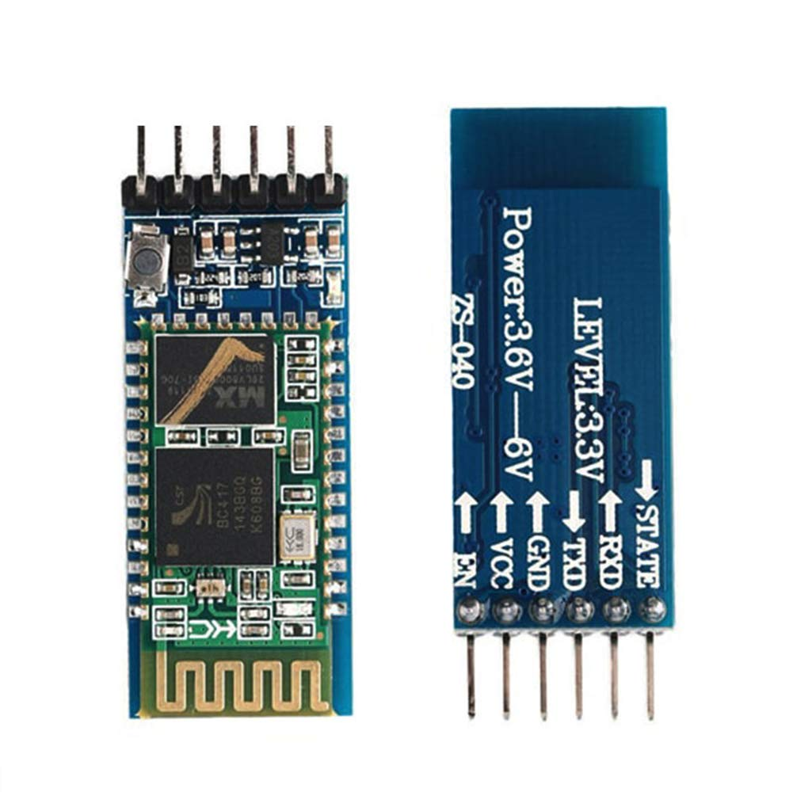
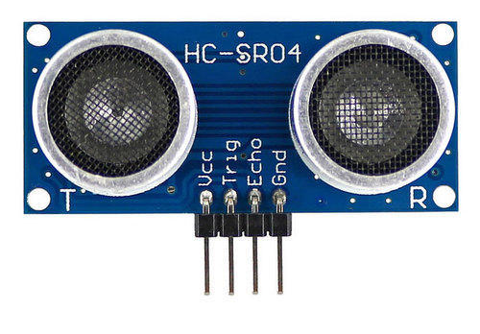
Hardware components
TT Gear Motor Bluetooth HC-05 Ultrasonic sensor

Slide 8
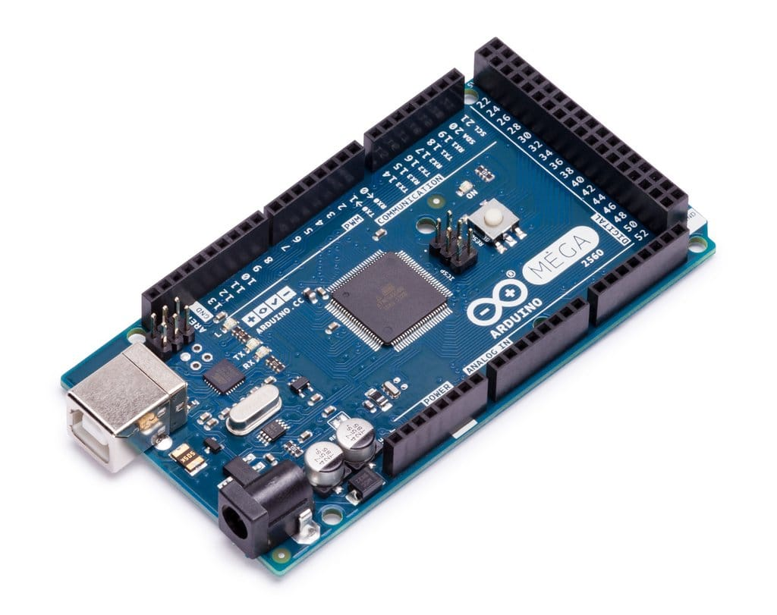
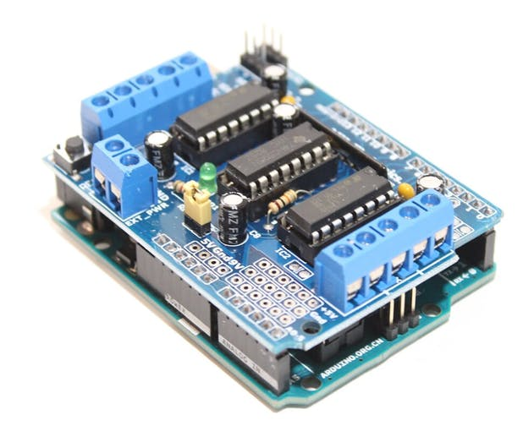
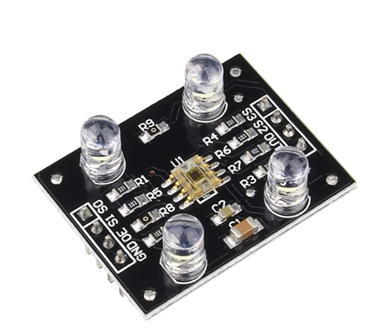
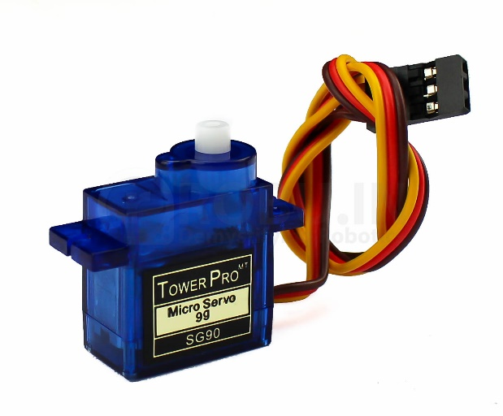
Hardware components (cont.d)
Arduino MEGA2560 Motor Driver Shield Color Sensor TCS230 Servo Motor (sg90)

Slide 9
Project Sections :
1. Mechanical part
In this part, we connected the motor drivers with the wheels in the car, and connected them with the four channels (M1, M2, M3 and M4) in the Motor Driver Shield, then we connected the Arduino MEGA with the Motor Driver Shield, after that we connected the Servo Motor with the car, and connected it with a header with 3 pins (ser1) in the Motor Shield.
Then we put the Ultrasonic sensor above the Servomotor using a small piece of wood to carry the Ultrasonic sensor, and then we connected the four pins of the Ultrasonic sensor with Motor Driver Shield .
After that , we connected the color sensors with the Arduino MEGA.
Finally, we connected the pins of the Bluetooth HC-05 with the Arduino MEGA.

Slide 10
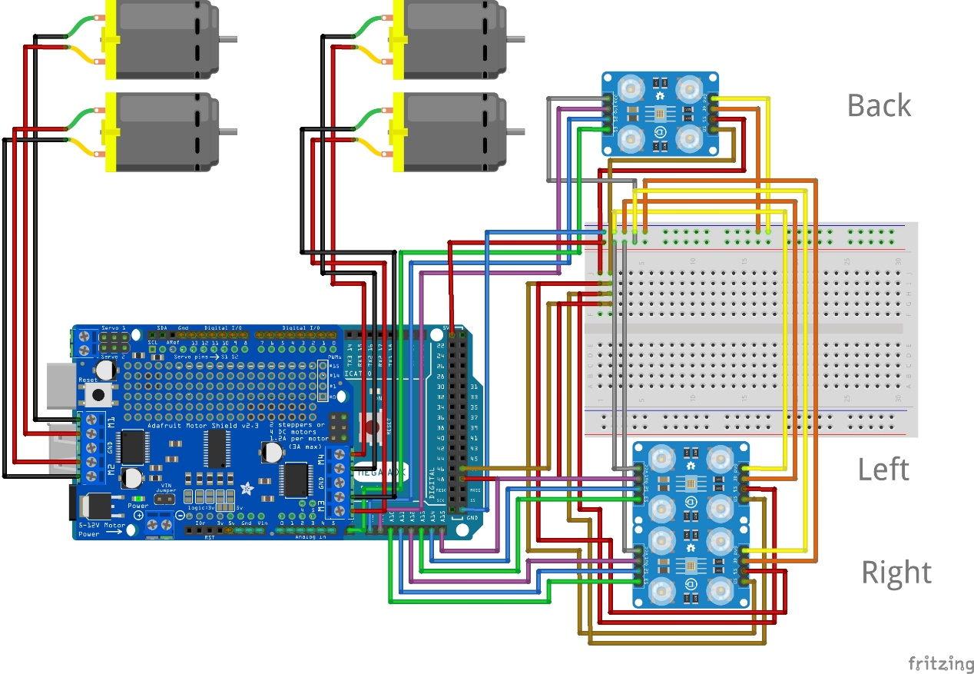
The connection of the color sensors

Slide 11
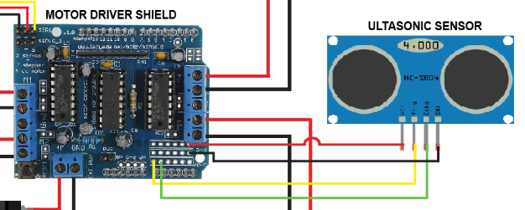
The connection of the Ultrasonic sensor

Slide 12
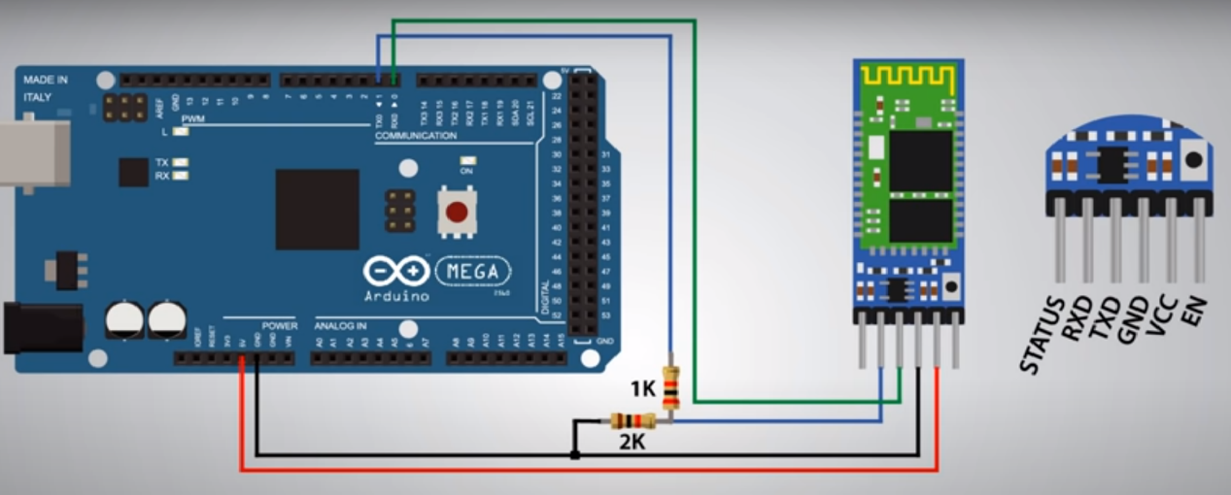
The connection of the Bluetooth HC-05

Slide 13
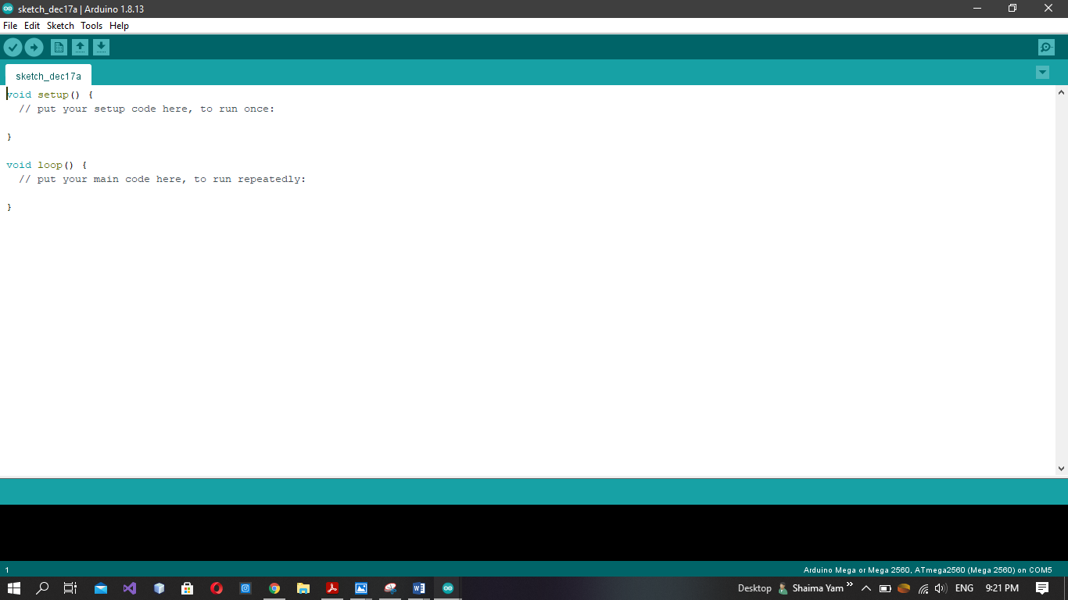
2. Software part
Used Tools:
We used the program ARDUINO IDE to write the code that runs the robot car.
Here is the program shown in the figure:

Slide 14
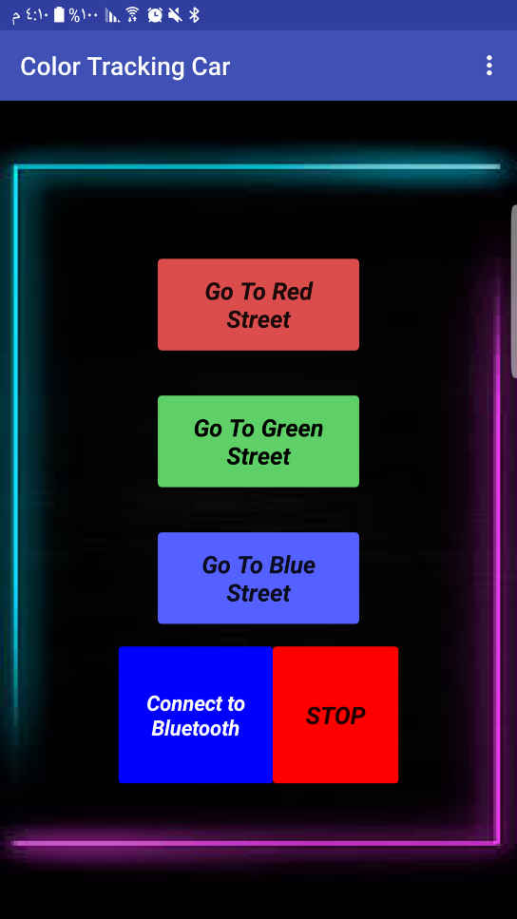
Mobile Application we used MIT app inventor to design the application

Slide 15
Results and Discussion
The project has done, the car follows the colored streets when it receives the commands from the mobile application through Bluetooth, the car will move on it's way until the end of the colored street then it will go back on the same way until it receives another command to continue moving on another colored street and so on.
It also avoids the objects on it's way when the Ultrasonic sensors finds an object in the way, the car takes an opposite direction away from the object and then continues it’s way on the street.

Slide 16
Constraints
1. The appearance of the Corona virus.
2. We had not the color sensor called (Lego Mindstorms Ev3 Color Sensor) in Palestine, this color is capable of detecting seven colors plus the absence of color.
Therefore, instead of EV3 color sensor, we used the color sensor (TCS230) that is not reliable enough and cannot give accurate values of the colors; this makes us to try many tests to have values that is approximately good to deal with in the project.

Slide 17
Conclusion and Future work
Our project that aims to control sensors and microcontrollers has been completed by using a robot car that moves on streets based on colors and avoids the obstacles that found on it's way.
In the future, we will make the car detects more colors to move on, and make the car looks for the other colored streets by itself .

Slide 18
Thank You ..

