Slide 1

An-Najah National University
Faculty Of Engineering
Civil Engineering Department
Graduation Project I I
Evaluation of the existing WDN and Design of the future Water and Sewer Network for Eastern pressure zone in Nablus city.
Prepared By :
Ahmad Fares
Mosab Shkokani
Saad Eddine Kharrousheh
Supervision of Eng. Hamees Tubeileh

Slide 2
Outline
Objectives and significance of the project
Methodology
Study Area
Water Consumption Types
Model Analysis Results
Design a New WDN
Design Sewer Network System
Cost Analysis
Discussion and conclusions
1

Slide 3
Objectives
Analysis the existing network.
Design a reliable water and wastewater network.
Meet the PWA design standards
Make sure that the networks performance are acceptable for the required design period.
Calculate total cost for each network
2

Slide 4
Methodology :
For WDN:
Select study area
Collect data
Analyzing collected data
Start using WaterCAD
Get the results
Run WaterCAD model
New Design or Redesign ?
Calculate the cost
3

Slide 5
For WWN:
Collect data
Start using sewerCAD
Distribute manholes
Select study area
Design sewage network
Run the model
Get the result
Calculate the cost
Calculate generated wastewater
4

Slide 6
Study Area
Location
Topography
Study area
Water resources
Population
5

Slide 7
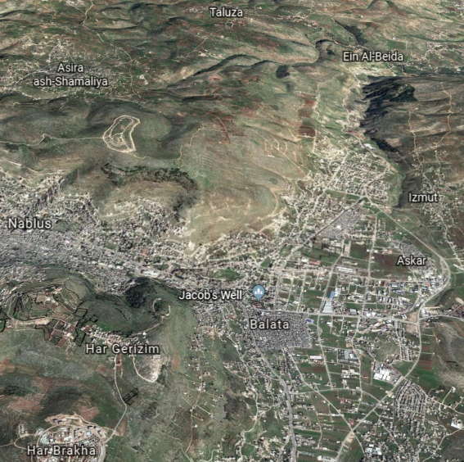
Location :
Al Masaken Al Sha'byeh is Palestinian locality in the West Bank follow Nablus governorate , which is located 3.9 km to the East of Nablus city, Located on the main road between Askar camp and Al-Bath’an village .
Area:
Is 1147 dunams.
6

Slide 8
Location
Topography
Study area
Water resources
Population
7

Slide 9
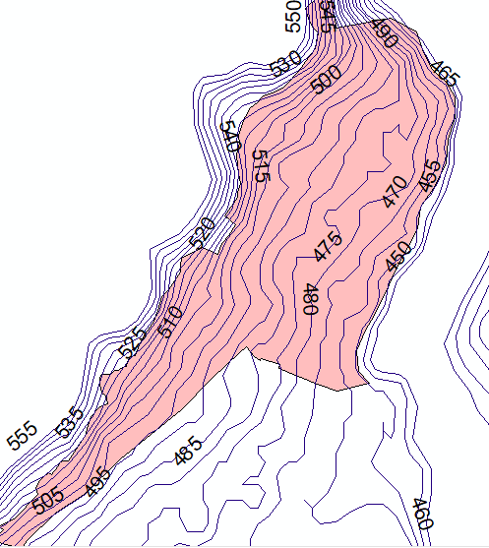
Topography :
Al Masaken al shabya is located on foothill and this make its topography mostly to be mountainous area.
Elevation Ranges from (450 to 555) m above sea level.
8

Slide 10
Location
Topography
Study area
Water resources
Population
9

Slide 11
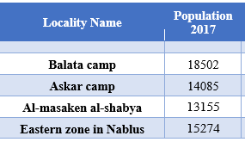
Population :
The population density of Al Masaken AL-shabya locality is 13155 person.
10

Slide 12
Location
Topography
Study area
Water resources
Population
11

Slide 13
Water Resources :
The main sources of water for A-masaken AL-shabya are Wadi AL-Bathan Well and Wadi AL-Far’a , they supply 400 m3/hr (may reach to 600 m3/hr) for Nablus city.
In summer season the demand increase so additional water will be required, Nablus Municipality bought from private wells
12

Slide 14
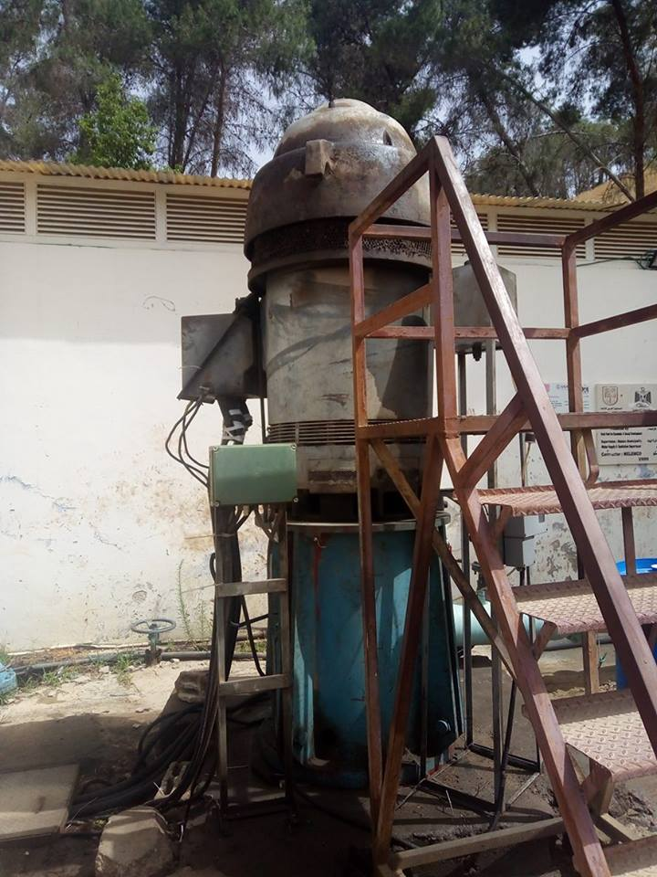
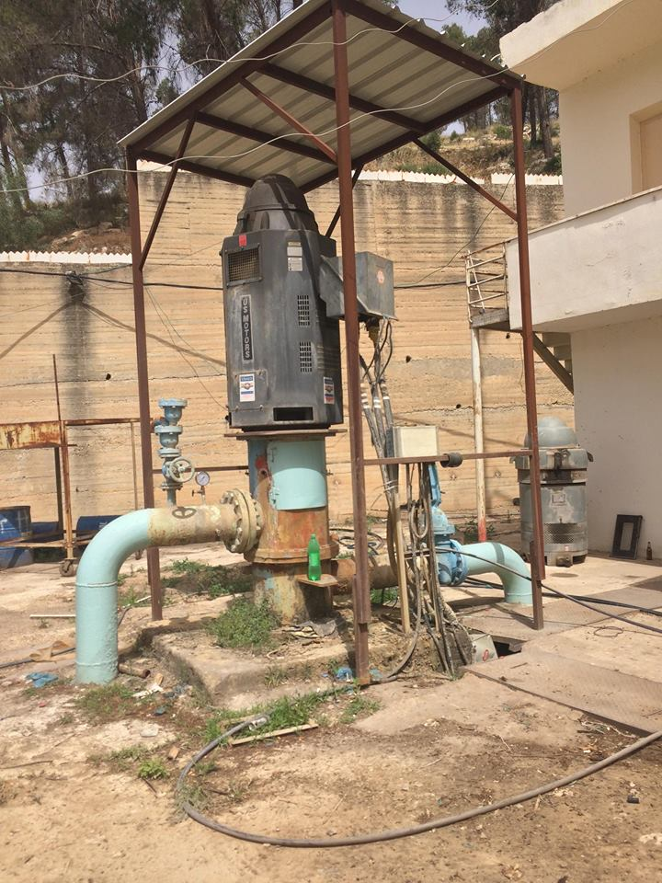
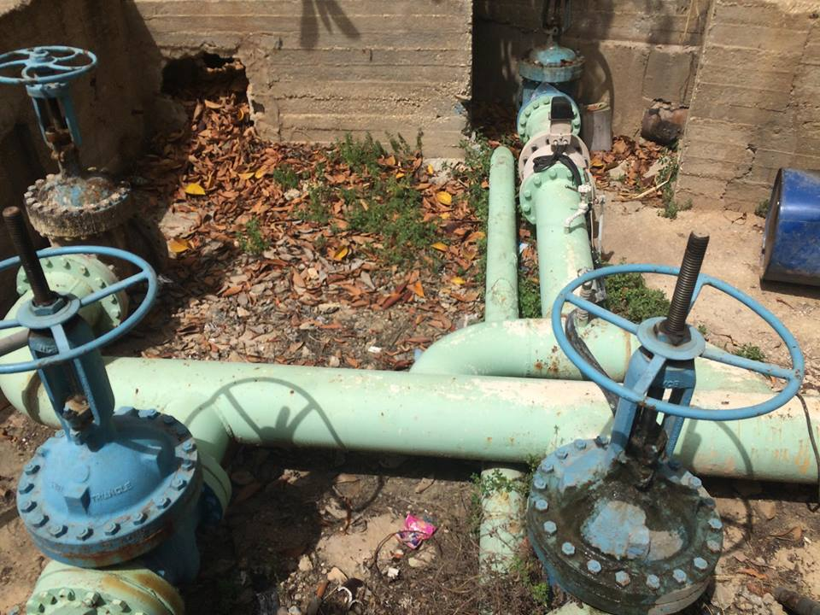
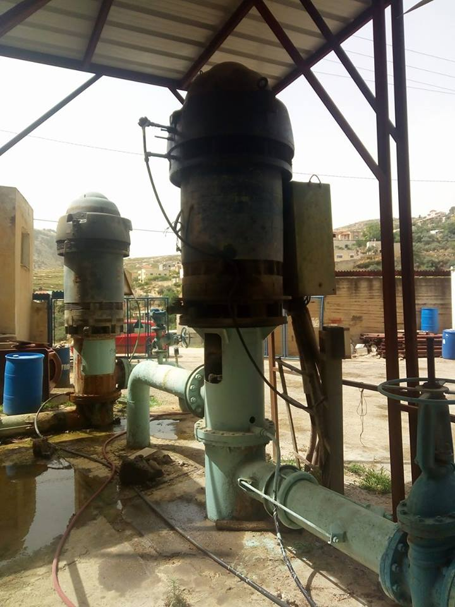
13

Slide 15
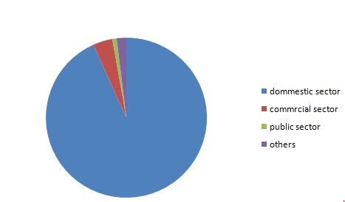
Water Consumption Type
After a visit to Nablus municipality the number of meters are 2197, they are classified as follows :
Domestic sector
Commercial sector
Public sector
Others
14

Slide 16
Domestic sector :
As shown in Figure above , the Dominant sector is the domestic sector 93% and the other sectors 6% so, this was expected because East pressure zone (Al-Masaken Alshabya) is almost a residual region.
15

Slide 17
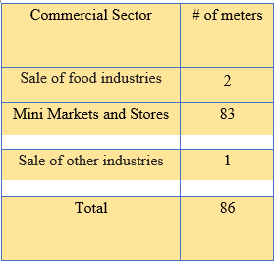
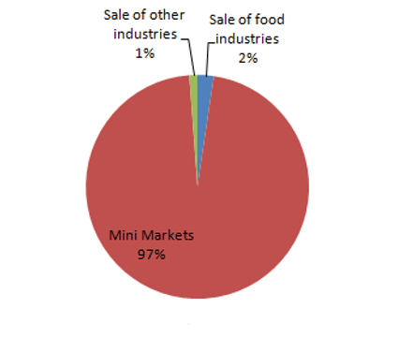
Commercial sector :
16

Slide 18
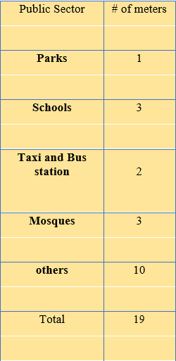
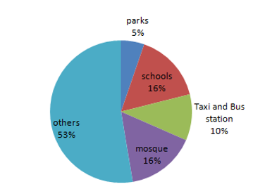
Public sector :
17

Slide 19
Others sector :
There were almost 43 meters that didn’t have any reading during the whole year and this can be explained that these meters are new and there is no consumption in them.
18

Slide 20
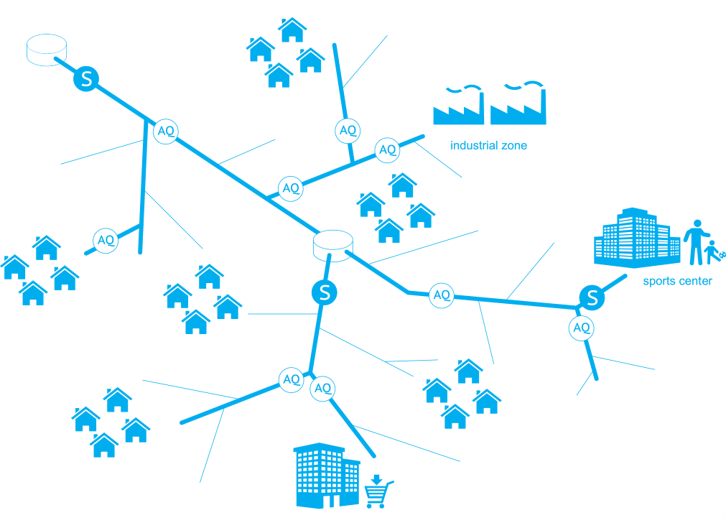
WDN Analysis:
19

Slide 21
WDN :
Design constraints:
Pressure at junction between (20-80) m.H₂O.
Velocity in pipe (0.3-3.0) m/s.
19

Slide 22
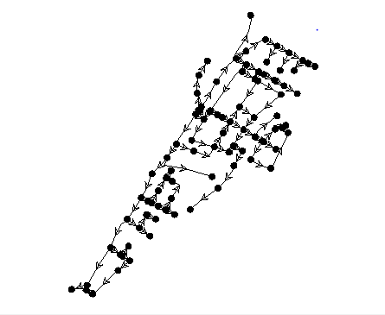
Modeling of WDN:
Element | Number or element
Reservoir | 1
pump | 2 in parallel
Nodes | 90
Pipes | 104
The elevation of the reservoir is approximately 515 m above sea mean level
20

Slide 23
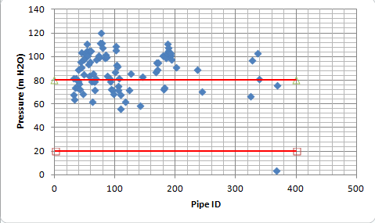
Result of analysis of WDN:
Pressure and velocity.
21

Slide 24

Design Of WDN
22

Slide 25
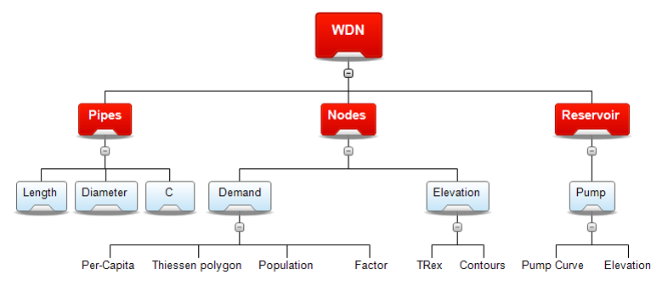
23

Slide 26
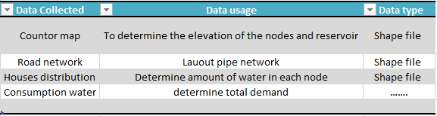
Data collection and calculation:
24

Slide 27
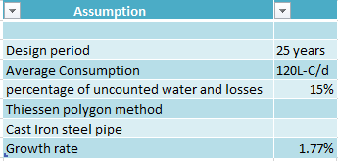
Assumptions
25

Slide 28
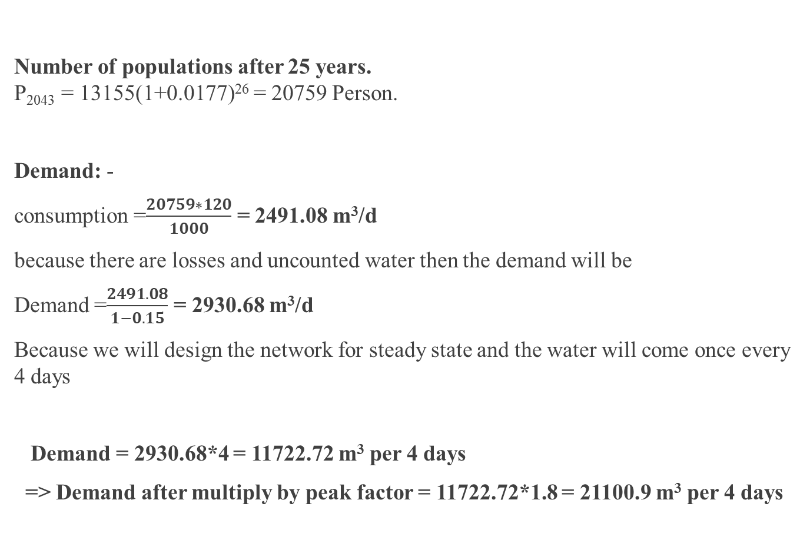
Demand Calculation
Number of populations after 25 years.
P₂₀₄₃ = 13155(1+0.0177)²⁶ = 20759 Person.
Demand: -
consumption =$\frac{20759∗120}{1000}$ = 2491.08 m³/d
because there are losses and uncounted water then the demand will be
Demand =$\frac{2491.08}{1−0.15}$ = 2930.68 m³/d
Because we will design the network for steady state and the water will come once every 4 days
Demand = 2930.68*4 = 11722.72 m³ per 4 days
=> Demand after multiply by peak factor = 11722.72*1.8 = 21100.9 m³ per 4 days
26

Slide 29
Design constraints:
Pressure at junction between (20-100) m.H₂O.
Velocity in pipe (0.3-3.0) m/s.
27

Slide 30
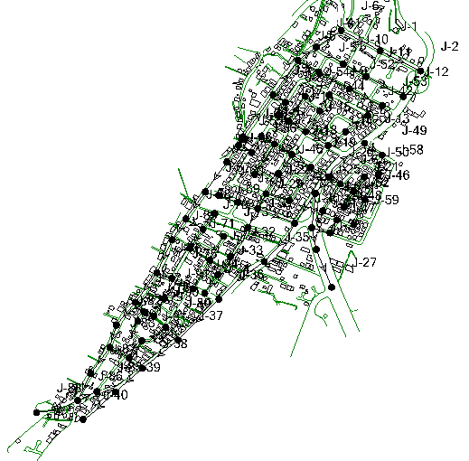
MODELING AND DESIGN
1 Reservoir
2 Pump
95 Pipes
91 Nodes
28

Slide 31
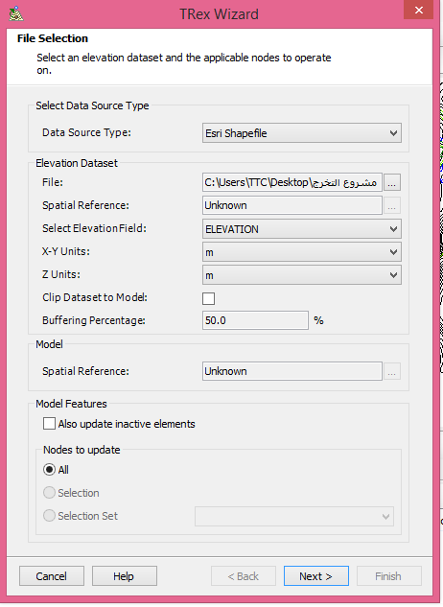
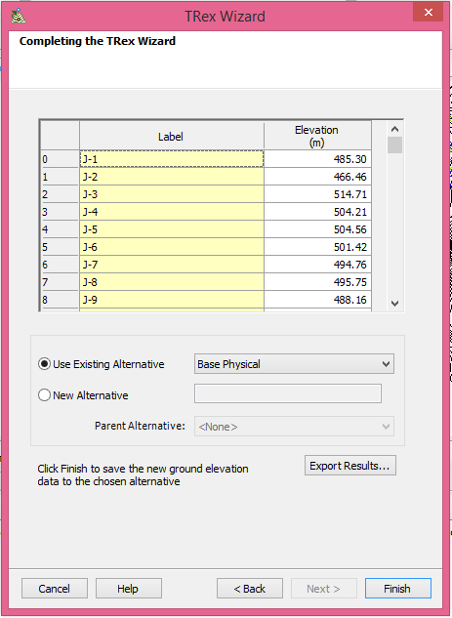
Elevation of Junctions
29

Slide 32
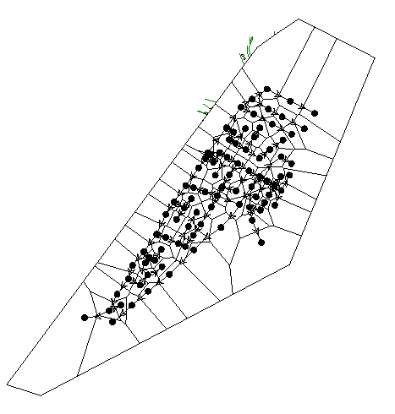
Nodal Demand
Nodal demand can be computed using a tool in WaterCAD Called Thiessen Polygon which based on distributing area on junctions
30

Slide 33
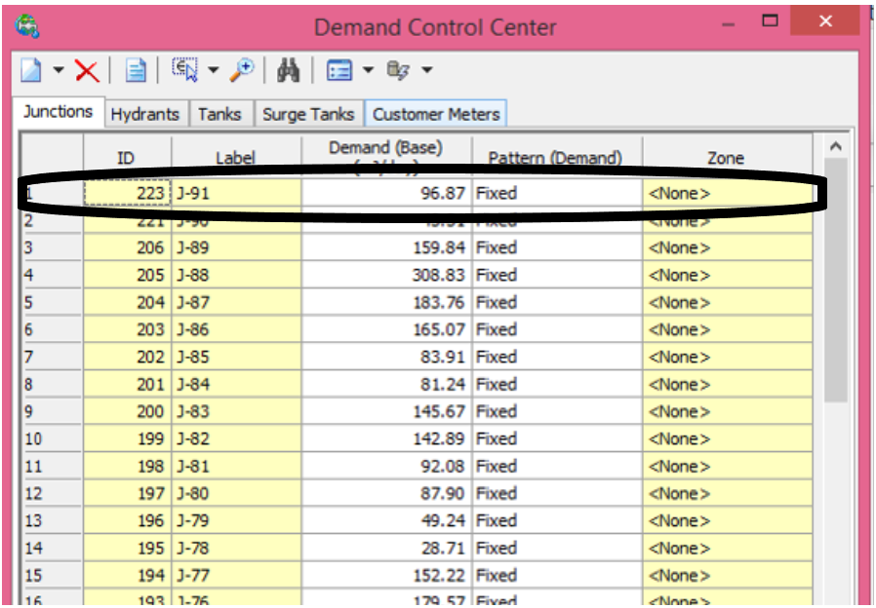
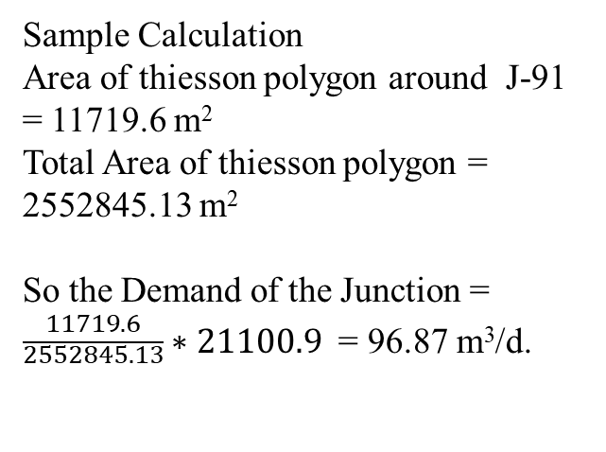
Demand Control Center
Sample Calculation
Area of thiesson polygon around J-91 = 11719.6 m²
Total Area of thiesson polygon = 2552845.13 m²
So the Demand of the Junction = $\frac{11719.6}{\begin{aligned}2552845.13 \\ \end{aligned}}∗21100.9$ = 96.87 m³/d.
31

Slide 34
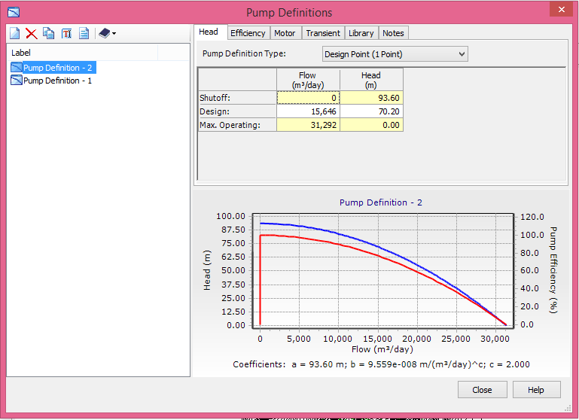
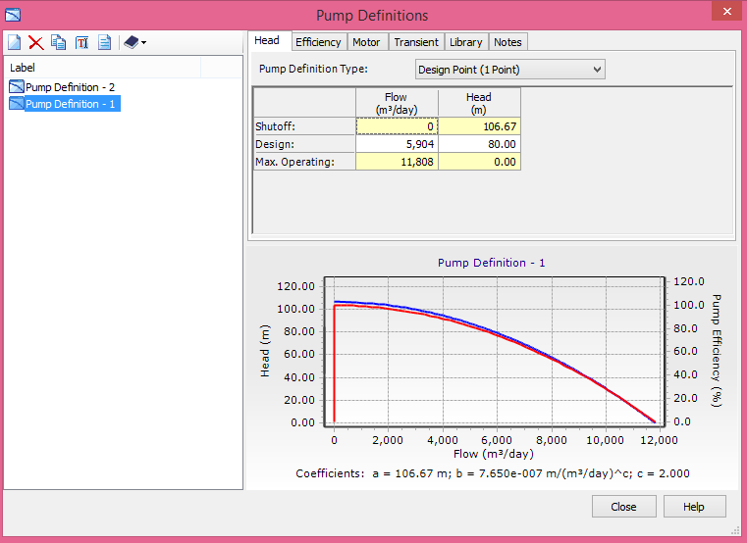
Pump Definitions
32

Slide 35
Results
33

Slide 36
Velocity(m/s)
34

Slide 37
Pressure(m)
35

Slide 38
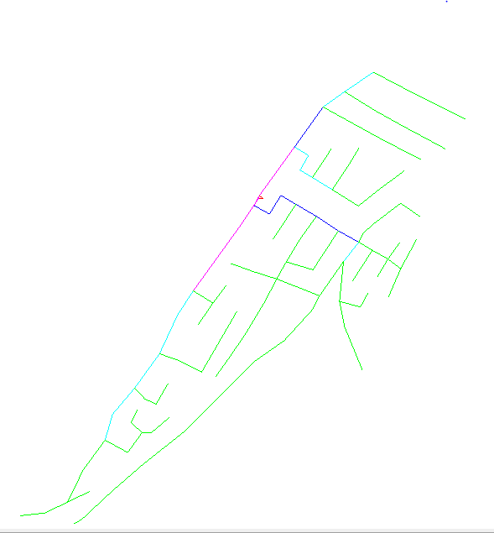
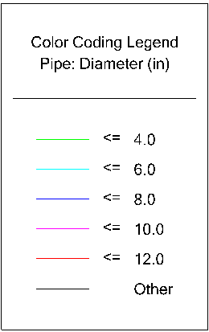
Diameter and length of Pipes
Diameter(in) | Length(m)
2 in | 2793
4 in | 5229
6 in | 1202
8 in | 649
10 in | 669
12 in | 35
36

Slide 39
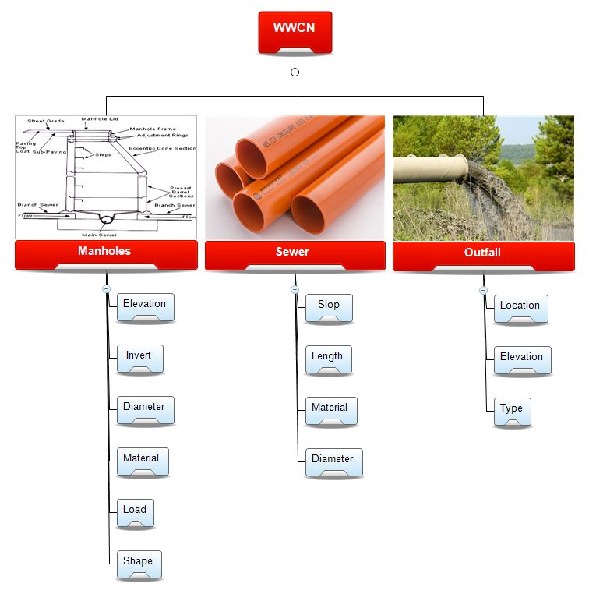
37

Slide 40
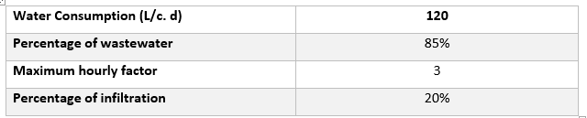
Assumptions
38

Slide 41
Wastewater generation
Each person in the town will generate about 85% of water consumption(120L/c/day).
Thus , Average wastewater generation = 0.85 * 120 * 13155/ 1000 = 1341.81 m³/day
Peak wastewater generation = Pf * Average wastewater generation
Where :
Pf : Peak factor = 14* {(Population in thousands)^(-1/6)} = 14 * (13155)^(-1/6) = 2.8….will take it = 3
The design flow rate = ((13155*(1+0.0177)^25)*0.85*120)*3+13155*(1+0.0177)^25)120*0.2=7293 m³/day
39

Slide 42
Design criteria
The velocity : (0.6 – 3 m/sec)
The cover : (0.8-6m)
The slope : (1-15%)
The Maximum distance between manholes is (30m)
40

Slide 43
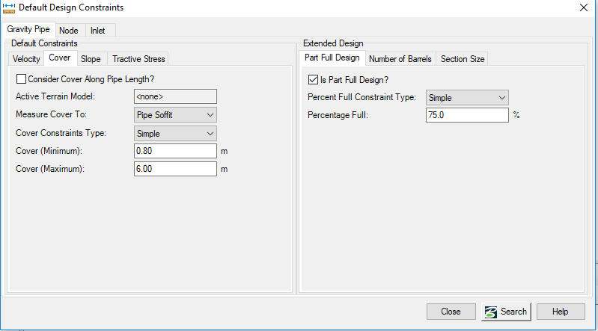
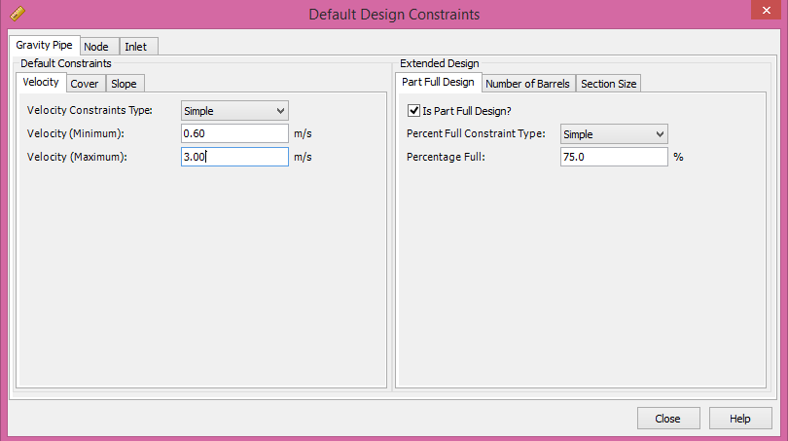
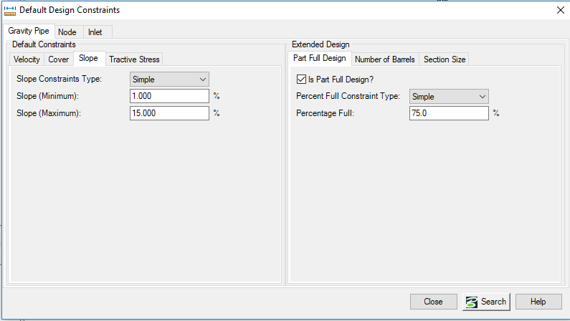
Design constrain
41

Slide 44
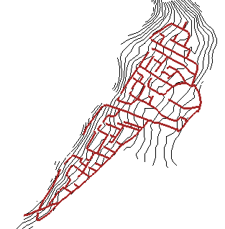
MODELING AND DESIGN
42

Slide 45
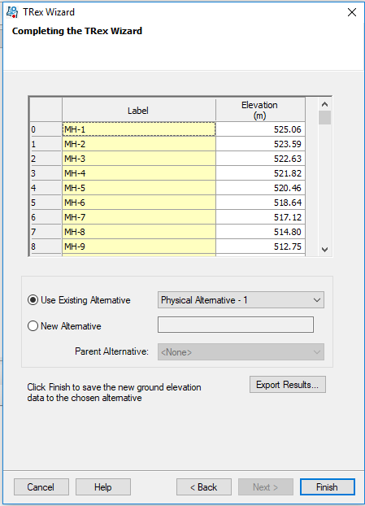
Elevation of Manholes
43

Slide 46
Location & Connecting Manhole
Before starting the design we should consider that the manholes must be located at the roads networks wherever there is:
An intersection.
Change in slop.
Change in direction.
Change in Diameter
Maximum distance of (30) m.
44

Slide 47
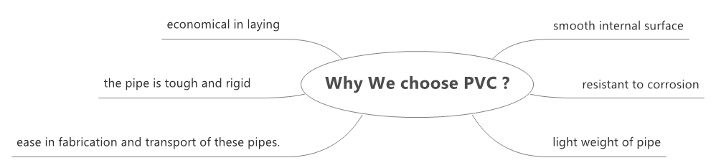
Choosing the PVC conduits
45

Slide 48
Loads on manholes
The loads on the manholes must be calculated based on the number of the houses that are connected to each manhole.
Each Building has Two Stories , each story has two apartments
Family Size which is 4.8
Sample Calculation:
Number of building at MH-5 equals 2, so population is 38 capita
Load on MH-5=(38*120*0.85*3/1000)+(0.2*0.85*38*120/1000) =12.4 m³/day
Load on MH-5 after 25 years = 19.8 m³/day
46

Slide 49
Results
47

Slide 50
Velocity(m/s)
48

Slide 51
Slope (%)
49

Slide 52
Cover(m)
50

Slide 53
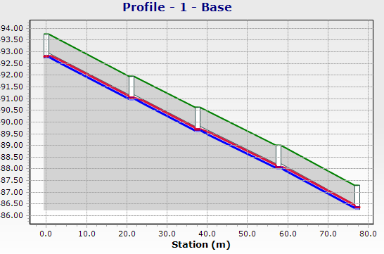
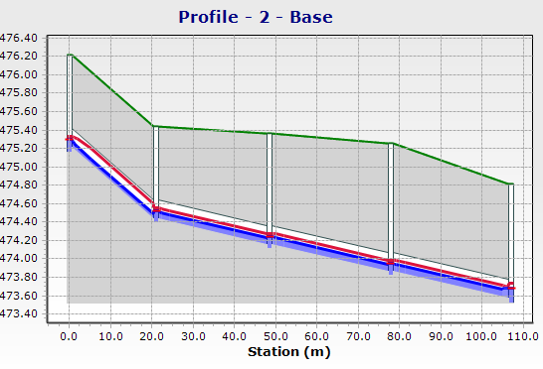
Profile
51

Slide 54
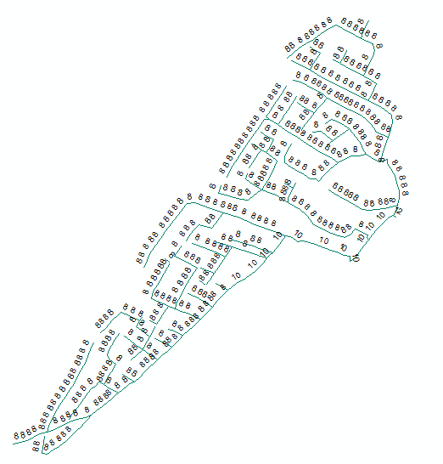
Diameter and length of Conduits
Diameters(inch) | # of conduits | Total length(m)
8 | 473 | 11798.3
10 | 34 | 807
12 | 1 | 15.1
Total | 508 | 12620.4
52

Slide 55

Cost of the new networks
53

Slide 56
Activities:
Excavation
Pipes/Conduits
Activities
Manholes
Backfill
54

Slide 57
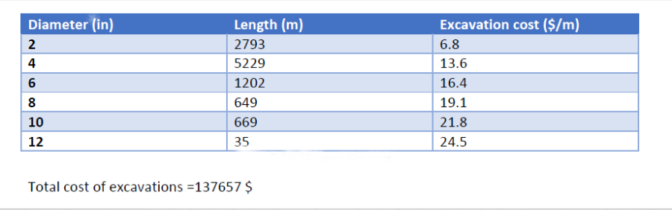
WDN Cost
Excavation Cost:
The Cost Of Excavation depends on the length, depth and the width of excavation.
55

Slide 58
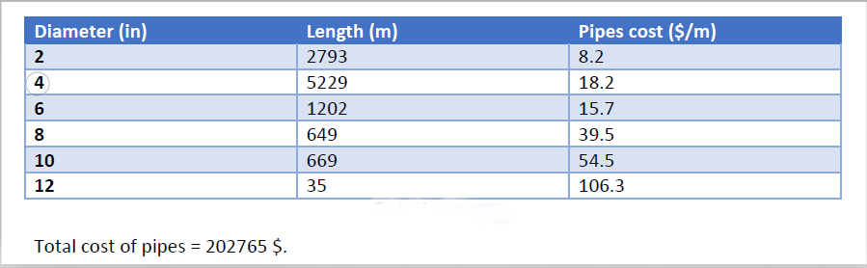
WDN Cost
Pipes Cost:
The Cost Of Pipes depends on the length, Diameter and material of pipes.
56

Slide 59
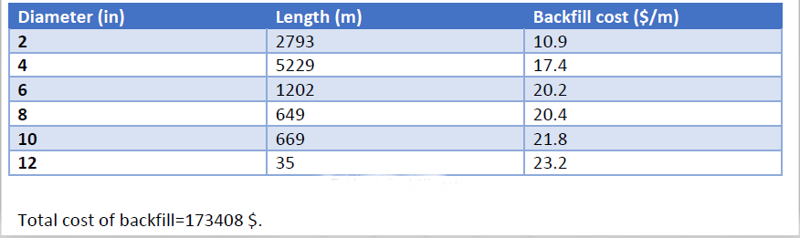
WDN Cost
Backfill Cost:
57

Slide 60
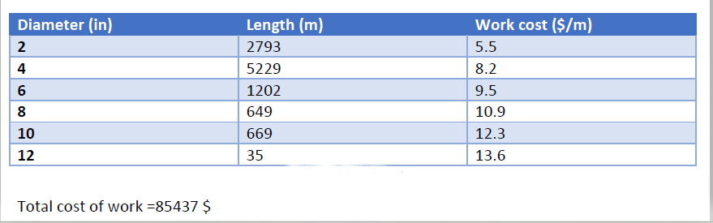
WDN Cost
Working Cost:
58

Slide 61
WWCN Cost
Excavation Cost:
The Cost Of Excavation depends on the length, depth and the width of excavation.
The length of excavation is equal to the length of pipes.
Width of excavation is equal (D+50 cm).
Excavation depth is equal to (average cover + diameter of pipe +20 cm of base coarse).
Cost of excavation for m3 is 12 $.
Total cost of excavations for pipes = 266008$.
59

Slide 62
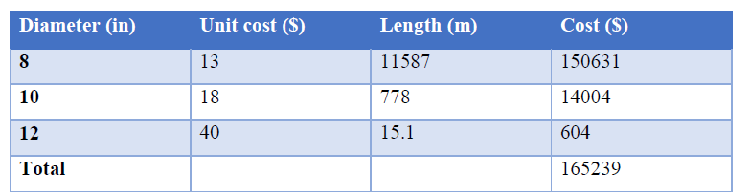
WWCN Cost
Conduits Cost:
The cost of pipes calculated in linear meter, it depends on the length, diameter, and material of pipes.
The material of pipes is PVC.
The total cost of Conduits is = 165239 $.
60

Slide 63
WWCN Cost
Base coarse Cost:
Length of the network is 12380 m.
The depth of base coarse layer is 0.15 m.
Width of trench is 0.70 m.
Unit price for m3 is 17 $.
Total cost of base coarse = 12380*0.15*0.70* 17 = 22098 $.
61

Slide 64
WWCN Cost
Sand Cost:
Depth of sand under Conduit is 0.15 m.
Depth of sand above Conduit is 0.20 m.
Depth of sand in each side is 0.20 m
Width of sand at each side is 0.25 m.
Unit price for m3 is 57 $.
Total cost of sand = 243453$
62

Slide 65
WWCN Cost
Backfill Cost:
Length of network is 12380 m.
Unit price is 19 $ /m3.
Volume of backfill = volume of excavation – volume of Conduits – volume of base coarse
volume of sand.
Total cost of backfill = 16180*19 =307420 $.
63

Slide 66
WWCN Cost
Re-paving Cost:
Length of the network is 12380 m.
Unit price for linear meter is 27 $.
Total cost = 334260$
64

Slide 67
WWCN Cost
Manhole Cost:
Cost of base is 150 $/unit.
Cost of ring is 115 $/unit.
Cost of cover is 120 $/unit.
Total cost = 196350$.
65

Slide 68

Total Cost of the networks
The Total cost of WDN = 599,267$
The Total cost of WWCN = 1,534,825 $
66

Slide 69
Discussion and conclusion:
Intermittent water supply in Nablus city caused by unavailability of enough water recourses due to Israelis restrictions to use water resources
The high losses in water which equal on average .535 % can be attributed to the old and week pipes and connections beside the meter losses. Updating the old pipes, replacing faulty meters and pursuing black losses will help in loss reduction
Domestic water consumption calculations show that consumption in current time equals 78 L/capita . day which is nearly equal to 74 L/capita. day given from Nablus Municipality, that gives an indication of how results meet the real situation
67

Slide 70
The velocity in pipes and conduits is within the range
The pressure at all nodes fall within the range.
The diameter of pipes varies between (2-12) in for WDN and 8,10 and 12 in for WWCN.
68

Slide 71
We recommended to use a PVC and circular sewer pipe because it has many advantages like Light, durable, resistant (inert material), easy and fast installation. Larger diameters require special reinforcement to carry the load above (traffic and fill materials)
69

Slide 72


