Slide 1
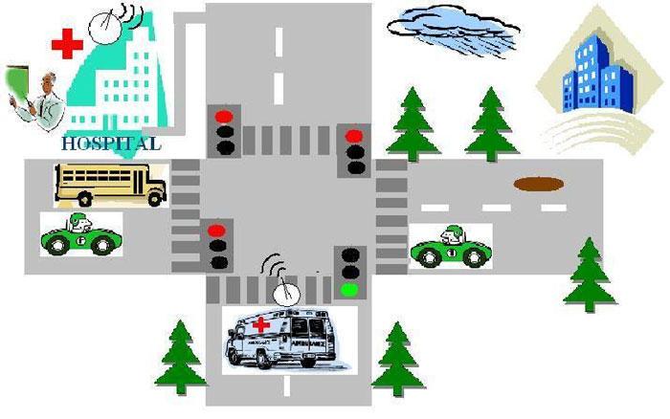
Emergency Smart Traffic Management based on WIFI Technology
Submitted by:
Batool Lahloh & Samah Nassar
Supervised by :
Dr. Saed Tarapiah

Slide 2
system over view
The system depends on bluetooth technology which is going to be used as follow :
Each emergency vehicle driver has a phone with a traffic control application.
traffic Lights will connect to a Arduino kit that is connected to a Bluetooth device that receives commands from the driver's side.

Slide 3
Literature Review
RFID:
Each individual vehicle is equipped with (RFID) tag (placed at a strategic location). We use RFID reader to read the RFID tag attached to the vehicle. It counts number of vehicles that passes on a particular path during a specified duration. It also determines the network congestion, and hence the green light duration for that path. In addition, when an ambulance is approaching the junction, it will communicate to the traffic controller in the junction to turn ON the green light.
it is more expensive than Bluetooth systems, Interference has been observed when devices such as walkie-talkies are in the area .

Slide 4
Literature Review
Cellular telephone system:
The cellular communication system determines the location of the emergency vehicle, and relays the location to the traffic planner. The traffic planner, in turn, controls the traffic lights to clear the traffic along the route traveled by the emergency vehicle.
It is complicated and needs an infrastructure for the project and its cost is high compared to Bluetooth technology.

Slide 5
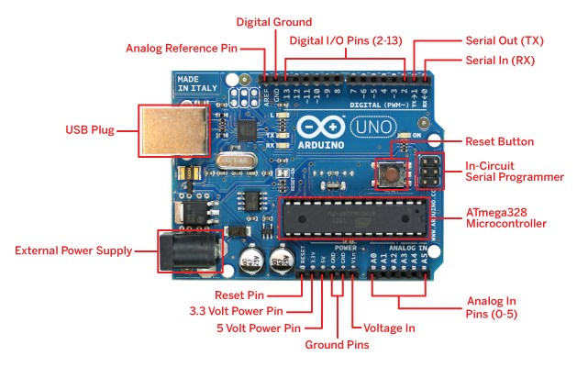
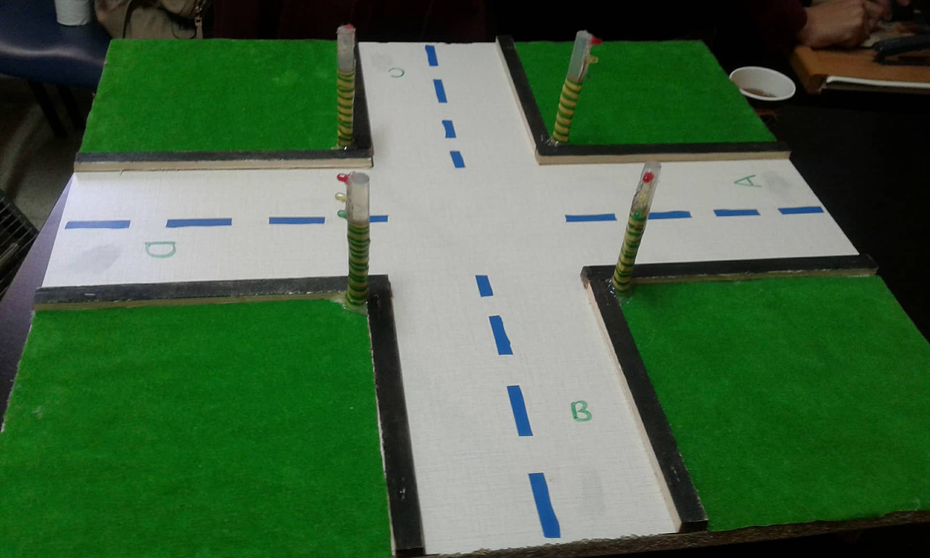
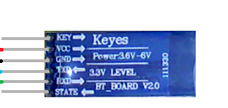
System Hardware Components:
Arduino Uno
Traffic light system:
Bluetooth device

Slide 6
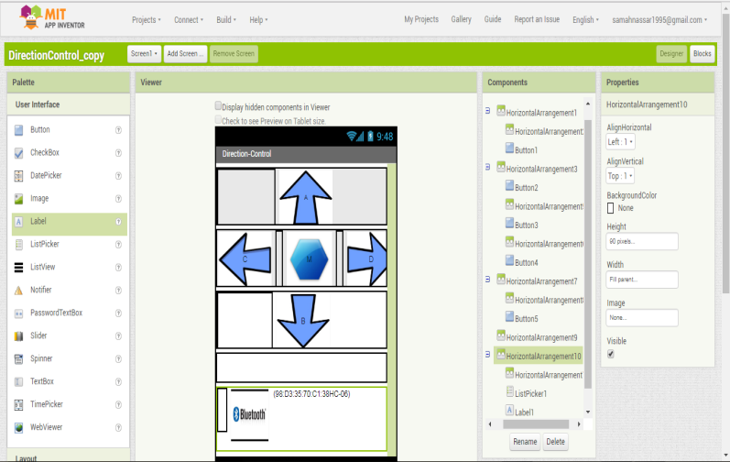
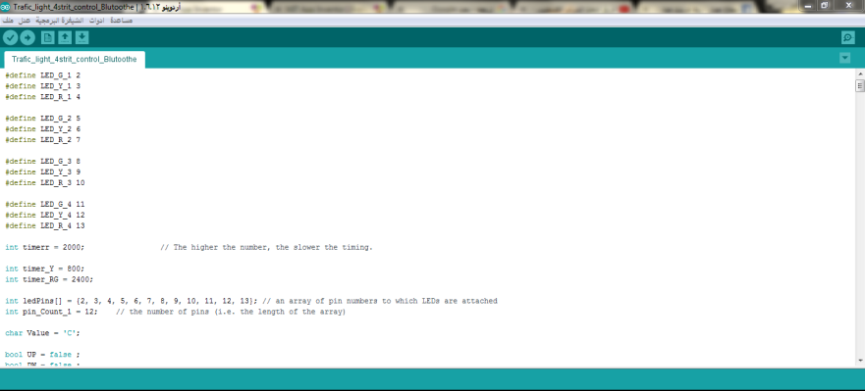
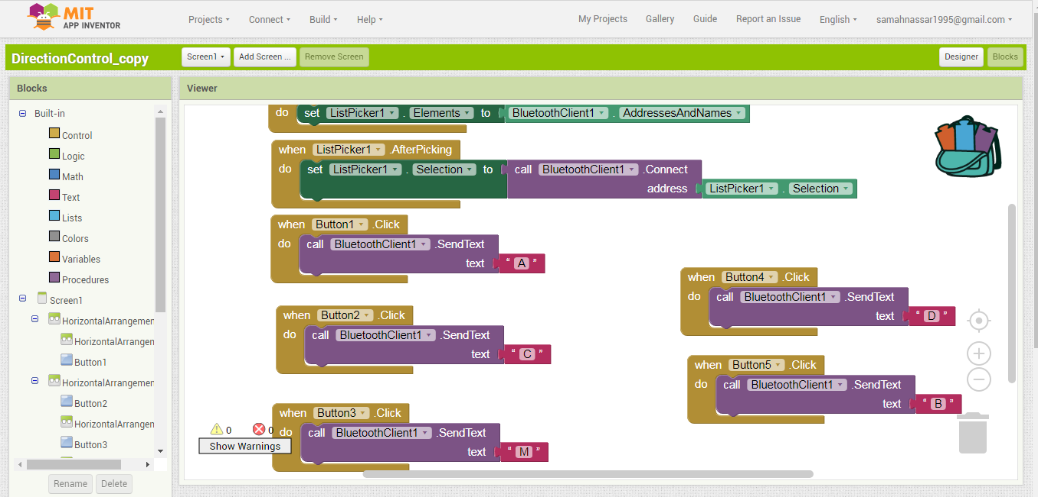
System Software Components:
MIT App Inventor
Arduino program

Slide 7
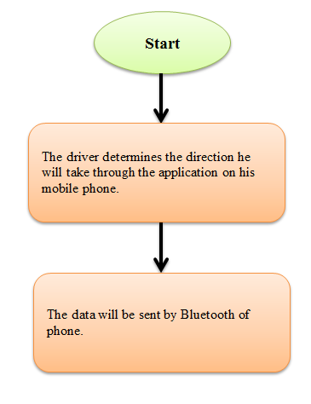
sequence of system functionalities
vehicle’s side:

Slide 8
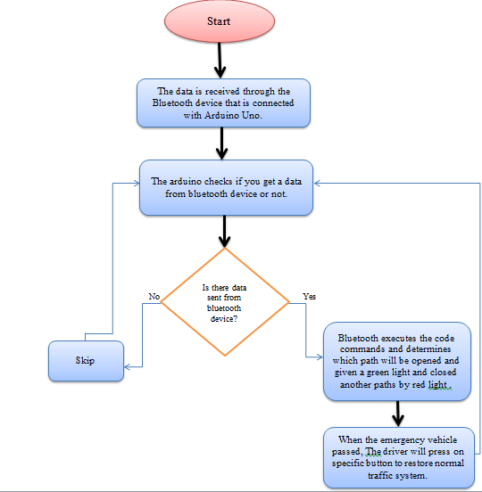
sequence of system functionalities
On Traffic light
side:

Slide 9
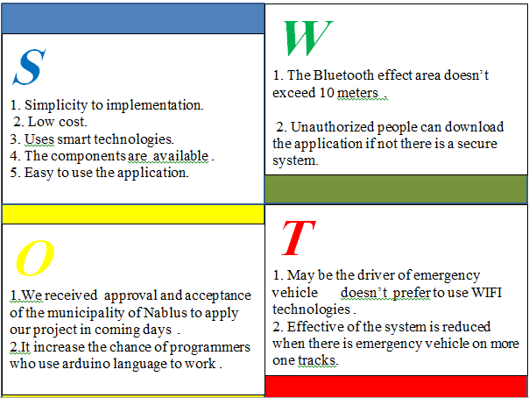
SWOT analysis:

Slide 10
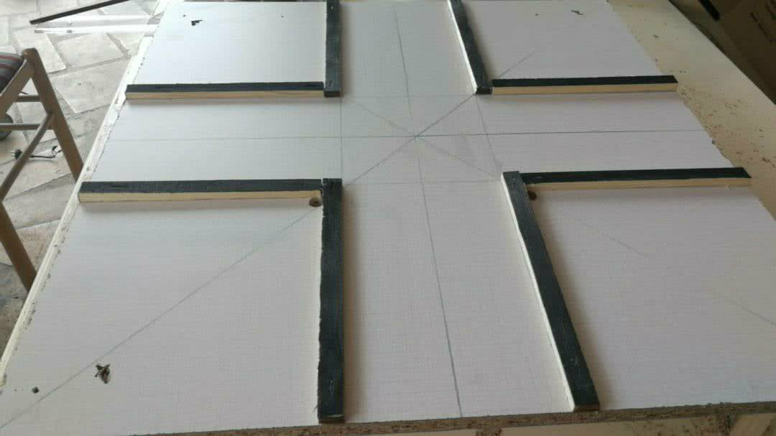
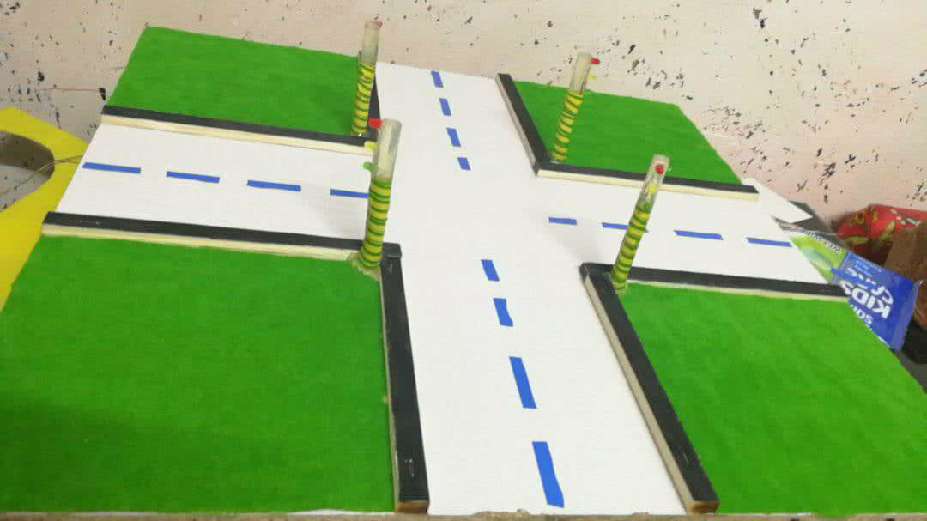
Steps to design the model:
1-Basic design of the intersection of roads.
2-Arduino connections with Bluetooth piece and traffic lights.

Slide 11
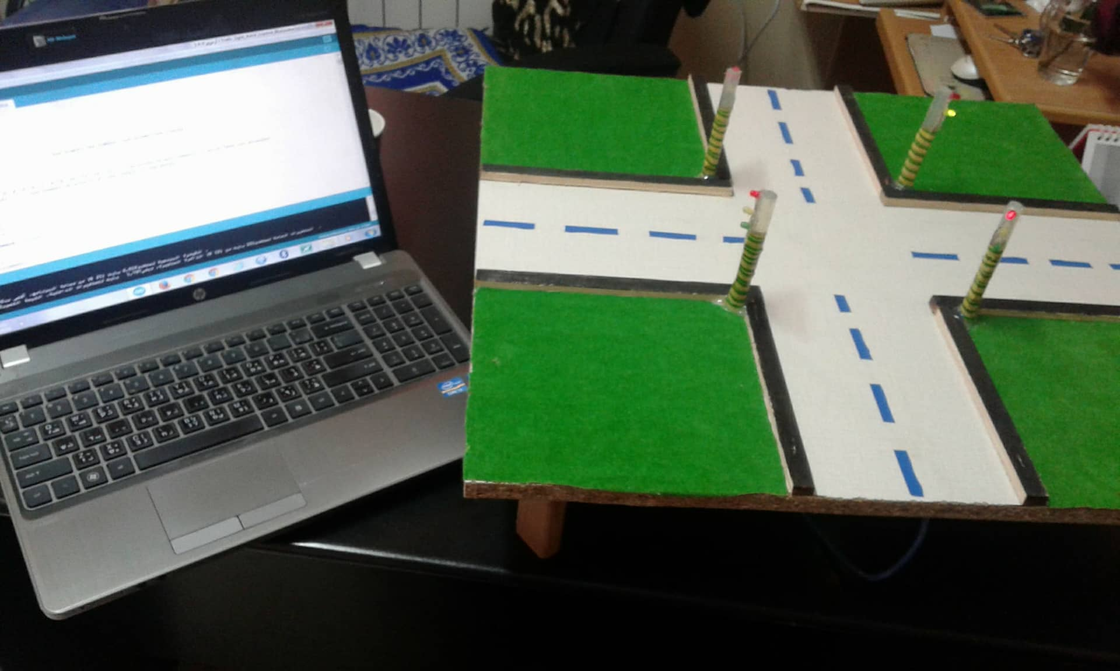
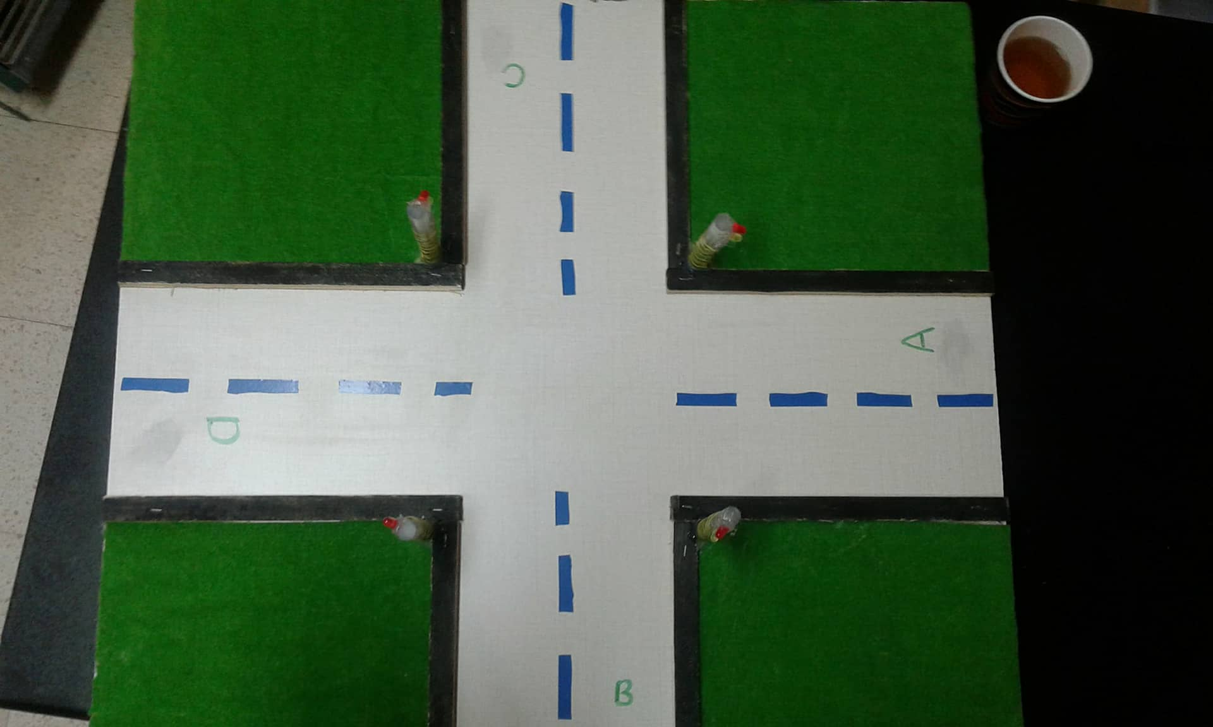
Steps to design the model:
3-Download the code on the kit of arduino and make sure the application works correctly.
4-Make some adjustments to make the model work correctly .

Slide 12
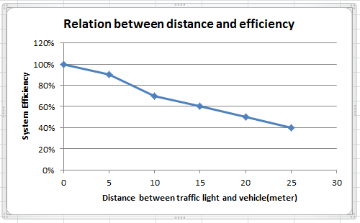
Notes and observations:
We have noticed that the system is less efficient whenever the location of the emergency car away from the traffic signal and this is disadvantages of using Bluetooth technology in this project.

Slide 13
Thank you

