Slide 1
Livesmart

Slide 2
Livesmart

Slide 3
Livesmart
Solar Pannel System
Save the converted electricity into lithium rechargeable battery
Rain Detection System
Due to rain detection it will be pulled
Irrigation System
Sense dry plants and irrigate them automatically

Slide 4
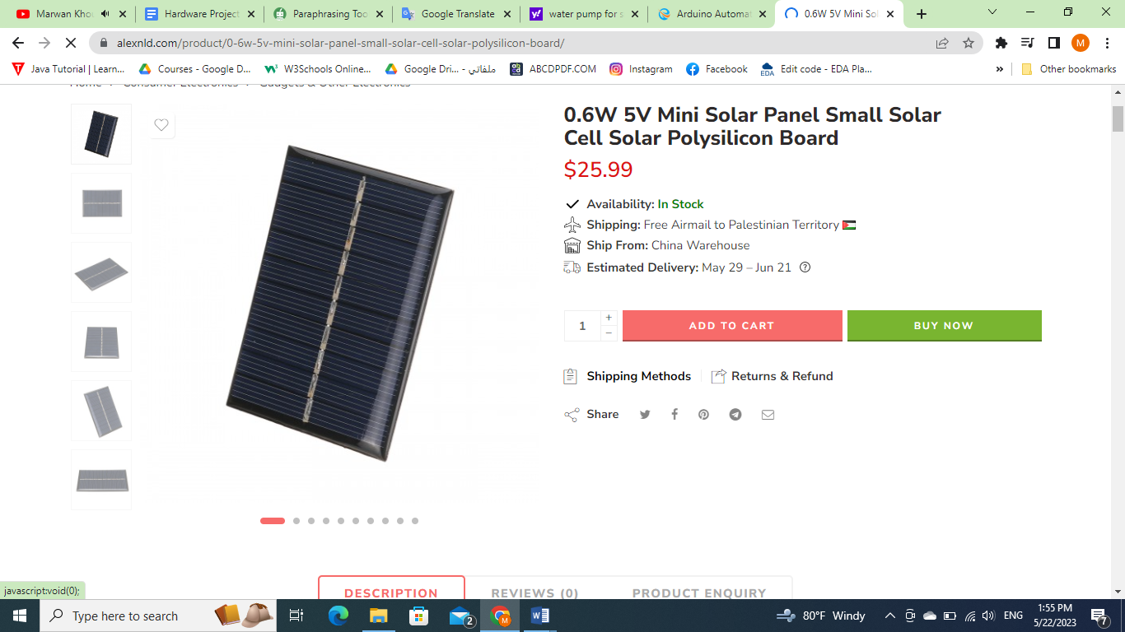
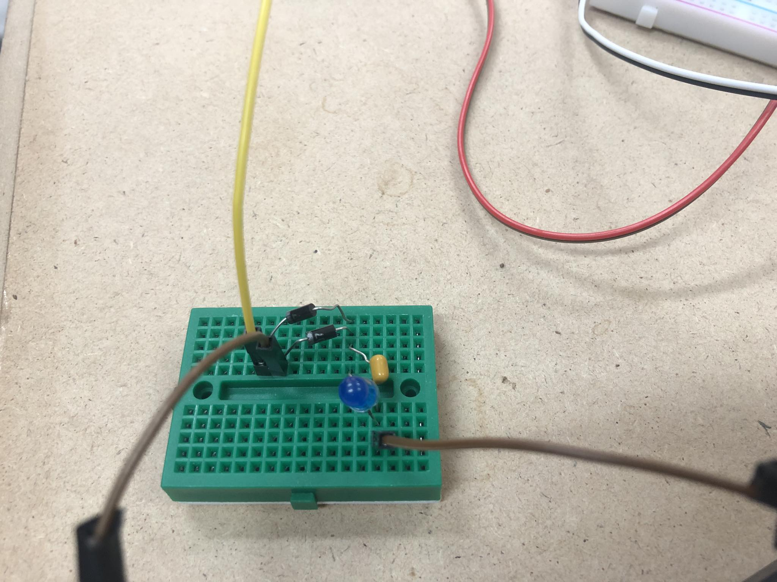
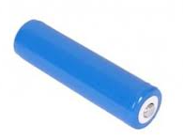
Solar Panel System
Sun
Lights
Solar Pannel
Rechargable Battries

Slide 5
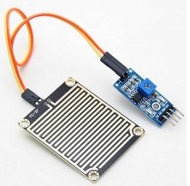
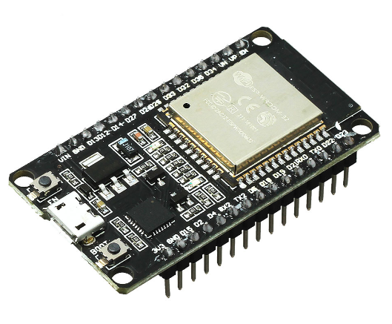
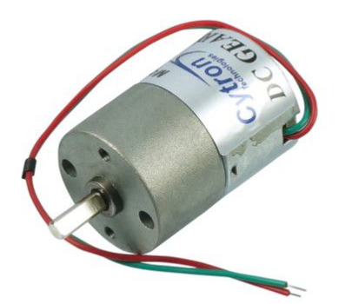
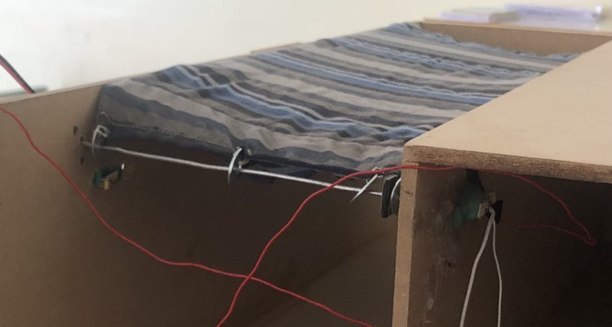
Rain Detection System
Rain Sensor
ESP
DC motor & Switch
Umbrella
ll
ll
ll
ll

Slide 6
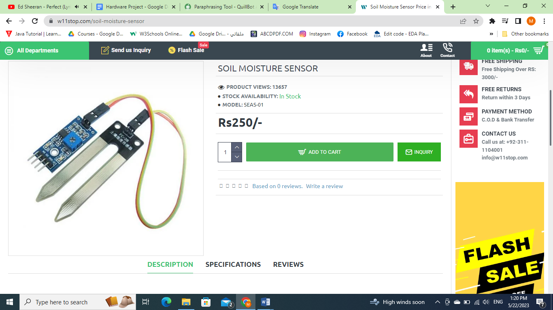
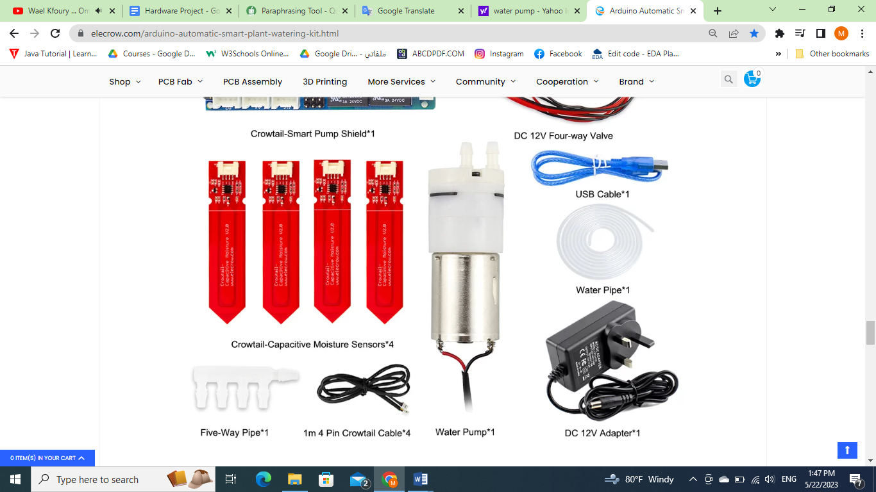
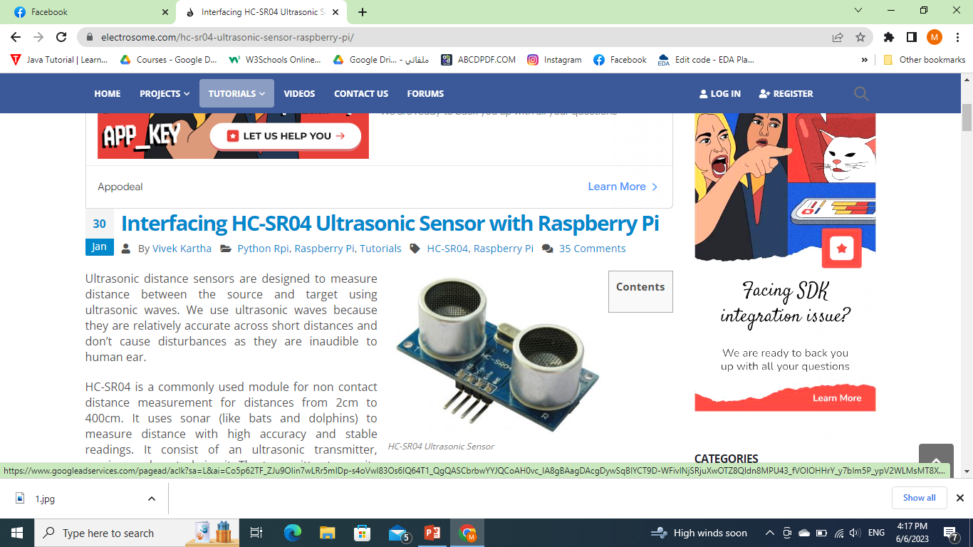
Irregation System
Water Pump
Soil moisture sensor
Plants
Ultrasonic Sensor

Slide 7
Livesmart
Solar Pannel System
Rain Detection System
Irrigation System
Google

Slide 8
Constraints
Inexperience of mechanical parts
Time Limitation
Problems in the way
ESP Sensetivity
Israeli Occupation

Slide 9
Future Work
Renewable Energy System
Smart Well

Slide 10
Thanks

