Slide 1

An-Najah National University
Faculty of Engineering & Information Technology
Energy and Environment Department
Hybrid Systems
“Economic and Technical Analysis of a Grid-Connected Photovoltaic System and Battery Energy Storage System”
Supervised by:
Dr. Aysar Yasin
Prepared by:
Hasan Dawod

Slide 2
01
Overview
Outlines
02
Objective
03
Methodology
04
Case Study
05
Results

Slide 3
Overview
System Capacity
Optimal Operation State
System Control
Peak Time
Operating Time
Highest Cost
Economically Feasible

Slide 4
Objective
Studying several cases to achieve the best operating state;
And the more feasibility state.

Slide 5
START
Methodology
Set PV-BES system power rates
Read hourly data
Irradiation, Temperature, Load
Calculate the PV system hourly energy production
EA,h
No
No
EA,h > EL,h ? SOCB,h > KB-min ?
Yes
Yes
Supply the energy demand EA,h
Discharge BES system and supply the energy demand EB,h
No
Charge BES system
No
E_{L,h} > 0 ?
SOCB,h = KB-max ?
Yes
Yes
No
Energy still available ?
Yes
Sell the energy surplus to the grid
Purchase the energy from the grid EG,h
END

Slide 6
Methodology
Scenario 1
On grid system
Maximum storage capacity
Scenario 2
The storage system operates at evening
Scenario 3
The storage system works at peak time
Financial analysis
Electricity costs

Slide 7
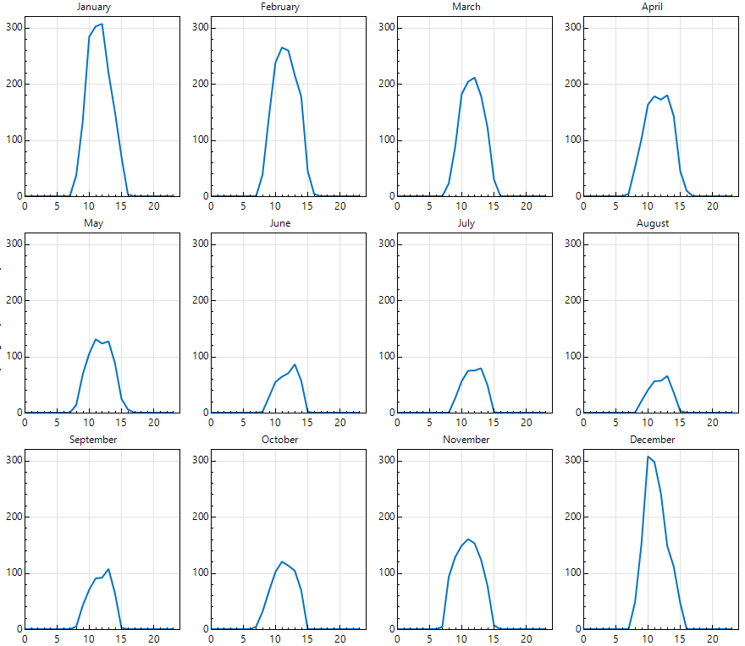
Case Study
Electricity that transfers to grid from scenario 1 [kW].
Time (hr.) | Electricity in August [kW]
9:00am | 20
10:00am | 40
11:00am | 58
12:00pm | 58
1:00pm | 70
2:00pm | 35
3:00pm | 5

Slide 8
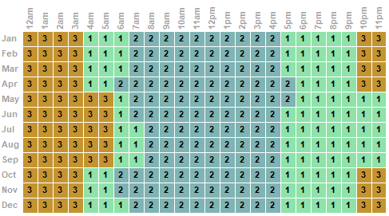
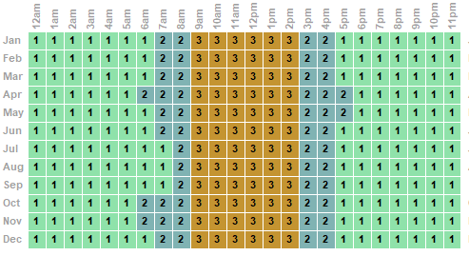
Case Study
Scenario 2
Scenario 3

Slide 9
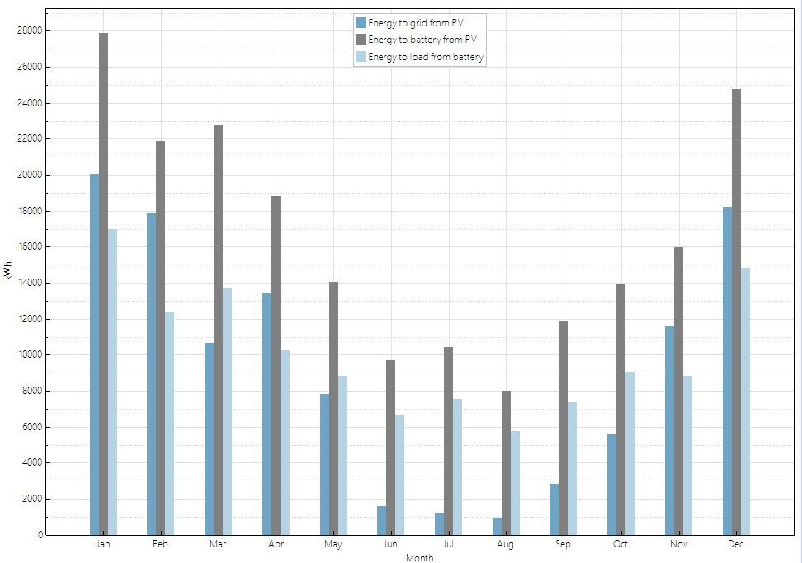
Results

Slide 10
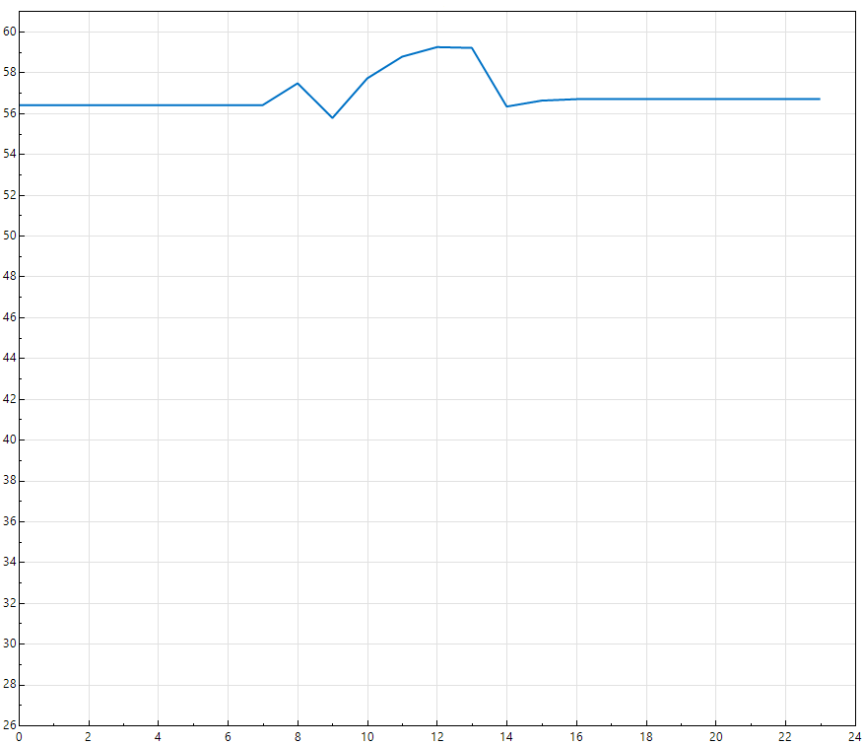
Results
Battery state of charge for the third scenario.
SOC [%]
Hour

Slide 11
Results
Period 1, the system is not working.
Period 2, sells the electricity according to PPA.
Period 3, 10% higher than the PPA cost, at peak time.
Period 4, 15% higher than the PPA cost, when the batteries are working.
Period 5, for the third scenario when the batteries and PV are supplying electricity.
Period | Charge ($/kWh)
1 | 0
2 | 0.145
3 | 0.16
4 | 0.167
5 | 0.327

Slide 12
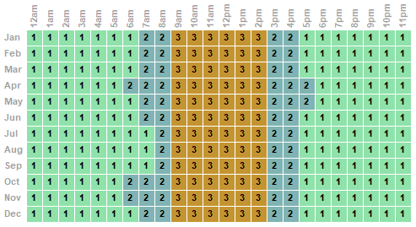
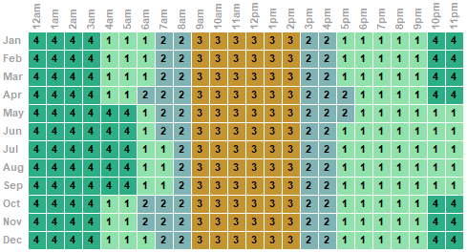
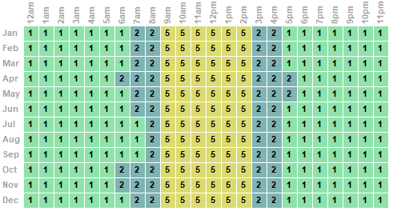
Results
Scenario 1
Scenario 2
Scenario 3

Slide 13
Results

Slide 14
Results
Scenario 3 achieves the highest financial parameters.
Despite the LCOE for Scenario 1.
Scenario 2 also achieves good economic indications.
Scenario | Annual Energy Production [kWh] | Net Capital Cost [$] | Annual Worth [$] | Net Present Value [$] | SPP [year] | IRR | LCOE [$/kWh]
Scenario 1 | 2,807,312 | $1,423,710 | $479,154 | $3,193,164 | 2.3 | 35% | 0.0365
Scenario 2 | 2,808,975 | $1,616,896 | $470,207 | $2,887,778 | 2.6 | 31% | 0.044
Scenario 3 | 2,809,182 | $1,616,896 | $847,638 | $6,352,127 | 1.5 | 52% | 0.044

Slide 15
Thank You

