Slide 1
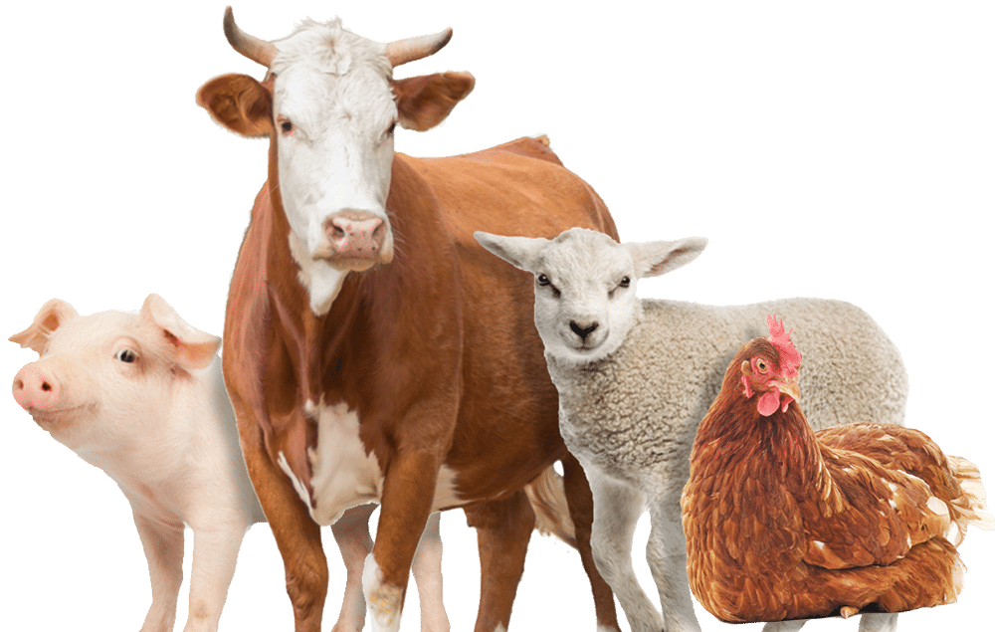
Our Farm

Slide 2
What is Our Farm?
Our Farm is a model for animals farm, which will facilitate animal welfare using new technology which will reduce farmer’s dealing with animals and provide good conditions for animals to grow up healthy and get high quality of animals products

Slide 3
Our Farm Objectives
Reducing human intervention on the farm.
Providing a suitable environment which will help in growing animals up
Keeping barn clean and healthy
Organizing feeding process.
Reducing farm workers.
Make it easier to take care of animals

Slide 4
Our Farm Features
Environment controlling System.
Cleaning Robot.
Feeding System.

Slide 5
Technologies used in Our Farm
IOT
MQTT Protocol

Slide 6
IoT
The internet of things is the concept of connecting devices and exchange data between them through the internet.

Slide 7
MQTT protocol
MQTT is stand for Message Queuing Telemetry Transport.
MQTT is a simple messaging protocol where it is a publish subscribing message protocol
This protocol runs over TCP/IP

Slide 8
MQTT protocol
Publish/Subscribe
Messages
Topics
Broker

Slide 9
Constraints:
Getting to the right structure took a long time.
Many courses which are related to hardware because of locking and online learning there project move to be simulated which reduce dealing with hardware before this project.
Working with sensitive component such as Esp8266 that heating up fast.

Slide 10
Future Work:
For the near future we are thinking of Inspecting the vital factors of the animal.
Linking the GPS pieces with the animal so that its location is known if it leaves.
Development of the security system.
Rebuild a powerful website and mobile application which will be more user friendly

Slide 11
Demo

Slide 12
Thank You

