Slide 1
Study of Slope Stability And Soil failure at Nablus Al-Bathan Road
(Station 2+100)
Mustafa Hamd
Ali Khalil
Mohammad Sholy
Under supervision of: Dr. Sami A. Hijjawi

Slide 2
outline
Introduction (Review of Graduation Project I)
Mythology (Data collected, Constrains)
Design of Sheet Pile System
Design of Hybrid System (Bridging & Sheet Pile)
General Conclusion & Recommendations

Slide 3
Introduction
Landslide is a global issue.
Landslides in Palestine.
Slope instability at Nablus Al-Bathan Road
{ study of GMT , study of CTRU }
Methods of slope stabilization and repair
Drainage, Excavation, Retaining Structures, Reinforcing Piles, Bridging, Removal and Replacement of the Sliding Mass

Slide 4
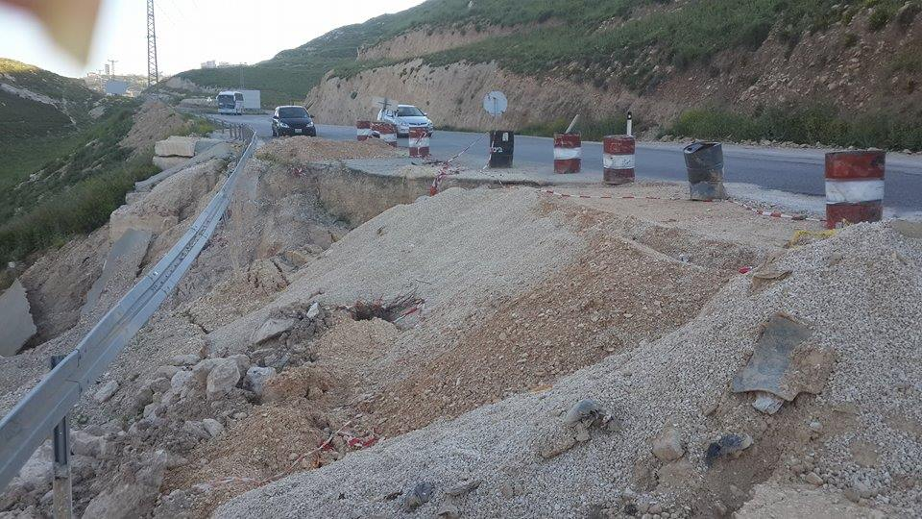
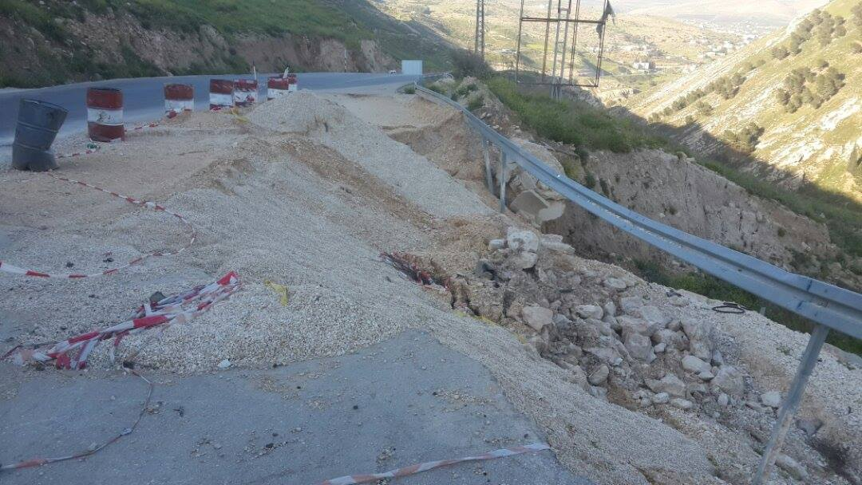
SITE VISIT

Slide 5
Mythology
(Data SOURCES, Constrains)
DATA SOURCES
constrains
GMT REPORT
AASHTO
University
Assumed Data
Lack of geotechnical information
(2 Boreholes only)
The uncertainty in these geotechnical data
An unavailability of traffic data for this road.

Slide 6
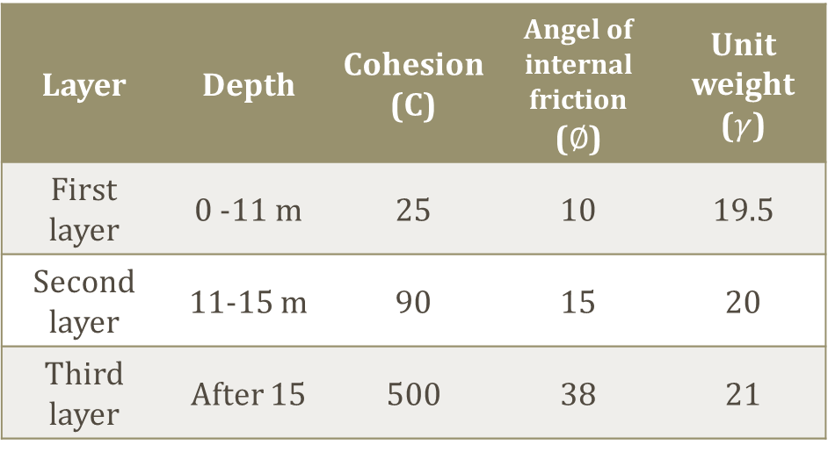
Mythology (Gmt report)
Soil Properties from GMT Report:
Three Layer's
Shear surface from (10-13)m
we take it 13m (conservative).
Unit weight ($γ$) | Angel of internal friction ($∅$) | Cohesion (C) | Depth | Layer
19.5 | 10 | 25 | 0 -11 m | First layer
20 | 15 | 90 | 11-15 m | Second layer
21 | 38 | 500 | After 15 | Third layer

Slide 7
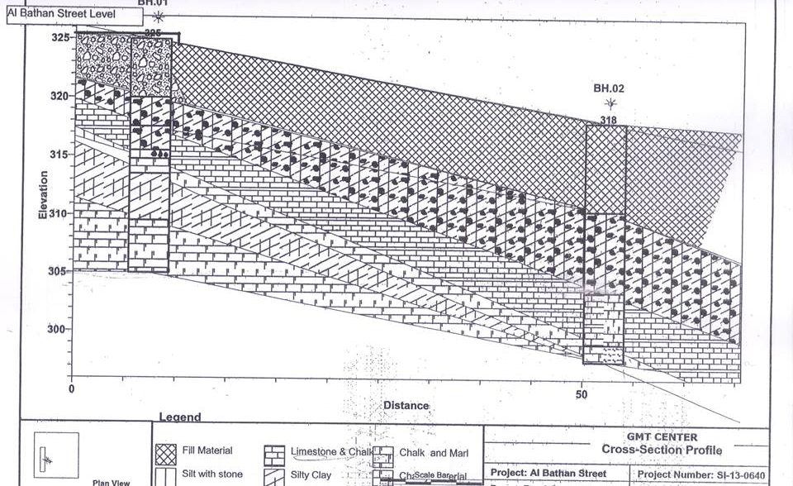
Mythology (Gmt report)
Profile of borehole 1 & borehole 2

Slide 8
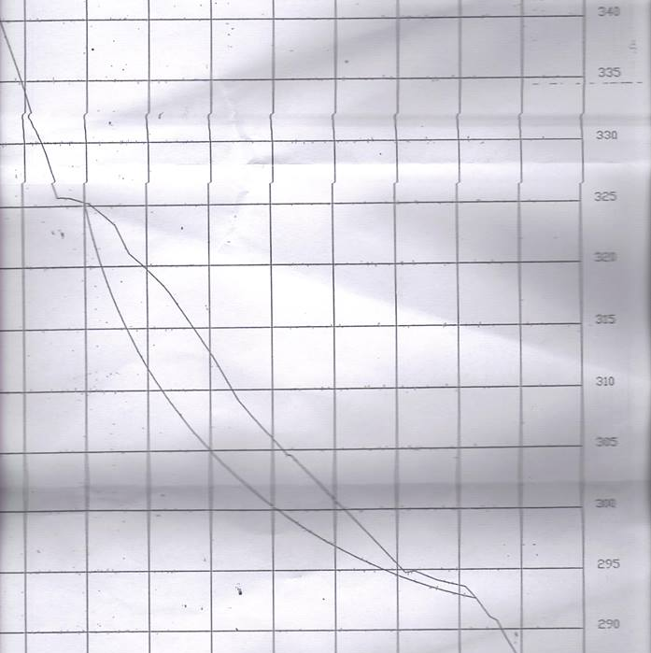
Mythology (Gmt report)
Profile of borehole 1 & borehole 2

Slide 9
Design of Sheet Pile System

Slide 10
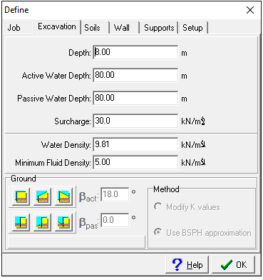
Design of Sheet Pile System
Input the data to spw911 as following:

Slide 11
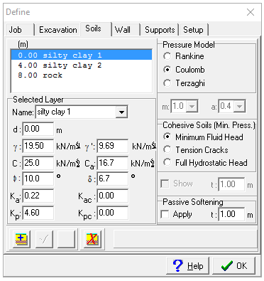
Design of Sheet Pile System
Input the data to spw911 as following:

Slide 12
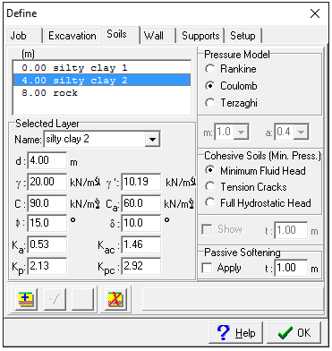
Design of Sheet Pile System
Input the data to spw911 as following:

Slide 13
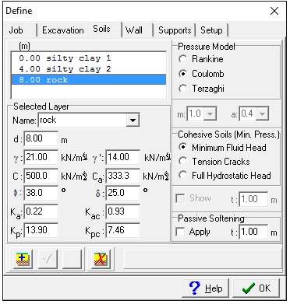
Design of Sheet Pile System
Input the data to spw911 as following:

Slide 14
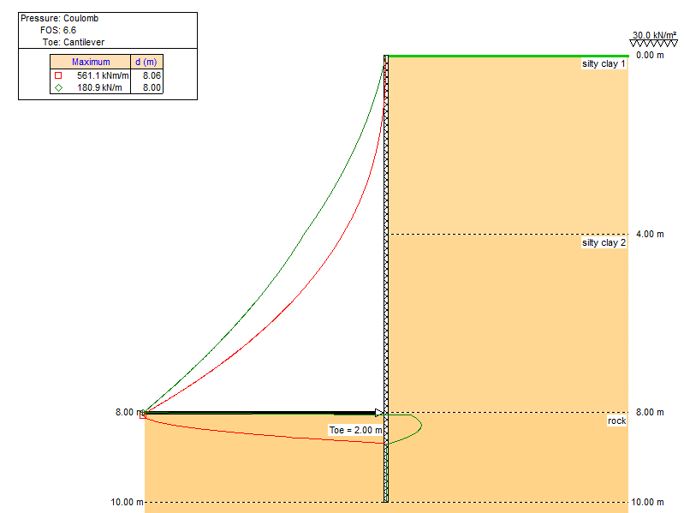
Design of Sheet Pile System
We use toe (2m)
The result from the program as following:
FOS = 6.6
Moment = 561 KN.M/M
Shear = 181 KN/M

Slide 15
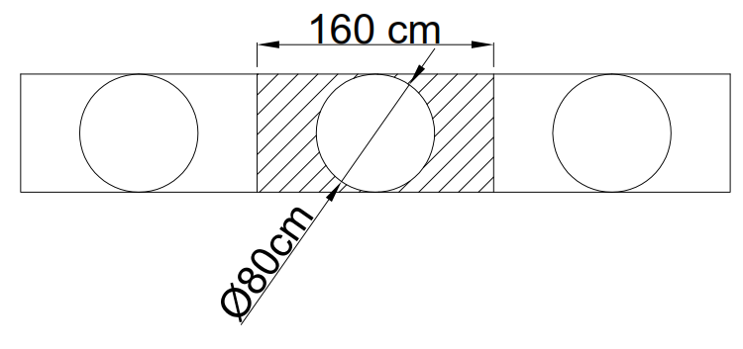
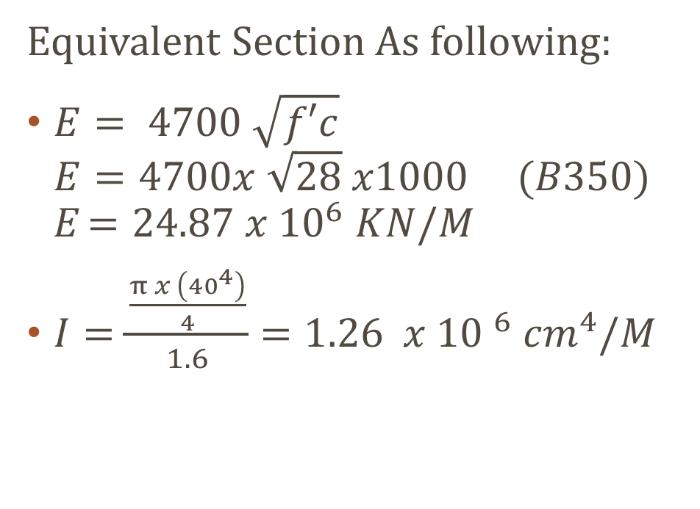
Design of Sheet Pile System
Equivalent Section As following:
$E= 4700 \sqrt{f′c}$
$E=4700x \sqrt{28} x1000 (B350)$
E $=24.87 x {10}^{6} KN/M$
$I=\frac{\frac{π x \left({40}^{4}\right)}{4}}{1.6}={1.26 x {10 }^{6} cm}^{4}/M$

Slide 16
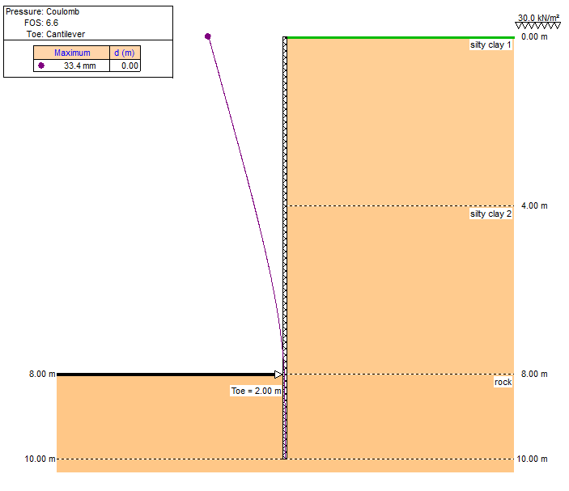
Design of Sheet Pile System
The deflection is 3.3 cm
The section moment = 897.8 KN.M
The section shear = 289.4 KN
The pile that have a diameter of 80 cm will resist these forces since it can bear 970 KN.M for moment and 386.35 KN for shear.

Slide 17
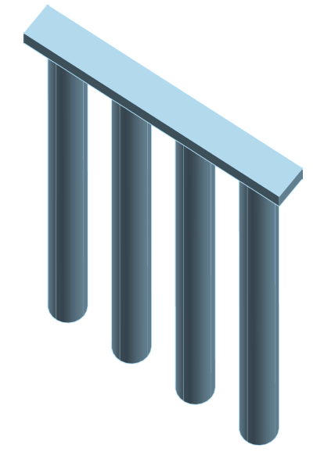
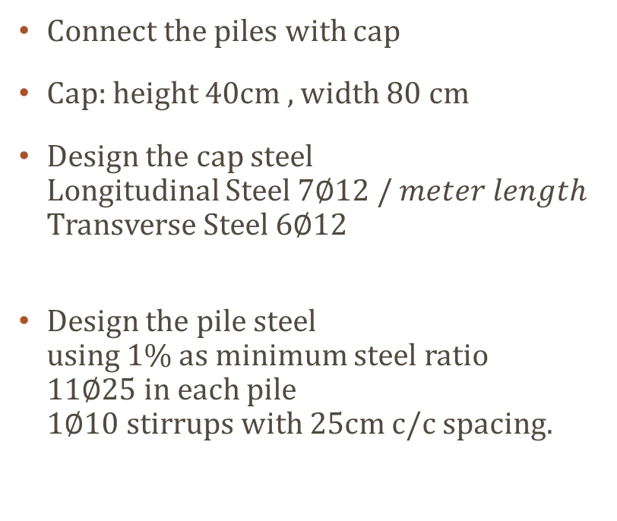
Design of Sheet Pile System
Connect the piles with cap
Cap: height 40cm , width 80 cm
Design the cap steel
Longitudinal Steel 7∅12 / 𝑚𝑒𝑡𝑒𝑟 𝑙𝑒𝑛𝑔𝑡ℎ
Transverse Steel $6∅12$
Design the pile steel
using 1% as minimum steel ratio
11$∅$25 in each pile
1$∅$10 stirrups with 25cm c/c spacing.

Slide 18
Design of hybrid system

Slide 19
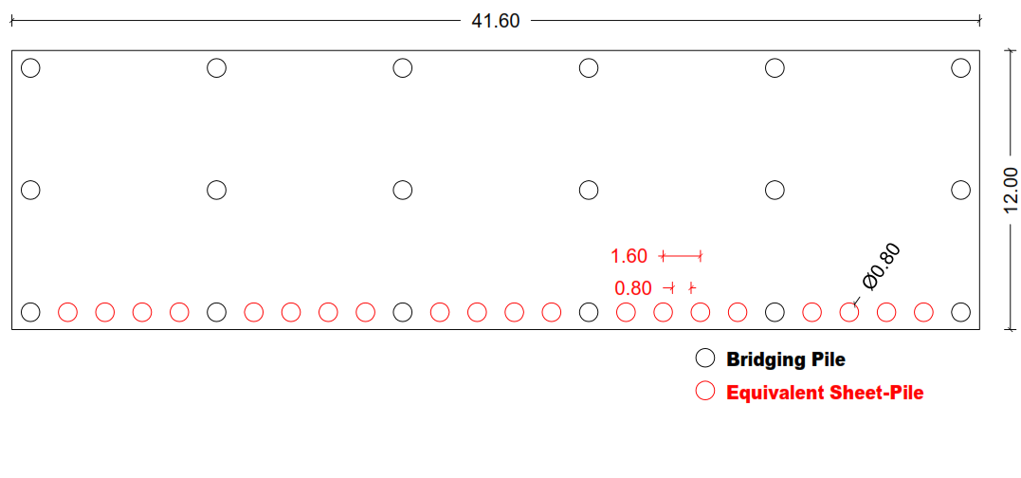
Design of hybrid system
Consist of two systems.
Sheet Pile System and Bridging System.
Bridging system will carry the slab and the traffic load.
Sheet Pile system will retained the soil and prevent it from moving.

Slide 20
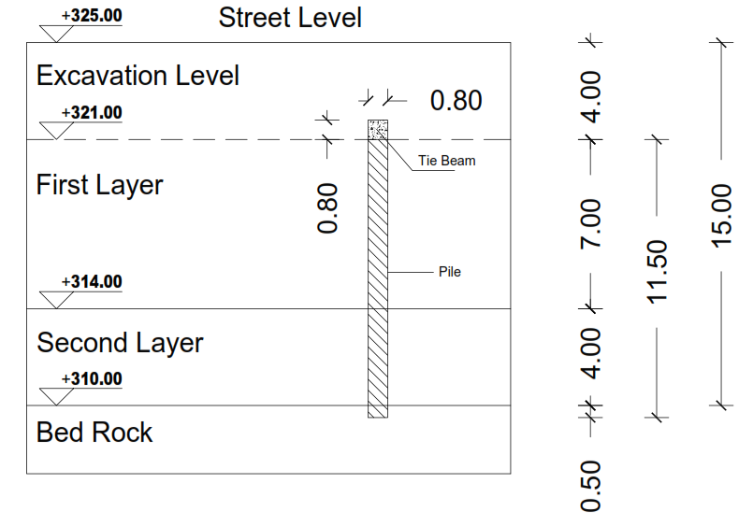
Design of hybrid system
Mythology:
Excavate 4m depth
Drill and install the piles which is 11.5m
Make 2 caps and a tie beam that connect the 2 system
To reach the level of road again, we construct a columns and we set the slab over them.

Slide 21
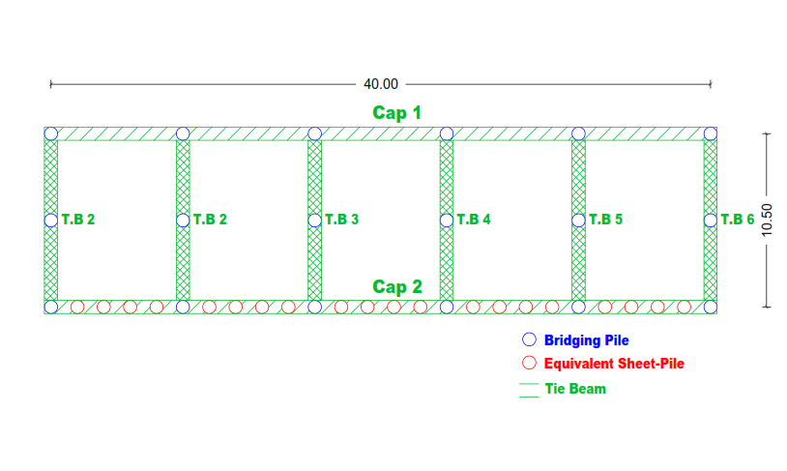
Design of hybrid system

Slide 22
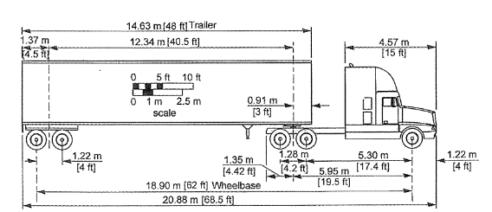
Design of hybrid system
Load Calculation:
4 vehicles WB19 = 1800 KN
12cm asphalt = 1438 KN
20cm base course = 2196 KN
1.2 M Assumed slab = 14950 KN
Total ultimate load 25,200 KN
Total ultimate per meter square
= 50.6/m2

Slide 23
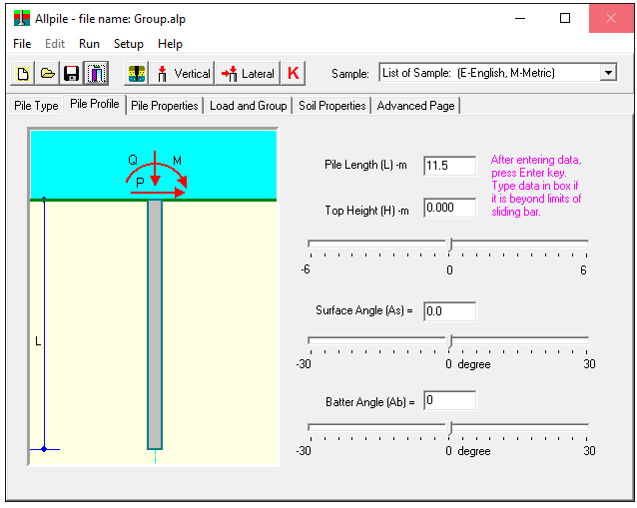
Design of hybrid system
Input the data to AllPile as following:

Slide 24
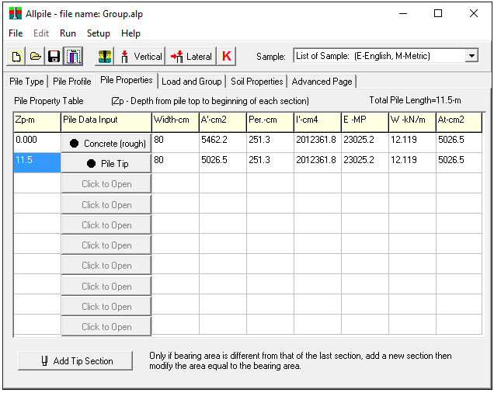
Design of hybrid system
Input the data to AllPile as following:

Slide 25
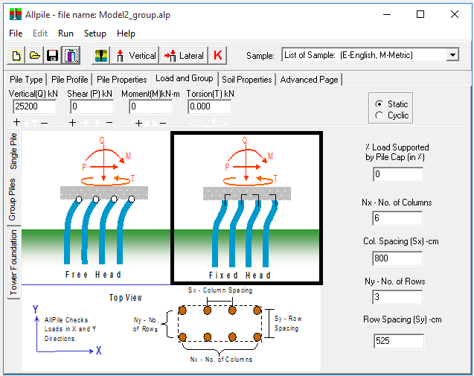
Design of hybrid system
Input the data to AllPile as following:

Slide 26
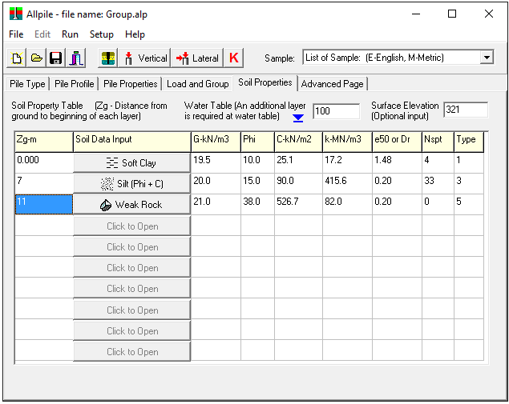
Design of hybrid system
Input the data to AllPile as following:

Slide 27
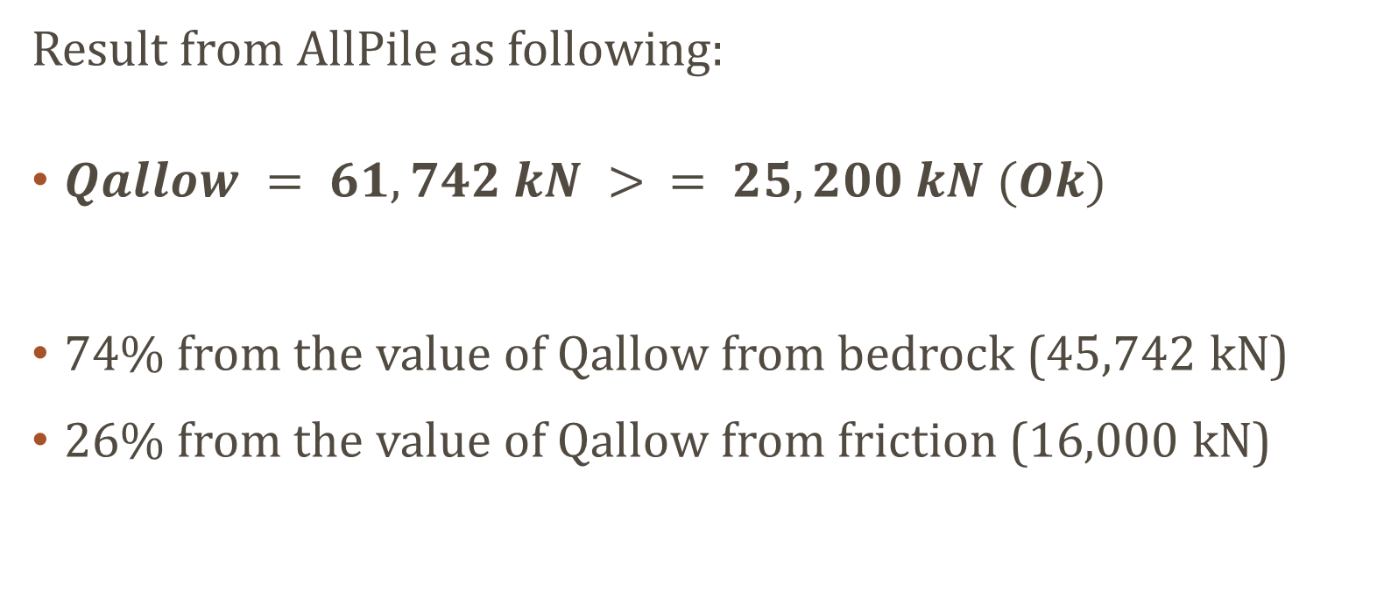
Design of hybrid system
Result from AllPile as following:
$Qallow = 61,742 kN > = 25,200 kN (Ok)$
74% from the value of Qallow from bedrock (45,742 kN)
26% from the value of Qallow from friction (16,000 kN)

Slide 28
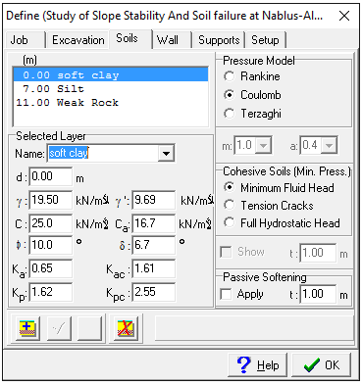
Design of hybrid system
Input the data to spw911 as the previous chapter:
Just the depth of excavation will be 9 since it represent the depth to the shear zone
The surcharge load is 50.6 KN/M2

Slide 29
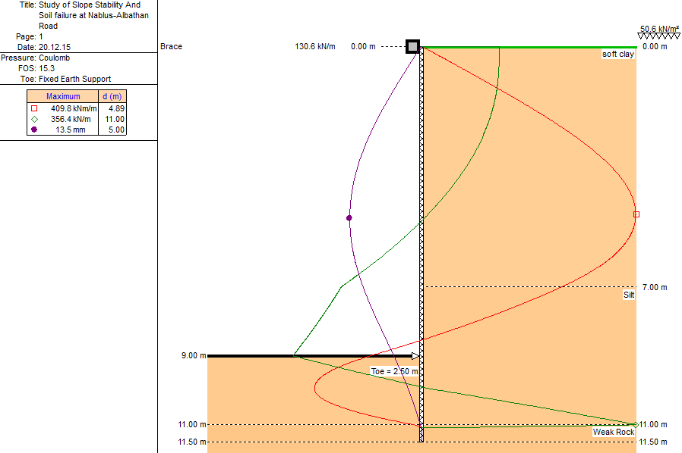
Design of Sheet Pile System
We use toe (2.5m)
We use fixed earth support
The same equivalent section as the previous solution.
The bracing will represent the cap connected to the tie beam
The result from the program as following:
FOS = 15.3
Moment = 410 KN.M/M
Shear = 356.4 KN/M
Deflection = 1.3 cm

Slide 30
Design of Sheet Pile System
Section Moment = 655.7 KN.M
Section Shear = 570 KN
Pile capacity for shear 386.35 kN for shear.
so we need stirrups to carry 374kN that concert can't resist it. 1∅10 stirrups with 10cm c/c spacing is required for .

Slide 31
General Conclusion & Recommendations
We do recommended to decrease the load on this area since the factor of safety for slope stability analysis is less than one.
We do recommended to enlarge the scope of these 2 solution if anyone of them is going to applied.
We do recommended to have more boreholes before any solution is applied to this area.
We do recommended to increase the ditch on both side since this will decease the amount of water that will go to weak soil in this area.

Slide 32
Thank you

