Slide 1
Business Plan and warehouse Management for start-up Rent ‘n Connect

Slide 2
Prepared by:
Zein Bitar
Yousef Dawood
Supervised by:
Dr.Ayham Jaaron

Slide 3
Outlines:
Introduction
Methodology
Business Model Canvas
Forecasting
Inventory Modeling
Decision making
Conclusions and Recommendations

Slide 4
Introduction
About Rent’ n Connect
Problem statement
Project objectives

Slide 5
Methodology:

Slide 6
Business Model Canvas

Slide 7
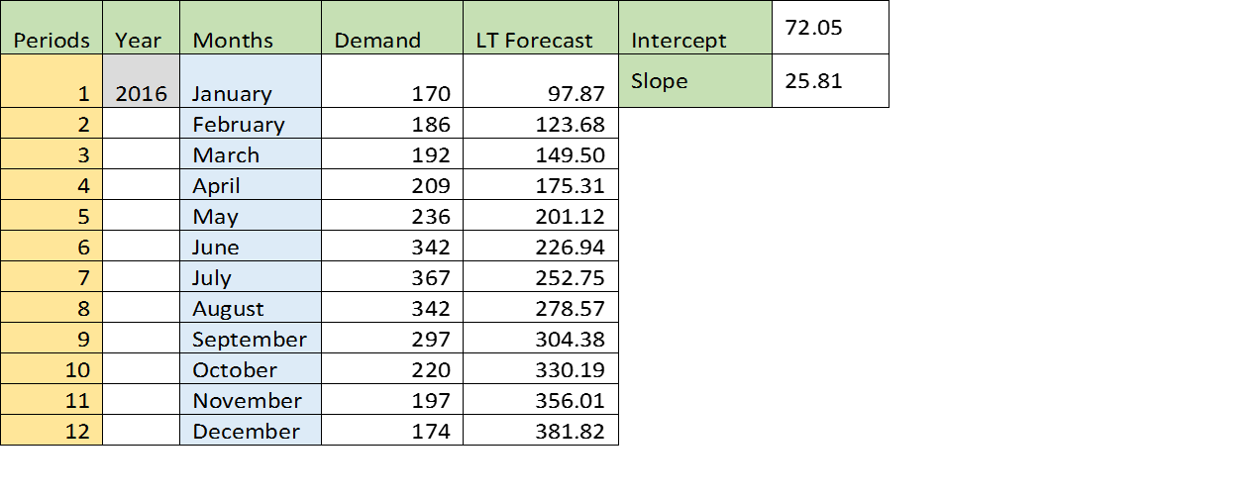
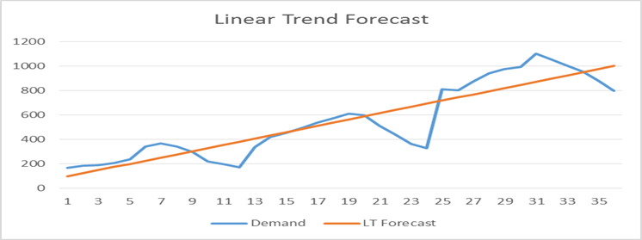
Forecasting:
Linear Trend Forecast for 2016

Slide 8
-Seasonality Indexing

Slide 9
Seasonality Forecast with trend
Periods | Year | Months | Demand | LT Forecast | Seasonal Forecast with trend
1 | 2016 | January | 170 | 97.87 | 78.23
2 |  | February | 186 | 123.68 | 105.62
3 |  | March | 192 | 149.50 | 138.00
4 |  | April | 209 | 175.31 | 174.37
5 |  | May | 236 | 201.12 | 213.22
6 |  | June | 342 | 226.94 | 262.61
7 |  | July | 367 | 252.75 | 318.69
8 |  | August | 342 | 278.57 | 337.05
9 |  | September | 297 | 304.38 | 334.50
10 |  | October | 220 | 330.19 | 323.02
11 |  | November | 197 | 356.01 | 311.56
12 |  | December | 174 | 381.82 | 301.04

Slide 10
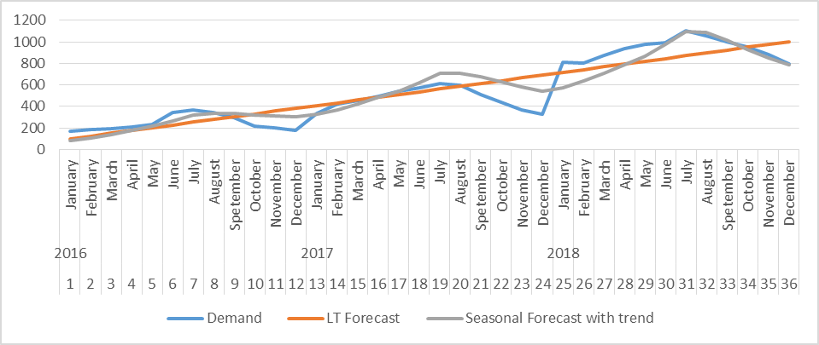
Seasonal Forecast with trend

Slide 11
Linear trend and seasonal forecast with demand for 2019 orders

Slide 12
Forecasting Errors
Periods | Year | Months |  | Demand | LT Forecast | Seasonal Forecast with trend |  | A-F | A-f/A
1 | 2016 | January |  | 170 | 97.87 | 78.23 |  | 72.13 | 0.42
2 |  | February |  | 186 | 123.68 | 105.62 |  | 62.32 | 0.34
3 |  | March |  | 192 | 149.50 | 138.00 |  | 42.5 | 0.22
4 |  | April |  | 209 | 175.31 | 174.37 |  | 33.69 | 0.16
5 |  | May |  | 236 | 201.12 | 213.22 |  | 34.88 | 0.15
6 |  | June |  | 342 | 226.94 | 262.61 |  | 115.1 | 0.34
7 |  | July |  | 367 | 252.75 | 318.69 |  | 114.2 | 0.31
8 |  | August |  | 342 | 278.57 | 337.05 |  | 63.43 | 0.19
9 |  | September |  | 297 | 304.38 | 334.50 |  | 7.379 | 0.02
10 |  | October |  | 220 | 330.19 | 323.02 |  | 110.2 | 0.50
11 |  | November |  | 197 | 356.01 | 311.56 |  | 159 | 0.81
12 |  | December |  | 174 | 381.82 | 301.04 |  | 207.8 | 1.19
MAD = 1.568 |  |  | MSE = 51.72 |  |  |  | MAPE=13.07

Slide 13
Decision Making:
Basic terminology:
1-Objectives and attributes: the attributes are used to measure the performance of courses of action on the objectives.
2-Value and utility: numerical score will take to measure attractiveness to the decision maker, if the decision has no risk and uncertainty the score will call value but if it has risk and uncertainty this score will call utility.
Simple multi-attribute rating technique -SMART

Slide 14
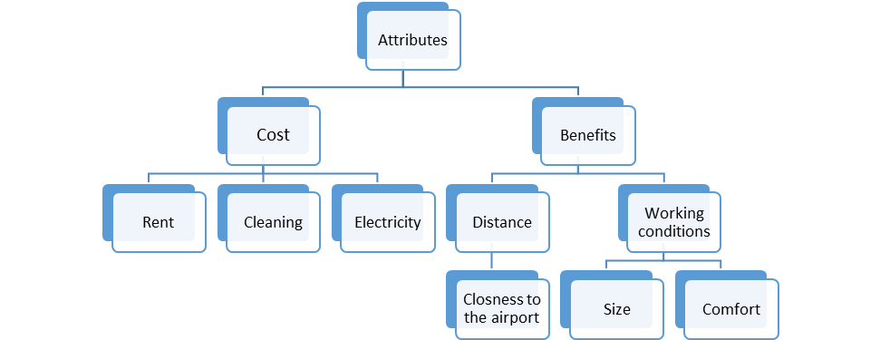
Value tree

Slide 15
Two approaches to measure these attributes:
1-Direct rating

Slide 16
2-Value functions
V(1500)=100
V(700)=50
V(400)=0
V(500)=25
V(1000)=75

Slide 17
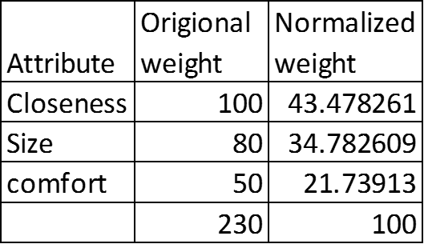
Swing weights

Slide 18
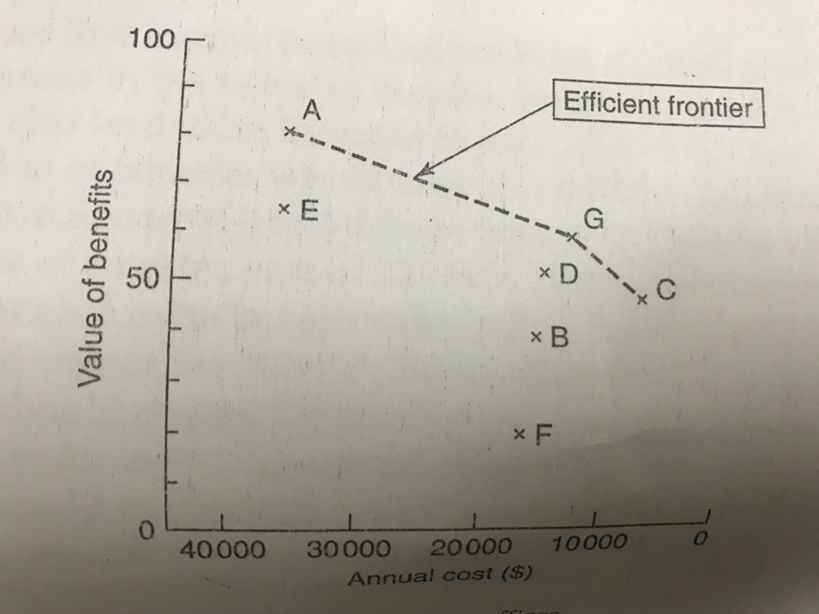
Trading benefits against cost:

