Slide 1
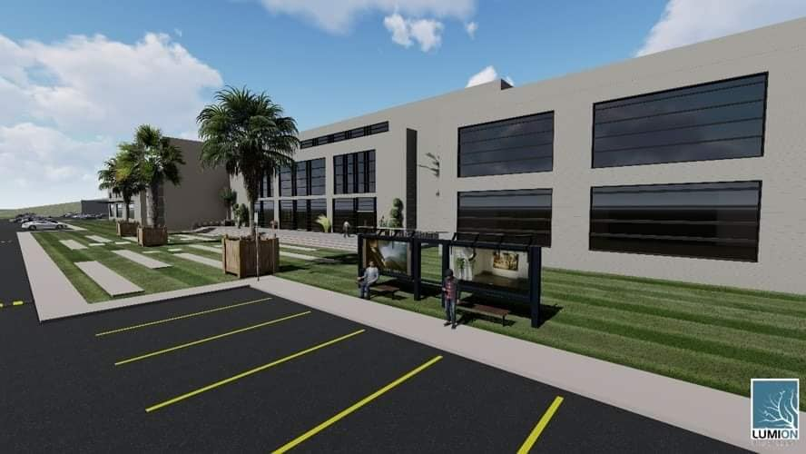
HEALTH Clinic
Building Engineering Department
Graduation project II
Prepared By:
Yazan Yameen
Rafeeq Amous
Supervisor:
Dr. Ahmad Saleh
Supervisor:
Dr. Moatasem Babaa

Slide 2
contents
Introduction
Architectural aspect
Environmental aspect
Structural design concept
Electrical aspect
Mechanical aspect
System integration
Cost Estimation

Slide 3
Introduction
Health Clinic
located in Palestine – Nablus city
It consist of second floor

Slide 4
Architectural Aspect

Slide 5
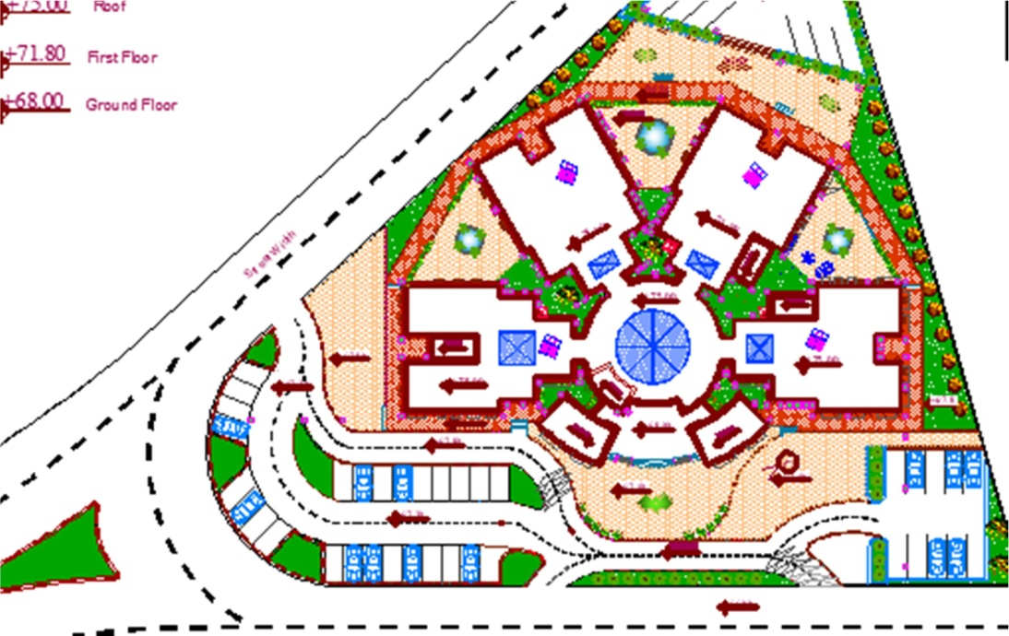
Project plans
Site Plan

Slide 6
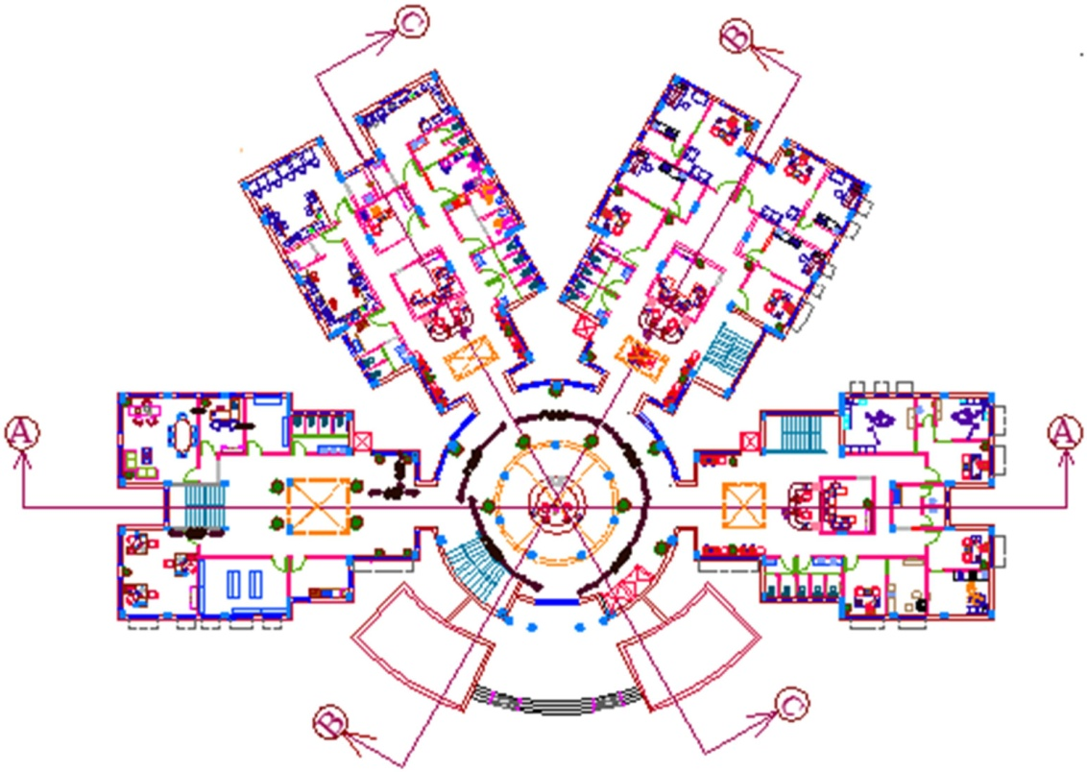
Project plans
Ground Floor Plan

Slide 7
Project plans
First Floor Plan

Slide 8
Environmental Aspect

Slide 9
Contents
Shading
Day light factor
Material Properties
Acoustical Analysis
Solar Radiation

Slide 10
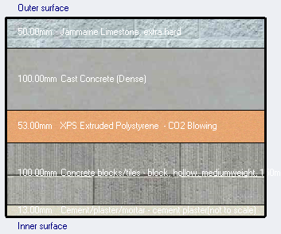
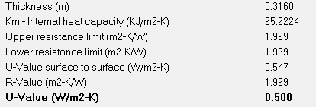
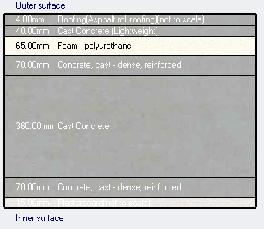
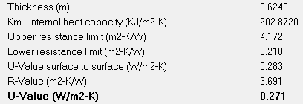
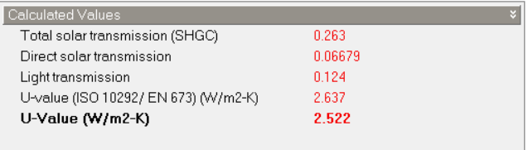
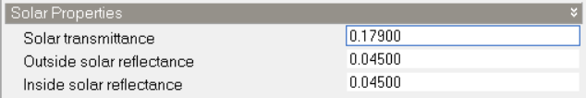
Material properties
External Wall
Roof material
Window Glass

Slide 11
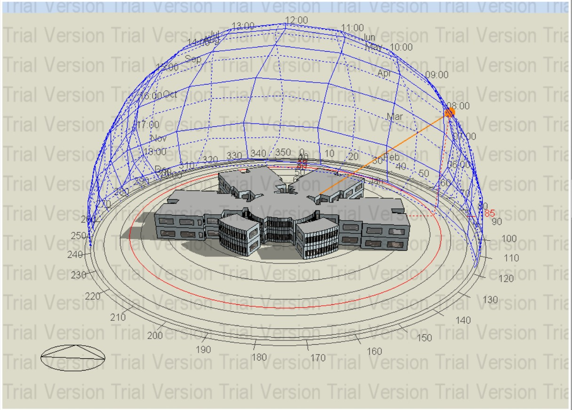
Shading
Shading in Winter at 8:00AM

Slide 12
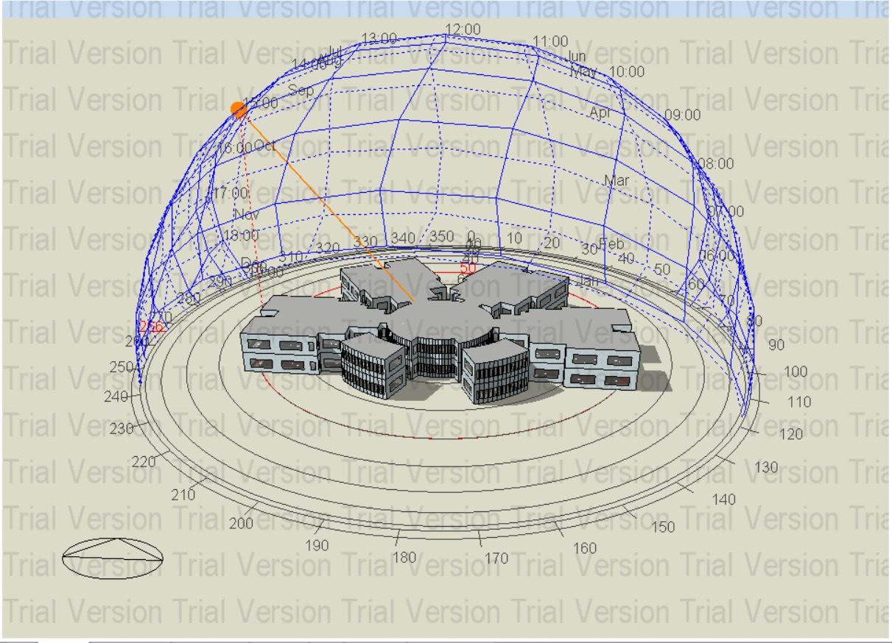
Shading
Shading in Winter at 3:PM

Slide 13
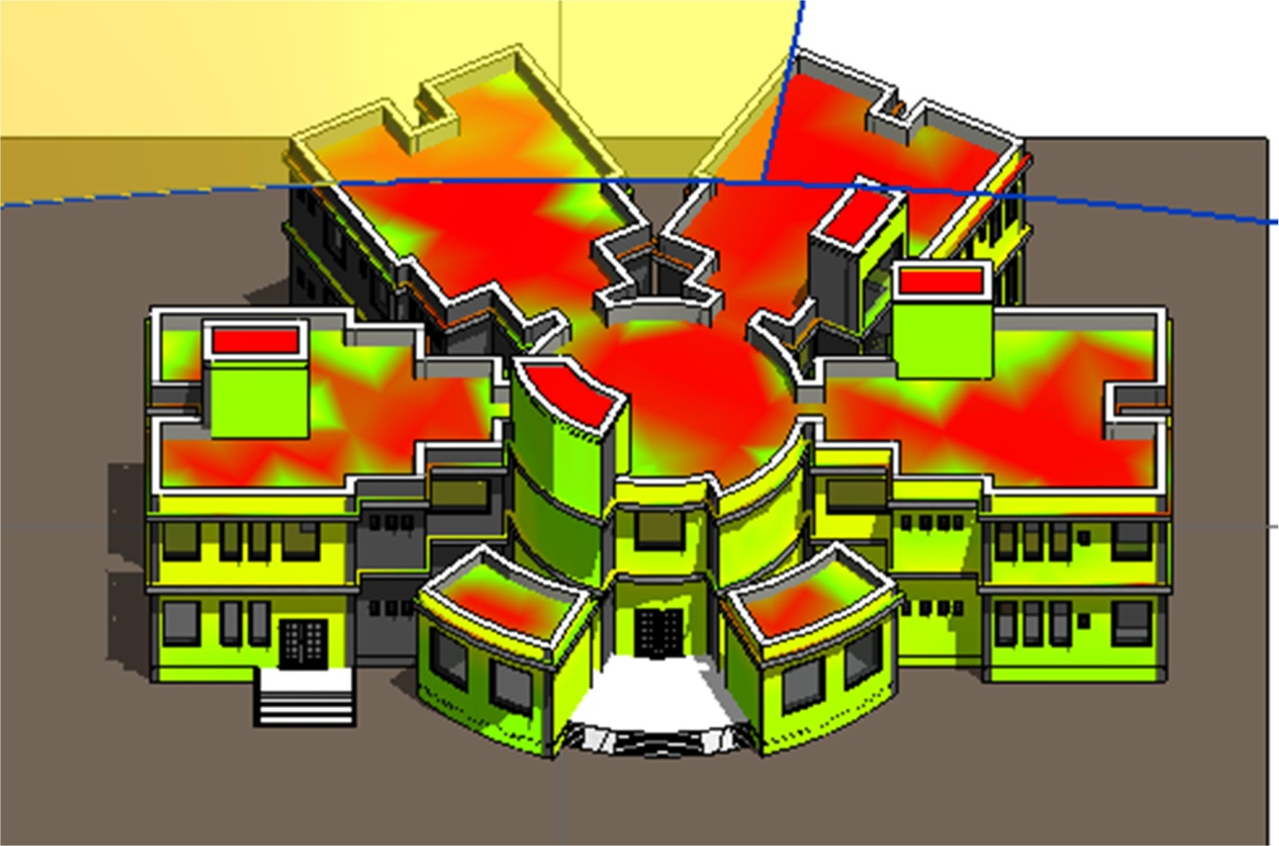
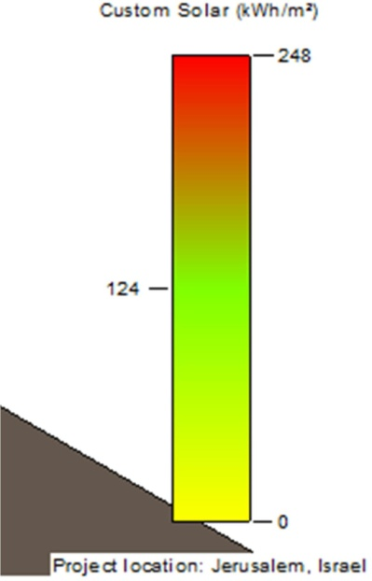
Solar Radiation
After Treatment

Slide 14
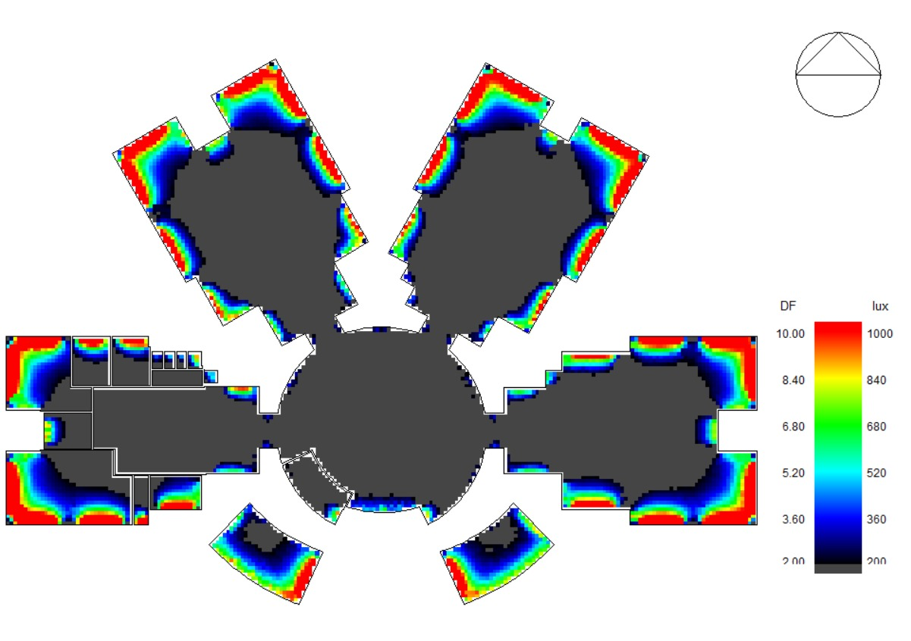
Daylight Factor
Ground floor
After Treatment

Slide 15
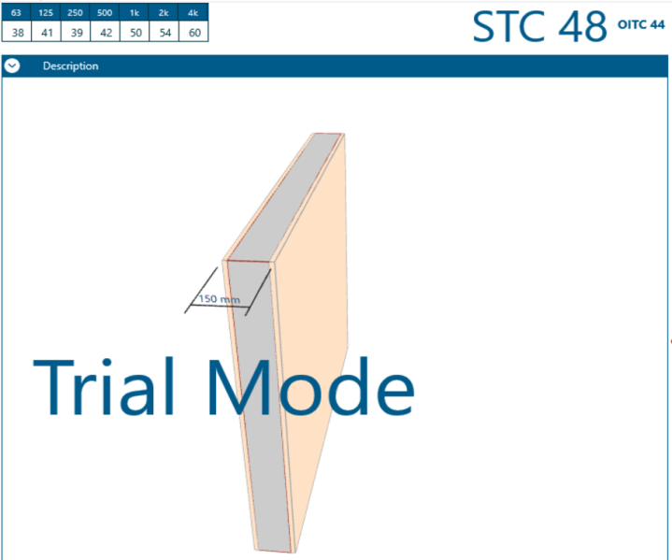
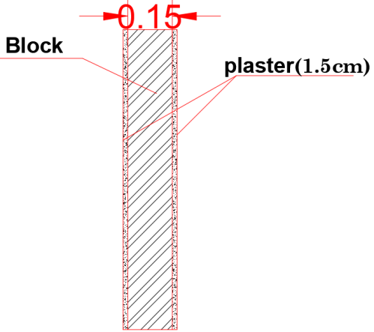
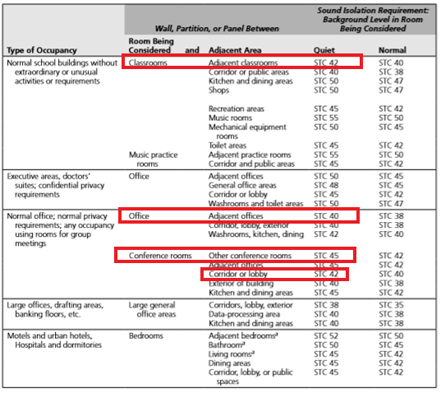
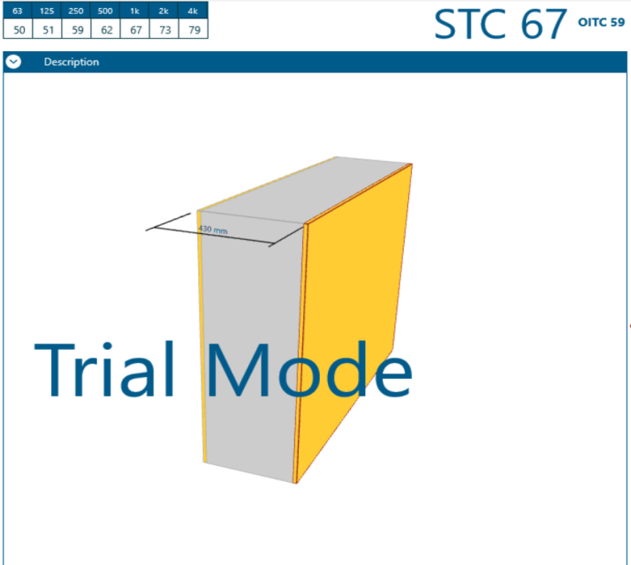
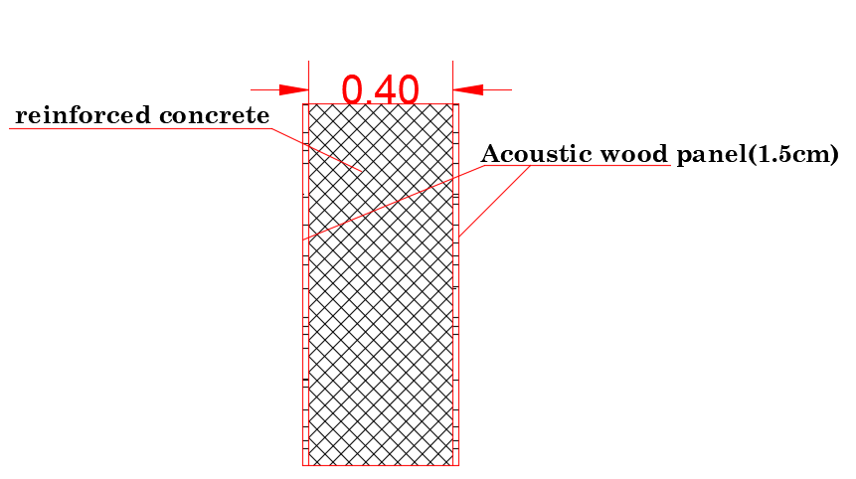
Acoustical Analysis
STC (Sound Transmission Class ) for Internal Wall

Slide 16
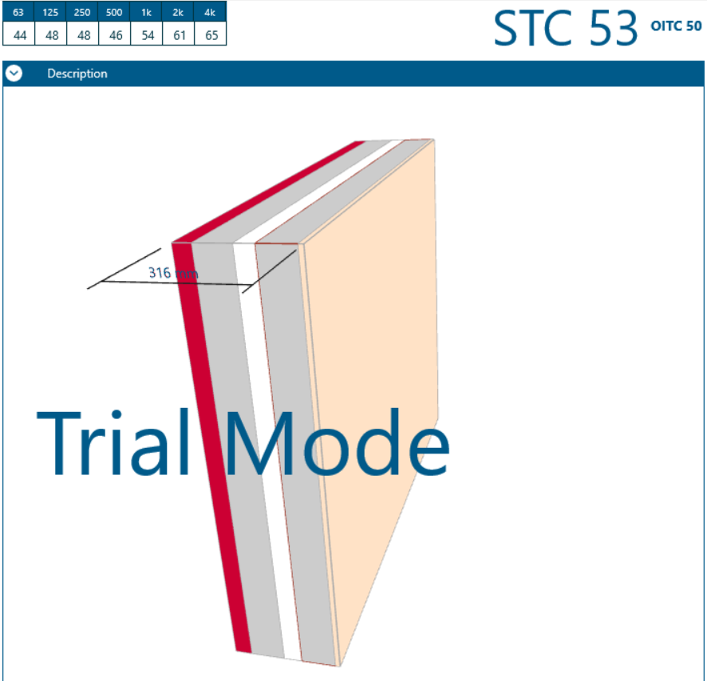
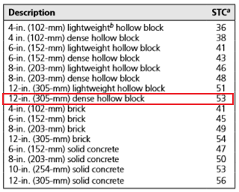
Acoustical Analysis
STC (Sound Transmission Class ) for
External Wall and OITC (Outdoor–Indoor Transmission Class)
(55 - 60 dBA)
Where the outdoor background noise level is between 55 dBA and 60 dBA, Since the amount of (background noise level) is 55dBA so that OITC rating not less than 55 – 25= 30dB this value is less than the actual OITC value of the wall 50dB, so its acceptable

Slide 17
Structural Aspect

Slide 18
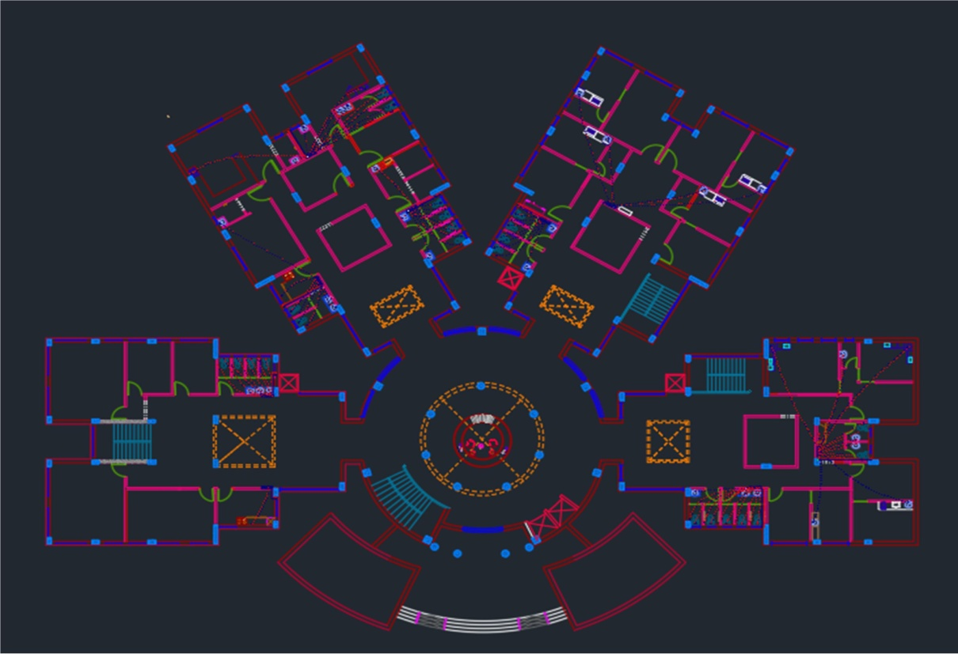
Ground floor Plan

Slide 19
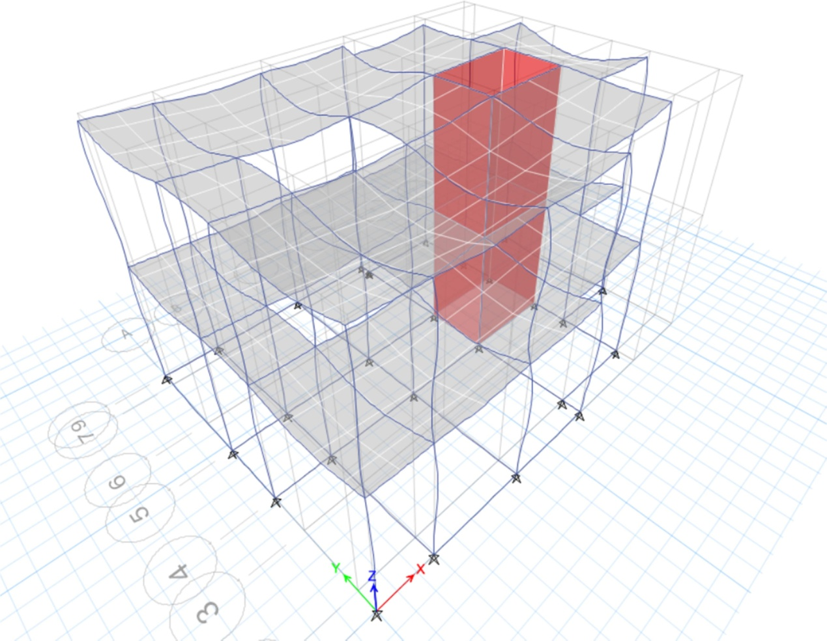
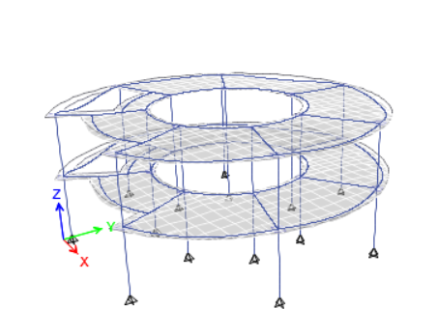
ETABS model for all blocks :
Block 1
Block 2
Block 2

Slide 20
Information Analysis :
Codes :
ACI318-14 Code
UBC-97
Material Specification :
Compressive strength (F'c = 28MPa)
Yielding strength of steel (Fy = 420Mpa)
Loads :
Live Load = 5KN/m2
SID = 4.3KN/m2
Wall Load = 22KN/m

Slide 21
Information for seismic Analysis :
The parameters seismic analysis :
Seismic zone : the building is located in Tulkarem city therefore the seismic zone is (2B) and the Z value is 0.20 .
Soil profile : type of soil is rock so the soil profile is SB .
Force Reduction Factor R = 5.5 (Building Frame System is used) (shear wall) .
Importance factor I = 1.25
Acceleration-Dependent Seismic Coefficient Ca = 0.2
Velocity-Dependent Seismic Coefficient Cv = 0.2
Weight source : Dead Load 100% and Live Load 25% .

Slide 22
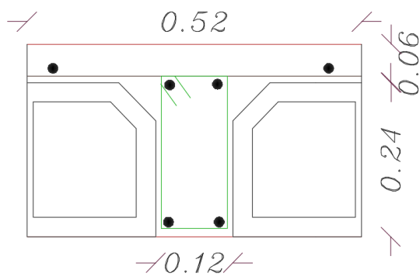
Element dimensions :
Slab Thickness(ribbed slab” used : 25 cm
Sections of Beams: 60*30cm, 50*50cm, 30*30cm and 50*50cm
Columns Sections: 50*50 cm, 21*100cm
Shear Wall: 21cm thickness

Slide 23
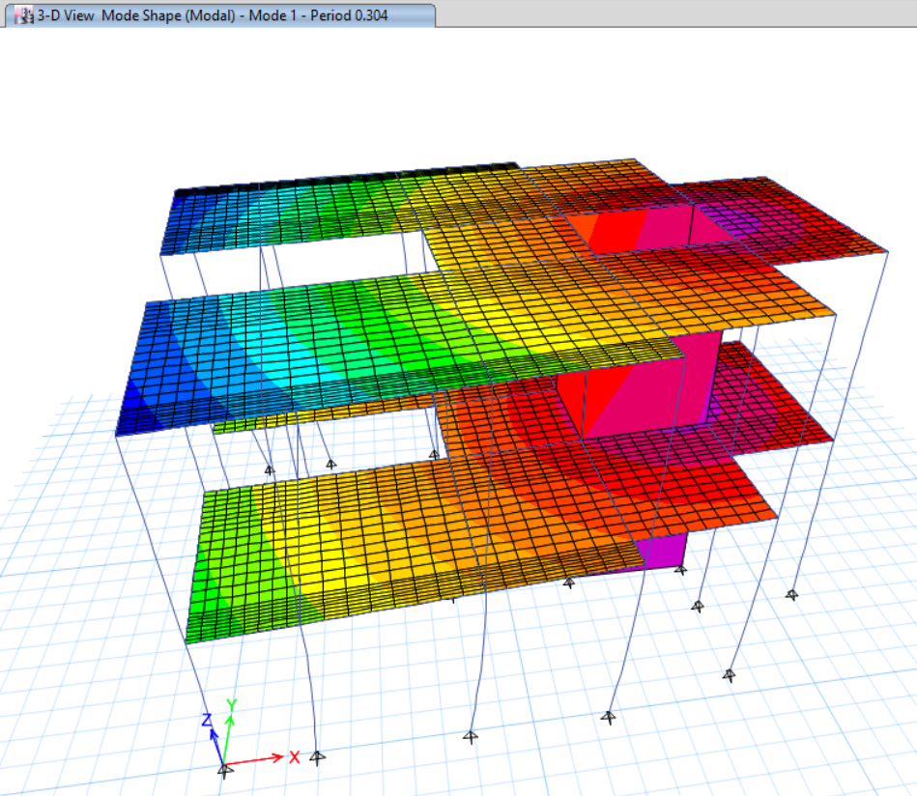
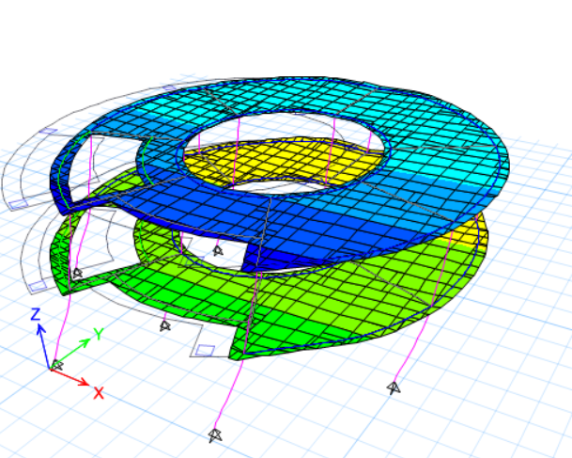
Models from programs :

Slide 24
Seismic checks :
Drift check for block 1 :
Drift check for block 2 :
:All drifts in floors is less than limit .
All drifts in floors is less than limit .
The values from ETABS is greater than manual values .

Slide 25
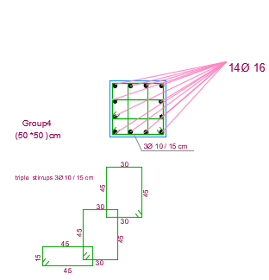
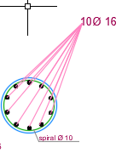
Design columns :
Table of design for block 1:
Detailing for columns :

Slide 26
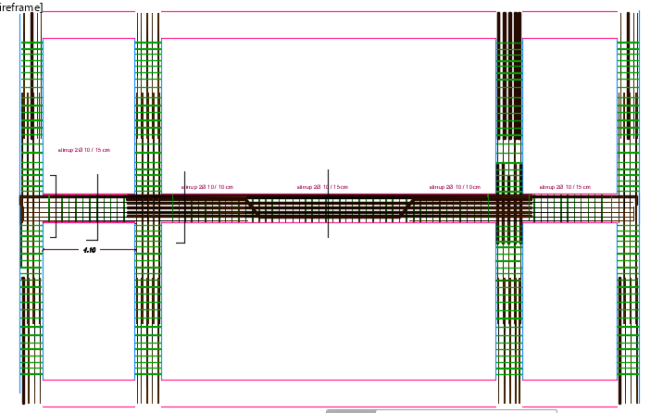
Design columns :
Detailing for columns :

Slide 27
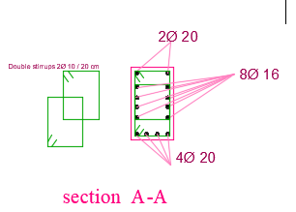
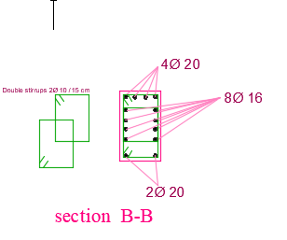
Design beams :
Detailing for beam :

Slide 28
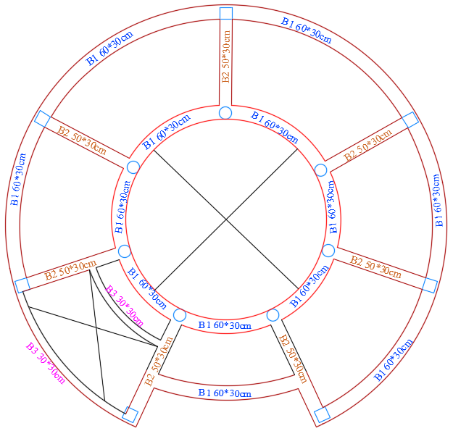
Detaling of beams

Slide 29
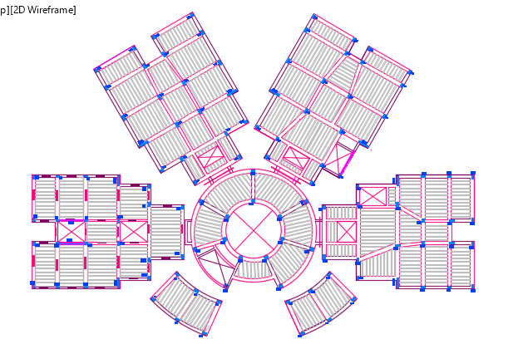
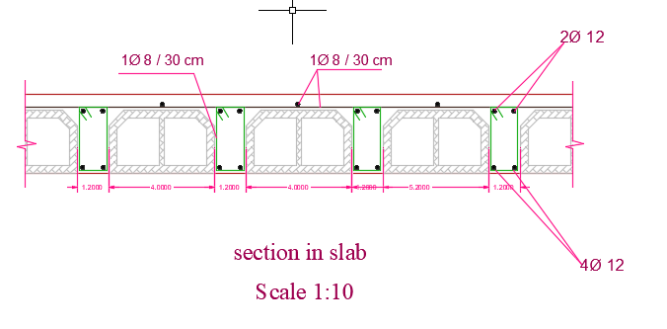
Design slab :
Detailing for slab :

Slide 30
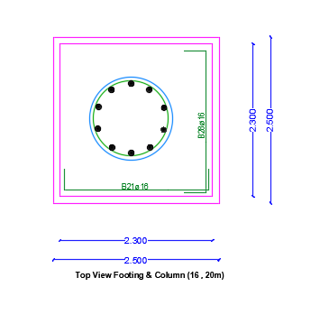
Design footing :
Plan footing
Allowable bearing capacity of soil = 350 KN/m²

Slide 31
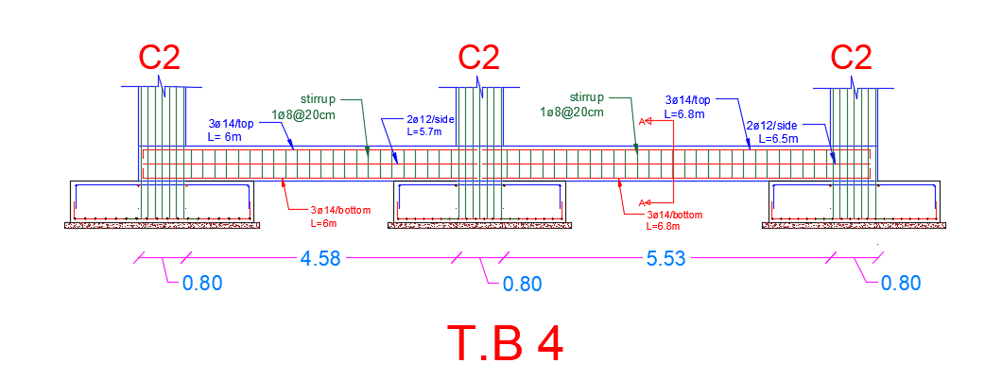
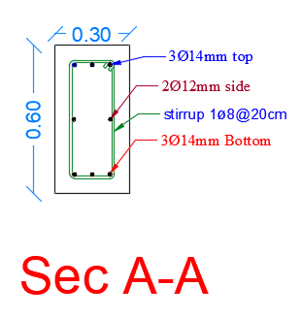
Design footing :
Detailing for footing and Tie beam :

Slide 32
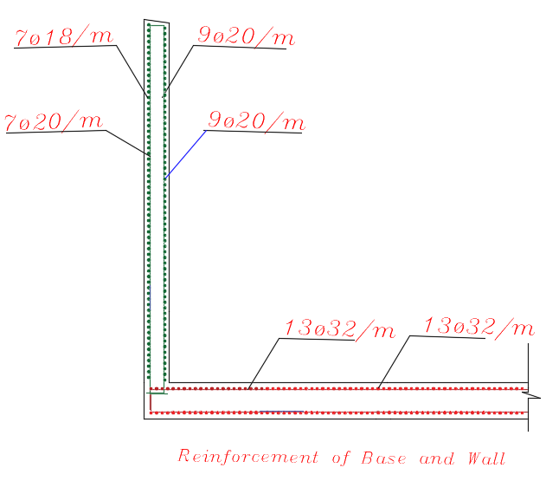
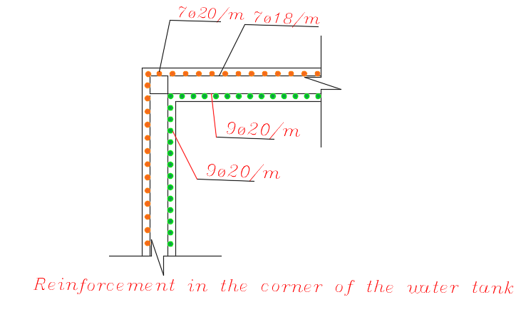
Design water tank :
Detailing for water tank:

Slide 33
Electrical Aspects

Slide 34
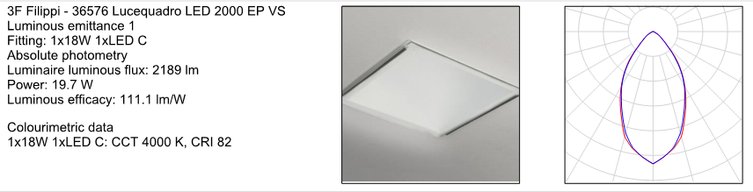
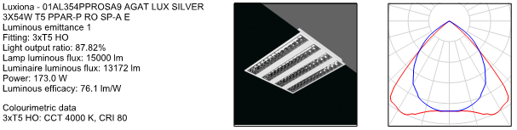
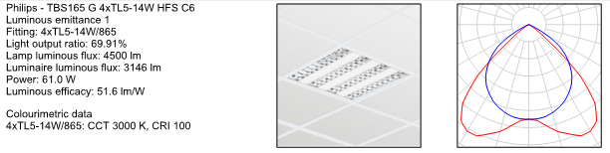
Artificial Lighting
Luminaries used in project
3F FILIPPI
LI43

Slide 35
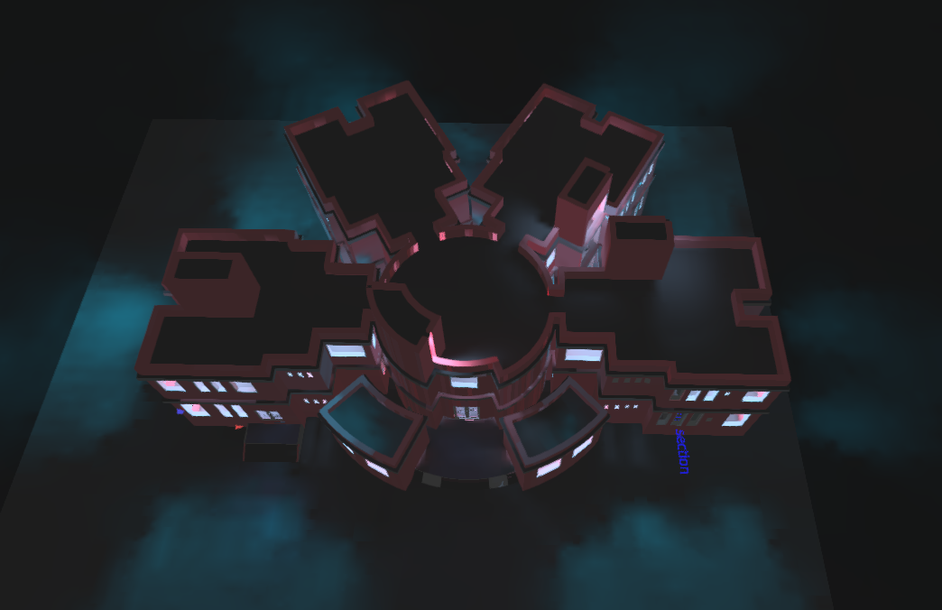
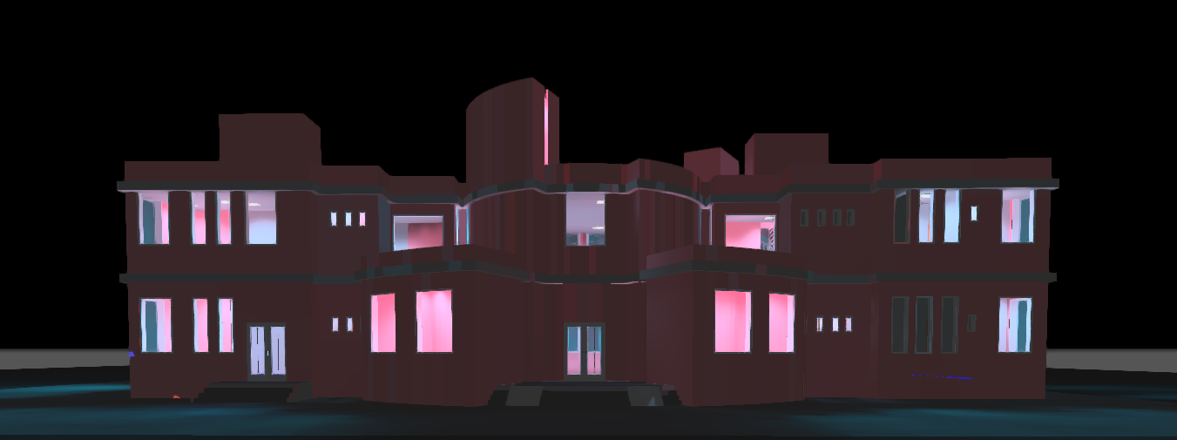
Result from DIALux .
Rendering for exteral building .

Slide 36
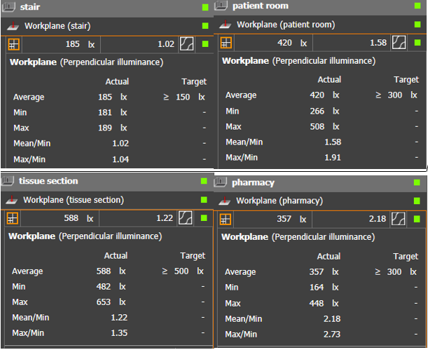
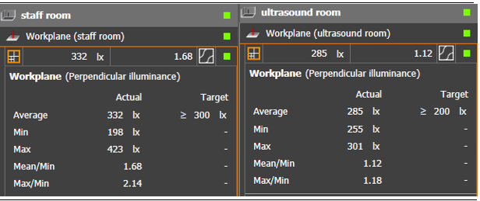
All Luminaries used for the building.

Slide 37
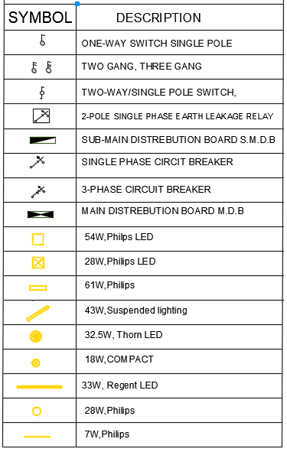
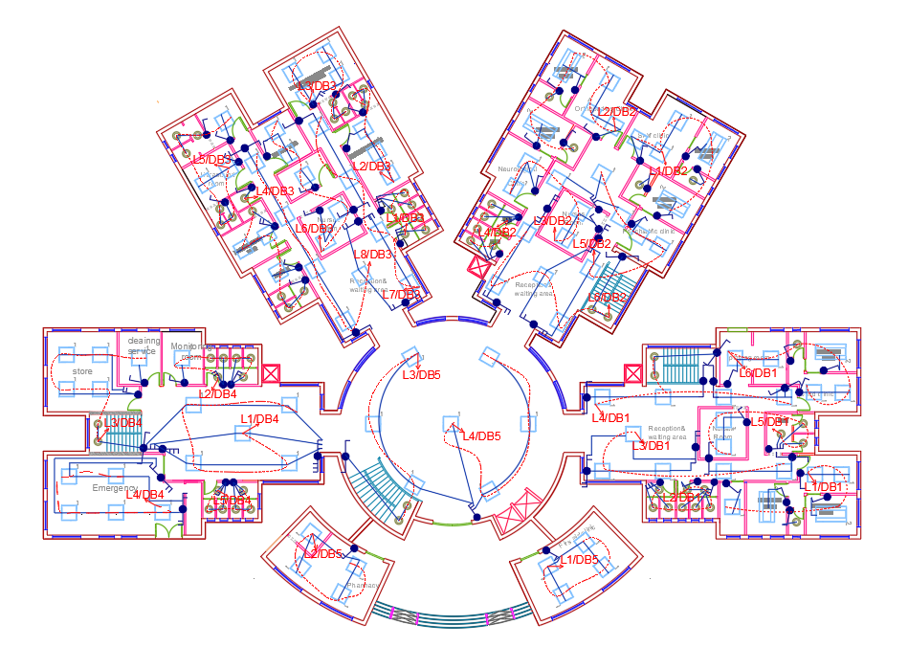
Distribute the lighting and branch on the ground floor
Symbols of Lighting

Slide 38
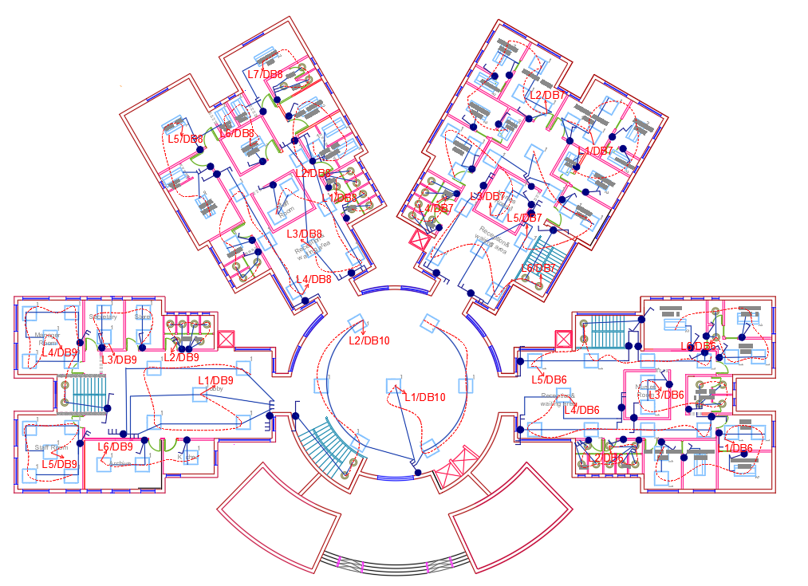
Distribute the lighting and branch on the first floor

Slide 39


Distribute the Sockets on the Ground floor
Symbols of Socket

Slide 40

Distribute the Sockets on the First floor

Slide 41


Main distribution board
Distribution of circuit breaker in distribution board ground and first floor

Slide 42

Main distribution board
Main distribution board of circuit breaker in the ground floor

Slide 43
Mechanical Aspects
Plumbing system
Water Supply system
Fire Fighting system
HVAC system

Slide 44
Plumbing system
NODE | SERV | Type | WFU | GPM | Size | Pipe Length | Pressure Drop (PSI)
1 | CW | FT | 30.5 | 19.67 | 1-1/2" | 3 | 0.06
 | HW | FT | 10.5 | 7.87 | 1" | 3 | 0.07
NODE | SERV | Type | WFU | GPM | Size | Pipe Length | Pressure Drop (PSI)
1 | CW | FT | 61 | 32.35 | 2" | 7 | 0.09
 | HW | FT | 21 | 14.06 | 1-1/4" | 7 | 0.16

Slide 45
Plumbing system
NODE | SERV | Type | WFU | GPM | Size | Pipe Length | Pressure Drop (PSI)
2 | CW | FT | 54.5 | 30.08 | 2" | 2 | 0.02
 | HW | FT | 4.5 | 4.33 | 3/4" | 2 | 0.05
NODE | SERV | Type | WFU | GPM | Size | Pipe Length | Pressure Drop (PSI)
2 | CW | FT | 109 | 45.04 | 2" | 7 | 0.16
 | HW | FT | 9 | 6.98 | 3/4" | 7 | 0.46

Slide 46
Plumbing system
NODE | SERV | Type | WFU | GPM | Size | Pipe Length | Pressure Drop (PSI)
3 | CW | FT | 6 | 5.21 | 3/4" | 0.6 | 0.02
 | HW | FT | 6 | 5.21 | 3/4" | 0.6 | 0.02
NODE | SERV | Type | WFU | GPM | Size | Pipe Length | Pressure Drop (PSI)
3 | CW | FT | 12 | 8.75 | 1" | 7 | 0.19
 | HW | FT | 12 | 8.75 | 1" | 7 | 0.19

Slide 47
Water supply
Water consumption
For Laundry Per Bed: -
NO. of Bed | 40 | Bed
Assume daily water consumption in L/bed | 600 | L/bed
Daily water consumption | 24 | m³
Size of water tank
Daily Domestic Water Consumption: -
water consumption per day for the building |  | 24 | m³
Daily Irrigation Water Consumption: -
water consumption per day for the building |  | 0 | m³
Total Daily Water Consumption For the Building: -
total consumption of water per day |  | 24 | m³
multiply the water consumption in 10% safety factor |  | 26.4 | m³
Under Ground or Ground Water Tank
the storage capacity for 2 days |  | 52.8 | m³
Roof Water Tank Capacity
the storage will be for 1 day |  | 26.4 | m³

Slide 48



Fire fighting system
The symbols of the suppression system in the plans

Slide 49


Fire fighting system
Fire fighting in floors
Distribution for Reception Hall:
L=8.5m
W=8.5m
Area = 57$m^{2}$
Number of Sprinklers = $\frac{w}{4}$= $\frac{8.5}{4}$= 2.12 =3 spr
Distance between two sprinklers S = $\frac{w}{num of spr }\frac{8.5}{3}$= 2.8 m
Distance between sprinkler and wall =$\frac{S}{2}= \frac{2.8}{2}=1.4 m$

Slide 50

Fire fighting system
Pump design room

Slide 51


HVAC system
The system used in the project VRF system
The table below shows the amount of design capacity for building floors

Slide 52



HVAC system
Specification of VRF System components
  2- Fan coil (daiken company)
  1- Diffuser

Slide 53


HVAC system
  3- Outdoor unit(daikken company)

Slide 54



HVAC system
  daimension of duct

Slide 55


HVAC system
Distributing the HVAC system on the Ground floor
Symbols of HVAC system

Slide 56
Cost Estimation
The information below is for the entire building
Mobilization = 18000 NIS
Excavation = 269950.1 NIS
Water Tank = 39166.5 NIS
Site Work = 515648.8 NIS

Slide 57
Thank
You

