Slide 1

3D Analysis and Design
Maythoon Police Station
By:
-Yara herzallah.
-Qasam Osta Ali.
Supervisor : Dr. Imad Al-Qasem.

Slide 2
Outline
Introduction.
What we do in graduation project 1.
Dynamic analysis:
-Modes and period.
-Response spectrum analysis.
Design of structural element.

Slide 3
Introduction
Maythalon police station is located in Jenin city in Palestine, This building divided in two parts, the first part consists of ground floor, one top floors, and staircase and the second part consists of two floors with a total area 842.2 m^2
Structural elements will be designed as reinforced concrete members according to strength and serviceability criteria as specified in ACI 318 for gravity load and as specified in IBC 2012 for seismic load.

Slide 4
We have two Blocks.
Floor | Area | Height
Ground | 482 | 3.85
First | 279.4 | 3.75
staircase | 48 | 3.25

Slide 5
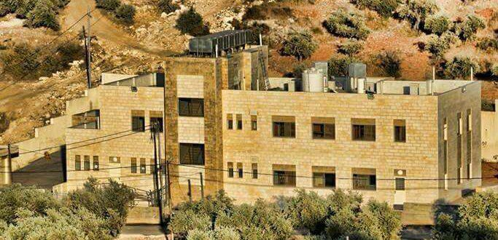

Slide 6
What we do in GP1?
Definitions Of Material.
CONCRETE
  fˋc=30 MPa (columns, shear walls,Footing).
  fˋc=24 MPa (slabs &beams).
STEEL
  fy=420 MPa.

Slide 7




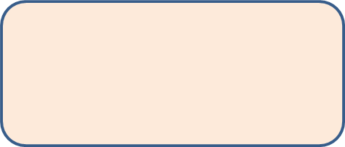

What we do in GP1?
Gravity Load
Dead
Superimposed
Live
  Wall = 20.8KN/m.
  Slab= 5 KN/m^2
stories =5kN/m^2
staircase=5KN/m^2

Slide 8
Structural Systems
One way solid slab(block A)
GF
&stair case
One way solid slab(block B)
GF
&First Floor
0.16m&0.15m thickness
0.18m ,0.2m thickness

Slide 9

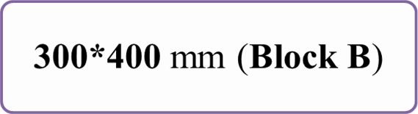
Columns
250*250mm
300*300mm
300*500 mm (Block A)
Beam

Slide 10
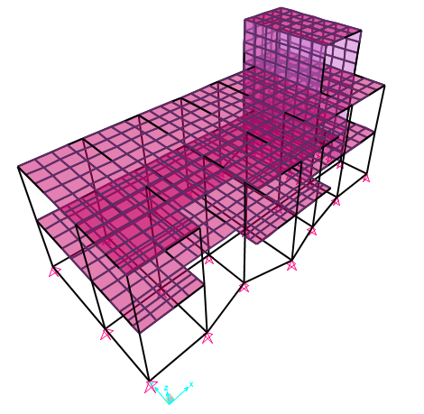
3D Model(A)

Slide 11
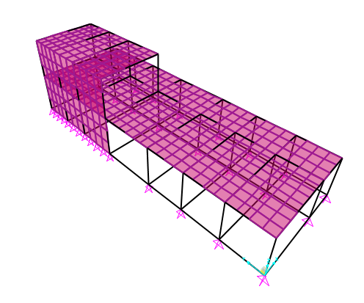
3D Model(B)

Slide 12
DYNAMIC ANALYSIS
Response Spectrum Analysis

Slide 13
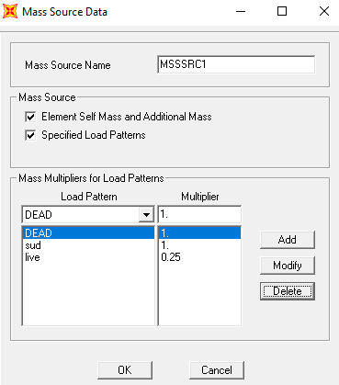
Definition of Mass Source

Slide 14
Seismic Parameters
0.2 | z
Rock(B) | Soil
0.5 | Ss
0.25 | Sa
1.25 | I
5 | R

Slide 15
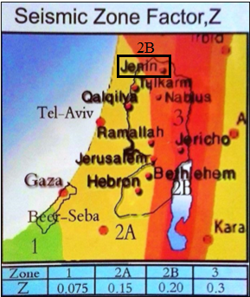
Seismic Zone Factor Z

Slide 16
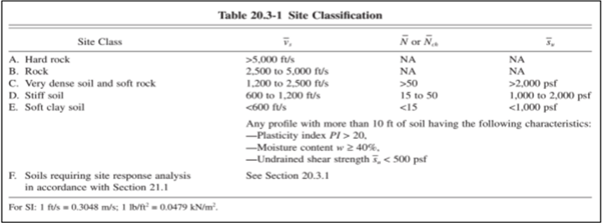
Site Class

Slide 17
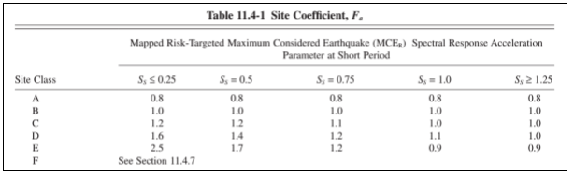
Site Coefficient at Short Period Fa

Slide 18
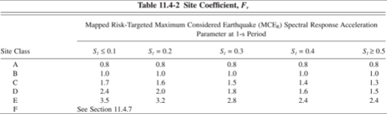
Site Coefficient at 1-second Period Fv

Slide 19
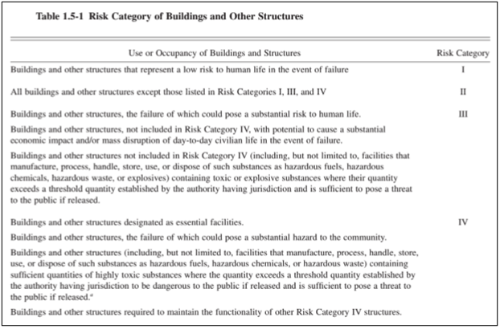
Risk Category

Slide 20
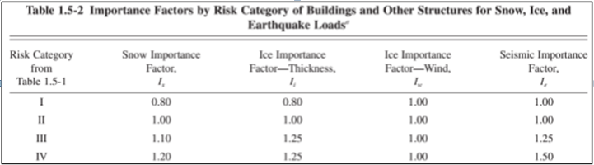
Seismic Importance Factor I

Slide 21
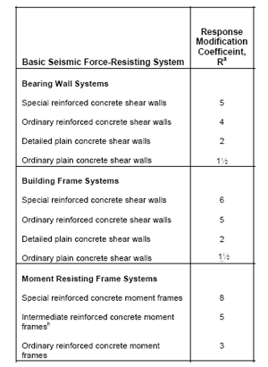
Response Modification Coefficient R

Slide 22
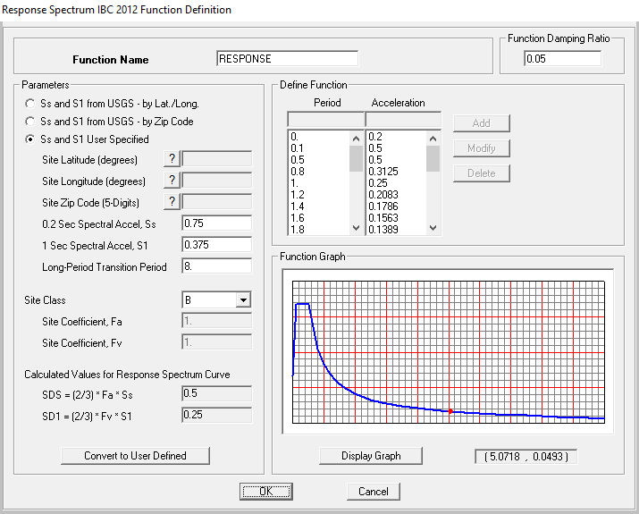
Define Of Response Spectrum Function:

Slide 23
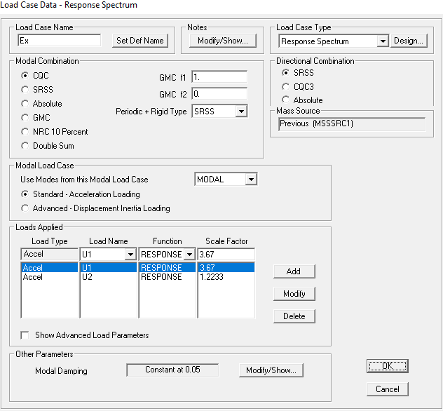

Response Spectrum In X-Direction
Factor = (gI/R)*(3/2)
= (9.81*1.25/5) * 1.5
= 3.67
Ey=EY+0.33Ex
(1/3)*3.67
=1.2233

Slide 24
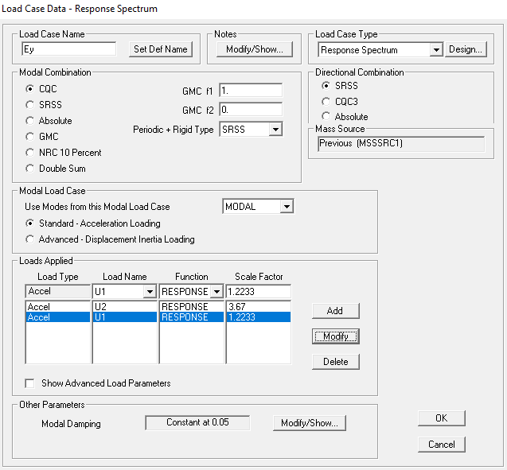
Response Spectrum In y-Direction
Factor = (gI/R)*(3/2)
= (9.81*1.25/5) * 1.5
= 3.67
Ey=EY+0.33Ex
(1/3)*3.67
=1.2233

Slide 25
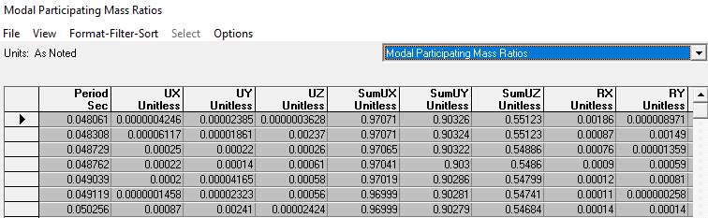
Modal Mass Participation Ratio
Block A:
According to IBC Code, we should have Modal Participating Mass Ratio (MPMR) more than 90% in both directions
at 12 modes we achieve 90%

Slide 26
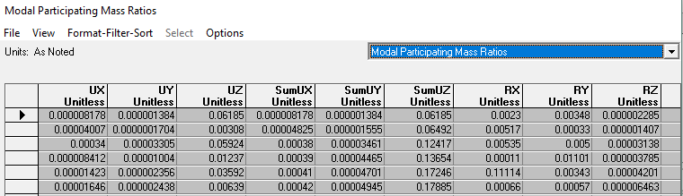
Modal Mass Participation Ratio
Block B:
The mass participation ratio is very small in (x,y) direction because the model is moving in z direction mainly and the Model has a lot of shear wall .

Slide 27
Verifications of structural analysis
Equilibrium Check
Stress Strain Check
Check deflection(Immediate and long term )
Check shear

Slide 28
Equilibrium
Block A:
Dead
Superimposed
Live
Hand Calculations
4461.65 KN
1987.37KN
1894.9KN
SAP
4403.4KN
1987.37KN
1894.9KN
Differences
1.3%
0%
0%

Slide 29
Equilibrium
Block B:
Dead
Superimposed
Live
Hand Calculations
3756.3KN
535.8KN
1420KN
SAP
3780.2KN
535.766KN
1413.2KN
Differences
0.6%
0%
0.49%

Slide 30
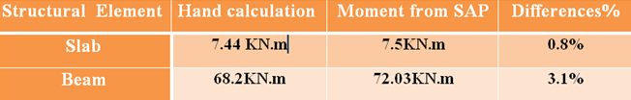
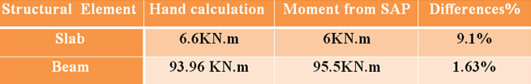
Stress-strain
Block A:
Block B:

Slide 31
Immediate deflection
* Allowable Deflection on solid slab (Block A):
From ACI 318-08 maximum deflection
= L/240
=(3.7*1000)/240=15.41 mm.
* Allowable Deflection on solid slab (Block B):
=(5.04*1000)/240=21 mm

Slide 32
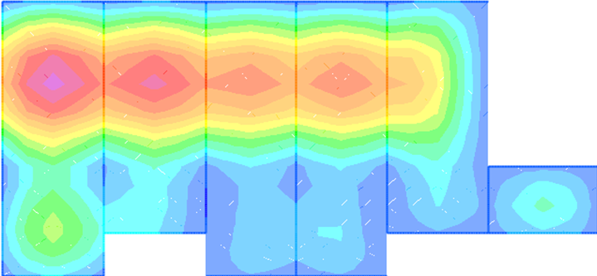


Immediate deflection in solid slab
maximum deflection in Solid slab = 14.97 mm
$$14.97mm<15.1mm →OK.$$
Block A
$$17.219 mm<29.6mm →OK.$$

Slide 33

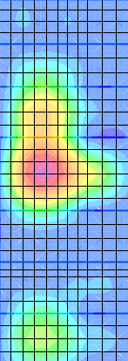

Immediate deflection in solid slab
Block B
maximum deflection in Solid slab = 21 mm
20.21$mm<21mm →OK.$

Slide 34
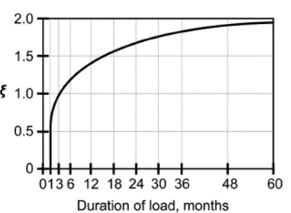

Long Term Deflection
The long term deflection is given by the following equation:
Δ Long term = Δ L + λ∞ x Δ D + λt x Δ SL
To find T
Where:
λt = λ∞ , since we assumed that the live load will sustained for 5 years ≈ ∞
λ = (such that is the compression steel ratio, T is a multiplier for long term deflection)
Δ L= deflection due to live load
Δ D= deflection due to dead load
Δ SL= deflection due to sustained live
As we notice from the figure at time 5 years
(60 months):
λ=$\frac{2}{1+50×0}$ = 2

Slide 35
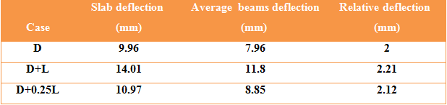
Long Term Deflection
* ∆_{Lt} on Solid slab (Block A)
∆Lt = 0.21 + 2* 2+ 2*0.12 = 4.45 mm < 15 mm

Slide 36
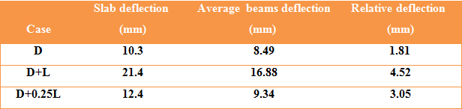
Long Term Deflection
* ∆_{Lt} on solid slab (Block B)
∆Lt = 2.71+ 2* 1.81+ 2*1.24 = 8.8 mm < 21 mm
→(OK).

Slide 37
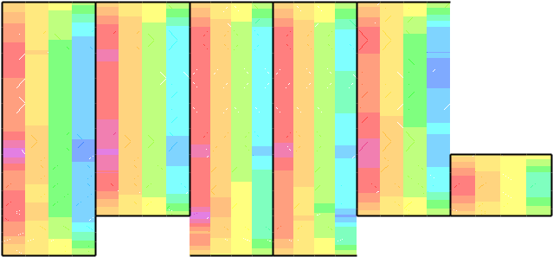


Check shear
$$φV_{c} =φ\frac{1}{6}\sqrt{f_{c}^{′}}b_{w}d=(0.75∗\frac{1}{6}∗\sqrt{24}∗1000∗140)/1000=\text{85}\text{.}\text{73 }\text{KN}\text{.}$$
Vu from SAP = 34KN.
→ 34 < 85.73 KN.
→ ( OK ).
Block A

Slide 38

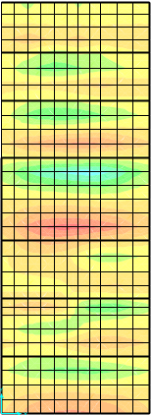

Check shear
$$φV_{c} =φ\frac{1}{6}\sqrt{f_{c}^{′}}b_{w}d=(0.75∗\frac{1}{6}∗\sqrt{24}∗1000∗120)/1000=\text{33}\text{.}\text{9}\text{KN}\text{.}$$
Vu from SAP = 34KN.
→ 20 < 33.9 KN.
→ ( OK ).
Block B

Slide 39
Design of structural element.
Load combinations
DESIGN OF SLAB
DESIGN OF BEAMS
DESIGN OF COLUMNS
Design of shear wall
Design of stair
DESIGN OF FOOTINGS

Slide 40
Load Combination
U = 1.4D (9-1)
U = 1.2D + 1.6L + 0.5(Lr or S or R) (9-2)
U = 1.2D + 1.6(Lr or S or R) + (1.0L or 0.5W) (9-3)
U = 1.2D + 1.0W + 1.0L + 0.5(Lr or S or R) (9-4)
U = 1.2D + 1.0E + 1.0L + 0.2S (9-5)
U = 0.9D + 1.0W (9-6)
U = 0.9D + 1.0E (9-7)
Where:
U: ultimate load
D: dead load
L: live load
W: wind load
E: earthquake Load
H: load due to weight or pressure of soil
ACI 318M-11-Equations (9.1-9.7)

Slide 41
DESIGN OF SLAB
design of Solid slab (Block A)
DESIGN OF solid SLAB (Block B )

Slide 42

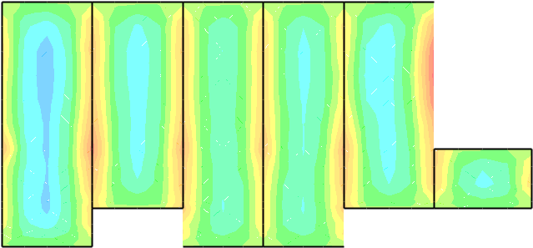
M11 in X direction:
Block A:
Max Positive Moment in panel → Mu = 12.03 KN.m.
Max Negative Moment in panel at both side is→ Mu = 18.9,14.9 KN.m.
For M+
ρ= 0.00165
For M-
ρ= 0.00262
ρ= 0.00205
use 5φ12/m

Slide 43
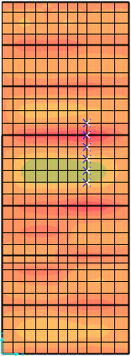

M22 in y direction:
Block B:
Max Positive Moment in pannel → Mu = 18.1 KN.m.
As min = 0.0018*1000*180 = 324mm2.
ρ =0.00292
use 5φ12/m
Max Negative Moment in pannel at both side is→
Mu = 22 , 18 KN.m.
ρ =0.00357
ρ =0.00292
use 5φ12/m

Slide 44
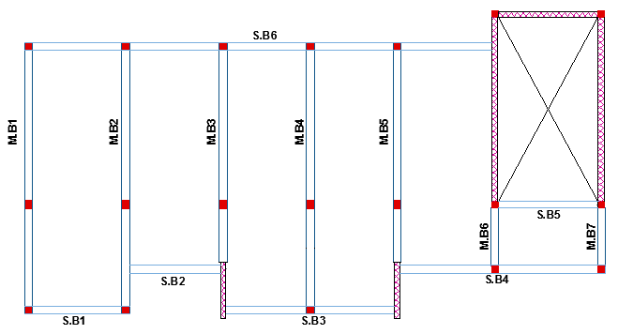
Design of Beams

Slide 45
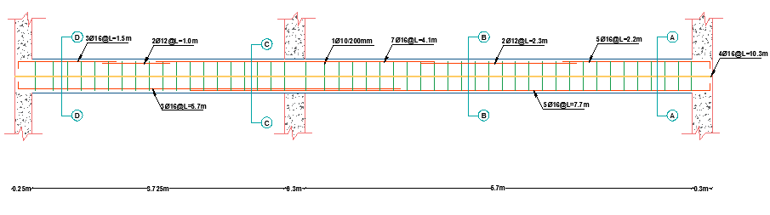

Slide 46
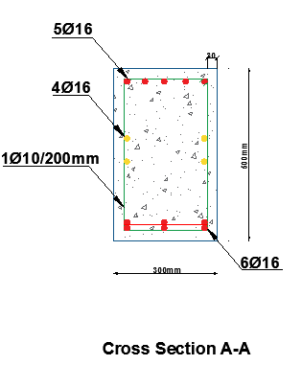
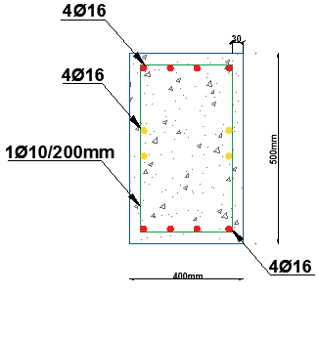
Designed Beam
Block A
Block B

Slide 47
Design of columns
Block A
Critical column | Columns | Area gross | Group
C9 = 329.81KN | C1,C4,C9 ,C14,C15, C16, C17, C18, C19. | 250*250 mm | Group 1
C5 = 798.5 KN | C2,C3,C5 ,C6,C7,C8 C10, C11, C12, C13. | 300*300 mm | Group 2

Slide 48
Check slenderness:
L_{u} = 3.85 - 0.25 = 3.6 m
r = 0.3 h = 0.3*0.25 = 0.075 m
Ky :
Ψ_{A}=0
Ψ_{B}= 0.453
Take K = 0.59
KLu/r=0.59*3.6/0.075<
34-12M1/M2
28.32 < 33.7
So it’s short column
M₁= 41.226 KN.m
M₁= 140.83 KN.m
I_{c} =3.25 *10⁻⁴ m⁴
I_{B}= = 3.125* 10⁻³m⁴
I_{C} = 0.7* 3.25 *10⁻ ⁴ = 2.275*10⁻⁴ m⁴
I_{B}= 0.35*3.125*10⁻³ = 1.1*10⁻³ m⁴
Kx :
Ψ_{A}=0
Ψ_{B}= 0.186

Slide 49
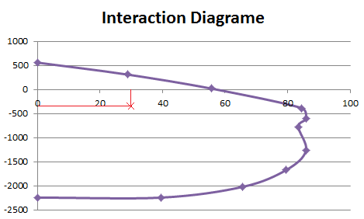

Slide 50
Summary of Columns
Bars | Area of steel (mm^2) | Cross sectional area(mm^2) | Critical axial load(KN) | Group
8ф 12 | 625 | 250*250 | 329.81 | 1
8ф 12 | 900 | 300*300 | 798.5 | 2
8ф 12 | 900 | 300*300 | 558.35 | 3

Slide 51
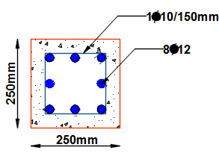
Ag from SAP =62500 mm^2
As=0.01*250*250=625 mm^2
Use 8φ12
Tie steel:
S ≤ 16* 12 = 192 mm
≤ 480 mm.
≤ 250 mm
Use 1 ф 10 / 150 mm
Group 1

Slide 52
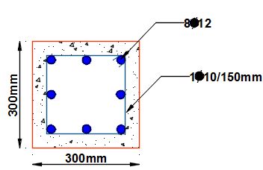
Block B
Block A
Group 2
Group 3

Slide 53
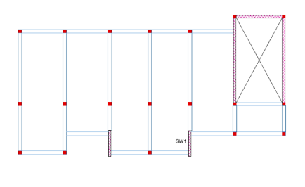
Designed shear wall under gravity load
𝑆ℎ𝑒𝑎𝑟 𝑤𝑎𝑙𝑙 ( 𝑋∗𝑌)
= ( 200𝑚𝑚∗2150𝑚𝑚).
𝐶𝑜𝑣𝑒𝑟 =40𝑚𝑚.

Slide 54




Designed shear wall under gravity load
F22
F11
F22 = 315KN
F11 = 70KN
Ag for strip 1 m = 200*1000=200000KN

Slide 55
Design Of Shear Wall
Use minimum Shear reinforcement.
→Use 𝜌min=0.0025
𝐴𝑠,ℎ𝑜𝑟𝑖𝑧𝑜𝑛𝑡𝑎𝑙
= 𝜌𝑚𝑖𝑛∗𝑏∗ℎ=0.0025∗1000∗200=500𝑚𝑚².
500/2=250 𝑚𝑚² on each side.
Assume ϕ10→4 ϕ10 / m in each side.
As, Vertical
𝑈𝑠𝑒 𝐴𝑠=1505.7𝑚𝑚².
Assume ϕ12 → 7 ϕ12 / m in each side.

Slide 56
Design Of Stair
Thickness of flight = 18cm
Load on stair:
*Live = 5 𝑘𝑁/𝑚²
*Superimposed = 5 𝑘𝑁/𝑚²

Slide 57
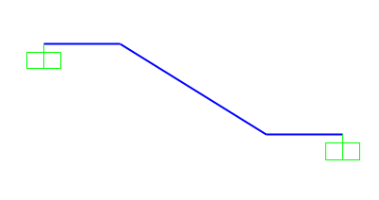
Design of Flexure for stair
Flight , Landing
𝐴𝑠= 0.0092*150*1000 = 1380
→ use 8φ16mm/1000mm
Max M33(Negative) = 33.27 KN.m
→ ρ = 0.0041 >0.0018
Use ρ = 0.0041
→ use 8φ16mm/m
Max M33(Negative) = 70.9 KN.m
→ ρ = 0.0092 >0.0018
Use ρ = 0.009

Slide 58
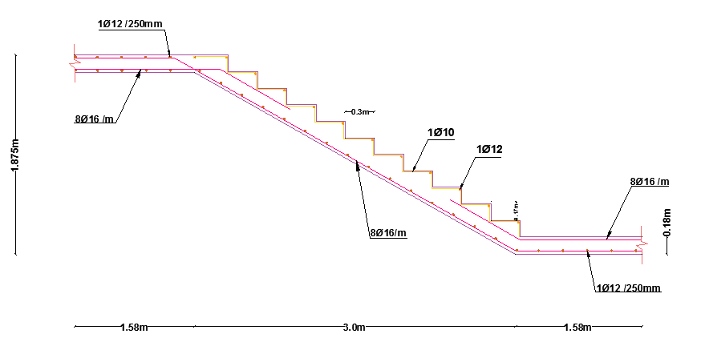
Design for Transverse steel
𝐴𝑠 𝑠ℎ𝑟𝑖𝑛𝑘𝑎𝑔𝑒 =0.0018×180×1000
=324𝑚𝑚².
(Use 1 ∅12/250mm )

Slide 59
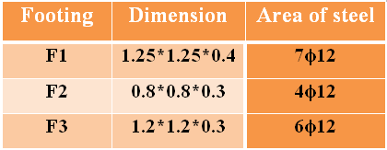
Design of Footing

Slide 60
Design of Footing
Footing 1:
Pservice = 595.733 KN Pu= 798.49 KN
Footing area = 1.5 m² ,
use B = 1.25 m , L = 1.25 m.
P_{u}= 798.49 KN
q_{u =511.03KN/m^2}
q_{all} = 400 KN/m

Slide 61
Check Wide Beam Shear
ΦVc = 0.75∗0.333∗√30∗330∗1000=226 KN
.
Vu= qu(L1-d)= 74.1 KN
.
Vu < ΦVc . OK

Slide 62
Check Punishing Shear
ΦVc p = 0.75∗0.333∗√30∗330∗2.52=1127 KN
.
Vup= Pu- qu A1= 595 KN
.
Vup < ΦVc p . OK

Slide 64
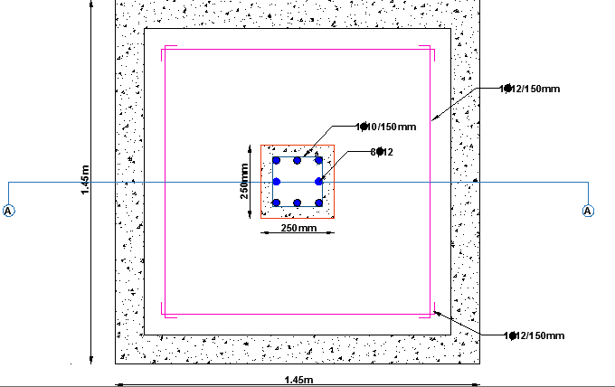

Slide 65
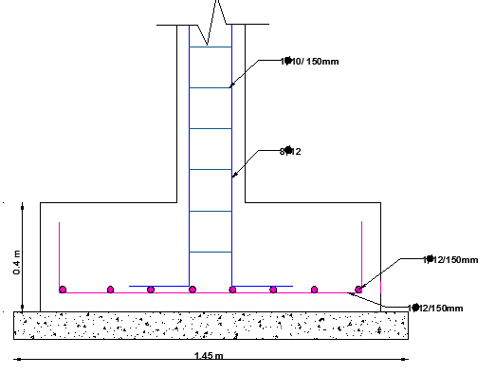

Slide 66
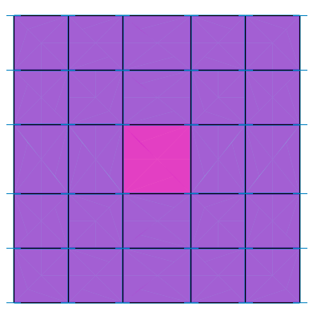

check deflection
Max deflection in Footing = 9.51 mm < 10 mm .

Slide 67
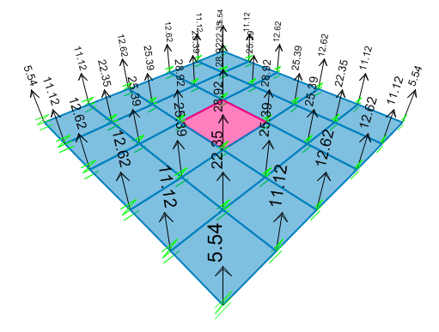
Check allowable max stress
Stress=28.92/0.3*0.3=321 KN/m^2 < 400 OK

Slide 68
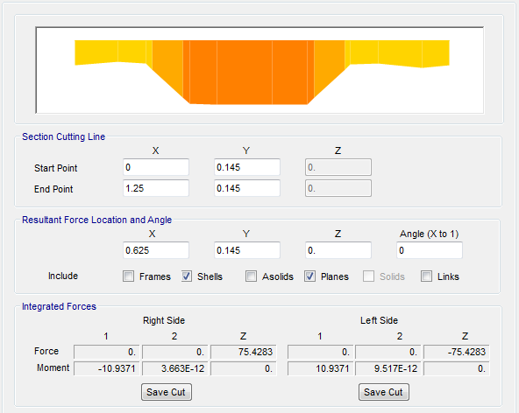
Check Shear from Ultimate Load
Section Cut at d
ϕ V_{c =} 226KN
Vu=75.43/1.25=60.3
Capacity of section ok

Slide 69


