Slide 1
Zajel of Palestinian Schools
Fadi Nabeel
&&
Hussein Ghanem

Slide 2
Introduction
Why we choose this project ?
We decided to work with this idea because there isn’t any real site up to these days concern with schools in Palestine , other thing we want to make benefit to all people dealing with schools , like students themselves
( and there fathers ) , teachers in the school , directories and ministry of education .

Slide 3
This site serve five entities in Palestinian ministry of education
Ministry, Directorates, School ,
Teachers and Students .
And every one of this has his own pages which can access them .

Slide 4
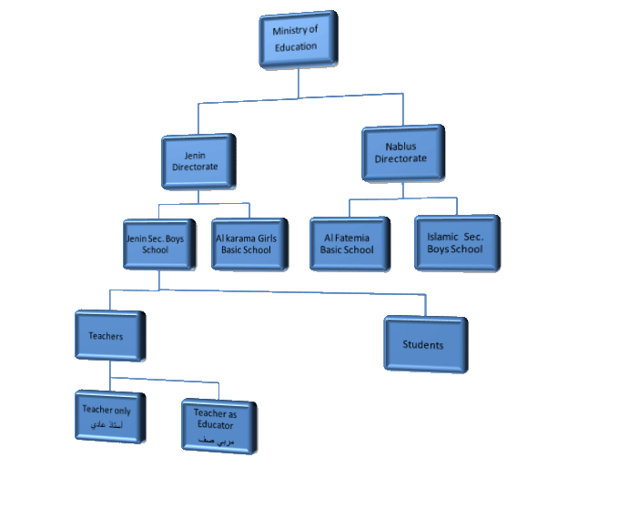
The hierarchal Shape of the site

Slide 5
This is the highest entity in the hierarchal state of our site , the ministry can do all things i.e it has all proprieties in the site .
What is the work of the ministry ?
1- Manage Site Codes .
2- Ministry Class Management
3- Subjects Management .
4- Directories Management .
5- School Management :
6- Study Year Management & database backup :
Ministry

Slide 6
What is its work ?
* Manage its schools :
When the user enter to the site as directorate it first face the schools which its responsible about them, and it can reach to its teachers and students in those schools
The directorate page can only be reached either by the directorate itself or by the ministry only .
Directorates

Slide 7
What are there work ?
1) School information Managing .
2) Teachers Management .
3) Students Managements
4) School Class Management .
Those pages can be entered by ministry and by the directorate in addition to the schools itself .
Schools

Slide 8
The teacher can enter to his pages those pages contain :
1- Information about the teacher : include - Personal information
- Job information .
- His Family
- His qualifications .
2- The teacher load : include the materials and classes the teacher teach in his school throw this page he can manage the grades of his students and rating s and many other things .
3- Anther information : ratings , terms , degrees , absence , awarding and penalties .
4- His messages from the ministry and school .
Teachers

Slide 9
* All the users of the site can reach to this point , especially student himself .
* The student need to know information stored about him , from here he can know every thing about his personal information , education information , family , his dispensing , failing , transferring , absence , also he can reach to the most important thing , his grades from first exam to the final exam . This technique allow the student father to show all his son information in his school .
Students

Slide 10
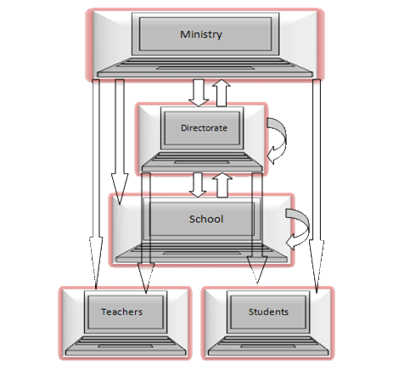
As we see in usual sites that there are techniques allow the users to send messages between them , so we used this idea in our site because its one of the most important thing needed in this environment of working .
Communication
in the site

Slide 11
In the security Features there are three main Parts we used :
1- Using Log in Password and user name to all entities of our site, so each user has its own user name and Password . And the features connect with this like Password Recovery , Password Change , …etc .
2- Using HTTPS security we used this feature when we want to transfer pages contain passwords , between client and server for example login page . So we used a free trial certificate that allow us to use HTTPS with IIS server and we can run the site by using any server .
3- No Concurrent Login : No concurrent same user can enter to the site at the same time from different locations . Unfortunately using sql server with asp.net doesn’t call the global function (session_end) so when we want to check if a user had logged out from his session , the session doesn’t be killed and he remains online so that we use cache with timer feature provided in asp.net .
Security In the site

