Slide 1
Structural Analysis and Design of Kadoorie Faculty of Science and Literatures building
Prepared By:
Mustafa Ramadan
Raghad Bishawi
Oday Kalbouneh
Under Supervision Of:
Eng. Ibrahim Arman

Slide 2
Outline
Background information
Analysis and design inputs
Codes and Softwares used
Analysis and results
Design and results

Slide 3
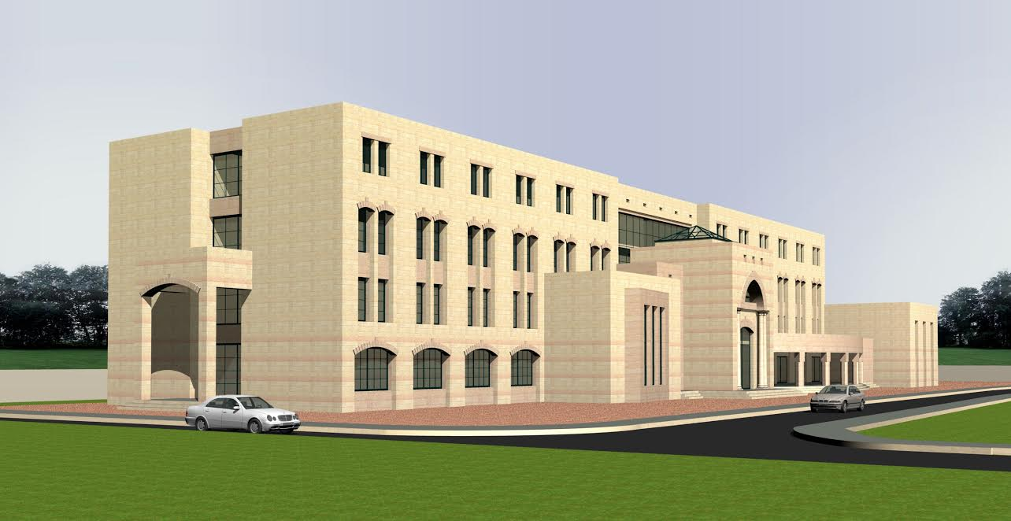
Background information
3D Architectural Model

Slide 4
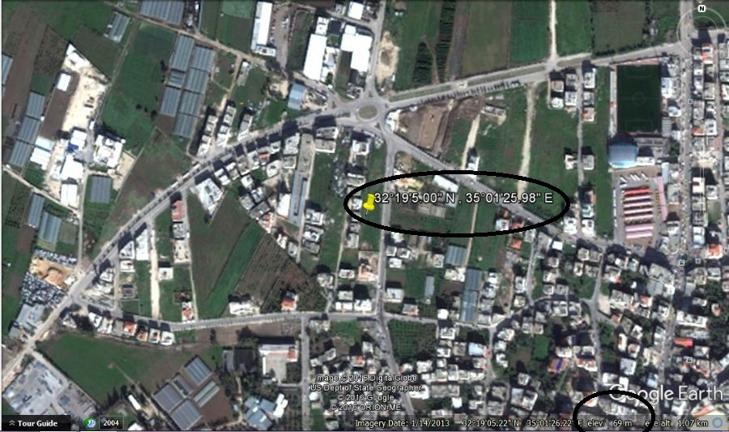
Background information
General location

Slide 5
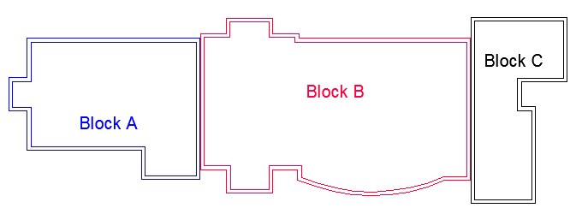
Background information
General information

Slide 6
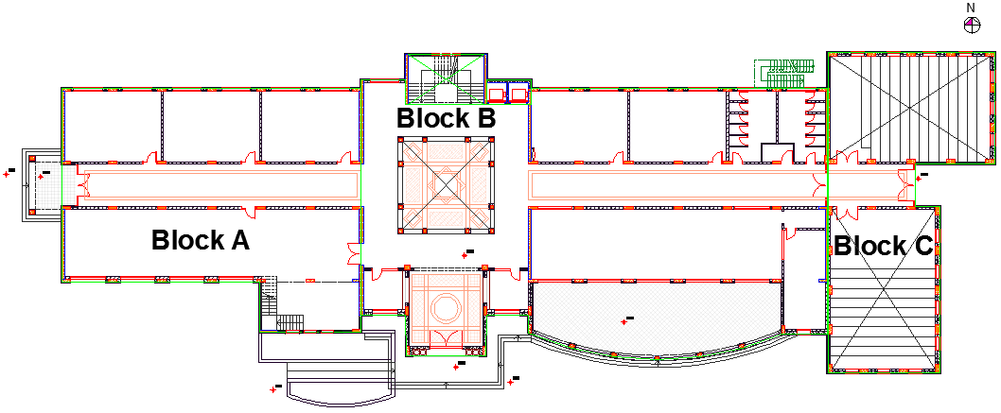
Background information
Architectural Plans
Ground floor

Slide 7
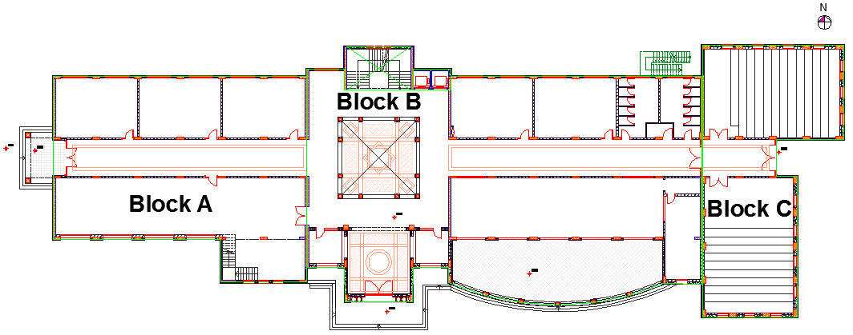
Background information
Architectural Plans
First floor

Slide 8
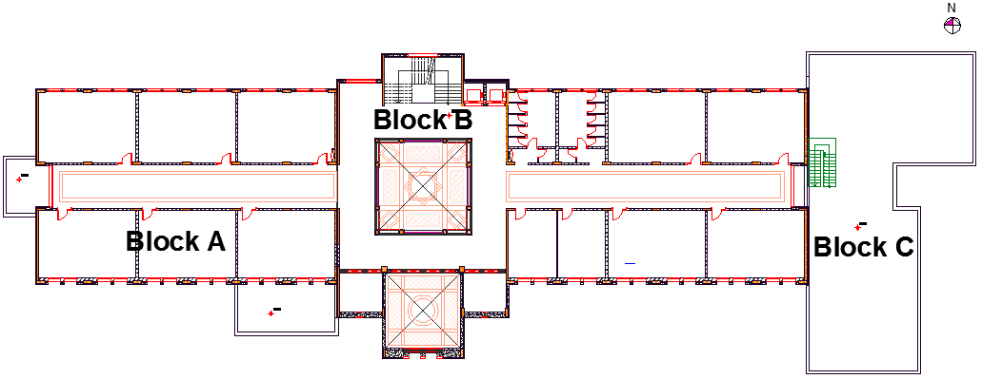
Background information
Architectural Plans
Second floor

Slide 9
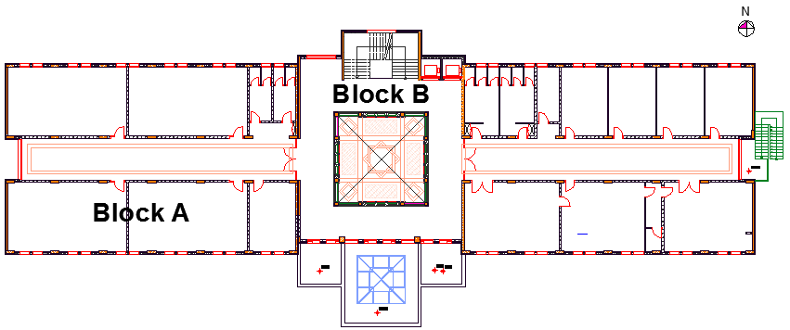
Background information
Architectural Plans
Third floor

Slide 10
Background information
General information
Floor | Area (m²) | Height (m) | Utilizations
Ground floor | 1449.17 | 3.7 | Classrooms, library, control, cafeteria, bathrooms
First floor | 1708.48 | 3.7 | Classrooms, teachers rooms, laboratories, bathrooms
Second floor | 1335.89 | 3.7 | Classrooms, teachers rooms, bathrooms
Third floor | 1240.79 | 3.7 | Chancellor’s room, meetings room, offices, secretaryship and reception, computer labs, bathrooms
Staircase | 108.49 | 3.25 | ----
Total sum | 5842.82 | ---- | ----

Slide 11
Analysis and design inputs
Construction materials
Concrete
Reinforcing steel
Other materials (non-structural materials)

Slide 12
Analysis and design inputs
Concrete
Structural Element | Concrete Type | f_{c}ʹ (MPa) | E_{c} (MPa) | f_{t}ʹ (MPa) | f_{r} (MPa)
Reinforced concrete elements | B350 | 28 | 2.48*10⁴ | 1.75 | 3.28
Tie beams | B300 | 24 | 2.30*10⁴ | 1.62 | 3.04
Blinding | B200 | 16 | 1.88*10⁴ | 1.32 | 2.48

Slide 13
Analysis and design inputs
Reinforcing steel
Yield strength (F_{y}) | 420 MPa
Ultimate strength (f_{u}) | 615 MPa
Steel grade | 60
Modulus of elasticity (E_{s}) | 200 GPa

Slide 14
Analysis and design inputs
Other materials (non-structural materials)
Material | Ɣ (kN/m³)
Blocks | 12
Tiles | 27
Masonry stones | 27
Plastering | 23
Concrete mortar | 23
Aggregates | 18

Slide 15
Analysis and design inputs
Loads:
Gravity loads (Dead, Super imposed dead and Live loads).
Lateral loads (Earthquake load).

Slide 16
Analysis and design inputs
Gravity loads
Dead load
The dead load includes the self-weight of the structural elements.

Slide 17
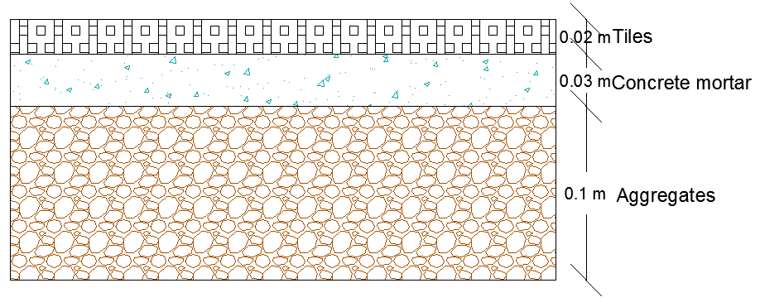
Analysis and design inputs
Super imposed dead loads:
Floor loads (4.5kN/m²)
Floor layers (3.38 kN/m²)

Slide 18
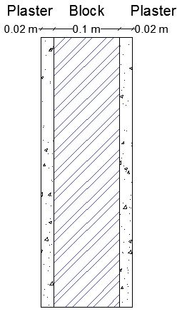
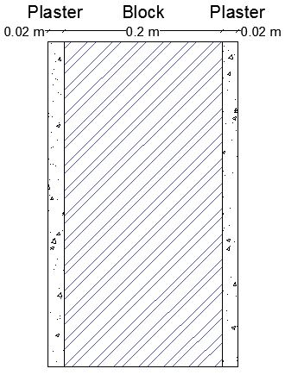
Analysis and design inputs
False ceiling (0.2 kN/m²)
Partitions: (0.92 kN/m²)

Slide 19
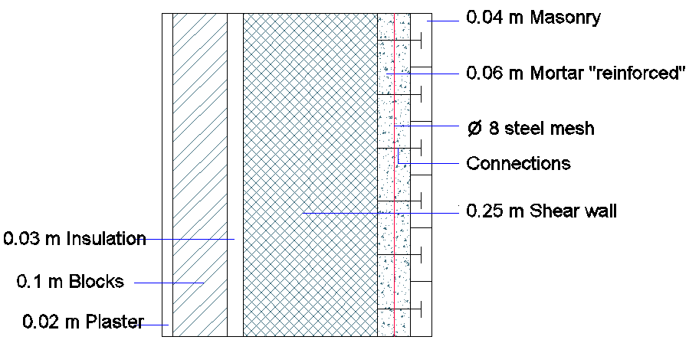
Analysis and design inputs
Exterior walls super imposed dead load
(2.6 kN/m²)

Slide 20
Analysis and design inputs
Live load
(IBC-2012)
7.2 kN/m² for libraries and 5 kN/m² for others were used.
Classrooms and teachers’ rooms | 2 kN/m²
Corridors | 5 kN/m²
Restaurant (Cafeteria) | 5 kN/m²
Terrace | 5 kN/m²
Roof | 2 kN/m²
Libraries | 7.2 kN/m²

Slide 21
Analysis and design inputs
Snow load
(Jordanian code 2006)
h = 69 m , h < 250 m
S0 = 0
Sd = S0 * µi = 0
No need to design the building for snow loads

Slide 22
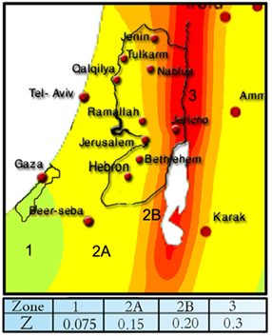
Analysis and design inputs
Lateral loads
Seismic loads according to response spectrum
Spectral response acceleration parameters:
*Israeli standard (SI 413)
Seismic zone:
Tulkarm (2A)
Seismic zone factor
UBC 97 Z = 0.15

Slide 23
Analysis and design inputs
Design spectral response acceleration parameters:
S_{DS} = 0.45 g
S_{D1} = 0.3023 g

Slide 24
Analysis and design inputs
Risk category (III): (IBC 2012 )
Importance factor (I_{e}) = 1.25 (ASCE 7-10 )
Seismic design category (SDC) D (IBC 2012 )
Redundancy factor (ρ) = 1.3 (ASCE 7-10 )

Slide 25
Analysis and design inputs
Seismic force-resisting system: (ASCE 7-10 )
Building frame system with special reinforced concrete shear walls.
Response modification coefficient (R) = 6
Overstrength factor (Ω₀ ) = 2.5
Deflection amplification factor (C_{d}) = 5

Slide 26
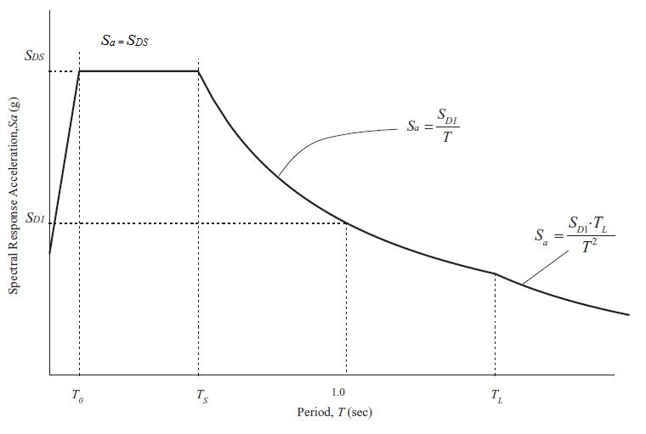

Analysis and design inputs
Elastic response spectrum curve: (ASCE 7-10)
S_{a} = Design spectral response acceleration
T₀ = 0.2 $\frac{SD1}{SDS}$ = 0.14 second
T_{S} = $\frac{SD1}{SDS}$ = 0.67 second
T_{L} = Long-period transition period (s)
, it is assumed to be (8 seconds)
T = The fundamental period
of the structure (second)

Slide 27
Analysis and design inputs
Load combinations (IBC-2012 )
Load combinations for factored loads:
Load Combination | Equation No.
U = 1.4(D+F) | 16-1
U = 1.2(D+F)+1.6(L+H)+0.5(Lr or S or R) | 16-2
U = 1.2(D+F)+1.6(Lr or S or R)+1.6H+(f1L or 0.5W) | 16-3
U = 1.2(D+F)+1.0W+f1L+1.6H+0.5(Lr or S or R) | 16-4
U = 1.2(D+F)+1.0E+f1L+1.6H+ f2S | 16-5
U = 0.9D+1.0W+1.6H | 16-6
U = 0.9(D+F)+1.0E+1.6H | 16-7

Slide 28
Analysis and design inputs
Load combinations for service loads:
Load Combination | Equation No.
D + F | 16-8
D + H + F + L | 16-9
D + H + F + (Lr or S or R) | 16-10
D + H + F+ 0.75(L) + 0.75(Lr or S or R) | 16-11
D + H + F + (0.6W or 0.7E) | 16-12
D + H + F + 0.75(0.6W) + 0.75L + 0.75(Lr or S or R) | 16-13
D + H + F + 0.75 (0.7 E) + 0.75 L + 0.75 S | 16-14
0.6D + 0.6W+H | 16-15
0.6(D + F) + 0.7E+H | 16-16

Slide 29
Codes and Softwares used
Codes and standards:
ASCE 7-10 : American Society of Civil Engineers.
ACI 318-11 & ACI 318-14 & ACI 209R-92 : American Concrete Institute .
IBC 2012 : International Building Code.
ASTM 1997 : American Society for Testing and Materials.
Jordanian code 2006.
Software programs:
ETABS 2015 (to analyze and design the model)
SAFE 2016.
AutoCAD 2014 (to prepare structural drawings)
Other programs such as: Microsoft Word 2010, Microsoft Excel 2010.

Slide 30
Analysis and results
Preliminary design:
Load combinations used:
1.4 D
1.2 D + 1.6 L
Where:
Live load (L) = 5 kN/m² (IBC-2012)
Dead load (D) = Super imposed dead load + Own weight
Super imposed dead load (SID) = 4.5 kN/m²

Slide 31

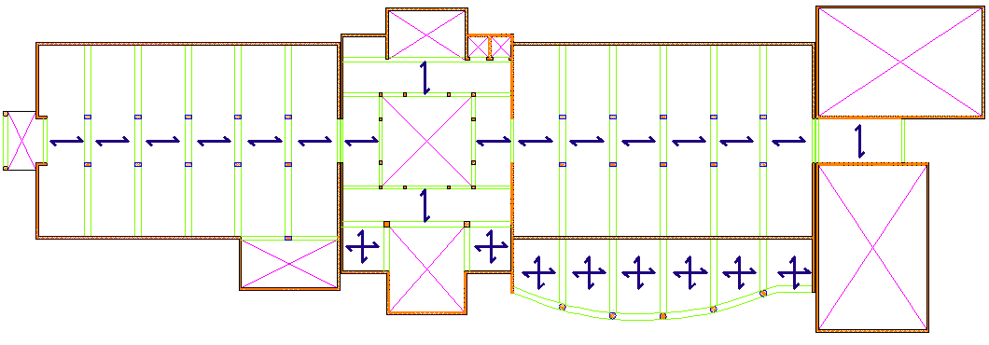
Analysis and results
Preliminary design:
Slabs:
(One way solid slab) & (Two way solid slab) Ground floor

Slide 32
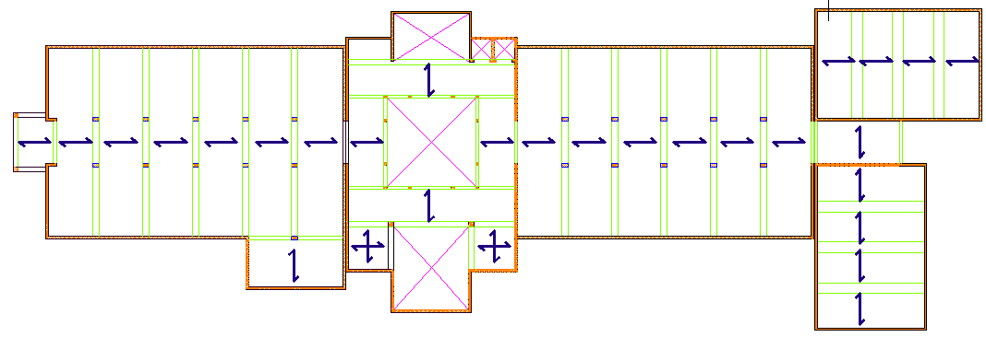
Analysis and results
Preliminary design:
Slabs:
(One way solid slab) & (Two way solid slab) 1st floor

Slide 33
Analysis and results
Slabs:
Thicknesses:
h = 0.2 m for block A (strips 1 & 2)
h = 0.25 m for block A (strip 3)
h = 0.2 m for block B (strips 1 & 4 & 5 & 6 & 7) & (panel #8 &
panel #9“two way”)
h = 0.2 m for block C (strips 10 & 11 & 12)

Slide 34
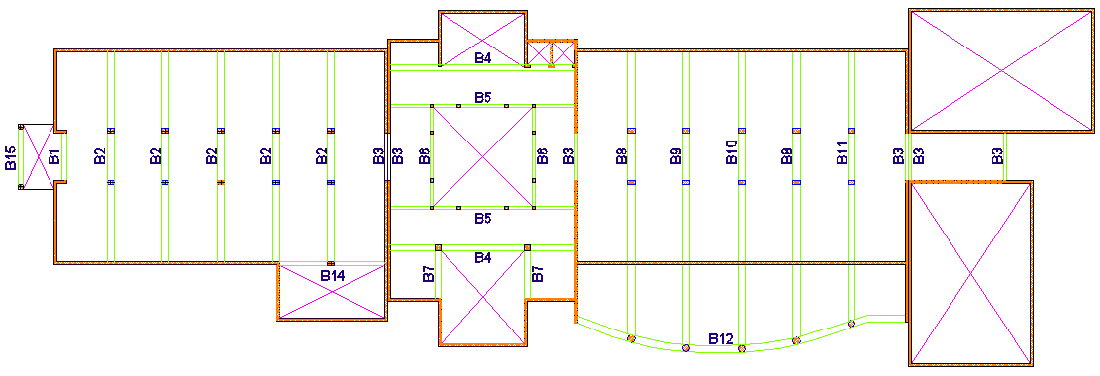
Analysis and results
Beams:
Main beams:
Beams layout: (GF)

Slide 35
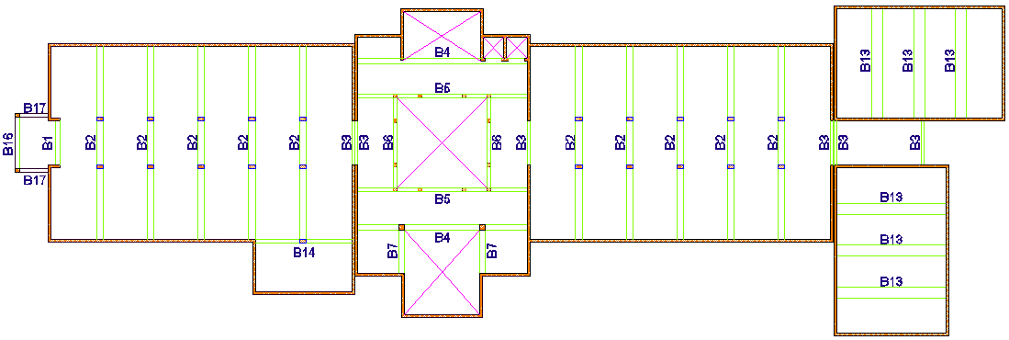
Analysis and results
Beams:
Main beams:
Beams layout: (1st Floor)

Slide 36
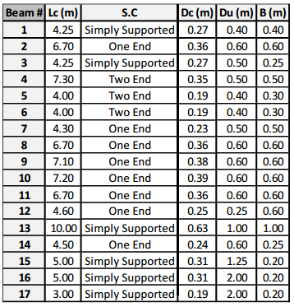
Analysis and results
Beams:
Main beams:

Slide 37
Analysis and results
Beams:
Tie beams:

Slide 38
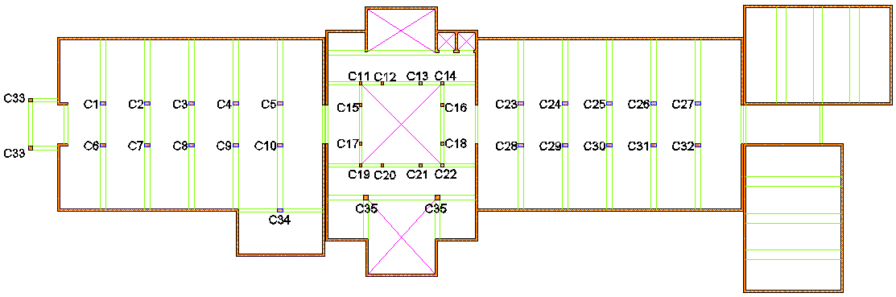
Analysis and results
Columns:
Columns’ layout

Slide 40

Analysis and results
Walls:
Assume the wall thickness:
(h) = 250mm
$ϕPn=0.55ϕfcʹAg [1−{\left(\frac{klc}{32h}\right)}^{2}]$
($ϕPn>$Pu, Thus the thickness is adequate from the strength perspective)

Slide 41
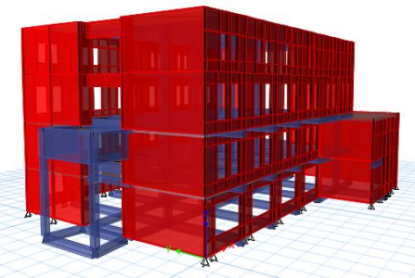
Analysis and results
Structural 3D modeling:

Slide 42
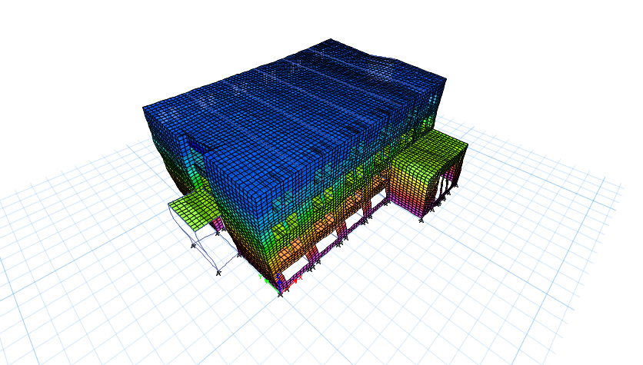
Analysis and results
Verification of structural analysis (model checks)
Compatibility check

Slide 43
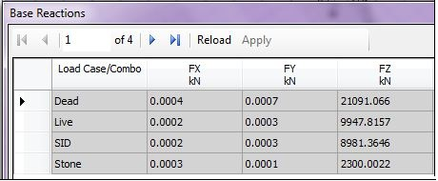

Analysis and results
2) Equilibrium checks
ETABS results:
% Error = $\frac{Hand calculations value − ETABS value}{Hand calculations value}$ * 100%
Gravity load name | Hand calculations value | ETABS value | % Error | Acceptable or not
Dead load | 21007 | 21091.066 | 0.4% < 5% | acceptable
Live load | 9948 | 9947.8157 | 0.00185% < 5% | acceptable
Superimposed dead load | 8982 | 8981.3646 | 0.007% < 5% | acceptable
Stone load | 2283.9 | 2300.0022 | 0.71% < 5% | acceptable

Slide 44
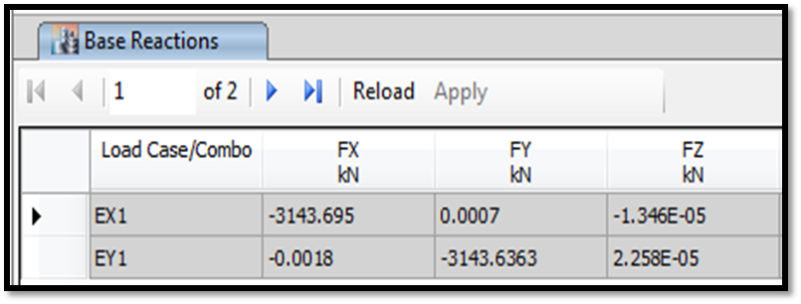
Analysis and results
2) Equilibrium checks
(For base shear): (ASCE 7-10)
Hand calculations:
V_{s} = C_{s} W = 3,224.78 kN
ETABS results:
V_{s} = 3,143.695 kN
% Error = 2.51 % < 5 % which is OK

Slide 45
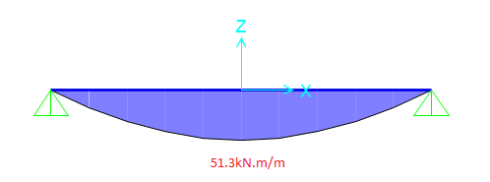
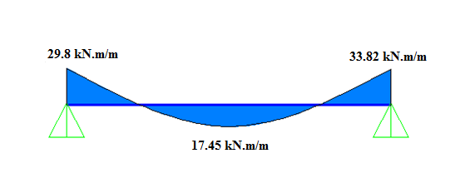

Analysis and results
3) Stress-strain check
Slabs:
Hand calculations:
M_{ult} = $\frac{Wu∗L^{2}}{8}$ = 51.3 kN.m/m
ETABS results:
(M_{ult}) = $\left(\frac{Right negative moment +Left nigative moment }{2}\right)$ + Positive moment
= 49.26 kN.m/m
% Difference = 3.97 % < 10 % which is OK

Slide 46
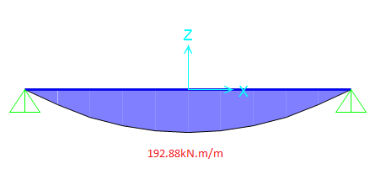
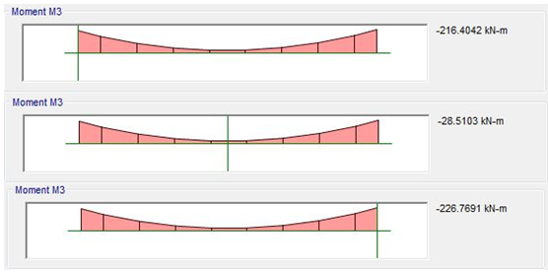

Analysis and results
3) Stress-strain check
Beams:
Beam #2:
Hand calculations:
M_{ult} = $\frac{Wu∗{Ln}^{2}}{8}$= 192.88 kN.m
ETABS results:
M_{ult} = 193 kN.m
% Difference=0.06 % < 10 %
which is OK

Slide 47
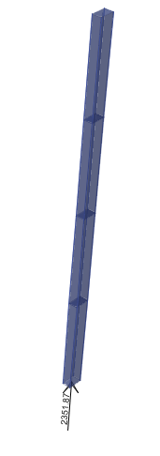
Analysis and results
3) Stress-strain check
Columns:
Column #9:
Hand calculations:
P_{u} = 1.2 P_{D}+ 1.6 P_{L} = 2305.8 kN
ETABS results:
P_{u} = 2351.87 kN
% of difference = 2 % < 10 % which is OK

Slide 48
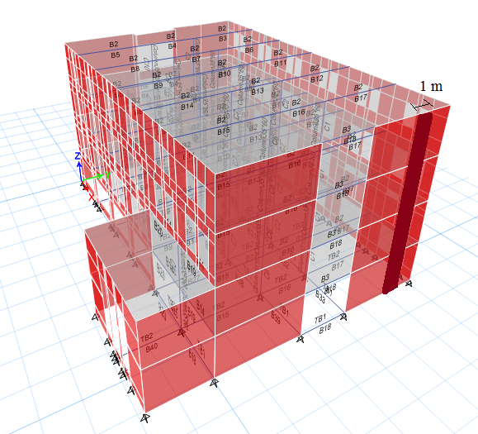
Analysis and results
3) Stress-strain check
Shear walls:
Hand calculations:
W_{u} = 1.2 W_{D}+ 1.6 W_{L} = 335.66 kN/m

Slide 49
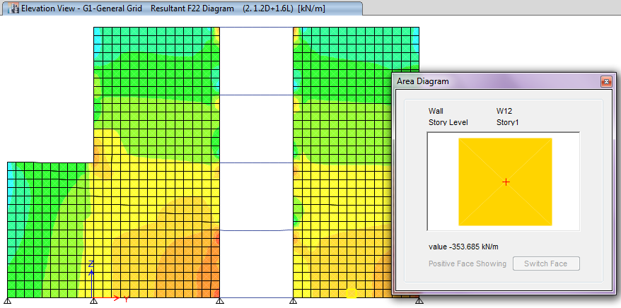
Analysis and results
3) Stress-strain check
ETABS results:
W_{u , ETABS} = 353.685 kN/m
% of difference = 5.37 % < 10 % which is OK

Slide 50
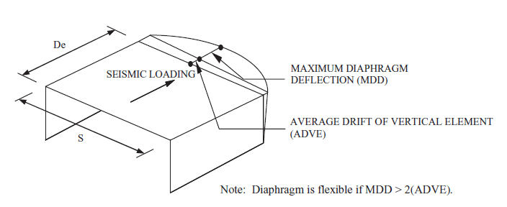
Analysis and results
Structural system checks
Rigidity check of diaphragms: (ASCE 7-10)

Slide 51
Analysis and results
Structural system checks
Rigidity check of diaphragms:
For the X-direction: (EX1)
For the Y-direction: (EY1)

Slide 52
Analysis and results
Structural system checks
Structural irregularities: (ASCE 7-10)
Horizontal irregularities: (EX1, EY1)
Type | Name | Occurrence
1a | Torsional irregularity | Not Existed
1b | Extreme torsional irregularity | Not Existed
2 | Reentrant corner irregularity | Existed
3 | Diaphragm discontinuity irregularity | Not Existed
4 | Out of plane offset irregularity | Not Existed
5 | Nonparallel system irregularity | Not Existed

Slide 53
Analysis and results
Structural system checks
Structural irregularities:
Vertical irregularities: (EX1, EY1)
Type | Name | Occurrence
1a | Stiffness-soft story irregularity | Existed
1b | Stiffness- extreme soft story irregularity | Existed
2 | Weight (mass) irregularity | Not Existed
3 | Vertical geometric irregularity | Existed
4 | In-plane discontinuity in vertical lateral-load resisting system irregularity | Existed
5a | Discontinuity in lateral strength-Weak story irregularity | Not Existed
5b | Discontinuity in lateral strength-Extreme weak story irregularity | Not Existed

Slide 54
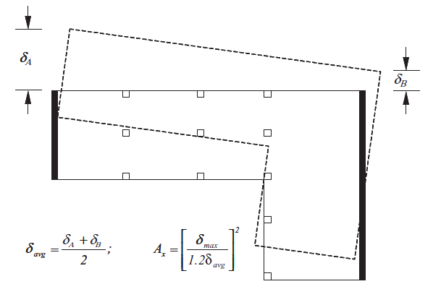
Analysis and results
Structural system checks
Check of amplification of accidental torsional moment (ASCE 7-10)
There are no torsional irregularities. Thus, A_{x} = 1

Slide 55
Analysis and results
Period check:
(ASCE 7-10 )
Check if: T_{n} ≤ C_{u} * T_{a}
T_{a} = C_{t} h^{x}_{n} = 0.0488 * (14)^{0.75} = 0.353 second
Where:
h = 14 m
C_{t} = 0.0488
x = 0.75
C_{u} = 1.4
C_{u} * T_{a} = 1.4 * 0.353 = 0.494 second

Slide 56

Analysis and results
Period check:
Rayleigh-method: (UBC-97)
T_{n} = 2 π $√\frac{Ʃ(MΔ^{2})}{Ʃ(FΔ)}$
X-direction:
Tn = 0.378 sec < 0.494 second
(There is no need to consider p-Δ effect)
 | M (ton) | delta (m) | F (kN) | M*(delta^2) | F*(delta)
Floor 1 | 1197.9096 | 0.0009 | 485.92648 | 0.000970307 | 0.437333832
Floor 2 | 1242.971 | 0.0014 | 545.99135 | 0.002436223 | 0.76438789
Floor 3 | 1157.6798 | 0.0019 | 485.92648 | 0.004179224 | 0.923260312
Floor 4 | 862.4859 | 0.0021 | 485.92648 | 0.003803563 | 1.020445608
 |  |  | Ʃ = | 0.011389317 | 3.145427642

Slide 57
Analysis and results
Period check:
The same procedure was conducted in Y-direction:
Tn = 0.351 sec < 0.494 second
(There is no need to consider p-Δ effect)

Slide 58
Analysis and results
Modal Mass Participation Ratio : (ASCE 7-10 )

Slide 59

Analysis and results
Deflection computations : (ASCE 7-10 )
Immediate and long term deflections were considered for both slab and beam
For immediate deflection:
∆_{immediate} = ∆_{L} ,,, ∆_{max} = $\frac{L}{360}$
For long term deflection:
∆_{LT} = ∆_{L} + ʎ∞*∆_{D}+ ʎ_{t} * ∆_{Ls} ,,, ∆_{LT, max} = $\frac{L}{240}$
ʎ∆$=$ $\frac{ξ}{1+50ρ′ }$

Slide 60
Analysis and results
Deflection computations:
Slab:
∆_{D}^{ʹ} = 3.8 mm ∆_{immediate} = ∆_{L} = 3.3 mm
∆_{SID}^{ʹ} = 3 mm
∆_{L}^{ʹ} = 3.3 mm ∆_{max} = 12.78 mm > ∆_{immediate} ,which is OK
Assumptions for long term deflection:
1. No compression steel (ρ′= 0)
2. Duration of application of sustained load ≥ 60 months (ξ = ξ_{max} =2)
3. Half of the live load is sustained
ʎ∞ = 2
ʎ_{t} = 2
∆_{LT} = 18.55 mm
∆_{LT, max} = 19.2 mm < ∆_{LT, max} ,which is ok

Slide 61

Analysis and results
Story drift : (ASCE 7-10 )
$δx=\frac{Cd∗ δxe}{Ie}$
X-direction:
Y-direction:
Δa = 0.015 hsx = 55.5 mm
Thus, all values of drift are less than the allowable drift limit

Slide 62
Design and results
Design principles:
The code used was ACI 318-14 for obtaining the design specifications.
Software results were taken (ETABS & SAFE) and checked.
Each member was designed for bending moment, shear, axial and torsion stresses.
Ductility requirements were satisfied by softwares.
Detailings are based on ACI 318-14.

Slide 63
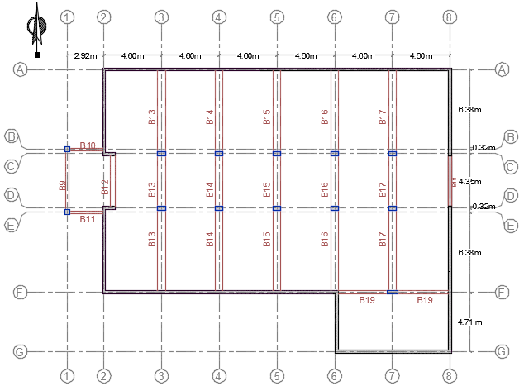

Slide 64
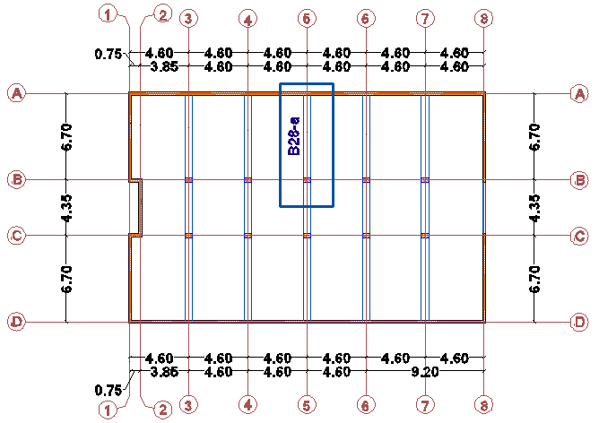
Design and results
Beams:

Slide 65
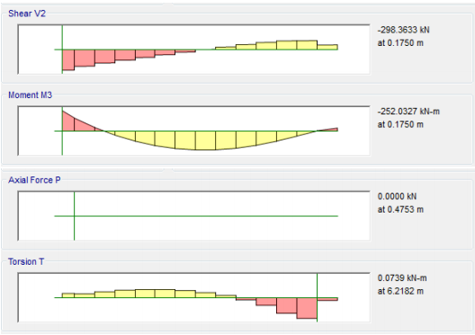
Design and results
Beams:
Load combination: 1.2D + 1.6L

Slide 66
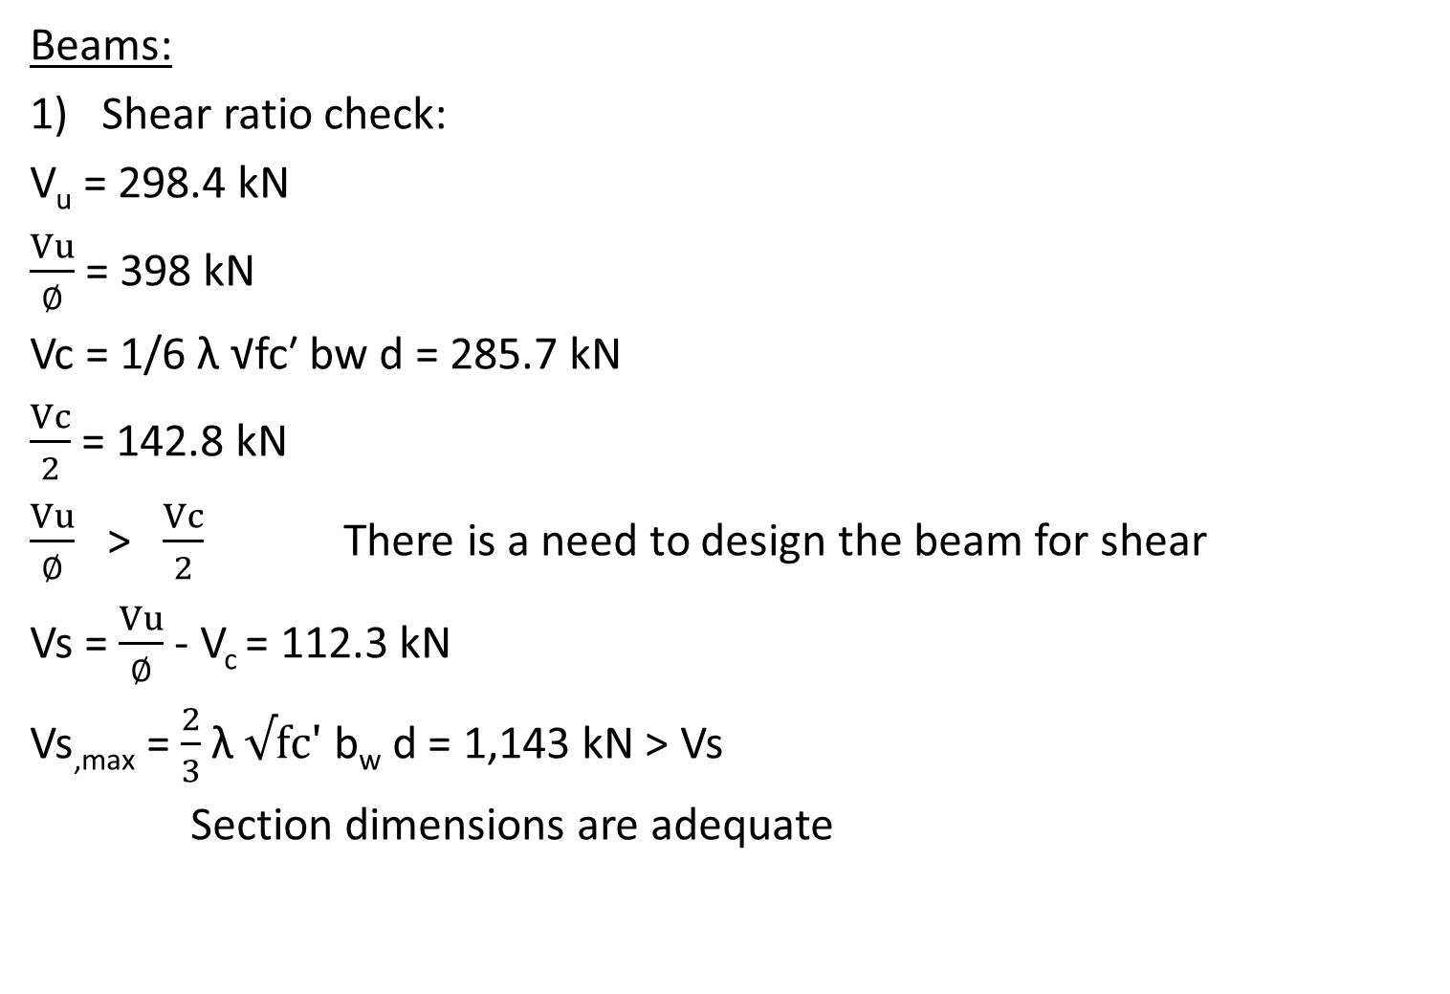
Design and results
Beams:
Shear ratio check:
V_{u} = 298.4 kN
$\frac{Vu}{∅}$ = 398 kN
Vc = 1/6 λ √fcʹ bw d = 285.7 kN
$\frac{Vc}{2}$ = 142.8 kN
$\frac{Vu}{∅}$ ˃ $\frac{Vc}{2}$ There is a need to design the beam for shear
Vs = $\frac{Vu}{∅}$ - V_{c} = 112.3 kN
Vs_{,max} = $\frac{2}{3}$ λ $√fcʹ$ b_{w} d = 1,143 kN > Vs
Section dimensions are adequate

Slide 67

Design and results
Beams:
Av/S = Vs/(Fyt*d) = 0.495 mm2/mm
(Av/S)min = max 0.062 √fcʹ bw / Fyt = 0.46
0.35 bw / Fyt = 0.5
Use Av/S = 0.5 mm2/mm = 500 mm2/m
(Av/S)ETABS = 506.3 mm2/m

Slide 68
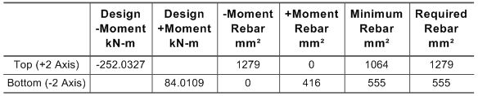
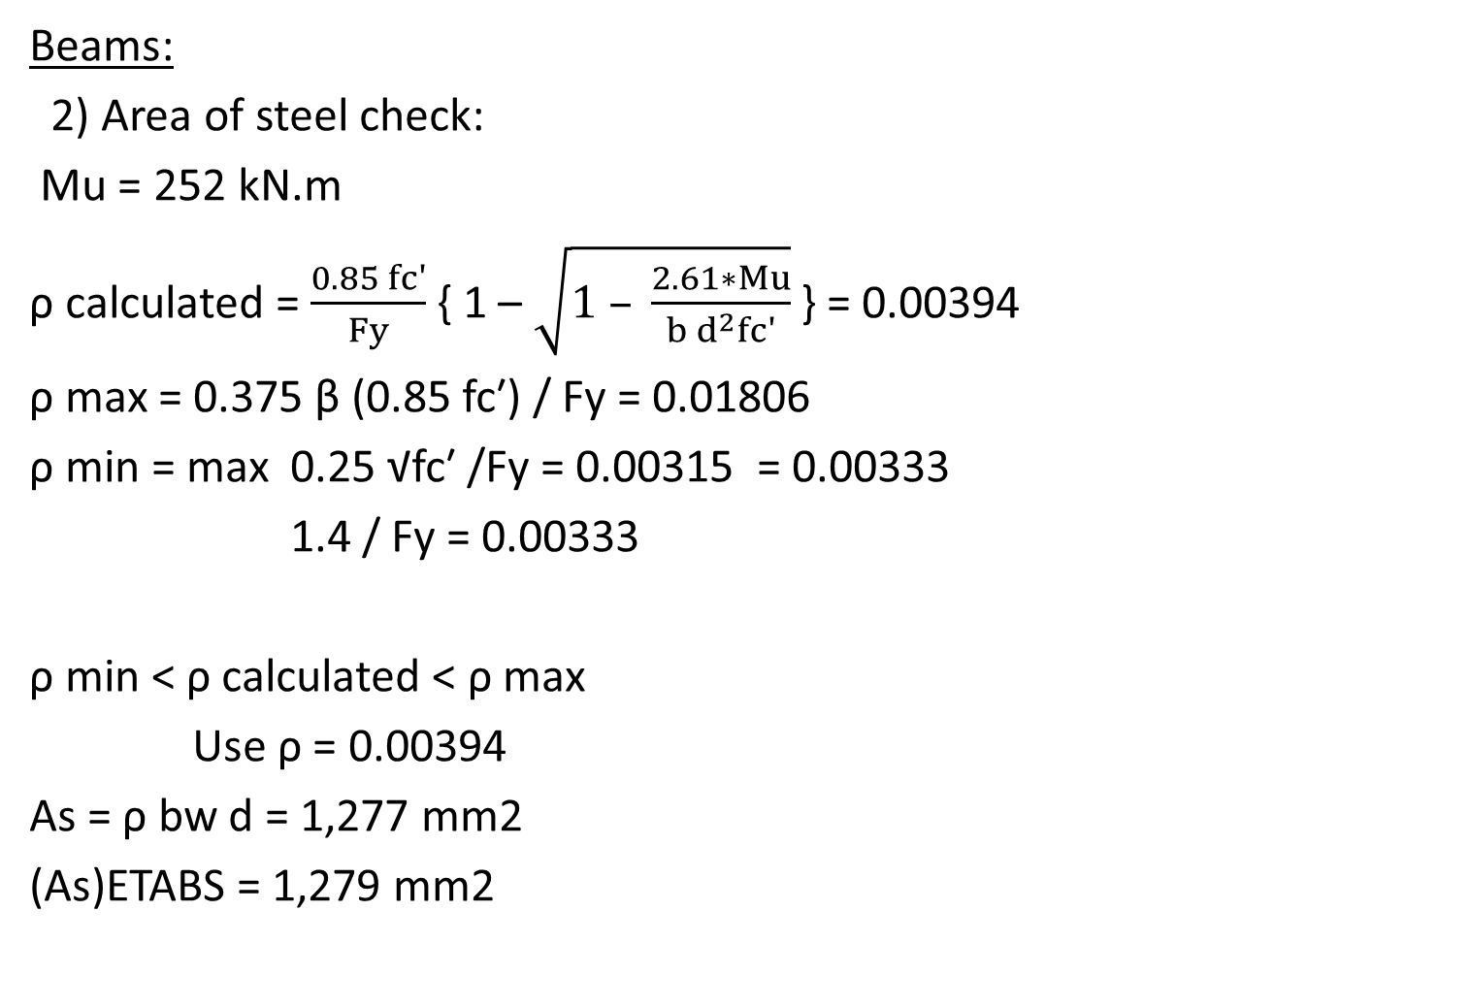
Design and results
Beams:
2) Area of steel check:
Mu = 252 kN.m
ρ calculated = $\frac{0.85 fcʹ}{Fy}$ { 1 – $\sqrt{1 – \frac{2.61∗Mu}{b d^{2}fcʹ}}$ } = 0.00394
ρ max = 0.375 β (0.85 fcʹ) / Fy = 0.01806
ρ min = max 0.25 √fcʹ /Fy = 0.00315 = 0.00333
1.4 / Fy = 0.00333
ρ min < ρ calculated < ρ max
Use ρ = 0.00394
As = ρ bw d = 1,277 mm2
(As)ETABS = 1,279 mm2

Slide 69

Design and results
Beams:
3) Torsion design check:
Tth = (∅ λ √fcʹ (Acp)² )/(12 Pcp) = 17.8 kN.m
Tu/∅ = 0.074/0.75 = 0.098 kN.m < Tth
No need for torsional reinforcement

Slide 70
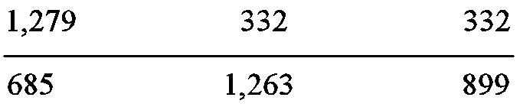
Design and results
Beams:
4) Area of steel distribution check:
5) Beam-axial check:
0.1 Ag fcʹ = 1,008 kN
Pu = 0.00 "rigid diaphragm" < 1,008 kN.
Thus, the beam shall not have axial reinforcement.

Slide 71
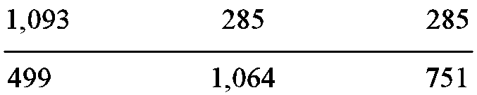
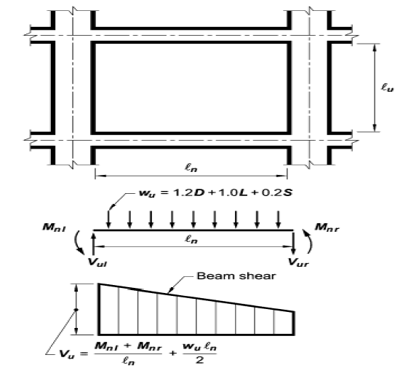

Design and results
Beams:
6) Shear strength check:
𝜙Vn ≥ min (a,b)
a- Vu = (Wu * $\frac{Ln}{2}$)+ $(\frac{MnR+MnL}{Ln}$) = 235 kN

Slide 72


Design and results
Beams:
6) Shear strength check:
b- Vu = 364.2 kN (U = 1.2D + 1.0L + 2E = 1.2D + 1.0L + 2E_{DY})
𝜙V_{c} = 214.3 kN
𝜙Vs = 𝜙 F_{y} d $(\frac{Av}{S}$) = 43 kN
𝜙Vn = 𝜙V_{c} + 𝜙Vs = 257.3 > min(235,364.2)

Slide 73

Design and results
Beams:
Design specifications:
Stirrups:
“Intermediate frames”:
d = effective depth of beam.
ds = diameter of steel bar used for stirrup.
db = diameter of the smallest longitudinal steel bar.
ld = development length of steel bars in tension.

Slide 74
Design and results
Beams:
Design specifications:
Stirrups:
a- At both ends of the beam, hoops shall be provided over a length
of at least 2h measured from the face of the supporting member
toward midspan. (2h = 1.2 m)
b- The first hoop shall be located not more than 50 mm from the
face of the supporting member.
c- Transverse reinforcement spacing shall not exceed d/2 throughout
the length of the beam. (540/2 = 270 mm)

Slide 75
Design and results
Beams:
Design specifications:
Stirrups:
d- Spacing of hoops shall not exceed the smallest of (a) through (d):
d/4 = 540/4 = 135 mm
Eight times the diameter of the smallest longitudinal bar enclosed
= 8 * 12 = 96 mm
24 times the diameter of the hoop bar = 24 * 10 = 240 mm
300 mm

Slide 76
Design and results
Beams:
Design specifications:
2. Longitudinal bars:
Beams shall have at least two continuous bars at both top and bottom faces.
Continuous bottom bars shall have area not less than one-fourth the maximum area of bottom bars along the span. These bars shall be anchored to develop Fy in tension at the face of support.
Development length of bars should be in accordance with the equation stated in ACI 318-14 (Section 25.4.2.2).

Slide 77


Design and results
Beams:

Slide 78

Design and results
Tie beams:

Slide 79


Design and results
Tie beams:
Tension check: (ASCE 7-10)
All ties shall have a design strength in tension at least equal to a force equal to 10 percent of S_{DS} times the column factored dead plus factored live load:
T = 0.1 * S_{DS} * Pu = 0.1 * 0.45 * 2,366 = 106.5 kN
As = $\frac{T}{ϕFy}$ = 282 mm²
As(min) = $\frac{1.4}{Fy}$ b d
Section | As
TB₁ | $\frac{1.4}{420}$ * 400 * 440 = 590 mm² = 3 𝜙 16
TB₂ | $\frac{1.4}{420}$ * 400 * 540 = 720 mm² = 4 𝜙 16

Slide 80



Design and results
Tie beams:
Shear reinforcement:
(∅Vc)/2 = 107 kN
Vu ≤ (∅Vc)/2 in all stations. Thus, no need for shear reinforcement
Design specifications:
S_{max} = $\frac{d}{2}$ through the length of the tie beam

Slide 81


Design and results
Tie beams:

Slide 82


Slide 83


Slide 84

Design and results
Columns:

Slide 85





Design and results
Columns:
Shear check:
𝜙 Vn ≥ min (a,b)
a- Vu = $(\frac{MnT+MnB}{Ln}$)
Vu2 = 177 kN
Vu3 = 103 kN

Slide 86


Design and results
Columns:
Shear check:
b- Vu (U = 1.2D + 1.0L + 3E = 1.2D + 1.0L + 3EDY)
Vu2 = 17 kN
Vu4 = 38 kN
𝜙Vn2 = 226 kN > min 177
17
𝜙Vn3 = 208 kN > min 103
38

Slide 87


Design and results
Columns:
Verification of column design:
Slenderness:

Slide 88


Design and results
Columns:
Verification of column design:
2) P-M interaction diagram (1.2D +1.0L + 1.3EDY):
emin = 0.015 + (0.03*h)
M2min = Pu * emin = 2,215 * 0.0255 = 57 kN.m
M3min = Pu * emin = 2,215 * 0.033 = 73 kN.m
For design:
M2 = max. (48 , 57) = 57 kN.m
M3 = max. (6.3 , 73) = 73 kN.m

Slide 89
Design and results
Columns:
Verification of column design:
P-M interaction diagram:
(1.2D +1.0L + 1.3EDY)
𝜙Pn2 = 2,985 kN
𝜙Pn3 = 3,000 kN
𝜙Pn0 = 𝜙 λ { 0.85 fcʹ (Ag – As) + Fy As } = 3,032 kN
𝜙Pn = 2,968 kN > Pu = 2,215 kN OK

Slide 90


Design and results
Columns:
Verification of column design:
3) Shear ratio check:
Vu =38.5 kN
Vu/∅ = 51 kN
Vc3 = 277 kN
Vc3/2 = 138.5 kN > 51 kN There is a need to design the column for shear
Use 1 $∅$10 / spacing
ETABS results:

Slide 91

Design and results
Columns:
Design specifications:
Stirrups:

Slide 92
Design and results
Columns:
Design specifications:
Stirrups:
At both ends of the column, hoops shall be provided at spacing (So) over a length (ℓo) measured from the joint face.
Spacing (So) shall not exceed the smallest of (a) through (d):
(a) One-half of the smallest cross-sectional dimension of the column = 0.5 * 350 = 175 mm
(b) Eight times the diameter of the smallest longitudinal bar enclosed = 8 * 16 =100 mm
(c) 24 times the diameter of the hoop bar = 24 * 10 = 240 mm
(d) 300 mm
Thus, we have to use 𝜙10 stirrups at 100 mm for columns {60*35, 80*25 and 40*40}.

Slide 93
Design and results
Columns:
Design specifications:
Stirrups:
3. Length (ℓo) shall not be less than the greatest of (a), (b), and (c) :
(a) One-sixth of the clear span of the column = 3.1 / 6 = 0.5 m
(b) Maximum cross-sectional dimension of the column = 600
(c) 450 mm
Thus, ℓo = 600 mm for column {600*350} and 450 mm for column {40*40}.
4. The first hoop shall be located not more than So/2 from the joint face, which equals
50 mm.
5. Maximum spacing of shear reinforcement shall be 150 mm for column (600*350)
and 170 mm for column (40*40) since Vs ≤ 0.33 fc′ * bw * d thus Max S = d/2 .

Slide 94

Design and results
Columns:
Design specifications:
Stirrups:
6. Transverse reinforcement at the spacing (So) over the full height beneath the level
at which the discontinuity occurs:
Pu (1.2D + 1.0L + 3 EDy) = 2,566 kN
(Ag * fc′ / 4) = 1,470 < 2,566
7. Transverse reinforcement shall extend into the discontinued member at least (ℓd)
of the largest longitudinal column bar:
8. Where the column terminates on a footing or mat, the required transverse
reinforcement shall extend at least 300 mm into the footing or mat.

Slide 95

Design and results
Columns:
Design specifications:
B) Joints:

Slide 96
Design and results
Columns:
Design specifications:
Joints:
(Av/S)min = max 0.062 √fcʹ bw / Fyt = 0.46
0.35 bw / Fyt = 0.5
= 0.5 mm2/m
In our case, the shear reinforcement in the joint was taken as 2 𝜙 10 / 10 cm
Longitudinal bars:
Development length and splicing of bars should be in accordance with the equation stated in ACI 318-14 (Section 25.4.2.2).

Slide 97


Design and results
Columns:
Element design (C3):

Slide 98

Design and results
Shear walls:
Piers:
h_{w} = 2.3 m
ℓ_{w} = 1.826 m
b_{w} = 0.25 m
Aspect ratios:
h_{w} / ℓ_{w} = 1.26 < 2
ℓ_{w} / b_{w} = 7.3 > 6
The pier is considered to be designed as a wall and there is no need to satisfy specified column design requirements

Slide 99


Design and results
Shear walls:
Piers:
Shear check (1.2D +1.0L + 1.3ED_{X}):
Vc = min 0.27 λ √(fcʹ) h d + $\frac{\text{Nu}\text{∗}\text{d}}{\text{4 }\text{Lw}}$ = 635 kN
(0.05 λ √(fcʹ) + $\frac{\text{Lw}\text{ ( }\text{0.1 }\text{λ} \text{√}\text{(}\text{fc}\text{ʹ)}+\text{0.}\text{2 }\text{(}\text{Nu}\text{/(}\text{Lw}\text{∗}\text{h}\text{)))}}{\text{Mu}\text{/}\text{Vu} \text{− }\text{Lw}\text{/}\text{2}}$) * h d = 1745 kN
= 635 kN
𝜙Vc = 476.3 kN
(𝜙Vc)_{ETABS} = 481.8 kN

Slide 100

Design and results
Shear walls:
Piers:
2) Shear ratio check:
$\frac{ϕVc}{2}$ = 241 kN ≈ Vu = 242 kN
$\frac{Av}{S}$ = ρ_{t,min} * t_{p} = 625 mm²/m
($\frac{Av}{S})$_{ETABS} = 625 mm²/m

Slide 101


Design and results
Shear walls:
Piers:
P-M interaction diagram (1.2D +1.0L + 1.3ED_{X}):
Bresler reciprocal load method:
$\frac{1}{ϕPn}$ = $\frac{1}{ϕPn2}$ + $\frac{1}{ϕPn3}$ ­- $\frac{1}{ϕPn0}$
𝜙Pn = 9,780 kN > Pu = 865 kN OK

Slide 102
Design and results
Shear walls:
Piers:
P-M interaction diagram (1.2D +1.0L + 1.3ED_{X}):

Slide 103
Design and results
Shear walls:
Piers:
4) Boundary element check:
0.2 fcʹ = 0.2 * 28 = 5.6 MPa
S_{22,right} = 4.3 MPa < 5.6 Mpa
S_{22,left} = 5 MPa < 5.6 MPa

Slide 104

Design and results
Shear walls:
Piers:
Design specifications:
Pier longitudinal reinforcement:

Slide 105
Design and results
Shear walls:
Piers:
Design specifications:
Pier longitudinal reinforcement:
At least two curtains of reinforcement shall be used in a wall if (Vu > 0.17Acvλ fc′) or (hw/ℓw ≥ 2.0):
hw/ℓw = 2.15 ≥ 2.0
Reinforcement spacing each way in structural walls shall not exceed 450 mm.
As,L = 5,131 mm2
As,L (For each layer) = 5,131/2 = 2,566 mm2 = 32 𝜙 12 Use 1 𝜙 12 / 250 mm

Slide 106

Design and results
Shear walls:
Piers:
Design specifications:
Pier shear reinforcement:
• As,T = 625 mm2/m
As,T (For each layer) = 625/2 = 313 mm2/m = 4 𝜙 10 / m Use 1 𝜙 10 / 250 mm

Slide 107


Design and results
Shear walls:
Piers:
B
B
B
B

Slide 108

Design and results
Shear walls:
Piers:

Slide 109


Design and results
Shear walls:
Spandrels:
h = 1.4 m
ℓ_{n} = 1.2 m
b_{w} = 0.25 m
Aspect ratio: (ℓ_{n} / h) = 1.2 / 1.4 = 0.86 < 2
Vu = 213 kN
Vu limit = 0.33 λ $\sqrt{fcʹ}$ A_{cw} = 550 kN > Vu
The spandrel was designed as a special beam

Slide 110


Design and results
Shear walls:
Spandrels:
Axial check:
Pu threshold = 0.1 Ag $fc$= 980 kN
Pu = 74kN < Pu threshold
Neglect axial force and consider the spandrel as a beam.
2) Flexure check:
Mu = 266.7 kN.m
ρ = 0.0022 = 0.22% , which is same as ETABS.

Slide 111


Design and results
Shear walls:
Spandrels:
Shear check:
For Vu = 213.3 kN
𝜙V_{c}= 𝜙 $\frac{1}{6}$ λ $√fcʹ$ b_{w} d = 0.75 * $\frac{1}{6}$ (1) $√28$*(250)*(1260)/10³ = 166 kN
𝜙Vs = Vu - 𝜙V_{c} = 213.3 – 166 = 47 kN Vs = 63 kN
$\frac{Av}{S}$ = $\frac{Vs}{Fyt∗d}$ = 0.118 mm²/mm
$(\frac{Av}{S})$min = 0.0025 b_{w} = 0.625 mm²/mm
Take $\frac{Av}{S}$ = $(\frac{Av}{S})$min = 0.625 mm²/mm

Slide 112
Design and results
Shear walls:
Spandrels:
1
1
1
1

Slide 113

Design and results
Shear walls:
Spandrels:

Slide 114





Slide 115

Design and results
Slabs:

Slide 116


Design and results
Slabs:
Shear check:
Slab A:
𝜙V_{c}= 𝜙 $\frac{1}{6}$ λ $√fcʹ$ b_{w} d = 106 kN/m
Vu₍₁₃₎ = 46 kN/m < 106 kN/m OK

Slide 117

Design and results
Slabs:
Flexural design:
Slab A:
As,_{min} = ρ_{min} * b * h = 0.0018 * 1,000 * 200 = 360 mm²/m = 5𝜙10/m
a = $\frac{As∗Fy}{0.85 fcʹ∗b}$ = 6.35 mm
Mu,_{min}= 𝜙Mn,_{min} = 𝜙As,_{min} * F_{y} * (d - $\frac{a}{2}$ ) = 21.6 kN.m/m

Slide 118

Positive ultimate bending moments (M11) for slab A from ETABS

Slide 119

Negative ultimate bending moments (M11) for slab A from ETABS

Slide 120


Design and results
Slabs:
Development length:
L_{dt} = $\frac{0.48∗Fy}{\sqrt{fc`}}$ * dp * $\frac{As,required}{As,used}$
L_{dh} =$\frac{0.24∗Fy}{\sqrt{fc`}}$ * dp * $\frac{As,required}{As,used}$
R_{hook} = 4 * dp
Slab reinforcement in X-direction for zone A

Slide 121


Slide 122


Slide 123
Design and results
Ground slab:
h = 100 mm
As,min = 0.0018 b h = 0.0018 * 1,000 * 100 = 180 mm2/m = 4 𝜙 8 / m
Use a mesh of ( 1 𝜙 8 / 25 cm ).

Slide 124


Slide 125

Design and results
Footings:
Design inputs:
Joints reactions:
Joint label | Reaction due to maximum service load
1 | 1808.4483
2 | 1798.9158
3 | 1798.5533
4 | 1800.6648
5 | 1707.6696
6 | 1798.0459
7 | 1767.9364
8 | 1793.1431
9 | 1802.7728
10 | 1707.5496
11 | 191.7916
12 | 191.9705
13 | 1212.4001

Slide 126

Design and results
Footings:
Design inputs:
b) Dimensions and thicknesses assumptions:
Footing name | Type | Dimensions (m*m) | Thickness (mm)
F1 | Single footing | 1.1 * 1.1 | 400
F2 | Single footing | 2.9 * 1.9 | 400
F3 | Mat foundation | 20.7 * 6.7 | 550
F4 | Wall footing | B = 1.8 | 400

Slide 127


Slide 128

Design and results
Footings:
Bearing capacity check:
qmax = 240 kN/m² < qall = 300 kN/m² OK

Slide 129

Design and results
Footings:
Thickness check:
Single footing (F1):
Punching shear:
Pu max = 241 kN
qu,max = 230 kN/m2 (From SAFE)
Vu,p = Pu – qu Acr = 115 kN
𝜙Vcp= 𝜙 1/3 λ √(fcʹ) bo d = 1330 kN > Vu,_{p} OK
Wide beam shear:
Vu = 230 * 0.35 = 81 kN/m
𝜙Vc = 𝜙 1/6 λ √(fcʹ) b d = 225 kN/m > Vu OK

Slide 130


Design and results
Footings:
Thickness check:
2) Single footing (F2):
Punching shear:
Pu max = 1555 kN
qu,max = 296 kN/m2 (From SAFE)
Vu.p = 1356 kN
𝜙Vcp = 1556 kN > Vu OK
Wide beam shear:
Fracture 1:
Vu,1 = qu,max * ( L - d ) = 210 kN/m
Fracture 2:
Vu,2 = 144 kN/m
𝜙Vc = 225 kN/m > Vu,1 & Vu,2 OK

Slide 131
Design and results
Footings:
Thickness check:
Mat foundation (F3):
Punching shear:
Pu max = 2382 kN
qu,max = 290 kN/m2
Vu = 2117 kN
𝜙Vcp = 2502 kN > Vu OK

Slide 132

Design and results
Footings:
Thickness check:
Mat foundation (F3):
Wide beam shear:
Vu.x = 622 kN (From SAFE)
𝜙Vc = 0.75 * 1/6 * 1 * √28 * 2280 * 490 / 1000 = 740 kN/m > Vu OK

Slide 133

Design and results
Footings:
Thickness check:
Mat foundation (F3):
Wide beam shear:
Vu,y = 745 kN (From SAFE)
𝜙Vc = 0.75 * 1/6 * 1 * √28 * 2280 * 490 / 1000 = 746 kN/m > Vu OK

Slide 134
Design and results
Footings:
Thickness check:
Wall footing (F4):
Wide beam shear:
Vu = qu,max * ( L - d ) = 142 kN/m
𝜙Vc = 𝜙 1/6 λ √(fcʹ) b d = 225 kN/m > Vu OK

Slide 135
Design and results
Footings:
Design specifications:
Longitudinal reinforcement of columns and structural walls resisting forces induced by earthquake effects shall extend into the footing, mat, or pile cap, and shall be fully developed for tension at the interface.
Where earthquake effects create uplift forces in boundary elements of special
structural walls or columns, flexural reinforcement shall be provided in the top of
the footing, mat, or pile cap to resist actions resulting from the factored load
combinations, and shall be at least the minimum flexural reinforcement value.

Slide 136


Design and results
Footings:
Single footing (F1): (ETABS results)

Slide 137



Design and results
Footings:
Single footing (F2): (ETABS results)

Slide 138

Design and results
Footings:
Mat foundation (F3): (ETABS results)

Slide 139

Design and results
Footings:
Mat foundation (F3): (ETABS results)

Slide 140

Design and results
Footings:
Mat foundation (F3): (ETABS results)

Slide 141
Design and results
Footings:
Wall footing (F4): (Hand calculations)
qu,max = 325 kN/ m2 (From SAFE)
Major bottom steel:
L = (2-0.25)/2 = 0.875 m
Mu = (qu * L2) / 2 = 125 kN.m/m
ρ = 0.00293
As = ρ bd = 1000 mm2 /m
Asmin = 0.0018 * 1000 * 400 = 720 mm2/m
use As = 1000 mm2
use 1𝜙 14 /150mm

Slide 142
Design and results
Footings:
Wall footing (F4): (Hand calculations)
Minor bottom steel:
Asmin = 0.0018 * 1000 * 400 = 720 mm2/m
use 1𝜙 12 /150mm
Minor bottom longitudinal steel:
Asmin = 0.0018 * 1000 * 400 = 720 mm2/m
use 1𝜙 12 /150mm
Major top longitudinal steel:
Asmin = 0.0018 * 1000 * 400 = 720 mm2/m
use 1𝜙 12 /150mm

Slide 143

Design and results
Footings:
Wall footing (F4): (Hand calculations)

Slide 144

Design and results
Stairs:
Step width = 0.3 m
Step height 0.168 m
Slab thickness = L/24 = 4.4/24 = 0.183 m ,
use h = 0.2 m
Live load = 5 kN/m2
Super imposed dead load = 4.5 kN/m2

Slide 145


Design and results
Stairs:
Deflection check:
∆allowable = L/240 = 18.33 mm
∆service.SAP = 2.7 mm < 18.33 mm OK
Shear check:
𝜙Vc = 106 kN/m
Vu = 86 kN/m < 106 kN/m OK
(Due to the ultimate load combination 1.2D + 1.6L)

Slide 146

Design and results
Stairs:
Flexural design:
As,min = 0.0018 * 1,000 * 200 = 360 mm2/m
a = (As*Fy)/(0.85 fcʹ*b) = (360*420)/(0.85*28*1,000) = 6.35 mm
Mu,min = 21.6 kN.m/m
Mu22 = 43 kN.m/m > 21.6 kN.m/m
ρ = 0.00462
As = 740 mm2
Use 5 𝜙 14 = 1 𝜙 14 / 250 mm
Use minimum area of steel in the other direction:
As,min = 360 mm2/m = 1 𝜙 12 / 300 mm

Slide 147

Design and results
Stairs:

Slide 148


Design and results
Stairs:

Slide 149
Thanks For Your Attention

