Slide 1

An-Najah National University
Faculty of Engineering
Industrial Engineering Department
Improving Maintenance Management System

Slide 2
Prepared by: Supervisors:
Abdarahim Abulaila Dr. Ramiz Assaf
Ahmad Sbaaneh Dr. Ayham Jaaron
Diaa Sharab
Ghadeer Issa

Slide 3
Agenda
Introduction
Maintenance management system objectives
NEDCO
Strategic planning
Medium term objectives
Availability analysis
Key performance indicator
Conclusion and recommendation

Slide 4
Introduction
Maintenance Management is an orderly and systematic approach to planning, organizing, monitoring and evaluating maintenance activities and their costs.
Maintenance types:
Reactive maintenance or corrective maintenance or Break down maintenance.
Preventive maintenance.
Predictive maintenance.
Proactive maintenance.

Slide 5
Cont...
Maintenance management aims to:
Monitoring and controlling.
Increase productivity.
Decrease cost.
Increase efficiency and availability.
Decrease down time for system.
Prevent and correct errors.

Slide 6

NEDCO
Northern Electricity Distribution Company(NEDCO) is a public company limited ownership, and owned by the municipalities of the north West Bank, where the company was founded in 2008.

Slide 7
Our case study
Because NEDCO don’t have a maintenance department.
NEDCO is chosen as a case study of our project, why?
That’s mean
Unscheduled maintenance activities and maintenance is a critical issue in the company.

Slide 8
Developing Strategic Objectives
Strategic plans are methods developed to achieve a particular goal in the long term depending on the charts and security procedures in the use of available resources in the short term.
The strategic objectives in our project are:
Increase availability of the electricity grid and reduce the average yearly power interruptions in each linking point from (27) hours per month to (15) hours.
Reduce the total loss of electrical network from (17%) to (13%) from technical point view.
Investment in skills development through training of staff to increase the speed of response in the event of a failures or interruptions.

Slide 9
Strategic planning
The strategic objectives :
Increase availability of the electricity grid and reduce the average yearly power interruptions in each linking point from (27) hours per month to (15) hours.

Slide 10
Strategic planning
The strategic objectives :
Reduce the total loss of electrical network from (17%) to (13%) from technical point view.

Slide 11
Strategic planning
The strategic objectives :
Investment in skills development through training of staff to increase the speed of response in the event of a failures or interruptions.

Slide 12
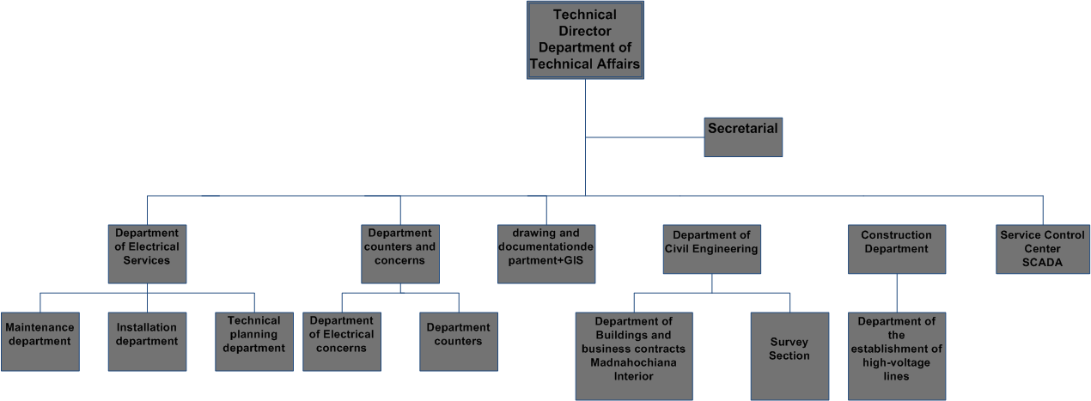
Organizational structure proposed

Slide 13
Medium term objectives
Building maintenance scheduling and planning system.
Follow up the electric network.
Providing training courses for maintenance department staff.
Identify the global standards for equipment used.
Reduce the time to repair the faults and problems that occur and reduce the transportation time.

Slide 14
Maintenance department main functions
Follow the work of the Department, personnel and distribution business to them regularly.
Preparing a work, evaluation and follow up scheduling.
Supervise all activities and maintenance work, whether routine, predictive, proactive, preventive and corrective.
Supervise the maintenance of the main, sub stations, linking points, transformers, and medium, high and low voltage switches and fuses.
Supervising the repair and inspection of ground and aerial cables.

Slide 15
Cont...
Supervision of all emergency maintenance work that transferred from the emergency department.
Overseeing the preparation of the necessary equipment and materials to work, maintenance and preservation it.
Supervising the implementation of the general safety rules and stick to them.
Perform any other functions assigned to it and have a working relationship

Slide 16

Availability analysis
Availability objective is to ensure that the system functions correctly where the customers do not complain about the system and its effectiveness.

Slide 17
Cont...
Linking point | Number of subscribers | Downtime | Weight | Availability
Askar | 15204 | 31:30:00 | 22.32% | 99.9700%
Hewara | 13079 | 37:20:00 | 23.26% | 99.9716%
Sara 1 | 13446 | 15:15:00 | 21.70% | 99.9855%
Sara 2 | 14017 | 33:40:00 | 25.23% | 99.9678%
Ennab | 4494 | 18:55:00 | 7.46% | 99.9568%
Total | 60240 | 136:40:00 | 100% | 98.4493%

Slide 18
Key performance indicator’s
“That which cannot be measured cannot be managed”.
A KPI is a great tool to measure and control the performance of any given process. The KPI can therefore be thought of as a measurement that tells that management the precise state of operations at any given point of time.

Slide 19
Cont...
Proposed KPI’s:
Average cases of tampering in the current (ACTC).
Average number of prepaid system (ANPS).
System Average Interruption Duration Index (SAIDI) .
System Average Interruption Frequency Index (SAIFI) .
The proportion of the training budget for the maintenance department budget .
The cost of annual training hours per employee in the maintenance department .

Slide 20
Average cases of tampering in the current (ACTC)
Measure how the system will decrease the percentage of network losses.
Number of theft cases.
ACTC can be measured by the inspection service department .
Customer service centers staff when the prepaid meters cards are filled for subscribers and compare the rates of consumption with normal consumption rates for subscribers.

Slide 21
Average number of prepaid system (ANPS).
Measure how increase or decrease in the number of subscribers who using the prepaid cards annually .
This system decrease the number of thieves in current .
Measuring the number of subscribers who use this system in order to decrease the total losses in the network .

Slide 22

System Average Interruption Duration Index (SAIDI) .
Measures the total duration of an interruption for the average customer during a given time period.
Where:
r_{i}= Restoration time, minutes.
N_{i} = Total number of customers interrupted.
N_{T} = Total number of customer served.

Slide 23
System Average Interruption Frequency Index (SAIFI) .
The average number of times that a system customer experiences an outage during the year .
Where:
n_{i} = Total number of customers interrupted.
N_{T} = Total number of customers served.

Slide 24
The proportion of the training budget for the maintenance department budget
To evaluate the interest in the company to invest in staff and interest to the development of their abilities and improve performance.
How it measured
The company sets the budgets of each department .
Divide to cover all requirements and needs .

Slide 25
The cost of annual training hours per employee in the maintenance department
Measure the annual cost of training per employee in the maintenance department.
Measured by dividing all costs paid by the maintenance staff training on the number of employees who benefited from the training.

Slide 26
Conclusions
Maintenance management system is very important for any company to facilitate and arrange their maintenance activities.
Depending on KPI’s, a lot of actions can be taken to reach the desired goals.
The preventive maintenance system is one of the best systems that can be implemented.
key performance indicators are the best methods to measure the main issues for the companies such as the efficiency and availability.

Slide 27
Recommendations
Increase installation of prepaid meters.
Increase investment in the training of the maintenance department staff .
Organize training sessions for the inspectors of the grid lines.
Study of the causes of failures, analyze and try to put the plans on how to deal with them.
Study the performance indicators and take the necessary decisions based on that.
Educate citizens through advertisements.

Slide 28
Thank you for your attention we welcome your questions

