Slide 1


Shine Craft
Software Graduation Project
Raya Shafai
Diana Qwariq
Dr.Haya Samaana

Slide 2
AGENDA:
1)INTRODUCTION
2) OBJECTIVES
3)TOOLS,METHODS,
Programming Languages
4)FEATUERS
5)FUTURE WORKS

Slide 3

INTRODUCTION:
Darwazeh Factory currently operates using a manual and outdated sales process through Instagram direct messages, which makes order tracking and customer interactions difficult. This system lacks automation, leading to inefficiencies in communication, order management, and financial tracking. Employees also struggle with administrative tasks such as vacation requests and salary tracking, as there is no unified platform to manage these functions. Additionally, customers lack an interactive and seamless experience when purchasing products online, which can result in lost sales and reduced customer satisfaction.

Slide 4



THREE TYPES OF USERS
Types of users:
Company (Admin)
Employees
Customers

Slide 5




TOOLS, METHODS AND PROGRAMMING LANGUAGES
TOOLS, METHOS, PROGRAMMING LANGUAGES:

Slide 6
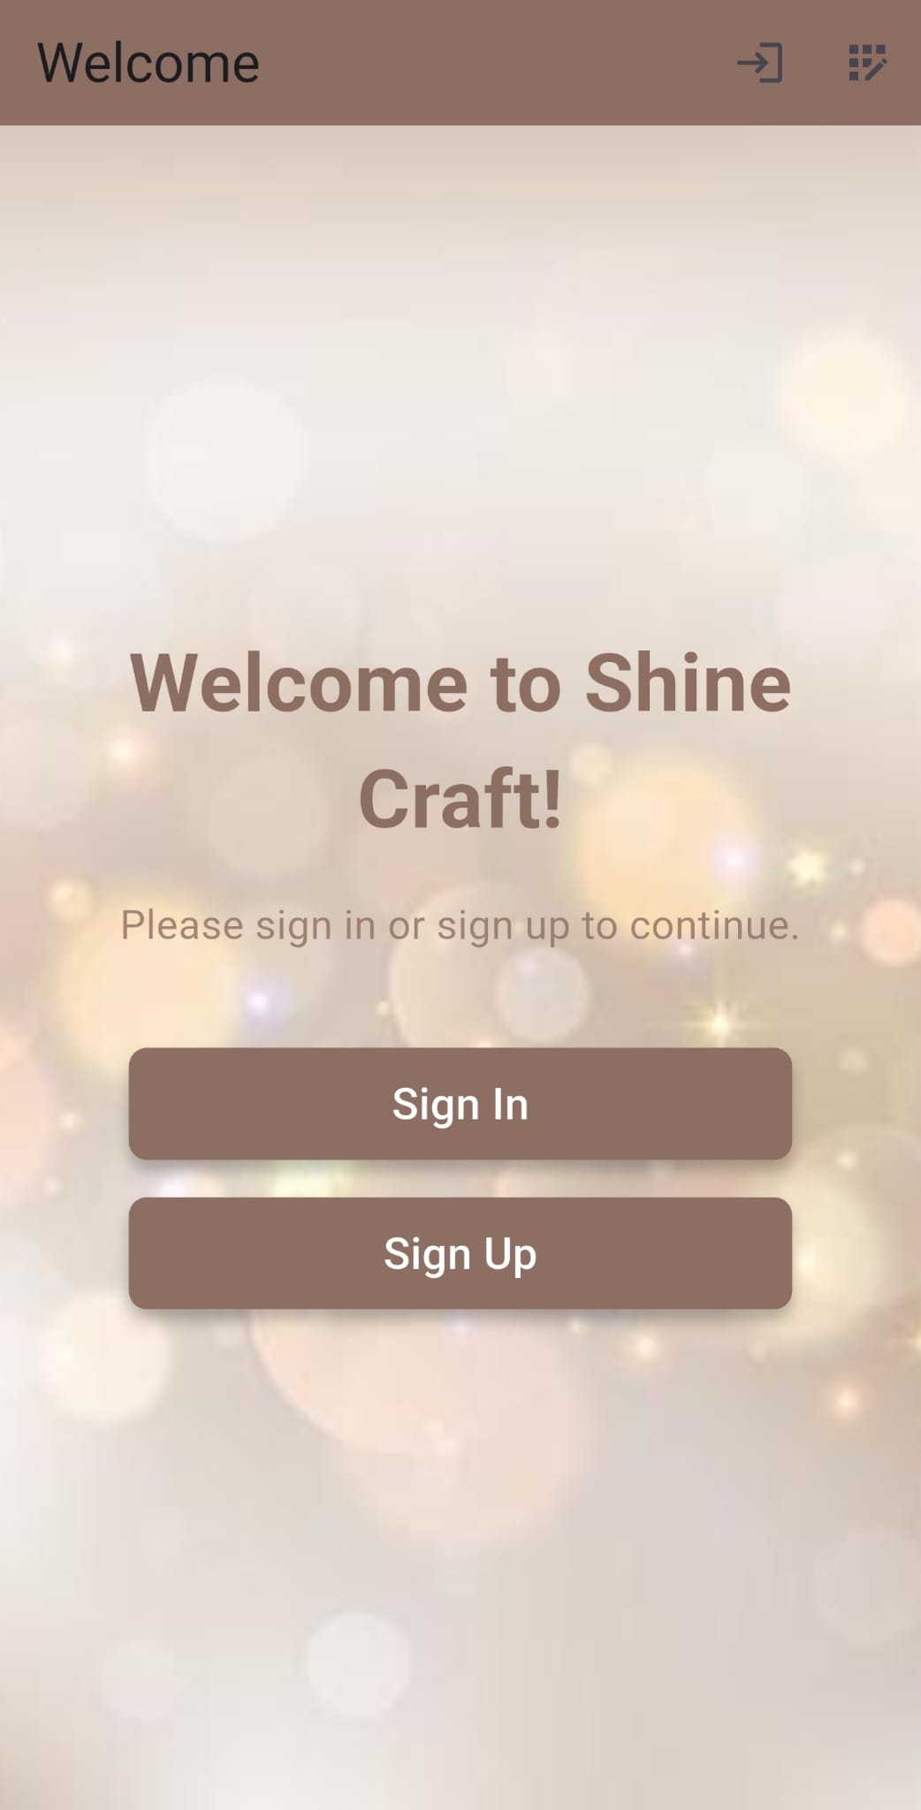
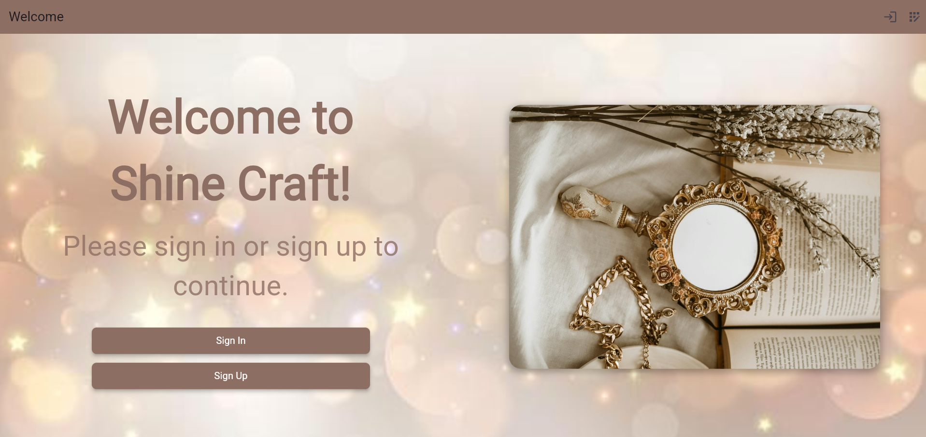
Welcome Page:

Slide 7
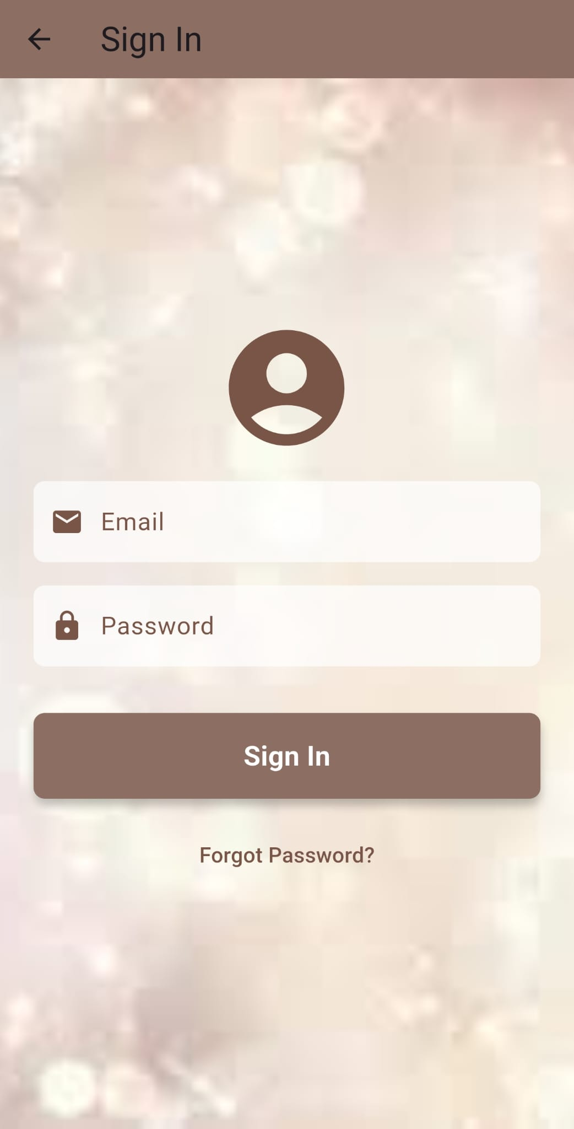
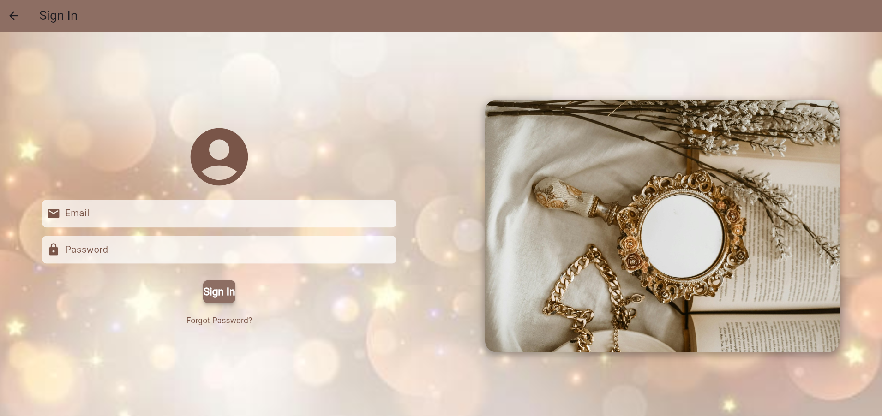
Sign In:

Slide 8
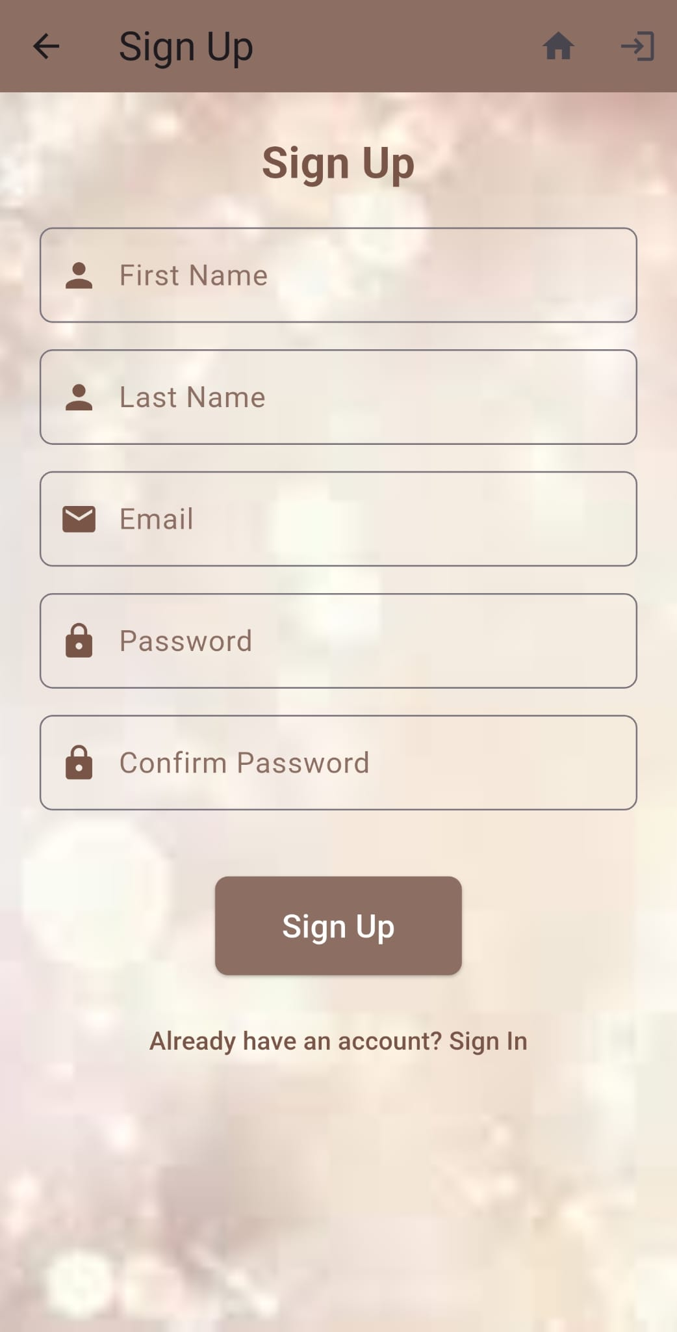
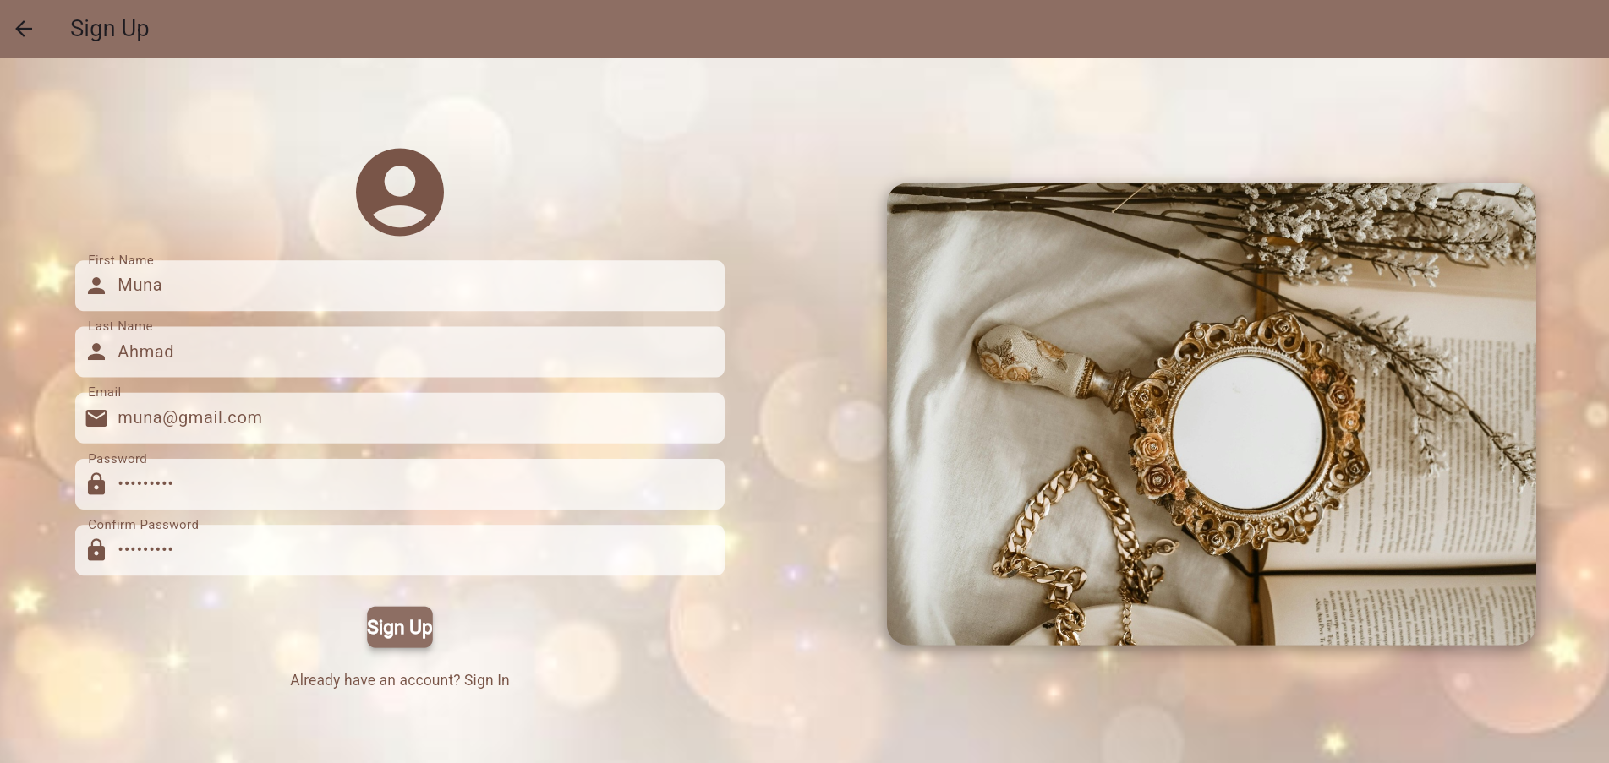
Sign Up:

Slide 9
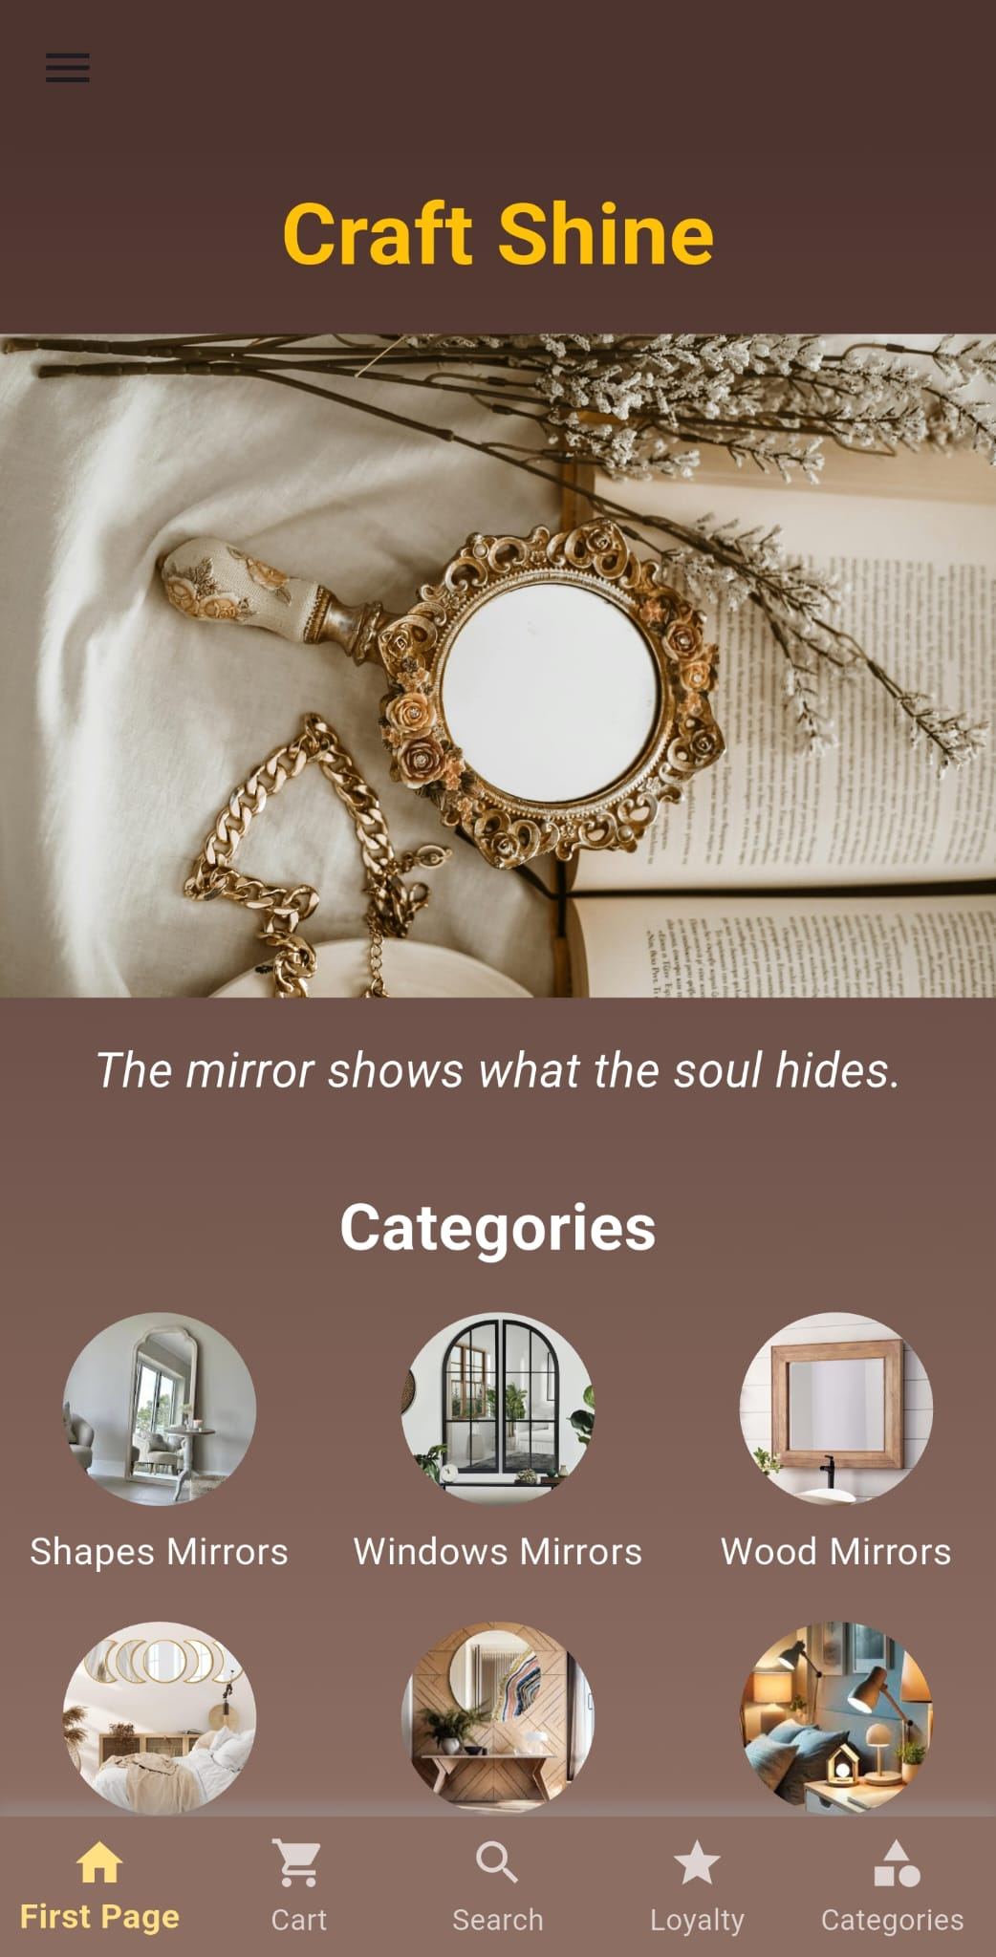
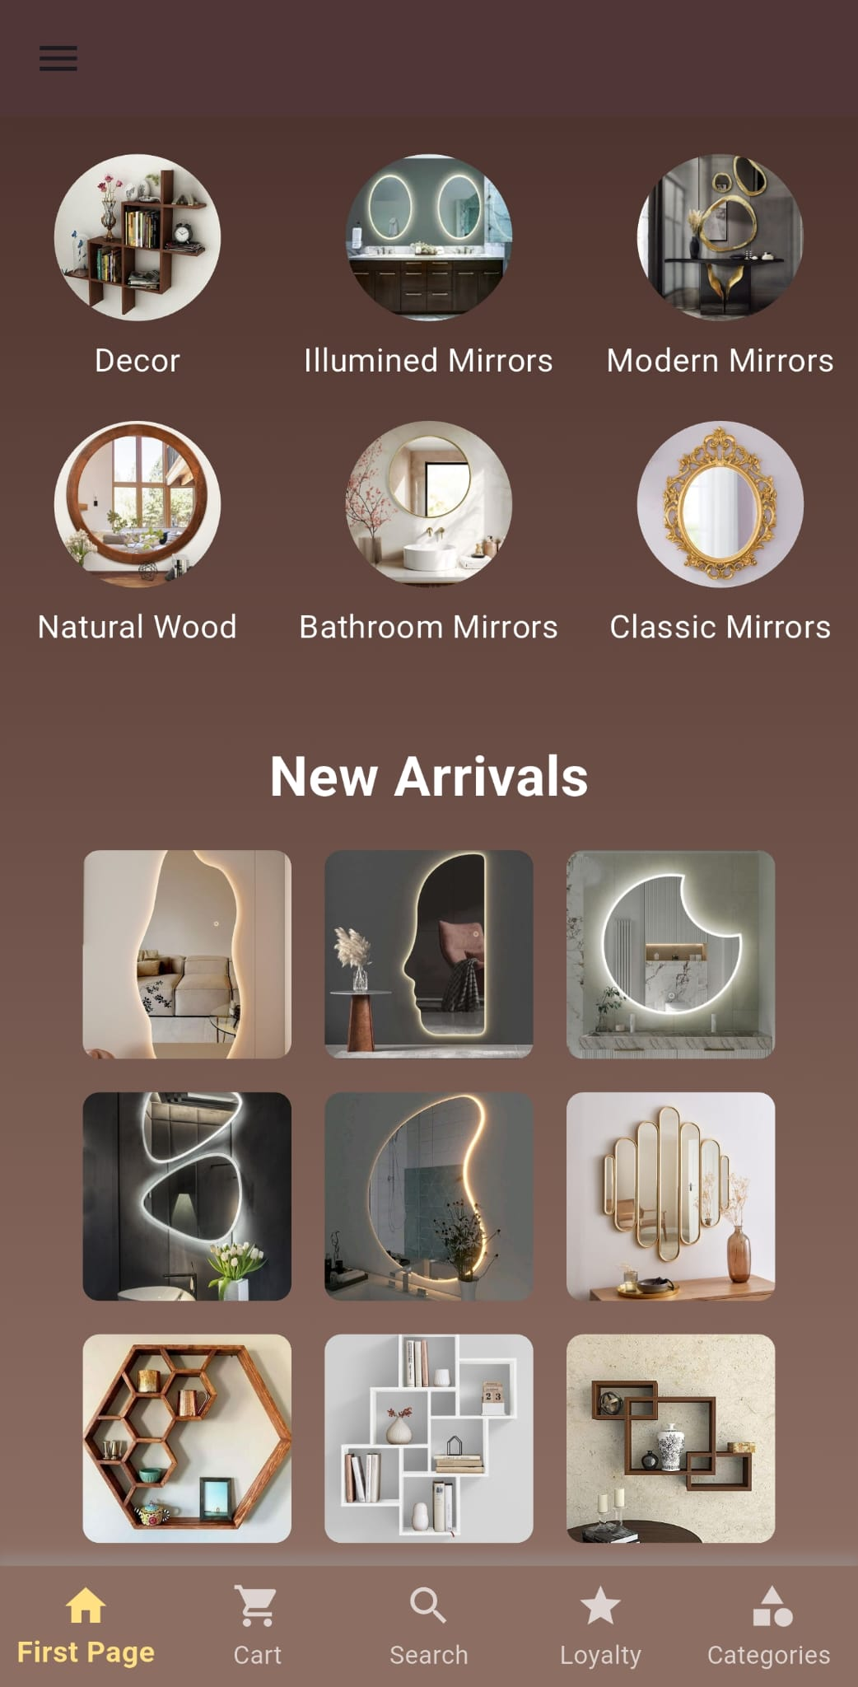
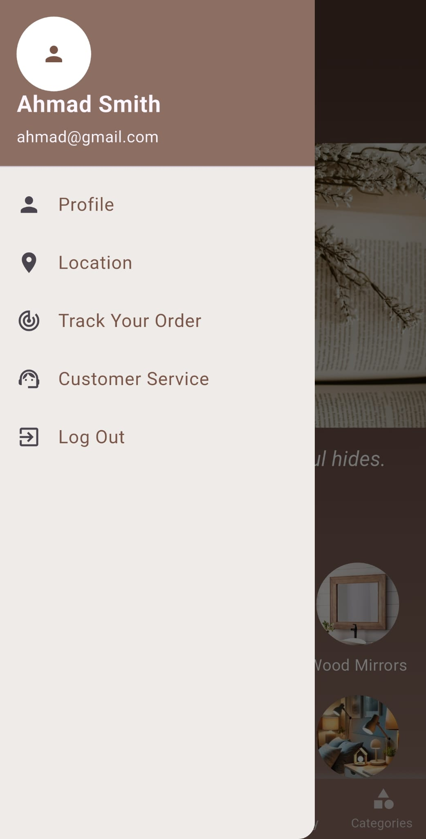
CUSTOMER
Home Page:

Slide 10

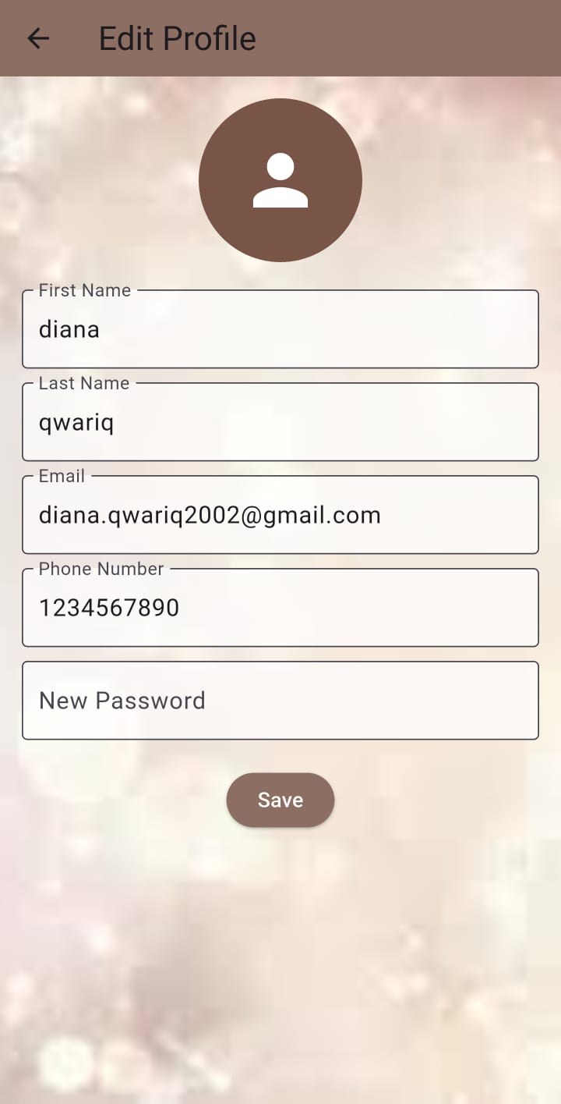
CUSTOMER
Profile:

Slide 11
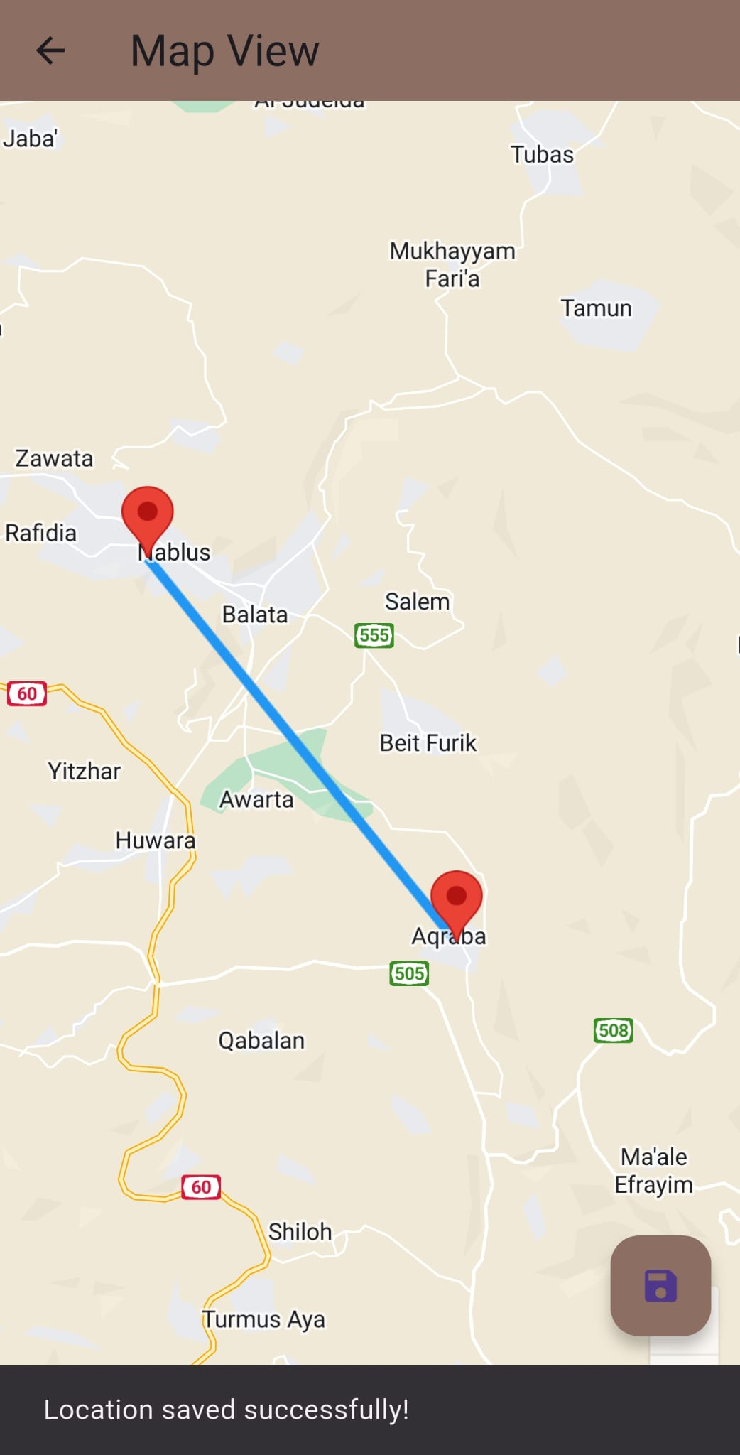
CUSTOMER
LOCATION:

Slide 12

CUSTOMER

Slide 13
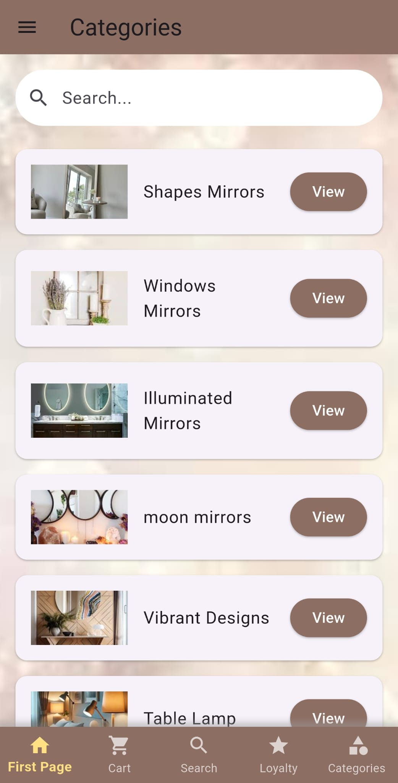
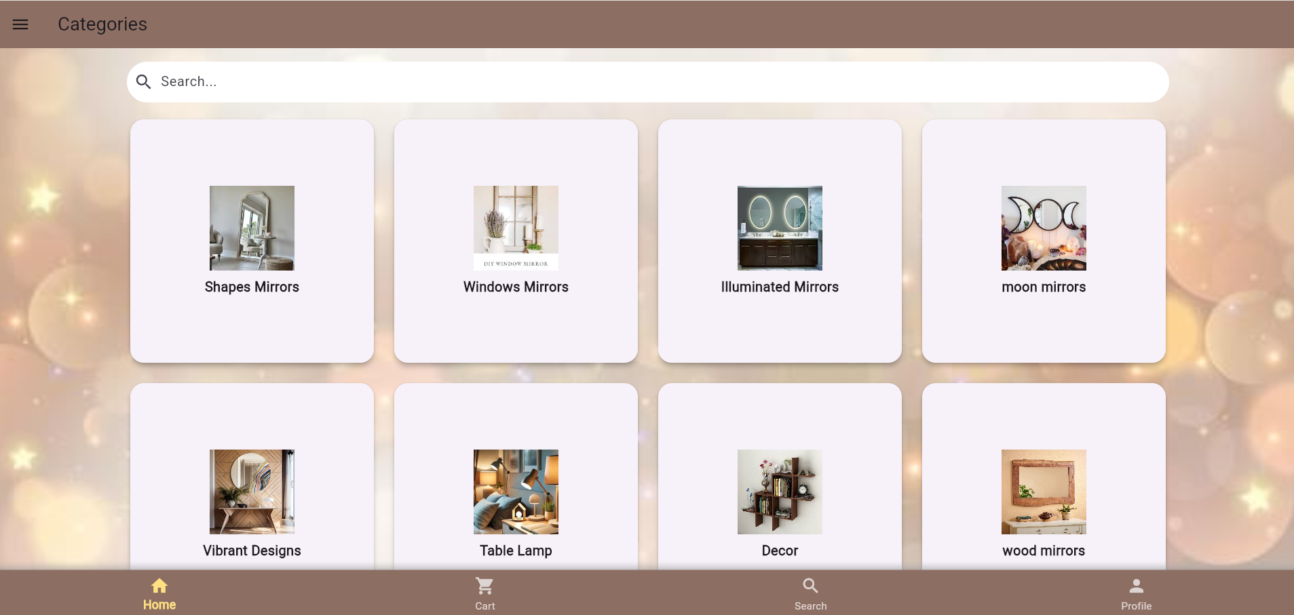
CUSTOMER
Home Page:

Slide 14
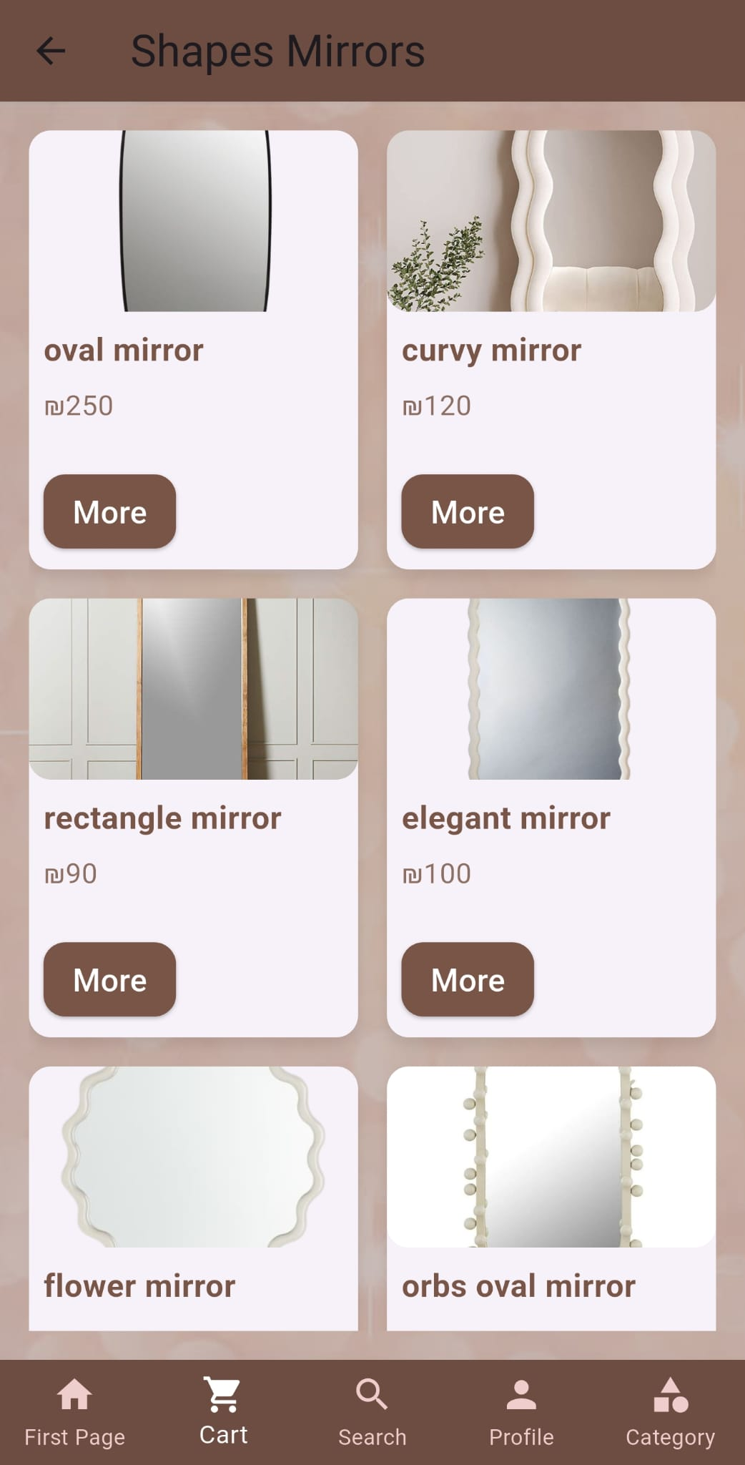
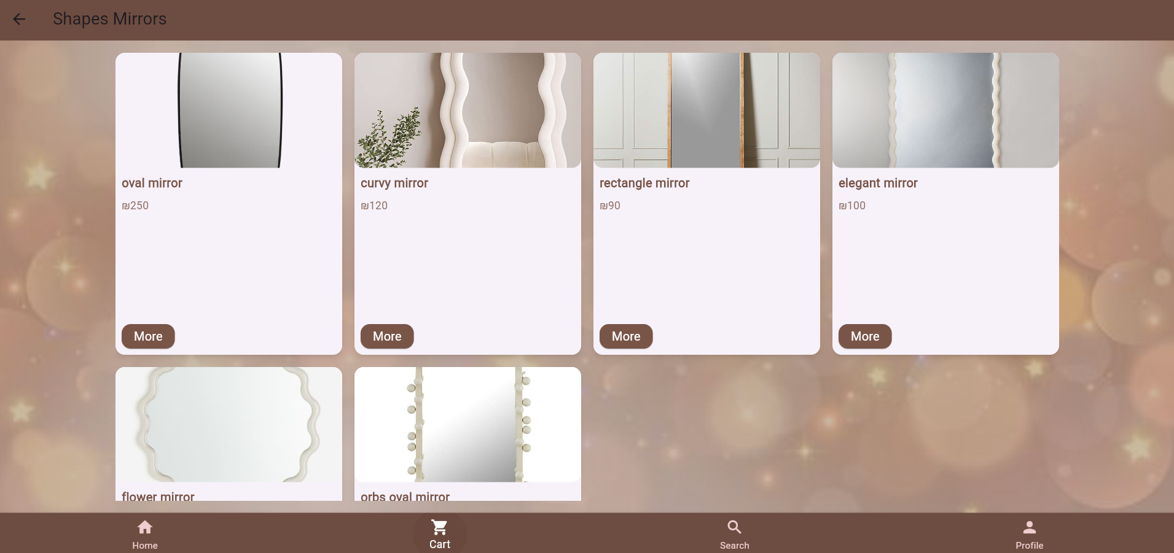
CUSTOMER

Slide 15
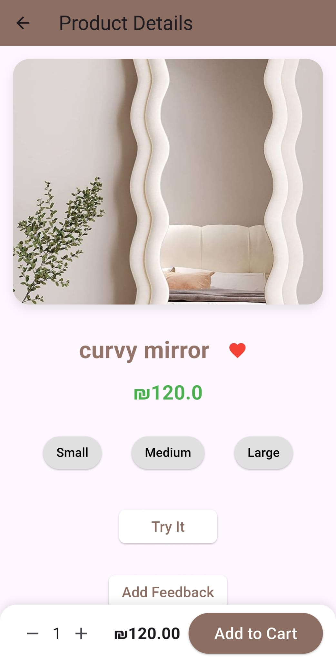
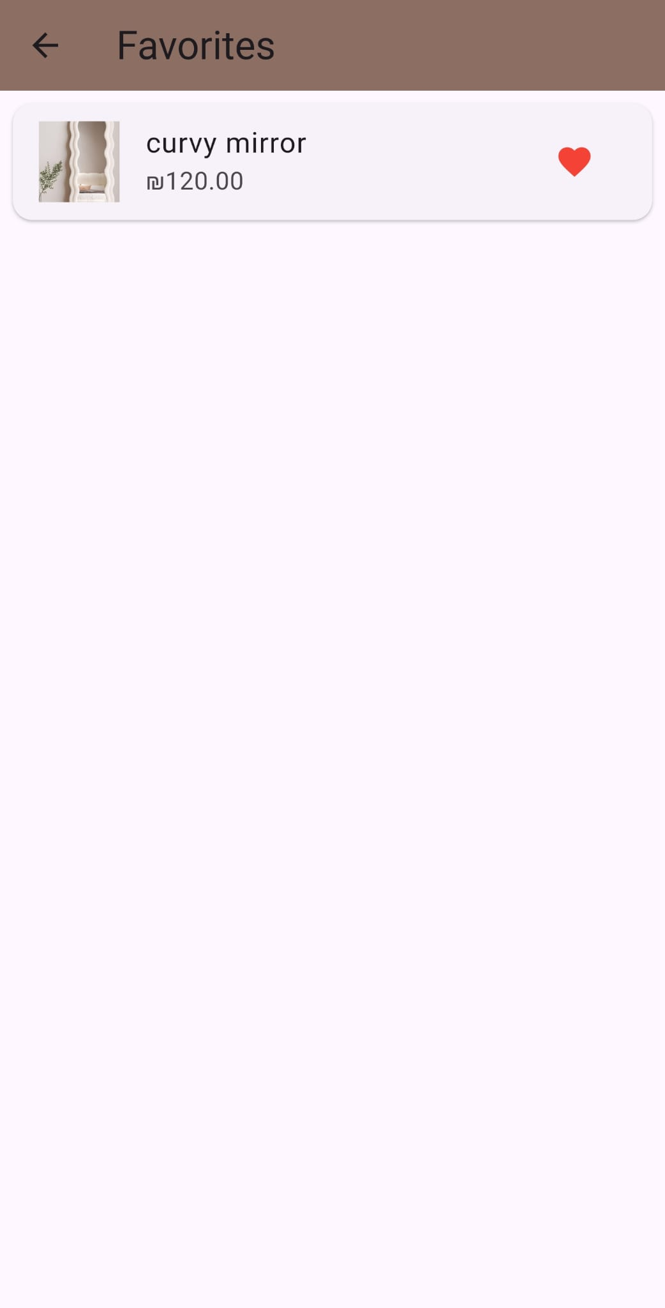
CUSTOMER
Adding Feedback:

Slide 16
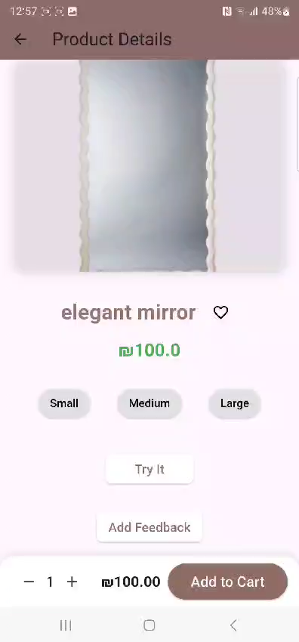
CUSTOMER

Slide 17
CUSTOMER
Try it:

Slide 18
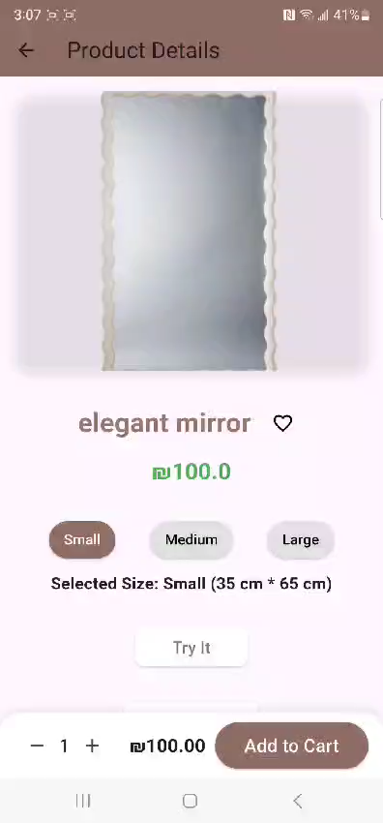
CUSTOMER

Slide 19
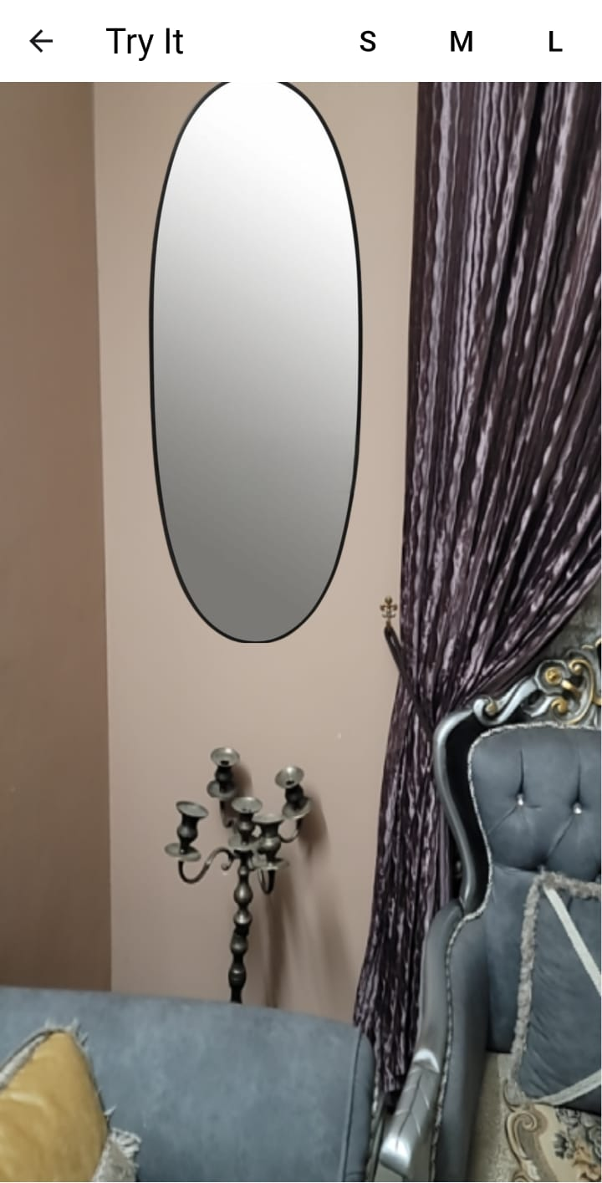
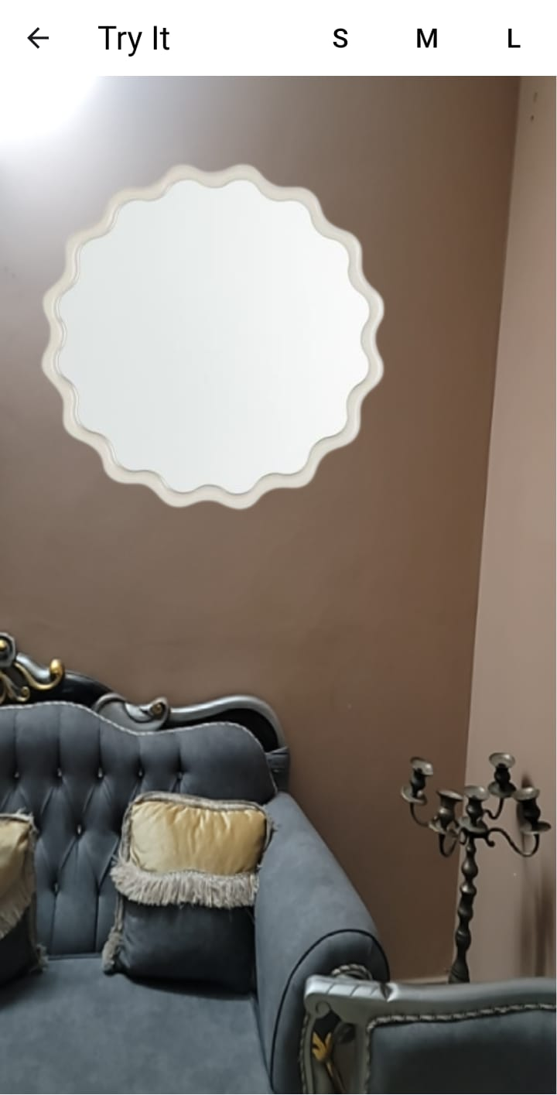
CUSTOMER
Try It:

Slide 20
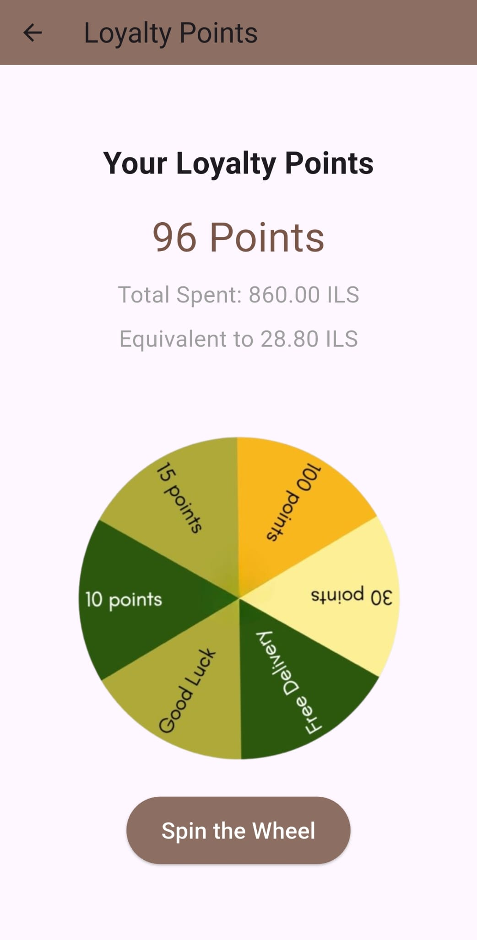
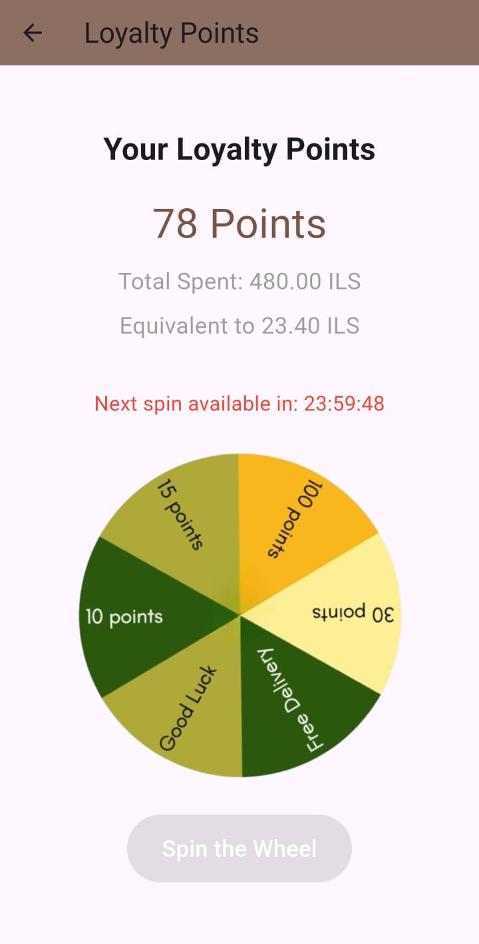
CUSTOMER
Loyalty:

Slide 21
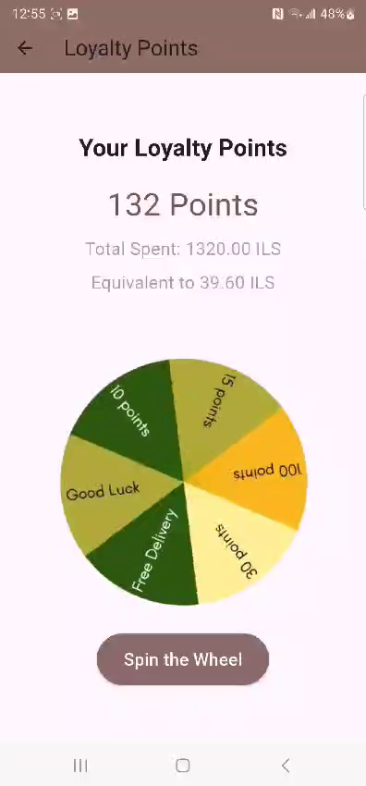
CUSTOMER

Slide 22
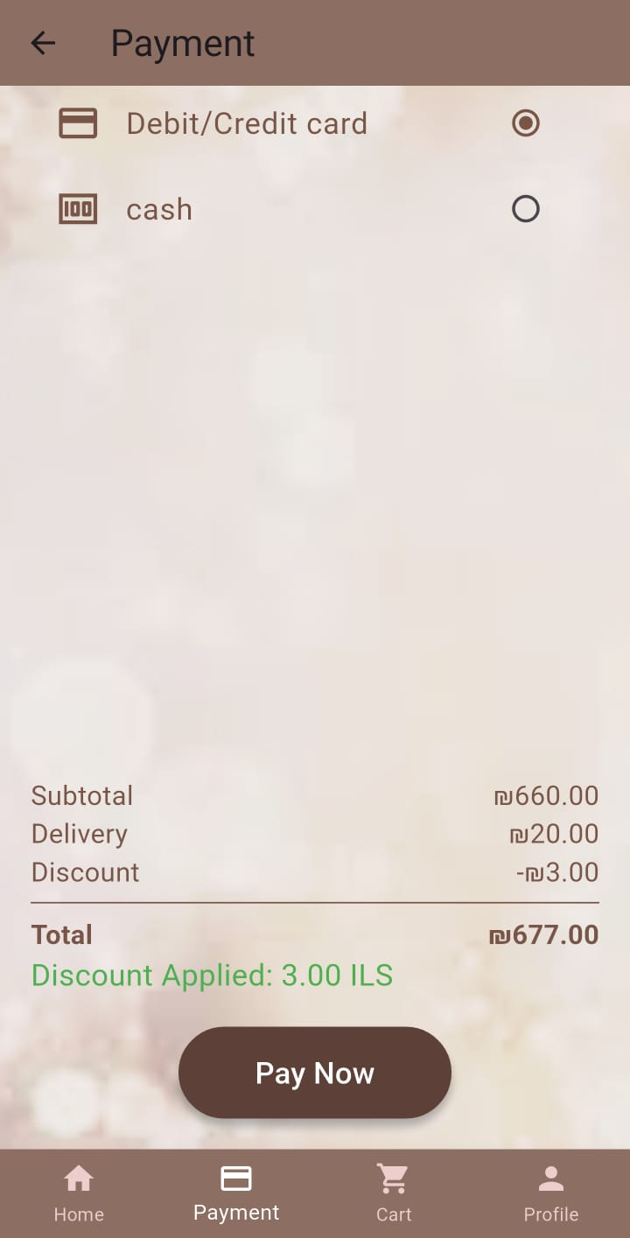
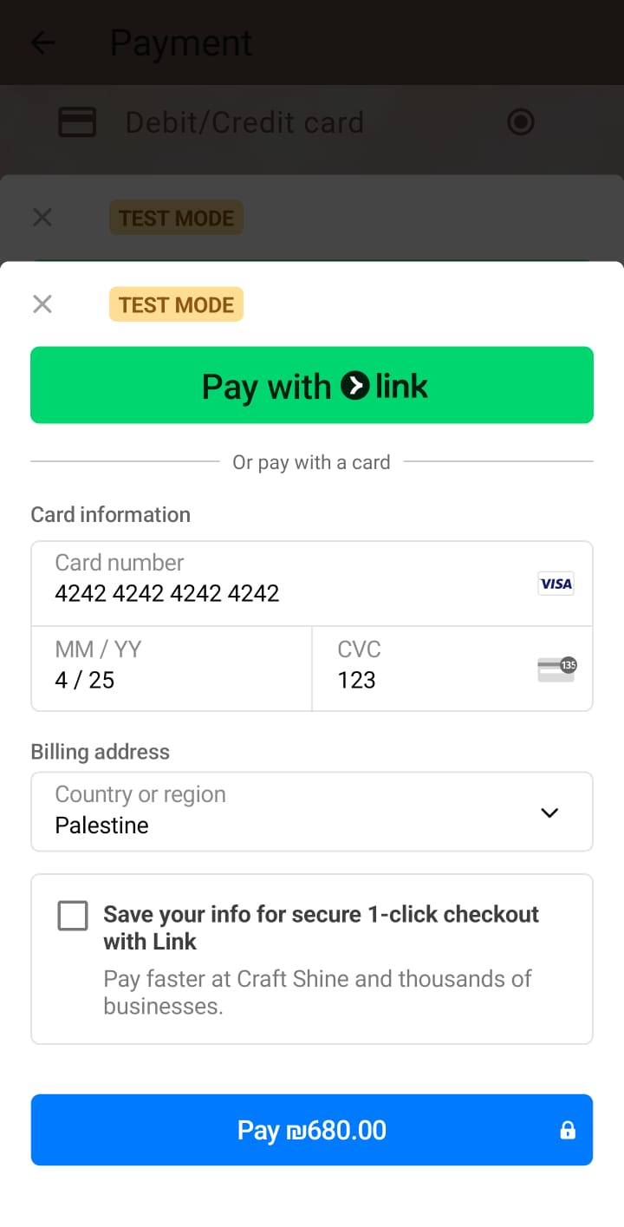
CUSTOMER
Payment:

Slide 23
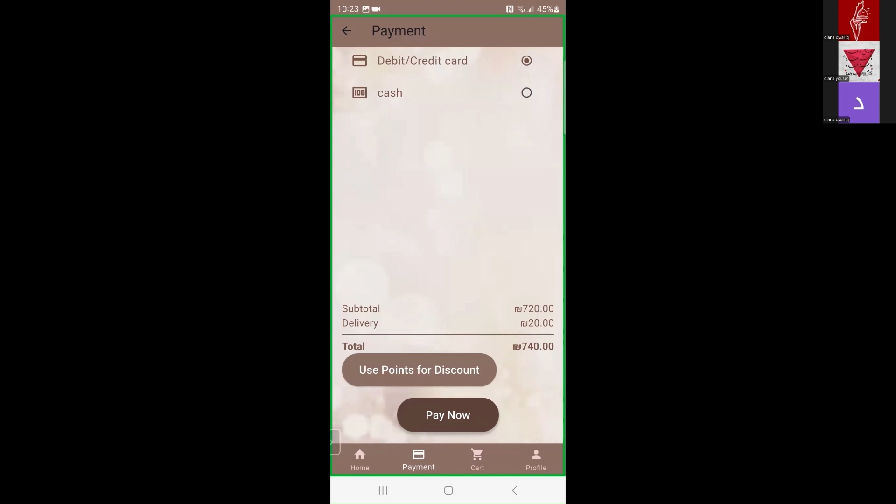
CUSTOMER

Slide 24
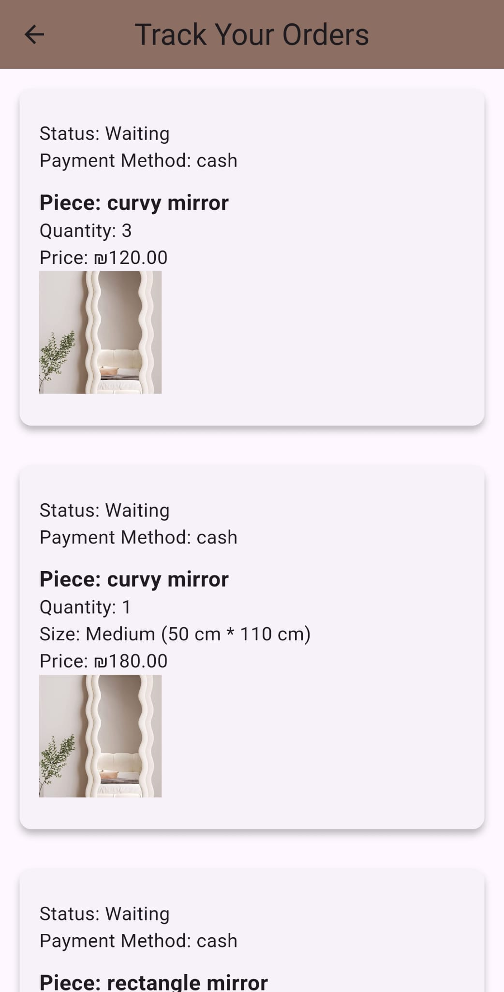
CUSTOMER
Track Your Order:

Slide 25
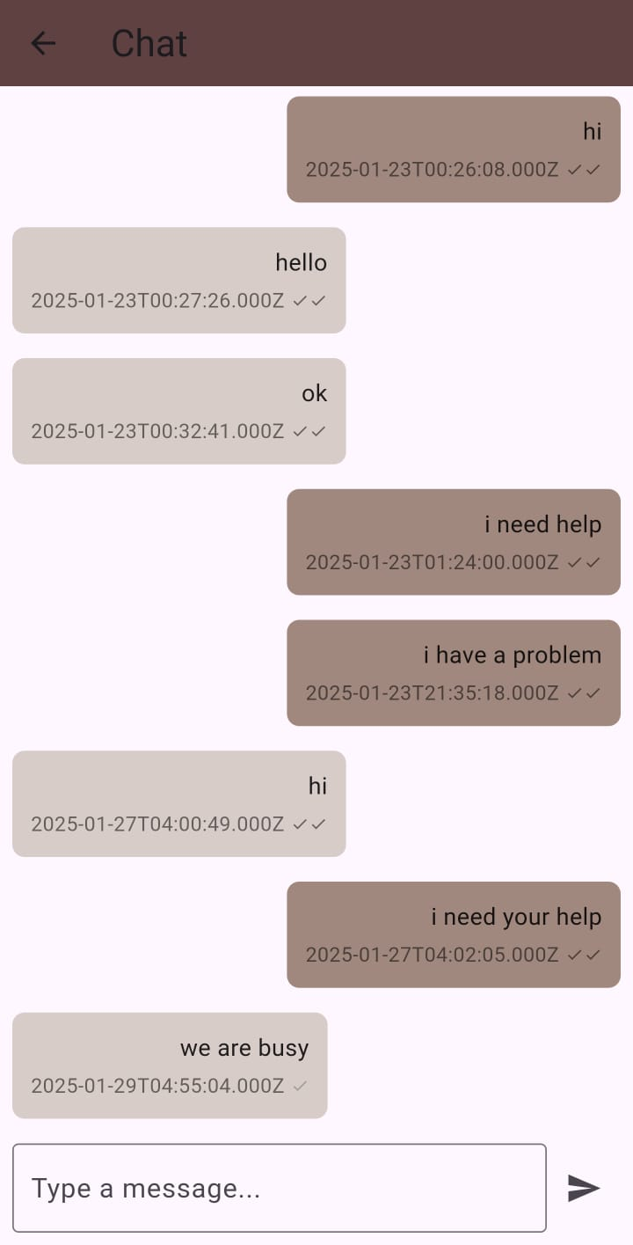
CUSTOMER
Customer Service:

Slide 26
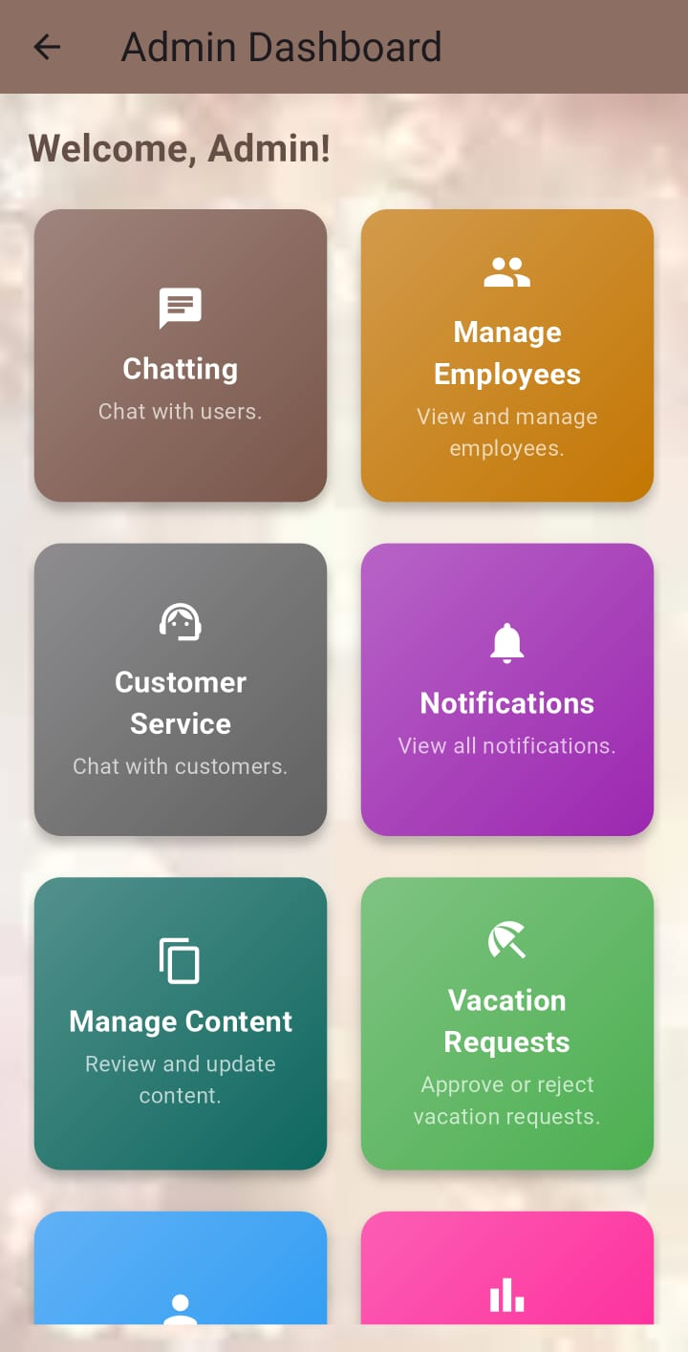
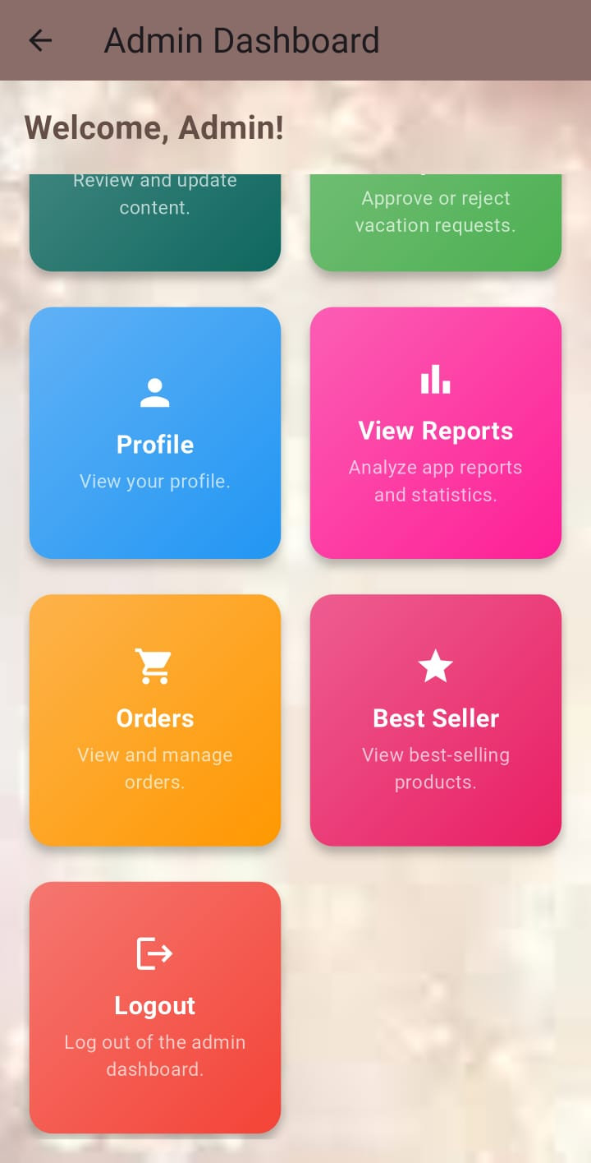
Company
Admin Dashboard:

Slide 27
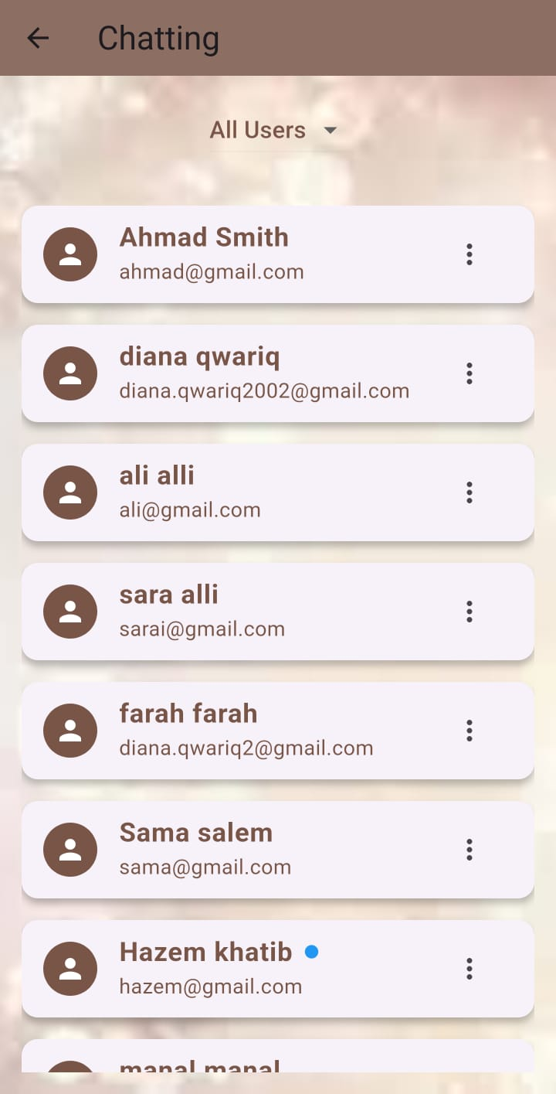
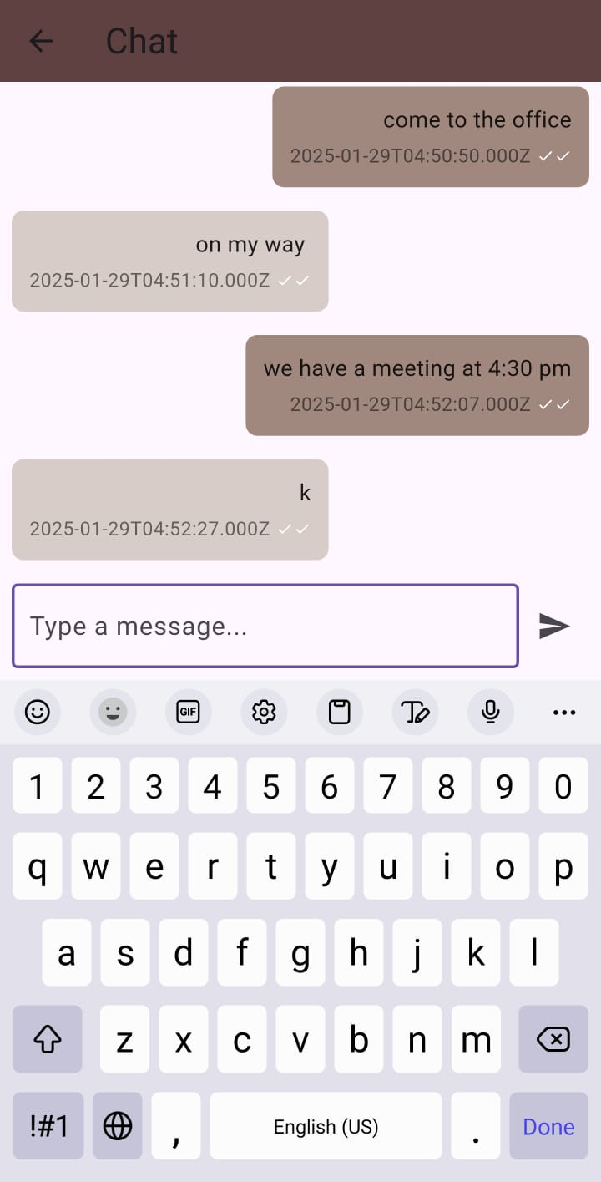
Company
Chatting:

Slide 28
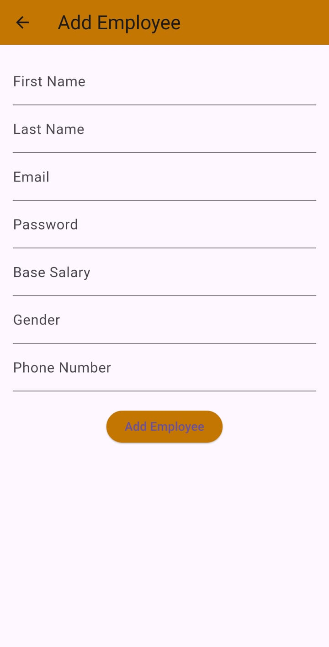
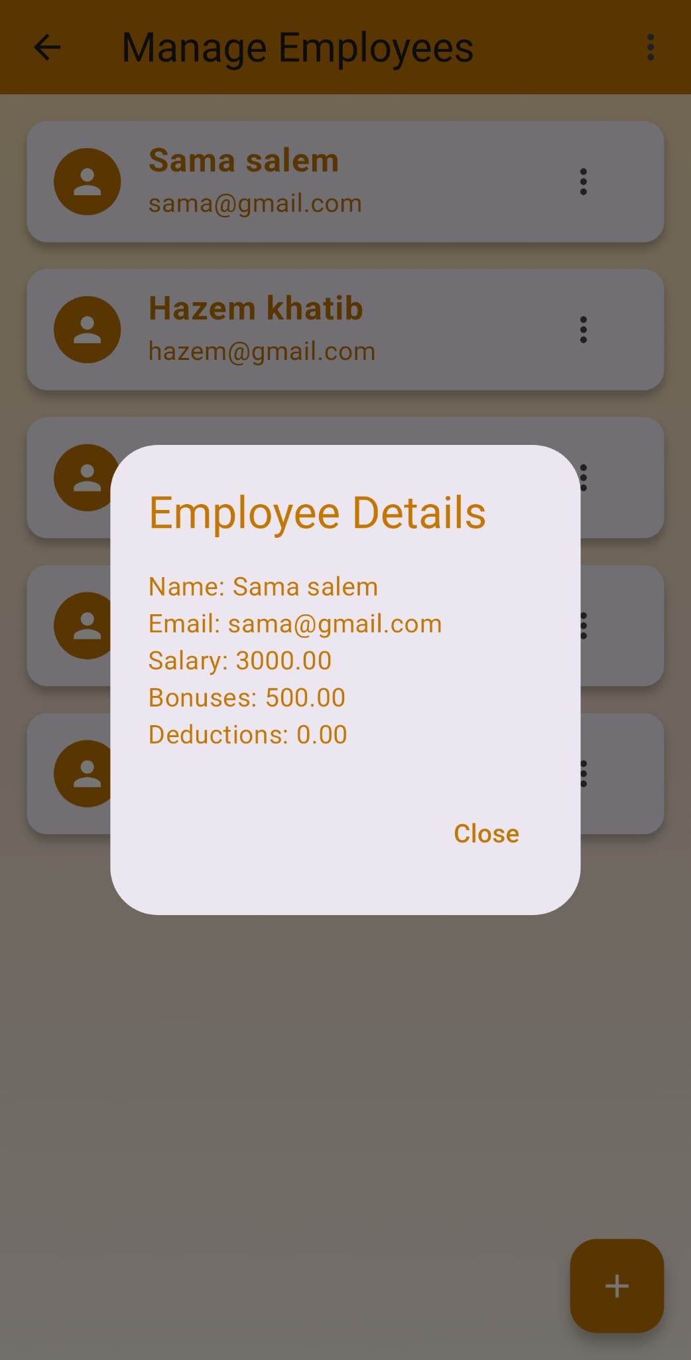
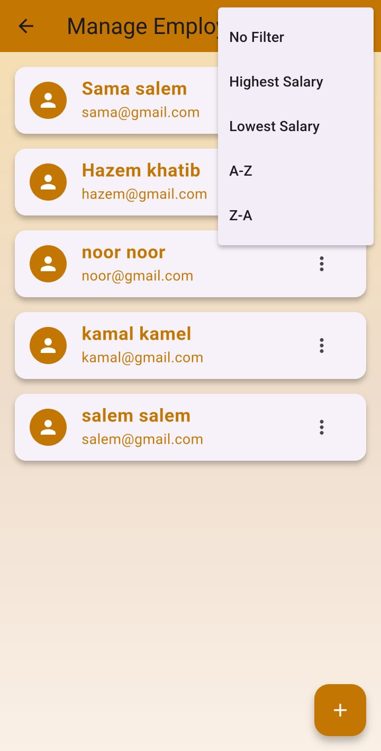
Company
Manage Employees:

Slide 29
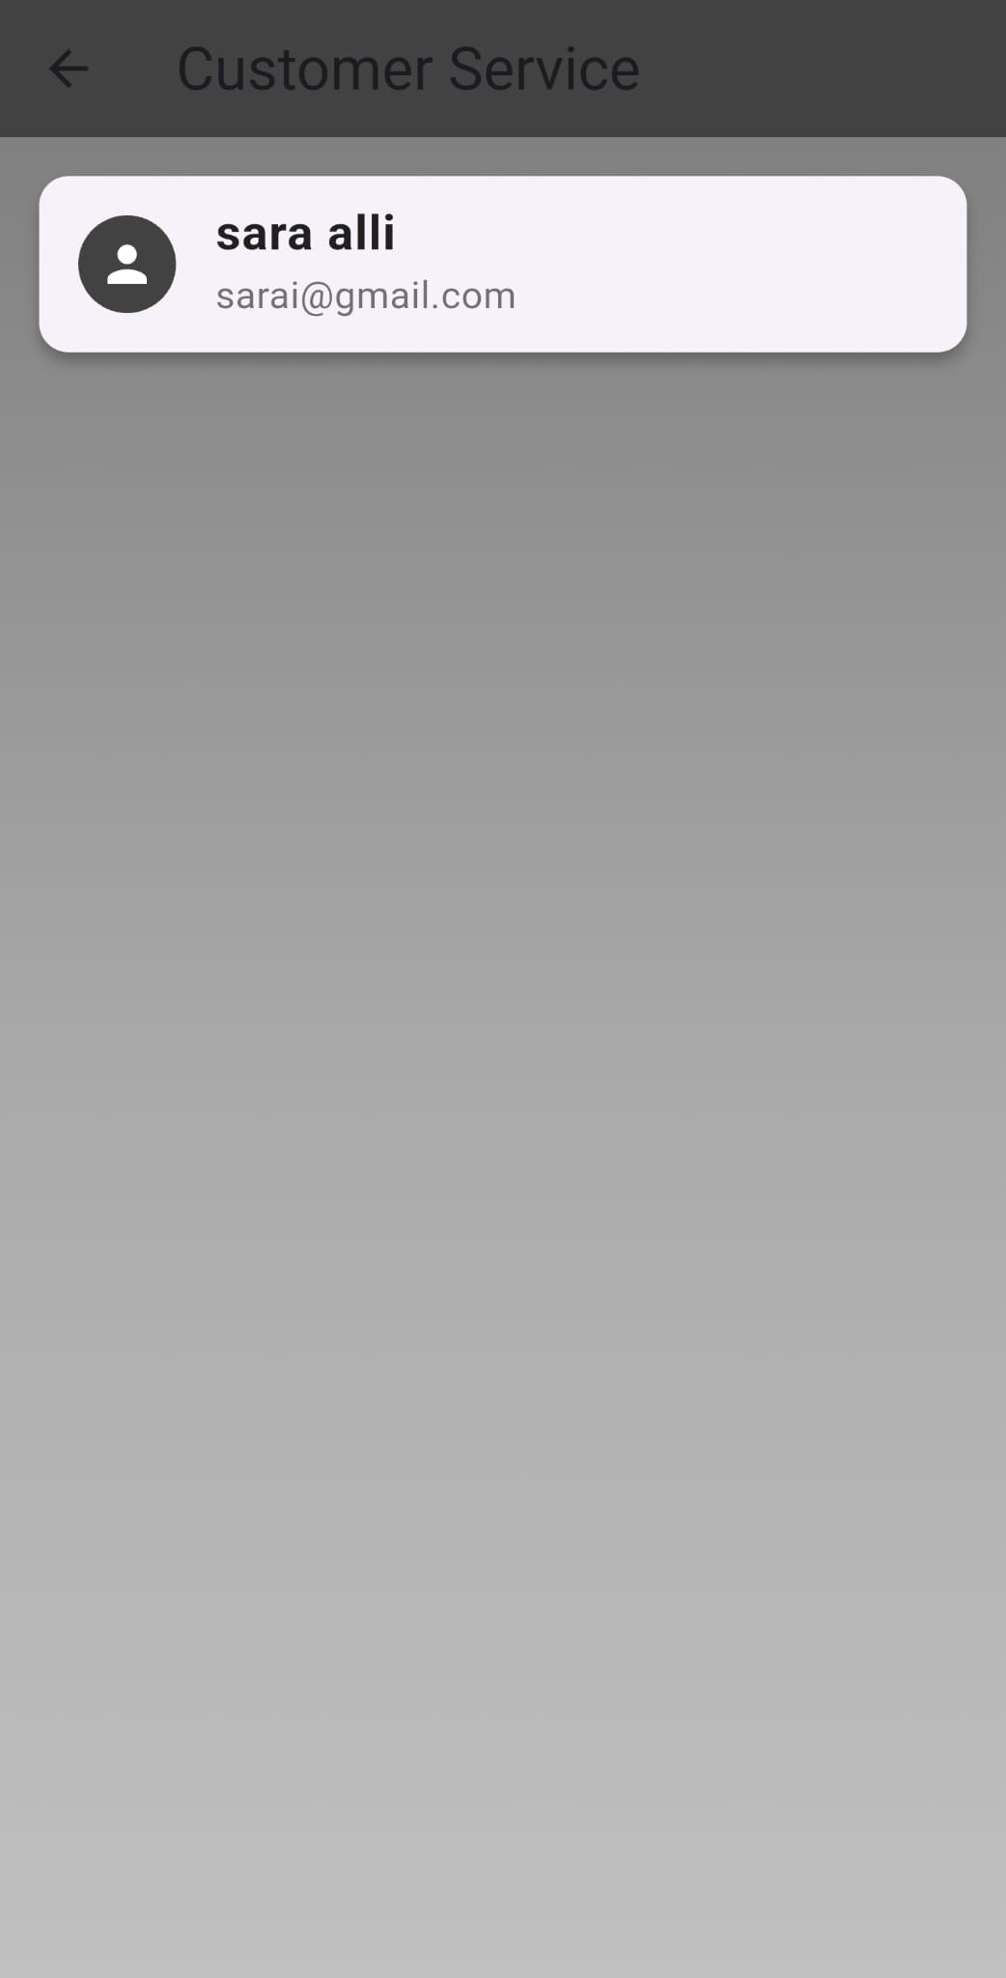
Company
Customer Service:

Slide 30
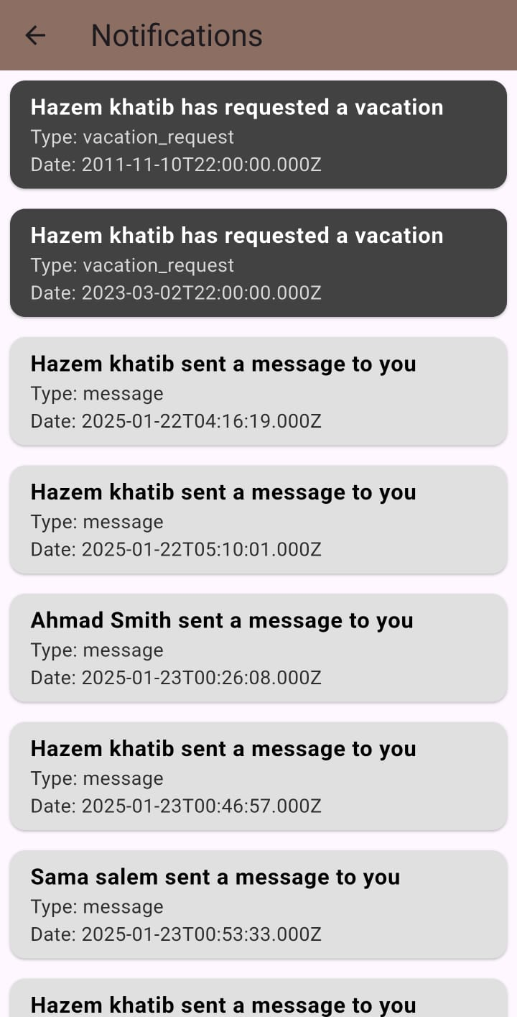
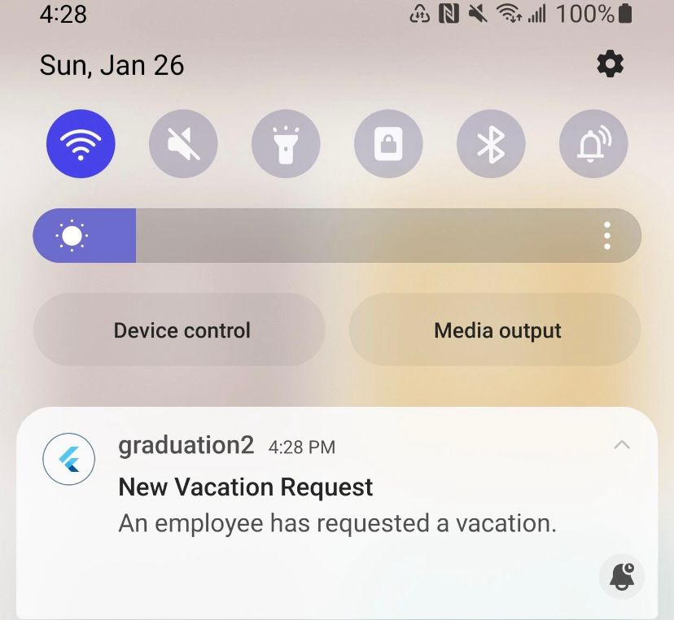
Company
Notifications:

Slide 31
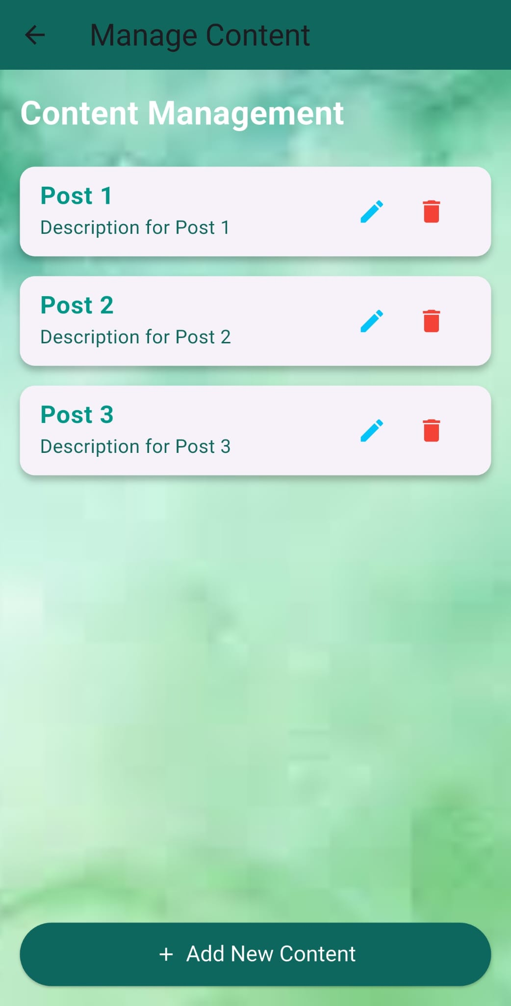
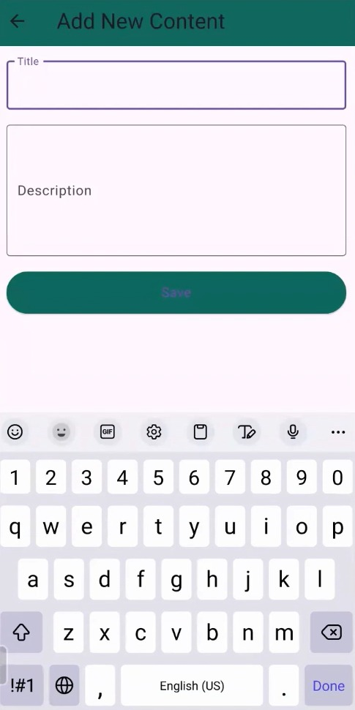
Company
Manage Content:

Slide 32
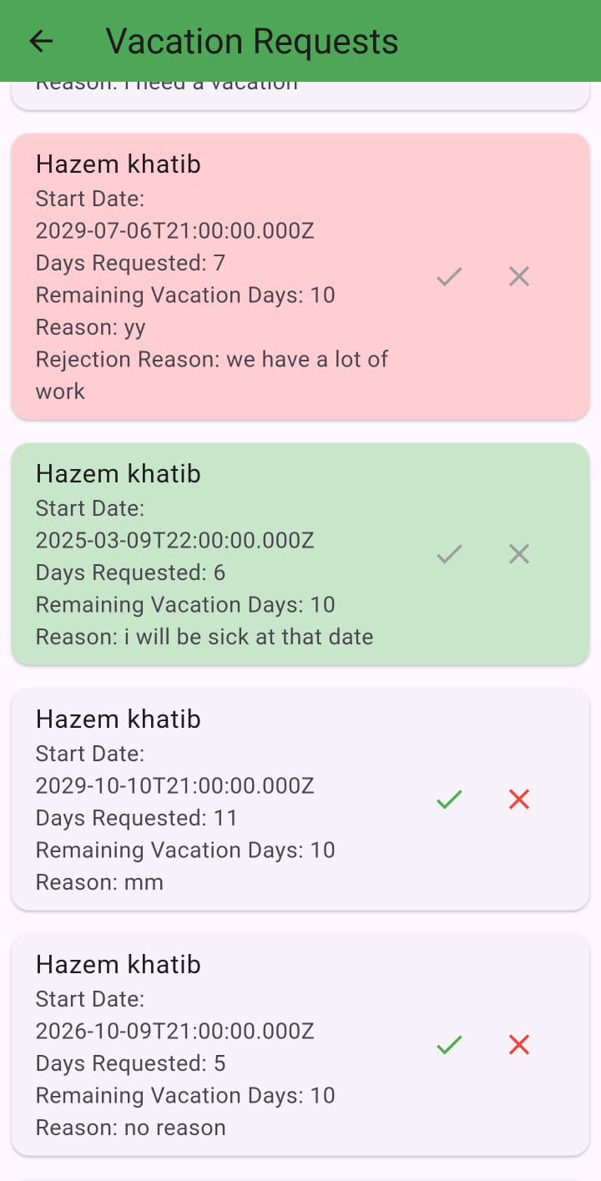
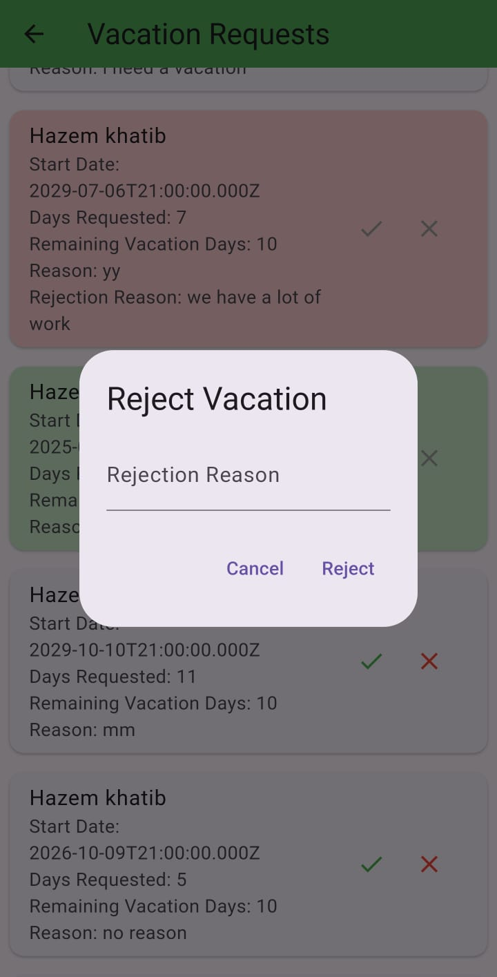
Company
Vacation Request:

Slide 33
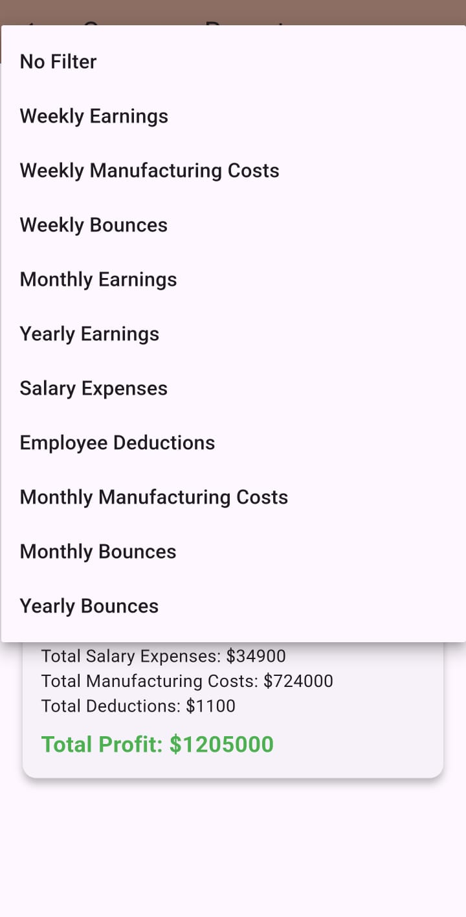
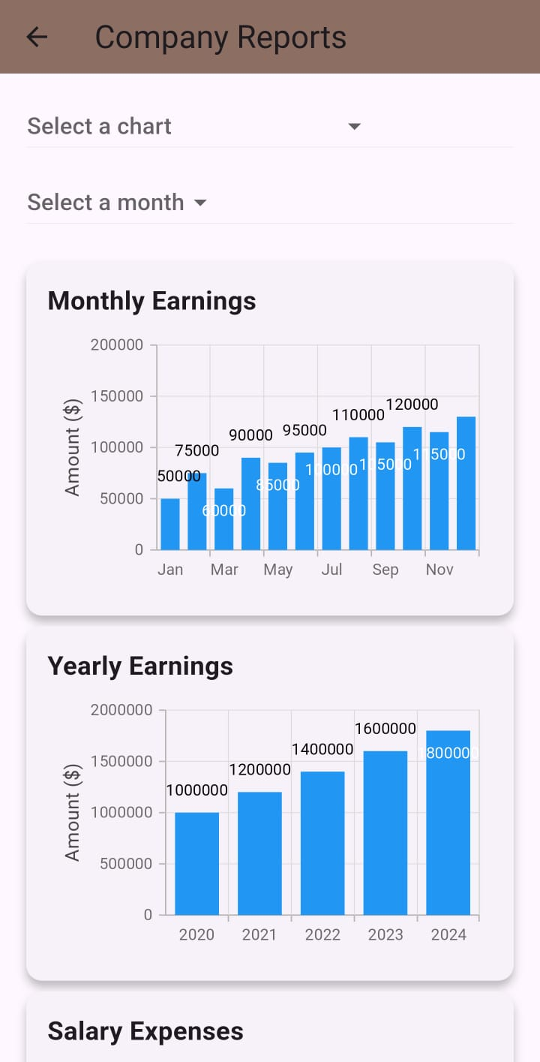
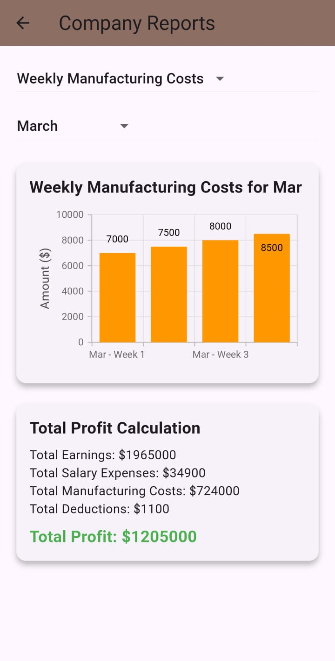
Company
View Reports:

Slide 34
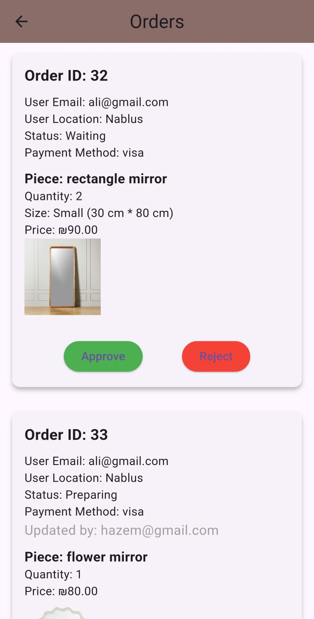
Company
Orders:

Slide 35
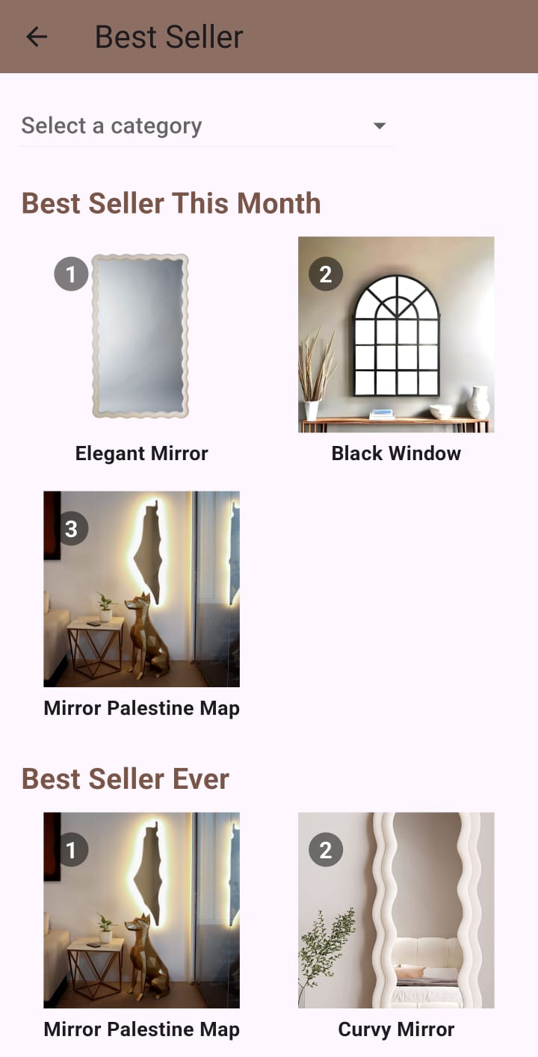
Company
Best Seller:

Slide 36
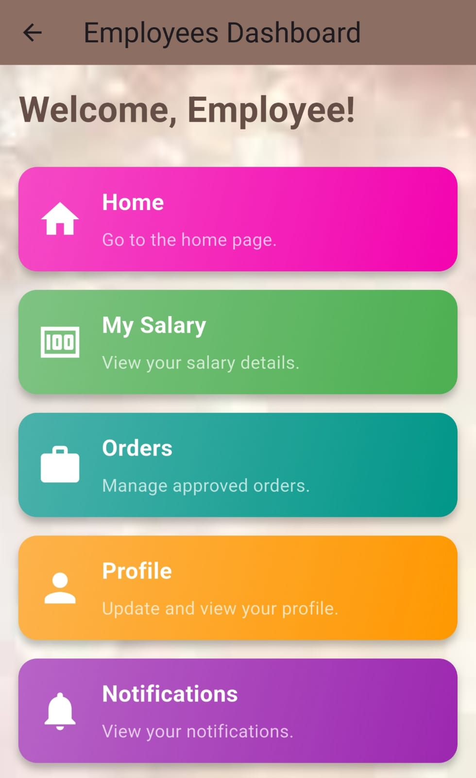
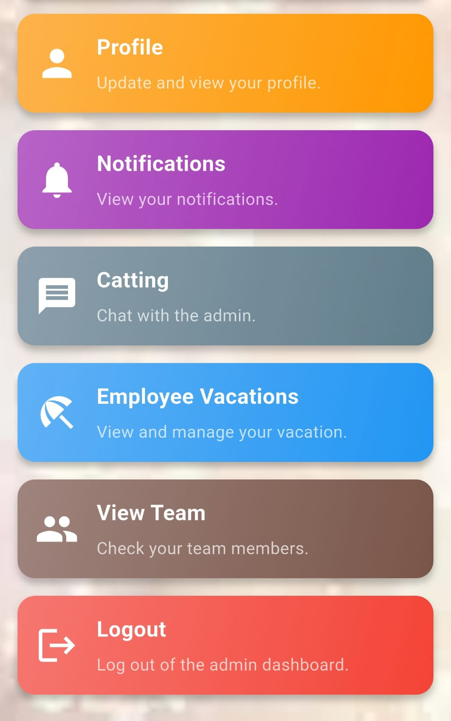
Employees
Employee’s Dashboard:

Slide 37

Employees
Employee’s Dashboard:

Slide 38

Employees
Salary:

Slide 39

Employees
Orders:

Slide 40


Employees
Notifications:

Slide 41

Employees
Vacations:

Slide 42

Employees
View Team:

Slide 43
Future Work:
Expansion to More Factories – Currently, Shine Craft is integrated with Darwazeh Factory. Future updates will include additional manufacturers, allowing customers to explore a wider range of products, compare quality, and choose from multiple suppliers.
AI-Powered Product Recommendations – An AI-driven search feature will enable users to discover similar products from different manufacturers, compare prices, and make informed purchasing decisions. This will ensure a competitive marketplace and better pricing transparency.
AI Shopping Assistant – An advanced AI assistant will analyze the customer’s home environment (such as walls, furniture, and space constraints) using the "Try It" feature. The AI will suggest the most suitable product based on color, size, and style, helping customers make the best purchasing decisions.
Augmented Reality (AR) Integration – To further enhance the "Try It" feature, an AR system could be implemented, allowing users to place and interact with 3D models of products in their environment in real time. This will provide a more immersive shopping experience.
Voice Search & AI Chatbot – Implementing a voice search function and an AI-powered chatbot will improve accessibility and assist users in finding products, tracking orders, and resolving queries without needing manual searches.
Improved Customer Loyalty System – Expanding the "Spin the Wheel" feature to include seasonal rewards, exclusive discounts, and referral programs will further incentivize purchases and increase customer engagement.
More Secure & Flexible Payment Methods – Future updates will integrate additional payment options such as PayPal, Apple Pay, and cryptocurrency payments, ensuring a secure and flexible checkout process.

Slide 44
THANK YOU

