Slide 1
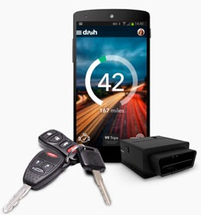
Car Diagnostic
System
Android Mobile Applicatin
Spitialest in Opel Engin

Slide 2
1.Vedio as Introduction

Slide 3
“The system is android app and hardware device to check opel engin and give the result in Arabic”

Slide 4

Why This System???
Limited knowledge of the mechanic in English.
To keep up with the massive development in
the automotive industry and its repair.
Accuracy in knowing and repairing errors.
For everyone interested in getting to know
their cars better.

Slide 5
Mechanical introduction
For more understanding……..

Slide 6
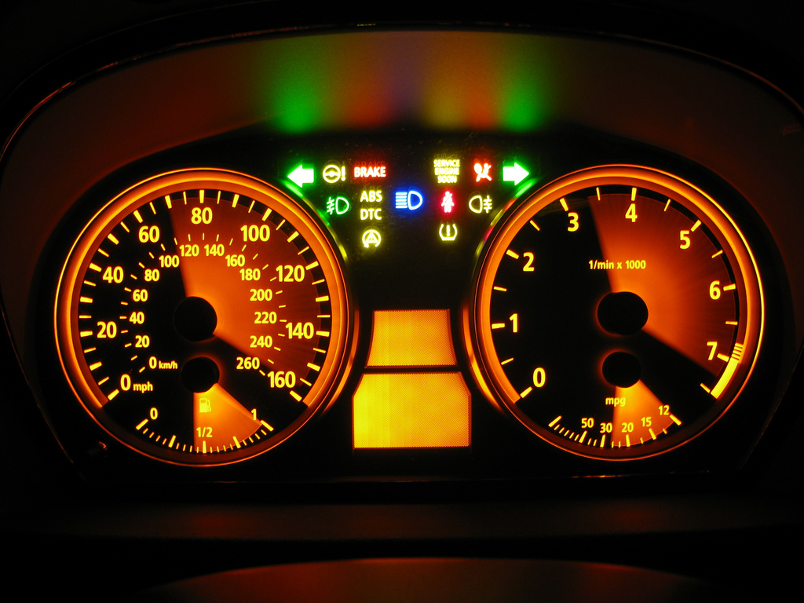
The Car Cluster
The cluster show the car system Air bag, check engine, sensors, oil.

Slide 7
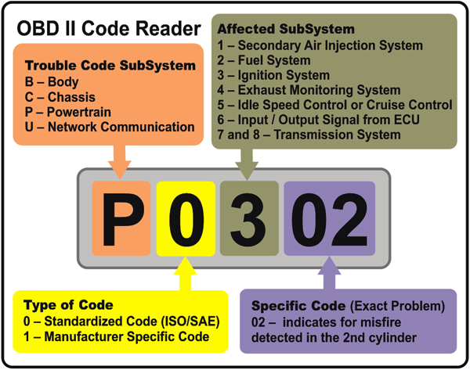
The OBD||
Trouble Code

Slide 8
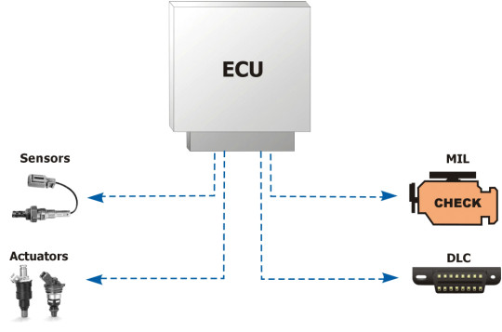
OBD System in Car

Slide 9

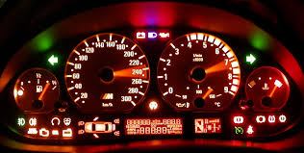
What Does The App Do !
checks the engine faults. shows the Real life
data for the car.

Slide 10
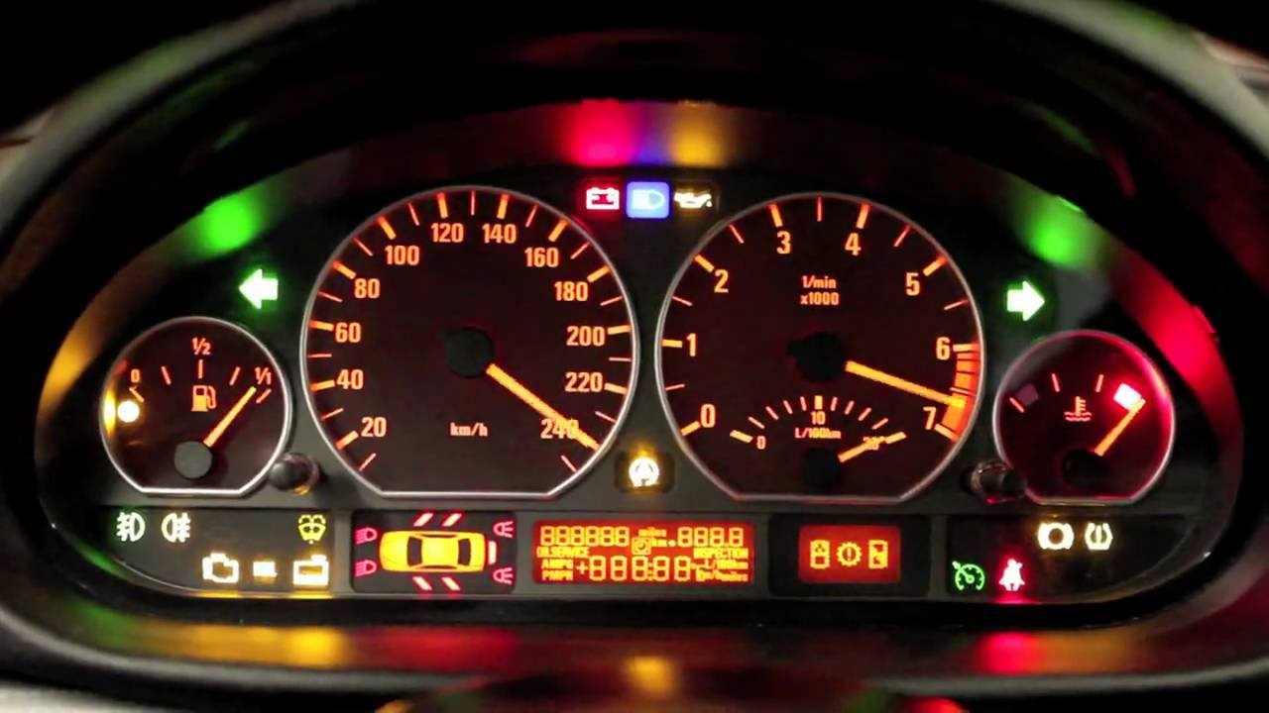
Want big impact?
USE BIG IMAGE.

Slide 11
The System Structure

Slide 12
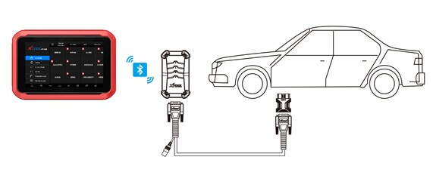
System Structure
The system consists of two parts :
Hardware connected with the car(OBD2).
Software receive data from the H.D via Bluetooth.

Slide 13
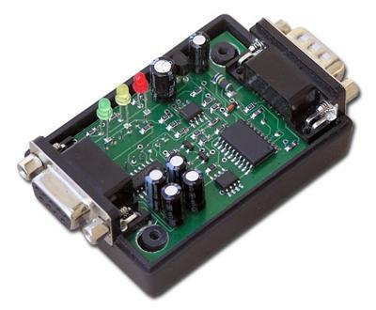
The Hardware
This is an obd device which use to transfer the command from\to the car via Bluetooth.

Slide 14
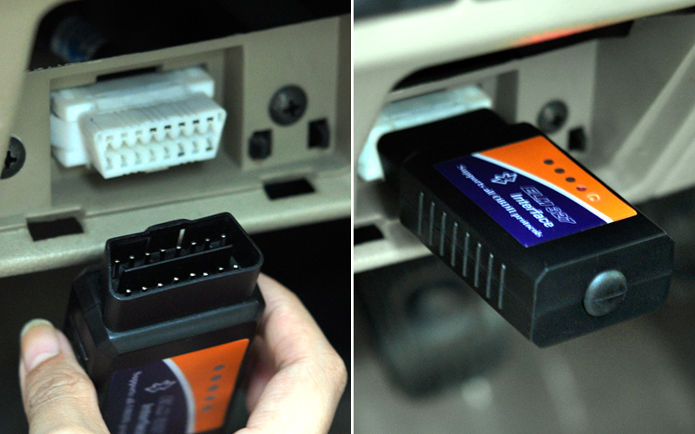
The Hardware cont>>
The OBD-|| port located inside the vehicle passenger compartment .

Slide 15

The Software Application
It is an android application that check engine failure for Opel car .

Slide 16
Information about application
Requirements:
Android Device 4.2 or more
1 GB memory (or more).
Obd2 hardware device.
Internet.
Libraries been used:
Obd-java-api.
DB library MySQl
Picasoo library
Bigger goals:
  Expansion to serve the Arab world.
  Expansion to all parts and types of cars.
  Expansion of the App services

Slide 17
Services & Features
Check engine : Search for engine trouble codes .
Translation : return the Arabic transition of the error .
Real life data: Show the speed , RPM , throttle position , engine temperature.
Reset Trouble code .
History: Show the history of errors for the car

Slide 18
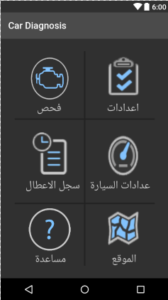
Home
This page contains the basic buttons:
  The Setting button
  The Check Engine button
  The Dashboard button
  The History button
  The location button
  The help button
Place your screenshot here

Slide 19
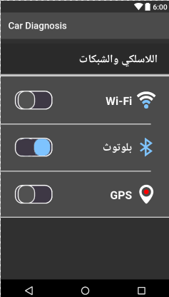
Setting
  Wi-Fi.
  Bluetooth.
  GPS .
Place your screenshot here

Slide 20
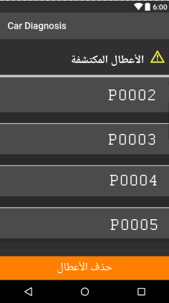
Trouble code
This page show a list of the returned codes from the car .
Place your screenshot here

Slide 21
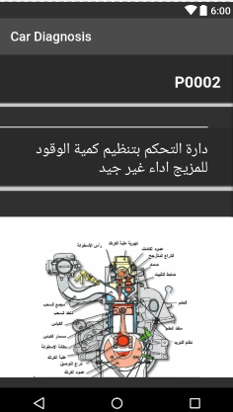
Result
This page contains the final results:
  error code.
  error in Arabic .
  error image in the engine
Place your screenshot here

Slide 22
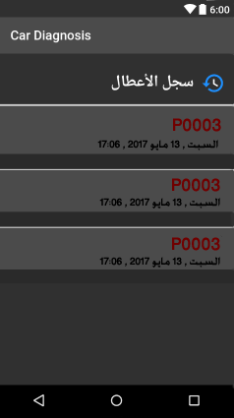
History
This page show history of the car Trouble codes
Place your screenshot here

Slide 23
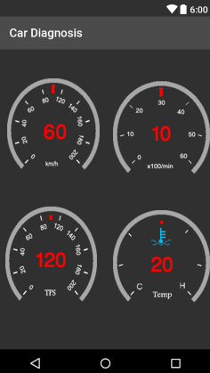
Reallife data
This page shows :
  The Car Speed
  RPM
  Engine Temperature
  Throttle Position
Place your screenshot here

Slide 24
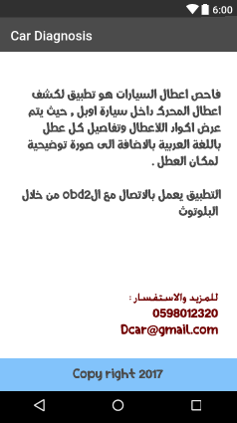
Help
This page has inf. About applicatin and contact info. To support the user.
Place your screenshot here

Slide 25
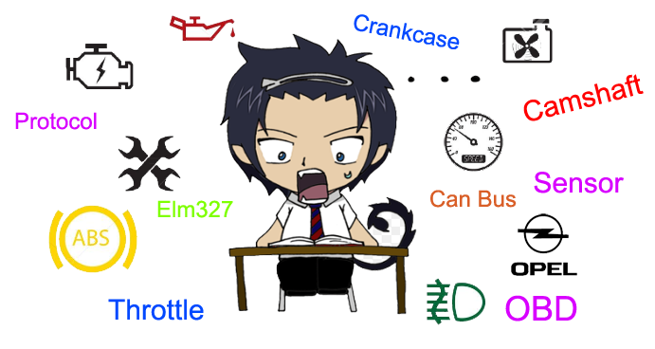
Problems we faced

Slide 26

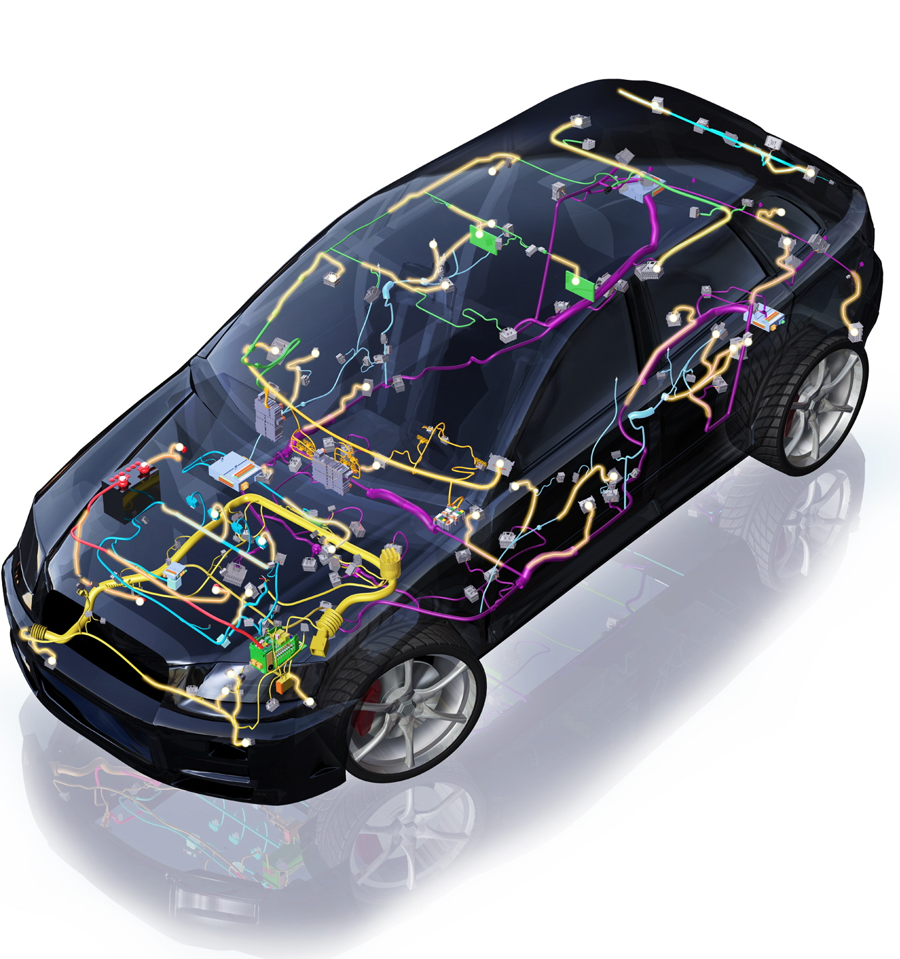
THANKS!
Any questions?
Supervisor :Dr.Amjad Hawash
The team work:
Raghad Awadeh
Rudab abu yaqub
Aalya al Haj Ahmad

