Slide 1

Investigating into the need of Total productive maintenance (TPM) at AL-Arz

Slide 2
Supervisor:
Eng. Tamer Haddad
Presented by:
Hazem Abo AL-Soud
Hiba AL-Jabi
Lana Sharif
Lara Draghmeh
Sabreen Shehadeh

Slide 3
Outline:
Introduction.
Problem statement.
Objectives.
TPM system.
Methodology.
Result and analysis.
Conclusion.
Recommendations.

Slide 4
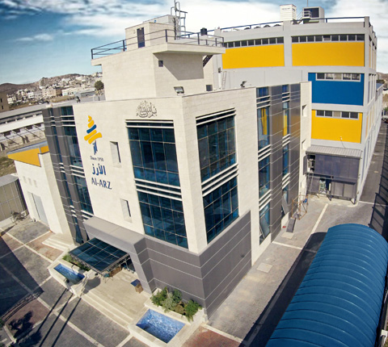
Introduction

Slide 5
AL-Arz company was established in 1950 by late Mohammad Anabtawi..
Al-Arz produces many products such as charms Almonds, Arz cream cinnamon caramel, summer and captain roll roasted pistachio, and Arz premium strawberry cheesecake.
The company aims to be pioneer in the field of ice cream manufacturing and distribution in Palestine and the whole world through presenting an advanced variety of ice cream.
Al Arz acquired the global food safety certificate HACCP. It was the first company to acquire this certificate among the ice cream and dairy producers in Palestine and Jordan.

Slide 6
Problem statement
High quality and food safety are the main core values of Al-Arz Ice Cream, and in order to maintain high quality, the company forms check list and distributes it to the maintenance department worker which means they follow preventive maintenance.
The preventive maintenance considers one aspect of total productive maintenance, so we want to know what are the needs required to replace the existing traditional formula of maintenance into fully total productive maintenance practices.

Slide 7
Objectives
Our main objective is to prepare Al-Arz Company to achieve a full implementation of total productive maintenance system and also we attend to analyze the entire main problems that the factory faces to recommend a key solutions to these problems, in order to obtain the advantages of TPM on this ice cream factory.

Slide 8
Total productive maintenance(TPM)
TPM is a maintenance philosophy with the objective of eliminating production losses due to equipment status, or in other words, keeping equipment in a position to produce at maximum capacity, the expected quality products, with no unscheduled stops.
TPM requires all staff participation and involvement, from senior management to plant operators. Including every one of them can guarantee the success of the objective.
TPM implementation in an organization can ensure better quality, higher productivity fewer breakdowns’ and lower cost.

Slide 9
Methodology
Reviewing & understanding TPM concept.
Primary field visit.
Selection of proper methods for collecting necessary data.
Design the assessment tools (Questionnaire).
Data collect and analysis(interviews & questionnaire).
Defines the gap between the current system applied in the factory and TPM system.
Provides recommendations to enhance the implementation of TPM.

Slide 10
Results and analysis

Slide 11
lines | Working hour target | Lack of material and supplies | The shortage of spare parts | Technical failure | Electricity failure | Schedules maintenance | Total hour of down time | Total actual working hour | The proportion of hours down time/the total working hours target
Cartos | 610 | 0 | 0 | 5.5 | 1.2 | 113 | 119.7 | 526.4 | 19.6%
Boxes | 40 | 0 | 0 | 1 | .3 | 8 | 9.3 | 33.4 | 23.25%

Slide 13
Production target and actual data
Lines | Production |  |  |  | Ratios and indicators
 | Target |  | Actual |  | Proportion of the actual target value
 | Quantity | Value | Quantity | Value
Cartos | 77590 | 232770 | 66993 | 200979 | 86.3%
Boxes | 6442 | 115950 | 5440 | 97920 | 84.4%

Slide 15
GMF line Productivity level
The lines | Actual production in 2017(unit) | Total actual working hour | Productivity (unit/hour)
Cartos | 66993 | 526.4 | 127
Boxes | 5440 | 33.4 | 162

Slide 16
Percent of actual value to target value

Slide 17
Productivity in terms of number of employees

Slide 19
Don’t know | Never | Rarely | Sometimes | Always | Factory
0 | 5 | 1 | 4 | 3 | AL-Arz

Slide 20
Don’t know | Never | Rarely | Sometimes | Always | Factory
1 | 9 | 2 | 0 | 1 | AL-Arz

Slide 21
TPM pillars | % of implementation | Main problem | Solutions
Autonomous maintenance | 78% | lack of inspection process. | applying a regular inspection process for machines and involvement of operators
Focused improvement | 78% | Non productive time due to technical malfunctions | modify the whole system to find the most cost effective ,time consuming and least disruptive solution to optimize the system
Planned maintenance | 71% | lack of analysis of the main causes of the non productive time | application of a program to discover the main causes of non productive time and how to reduce it
Quality maintenance | 75% | shortage of raw materials | prevent defects from being produced ordinary
Education and training | 50% | Shortage of training courses of dealing with emergency situation | Increase skills and performance of all personnel in the organization
Safety health and environment | 55% | non completely suitable environment and workplace for the employees | fostering a safe and healthy work environment and focusing on protective of employees
Office TPM | 73% | shortage of calibrating and monitoring devices | program for calibration schedule of valid spare parts and record any shortage
Development management | 72% | No cleaning inspection program and lack of participation of operators. | applying a program for cleaning inspection and motivate operators to participate in improvement process

Slide 22
Recommendations
Institute training program.
Safety assurance.
Empowerment of the employees.
Regular reports.
Inspection and cleaning process.
Use improvement tools as maintenance check sheet and cause and effect diagram.

Slide 23
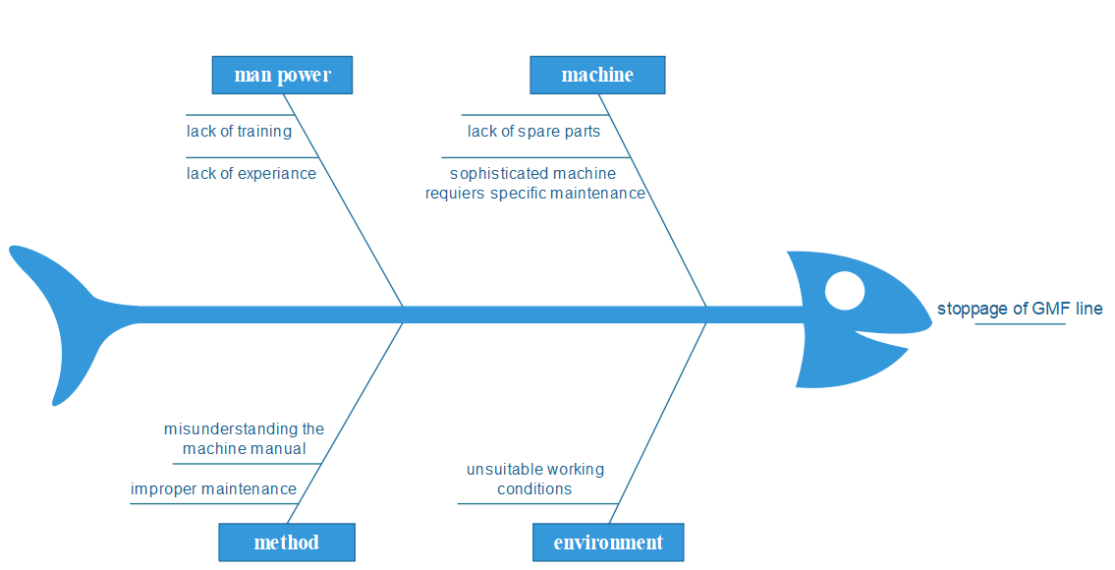
Cause and effect diagram.

Slide 24
conclusion
In order to achieve our goal we used different tools and we focused on distributing questionnaires on different employees in the factory and the questions was focusing on finding the problems and receiving a useful recommendations from the employees and operators themselves in order to make them a part of the improving system. After we analyzed the current situation of the factory we found that they implement a 69% of the TPM system and we produce some effective solution in order to reach a complete implementation of TPM.

