Slide 1
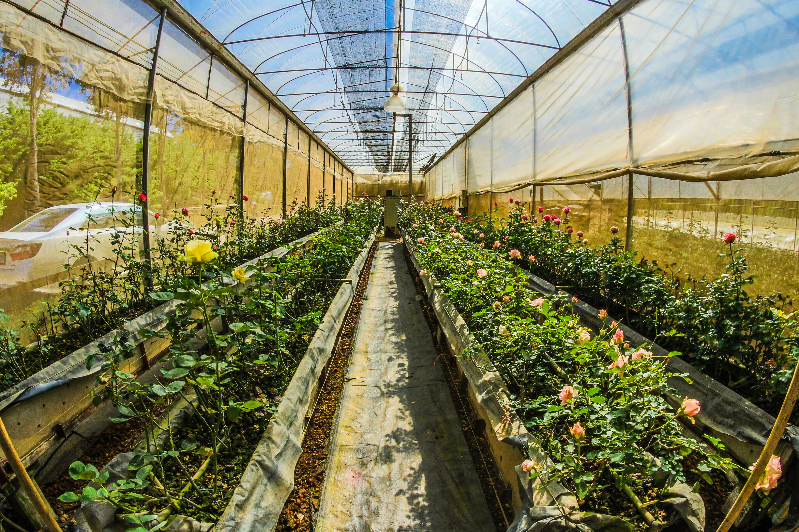
AGRIBOTIX

Slide 2
TABLE OF CONTENT
Introduction
1
Objectives
Features
Components & Specifications
3
Control Page
3
2
4
Features
Features
4
Control Page
3
4
Constraints
5
6
Future Work
7
Acknowledgement
1

Slide 3
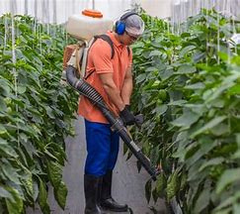

INTRODUCTION
General Background:
  Importance of smart robotics assistants for easier daily life.
  Evolution of robotics in modern agriculture
2

Slide 4
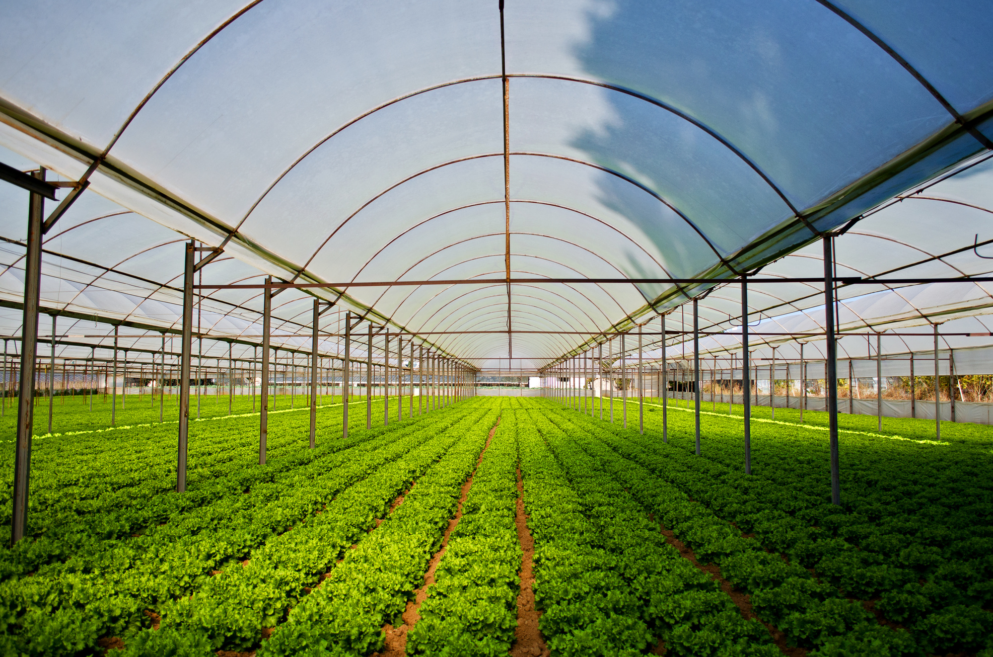
Objectives
  Reducing manual labor by using automated systems for key agricultural tasks
  Automating irrigation System
  Automate Pesticide Application
  Enhancing the precision of greenhouse navigation
  Improving crop monitoring through real-time data
  Developing an integrated system that facilitates easier control and operation of farming processes
3

Slide 5
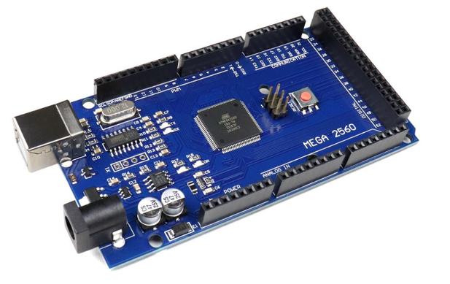
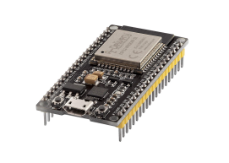
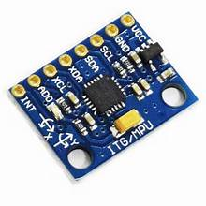
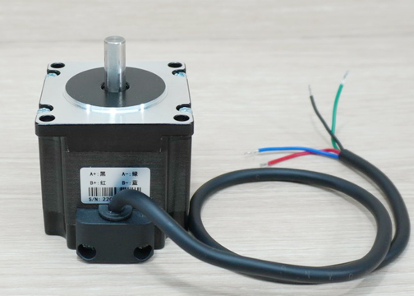
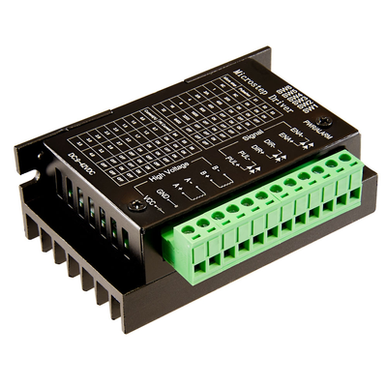
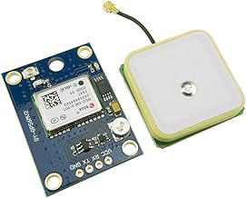
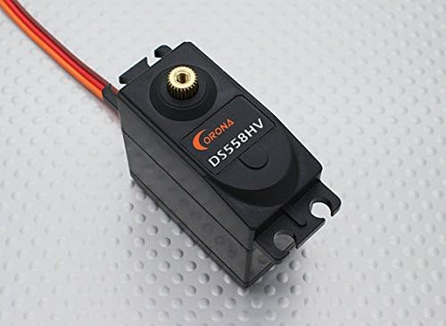
COMPONENTS AND SPECIFICATION
MOVEMENT CONTROL COMPONENTS
ESP32 MODULE
MPU6050 GYROSCOPE
Arduino Mega 2560
Stepper motor &
Tb6600 Driver
NEO6MV2 GPS module
Corona DS558HV Servo
4

Slide 6
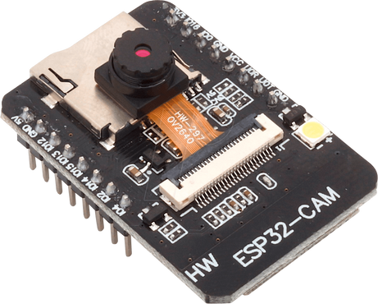
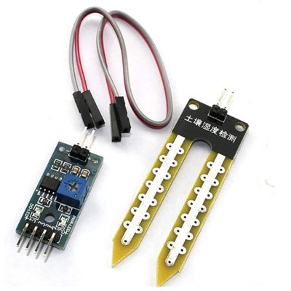
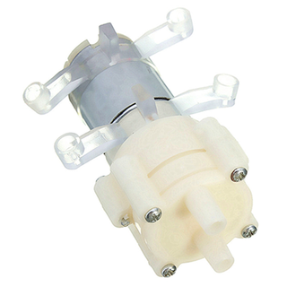
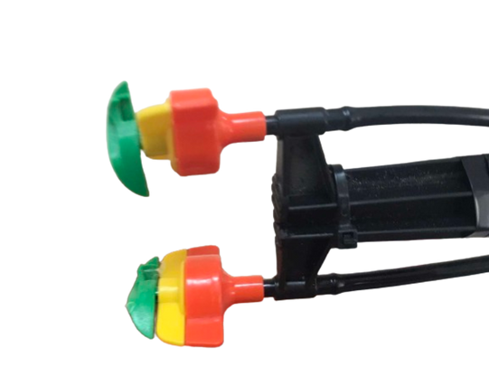
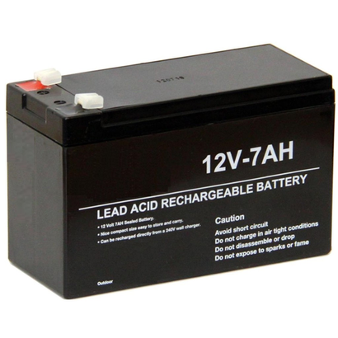
COMPONENTS AND SPECIFICATION
MONITORING AND SPRAYING COMPONENTS
ESP32-CAM MODULE
ESP32 MODULE
SOIL MOISTURE SENSOR
DIAPHRAGM PUMP
SPRINKLERS
LEAD ACID BATTERY
5

Slide 7
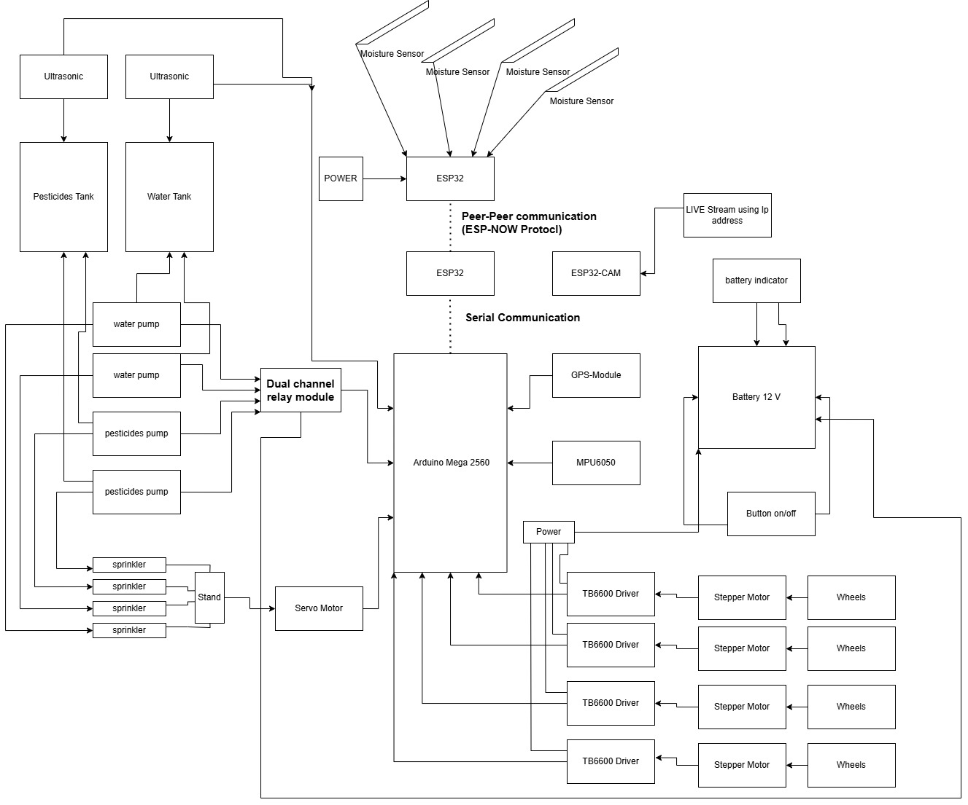
Block Diagram
6

Slide 8

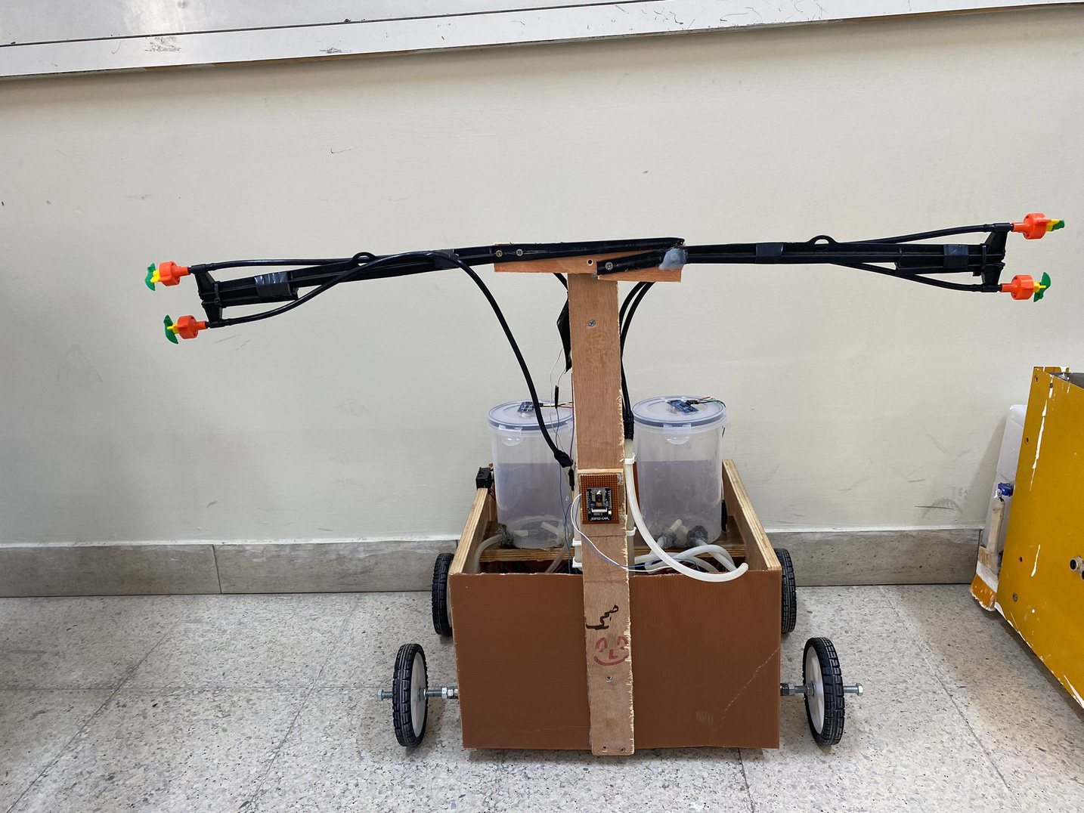
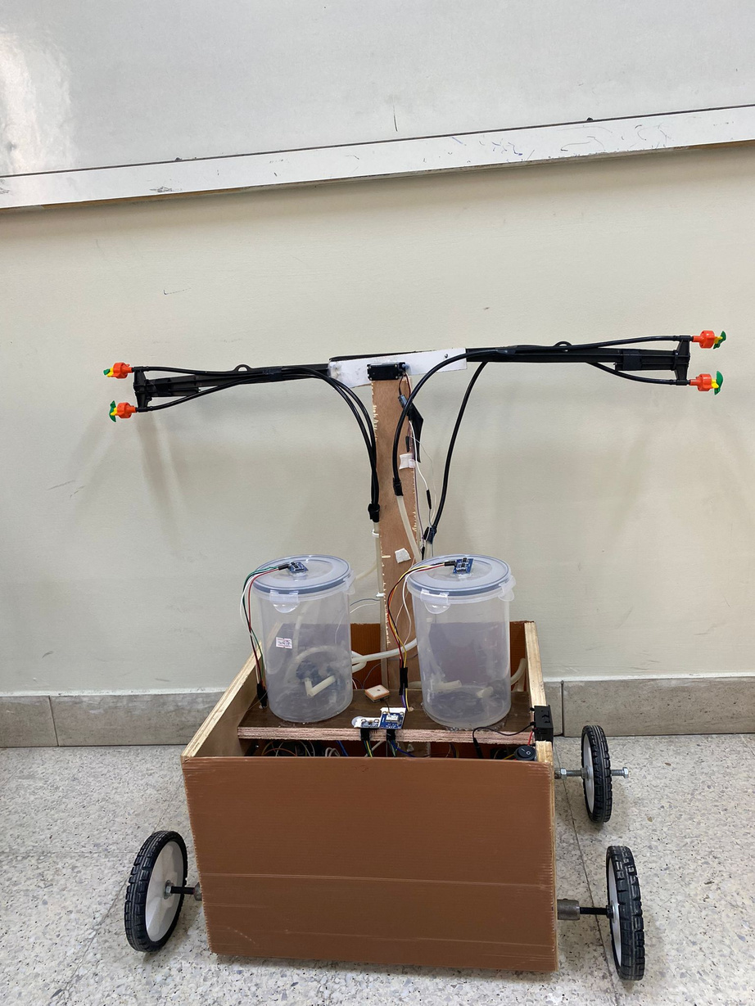
The Results
7

Slide 9

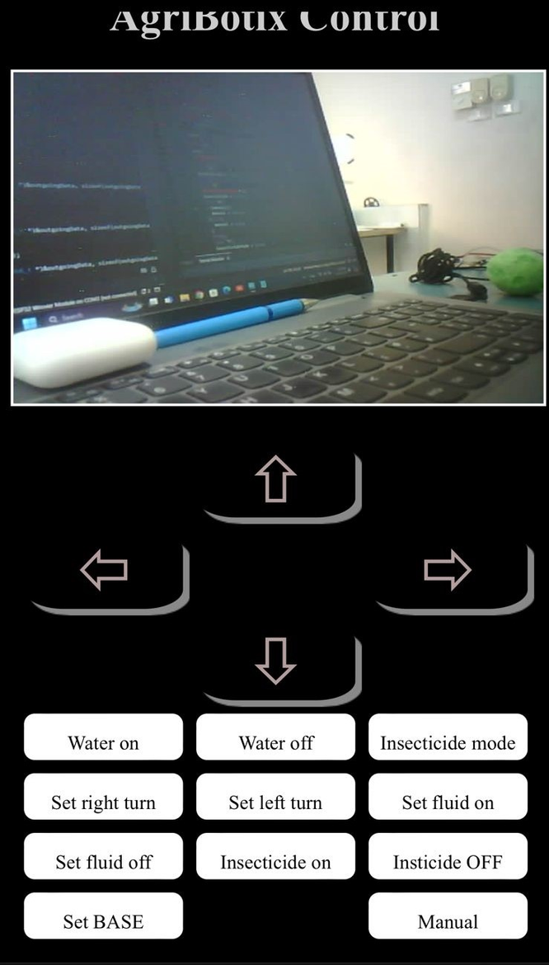

Control Page
Responsive Web page
Robot Navigation
Live Video Stream
Irrigation Control
8

Slide 10
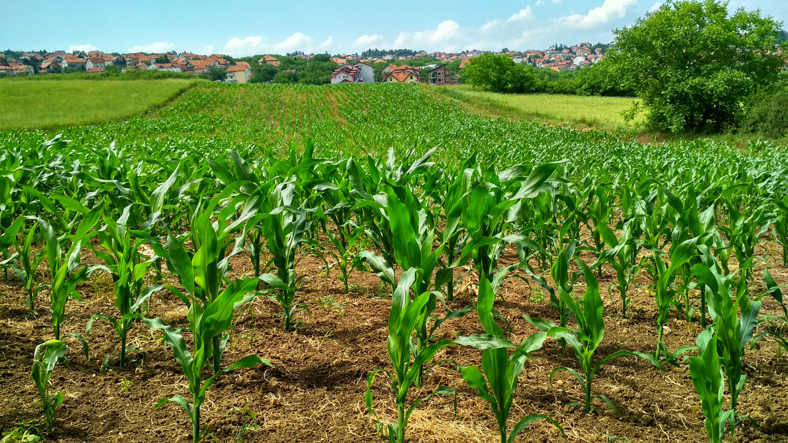
Features
  Automated Irrigation System
  GPS-Based Navigation
  ESP-NOW Communication
  Multitasking Capabilities
  Real-Time Monitoring
  Automated Pesticide System
9

Slide 11
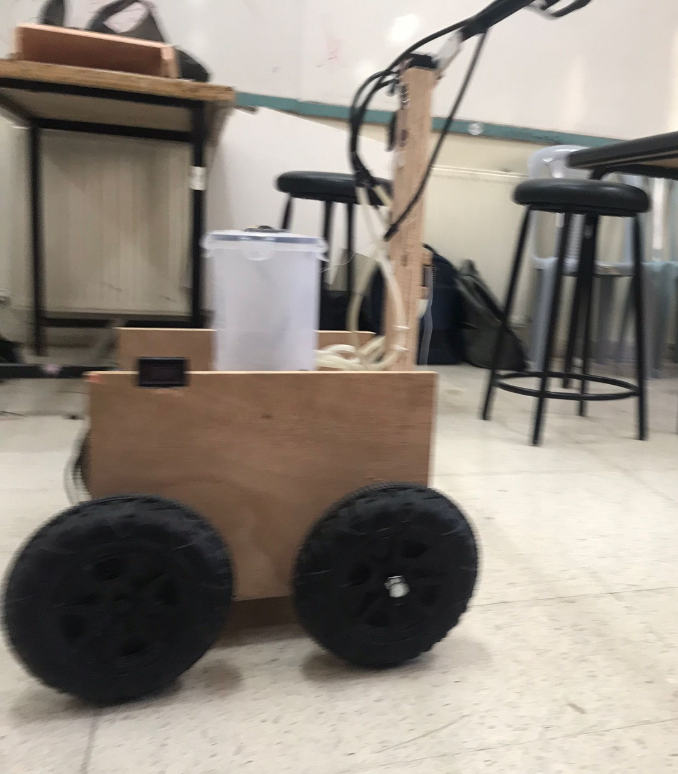

01
Wheel Limitation
Constraints
GPS Signal Interference
02
Alternative Sprinkler Systems
03
04
Limited Time
Power Consumption and Battery Life
05
10

Slide 12


Future Work
Implement Track-Based Wheels
Enhance GPS Reliability
Expand to Open-Field Farming
Increase Multitasking Capabilities
Image Processing for Path Detection
AI-Powered Monitoring
11

Slide 13
CONCLUSION
Thank You for Listening!
QUESTION AND ANSWER
12

