Slide 1


Slide 2


Learn Plus
Julia Qutmosh
Yasmeen Edaly
Supervised By
Dr. Husam A. Halim

Slide 3
Project Idea
1
Data Collection
2
What Are We Used
3
Outline:
Challenges
4
Design Diagrams
5
Conclusion
6
Future Works
7

Slide 4




Transition Slide
IDEA
Design Option #2
Helps instructors and students collaborate online.
Improve communication between instructors and students.
Organizes course resources on an online platform.
4
Photo credit: T0nymix via Pixabay (Creative Commons Zero license)

Slide 5


Transition Slide
DATA COLLECTION
Design Option #2
Information about current system working .
Determine what is authorized for the student and instructor in current system.
All available instructor's features in Moodle .
5
Photo credit: T0nymix via Pixabay (Creative Commons Zero license)

Slide 6









Transition Slide
What Are We Used
Design Option #2
6
Photo credit: T0nymix via Pixabay (Creative Commons Zero license)

Slide 7
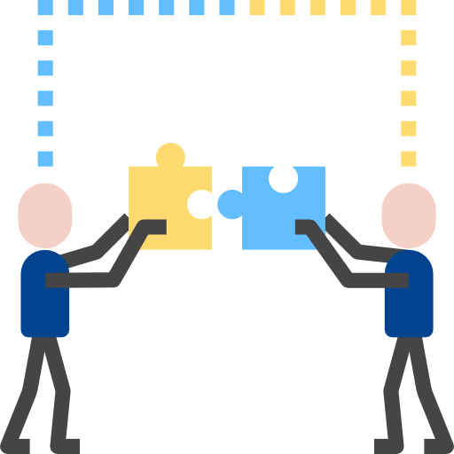
Transition Slide
CHALLENGES
Unlimited availability of features.
Dealing with security on our project.
Design Option #2
7
Photo credit: T0nymix via Pixabay (Creative Commons Zero license)

Slide 8


Diagrams
Proposed System Architecture
Context Diagram
Use Case Diagram
Class Diagram
Sequence Diagram

Slide 9
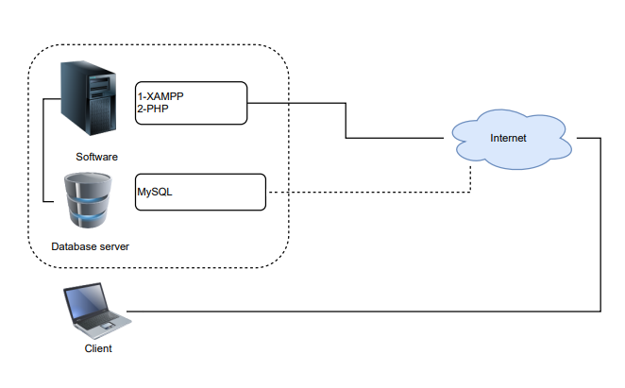
Proposed System Architecture

Slide 10
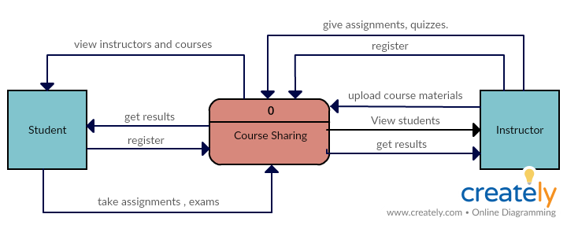
Context Diagram

Slide 11
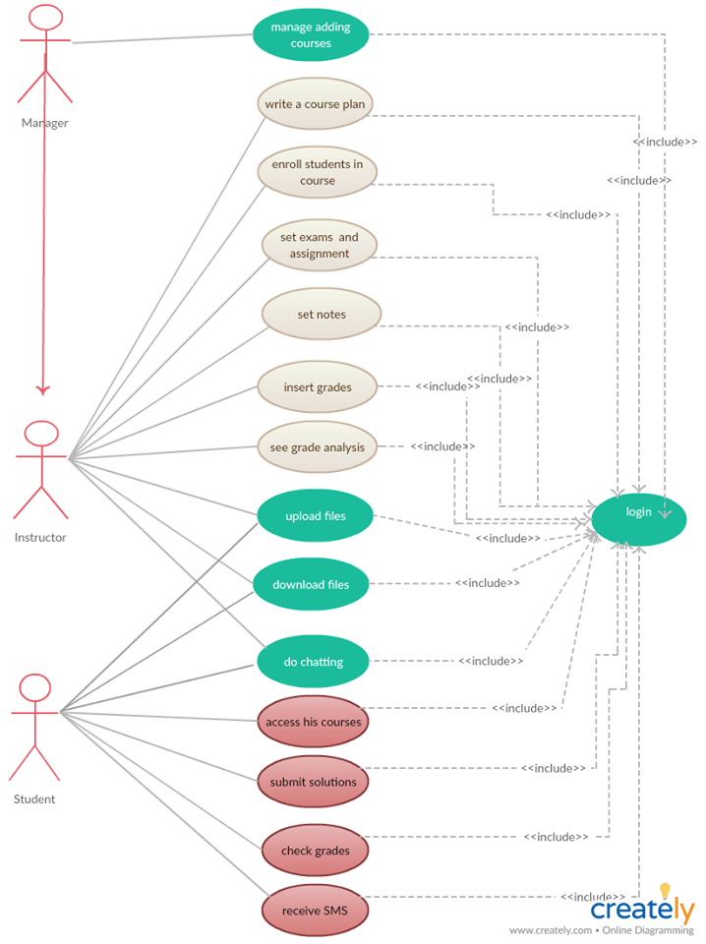
Use Case
Diagram

Slide 12
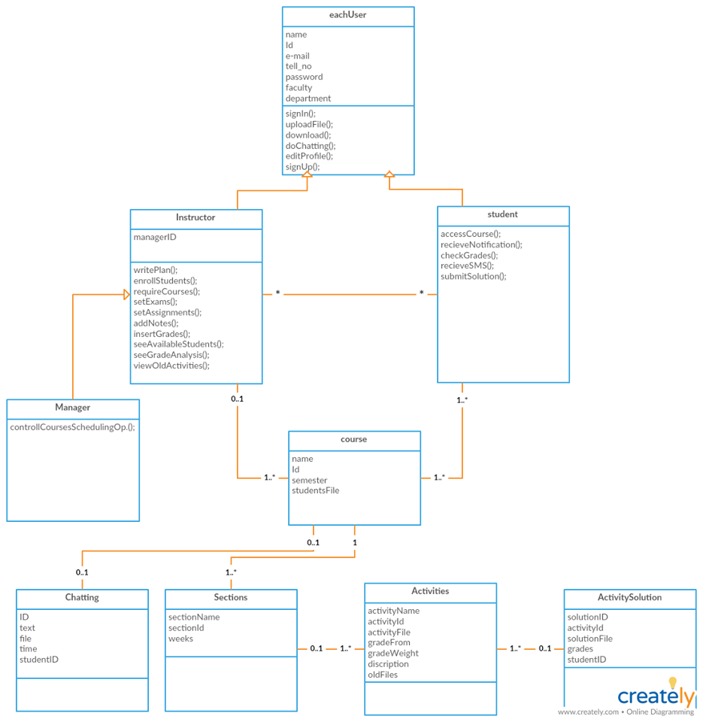
Class Diagram

Slide 13
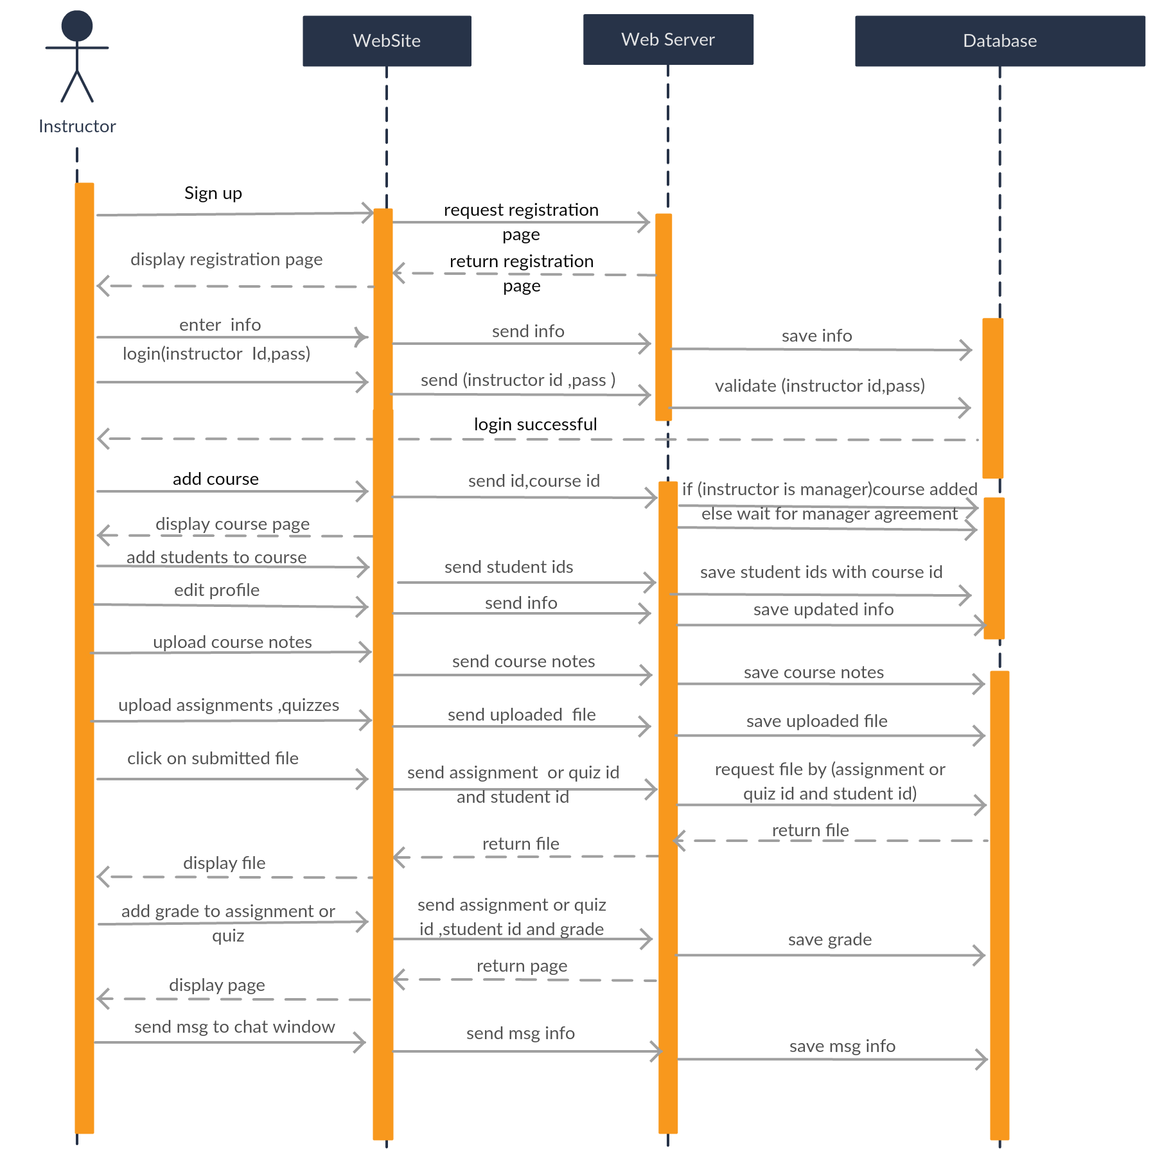
Sequence Diagram
(Instructor)

Slide 14
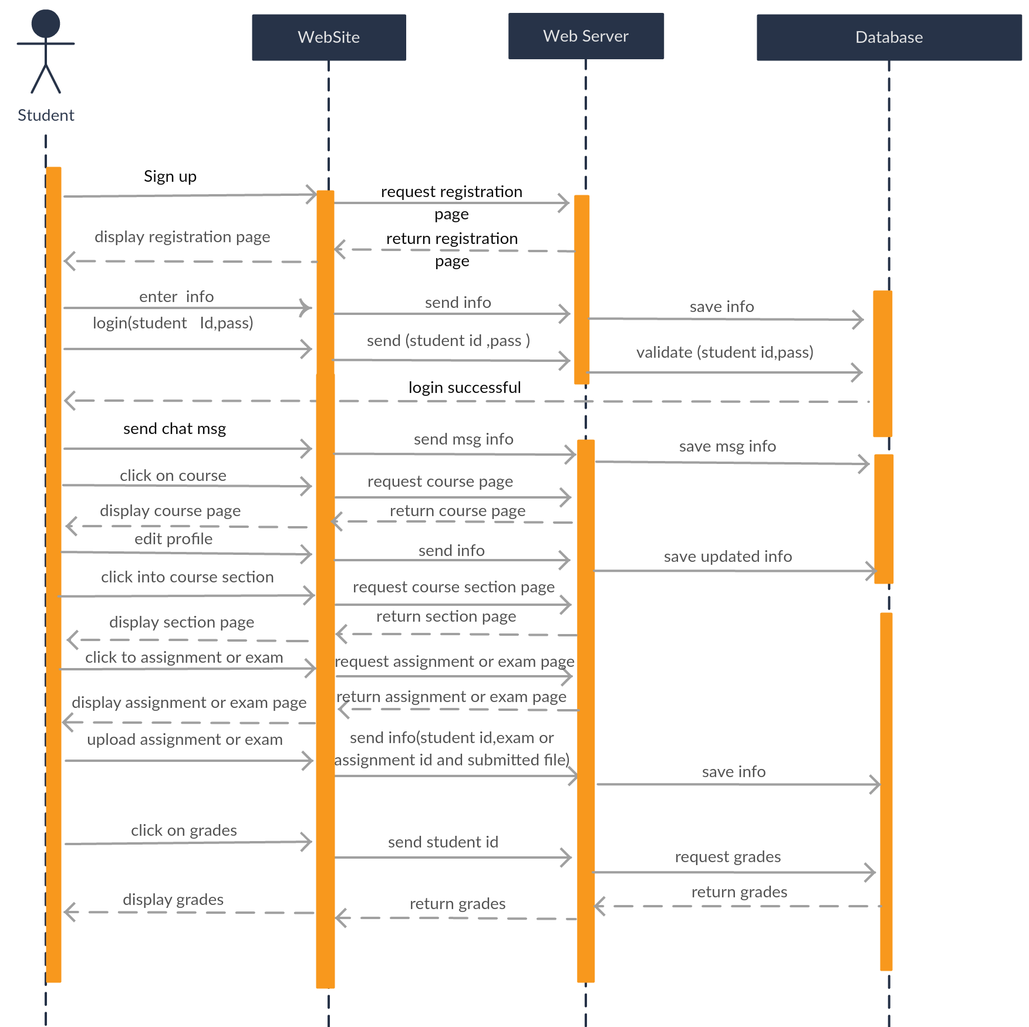
Sequence Diagram
(Student)

Slide 15
CONCLUSION
Learn Plus
Learn Plus is designed to cover the needs of instructors and students that does not present in the current system, such as chatting, notification, etc.
depending on instructors needs and in away that facilitate educational process and communication between instructors and students.

Slide 16
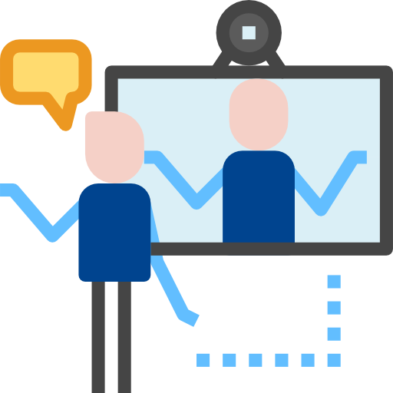


FUTURE WORK
Learn Plus
Add video conference feature.
Develop Learn Plus as app on android and iOS.

Slide 17

Thank You
Ramadan Mubarak

