Slide 1

Graduation Project ( 2 )
Remediation of Wastewater Containing Divalent Heavy Metals using Silica-Embedded Metal Oxide Nanoparticles
By: Saqr Abuhatab
Hana Hamdan
Wessal Ziad
Under the supervision of
Dr. Amjad El-Qanni
May 20, 2019

Slide 2
Outlines
Synthesis of Silica-Embedded NiO -MgO NanoParticles .
pH, Isotherm and Kinetics Adsorption Experiments.
Coexisting Ions effect.
Reusability of NiO -MgO SBNs.
Adsorption of Cr²⁺from real wastewater sample.
Cost estimation for synthesizing NiO-MgO SBNs.
Conclusion and Recommendations.

Slide 3


Synthesis of NPs.
Step1: Mixing
Colloidal Silica
Deionized water
Nitric acid
NiO-MgO SBNs
Nickel nitrate
Sucrose
Magnesium nitrate
1

Slide 4
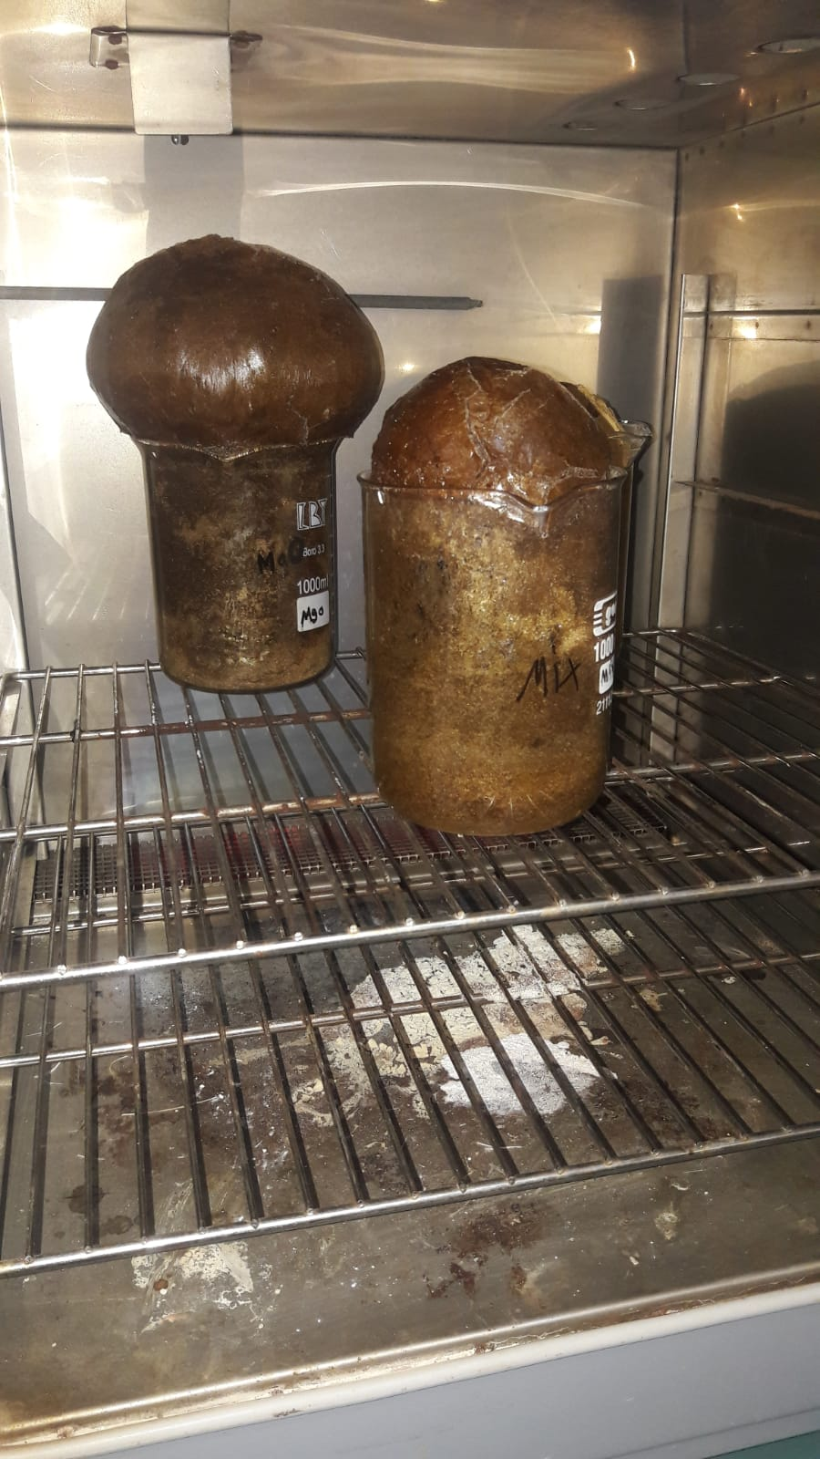
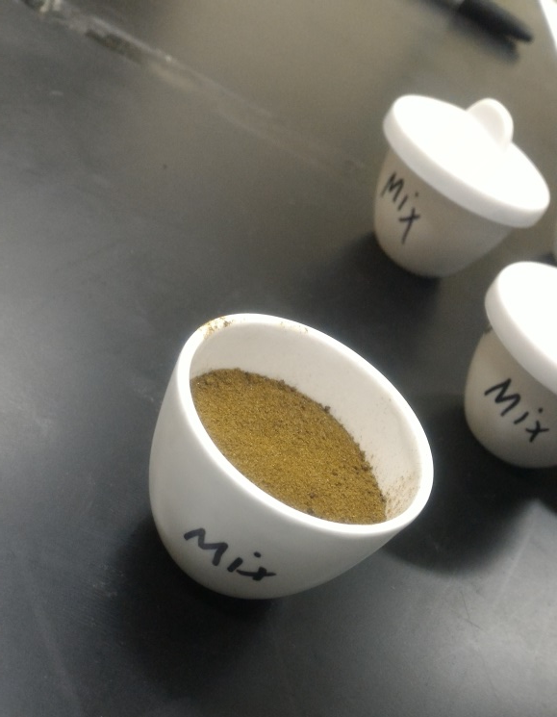
Afterward, the glass beaker was then placed in the oven at 100 ᵒC for 48 h to evaporate the water.
After 48 h, dried solid materials looking like sponge cakes were obtained. These solid materials were placed in the oven at 250 ᵒC for 12 h.
Step2: Drying
Step3: Calcination
The obtained powder was milled until it become homogenous, then it was calcined in the oven at 800 ᵒC for 3 h in a flow of air.
2

Slide 5
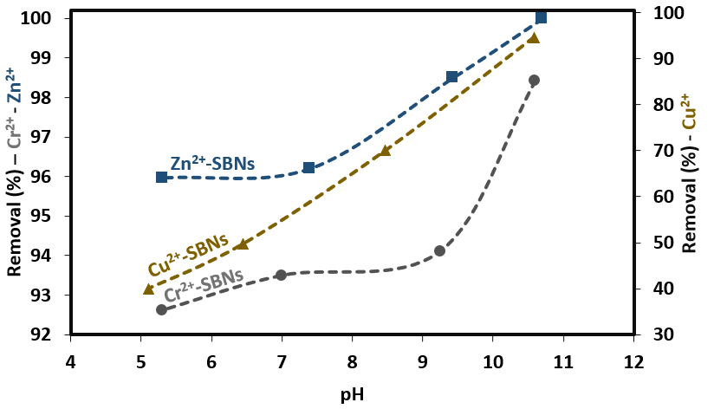
pH Effect
The effect of solution pH on the adsorption performance was investigated by varying it from about 3 to 11.
The removal uptakes of the metal ions have been found to be strongly pH dependent for Cu^{2+,} while slightly dependent for Zn²⁺ and Cr^{2+.}
3

Slide 6
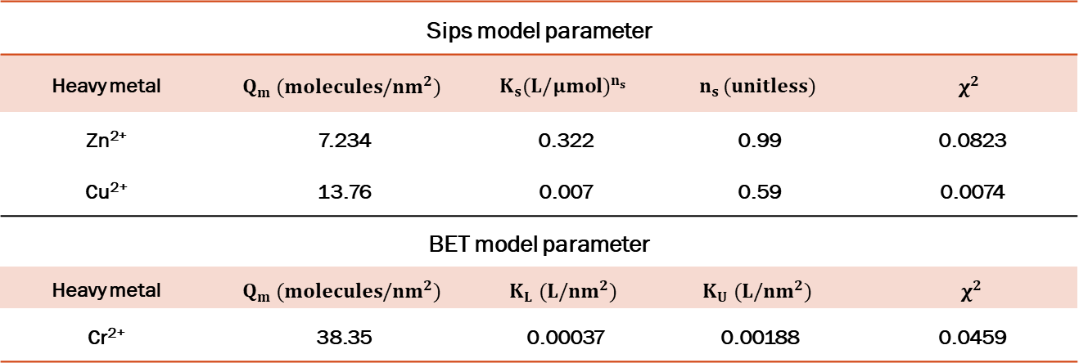
Adsorption Isotherms.
Adsorption isotherms for Zn²⁺, Cu²⁺, and Cr²⁺ metal ions onto NiO-MgO SBNs were conducted by varying the initial concentration of the metal ions from 50 to 400 mg/L at 25 ℃ and pH of around 5.5.
The adsorption uptakes (molecules per surface area) of SBNs was determined based on a mass balance analysis.
The adsorption of Cu²⁺ and Zn²⁺ onto NiO-MgO SBNs were described using the non-linear Sips model, while the adsorption of Cr²⁺ ions was perfectly described by the non-linear BET model.
Sips model parameter
Heavy metal | $$Q_{m} (molecules/{nm}^{2})$$ | $$K_{s}{(L/μmol)}^{n_{s}}$$ | $$n_{s} (unitless)$$ | $$χ^{2}$$
Zn²⁺ | 7.234 | 0.322 | 0.99 | 0.0823
Cu²⁺ | 13.76 | 0.007 | 0.59 | 0.0074
BET model parameter
Heavy metal | $$Q_{m} (molecules/{nm}^{2})$$ | $$K_{L} (L/{nm}^{2})$$ | $$K_{U} (L/{nm}^{2})$$ | $χ^{2}$
Cr²⁺ | 38.35 | 0.00037 | 0.00188 | 0.0459
4

Slide 7
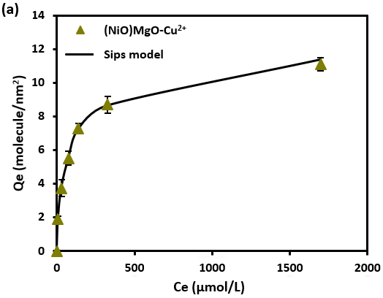
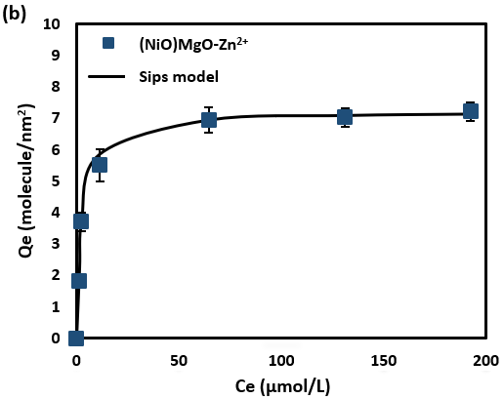

Cu²⁺
Surface of SBNs
$Q_{e}=\frac{Q_{m }{\left(K_{s}C_{e}\right)}^{n_{s}}}{1+{\left(K_{s}C_{e}\right)}^{n_{s}}}$ (Sips Model)
Zn²⁺
Surface of SBNs
5

Slide 8
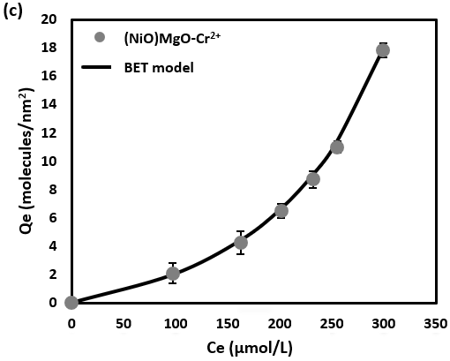
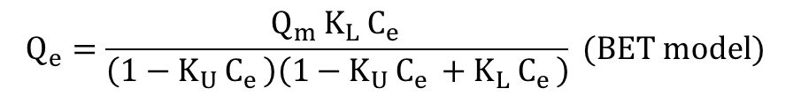
Cr²⁺
Surface of SBNs
$$Q_{e}=\frac{Q_{m }K_{L }C_{e }}{\left(1−K_{U }C_{e }\right)\left(1−K_{U }C_{e }+K_{L }C_{e }\right)} (BET model)$$
6

Slide 9
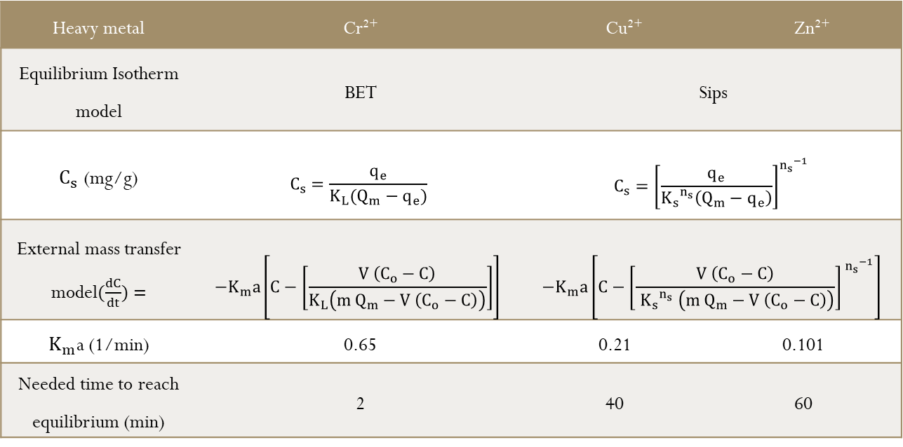
Adsorption Kinetics
The adsorption kinetics of Zn²⁺, Cu²⁺, and Cr²⁺ metal ions onto NiO-MgO SBNs were only affected by the film diffusion, of which it can be considered as the rate-limiting step in the kinetics study.
The adsorption kinetics of Zn²⁺, Cu²⁺, and Cr²⁺ metal ions onto NiO-MgO SBNs were conducted in single solutions by fitting the obtained experimental data to the external mass transfer model.
Heavy metal | Cr²⁺ | Cu²⁺ |  | Zn²⁺
Equilibrium Isotherm model | BET | Sips
$C_{s}$ (mg/g) | $$C_{s}=\frac{q_{e}}{K_{L}(Q_{m}−q_{e})}$$ | $$C_{s}={\left[\frac{q_{e}}{{K_{s}}^{n_{s}}\left(Q_{m}−q_{e}\right)}\right]}^{{n_{s}}^{−1}}$$
External mass transfer model$(\frac{dC}{dt})=$ | $$−K_{m}a\left[C−\left[\frac{V \left(C_{o}−C\right)}{K_{L}\left(m Q_{m}−V \left(C_{o}−C\right)\right)}\right]\right]$$ | $$−K_{m}a\left[C−{\left[\frac{V \left(C_{o}−C\right)}{ {K_{s}}^{n_{s}} \left(m Q_{m}−V \left(C_{o}−C\right)\right)}\right]}^{ {n_{s}}^{−1}}\right]$$
$K_{m}$a (1/min) | 0.65 | 0.21 | 0.101
Needed time to reach equilibrium (min) | 2 | 40 | 60
7

Slide 10
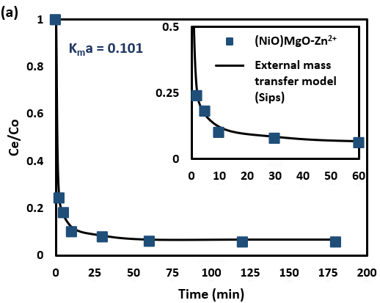
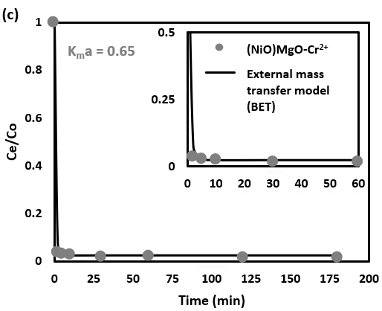
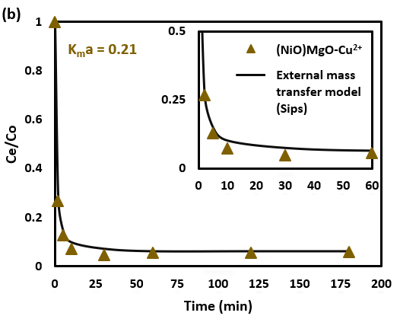
Estimated time: 60 min
Zn²⁺
Estimated time: 2 min
Cr²⁺
Estimated time: 40 min
Cu²⁺
8

Slide 11
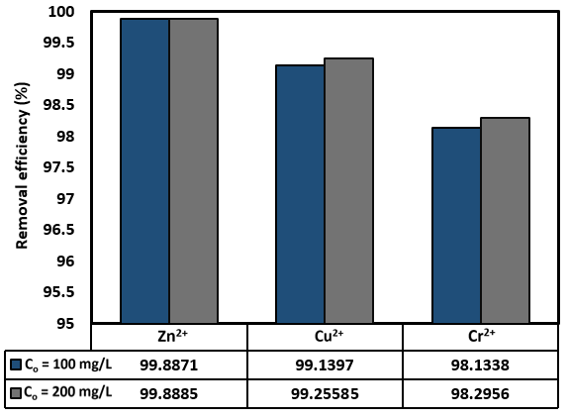
Coexisting ions effect
The data in Figure below shows the obtained experimental data of the coexisting metal ions experiment. It was found that the total adsorption capacity of Zn²⁺, Cu²⁺, and Cr²⁺ onto the NiO-MgO SBNs in multi-component system increases.
9

Slide 12
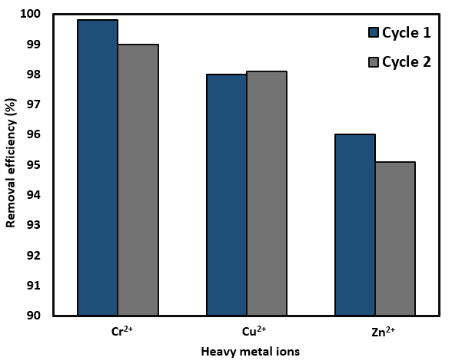
Reusability of NiO-MgO SBNs
The regeneration of the commercial available adsorbents, e.g. activated carbon, is energy intensive, costly, time-consuming process and environmentally unfriendly
The Figure below, shows the removal efficiency (R%), of single Zn²⁺, Cu²⁺, and Cr²⁺ metal ions after two adsorption cycles onto the NiO-MgO SBNs. It is obvious from the results that the used NiO-MgO SBNs are reusable sustainable for the adsorptive of these metal ions.
The regeneration of the Zn²⁺- (NiO-MgO) SBNs consumed the largest amount of HNO₃ and DI water until no any metal ions were found in the washing water, followed by Cu²⁺-(NiO-MgO) SBNs and finally by Cr²⁺- (NiO-MgO) SBNs
10

Slide 13
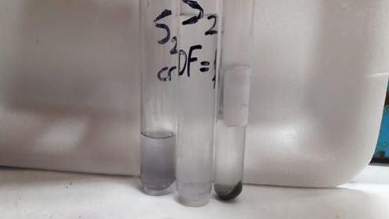
Adsorption of Cr²⁺ ions from real wastewater sample
The leather tanning wastewater sample before (the left side) and after adsorption (the right side).
11

Slide 14
Cost estimation for synthesizing NiO-MgO SBNs .
Material | Commercial cost (USD) | Used amount | Cost (USD)
Colloidal Silica | 58.2 USD/ 1L | 5.1g | 0.229
Nickel nitrate | 306.4 USD/ 100g | 9.9g | 30.3
Magnesium nitrate | 337 USD/ 50g | 9.1g | 61.3
Sucrose | 1 USD/ 1 kg | 15g | 0.015
Nitric acid | 235 USD/ 475mL | 1.5mL | 0.742
Total Cost |  |  | 92.59 USD/ 5g NPs
12

Slide 15
Cost comparison of the in-house prepared NiO-MgO SBNs with common metal oxides nanoadsorbents
Metal Oxide NPs | Commercial cost (USD) | Cost for 1 g (USD)
NiO | 76.3 USD/ 25g | 3
MgO | 125 USD/ 5g | 25
NiO-MgO SBNs | 92.59 USD/ 5g | 18.5
13

Slide 16
Recommendations
Our project can be extended to further work details:
Working on further divalent heavy metal such lead and cadmium in signle, binary, and ternary systems.
Studying the efficiency of single NiO or MgO SBNs for the removal of heavy metal ions.
Scalling up the process by first studying the hydraulic design of a packed bed column.
Perform recrystallization experiments for the heavy metals after the adsorption.
14

Slide 17
Thanks for Listening and for your time.
Any Questions?
The end…
15

