Slide 1
Design of foundation for Fattouh building in Nablus
Prepared by
Israa Hanani
Noor Sobuh
Nibal Awwad
Supervisor
Dr: Sami Hijjawi

Slide 2
Outline
1- Introduction and site description.
2- Load description and type of foundation.
3- Design of foundation.
a. single footing
b. mat foundation
c. pile foundation

Slide 3
Introduction and site description
The building foundation or sub structure is that part of a structure which is placed below the surface of the ground and which transmits the superstructure load to the underlying soil ultimately .
It is the part of a structural system that supports and anchors the superstructure of a building .
Building located Fattouh for Aljnied prison and consists of 7 floors. Soil type built by architecture is clay soil . And the allowable bearing capacity is 182 KN/m².
Based on soil testing, the origin was designed to foundations mat foundation and under it pile .

Slide 4
Load description
The proposed building has 23 type
of columns based on their dimension .
The distribution of these columns and there corresponding load are shown in table.
As shown from the table below, the columns service loads range from 100.6- 578.8 Tons .
Col. no | Dimension | Load (KN)
C1 | 20x60 | 2110
C4 | 50x50 | 2235
C17 | 30x160 | 2170
C18 | 20X100 | 1540
C19 | 20x175 | 2940
C23 | 20x120 | 1314

Slide 5
Type of foundation
Pile
Type
Mate
Single

Slide 6
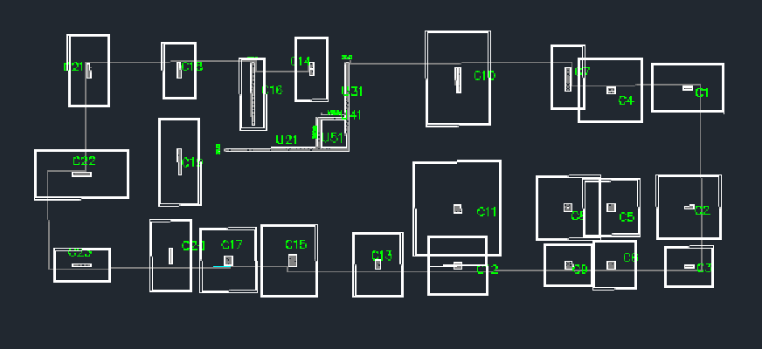
Design single footing
The dimension of single footing according to applied service load and bearing capacity of soil as follow :
For column 1 (as an example ) :
Area of footing = P_{all} / Q _{all}
= 2110 / 182 =11.6 m² (4.5m * 3m)
and repeat it for all column .
From the Fig. we see the overlap between the adjacent footing, so the single footing doesn't fit for this project.

Slide 7
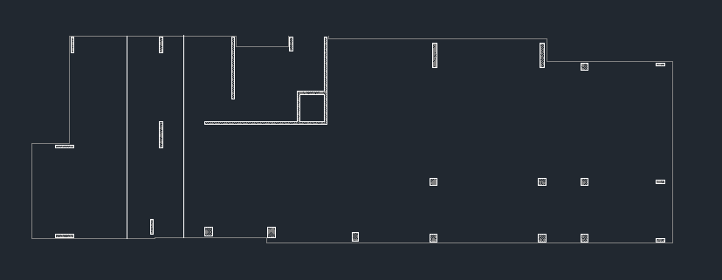
Mat Foundation
Area of mat footing = 579.4 m²

Slide 8
Calculate the center of loading that applied at columns
(col. 1 as an example) :
column Name | Service KN))load | Yi | Xi | P*Xi | P*Yi
C1 | 2110 | 11.65 | 39.9 | 84189 | 24581.5
After that
1) We calculate center of loads
X p= 1353055.8/ 65563 = 20.64 m
Yp=438341.64 / 65563 = 6.685 m
2) Calculate the eccentricity in X and Y directions e_{x} = Y_{P} – Y_{G} = 6.684 – 6.8 = -0.114 m e_{y} = X_{P} – X_{G} = 20.64 – 21.3 = -0.66 m

Slide 9
q= -(Q/A) – (M_{y} X/ I_{y} ) – (M_{x}y/I_{x}) I_{x} = bh³ / 12 = 8928.87 m⁴ I_{y} = 87616.6 m ⁴ M_{x} = Q e_{x} = 7605.5 KN.m M_{y} = 35854.5 KN.m q = 125 < 182 KN/m² ……. Ok
We take internal stripe in y- direction with width 4.53m as shown in fig. above
Total soil pressure = 4.53* 13.45 *113.13
=6892.8 KN
∑ col loads = 1540 + 2938 + 2340
= 6818 KN

Slide 10
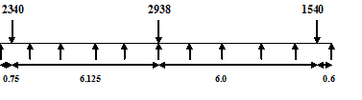
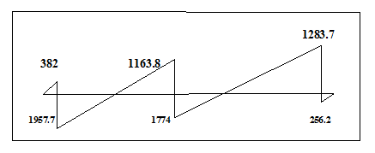
Shea force diagram

Slide 11

B.M.D.
M_{u} = 3615.5 KN.m
From the figure of shear and moment we do the
checks and compare the result to the max. value

Slide 12
Calculate the thickness of mat footing:-
Width of strip 4.53m
V_{u} = 1957.7 KN
Assume
D =800 mm h =900 mm
Wide beam shear check :-
Ø v_{c} = (0.75 / 6) (28 ) ^{0.5} *4530 * 800 / 1000
= 2397.1.3 KN > V_{u} ok
M_{u} = 3615.5 KN.m
ρ = 0.0034 > ρ _{min ok}
A_{s} = ρ bd
= 0.0034 * 4530 *800
= 12304.6 mm ² > A_{s min} 1Ø 25 / 200 mm
A_{s min} = 0.0018bh = 1296.0 mm²

Slide 13
Check Punching :-
Check punching for C 8 :-
P_{u} = 1.4 * 3230
= 4522 KN
ØV_{c} = ( Ø /3 ) (f_{c} )^{0.5} b_{o}d
= ( 0.75 / 3) (28)^{0.5}(2*1200 + 2* 1200 ) (800 ) /1000
=5503.16 KN > P_{u}
For columns 11 and 10 we may use drop panel or increase the amount of steel to make it ok for punching

Slide 14
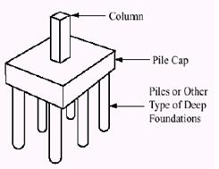
Pile Footing
A pile is a relatively long columnar construction element made of wood, or reinforced concrete, or metal, or a combination thereof. It is embedded into soil to receive and transmit vertical and transmit vertical and inclined loads into the soil or to rock below the ground surface

Slide 15

Design Pile Foundation For Column 11
Use All-Pile program
Total Ultimate Capacity (Down)= 2195.38-kN,
Total Ultimate Capacity (Up)= 2068.05-kN
Total Allowable Capacity (Down)= 731.79-kN,
Total Allowable Capacity (Up)= 761.28-kN

Slide 16
Design Pile Foundation For Column 11
where it's service load equal 5788 KN/m²
Number of Pile
Find the min. length for pile from the equation and satisfied the min.
E_{p} R_{I} / S_{u} = 461538
So from table min. length = 11* D = 8.8 m
Assume allowable capacity of a 0.8-m-diameter and 15-m-long pile
Total Allowable Capacity (Down)= 731.79-kN
F=( P/N) +( Mxy/Σyi2) + (Myx/Σxi2) ≤ qall
F= (5788)/N ≤ 731.79 → N=8→ Use 8 Piles

Slide 17
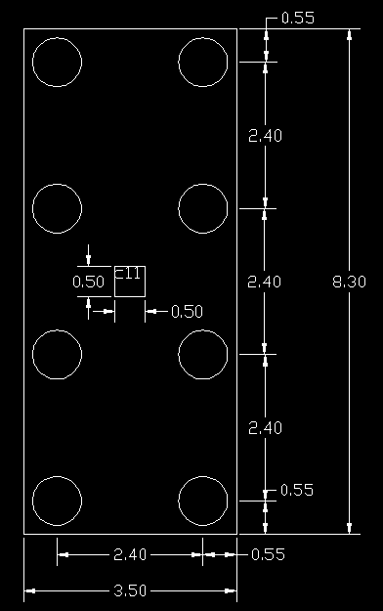
The PLAN show the pile distribution and the spacing

Slide 18
Thickness of cap: Pu = 1.2 DL + 1.6LL = 7813.8 KN Ru =Pu/N = 7813.8/8 = 976.72 KN
Wide beam shear :
Vu =976.72*2 = 1953.44 KN ϕVc = 0.75(1/6) (√fc) bd /1000 = 0.75(1/6)(√28)(3500)d/1000=
→ d = 850 mm
→ h =1050 mm

Slide 19
Punching shear :
For column: Vu= 7813.8 KN ϕVc= 0.75(1/3)(√28)*800*(1350*2+1350*2)/1000= 6071KN >7813.8 KN → NOT OK SO we increase d= 1000 mm , h=1200 mm ϕVc = 7937 > 7813.8 KN → OK

Slide 20
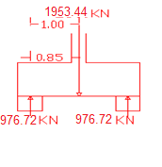
Reinforcement
Long direction
Mu = Pu L / 4 = 1172 KN.m , d= 1000 mm, ρ= 0.617 * 10-3
As = 0.892 *10-3* 3500 * 1000 = 3122 mm2
As min = 0.0018bh
= 0.0018 * 3500 * 1200 = 7560 mm2 For bottom steel > As
→ Use As min
→ use 15 ϕ 25
For Top Steel ->> 7560/2 = 3780 mm2
use 12 ϕ 20
Short direction
As min = 0.0018bh
= 0.0018*3500*1200 = 7560 mm2 >As
Use As min → use 15 ϕ 25

Slide 21
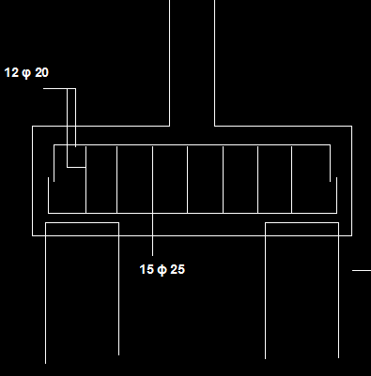
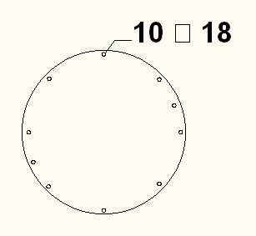
From Table at Dia. 800 mm Mcapacity = 901.5 KN.m As = 25.1 (10 φ 18)
The figure show the distribution of the steel (a) Show the distribution steel for cap from analysis and (b) Show the distribution of the steel for Pile from classification
φ

Slide 22


