Slide 1
Sorting Robot
“directional”
Dr.Asmaa Afefy
Dr.Ashraf Armoush
Inas Zaid
Noura shenawi

Slide 2
Outlines
Introduction
Tools
Procedure
Constraints
Future work
Demo

Slide 3
Introduction
What are sorting Robot
Problem
Objectives

Slide 4
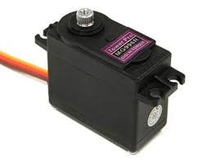
Tools
Servo motor MG 996R

Slide 5
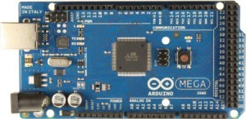
Tools (cont.)
Arduino Mega 2540

Slide 6
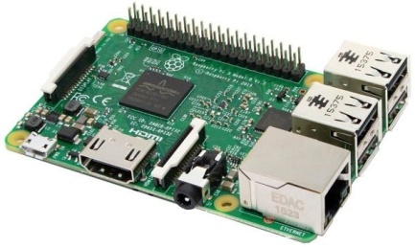
Tools (cont.)
Raspberry Pi 3

Slide 7
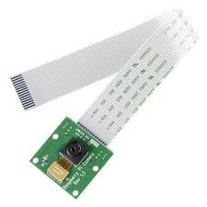
Tools (cont.)
Pi camera module

Slide 8
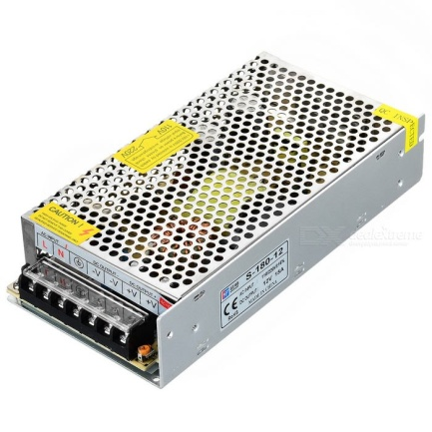
Tools (cont.)
Power supply

Slide 9
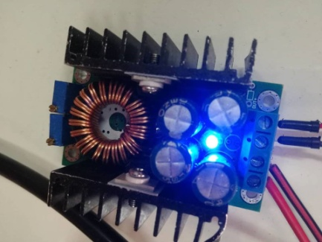
Tools (cont.)
Voltage regulator

Slide 10
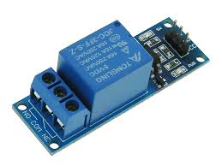
Tools (cont.)
Single 5V SPDT Relay Board

Slide 11
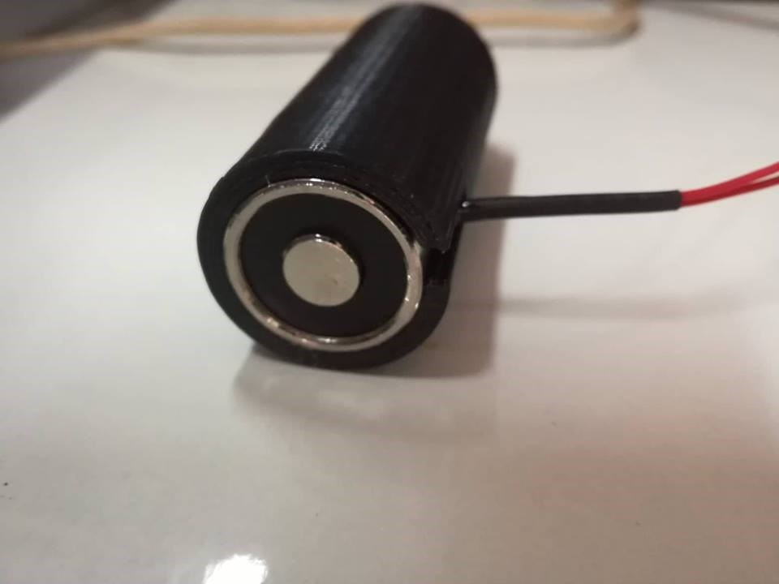
Tools (cont.)
Magnetic

Slide 12
Tools (cont.)
Metal objects

Slide 13
Procedure

Slide 14
Constraints

Slide 15
Future work
That it can take a greater number of objects.
It could use for any type of objects, not just metal boxes.

Slide 16
Demo

