Slide 1
Supervisor:
Dr. Mahmoud Assad
Cleaning Machine
Prepared By:
Othman Shuqqo
Rafeeq Tanbour
Samer Qamhiyeh
Graduation Project 2

Slide 2
OUTLINE
3
Methodology
Project methodology
The main work of the system
Comparison between electric vehicles and internal combustion vehicles
1
Introduction
Idea of the project
Aim of the project
2
Literature review
7
Conclusion
4
5
6
Design
Optimal design
Economical study

Slide 3
Introduction
1.1 Idea of the project
The main idea of this project is to design a cleaning machine that can be used on small roads, public parks, or on the university campuses,
The purpose of this machine Is to reduce the effort of manual cleaning and to improve the efficiency and time of the cleaning process,
Introduction

Slide 4
Introduction
1.2 Aim of the project
reduce the human effort involved in such activities
provide an easy and more effective method for cleaning roads, parks, and floors of large buildings,
Target 12.4: achieve environmentally sound management of all wastes, and significantly reduce their release to air, water and soil in order to minimize their adverse impacts on human health and the environment.
achieve at least one of the united nations’ sustainable development goals

Slide 5
OUTLINE
3
Methodology
Project methodology
The main work of the system
Comparison between electric vehicles and internal combustion vehicles
1
Introduction
Idea of the project
Aim of the project
2
Literature review
7
Conclusion
4
5
6
Design
Optimal design
Economical study

Slide 6
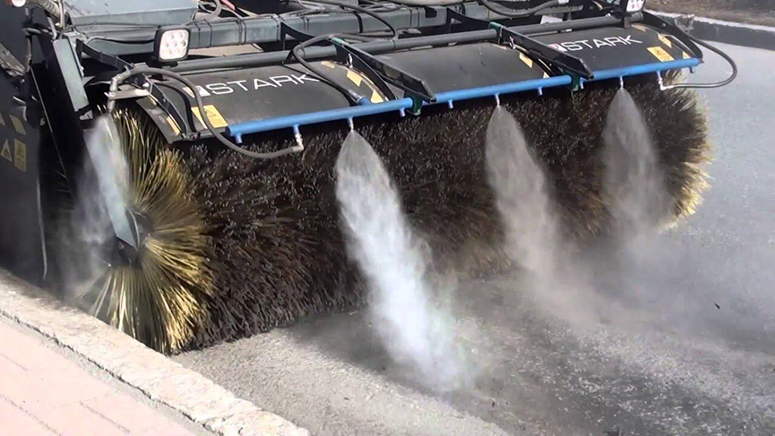
Literature review
Self-cleaning is to reduce dust and temperatures for roads and lanes and to maintain a safe and clean atmosphere
mid-size road cleaning vehicle

Slide 7
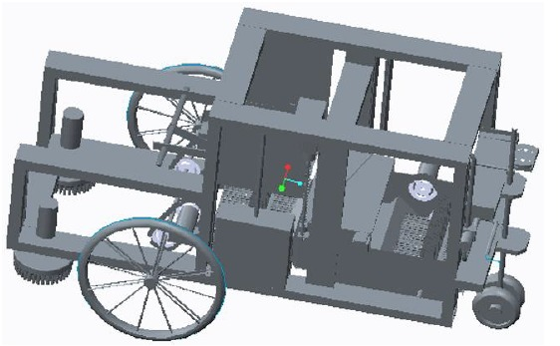
a Cleaning and disinfection small vehicle which integrates the functions of road cleaning, and garbage collection
Literature review
small-size Cleaning and disinfection vehicle

Slide 8
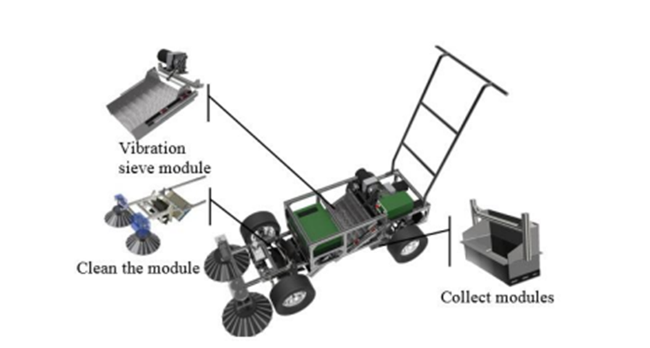
It differs from the previous carts in that it contains a system for separating mud and sand from the dirt
Literature review
Electric-powered beach cleaning vehicle

Slide 9
OUTLINE
3
Methodology
Project methodology
The main work of the system
Comparison between electric vehicles and internal combustion vehicles
1
Introduction
Idea of the project
Aim of the project
2
Literature review
7
Conclusion
4
5
6
Design
Optimal design
Economical study

Slide 10
Methodology
The work in this project has been performed according to the following steps:
The possibility of implementing this project was studied, especially as it would be a good alternative solution for manual cleaning, and it was compared with the previous research works
The advantages and disadvantages of each proposed system have been studied in the research process.
The solution that worked the best with the available resources and current circumstances was chosen.
An actual size fully functioning prototype of the machine was made.
The required system was modeled using SOLIDWORKS.
01
02
03
04
05

Slide 11
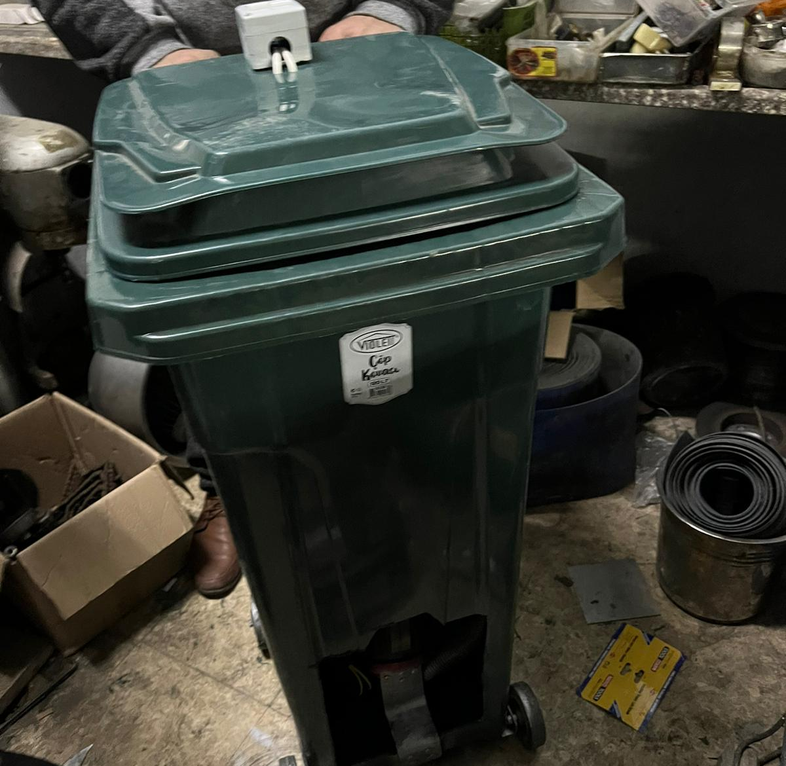
Methodology
The main work of the system
battery
Electric motor
Cleaning brushes
Vacuum system
Pressure container
Dust and particles

Slide 12
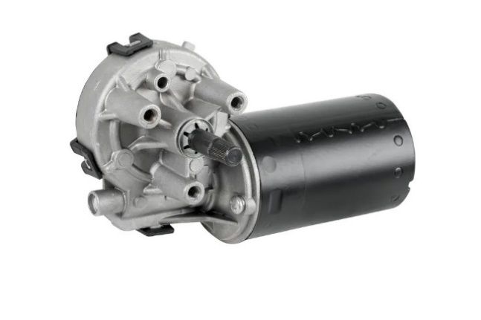
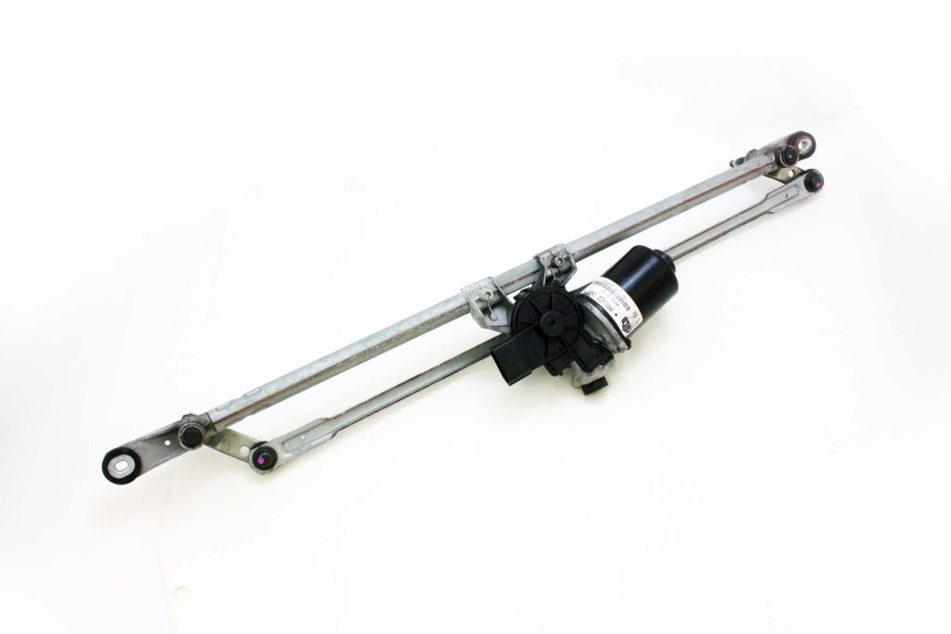
Methodology
Project components
the power source for this motor is the batteries, which send current to this motor, and works on 12 v.
1- Wiper motor

Slide 13
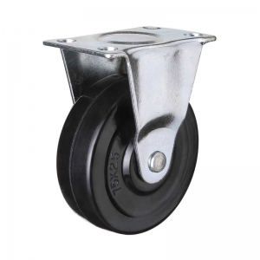
Methodology
Project components
Where they are moved manually
2- The wheels

Slide 14
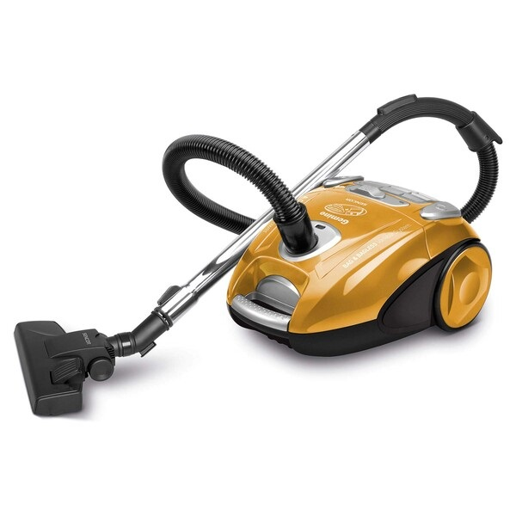
Methodology
Project components
when the machine is running, a quantity of voltage is sent from the batteries to a vacuuming machine and controlled by specific button.
3- Vacuuming system

Slide 15
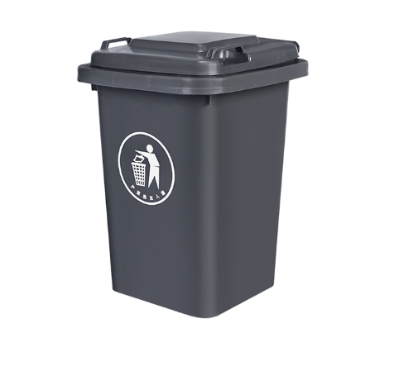
Methodology
Project components
this is the box that all waste and papers are sent to, and it is emptied when it is full so that the suction does not malfunction.
4- Dirt packing box

Slide 16
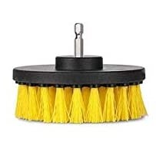
Methodology
Project components
5- Dirt packing box: This is the box that all waste and papers are sent to, and it is emptied when it is full so that the suction does not malfunction.
6- Cleaning Brushes: Powered by electric motors, they rotate to agitate dust particles and lift them off the ground so the vacuum system sucks them into the dirt packing box.

Slide 17
OUTLINE
3
Methodology
Project methodology
The main work of the system
Comparison between electric vehicles and internal combustion vehicles
1
Introduction
Idea of the project
Aim of the project
2
Literature review
7
Conclusion
4
5
6
Design
Optimal design
Economical study

Slide 18
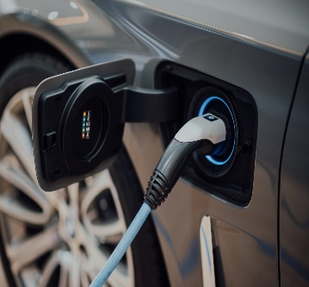
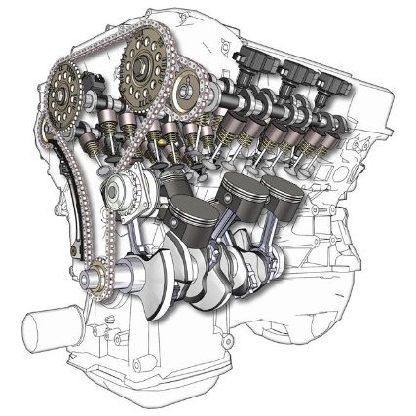
3.3 Comparison between electric vehicles and internal combustion vehicles
electric vehicles
works efficiently at any time and at any speed
internal combustion vehicles
produces torque and power that makes it within a limited speed range

Slide 19
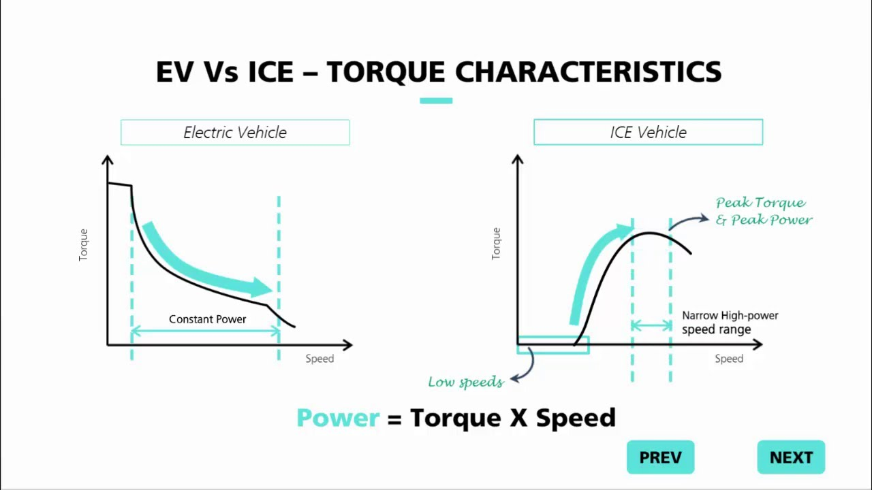
3.3 Comparison between electric vehicles and internal combustion vehicles
electric vehicles
internal combustion vehicles
does not produce rotational movement directly, because the movement of the piston is linear
and therefore it must be converted into a rotational movement, and some energy is wasted in this conversion.

Slide 20
3.3 Comparison between electric vehicles and internal combustion vehicles
electric vehicles
starts itself
the weight is less, and therefore the efficiency of the machine is greater.
internal combustion vehicles
does not start itself like an electric motor, and it needs an additional starter, which adds more to the weight of the vehicle.

Slide 21
OUTLINE
3
Methodology
Project methodology
The main work of the system
Comparison between electric vehicles and internal combustion vehicles
1
Introduction
Idea of the project
Aim of the project
2
Literature review
7
Conclusion
4
5
6
Design
Optimal design
Economical study

Slide 22
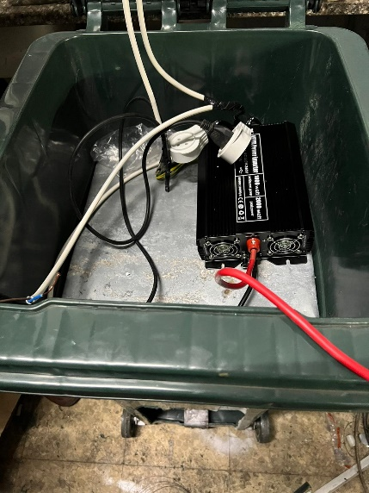
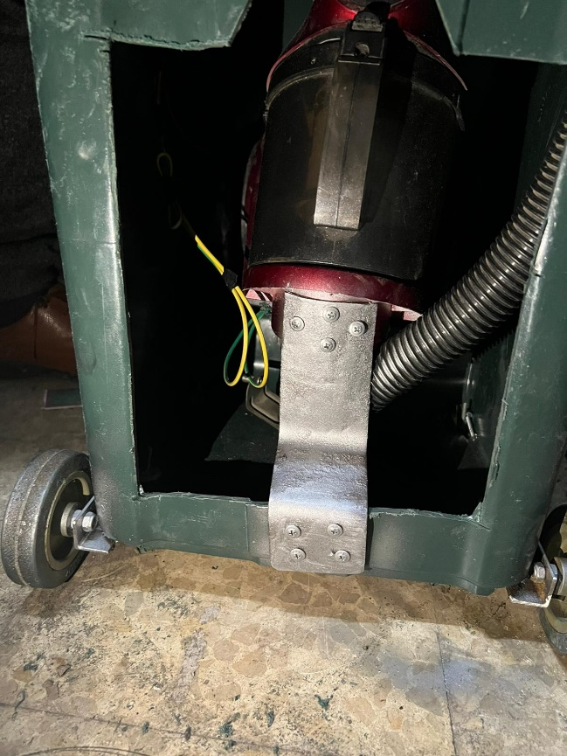
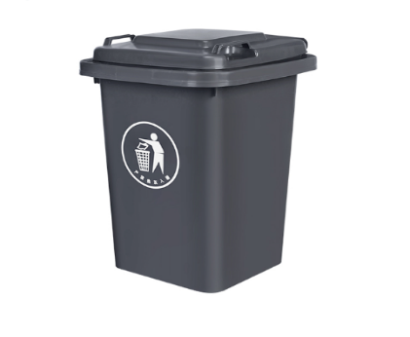
Design
Preparing packing box
Wheel base
Separate the box in two parts
Fix wiper motor above brush
Take current from battery directly to wiper motor
Take current from battery indirect to vacuum system through invertor
Cut part from the box to collect rubbish
Make two buttons one to control wiper and the other for vacuum
Battery and invertor in upper section / lower section :vacuum & wiper motor

Slide 23
OUTLINE
3
Methodology
Project methodology
The main work of the system
Comparison between electric vehicles and internal combustion vehicles
1
Introduction
Idea of the project
Aim of the project
2
Literature review
7
Conclusion
4
5
6
Design
Optimal design
Economical study

Slide 24
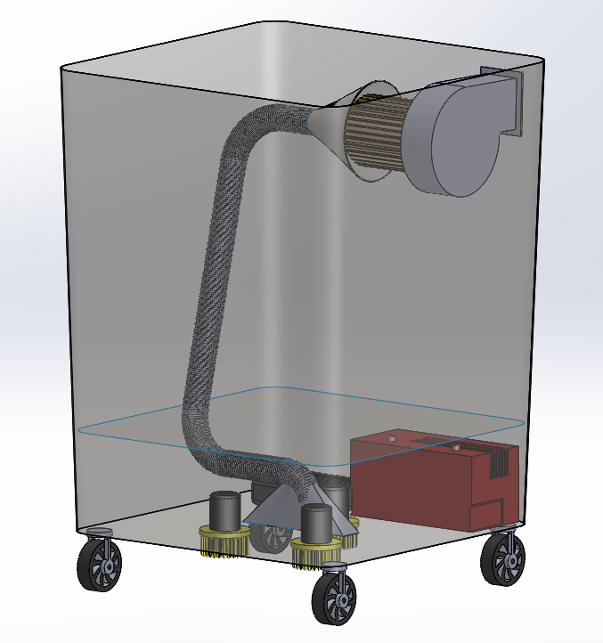
Optimal Design
The optimal design is larger, more stable, more efficient, and more practical, through a large vacuum, and an air filter for separating dirt so as not to get stuck between the suction blades, and the three motors that run the brushes

Slide 25
Optimal Design
As for the design of the machine, it will have a greater spacing between the wheels in order to achieve higher Possible balance, and therefore it will be more effective on the ground and can be used by public places and private centers.

Slide 26
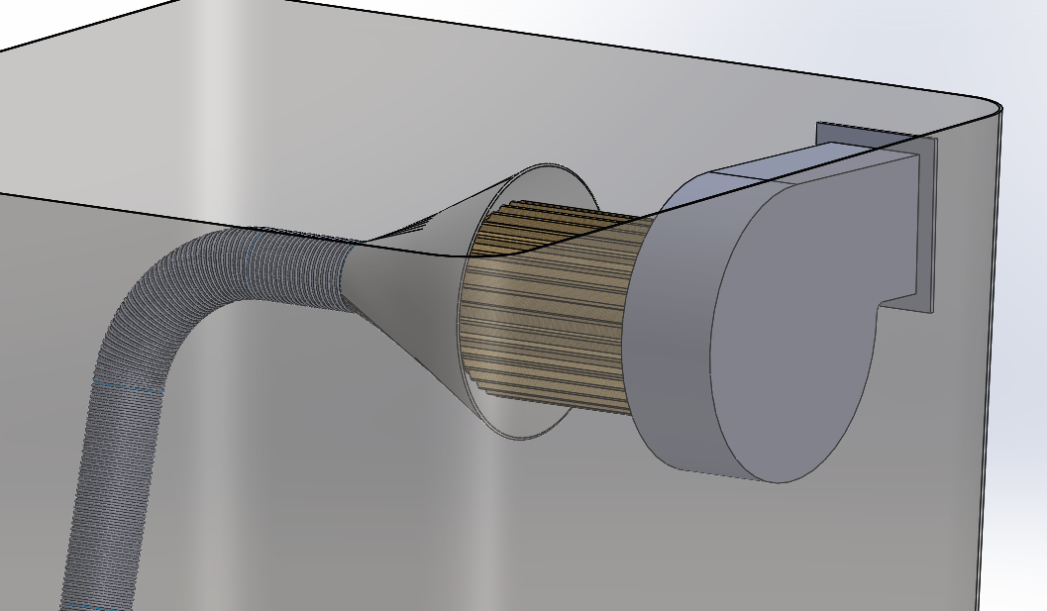
Optimal Design
The optimal design uses a fan blower vacuum system instead of a conventional vacuuming machine; so, it can have more powerful suction, and it has a larger battery and invertor, and it has 3 sweeping brushes instead of 1, in addition to having 360 degree wheel design to make the moving prosses much easier.
In this section we can see the fan blower which is equipped with an air filter to prevent particles from entering to the blower and damage the blades.

Slide 27
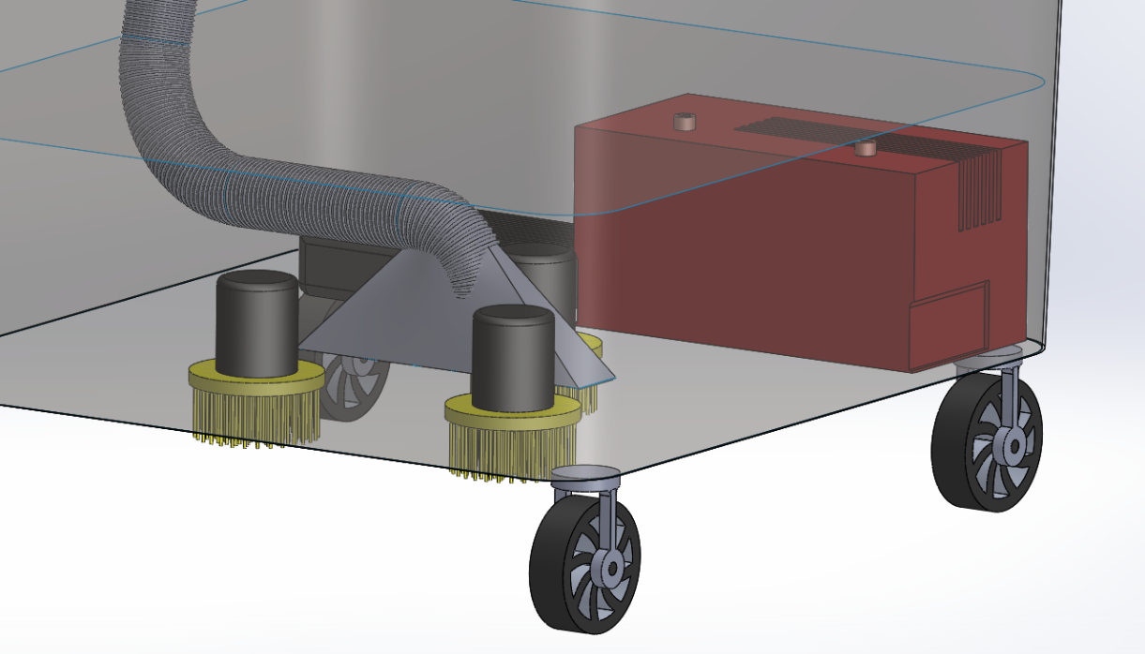
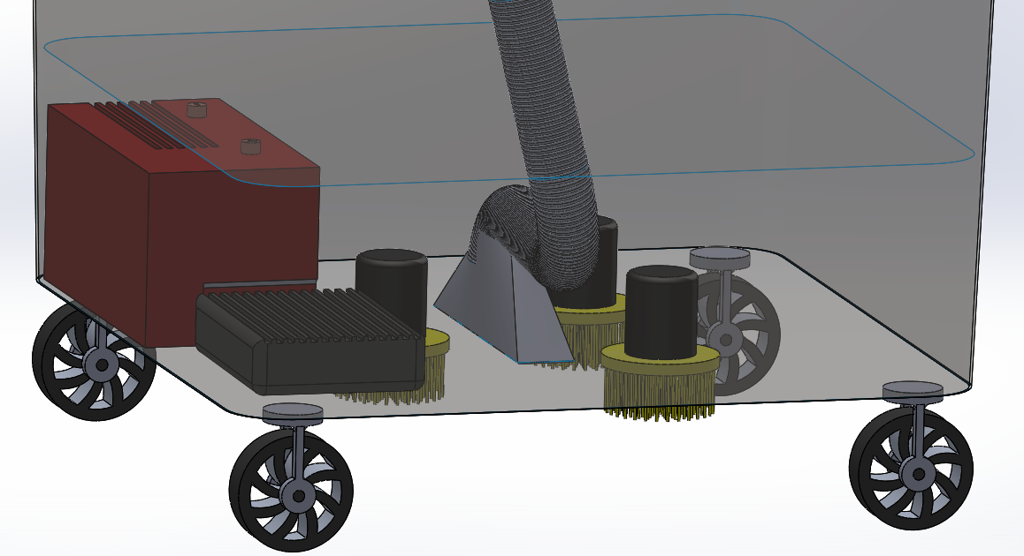
Optimal Design
This section shows all the important parts that are providing power to the system which are the battery and the invertor and the wiper motors

Slide 28
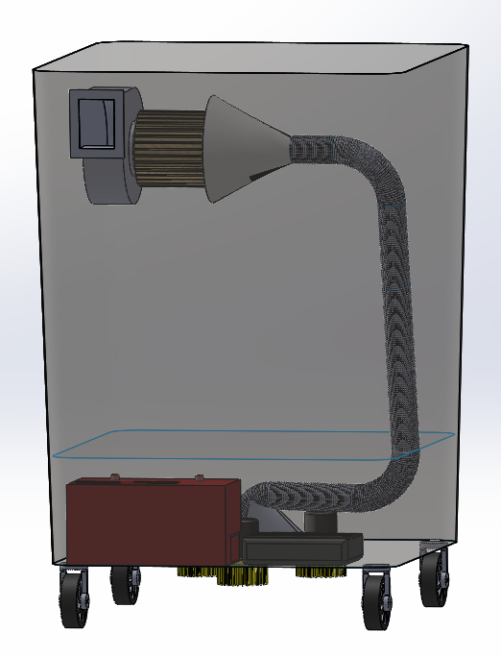
back vent
Optimal Design
The back vent of the blower allows the excess air to escape the system.

Slide 29
OUTLINE
3
Methodology
Project methodology
The main work of the system
Comparison between electric vehicles and internal combustion vehicles
1
Introduction
Idea of the project
Aim of the project
2
Literature review
7
Conclusion
4
5
6
Design
Optimal design
Economical study

Slide 30

Economical study
Our project
The Box | 180
Wiper Motor | 50
Brushes | 40
Vacuum | 200
Battery | 500
Inverter | 500
Wheels | 20
Wheel base | 20

Slide 31
Economical study
Our project
lathing cost:
A square piece of (sheet metal, wood) has an area of 40 * 41 cm = 40
Used to hold the battery and inverter.
A small sheet metal door with an area of 20 * 10 cm = 30
Used to cover and protect the vacuum system and motor.

Slide 32
Economical study
Our project
final cost
The final price is for one piece = 1580

Slide 33
Economical study
Optimal design
Element | Cost
The box | 500
Inverter (2kw) | 1100
Three Wiper motor | 150
Brushes | 120
Batteries | 1500
Wheels | 40
Blower fan Vacuum system (1.8 kw) | 600
Lathe of the box element | 150

Slide 34
Economical study
Optimal design
final cost of optimal design:
The final price is for one piece = 4160

Slide 35
OUTLINE
3
Methodology
Project methodology
The main work of the system
Comparison between electric vehicles and internal combustion vehicles
1
Introduction
Idea of the project
Aim of the project
2
Literature review
7
Conclusion
4
5
6
Design
Optimal design
Economical study

Slide 36
Conclusion
the atomization of the cleaning proses is a necessity in the current days, as the public environment is in becoming more and more crowded and full of dirt, and the need to treat it in any possible way.
this project aims to reduce the physical effort and health damage that the janitor can be exposed to on a daily basis.
using an electric motor is more sustainable than using an internal combustion engine, which affects the environment and people’s health, especially in closed areas.
Thank You

