Slide 1
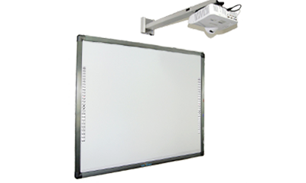
Interactive Whiteboard (IWB)
Presented by: Murad Dweikat
Waddah Janajreh
Supervisor: Dr. Aladdin Masri
Ms. Asma’ Afefe
Graduation Project Presentation

Slide 2
Content:
Introduction.
Idea.
Frameworks And Tools.
IWB In Details.
Problem.
Future Work.

Slide 3
Introduction:
Most of the communities nowadays prefer using technology that raising the level of student engagement in a classroom, and motivating students.
An interactive whiteboard is a touch-sensitive screen that works with a computer and a projector.
IWB avoid use of mouse, keyboard and pens. The user can conduct a presentation from the whiteboard.

Slide 4
Idea:
Create desktop application that make any traditional projector and whiteboard like interactive whiteboard by using camera.
By replacing IWB with our program we reduce the price of IWB and price maintenance.

Slide 5
Frameworks And Tools.
Frameworks used while development:
  QT .
  OpenCV .
Tools:
  QT Creator.
Programming Languages:
  C++:

Slide 6
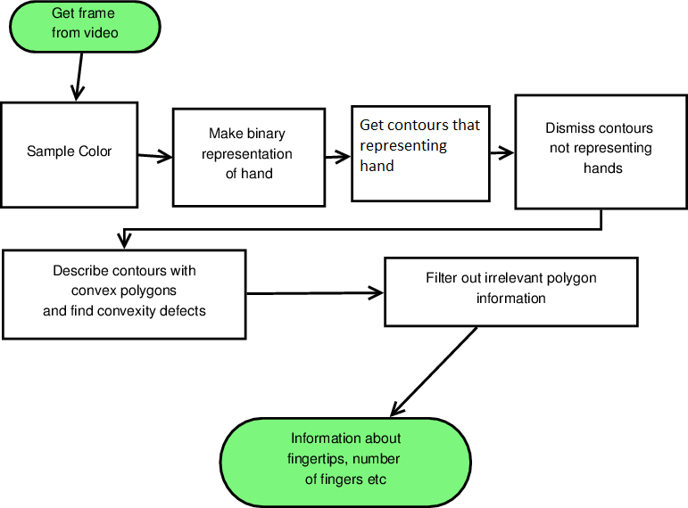
Interactive Whiteboard
First : Detect the Hand and Fingertips.

Slide 7
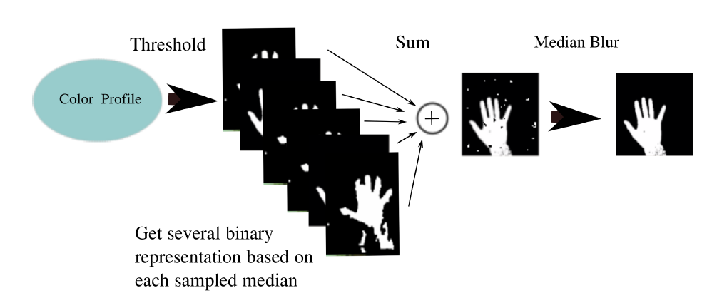
hand recognition

Slide 8
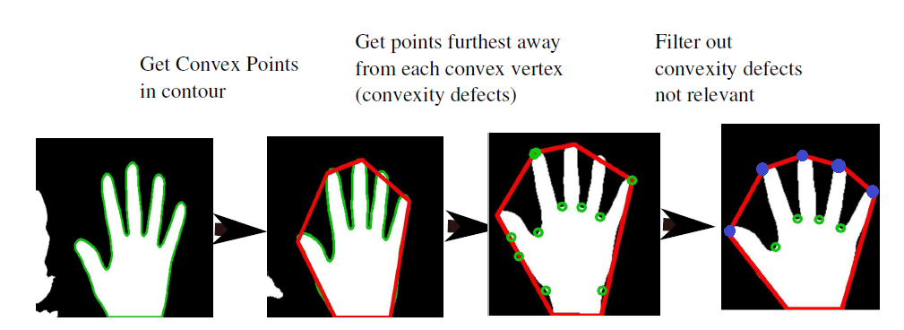
hand recognition
Blue Dot : Convex Points
Red Dot : Defect Points

Slide 9
The analysis results in data that can be of further use in next step in gesture recognition:
Fingertip positions
Number of fingers
Number of hands
Area of hands

Slide 10
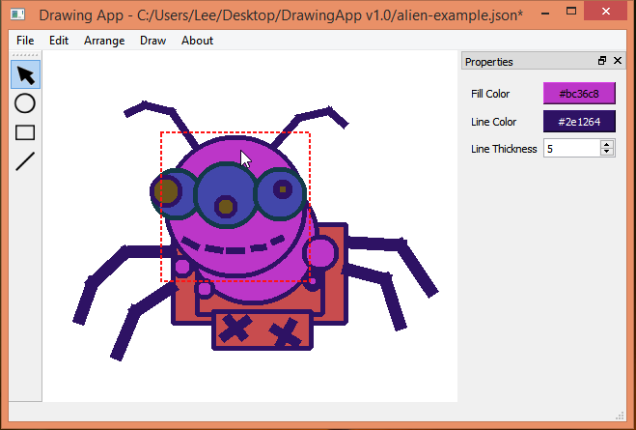
Drawing App :

Slide 11
Drawing tools :

Slide 14
Thank You ☺

