Slide 1


Electronic Archive System
Supervisor: Dr. Suhad Daraghmeh
An-Najah National University
2021-2022
Notes:
Image used in the preview file :
https://unsplash.com/photos/bXq8pVfP-fY
https://unsplash.com/photos/dPQSboG6b_0

Slide 2
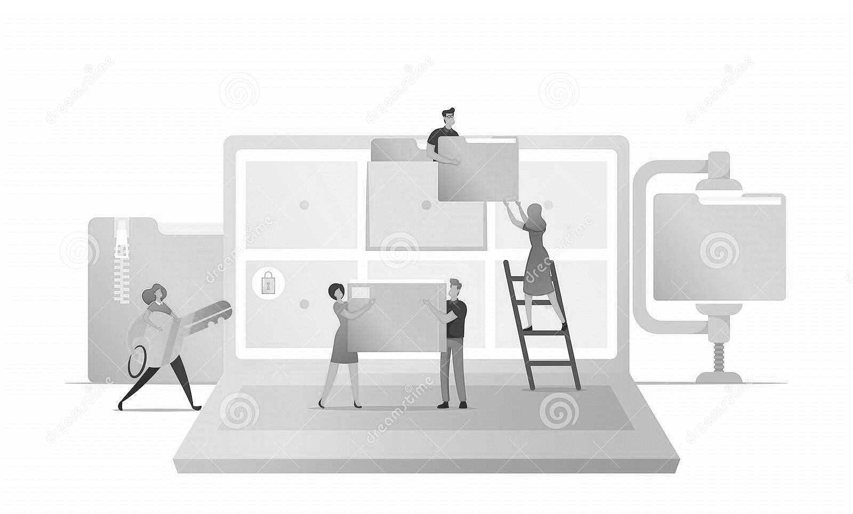
Electronic Archive System
Our Awesome Team
Ayman Saleem
Moatadil Dweikat

Slide 3

Vertical Timeline
Think Create Innovate
Idea Formation
Problem
Solution
Goals & Objectives
how are we doing this?
Electronic Archiving System
Permissions System
Meeting Management Archiving
Certification
Notes:
Multiple image used in Unsplash collection : https://unsplash.com/collections/4735930/thepress

Slide 4


Value Proposition
Development
Technologies & Services
PHP Laravel
MYSQL
Html5 &Css3
JavaScript
Notes:
Multiple image used in Unsplash collection : https://unsplash.com/collections/4735930/thepress

Slide 5

Idea Formation
Problem
Solution
Goals & Objectives
Notes:
Image used in the preview file : https://unsplash.com/photos/NbzjTLL95DM

Slide 6

Problem
Large Amount Of Documents
Affected people/institutions
01
Organization
02
Municipalities
03
Citizens
Notes:
Image used in the preview file : https://unsplash.com/photos/CCy2UFLO1Mg

Slide 7

Solution
Electronic Archiving System (EAS)
The primary purpose: We replace the traditional method of archiving and dealing with documents, with a new and modern process that has given institutions and organizations a good experiment in solving this problem Large Amount Of Documents
.
Reduce the time lost in getting documents which take a hours or days between Citizens and Employees at the Organization.
Takes safety and comfort for Employees and Citizens .
Notes:
Image used in the preview file : https://unsplash.com/photos/ej7RYC0ED_c

Slide 8

Goals & Objectives
01
Find a solution to Large Amount Of Documents
.
02
Eco-friendly .
03
You will not Lose Data .
Notes:
Image used in the preview file : https://unsplash.com/photos/gMes5dNykus

Slide 9
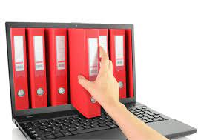
04
Confidentiality of the Data .
05
Quick Access to what you want .
06
Easy Retrieval Data.
Notes:
Image used in the preview file : https://unsplash.com/photos/N2zk9yXjmLA

Slide 10

How Are We Doing This?
Notes:
Image used in the preview file : https://unsplash.com/photos/nenX2J7JltU

Slide 11

Electronic Archiving System
Documents Managements Systems (DMS)
How Use it?
1. Checking Content of Documents to know what type of Documents and Object related to .
2. Creating an Object based on content of Documents if not exists on System .
3 Storing the Data and Documents .
01
.
.
Notes:
Image used in the preview file : https://unsplash.com/photos/B933FT2BO5k

Slide 12

Permissions System
02
Route middleware is an extremely powerful tool in Laravel. As an example of how powerful Laravel route middleware can be, the awesome that handles authentication is a route middleware tool .
And we use this to check user permissions.
How to use?
Permissions:
-when entering System the menu item show based in permissions .
- Add data and retrieving data based in permissions .
Notes:
Image used in the preview file : https://unsplash.com/photos/iGrsa9rL11o

Slide 13
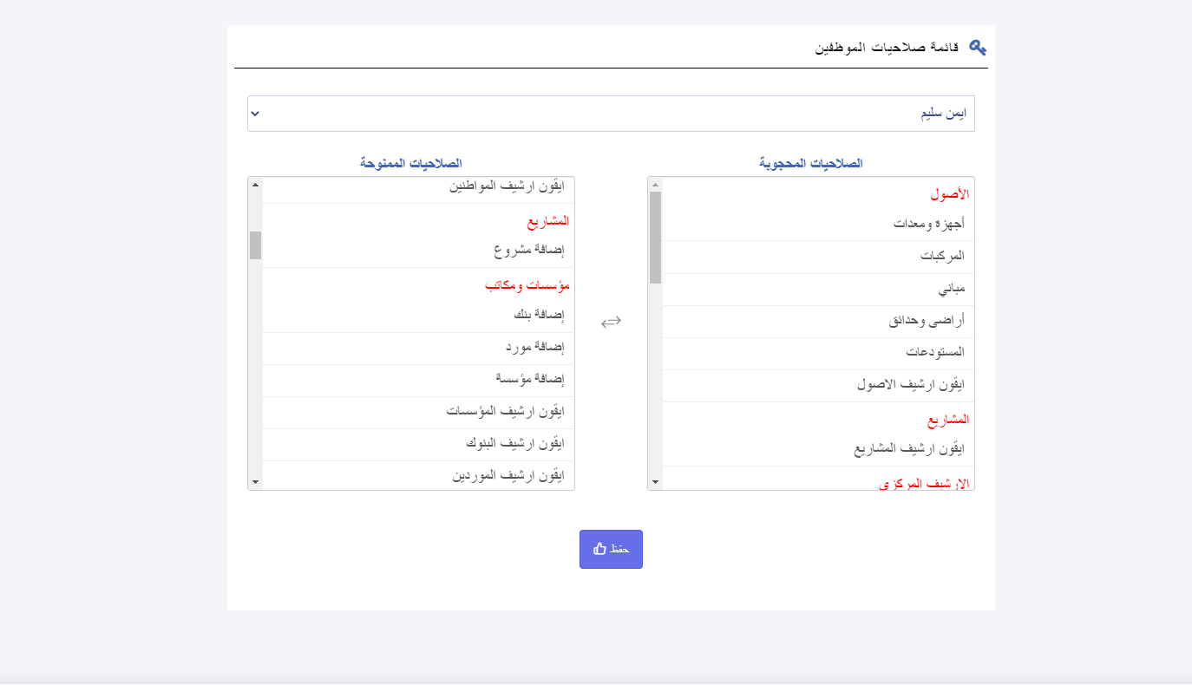

Slide 14
Organization Permissions | User Permissions
updateOrganization | updateOrganization
permissions | employee
employee | out_archieve
department | Store_archive
out_archieve
in_archieve
Store_archive

Slide 15
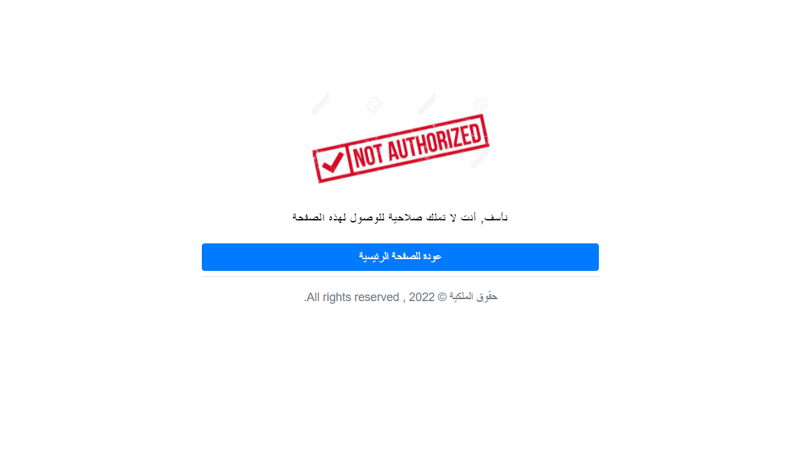

Slide 16


03
Management Meetings
How does it?
We manage all the details of the meetings within the Organization and we archive all the details of this meeting to return to it later if we want.
Where we can access all the details of the meeting in a very simple way, as this is also based on the permissions granted.
Notes:
Image used in the preview file : https://unsplash.com/photos/iGrsa9rL11o

Slide 17

04
Certification
How Use it ?
We are defined template we used mostly .
Select the Benefit of this Certificate .
Fill in the data related to the beneficiary of this certificate.
Store the certificate
Then archive and print the certificate
Notes:
Image used in the preview file : https://unsplash.com/photos/iGrsa9rL11o

Slide 18
Design
APPLICATION DEMO

Slide 19
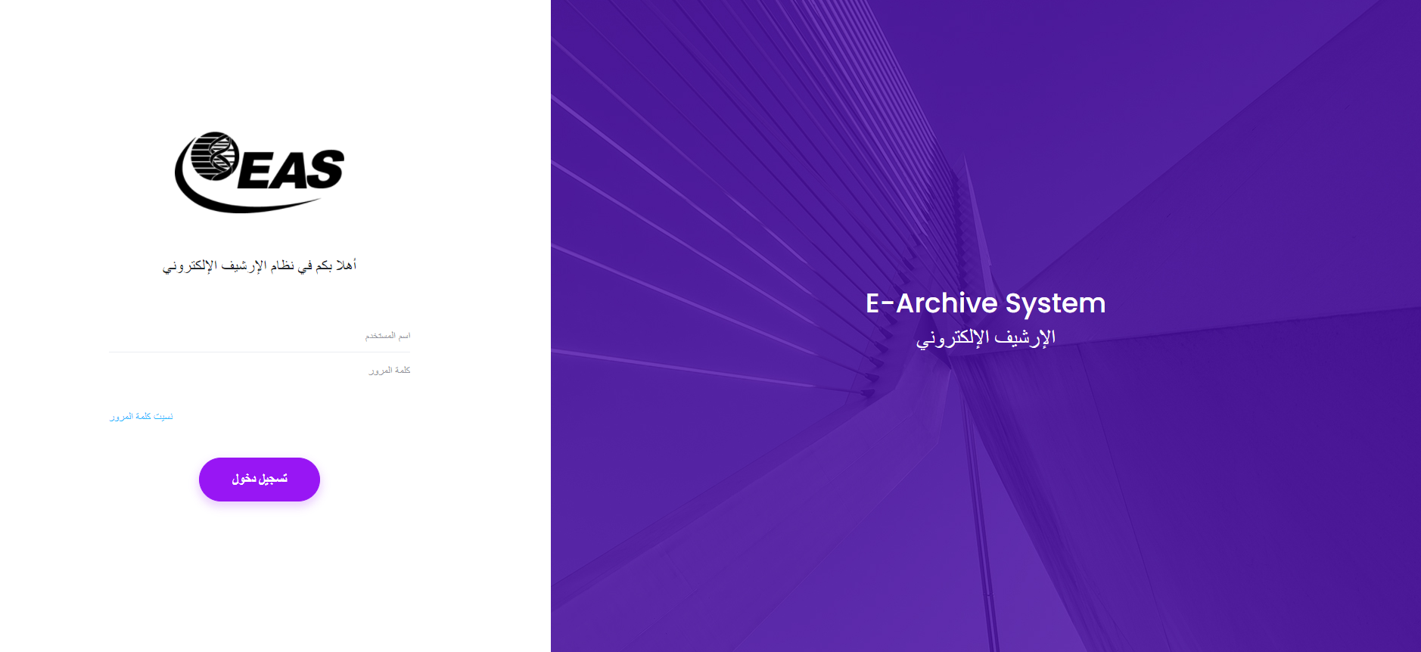

Slide 20
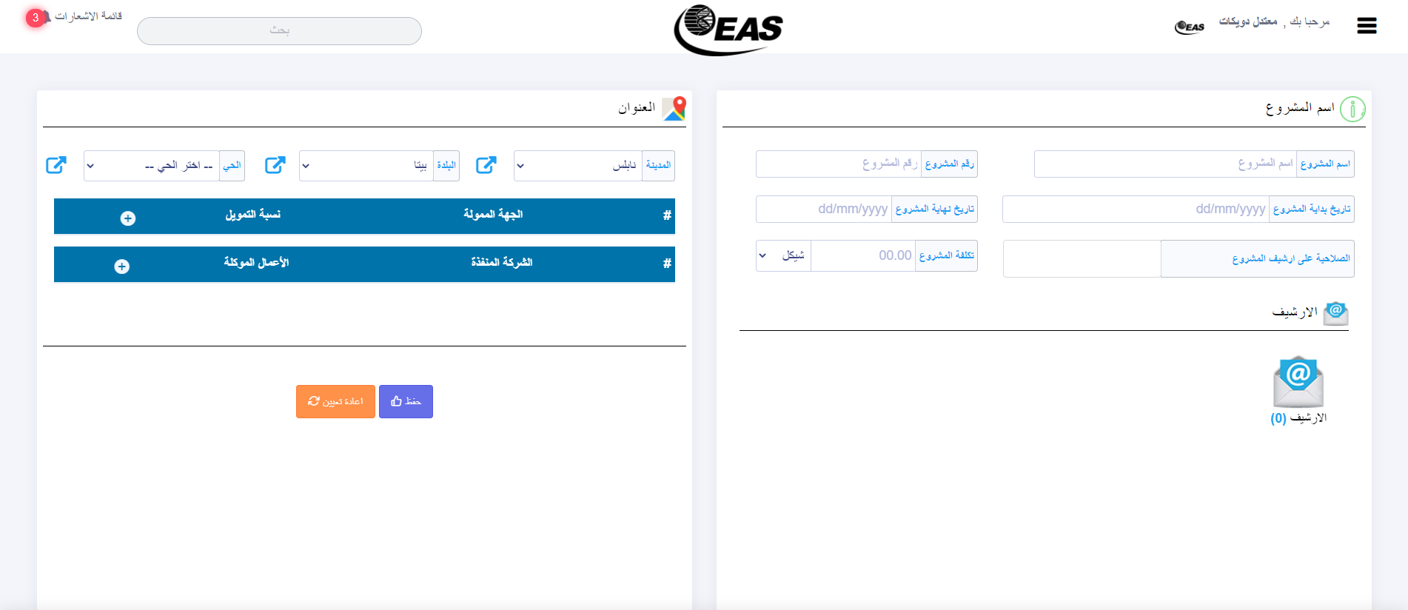

Slide 21
Development
Technologies & Services

Slide 22
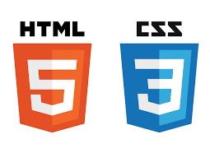



Back-End
Front-End
Back-End
Front-End
MYSQL
Laravel
HTML & CSS
JavaScript&jQuery

Slide 23


MYSQL (Back-End)
What?
MySQL is a relational database management system (RDBMS) developed by Oracle that is based on structured query language (SQL). A database is a structured collection of data. It may be anything from a simple shopping list to a picture gallery or a place to hold the vast amounts of information in a corporate network.
Why?
1. Easy of use
2. Open distribution and source code
3. Very fast
4. Reliable & Scalable
5. Relational Database
Notes:
Image used in the preview file : https://unsplash.com/photos/pfNmcyaT_es

Slide 24



Laravel (Back-End)
What?
Laravel is a web application framework with expressive, elegant syntax. freeing you to create without sweating the small things.
Why?
1. simplify their development process
2. Fast Caching Integrations
3. Safe, secure transactions
4. Fast URL Routing
5. Web Applications for Multiple Languages
Notes:
Image used in the preview file : https://unsplash.com/photos/pfNmcyaT_es

Slide 25



HTML&CSS (Front-End)
What HTML?
HTML is the language for describing the structure of Web pages. HTML gives authors the means to:
Publish online documents with headings, text, tables, lists, photos, etc.
Retrieve online information via hypertext links, at the click of a button.
Design forms for conducting transactions with remote services, for use in searching for information, making reservations, ordering products, etc.
Include spread-sheets, video clips, sound clips, and other applications directly in their documents.
What CSS ?
CSS is the language for describing the presentation of Web pages, including colors, layout, and fonts. It allows one to adapt the presentation to different types of devices, such as large screens, small screens, or printers. CSS is independent of HTML and can be used with any XML-based markup language. The separation of HTML from CSS makes it easier to maintain sites, share style sheets across pages, and tailor pages to different environments. This is referred to as the separation of structure (or: content) from presentation
Notes:
Image used in the preview file : https://unsplash.com/photos/pfNmcyaT_es

Slide 26




JavaScript &jQuery(Front-End)
What?
JavaScript is used to develop interactive web applications. JavaScript can power featured like interactive images, carousels, and forms.
jQuery is a JavaScript library designed to simplify HTML DOM tree traversal and manipulation, as well as event handling, CSS animation, and Ajax. It is free, open-source software using the permissive MIT License
Why?
1. AJAX calls and DOM manipulation
2. open-source
3. jQuery is a lightweight, "write less, do more", JavaScript library.
Notes:
Image used in the preview file : https://unsplash.com/photos/pfNmcyaT_es

Slide 27
Thanks
Electronic Archive System
An-Najah National University
2021-2022
Notes:
Image used in the preview file : https://unsplash.com/photos/jeWWV3OqN78

