Slide 1

An-Najah National University
Engineering and IT Faculty
Civil Engineering Department
Hydraulic Analysis for a WDN & Design a WWC & SWCN for Kofr Ra‘I Town
Prepared by:
Abed Al-Malik Ayaseh Osaid Ayaseh Emad Salem
Under supervision of:
Dr. Muhammed N. Almasri
Year 2019 - 2020

Slide 2
Content:
General Background.
Main objectives.
Description of the study area.
Analysis of water distribution network.
Design of wastewater collection network.
Design of storm water collection network.

Slide 3
General Background WDN:
Make analysis for the existing network to determine the velocity and pressure.
Analyze the WDN after 30 years from now.
Compare the result with standard.
WDN for KofrRai’

Slide 4
General Background WWCN:
In this Town they don’t have a Wastewater collection network.
And most of them has a septic holes that have an effect such as:
1. Bad effect on the environment.
2. Cost of evacuation.
3. Re-use treated wastewater such as in irrigation.
WWCN for KofrRai’

Slide 5
General Background SWCN:
They do not have storm water collection network.
And we choose this town, because of:
1. High density of population.
2. The town suffers from flood in winter.
SWCN for KofrRai’

Slide 6
The main objectives of this project:
Hydraulic analysis of the existing water distribution network.
If the result not meet constrains → Re-design.
Design a wastewater collection network.
Design a Storm water collection network.

Slide 7
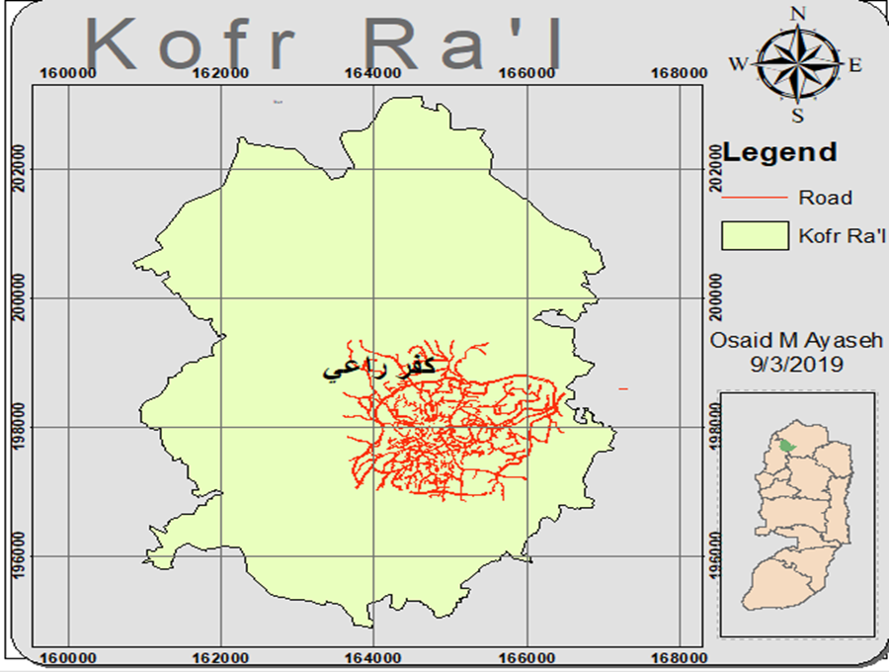
Description of the study area:
1. Location:
The town of Kofr Ra'I is located 23 km
away to the south-west of Jenin
governorate, in the northeast of
Tulkarem in the northern West Bank.

Slide 8
2.Climate
Temperatures: the temperatures range is from 28 to 34 degrees in summer, (6 - 12) degrees in winter.
Rain: from 550 to 650 mm per year, and According to the Meteorological Department, the town of Kofr Ra'I.
Humidity: the humidity is relatively high and its 70-80 in winter and 40-60 in summer.

Slide 9
  3. Topography:
  The village is located on six intermediate mountains, the height of the village is 400 meters above mean sea level on average, the highest rise in the village is up to 580 meters above sea level and the minimum is 165 m above the sea level.
  4. Population:
Year: | Population (person.):
2007 | 7364
2017 | 8471
2018 | 8590
2048 | 13075

Slide 10
  5. Water resources:
Illar
Receiving tank
Main tank(1500 m3)
Kofr Ra'I
Fahma
Alrama

Slide 11

Methodology for WDN:
Specification
Validate and run
GIS, WaterCAD...
Municipality
Interviews
Kofr Ra‘I

Slide 12
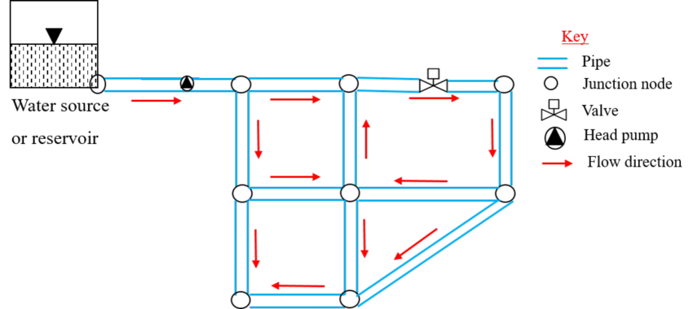
Analysis of the water distribution network

Slide 13
Collected data
Population
Using geomolg we found that the population is 8591 persons .
        Layout of the network
By using an A3 plan for the village roads , the network was drawn by the municipality water engineers showing the pipe line location and diameter .
The next picture shows the A3 plan

Slide 14
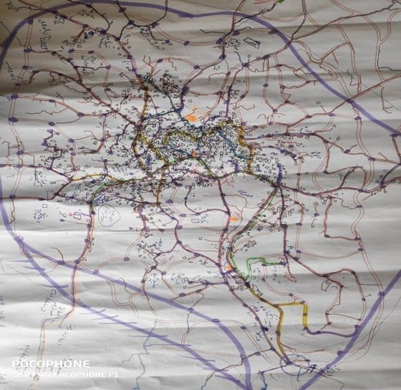

Slide 15
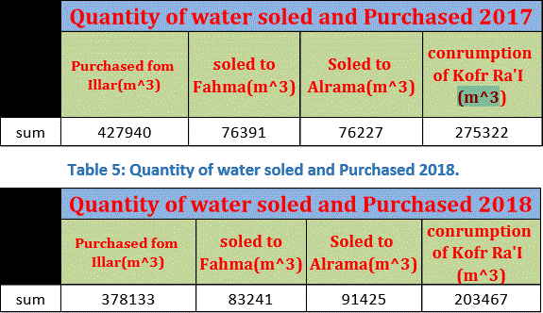
Water Consumption data
The amount of water purchased from iilar and sold to fahma and rama villages using municipality reports for 2017 and 2018 :
2. the amount of water that have been sold to citizens is 180221 (m^3) / year

Slide 16
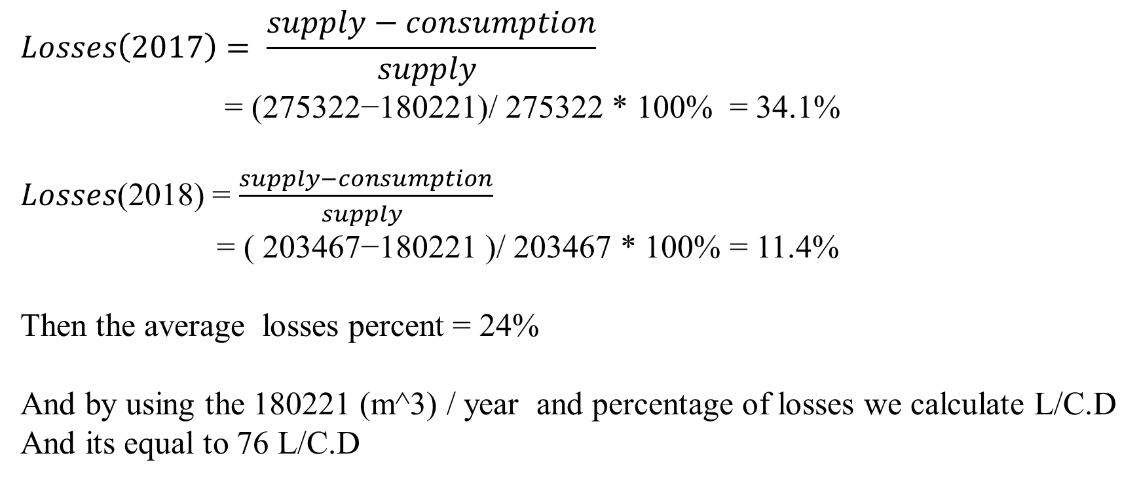
Calculated data
Losses percentage and the average daily consumption per capita
$$Losses\left(2017\right)= \frac{supply−consumption}{supply }$$
= (275322−180221)/ 275322 * 100% = 34.1%
𝐿𝑜𝑠𝑠𝑒𝑠(2018) = $\frac{supply−consumption}{supply }$
= ( 203467−180221 )/ 203467 * 100% = 11.4%
Then the average losses percent = 24%
And by using the 180221 (m^3) / year and percentage of losses we calculate L/C.D
And its equal to 76 L/C.D

Slide 17
Water distribution network layout
By using the A3 plan the network was drawn as next:
Determine and location each junction that needed for the network drawing.
2. Connect the junction by the reacquired pipe according to the A3 plan .
The next picture shows the network and the diameter of the pipes

Slide 18

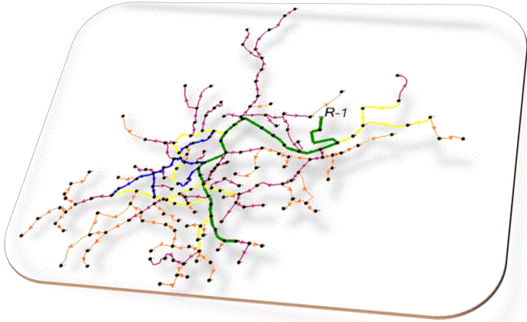
Pipe color diameter (in)
Green 6
Blue 4
Yellow 3
Purple 2
Orange 1

Slide 19
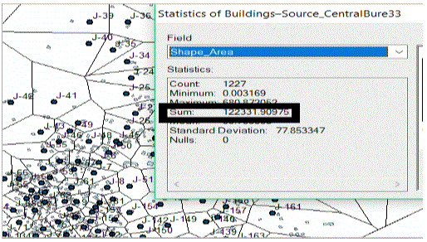
        Data from GIS
By using GIS program we calculated the total surface area of the building
in the village to use it in the demand distribution laterally
The total surface area of buildings is 122332 (m^2)

Slide 20
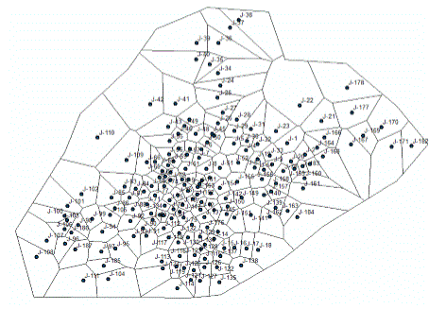
Demand calculation
In our project the demand distribution was depending on the percentage of the surface area of the building that each junction serve from the total building area and the calculation as next :
Population on each joint :
Theisen polygon
By using Theisen polygon we found the served area by each node

Slide 21
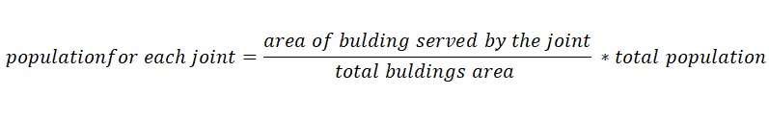
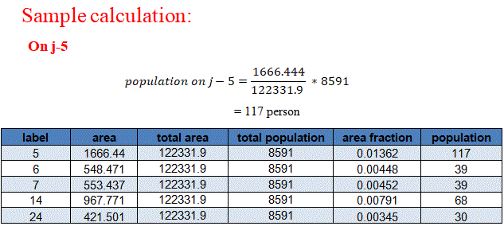
Population calculation
After finding the surface area of building for each joint we can now calculate the population number served by each joint by the next formula :

Slide 22

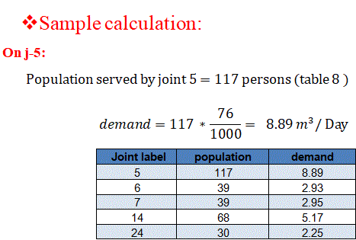
Demand calculation for each joint :
After calculating the population served by each nod we can now calculate the demand on each joint by using the next equation ;

Slide 23
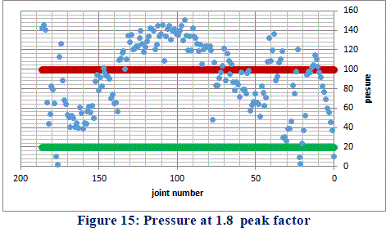
Analysis of the network
The analysis of the network was done on peak factor 1.8 and 0.27 and it was as next :

Slide 24
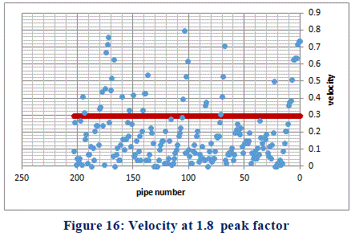

Slide 25
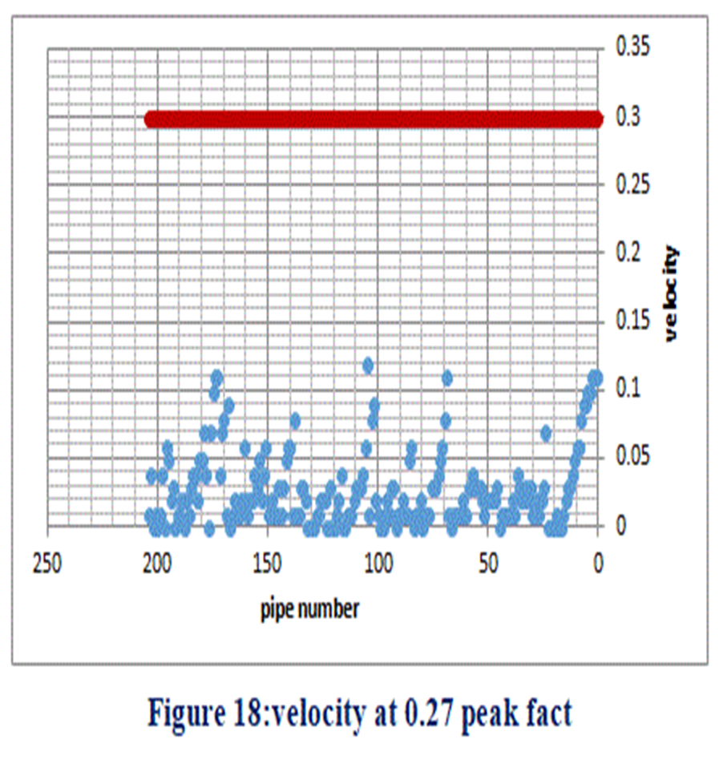
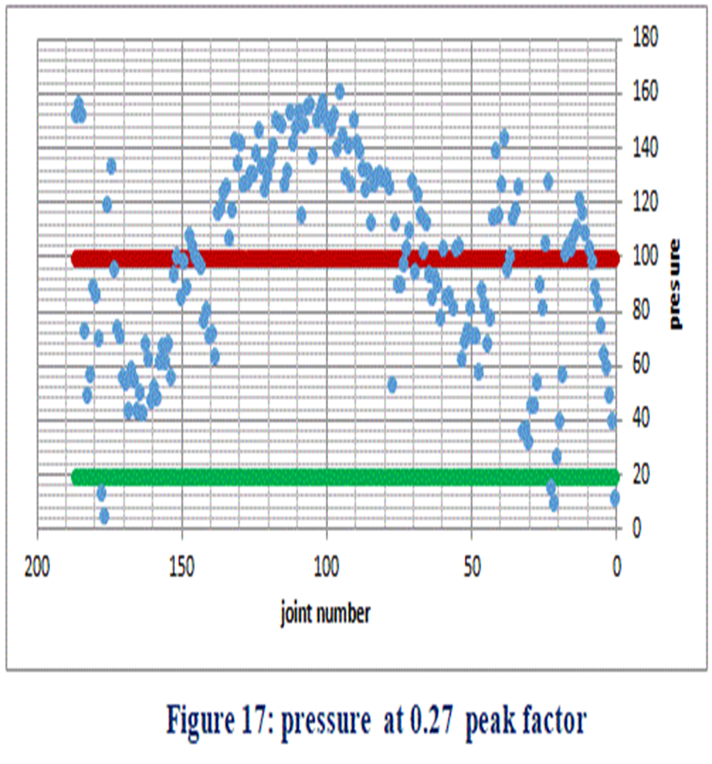

Slide 26
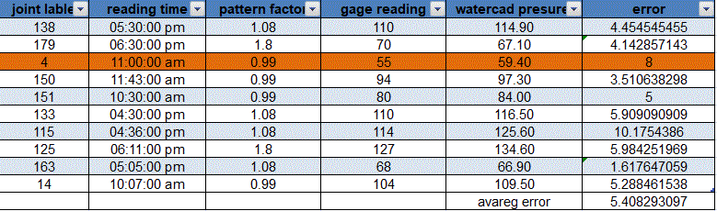
Results checks
To check if the results simulate the existing network or not , we use a gage pressure to measure the pressure and compare it with the WaterCAD results , the results as following :

Slide 27
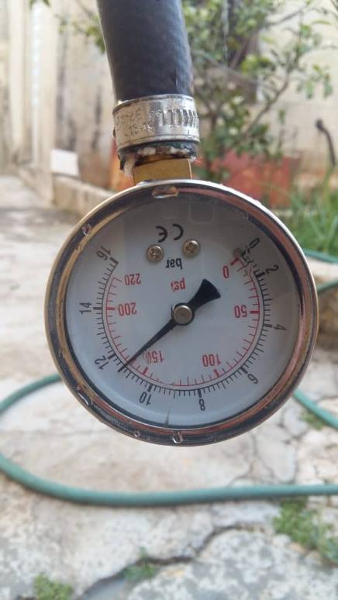

Slide 28
Analysis for the future water distribution network
in 2048

Slide 29
Collected data and calculated
For this part of the project its depends on the data in the previous parts so the data that we used is :
The contours
The layout of the existing network
The demand of the joint
The population distribution
The average daily consumption 100 L/C.D
Growth rate 1.41%

Slide 30

Population calculations
For population distribution in the future we assumed according to the free area of the village ( areas without buildings ) , we divide the village to tow parts fixed density area and unfixed density area .
By using GIS we choose the joint that serve the fixed density area and calculate the population in it :
The increased population is 13075 – 8591 = 4484 person , we assumed that these will be uniformly distributed in the unfixed density areas

Slide 31
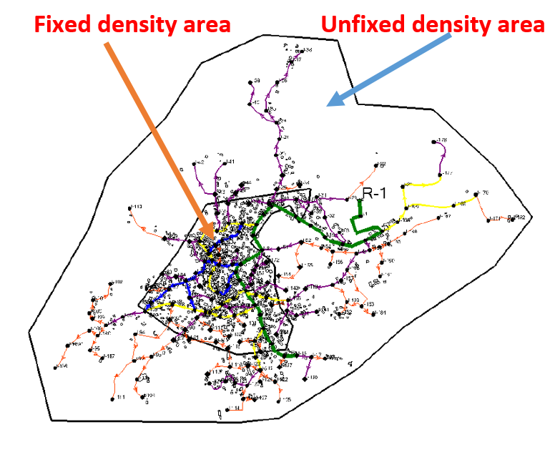

Slide 32

Demand calculations
To calculate increased demand we assume :
consumption = 100L/c.d.
2. %Losses = 24%.
Demand = $\frac{Consumption}{1−Losses }=\frac{100}{1 −0.24}=$ 132L/c.d

Slide 33
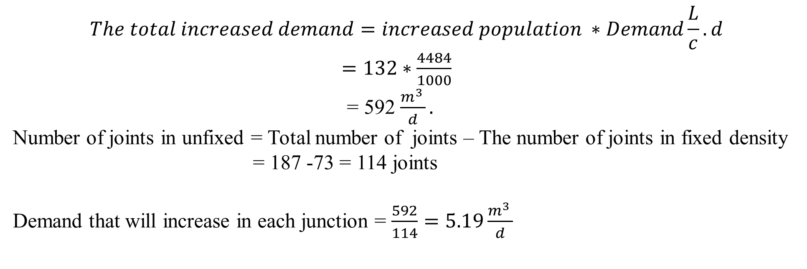
Demand calculations
Demand for unfixed density area
According to our assumptions the demand of joint of these area will be the same demand in 2018 plus the extra demand from the extra population :
$$The total increased demand=increased population ∗Demand\frac{L}{c}.d$$
$=132∗\frac{4484}{1000}$
= 592 $\frac{m^{3 }}{d}.$
Number of joints in unfixed = Total number of joints – The number of joints in fixed density
= 187 -73 = 114 joints
Demand that will increase in each junction = $\frac{592}{114}=5.19\frac{m^{3 }}{d}$

Slide 34
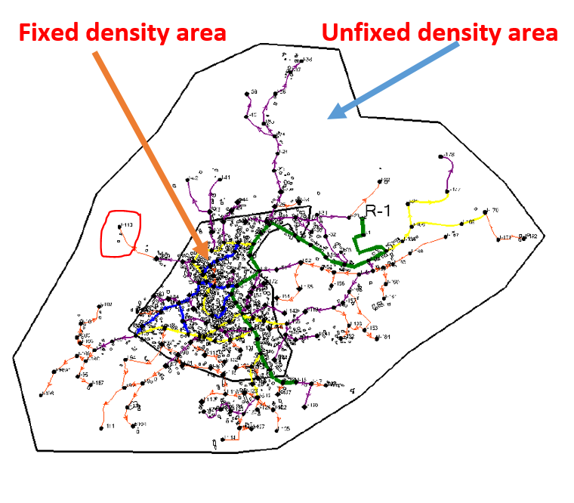
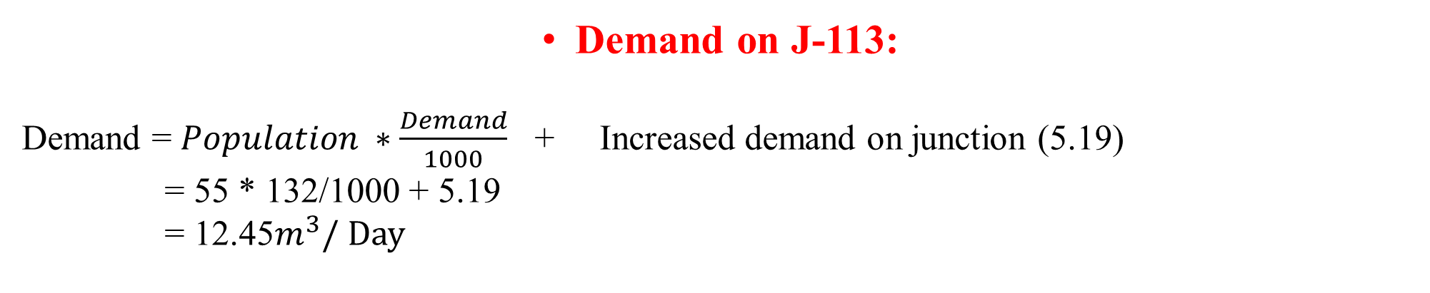
Demand on J-113:
Demand = $Population ∗\frac{Demand}{1000}$ + Increased demand on junction (5.19)
= 55 * 132/1000 + 5.19
= 12.45$m^{3}/ Day$

Slide 35
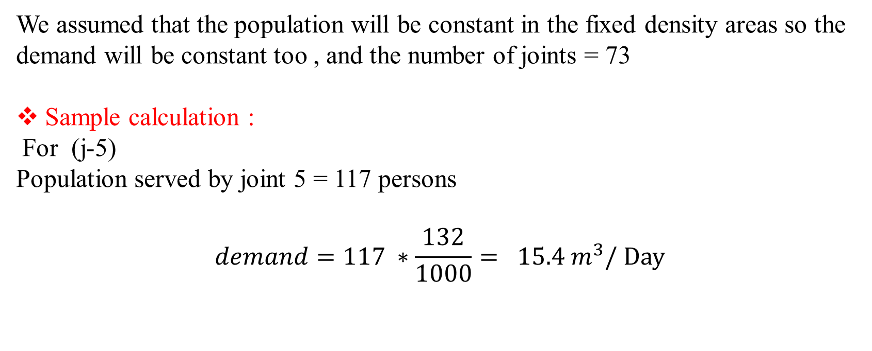
        Demand for fixed density areas :
We assumed that the population will be constant in the fixed density areas so the demand will be constant too , and the number of joints = 73
Sample calculation :
For (j-5)
Population served by joint 5 = 117 persons
$$demand=117 ∗\frac{132}{1000}= 15.4 m^{3}/ Day$$

Slide 36
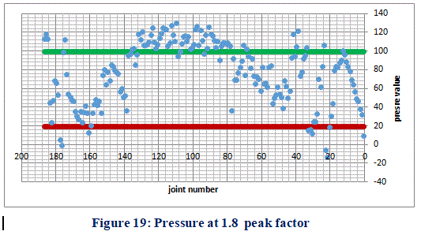
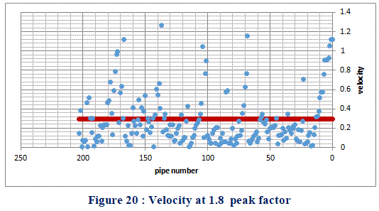
Analysis of the network
The analysis of the network was done on peak factor 1.8 and 0.27 and it was as next :

Slide 37
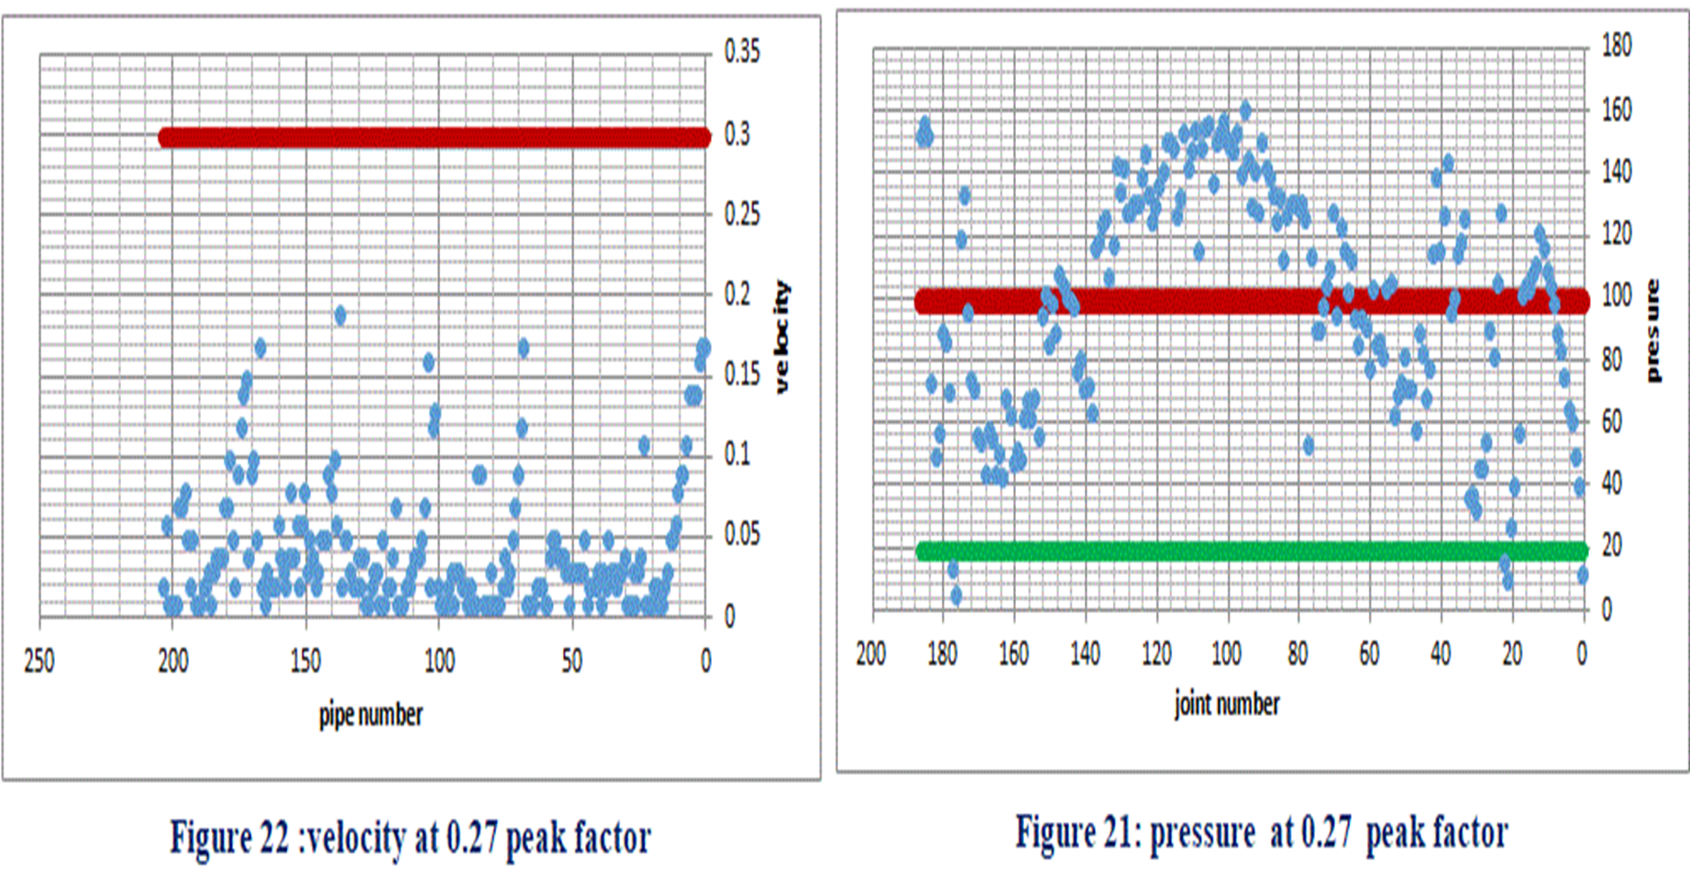

Slide 38
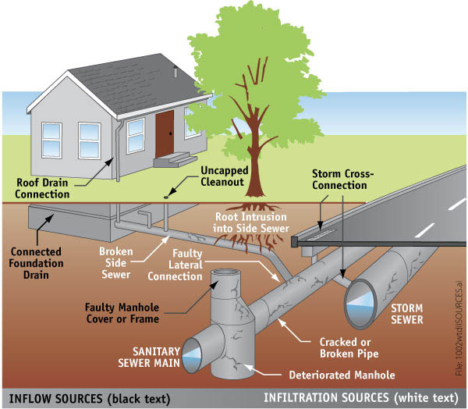
Design of the waste water collection network

Slide 39
Methodology:
Selection of the study area
Data collection
Determine the problem for studying
Determine loads
Entering the data to SewerCAD
Design wastewater collection network

Slide 40
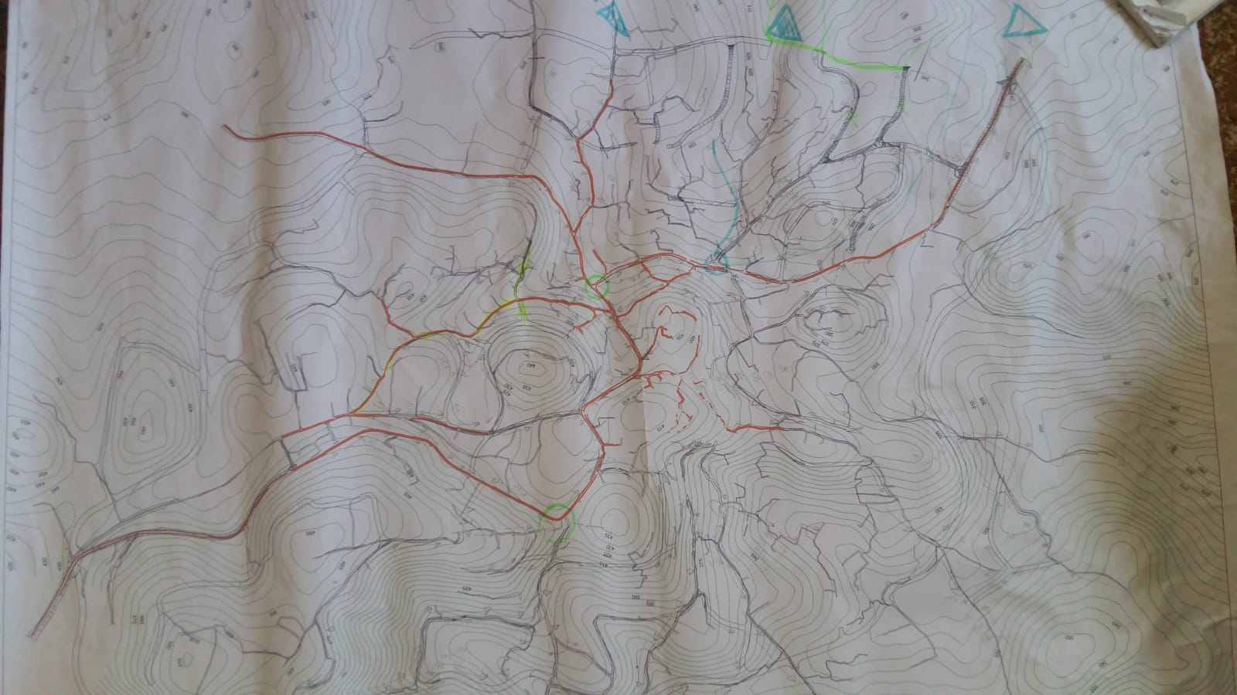
Data Collection:
Collecting information
Design network
Location of manholes
Sewer pipe(PVC)
Geomlg
A2 Paper
Entering Load on each manhole

Slide 41
several considerations to allocate manholes on the network:
We depend on these constrains to allocate manhole on roads:
Distance between manhole(30 -50)m.
Manhole must be located at each intersection of roads
When there is a change in slope or diameter of sewer pipes.
Depend on building distribution.
Road network.

Slide 42
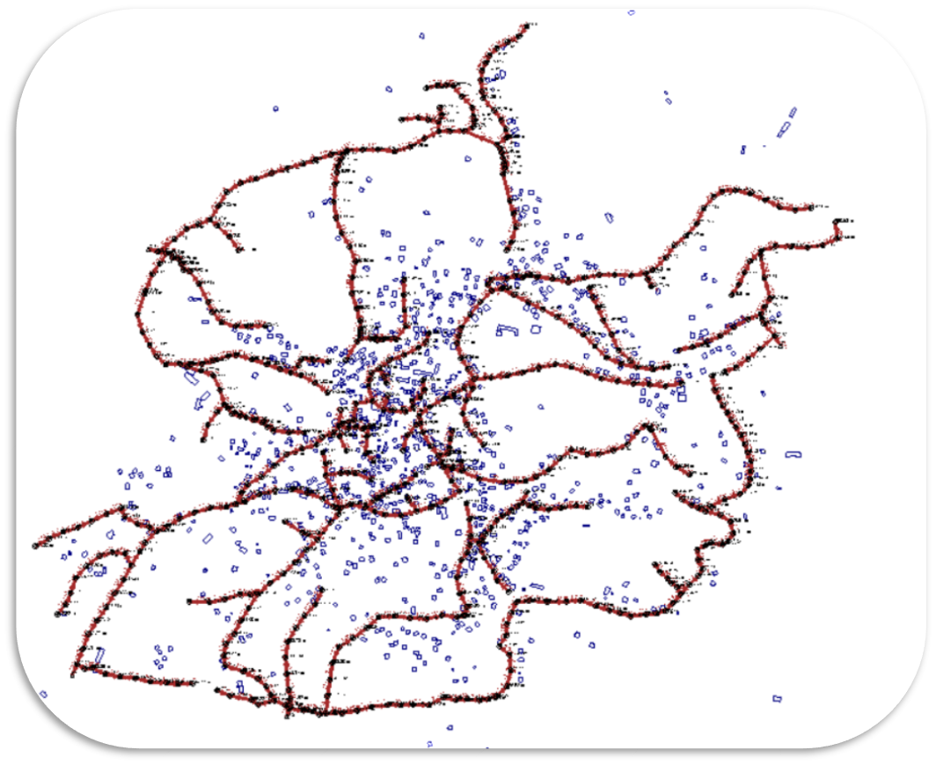
Wastewater Collection Network in SewerCAD

Slide 43
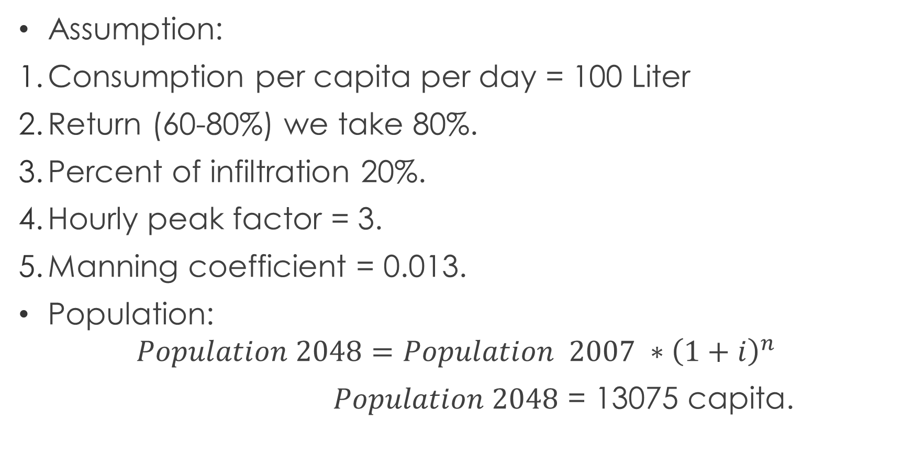
Determine of Wastewater Loads
Assumption:
Consumption per capita per day = 100 Liter
Return (60-80%) we take 80%.
Percent of infiltration 20%.
Hourly peak factor = 3.
Manning coefficient = 0.013.
Population:
$$Population 2048=Population 2007 ∗{\left(1+i\right)}^{n}$$
$Population 2048$ = 13075 capita.

Slide 44
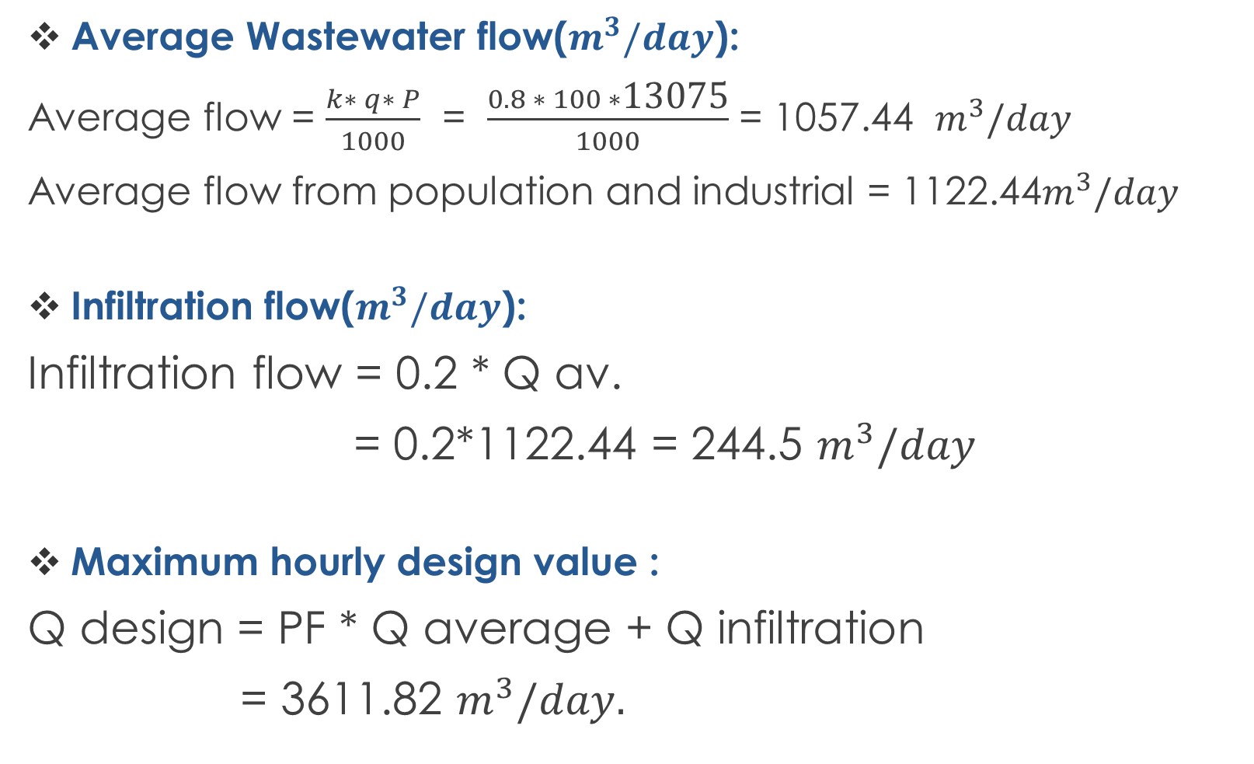
Average Wastewater flow($m^{3}/day$):
Average flow = $\frac{k∗ q∗ P}{1000}$ = $\frac{0.8 ∗ 100 ∗\text{13075}}{1000}$ = 1057.44 $m^{3}/day$
Average flow from population and industrial = 1122.44$m^{3}/day$
Infiltration flow($m^{3}/day$):
Infiltration flow = 0.2 * Q av.
= 0.2*1122.44 = 244.5 $m^{3}/day$
Maximum hourly design value :
Q design = PF * Q average + Q infiltration
= 3611.82 $m^{3}/day.$

Slide 45
We have two way to determine load on manholes:
Load on each manhole
Sewershed
equal distribution load
We use it in our project
By GIS

Slide 46
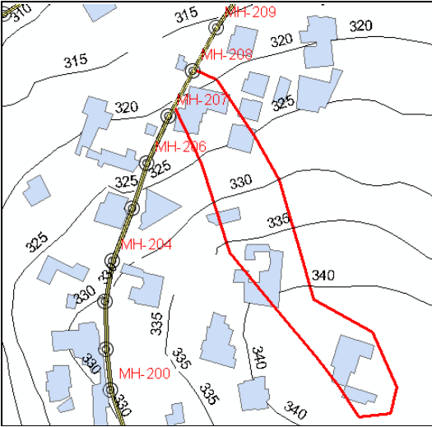
Sewershed
The right way to determine load on each manhole by using Sewershed.
The concept of Sewershed:
Draw Sewershed by using GIS depend on:
Contours line.
Expected population in future.
Location of building.

Slide 47
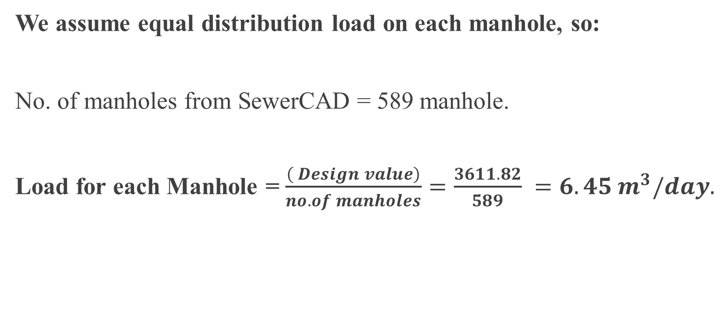
Load on each manhole:
We assume equal distribution load on each manhole, so:
No. of manholes from SewerCAD = 589 manhole.
Load for each Manhole = $\frac{\left( Design value\right)}{no. of manholes}=\frac{3611.82}{589} =6.45 m^{3}/day.$

Slide 48
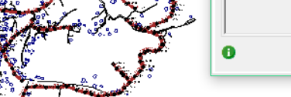
RUN
After building a model and checking that all processes are valid, the model is ready to run.
After First RUN we face some problem with ( Cover, velocity), and we solve these problem by:
The network need another Outfall.
Change direction of flow to another Outfall.
We use Drop manholes structure.
Then we make a Second RUN and we don't have any problem.

Slide 49
RESULT of wastewater collection network:
1. Cover :
Used to keep the velocities and slopes with acceptable limits.
Constrains( 1 - 4) m.

Slide 50
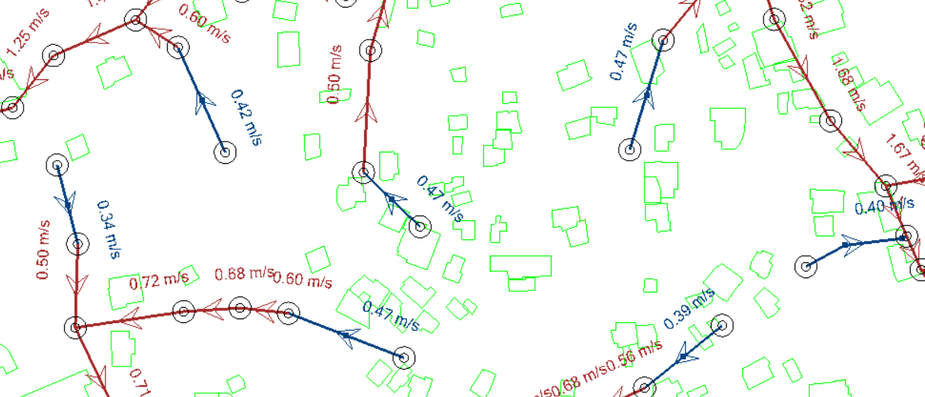
2. Velocity
The velocity should be more than(0.5-0.6)m/s to avoid deposition, and less than 3m/s to eliminate corrosion.

Slide 51
3. Slope:
We assumed slope of sewer pipe (1 -10)%.

Slide 52
4. Diameter of sewer pipe:
The minimum diameter used to design this network equal to 8 inch.
Outfall diameter = 10in.

Slide 53
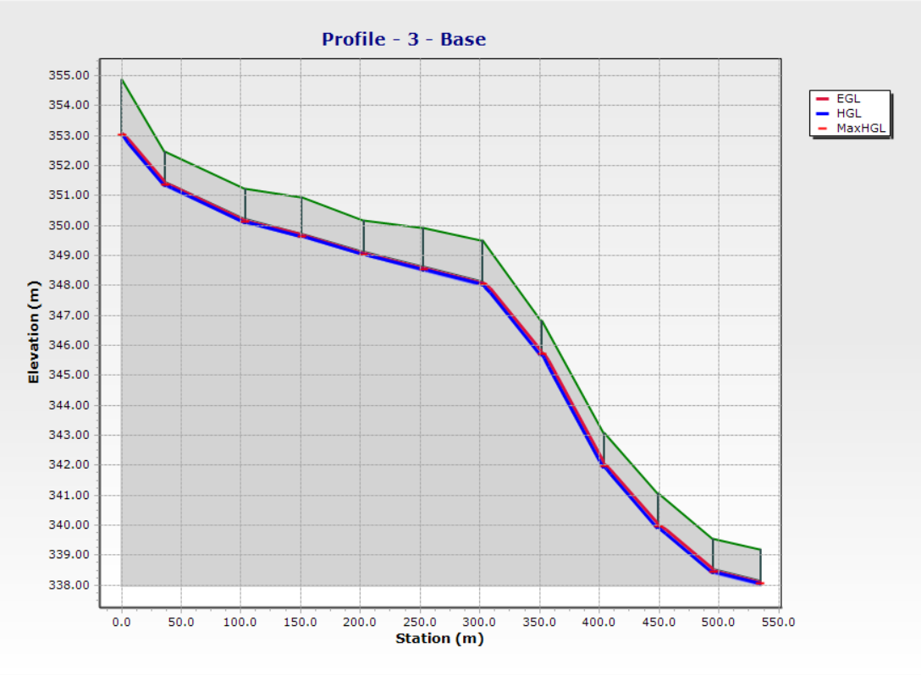

Slide 54
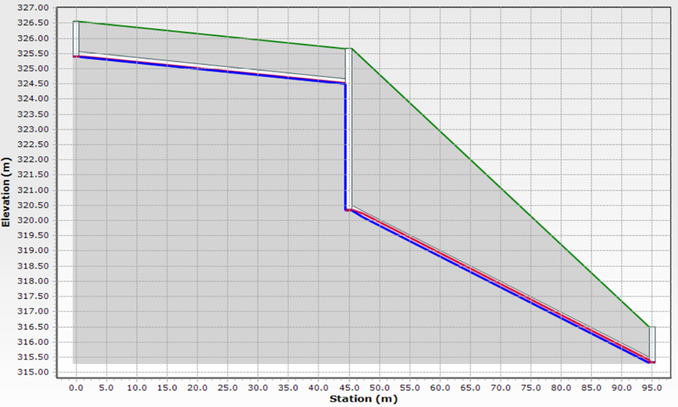
5. Profile :
We use a drop manhole.

Slide 55
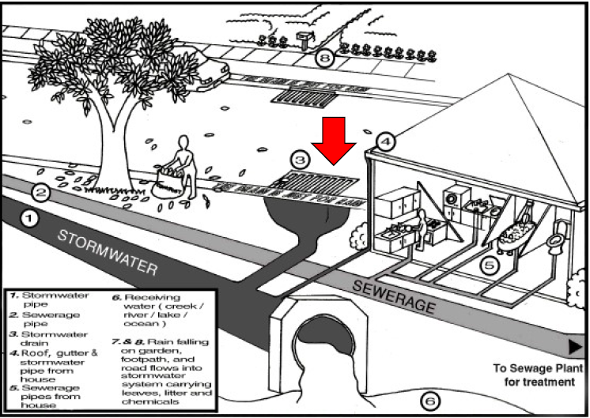
Storm water collection network

Slide 56
Methodology of SWCN
Problem Definition
Selection of the study area
Data collection
Drawing the stormwater network
Model development
Run the model
Checks
Conclusions and recommendations

Slide 57
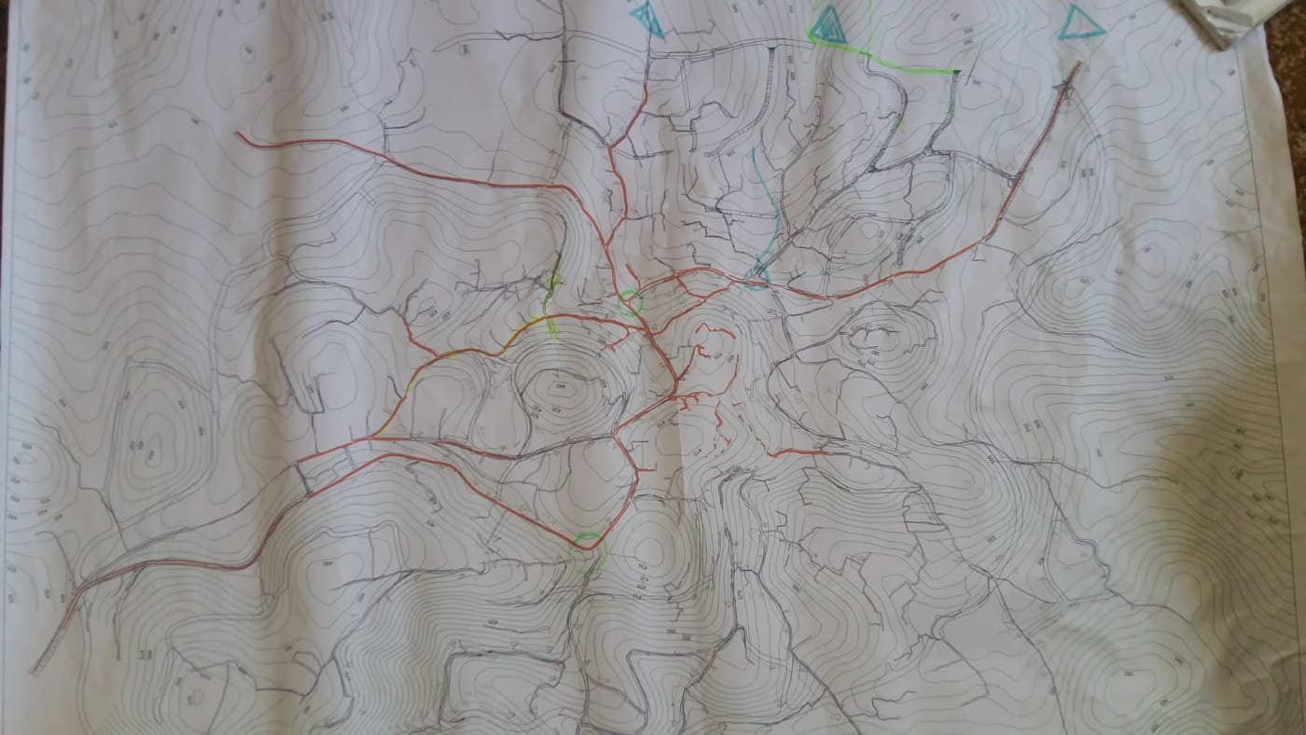
Data collection:
Collecting information
Design network
Location of catch basins
Sewer pipe
Geomlg
A3 Paper
Catchments
Rain fall for:
KofrRa’I
Nablus
Outfall
PVC
Concrete
C , I , A
( 30 – 50)m
At the Lowest point

Slide 58
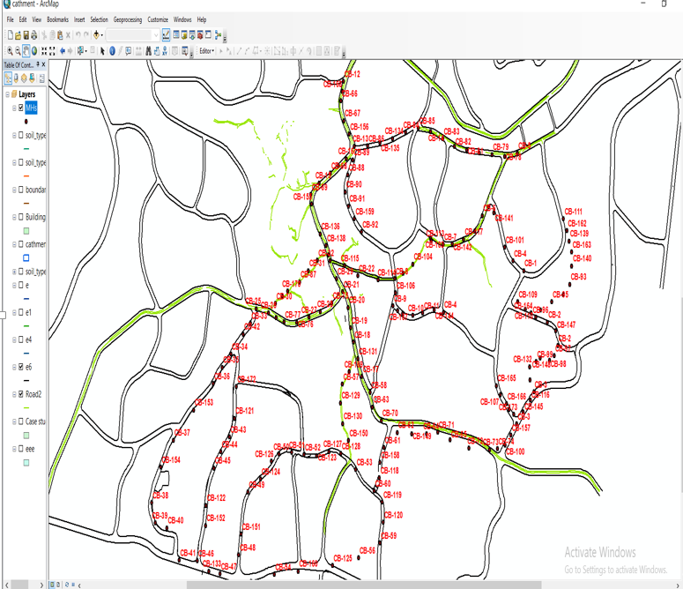
Drawing the network on GIS
We distribute the location of
the catch basins.
2. Then, we draw the catchments
for each catch basin.
3. After that we convert it to shape files.

Slide 59
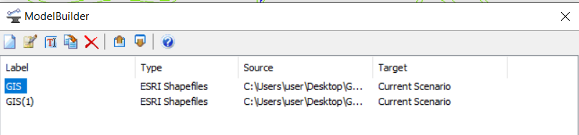
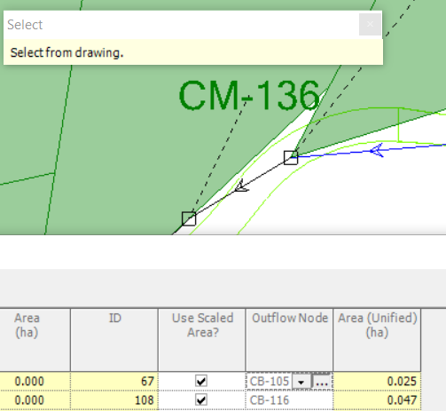
Drawing the network on StormCAD
We use Model Builder :
Then we connect between catch basin by conduits.
Also, we define for each catch basin the catchment flow into it.

Slide 60
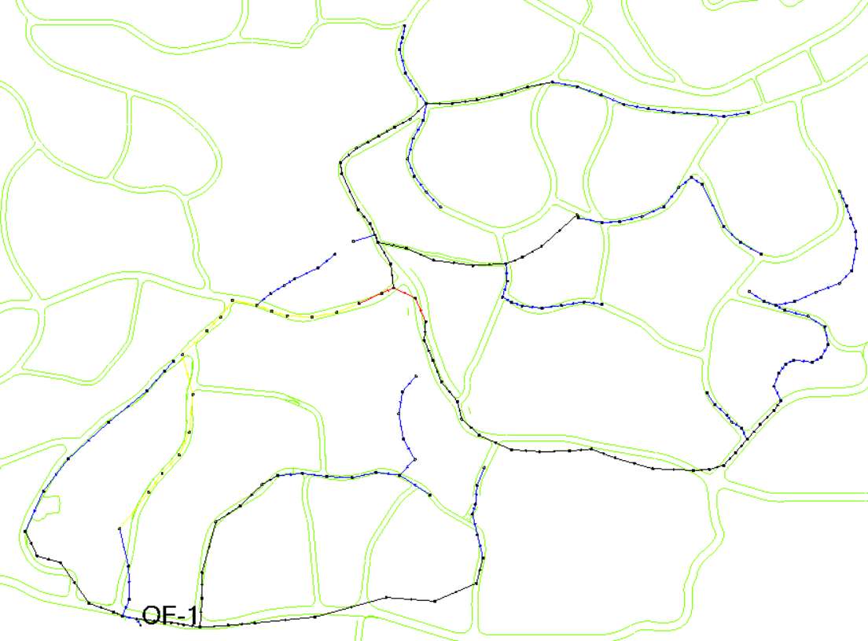
Storm water collection Network in StormCAD program

Slide 61
SWCN Components:
Catchments:
There are many factors affecting the movement and direction of water in the catchment areas:
Size of the catchment.
Surface type that related to Runoff coefficient(C).
Topography of the catchment.
Then, we determine the flow for each catchment by using (Rational method):
Q = 0.0028 * C * I * A
where:
I(mm/hr).
A(hectares).
Flow(m3/d)(Q)
Runoff coefficient(C)
Intensity(i)
Area(A)

Slide 62
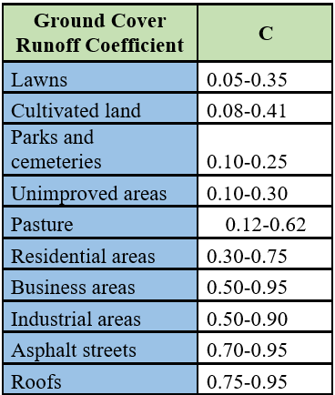
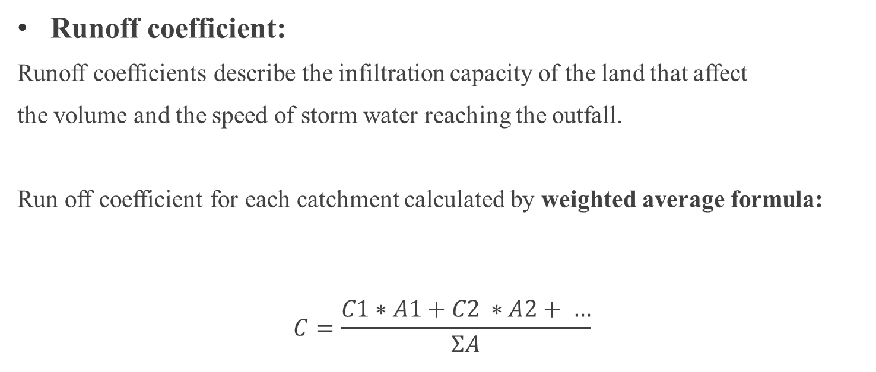
Rational Method:
Runoff coefficient:
Runoff coefficients describe the infiltration capacity of the land that affect
the volume and the speed of storm water reaching the outfall.
Run off coefficient for each catchment calculated by weighted average formula:
$$C=\frac{C1∗A1+C2 ∗A2+ …}{ƩA}$$

Slide 63
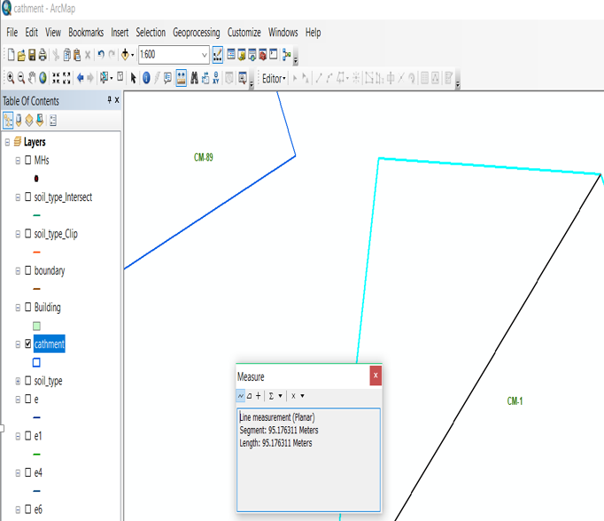
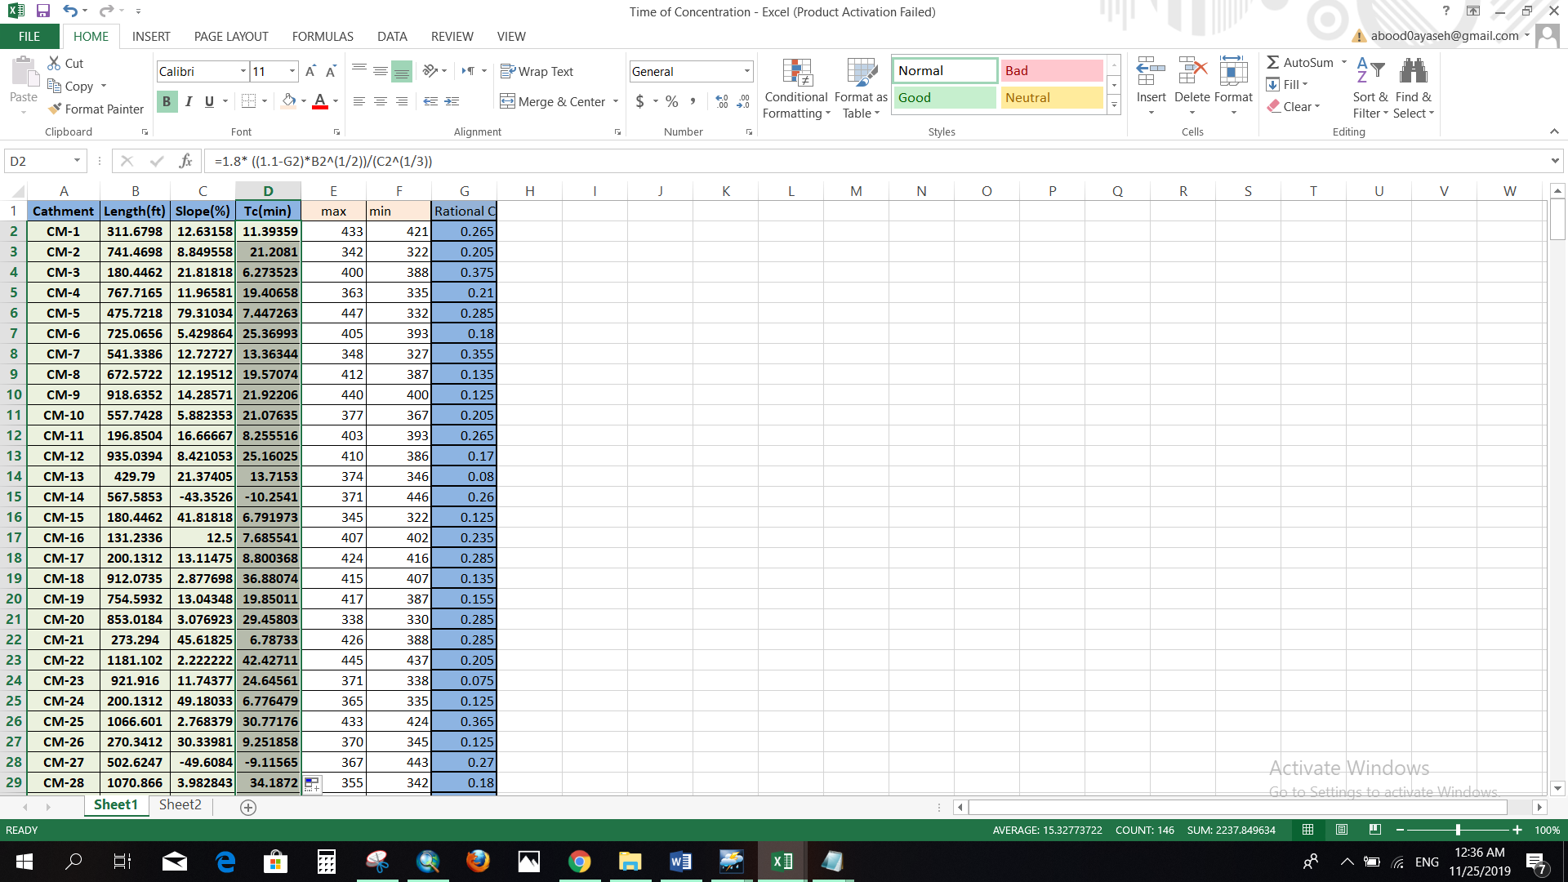

Rational Method:
Time of concentration:
We need Kirpich Equation’s to calculate time of concentration.
$$tc= 1.8\frac{\left(1.1−C\right)L^{0.5}}{S^{\frac{1}{3}}}$$

Slide 64
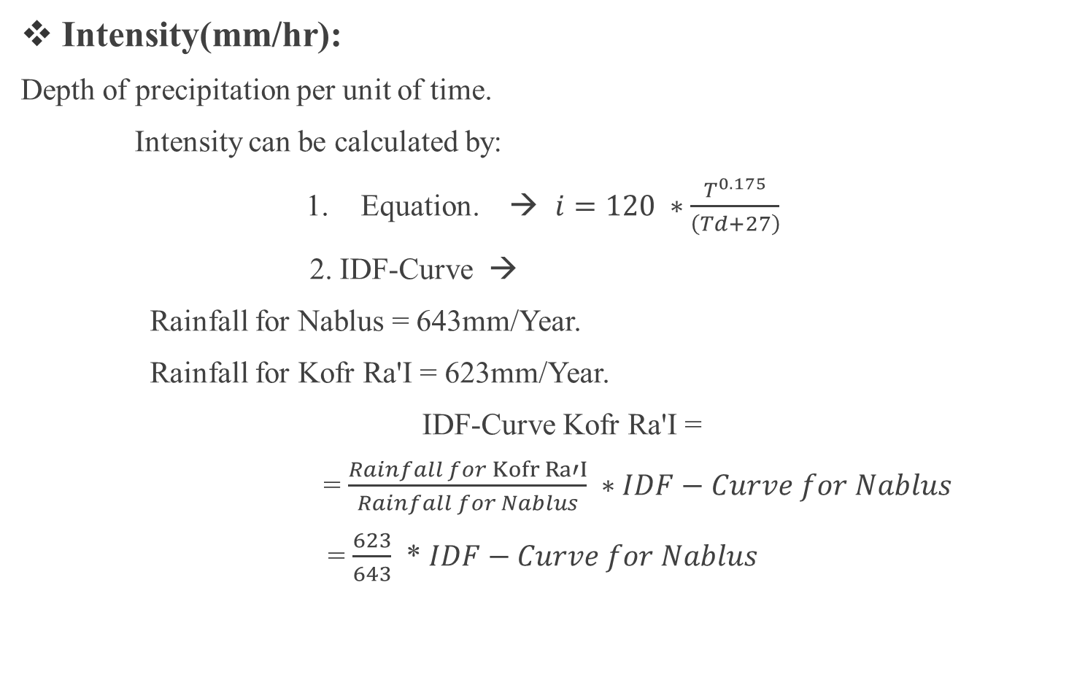
Rational Method:
Intensity(mm/hr):
Depth of precipitation per unit of time.
Intensity can be calculated by:
Equation. → $i=120 ∗\frac{T^{0.175}}{\left(Td+27\right)}$
2. IDF-Curve →
Rainfall for Nablus = 643mm/Year.
Rainfall for Kofr Ra'I = 623mm/Year.
IDF-Curve Kofr Ra'I =
= $\frac{Rainfall for Kofr Ra′I}{Rainfall for Nablus} ∗IDF−Curve for Nablus$
= $\frac{623}{643}$ * $IDF−Curve for Nablus$

Slide 66
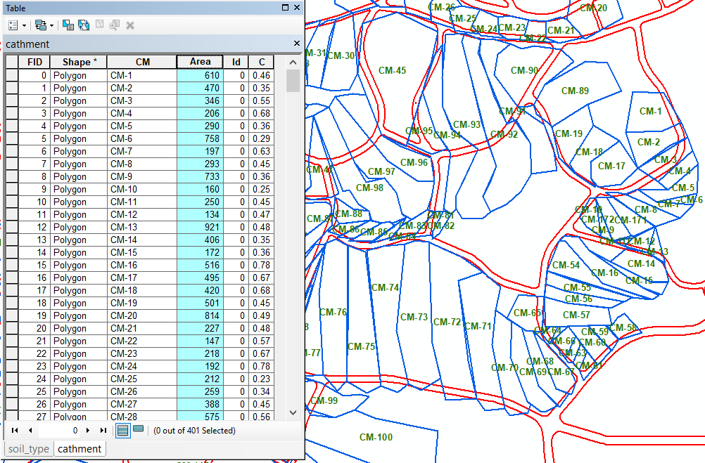
Rational Method:
Area of catchment:
we calculate the area of catchment by GIS.

Slide 67

Entering constrains to StormCAD:
1. Minimum &Maximum velocity.
V min. = 0.6 m/s.
V max. = 5 m/s.
2. Minimum & maximum slopes of sewer lines.
S min = 1%
S max = 10%
3. Minimum & maximum cover
Cover min. = 1m
Cover max. = 5m
4. Pipe material
PVC for conduits that have diameter <16” with manning coefficient (n=0.013).
Concrete for conduits that have diameter >16” with manning coefficient (n=0.015).

Slide 68

For catch basin:
We use clogging factor = 80%.
Sump depth = 0.5m
Inlet:
Type : Grate.
Dimension = 0.6 * 0.6 m.

Slide 69


Entering storm data:
IDF – Curve For KofrRa’i
Return Period (Year)

Slide 70
RUN the model:

Slide 71
Result from StormCAD:
Cover:
The cover depth we obtained in our design was convenient and within constrains (1-5)m, where the maximum average cover depth reached to 4.88m.

Slide 72
Result from StormCAD:
2. Velocity:
The velocity values of the flow we obtained were all within (0.6-5) m/s. where the maximum velocity we obtained was 4.845 m/s.

Slide 73
Result from StormCAD:
3. Slope:
In our design we designed the slope to be within (1-10) %

Slide 74
Result from StormCAD:
4. Diameter :
Design diameter range between(4 – 36)in.

Slide 75

Result from StormCAD:
5. Profiles:

Slide 76
Conclusions and Recommendations:
Conclusions:
Water distribution network:
After we make analysis for WDN Kofr Ra'I town for existing network and for future the network doesn’t need Re – design.
Waste water collection network:
There are four outfalls of the study area.
The final model has 589 conduits and 589 manholes.
The Network have an 8in pipe diameter.
Outfall diameter equal to 10in.
Storm water collection network:
Out fall flow equal to 100,702𝑚3/𝑑𝑎𝑦.
Design diameter ( 4 – 36)in.
Catch basin ( 0.6 * 0.6)m.
Conduit materials:
PVC and concrete.

Slide 77
Recommendations:
Waste water collection network:
We recommended the out flow from Kofr Ra’I town and surrounding town to design WWCN to transfer the waste water to treatment planet.
Storm water collection network:
Aggregation storm water to use it in several uses.
Reduce from flooded.

Slide 78


