Slide 1
Servic_sync
Services management application

Slide 2
Idea
The idea came from the online services sharing in our company is too messy and annoying
So the idea of this project is to organize them and the sharing process in one place

Slide 3
Simple market research
To check the idea and the demand of it I did some simple market research
As research suggests: the online services supply and demand increased since Covid-19 era
Also it suggests that the most demand thing nowadays is innovation
It also discovered that some of problems that faces the innovators like: collaborations, learning resources, and platforms

Slide 4
Project’s aims
This project aims to build a place for the organizations to share the services with their stakeholders
It also supported to connect the service providers with the users and organizations that are interested in their place

Slide 5
Roles
Organizations
Users
Service Providers
Global system admin

Slide 6
Main features
Make workspaces to enable the organizations to share the services with their stakeholders
Enable the organizations to store and manage their services in a singles place and give access to them for their managers
Enables the user to store and manage their services
Enables the service providers to share their services to users and organizations
Enable the users and the organizations to find the services that they need

Slide 7
Workspaces
Workspaces is main place for the collaboration between the organizations and their stakeholders
Workspace contains many groups, many managers and announcements

Slide 8
Workspaces’ groups
Workspaces’ groups is a part of workspace to diver in the priviliges
Group has many authorized managers
Group has multiple local group’s admin and members

Slide 9
Technologies
Angular: for the frontend
Django with it’s rest framework: for the backend
PostgreSQL: database

Slide 10
Service management
Enabling the user, and the organization to store informations and comments about his own services

Slide 11
Service providers
Allow the service providers to share his services and it’s information
Then the users and the organizations can find the services that they interested in

Slide 12
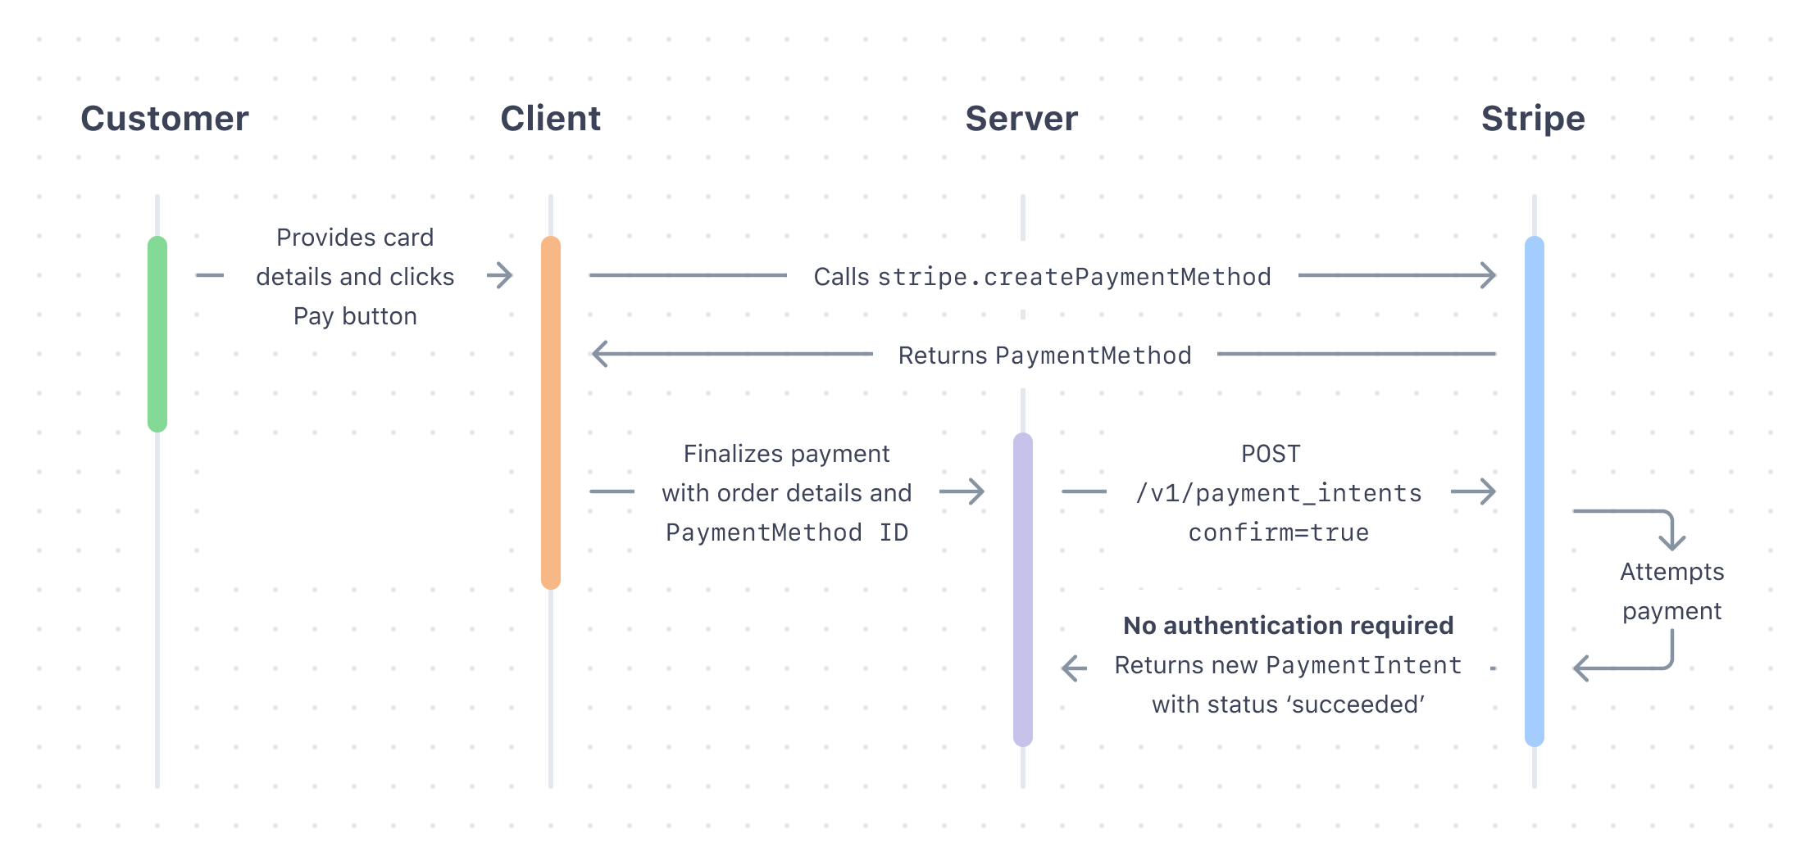
Payment
Stripe payment API used to subscribe the organizations and the service providers
It’s very secure and reliable payment gateway
It’s integrated with the server via the webhook

Slide 13
Administration
Used Django admin panel
Also help with the Dajango REPL shell

Slide 14
Security and safety
Security
Authentication and authorization
Email
Email security
Links security
Secure information
Logging

Slide 15
Authentication and authorization
Implemented using JWT with a different permission classes
Implemented from scratch

Slide 16
Email
Searching and personal operations performed using email

Slide 17
Emails Security
Detect disposable and risky mail addresses
Implemented using kickbox API

Slide 18
Links security
Using the API of the common web sandbox: urlscan.io

Slide 19
Store secure information
Sensitive information like usernames and passwords shouldn’t stored as a clear text, they should be secured
Implemented two way strong encryption using django Fernet cryptography library

Slide 20
Logging services
Implement a logging service that tracks all changes to workspaces; in order to increase accountability
It considers the time dimension

Slide 21
Future work
Chats system
Recommendations system
Reviews system
Reports system
Automatic fraud detection

