Slide 1
Human Following Robot
By :
                Sa’d Qamhiya
                Murad Nassif
                Shareef Tamimi
                Omyr Wahbe

Slide 2
Contents
      Introduction
      Why Shopping Cart
      Design Of System
      Work Principle
      Conclusion

Slide 3

Introduction
Having a cart that follows you in shopping markets that can carry the goods and move it in the various sectors of the market is such an incredible thing !

Slide 4
Why Shopping Cart
The wide range of using this application and the scarcity of these types of automated applications in our country, so from this point we decided to do such a project.

Slide 5
Advantages
Help people by carrying their own stuff.
Make the shopping process easier.
Save time during shopping process.
Make the shopping process more fun.

Slide 6
Design of the system
Our project consists of two main systems
    mechanical system
    electrical system

Slide 7
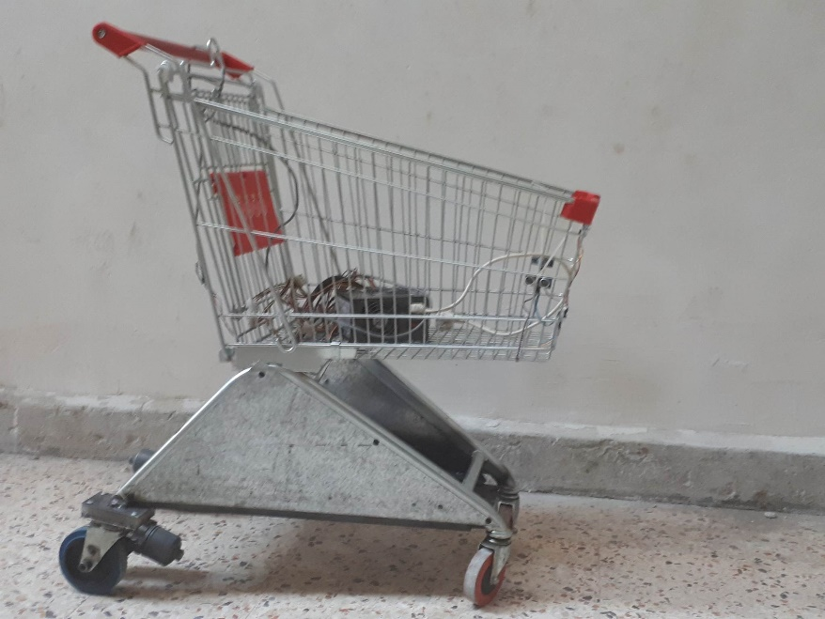
Mechanical System
Body
We chose the standard cart and with a mechanical modifications in a way that fits our purpose.
  Advantages
    Availability in the markets
    The most stable Design
    Economizing
Notes:
Installing the system to the cart that already existed will save us money

Slide 8
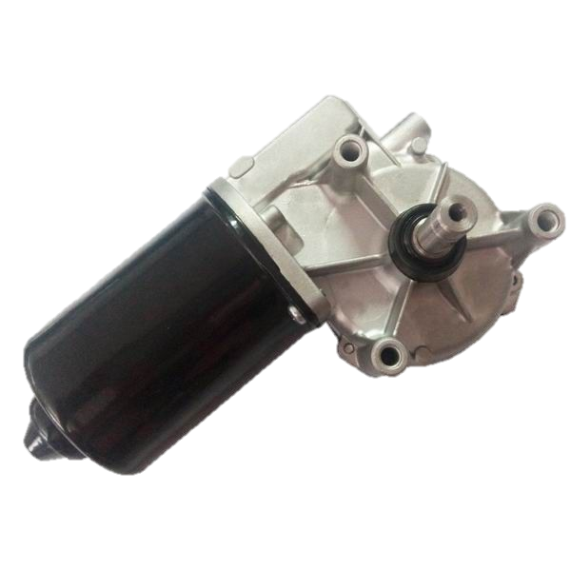
Mechanical System
Motor with a gearbox
Notes:
A torque of 29N.m and high torque with a low current, long life, glass fiber gears and that gives a high-wearing-resistance and low noise

Slide 9
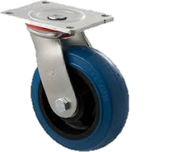
Mechanical System
Wheels
Notes:
Wheels have been adjusted to ensure the goal, built in bearing has been removed and replaced with an ocolon box to make the wheel rotates whenever the motor rotates

Slide 10
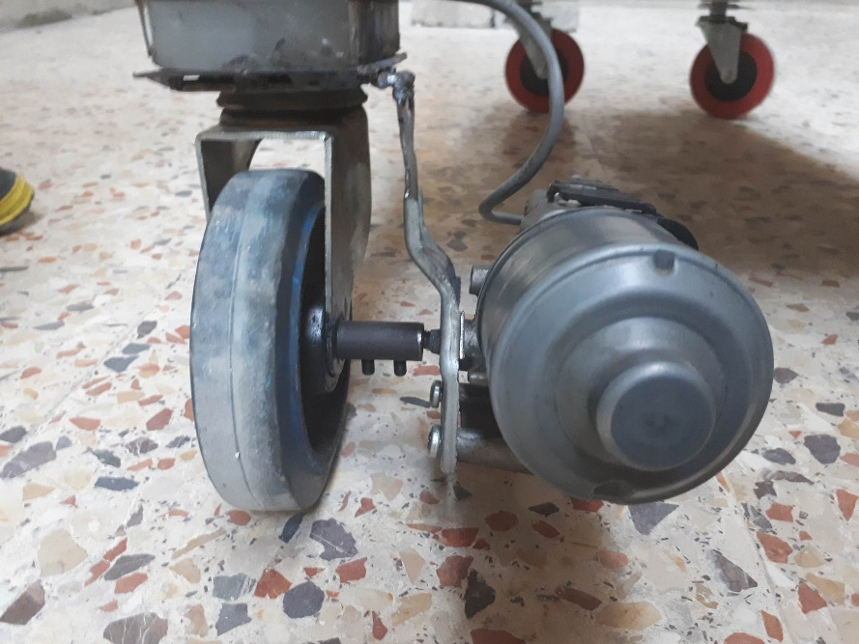
Mechanical System
Connection between wheels and motors:
Coupling, to transmit the power between motors and wheels with the lowest losses and highest efficiency, and a holder to attach the motor with the body

Slide 11
Mechanical System
Factors we depended on for choosing the motors:
  Walking speed for the adult.
  The diameter of the wheel
  The load that the cart will carry.
Notes:
0.5-1 m/s, 5 inch for the rear wheel, we assumed that the load is around 80 KG

Slide 12
Electrical system
Power supply (Battery)
Cart’s components
Hand chip

Slide 13
Electrical system
Power Supply

Slide 14
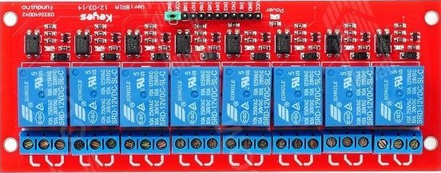
Electrical system
Cart’s components
Relays

Slide 15
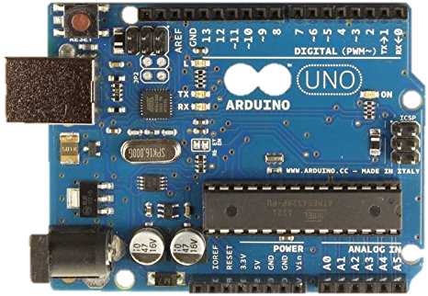
Electrical system
UNO-Arduino

Slide 16
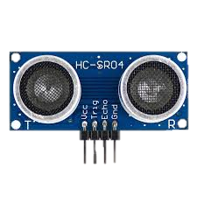
Electrical system
Ultra-sonic sensor

Slide 17
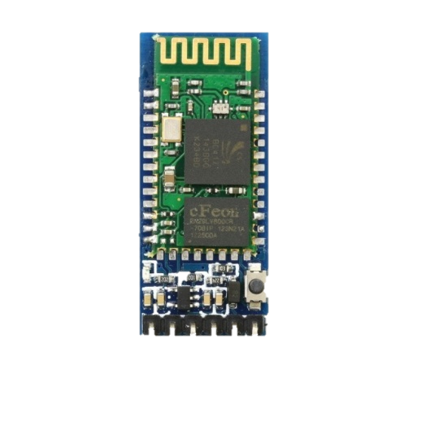
Electrical system
Bluetooth

Slide 18
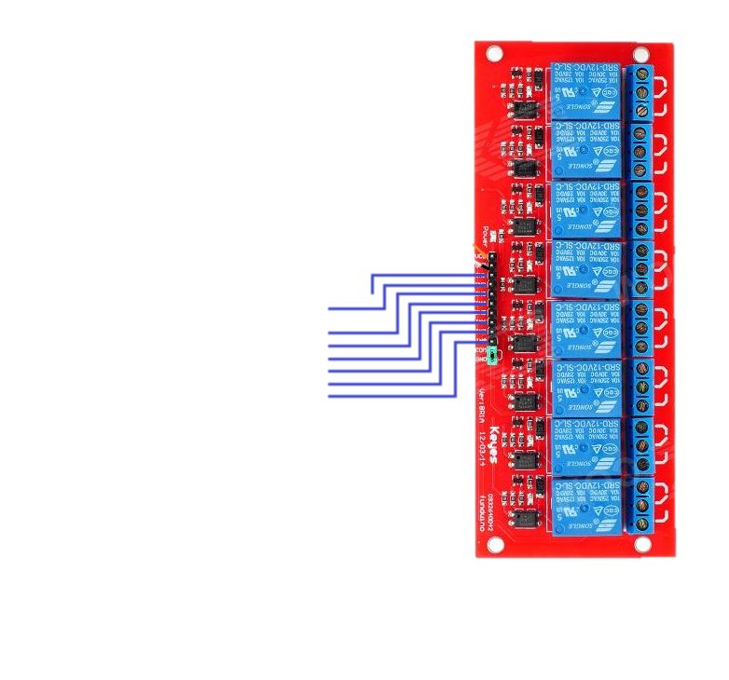
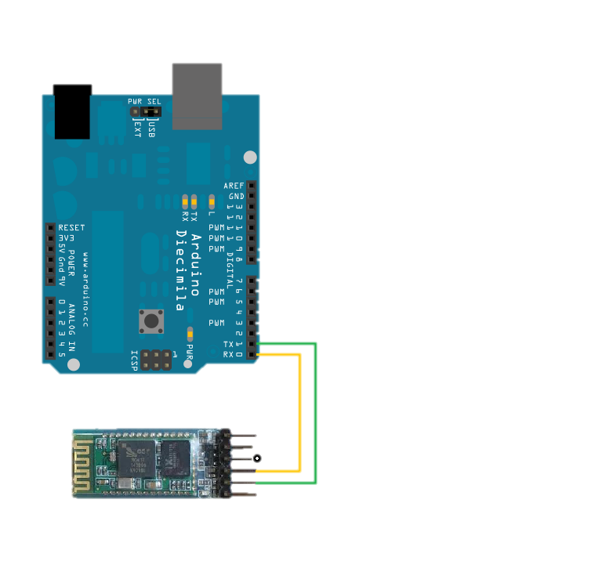
Electrical system
Cart’s circuit
This circuit consists of three electronic parts which are Arduino-UNO, Bluetooth and 8-Channel Relay,
Notes:
the figure below will describe these parts and how we connect them :

Slide 19
Electrical system
Hand chip components
Nano-Arduino
Gyroscope sensor
Bluetooth
9-Volt battery

Slide 20
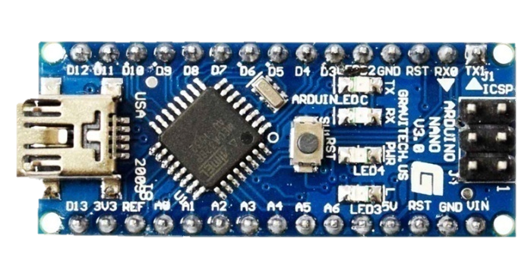
Electrical system
Hand chip components
Nano-Arduino

Slide 21
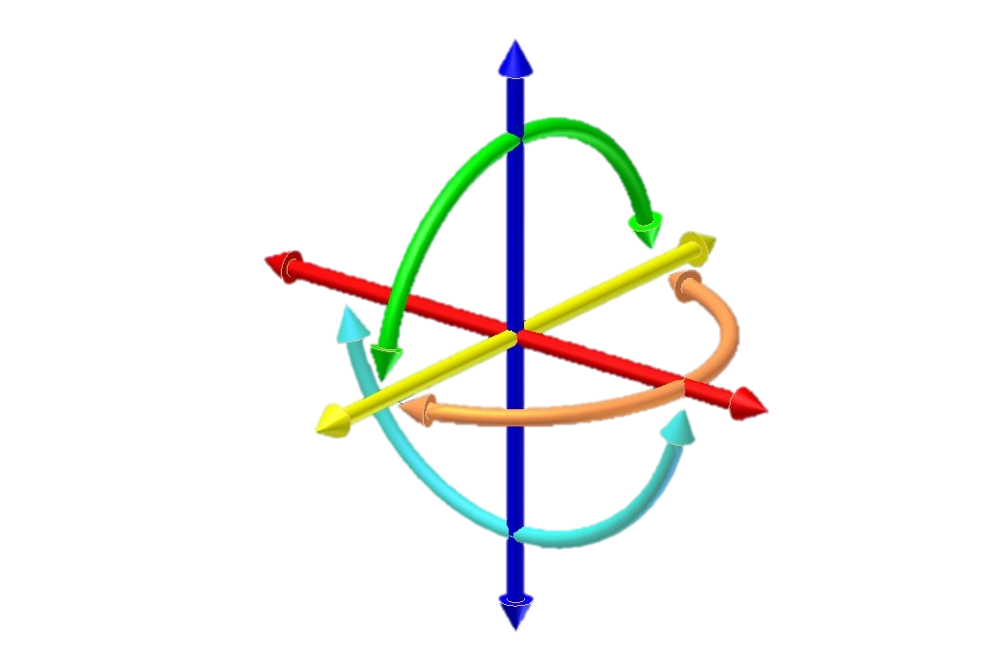

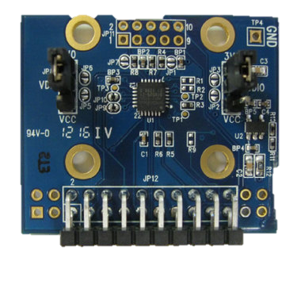
Electrical system
Gyroscope sensor
Gyroscope is a device that uses Earth's gravity to help determine orientation.

Slide 22
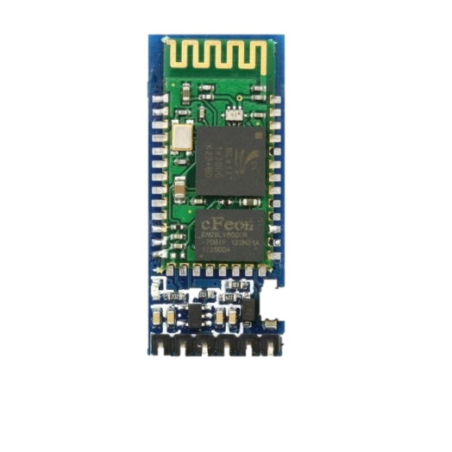
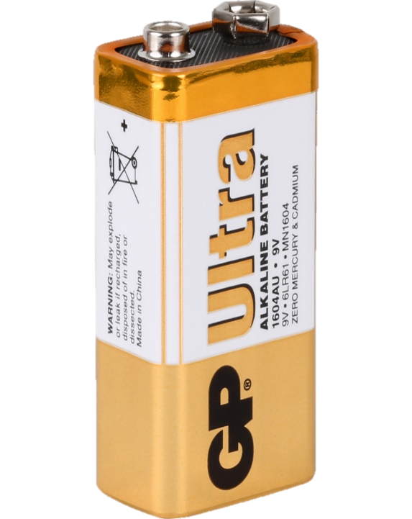
Electrical system
Bluetooth and 9-Volt Battery

Slide 23
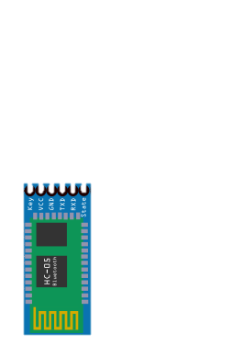
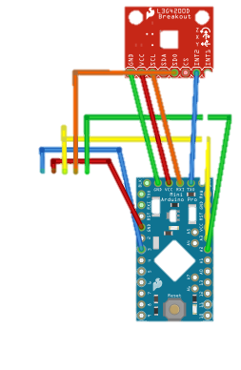
Electrical system
Hand-chip circuit
Also this chip consists of three electronic parts which are, Nano-Arduino, Bluetooth and Gyroscope sensor, the
Notes:
figure below describe these parts and how we connect them:

Slide 24
Hand-chip
We saw that the best way to put this chip with the user is to make this chip as a watch as follow:

Slide 25
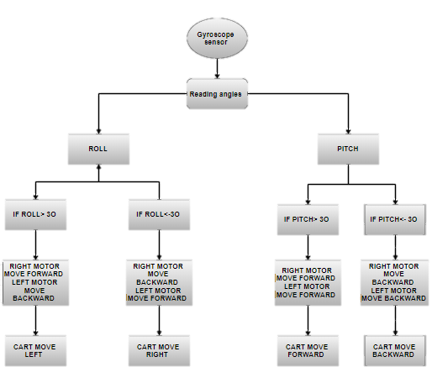
Work Principle

Slide 26
Conclusion
Gave an overview about the project.
Defined the major parameters.
Techniques of the project
Advantages.

