Slide 1

Networks Educational System:
Annotation – Based Learning
Observe by: d. Amjad Hawash
Sanabel Sultan & Duaa Dabeek ( CS Department)
Shahd Awwad ( NIS Department )

Slide 2
Problem
1. Difficulty in Clarifying Concepts
2. Inefficient Content Navigation
3.Absence of Immediate Clarification
4. Missed Opportunities for Continuous Improvement

Slide 3
Solution
1. The system provides short quizzes or videos directly from terms, promoting self-paced learning.
2. Allowing users to comment on keywords, making it easier to revisit and review.
3. Quick access to quizzes or videos, receive immediate clarification and support.
4. The system actively incorporates user feedback, allowing for iterative updates and improvements.

Slide 4
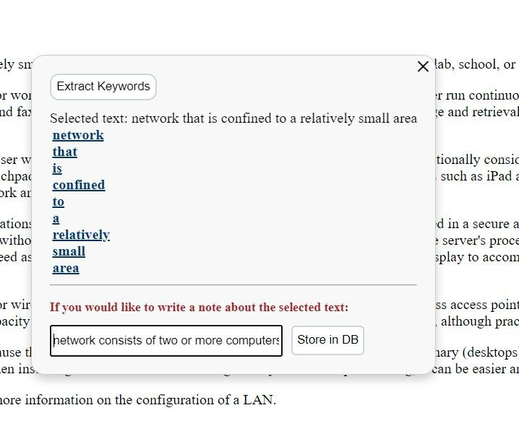
What is Annotation-Based Learning ?
An Annotation-Based System is a software or technological framework that revolves around the ability to add comments. This system allows users to mark, highlight, or annotate specific sections of text, adding a layer of personalized and interactive engagement.

Slide 5
Component
Annotation Feature
User Account
User Interface
2. Annotation Feature
3. User Account
4. Keyword Extraction
5. Tell My Friends
6. Learning Resources
Keyword Extraction
Tell My Friends
Learning Resources
User Interface

Slide 6
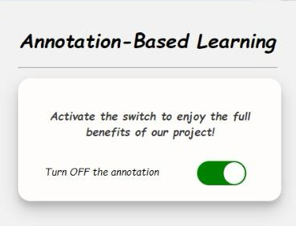
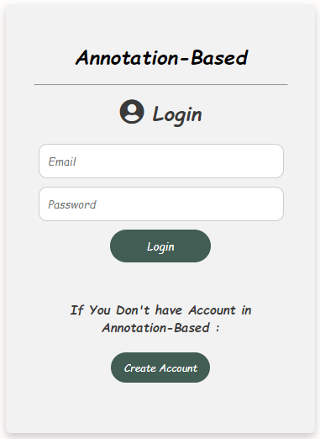
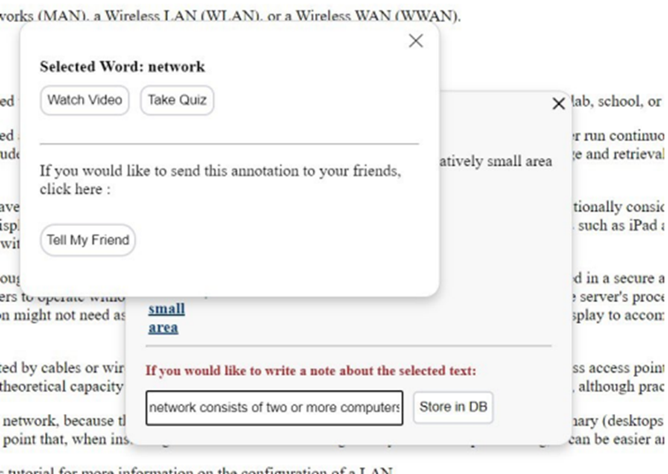
User Interface
2
3
1

Slide 7
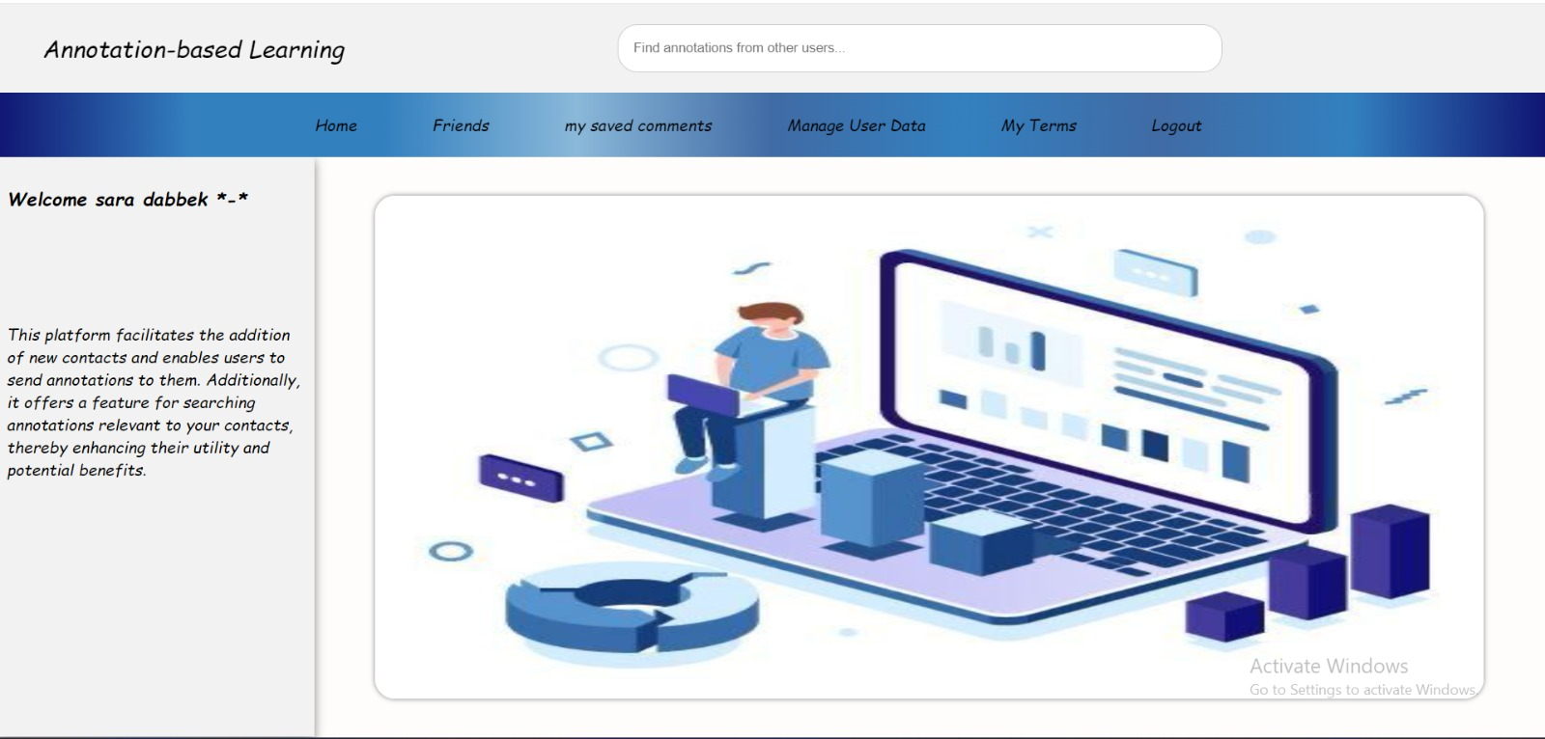
User Interface
Graphical interface for interaction with the system.

Slide 8
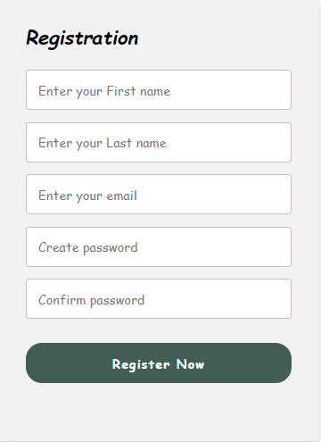
User Account
Manages user , personalized learning experience.
Upon activation, the Annotation Feature interacts with the User Account to handle user authentication and track user-specific data.

Slide 9
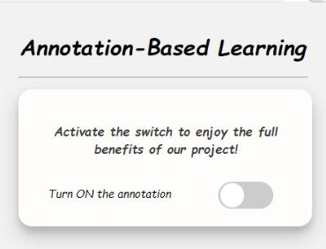
Annotation Feature
The core component activated by the user, Active or De active.
The Annotation Feature is triggered by user activation through the User Interface.

Slide 10
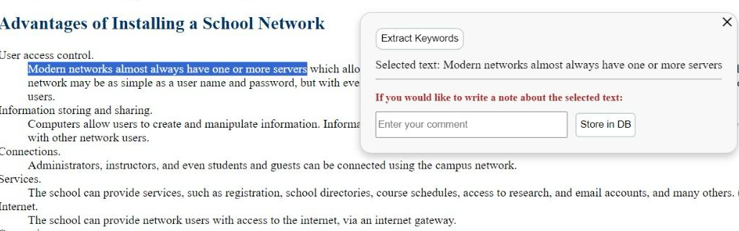
Keyword Extraction
When active annotation feature, user can select any text from any website and interaction with text.
After select text, the system show PopUpWindow contain selected text with two service:
Extract keywords and store in DB.

Slide 11
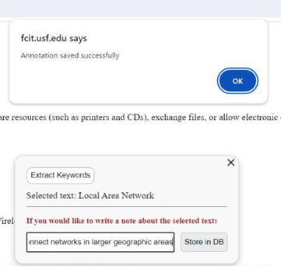
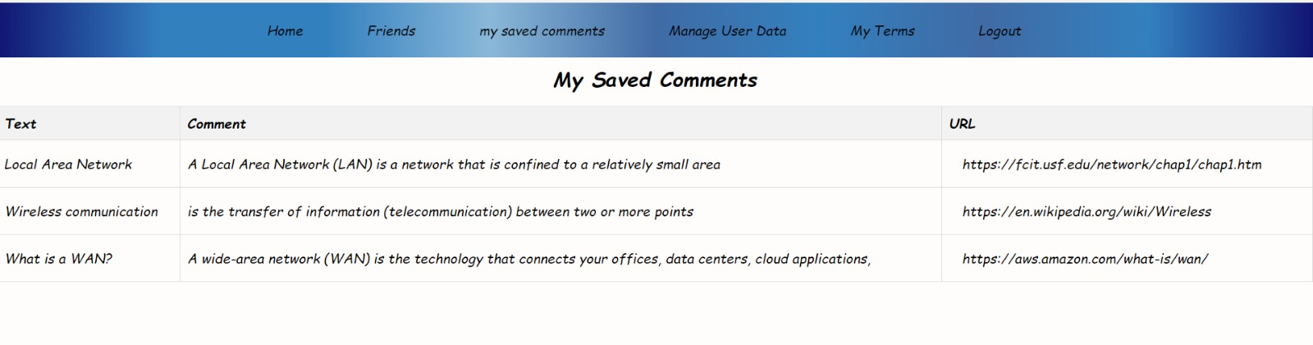
Keyword Extraction:
Store in DB
When some text is selected
you can add comment
at this selected text and save
it as interaction for user.

Slide 12
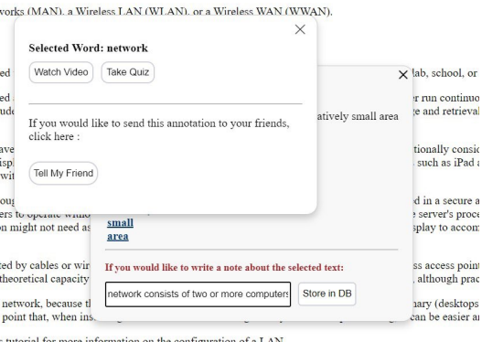
Keyword Extraction
When clicked on Extract Keywords
Show list of keywords from selected text.
When click on any keywords from list, show three options.

Slide 13
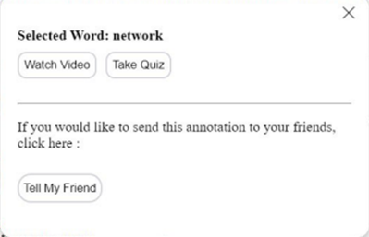
Keyword Extraction
When a user clicks on one of these terms once the terms have been extracted, the system can provide three distinct services depending on the clicked term:
Watching YouTube videos.
Involve in a quiz.
Suggest the term to the
user’s friends.

Slide 14
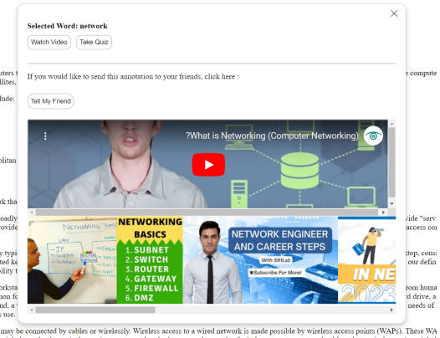
Keyword Extraction :
Watch video
Watching YouTube videos
about the term a user clicked
on is the first service.
Within the same annotation window is a list of linked videos.
The user can select any video that explain the term clicked on.

Slide 15
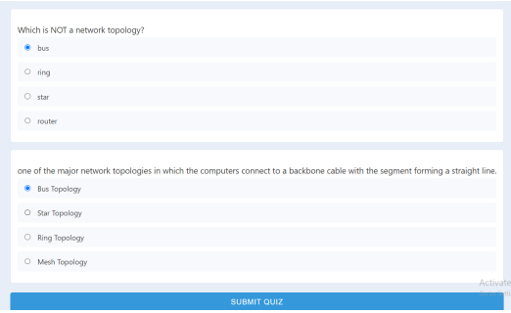
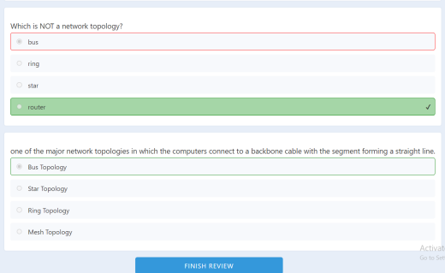
Keyword Extraction :
Take quiz
The system is capable of creating a
series of quizzes that the user can respond to.
quiz contain 5 random questions that related term clicked on.
After which the system makes the necessary corrections and produces a report with the user’s responses.
The system show result of quiz and can review quiz to show correct answer.

Slide 16
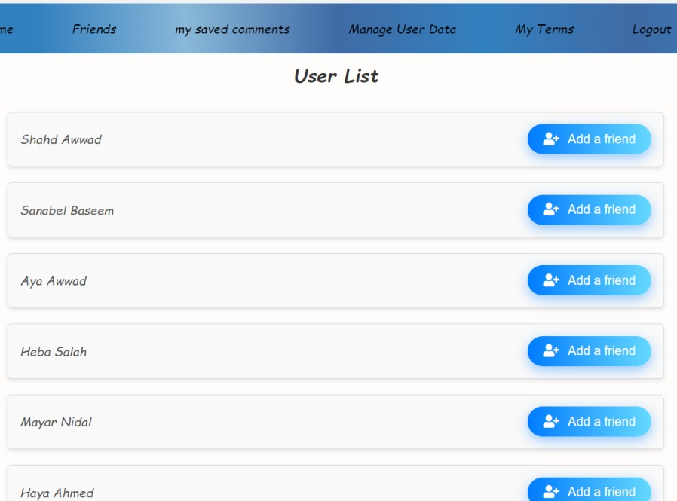
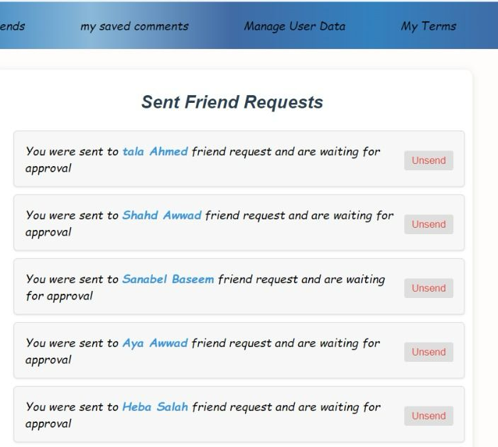
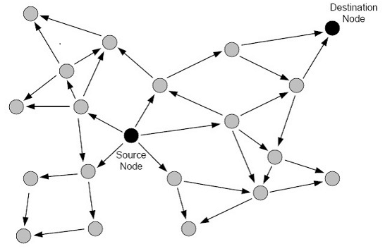
Tell My Friends ( network flood .. Algorithm )
Sent friend Requests contain sent requests to users.
The user list contains suggested friends, and the user can add them.

Slide 17
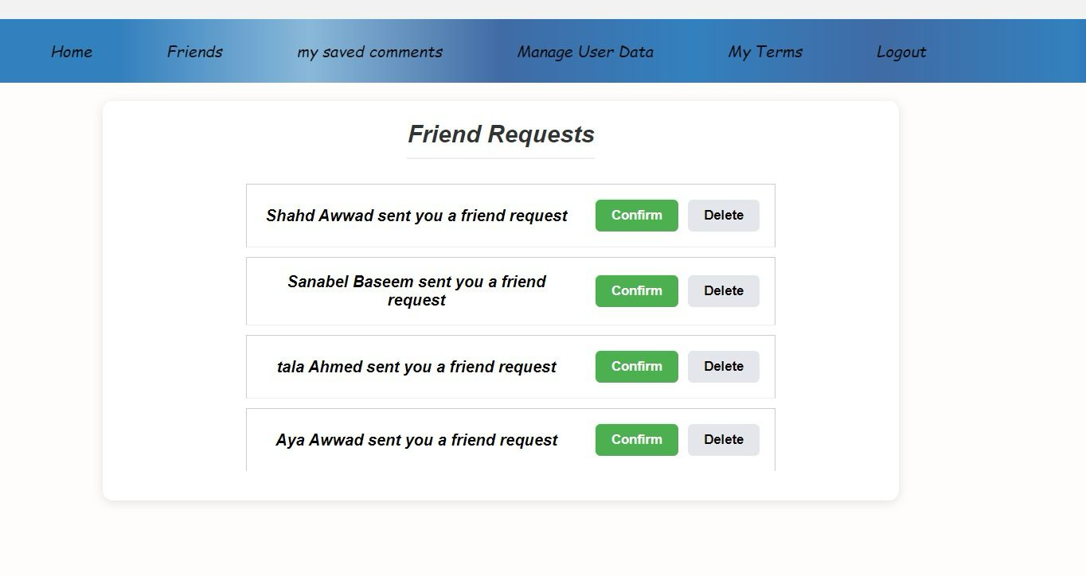
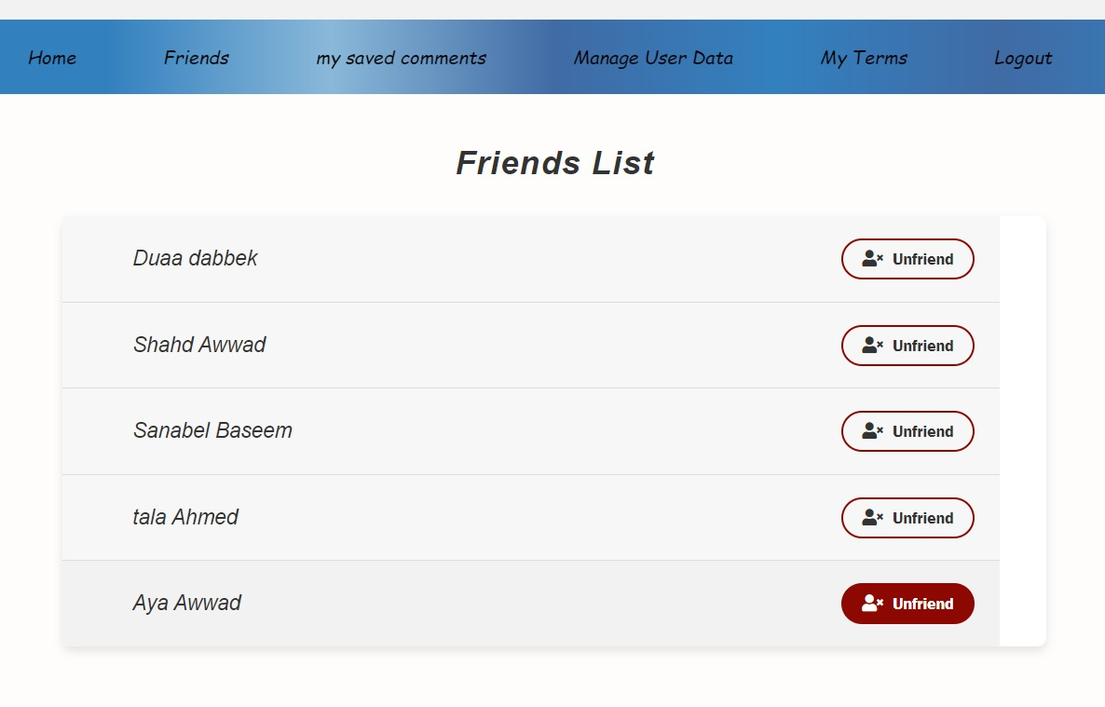
Tell My Friends
The friends list includes the user's friends.
Friend requests are requests received by the user, and the user has the option to accept or delete the request.

Slide 18
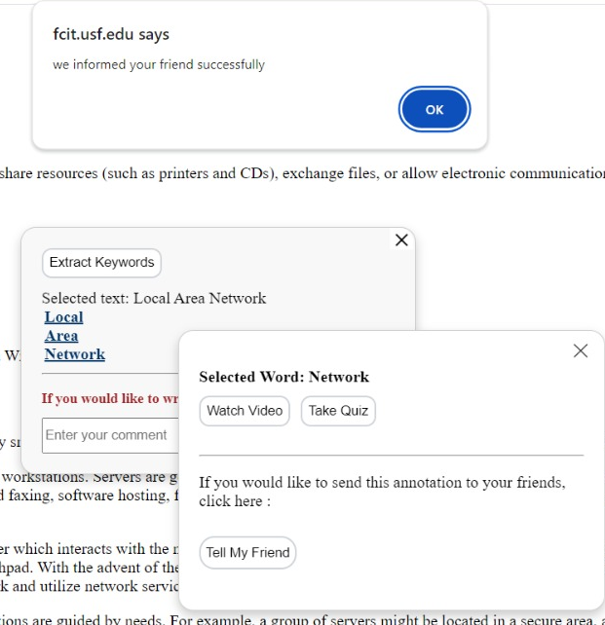
Keyword Extraction:
Tell My Friends
Enables users to easily share keywords with friends and ensures that the shared content is accurately delivered to the intended recipients.

Slide 19
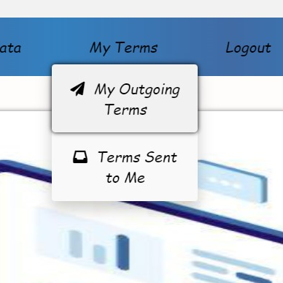
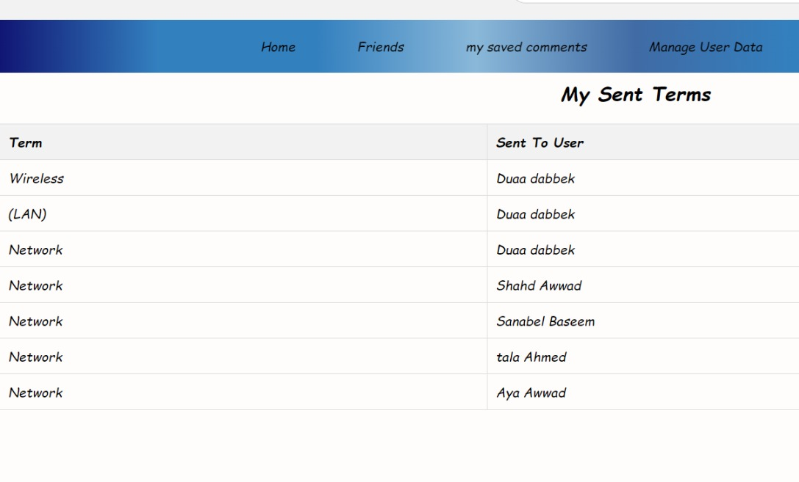
Tell My Friends
The “My Outgoing Terms” feature in the interface helps me keep track of the terms I have shared with my friends.

Slide 20
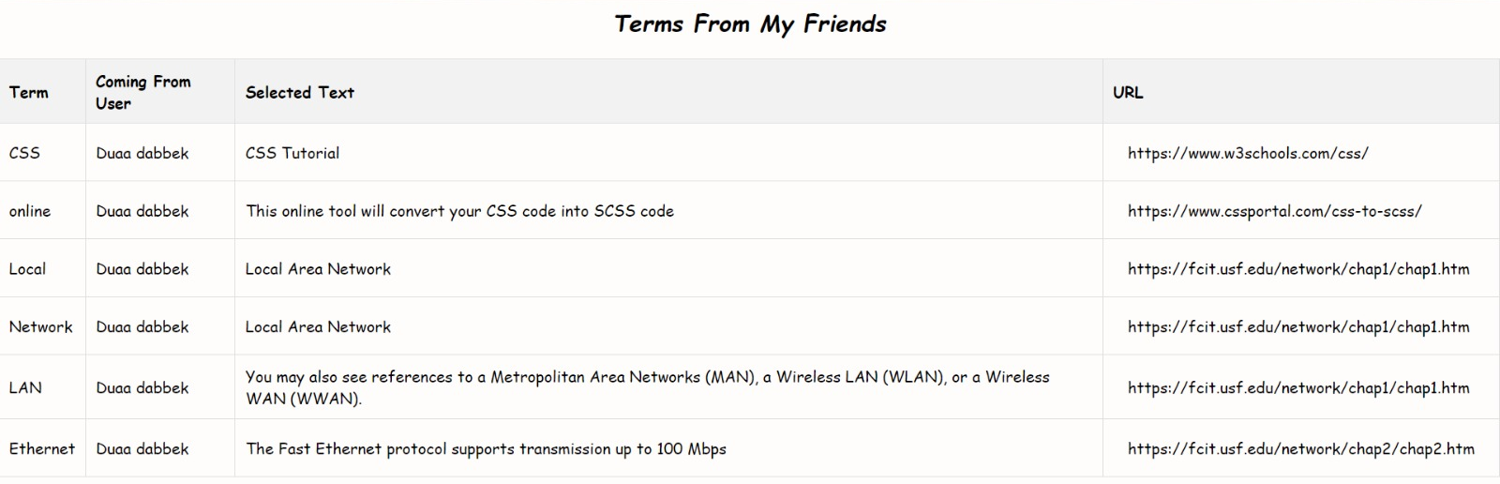
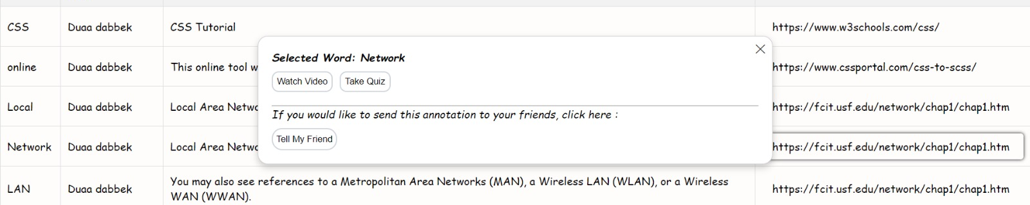
Tell My Friends
Users can interact with any term they receive from their friends. When they click on a term, they can take various actions such as watching a video, taking a quiz, or sharing with their friends.
1
2

Slide 21
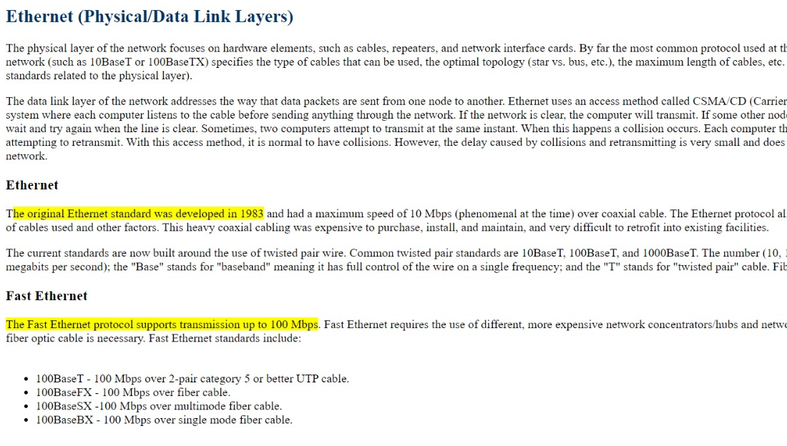
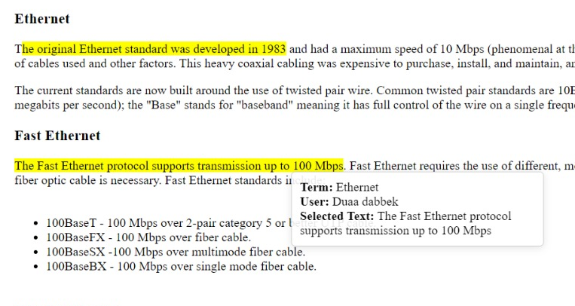
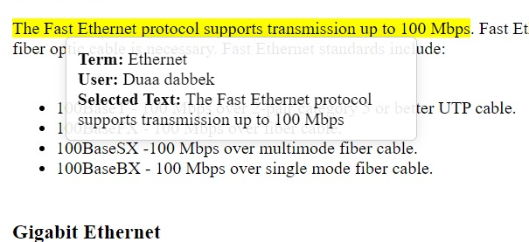
Tell My Friends
When open any website that users visit it and shared terms with others.
All selected text are highlight with user, term shared and selected text.

Slide 22
Learning Resources
Houses interactive learning materials, quizzes and questions.
The User Interface facilitates navigation between the annotated text, extracted keywords, and the associated Learning Resources.
The Learning Resources component, based on user interactions and preferences stored in the User Account.

Slide 23
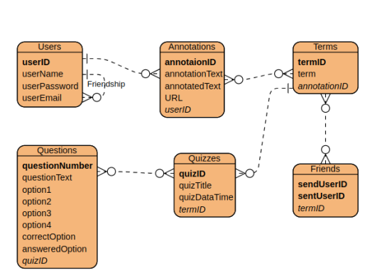
ER-Diagram
“learning Resources” include quizzes and questions store in database
ER- Diagram for data

Slide 24
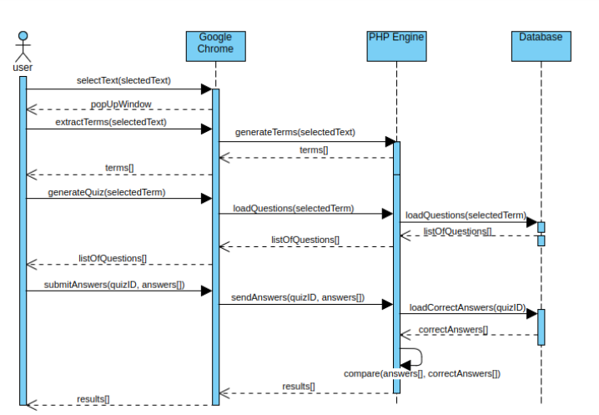
Sequence Diagram

Slide 25
Conclusion
Through interactive features, collaboration, and adaptability, the system empowers users to actively participate in their learning journey.
The emphasis on personalization and continuous improvement reflects a commitment to providing a dynamic and effective tool that evolves with the ever-changing landscape of education.
With this system, we aim to create an engaging and inclusive learning environment that caters to the diverse needs of educators and learners alike.

Slide 26
Future work
1. Chat box.
2. Automating Quizzes creation.

