Slide 1
Guardians -Within

Slide 2




Problem | opportunity
  Huge gap between theoretical material Vs. practicality in current educational curriculum.

Slide 3

Education
Should be enhanced with practice, as practice can turn an amateur to a master

Slide 4




Solution
  Combining theoretical knowledge in fun attractive game.

Slide 5
Value Proposition
An Educational game
Implemented in virtual environment
Simulate human biology
Create better visualization of theoretical knowledge related to human body

Slide 6

Revealing Magic
Guardians –Within
  Simulate human body
  Our Guardian wander around the body to protect it
  Solves the case of Tuberculosis

Slide 7
Guardians - Within
Marathon
Lymph nodes
Lung savior

Slide 8
1.
Marathon
Running through Blood Vessel Gates before
the end of timer

Slide 10
2.
Lymph Nodes
Kill all Viruses to clean up the nodes

Slide 12
3.
Lung savior
Final combat between Guardian and Tb
Bacteria cells

Slide 14
Target Market
Based on market studies conducted to measure the ability of students to understand and interact with Guardians-Within
Kids of age
13 - 16

Slide 15
43.5 million
VR users World Wild now
According to KZERO researchers

Slide 16
700,000,000$
15,000,000 users
By 2020
That’s a lot of money
And a lot of users
So near

Slide 17
Business Model
Channels
Distrubite it in schools
Children clinics
Application stores
Revenue Market
Sell a package of different illnesses levels with the ability to get new packages
Provide a simplified version with payed upgrades to get any disease package

Slide 18


Competition
 | 3D enviroment | Virtual Reality | Cross platform
Gurdians - Wthin
Dr. Nano
The human body game

Slide 19
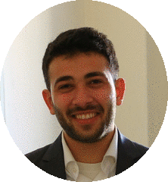
Our Team

Slide 20
Financial Projection

Slide 21
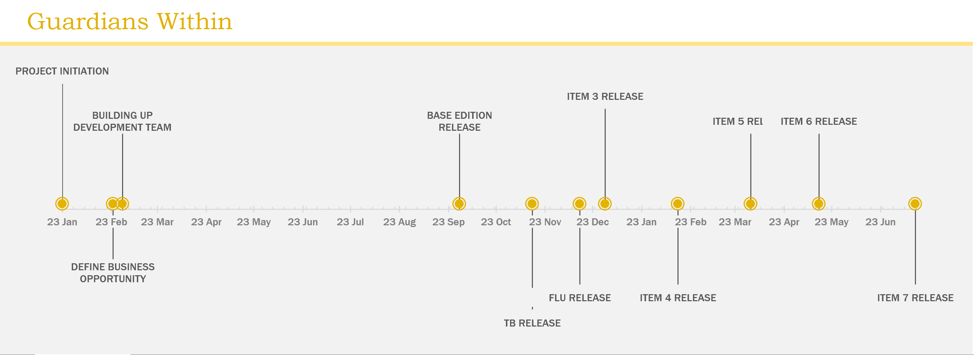
Timeline

Slide 22
OUR PROCESS
1.
Ideation
2.
Initial prototype
3.
Market Feedback

Slide 23
THANKS!
Any questions?

