Slide 1
Vertical/rotary car parking system
Supervisor: Dr. Samer Mayaleh
Introduced by:
Ammar Bannan
Majde Zagha
Yasir Tobbileh

Slide 2
Outline
Introduction.
-Basic Component :-
* Mechanical Component.
* Electrical Component.
Flow chart.
Work done.
Problem Statement
Advantages & disadvantages
Cost
Future work & conclusion

Slide 3
Introduction
What is the main objective of the project?
Types of parking System :-
Puzzle Automated Parking System
Shuttle Automated Parking System
Optima Parking system
Crane Automated Parking System
Vertical car parking system
Circular/multi level/tower car parking system

Slide 4
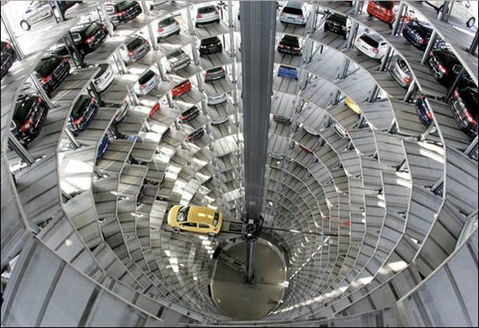
Circular/multi level/tower car parking system

Slide 5
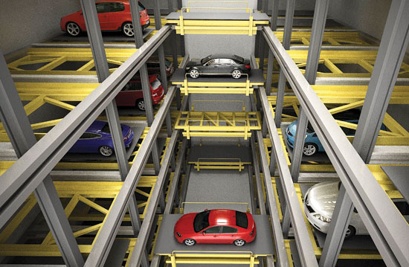
Shuttle Automated Parking System

Slide 6
Introduction
Why we choose vertical/rotary parking ?
Why we made a new Design ?

Slide 7
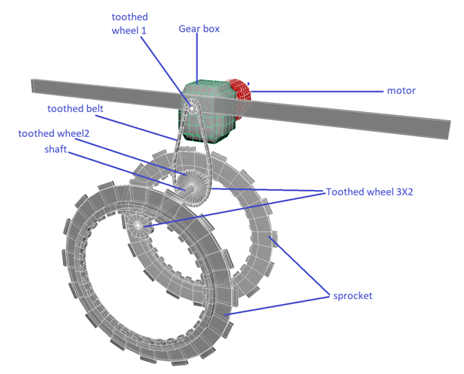
Basic components
Mechanical components
Gear

Slide 8
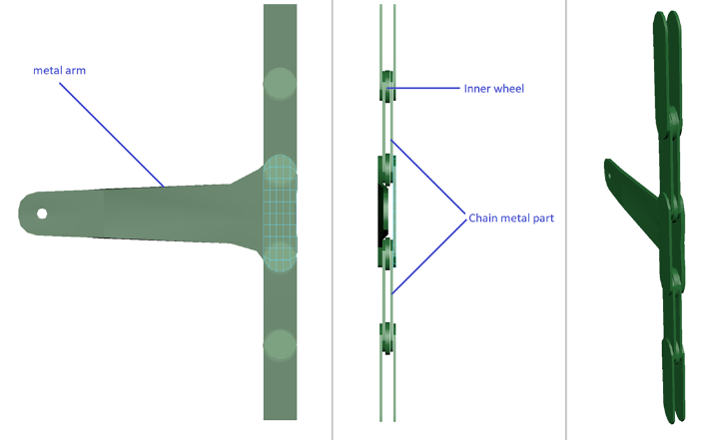
Mechanical components
Roller chain

Slide 9
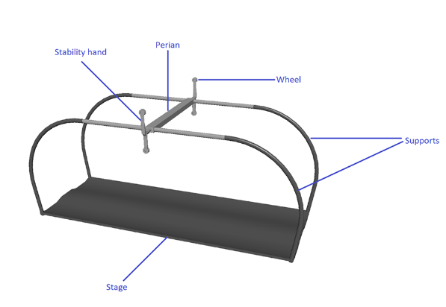
Mechanical components
Pallet

Slide 10
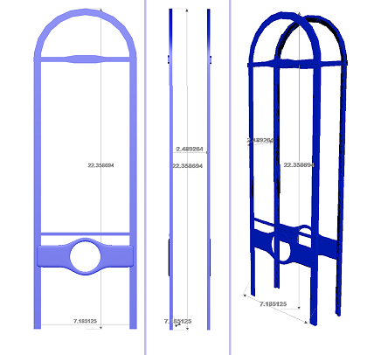
Mechanical components
outer frame

Slide 11
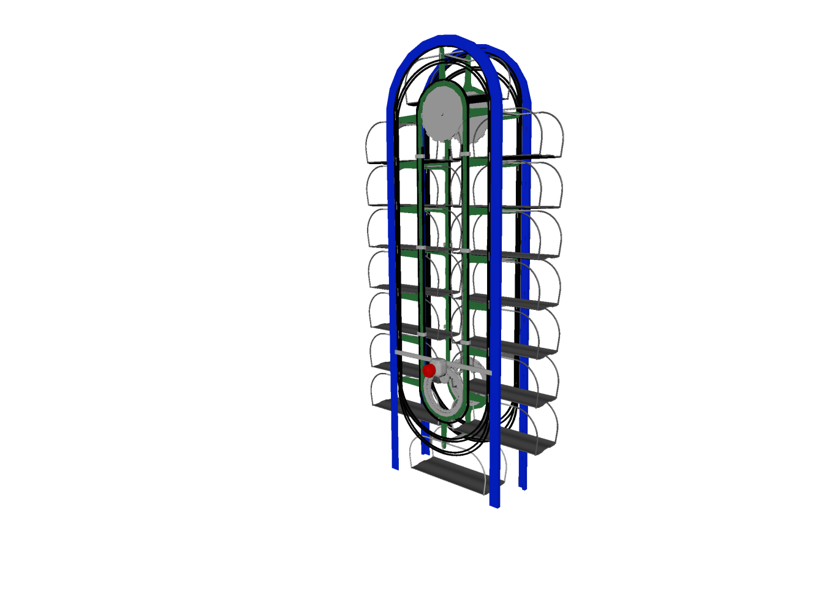
System overview

Slide 12
Basic components
Electrical components
Electric motor
Variable frequency drive (VFD)
Soft starter
Relays and contactors circuit
Safely circuit breaker for motor
Sensors
LCD interface
PLC

Slide 13
Electrical components
Electric motor
3 phase induction motor
Why we choose induction motor over synchronous motor?
-No DC excitation required
-No Starting mechanism
-less maintenance, economical and reliable
-Cheaper
-Size from 1 to thousands of hp

Slide 14
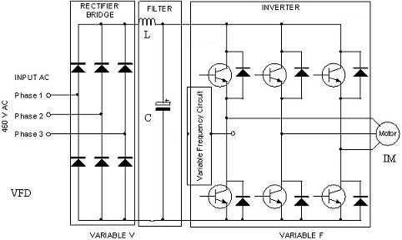
Electrical components
Variable frequency drive (VFD)

Slide 15
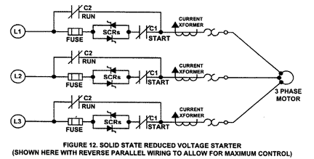
Electrical components
Soft starter

Slide 16
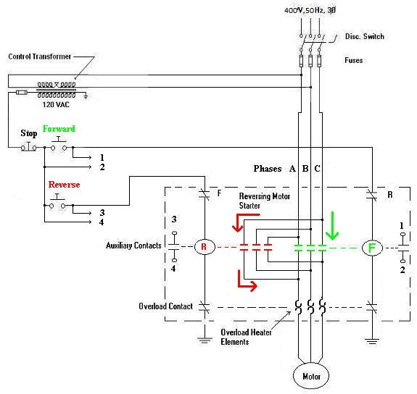
Electrical components
Relays and contactors
circuit.

Slide 17
Electrical components
Safely circuit breaker for motor
KVA motor code: G (5.6-6.29) KVA/HP at * starting
Irated =Pin/ ((3^{1/2})* VL *pf)
=18500/ 1.73*400*0.85=33.32A
S= KVA motor code* HP
=5.9*25= 148.625 KVA
Istart= 148625/ ((3^{1/2})*400) = 214.5A
ICB>Istarting ICB>214.5A ICB=225A

Slide 18
Electrical components
Sensors
IR
Limit switch
Proximity sensor

Slide 19
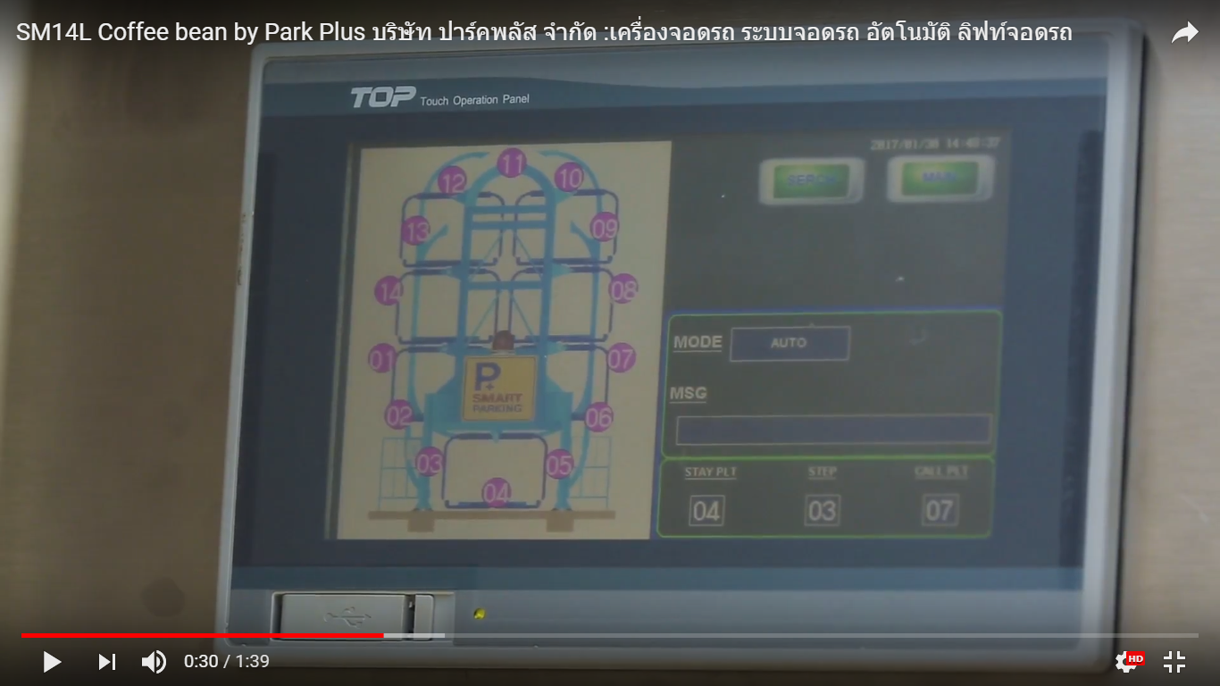
Electrical components
LCD interface

Slide 20
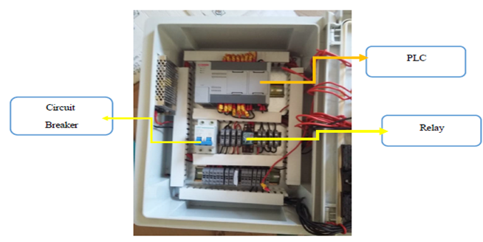
Electrical components
PLC
Why we choose
PLC?

Slide 21
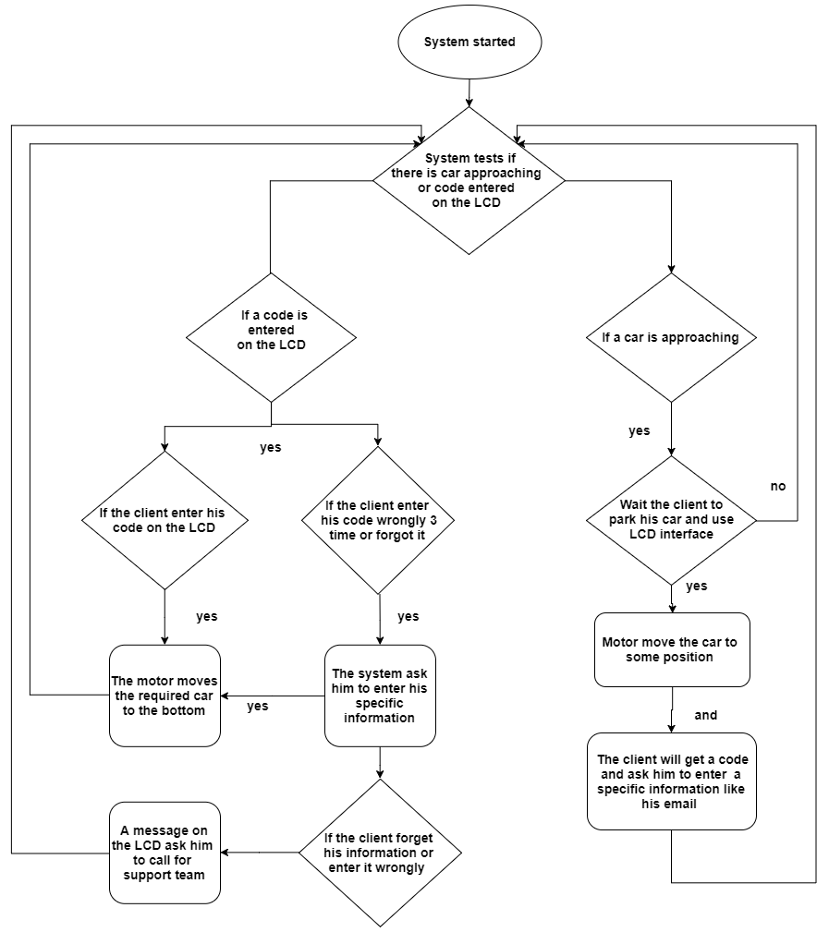
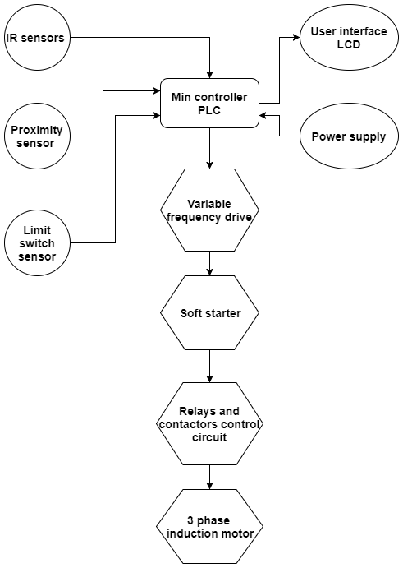
Flow chart
System components and PLC I/O
System operation sequences

Slide 22
Work done
New design
Modulation for system and transfer function
Torque calculations
Calculation for circuit breaker

Slide 23

Problem statement
*The first problem is the stability of the new design
* The second problem is how to move the system at a constant speed with different weight and torque

Slide 24
Advantages
Easy installation
Powerful software
Independent operation
Easy to relocate
Multiple entry points
Save and earn money
Easy to scale
Little space required
Long lasting system

Slide 25
Disadvantages
There is no safety code in our country
It has refused to give a statement to the implementation of this project in the recoil distance
The possibility of providing the type of suitable pieces in our country

Slide 26
cost
Total Cost | Cost per piece | Quantity | Equipment
600$ | 600$ | 1 | 3 phase Induction Motor
320$ | 320$ | 1 | Programmable Logic Controller (PLC)
200$ | 200$ | 1 | Circuit Breaker (C.B) 200A
50$ | 50$ | 1 | Relay
200$ | 200$ | 1 | Drive Multi-Function (VFD)
8$ | 8$ | 1 | Proximity sensor | Sensors
8$ | 8$ | 1 | Limit switch sensor
384$ | 24$ | 16 | IR sensor
400$ |  |  | Sensors total cost
2000$ | 1000$ | 2 | Cast Iron ( Outer Frame )
1000$ | 62.5$ | 16 | Cast Iron (Pallets)
1100$ | 550$ | 2 | Chain
700$ | - | 4+16+16+16 | Sprocket , "L" Shaped connector and Bush Bearing
6400$ | Total cost

Slide 27
Future work and conclusion
Build a small model.
Programming the PLC using ladder diagram.
Use a SCADA program to monitor and control the system.
Make simulation using MATLAB.

Slide 28


