Slide 1

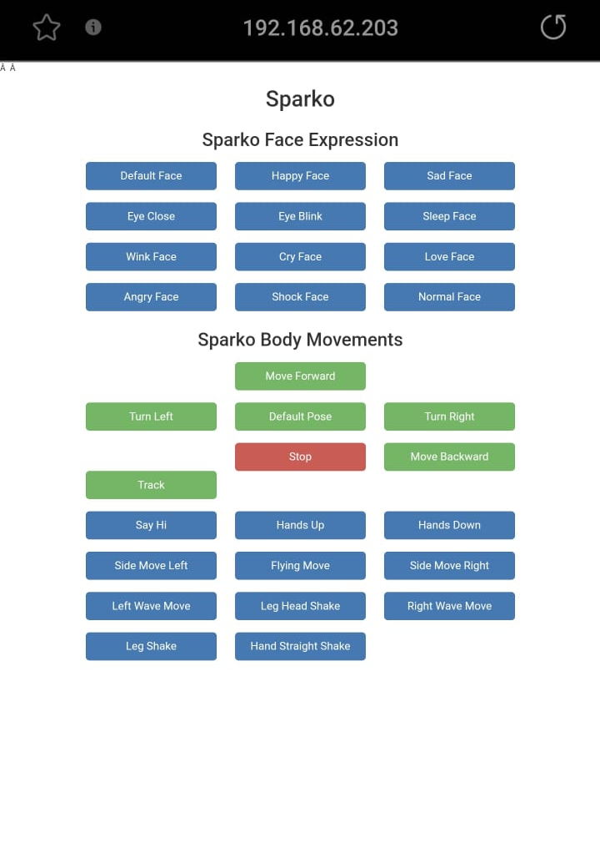


GRADUATION PROJECT 2:
Sparko: Unleashing the Potential of Smart Robotics
Supervisor
Presented By
Dr. Luai Malhis
Abdallah Khayat
Salahaldin Shehada

Slide 2
TABLE OF CONTENT
Introduction
01
Design and Development
02
Components
03
Specifications
04
05
Limitations
Features
06
Future Work
07
Conclusion
08
Acknowledgement

Slide 3
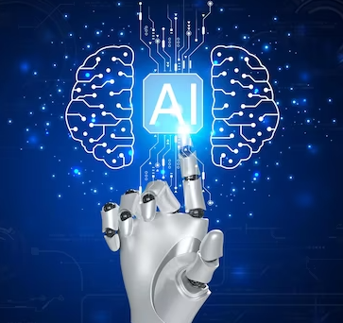
INTRODUCTION
General Background:
Evolution of AI and robotics in modern society.
Importance of smart robotics assistants for easier daily life.
Objectives:
Develop Sparko to perform multiple tasks:
Interactive communication.
Movement control.

Slide 4

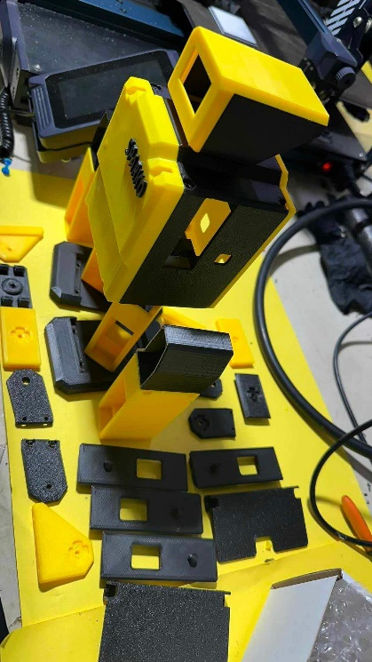
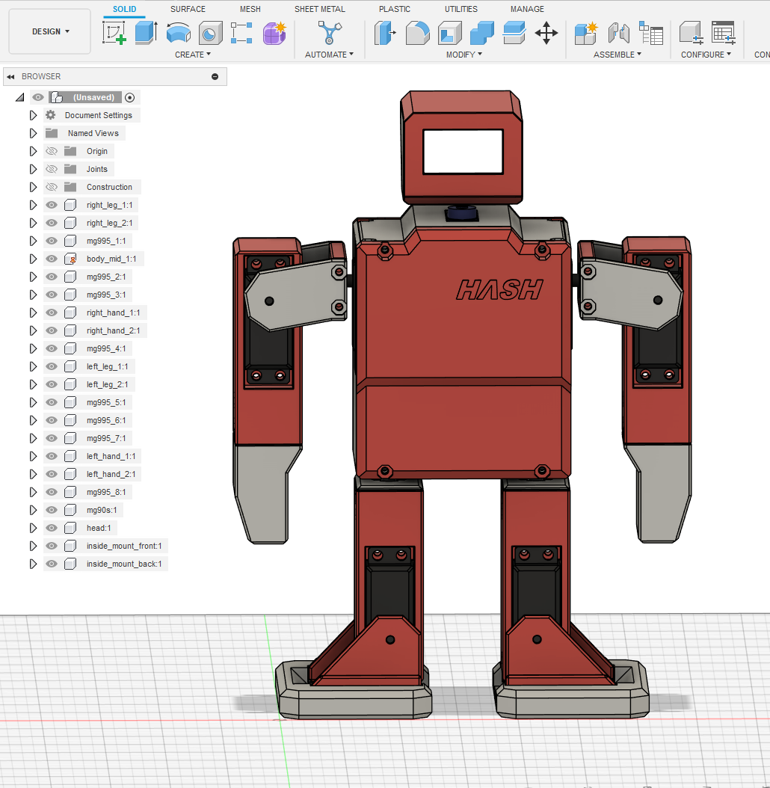
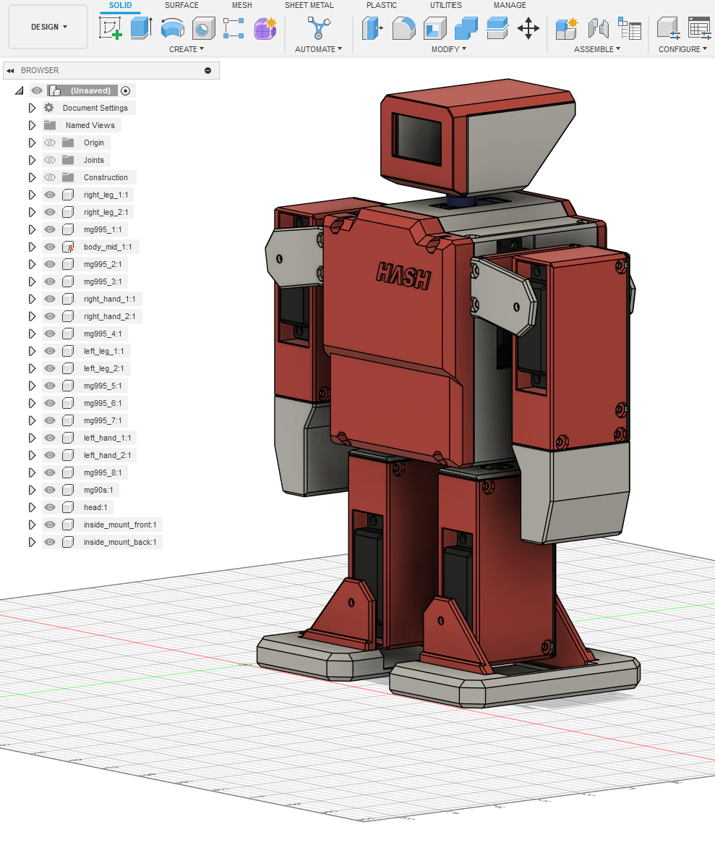
Design and Development
1
Built using 3D printed components.
designed using (Autodesk Fusion).

Slide 5
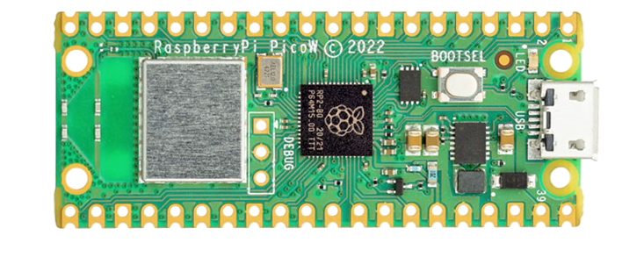
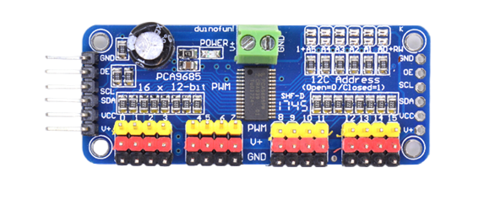
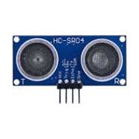
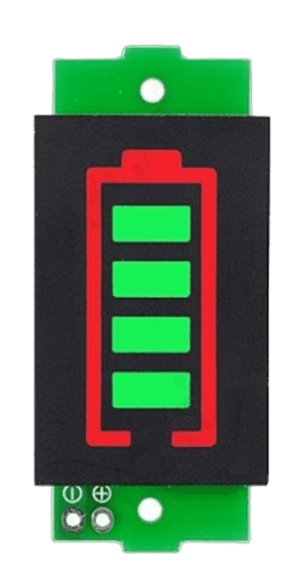
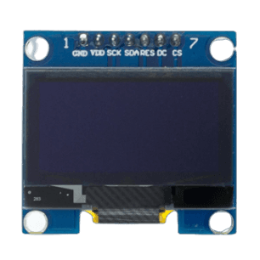
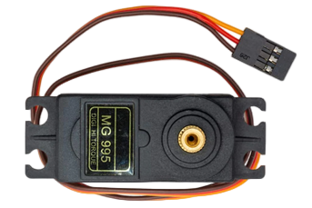
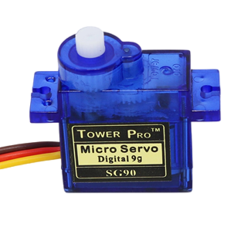
Movement control components
Components
2
PCA9685
Ultrasonic sensor
Raspberry Pi Pico W
MG995
SG90
OLED LCD
Battery Indicator

Slide 6
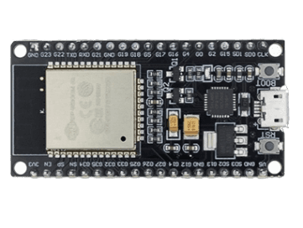
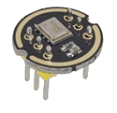
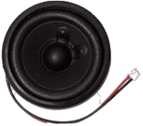
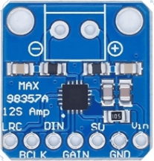
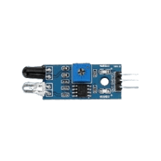
Voice chat components
ESP32 MODULE
INMP441 microphone
Speaker
MAX98357A
IR Sensor

Slide 7
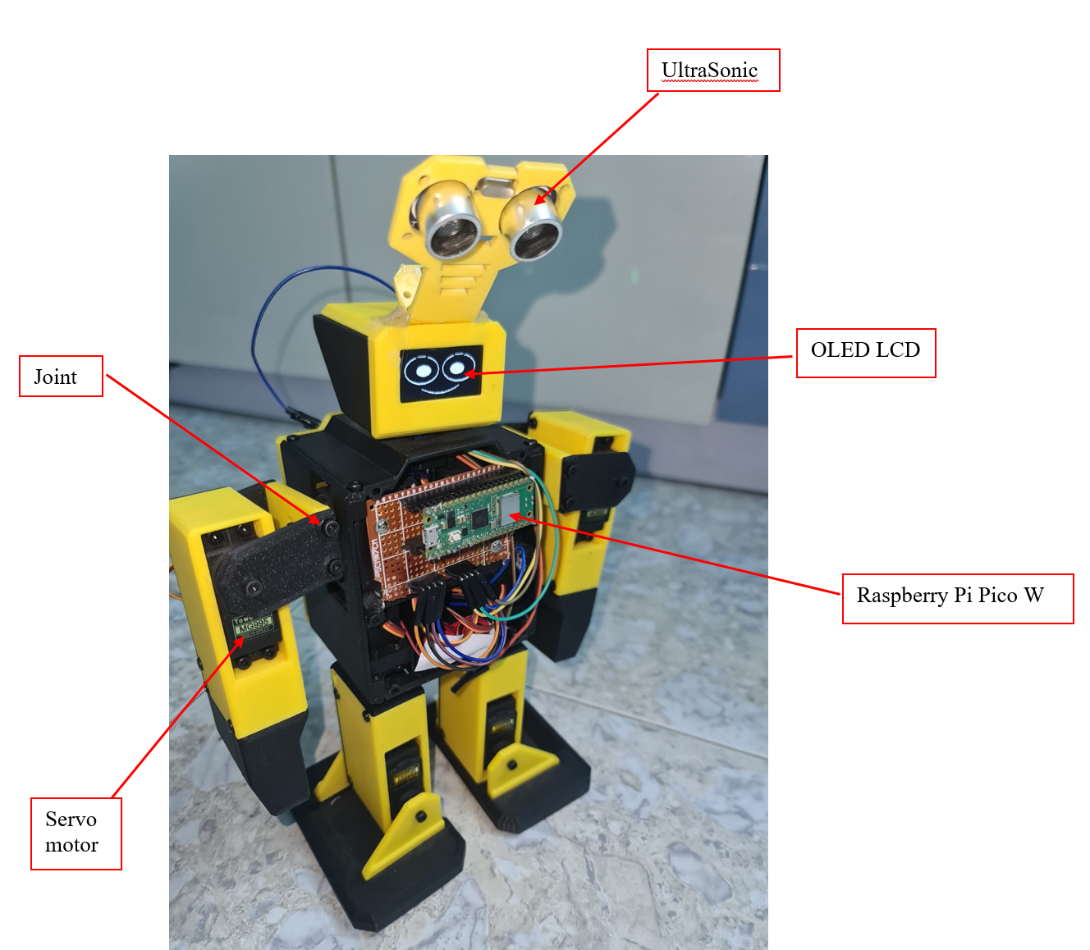
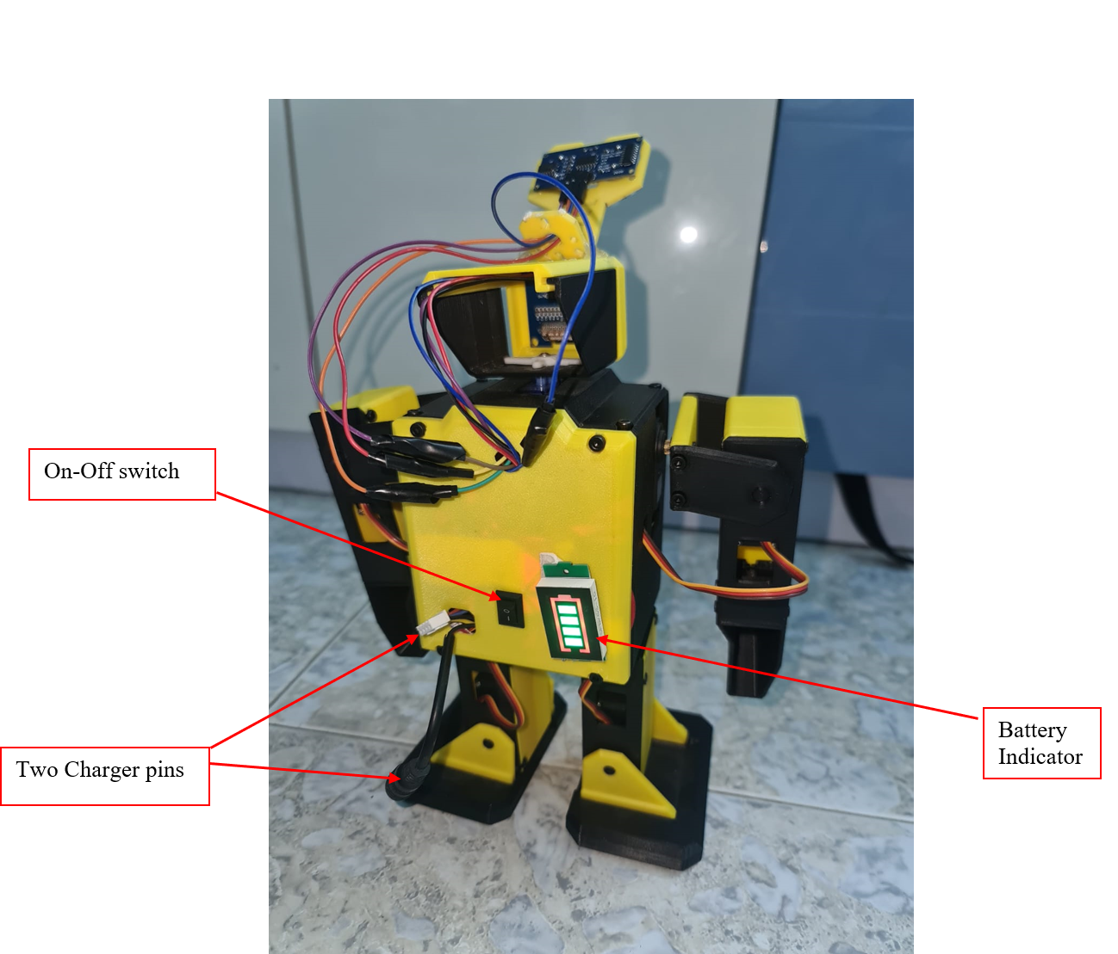
Specifications
3

Slide 8


Features
4
Movement Control:
9 servo motors for flexible movements.
Controlled via WiFi on local network.
Facial Expressions:
LCD screen on the head for displaying facial expressions.
Obstacle Avoidance:
Ultrasonic sensor for detecting and avoiding obstacles.
Interactive Voice Communication:
ESP32 modules for speech recognition and response using Google Cloud API and ChatGPT API.

Slide 9
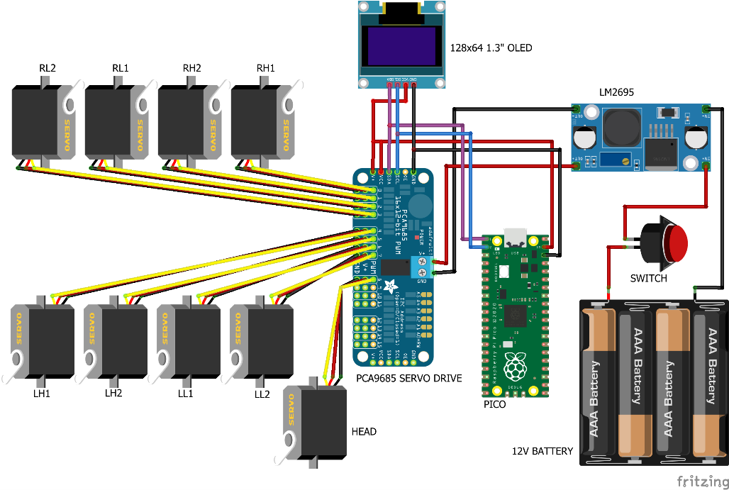
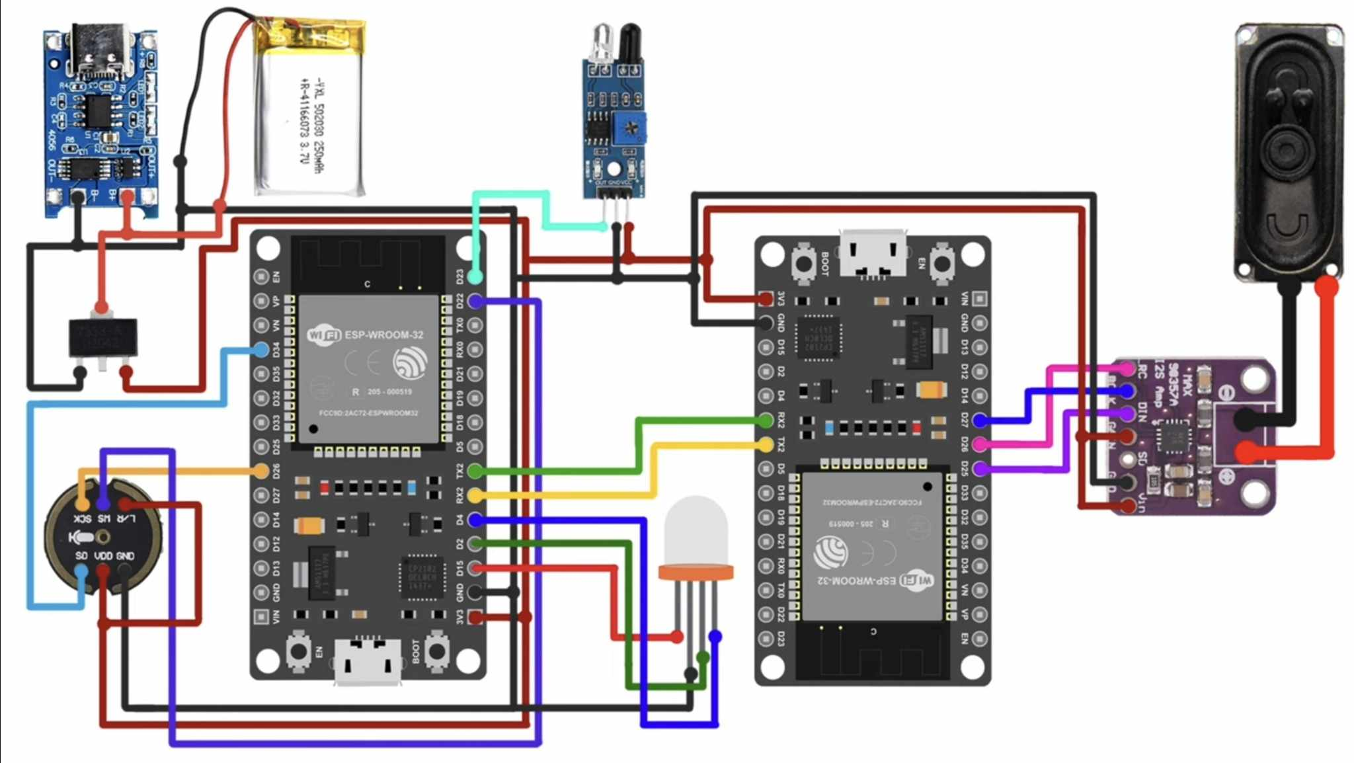
COnnections
Facial & Movement Control Circuit
Voice Circuit

Slide 10
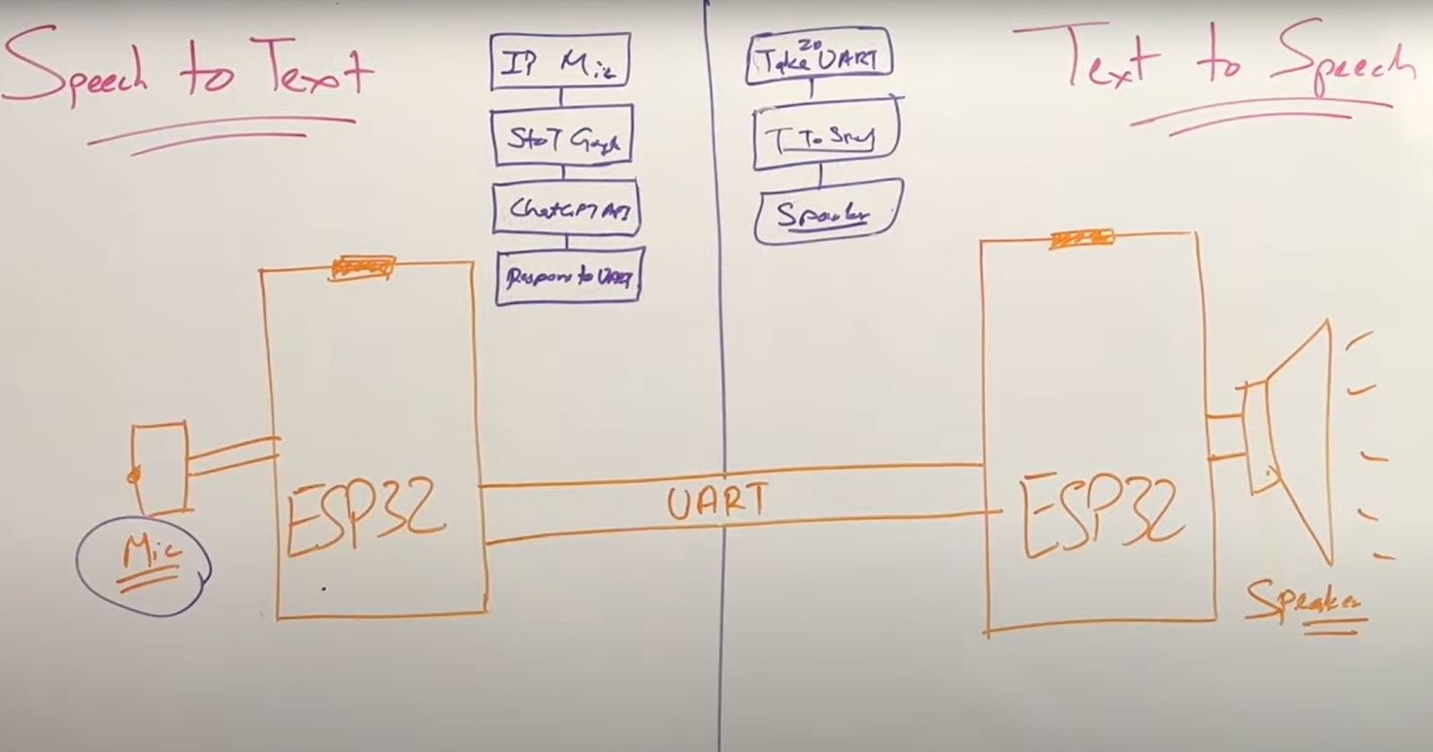
Interactive Voice Communication
Google API
ChatGPT API

Slide 11
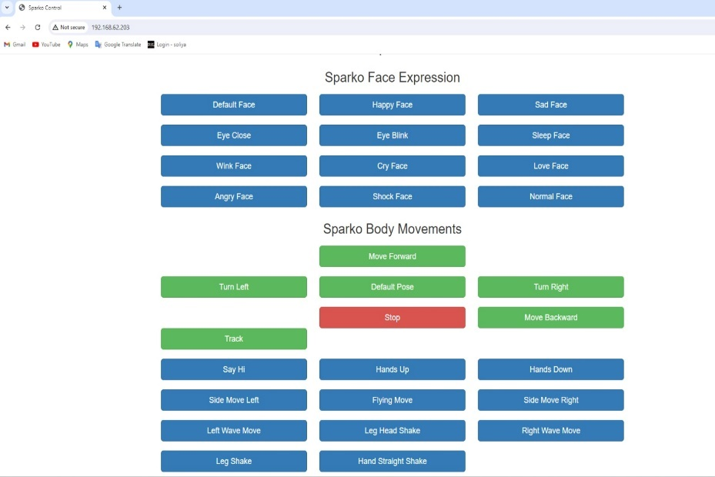
Movement-control & Facial expressions

Slide 12
Sparko Start up
Generate
Action
Button
Pressed
Web
page
Movement
Control
Pressing Button Again
ON-OFF
Switch
Voice
Control
Triggering
IR Sensor
Ask Your
Question
Get Answer
Retriggering
IR Sensor

Slide 13
limitations
5
Technical Limitations (Hardware):
Response limit of 30 words due to ESP32 memory.
Response takes some time around 20 seconds.
Complexity of the 3D design:
Difficult to assemble.
Time consuming.
Operational Challenges:
Occupation daily restrictions.
Buying from multiple providers (expensive).
Difficulty of importing.

Slide 14
Future work
6
Improvements:
Upgrading ESP32 for faster responses and Increased memory.
Movement Control using voice commands.
Replace the connections using a printed PCB.
Additional Features:
Additional Sensors.
Develop an advanced control interface.
Camera to recognize environment and answer when asked “what can you see”.

Slide 15
Conclusion
7
Summary:
Sparko's Achievement: A major step forward in smart, interactive robots.
Applications: Useful for helping with tasks, teaching, and entertainment.
Final Thoughts:
Impact: Sparko has the potential to change how we use robots in everyday life especially with it’s ongoing updates.

Slide 16

