Slide 1

An-Najah National University
Faculty of Engineering and Information Technology
Soil Nailing
Prepared by:
Maya Awad Jeries Khalil 11819218
Ahmad Zakria Ahmad Eid 11819470
Ibraheem Sami Shafiq Shaar 11820741
Sundos Rasheed “Mohammad Reda” Fatoom 11819642
Supervisor: Dr. Isam Jardaneh

Slide 2
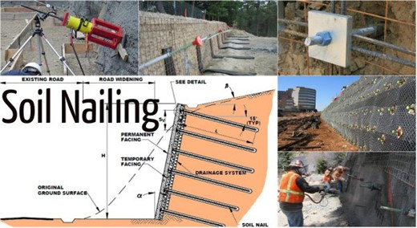
Soil Nailing

Slide 3
Soil nailing is a method to safe stability in slopes, and vertical cuts, it has many advantages and limits, advantages like: It can be used on a new structure that aids in trapping slopes; there are no elections at all; there are no restrictions on the height of the walls; the construction process is sped up; etc. However, there are some restrictions that make it unsuitable, such as high water table, soil types, low-strength soils, the use of nails, which are only used for permanent long-term applications in delicate and expanding soil, corrosion with metal nails, a higher liquid limit, reduced undrained.
Soil nailing techniques include driven, self-drilling, launched, jet-grouted, and its varieties (single fluid, double fluid, and triple fluid). And the tools employed include drilling rigs, grout pumps, jet grout, drilling and grout mixing equipment, as well as rotary machines with downhole hammers.
It is utilized to support high-rise buildings, widen roadways, bridge abutments, strengthen retaining walls and soil slopes, etc.
Its installation for the soil's surface, the building's top-to-bottom progression, the drilling of nail holes, the excavation for the soil cut, the provision of the final facing, the soil nail, and the grout.

Slide 4
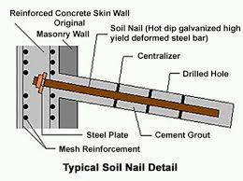
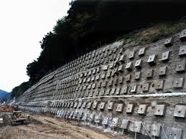
This component includes tendon, grout, and corrosion-proof soil nail.

Slide 5
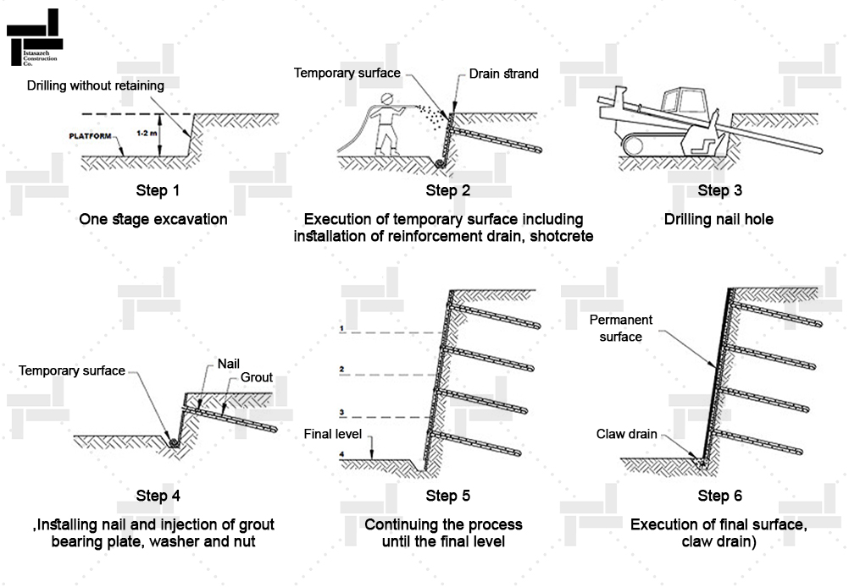
Steeps

Slide 6
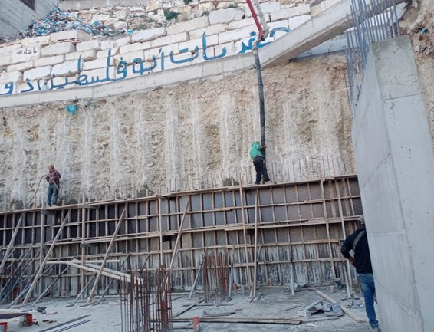
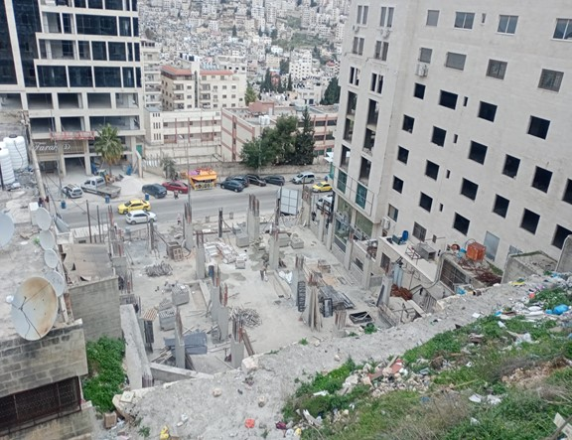
design

Slide 7
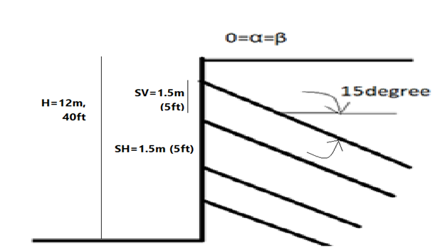
It shows the building that was worked on to design the wall, where the height of the wall is 12 meters, the width of the building is 30 meters, and the soil is silt clay ,
And the bearing capacity 250Kn/m^2,c=40,thita =25.
Dense Silly Sand
γ=18KN/m3 nearly 120 PCF
ϕ=25 degrees
C=40 KN/m2
1. Wall Length >> H: Face batter α=0, β=0.
2. Soil Nail spacing SH=SV=1.5m (5ft).
3. Soil Nail pattern on wall face: uniform.
4. Soil Nail inclination=15 degrees.
5. Soil Nail length distribution: uniform.
6. Soil Nail Material (Nail Bar): Grade 420, Fy=420 Mpa (60 Ksi).
q= 125 KPa (18 psi), select DDH=150mm (6 in)
Select, Fsp=2

Slide 8
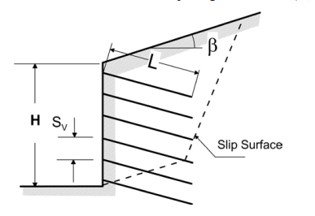
Normalized bond strength=0.23
Drill hole diameter: select minimum diameter compatible with condition
DDH= 150 mm(6in).
T _{max-s=}70.56 Kip cross-section area of steel:At=1.764 in²
Select a No 25 (No.8) threaded bar with cross-sectional area A=510 mm2 (0.79 in²)
Diameter =25 mm (1.12 in).
Cover is at least (6-1.12)/2=2.44 in (62mm>minimum cover(25mm))
Maximum design tensile force at the face: To= 50.3 kip
Facing geometry
Temporary facing thickness (h) =100mm (4 in)
Permanent facing thickness (h) =200mm (8 in)
Steel reinforcement
(fy)=420Mpa (60ksi)
*temporary facing reinforcement select
(WWM)=4*4- W2.9*W2.9
*Select rebar: horizontal and vertical water bars = 2*No3. Grade 60
As=2* 0.11=0.22 in² (in both directions)
*permanent facing reinforcement: No.5 @12 in each way
Concrete strength, fc’= 21 Mpa (3000psi)

Slide 9
*Soil nail length
L =0.7*H 0.7*40=28 ft
0.7*12=8.4 m Use L= 9m
9m length for one nail Ok (between 0.6* H, 1.2* H)
*Check for SV, SH
Sv =3 ft <5 ft Ok
*Check SH*SV=25 ft2 < (35 -42) ft2
*Svo: the spacing between the first row and top of wall (SVo)
Svo= 3ft < 3.5 ft Ok.
Result:we use 96 nails :6 in vertical and 16 in horizontal that diameter 150 mm,grade 60 facing short concrete :diameter 8 mm ,cover at last 2.44 in ,
*temporary facing reinforcement select
W2.9*W2.9 the distance between each nail in vertical and horizontal is 1.5 m .

Slide 10
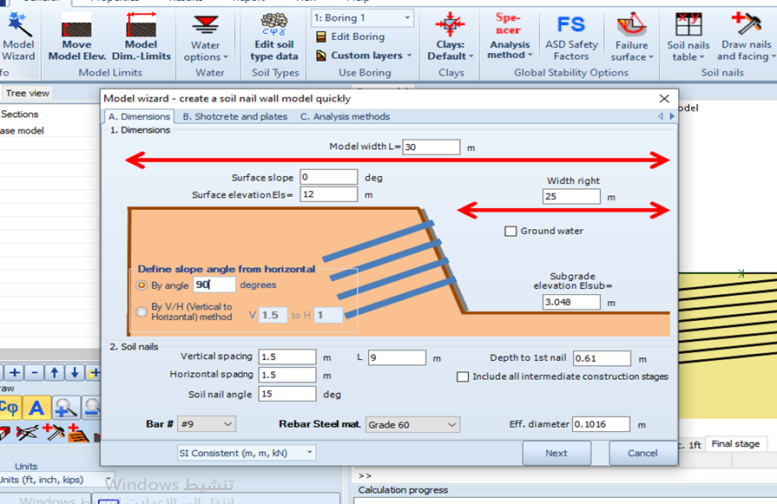
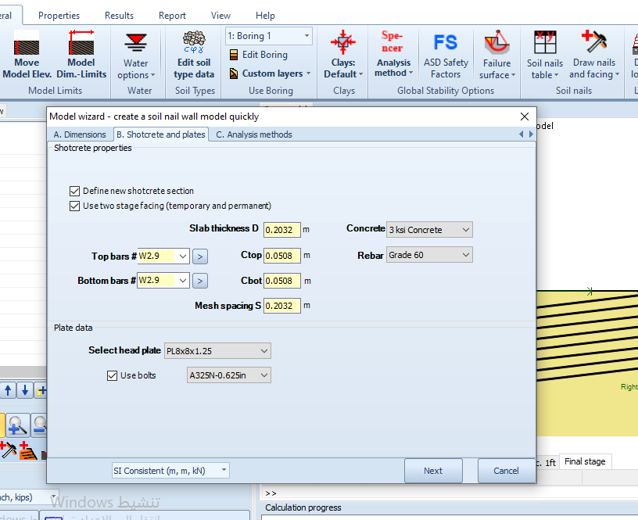
Design program soil nail plusb 2013 .deep excavation

Slide 11
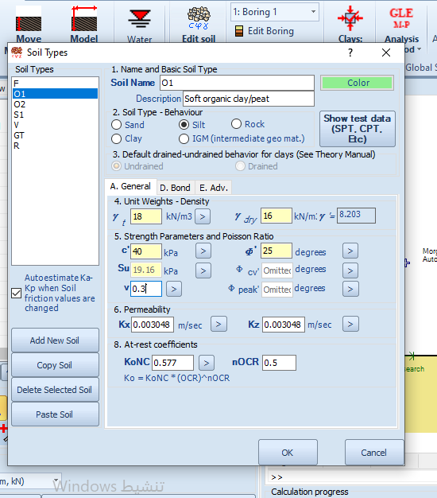
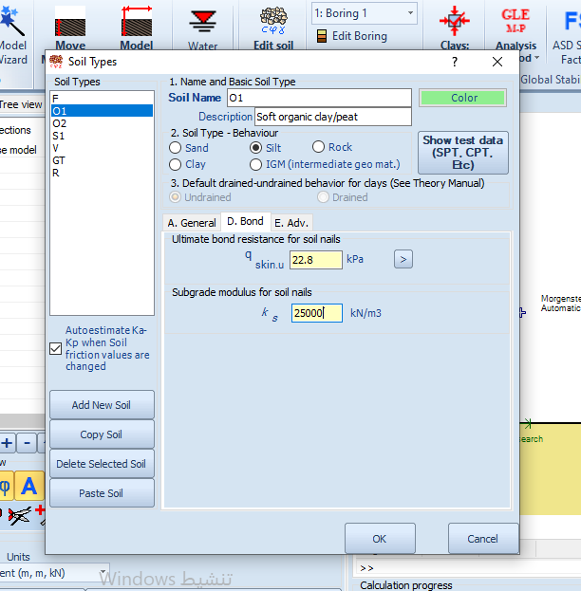
Soil properties

Slide 12
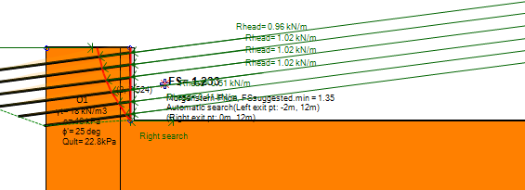
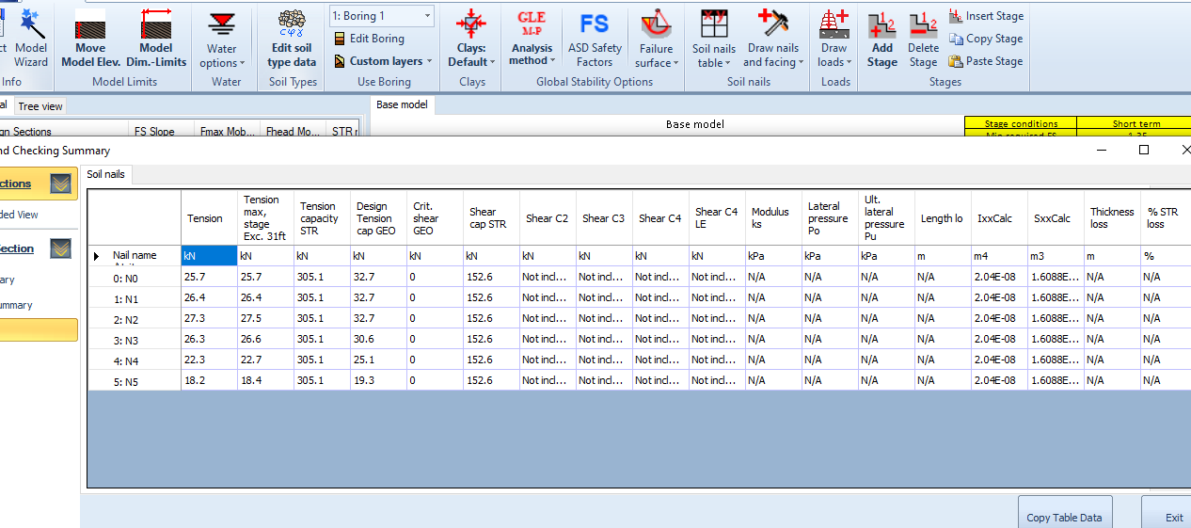
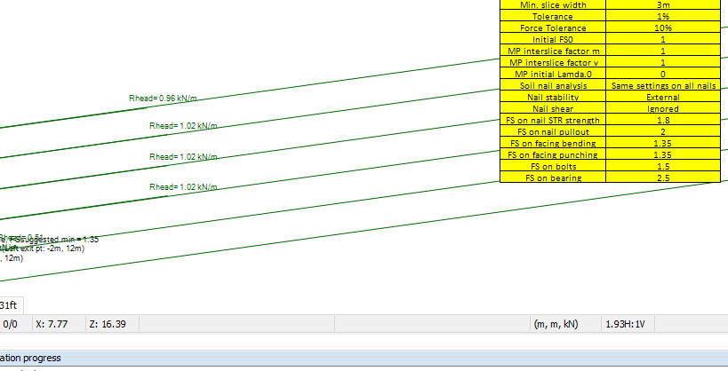
Results and details of the design

Slide 13
The cost difference in using nails and bales
In use piles we have 22 pils ,one pile is cost 15000 shekels
: 22 *15000=330000 shekels
= 66000 Dinar
In use nail ,we have 96 nails one nail is cost 3000 shekels
:96*3000=288000
57000 dinar
If we use nailing We can save about 10,000 Jordanian dinars, or about 50,000 shekels

