Slide 1

Faculty of Engineering and Information Technology
Chemical Engineering Department
Preparation and Characterization of Bioplastics from Food Waste Derived Starch
Prepared by:
Mai Dwiekat
Manar Yamak
Waed Hababeh
Supervisor :
Dr. Shadi Sawalha

Slide 2
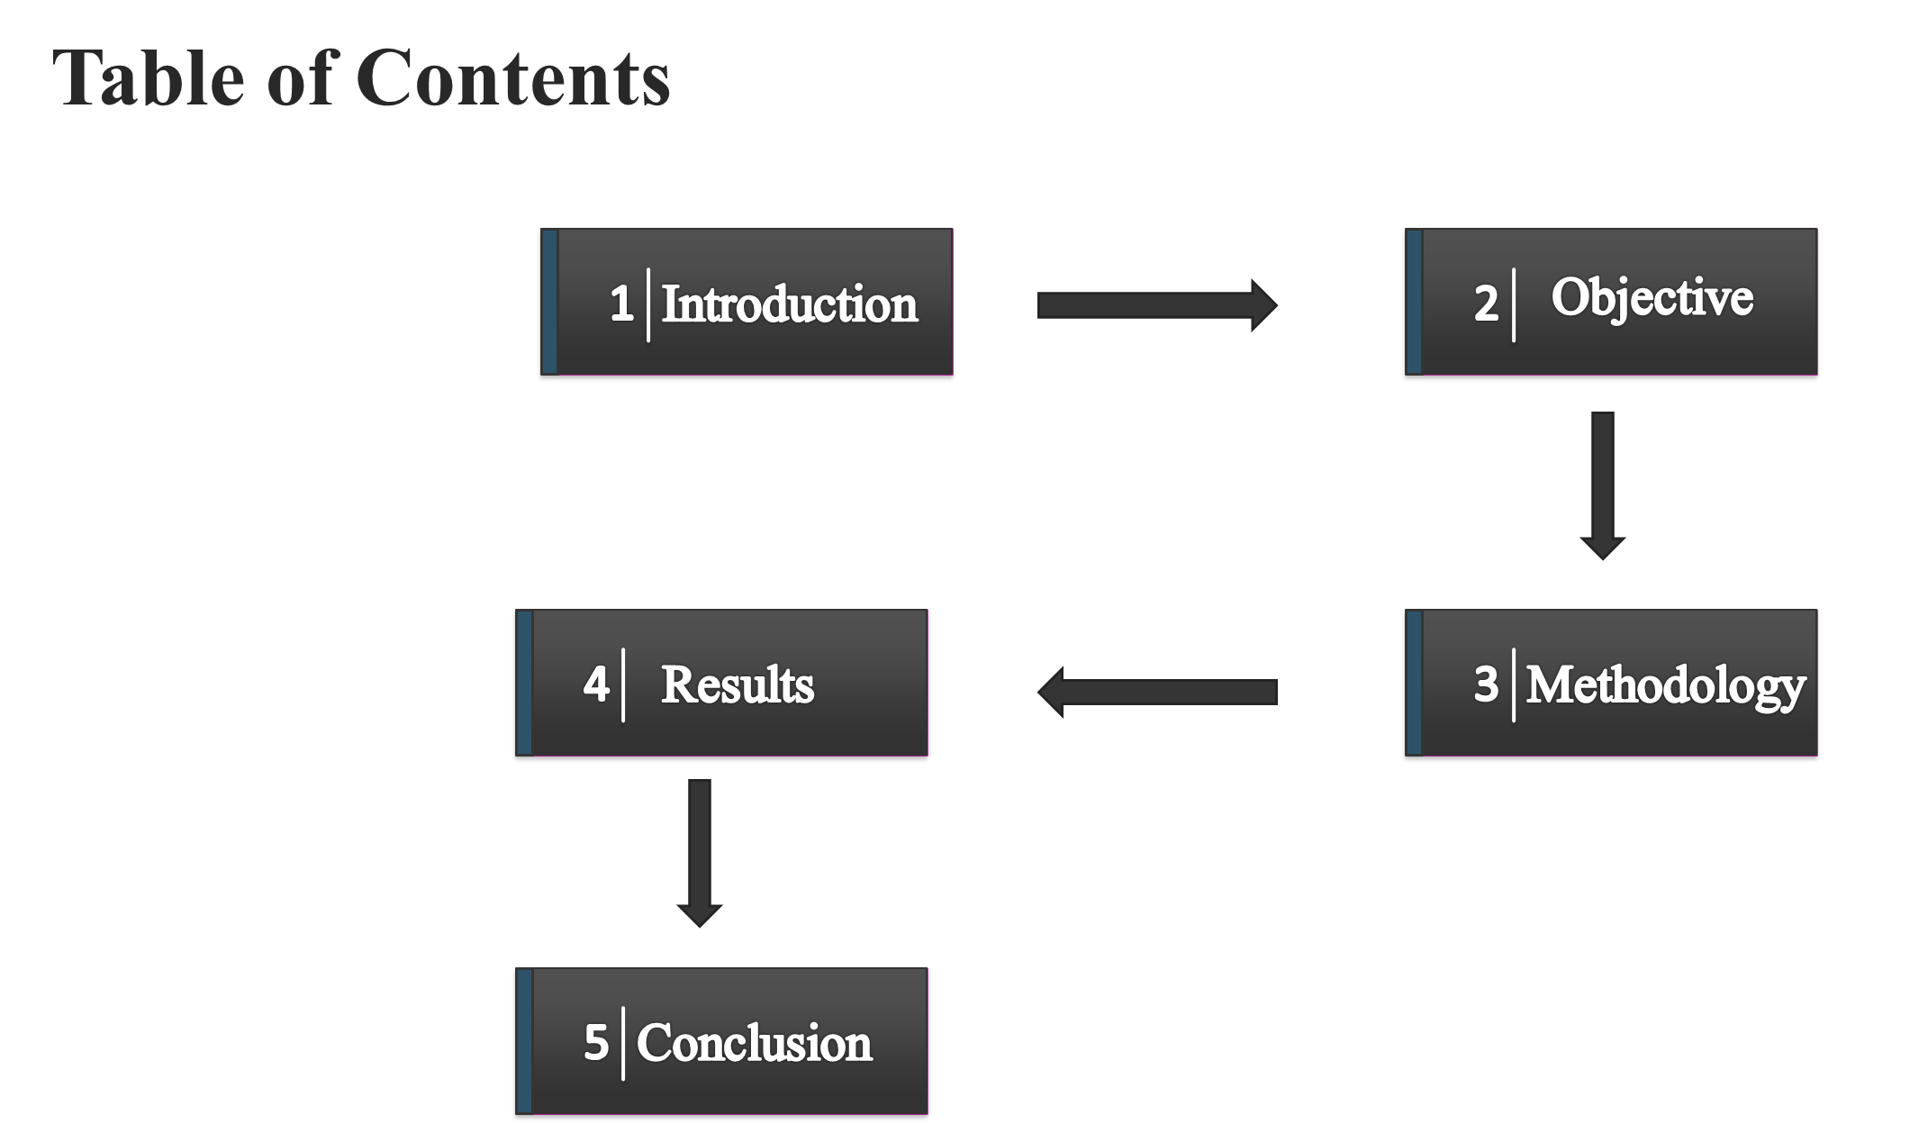

Slide 3


Introduction
The wide spread use of conventional plastics has led to significant environmental harm, including contamination, greenhouse gas emissions, and long-term ecological damage. Inadequate disposal, combustion, and decomposition release toxic substances into the environment, posing severe threats to ecosystems and human well-being.
This global challenge has spurred research into decomposable polymers, known as bioplastics. These are typically made from renewable biological feedstocks like starch and cellulose, offering an eco-friendly alternative that reduces reliance on fossil fuels and diminishes persistent plastic waste.

Slide 4
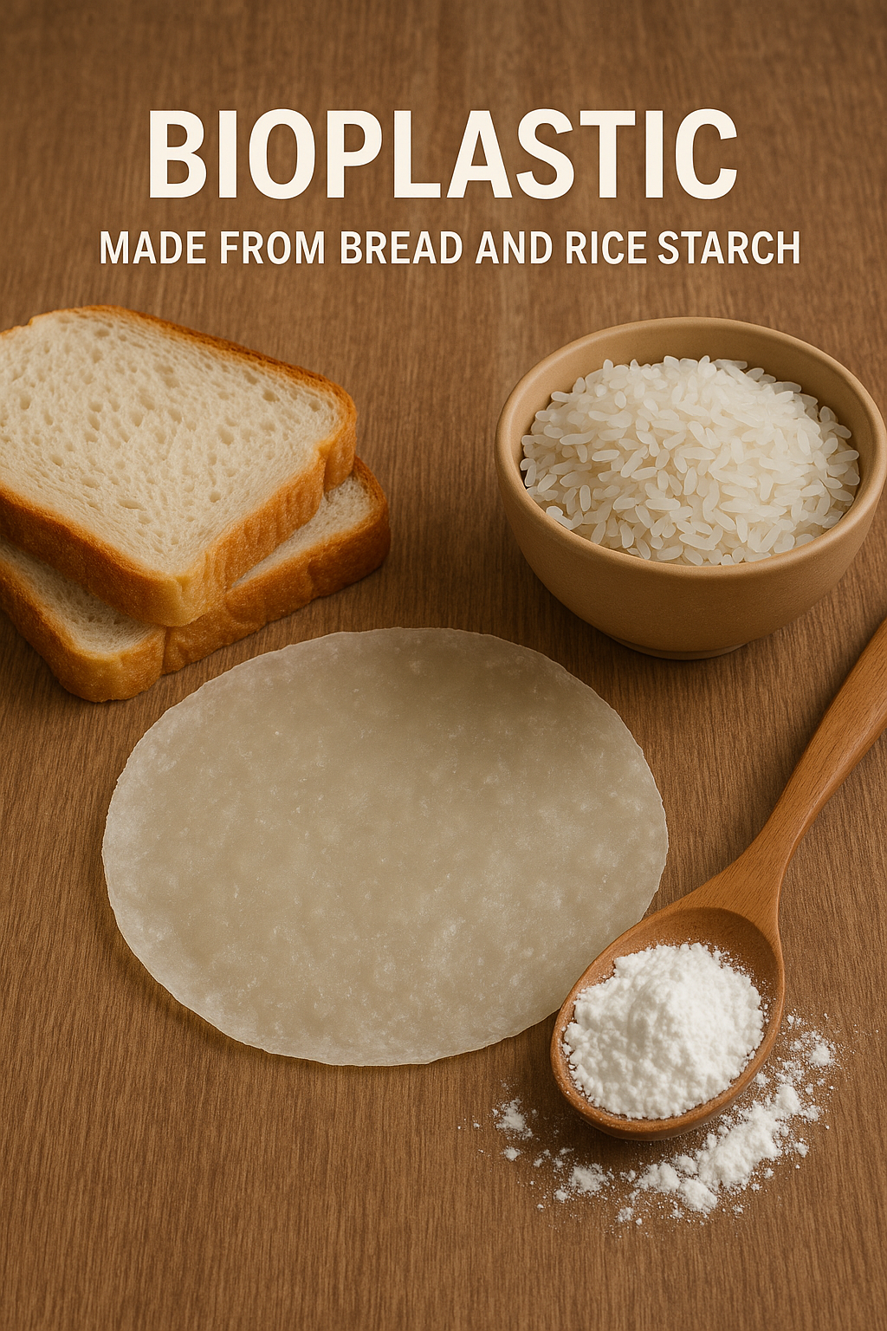
Objective
The primary objective of this study is to develop some biodegradable bioplastics using starch which is extracted from food waste sources such as rice and bread and we will evaluate just how different concentrations of glycerin plus acetic acid can affect their physical, mechanical, and thermal properties.

Slide 5



Starch-Based Bioplastics
Starch is a promising base for bioplastics due to its natural abundance, biodegradability, and film-forming traits. However, pure starch films often lack mechanical strength and are highly water-sensitive, limiting their practical uses.
To overcome these issues, plasticizers like glycerin are added to improve flexibility and ductility. Acetic acid enhances component compatibility and film integrity.
Renewable Source
Biodegradable
Enhanced Properties
Utilizing starch from food waste reduces reliance on fossil fuels.
Bioplastics naturally decompose, minimizing environmental impact.
Additives like glycerin and acetic acid improve flexibility and stability.

Slide 6
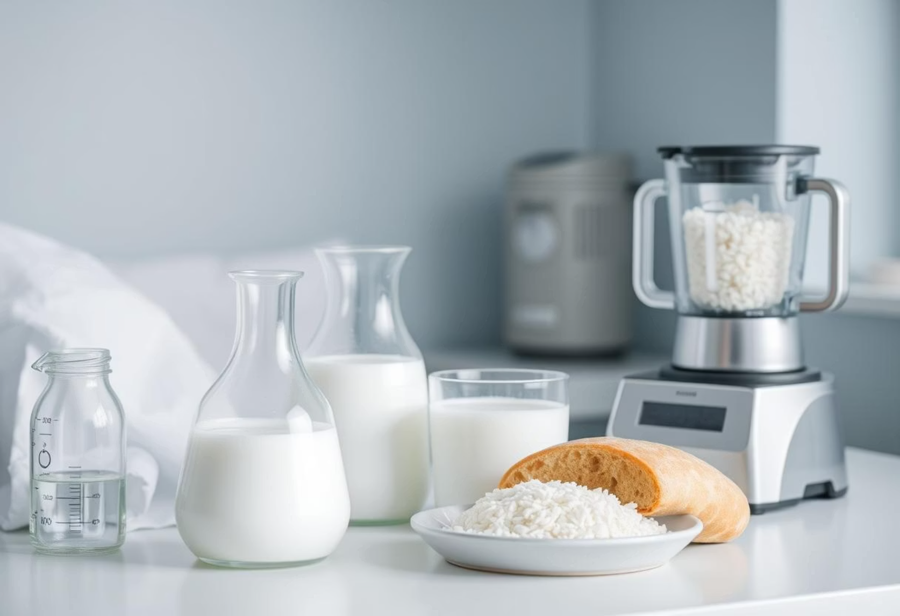
Methodology:
Starch Extraction
Rice and bread, chosen for their availability and high starch content, were dried at 75°C for 24 hours. The dried material was soaked in water (2:1 ratio), blended, and filtered. The filtrate settled for 24 hours, then the starch was dried in the oven.
The starch yield was calculated using the following formula:
Starch Yield (%) = 𝑤𝑒𝑖𝑔ℎ𝑡 𝑜𝑓 𝑡ℎ𝑒 𝑠𝑡𝑎𝑟𝑐ℎ *100
𝑤𝑒𝑖𝑔ℎ𝑡 𝑜𝑓 𝑡ℎ𝑒 𝑚𝑎𝑡𝑒𝑟𝑖𝑎𝑙𝑠
Based on this, the yield for bread was 25%, while for rice it was 20.1%.

Slide 7
Bioplastic Preparation
Experimental Design
5g starch + 50mL distilled water
A systematic experimental design investigated the influence of glycerol and acetic acid concentrations on starch-based bioplastic properties. Two sets of experiments were conducted:
Varying glycerol and acetic acid
Heated to gel, molded, and air-dried
Varying Acetic Acid
Glycerol fixed at 1mL, acetic acid varied from 0.5mL to 2.5mL.
Varying Glycerol
Acetic acid fixed at 1mL, glycerol varied from 0.5mL to 2.5mL.

Slide 8
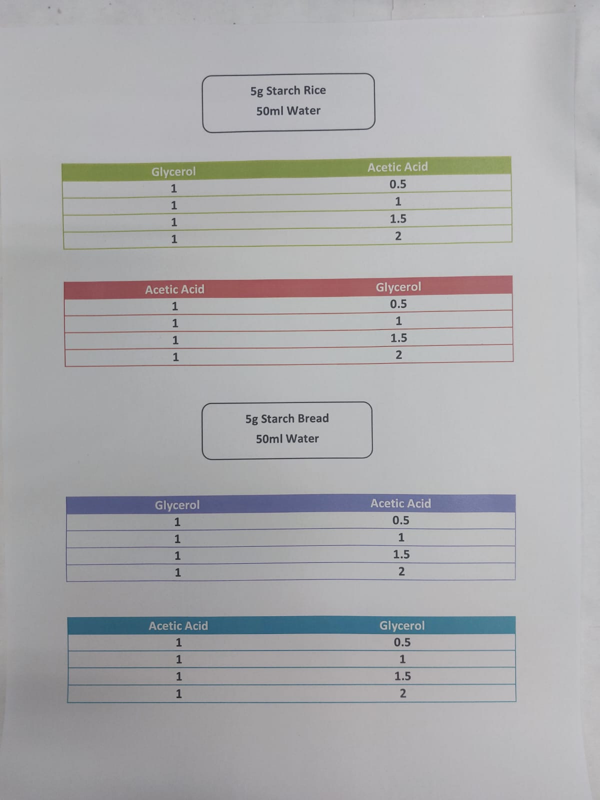

Slide 9
Characterization method
Test | Method
Moisture Content | Weigh → Oven dry at 105°C → Re-weigh → Calculate weight loss (%)
Solubility Test | Weigh sample → Soak in water 24h → Dry undissolved part → Calculate (%)
Water Absorption | Dry and weigh sample → Soak in water 24h → Re-weigh → Calculate (%)
Tensile Test | The testing was done using ASTM D882
TGA (Thermogravimetric Analysis) | Heat from 25°C to ~600°C → Record weight loss as temp increases

Slide 10

Physical Properties:
Moisture Content
Bioplastic samples of size 4 cm³ were weighed to measure the initial weight (W₁). Samples were dried in an oven at 85°C for 24 h. Final weight was measured (W₂). Moisture content is determined using the following formula:
Moisture Content (%) =
× 100

Slide 11
Figure 1: Moisture Content for Bioplastic Derived from Rice Starch
Figure 2: Moisture Content for Bioplastic Derived From Bread Starch

Slide 12
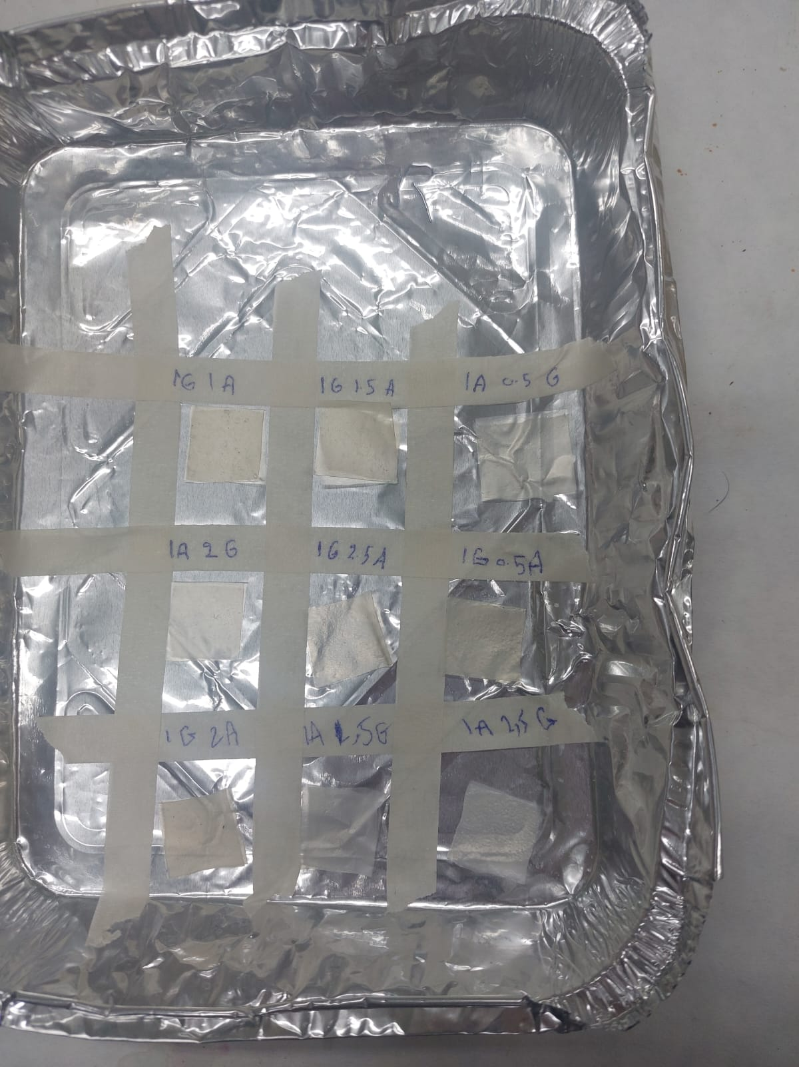
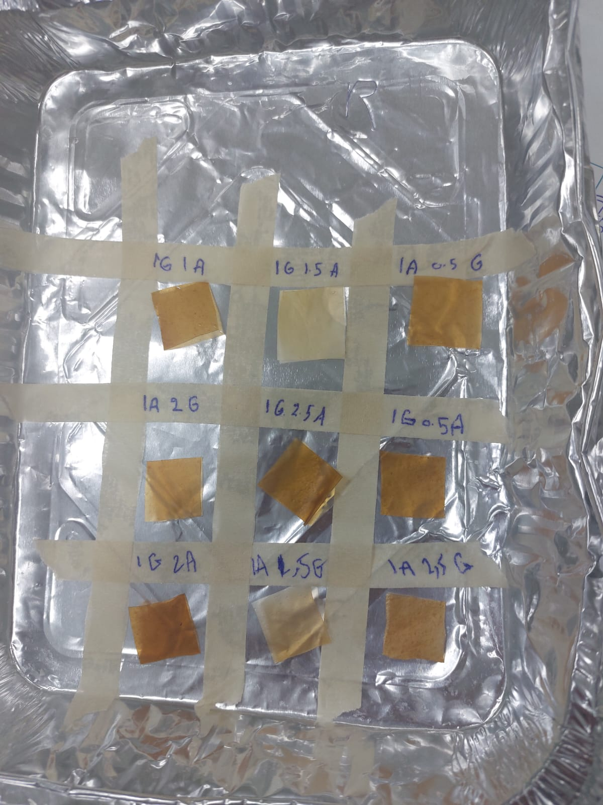

Slide 13
Solubility in Water
Bioplastic films of 2 x 2 cm³ were dried in an oven at 85°C for 24 h to measure its dry weight (W₁), then placing them in a beaker of 50 ml distilled water at room temperature for 24 h. After 24 h the bioplastic was dried in the oven at 85°C for 24 h then weighed to find final weight (W₂). The solubility was determined using the following formula:
Solubility in water (%) =
× 100

Slide 14
Figure 3: Solubility for Bioplastic Derived from Rice Starch
Figure 4: Solubility for Bioplastic Derived From Bread Starch

Slide 15
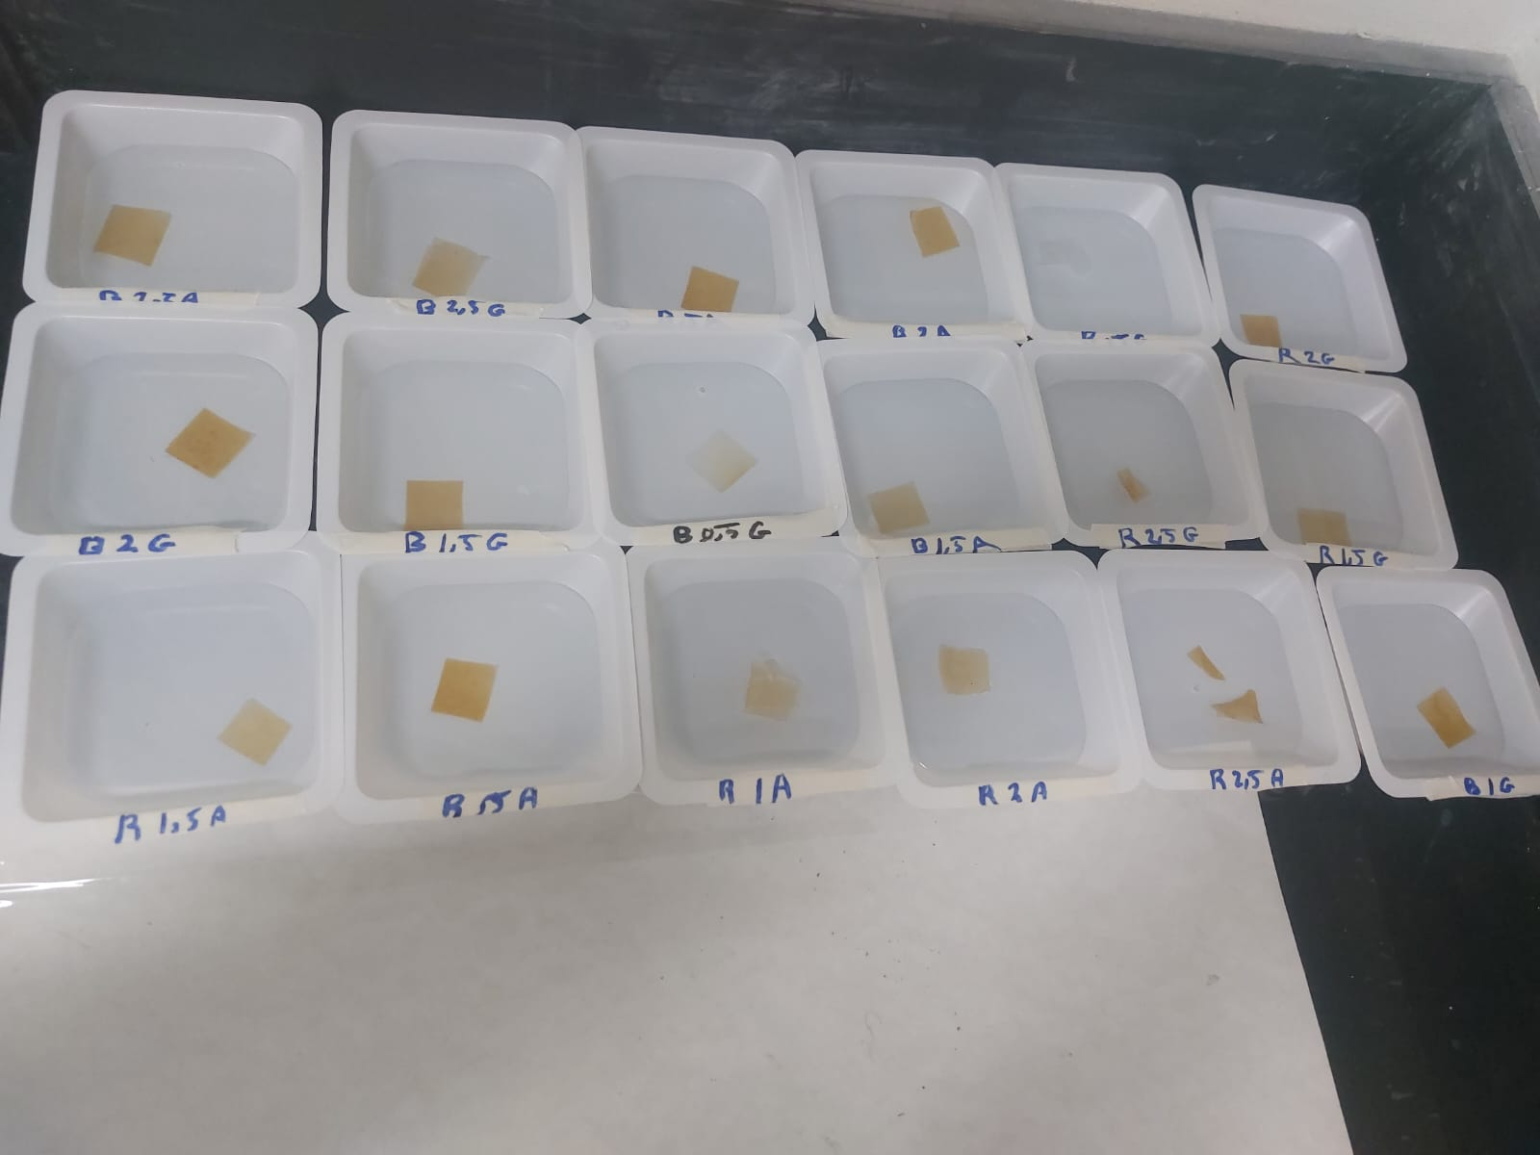

Slide 16

Absorption of Water
Bioplastic film's water absorption was tested using ASTM D570-98 Bioplastics sheets were cut at 2x 2 cm³ and weighed measuring dry weight (W_{d}). The sheets were placed in a petri plate with distilled water for 24 h. After that the bioplastic weight was measured (W_{w)}. The water absorption was determined using the following formula:fdmdjfjfjfd
Water Absorption (%) =
× 100

Slide 17
Figure 5: Absorption for Bioplastic Derived from Rice Starch
Figure 6: Absorption for Bioplastic Derived From Bread Starch

Slide 18
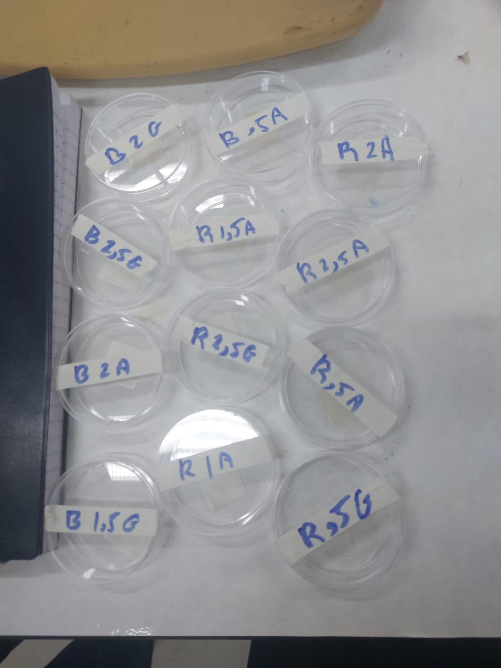

Slide 19
Mechanical Properties: (Tensile Test)
The tensile test is a mechanical test used to determine the properties of a material, such as tensile strength, elongation, and elastic modulus. In this test, the sample is pulled with an increasing force until it breaks to measure its ability to withstand stress and strain.

Slide 20
Figure 7: Mechanical Properties of Rice Starch Bioplastics under Varying Acetic Acid Concentrations.
Where (A) Tensile Strength, (B) Modulus of Elasticity, (C) Ductility
When glycerol was constant, tensile strength first decreased then increased with more acetic acid. Low acid levels weaken the structure, while higher levels enhance crosslinking. Elasticity peaked at 1 ml, then decreased due to plasticization. Ductility improved at higher acid concentrations, increasing flexibility.

Slide 21
Figure 8: Mechanical Properties of Rice Starch Bioplastics under Varying Glycerol Concentrations.
Where (A) Tensile Strength, (B) Modulus of Elasticity, (C) Ductility
When acetic acid was constant, increasing glycerol gradually reduced tensile strength and elasticity due to its plasticizing effect and increased porosity. Ductility started high but decreased at higher glycerol levels, as excessive glycerol weakened the structure.

Slide 22
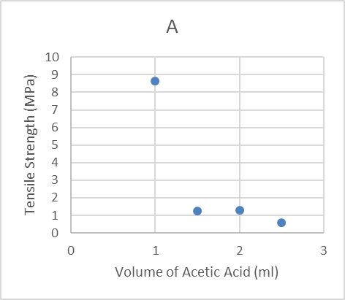
Figure 9: Mechanical Properties of Bread Starch Bioplastics under Varying Acetic Acid Concentrations.
Where (A) Tensile Strength, (B) Modulus of Elasticity, (C) Ductility
With constant glycerol, increasing acetic acid in bread-based bioplastic sharply reduced tensile strength and modulus, showing significant loss of stiffness. Ductility increased, indicating more flexibility, but the material became too weak for structural applications.

Slide 23
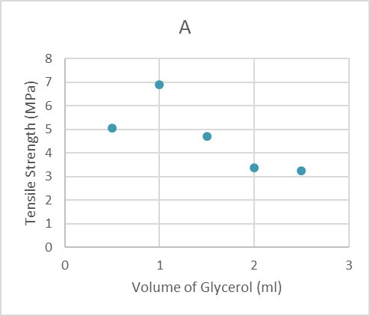
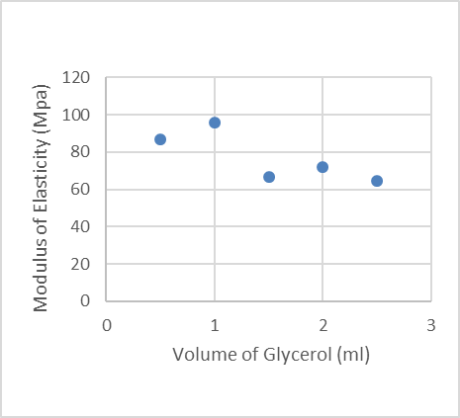
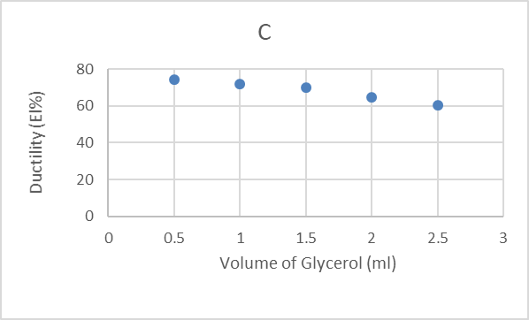
Figure 10: Mechanical Properties of Bread Starch Bioplastics under Varying Glycerol Concentrations.
Where (A) Tensile Strength, (B) Modulus of Elasticity, (C) Ductility
Tensile strength peaked at 1 ml glycerol with constant acetic acid, showing stable performance. Ductility stayed high but slightly decreased with more glycerol. The modulus showed minor changes, indicating better internal cohesion. Glycerol improved flexibility and strength balance up to a limit, after which it weakened the structure.

Slide 24
Thermal Properties: Thermogravimetric Analysis (TGA)
TGA revealed that thermal stability generally increases with higher concentrations of glycerin or acetic acid, indicating improved plasticization or cross-linking. Bread starch bioplastics with 0.5% glycerin showed gradual degradation, while 2.5% glycerin led to earlier but steadier disintegration.
Rice starch bioplastics with 0.5% glycerin showed poor heat tolerance, degrading quickly. However, with 2.5% glycerin, structural integrity was maintained up to 300°C, demonstrating better thermal endurance. Similarly, higher acetic acid content in rice starch bioplastics augmented matrix integrity and heat resistance.

Slide 25
Figure 11: TGA of Bread Starch Bioplastics with Glycerin
Figure 12: TGA of Rice Starch Bioplastics with Glycerin

Slide 26
Figure 13: TGA of Rice Starch Bioplastics with Acetic Acid

Slide 27
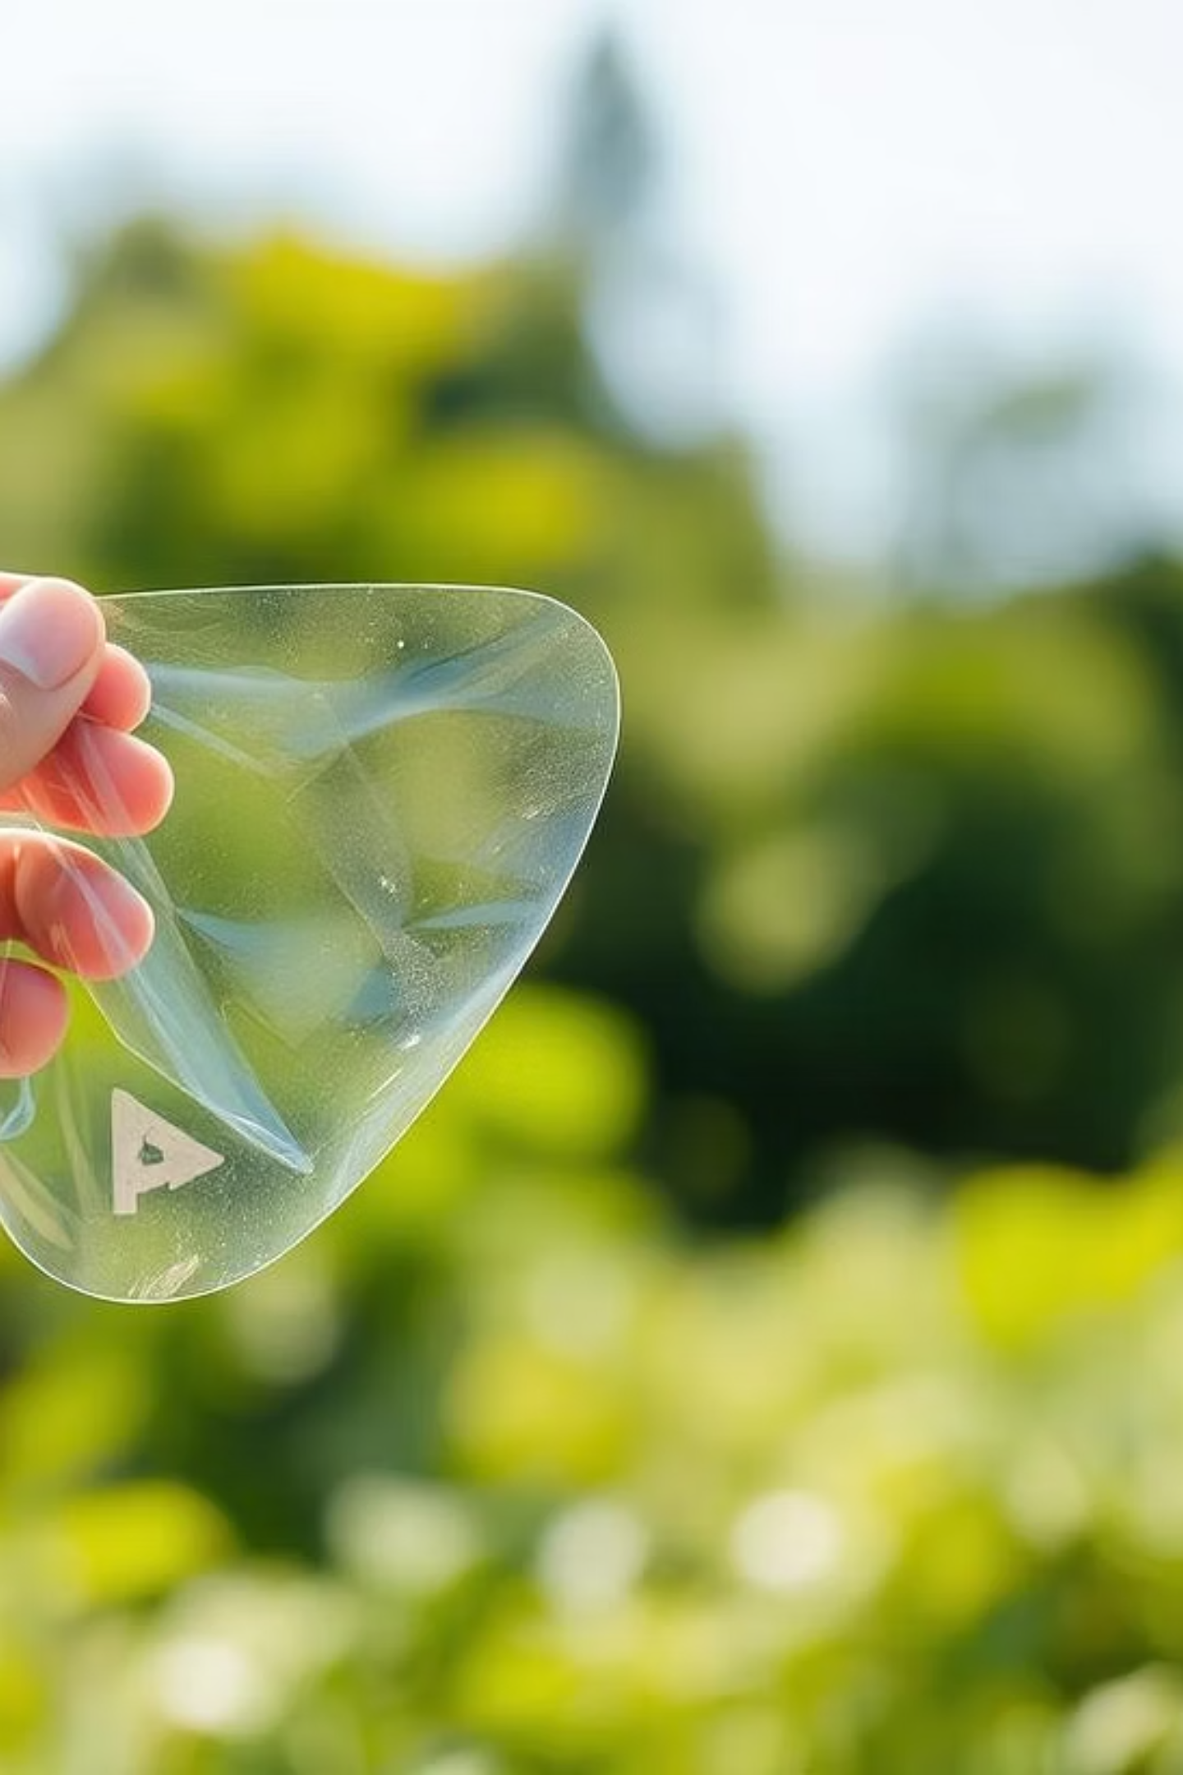
Conclusion
The study successfully demonstrated the ecological potential of preparing bioplastics from rice and bread waste starch, offering a sustainable recycling method and functional biopolymer films. Physical tests confirmed glycerin's impact on moisture and flexibility, while acetic acid improved solubility and thermal behavior.
Tensile tests validated mechanical viability, and thermal analysis (TGA) confirmed stability. These bioplastics, made with simple techniques and accessible materials, are suitable for disposable and short-life packaging. Future work should focus on industrial scalability and long-term biodegradability testing in real environmental conditions, advancing sustainable material systems.

Slide 28
Thanks for watching

