Slide 1


Pets Club
Done By:
Marah Jaber
Seba Salahat
Supervised By: Dr.Samer Arandi

Slide 2
Table Of Contents:
1
3
Motivations
Features
2
4
Project Idea
Challenges

Slide 3
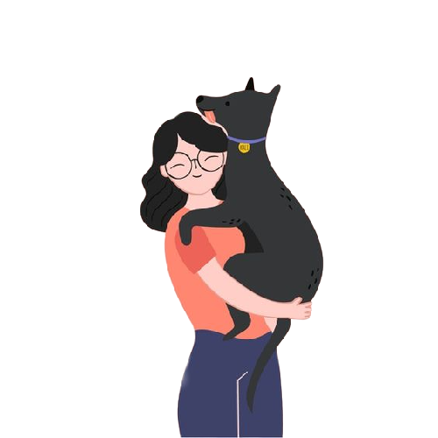
Motivations

Slide 4
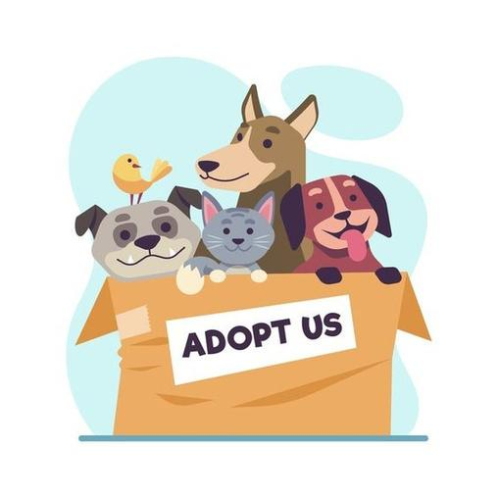
Motivations:
We've all seen pets on the road without water or food, in both cool and hot weather, in desperate need of vet care and a lot of love.
Owners of pets must interact with others to learn from their knowledge of how to handle the pet.

Slide 5
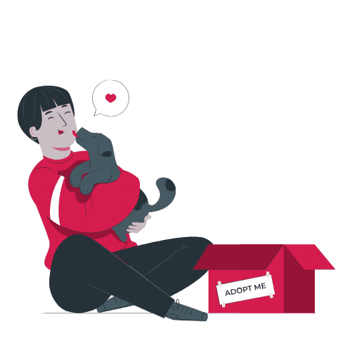
Motivations:
3. Most pet owners turn to social media sites for assistance with their pet, such as finding an adopter, purchasing food, clothes, and tools.

Slide 6
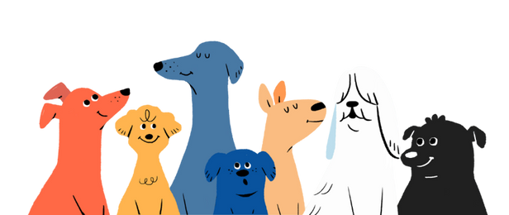
Pets Club has two parts:
Mobile Application For Users
Website For Admin

Slide 7
Project Idea
Platform for pet owners and lovers that provides them with all the services and supplies they need to breed their pet in one place.
With a website for admin to monitoring the app and controlling it's data.

Slide 8
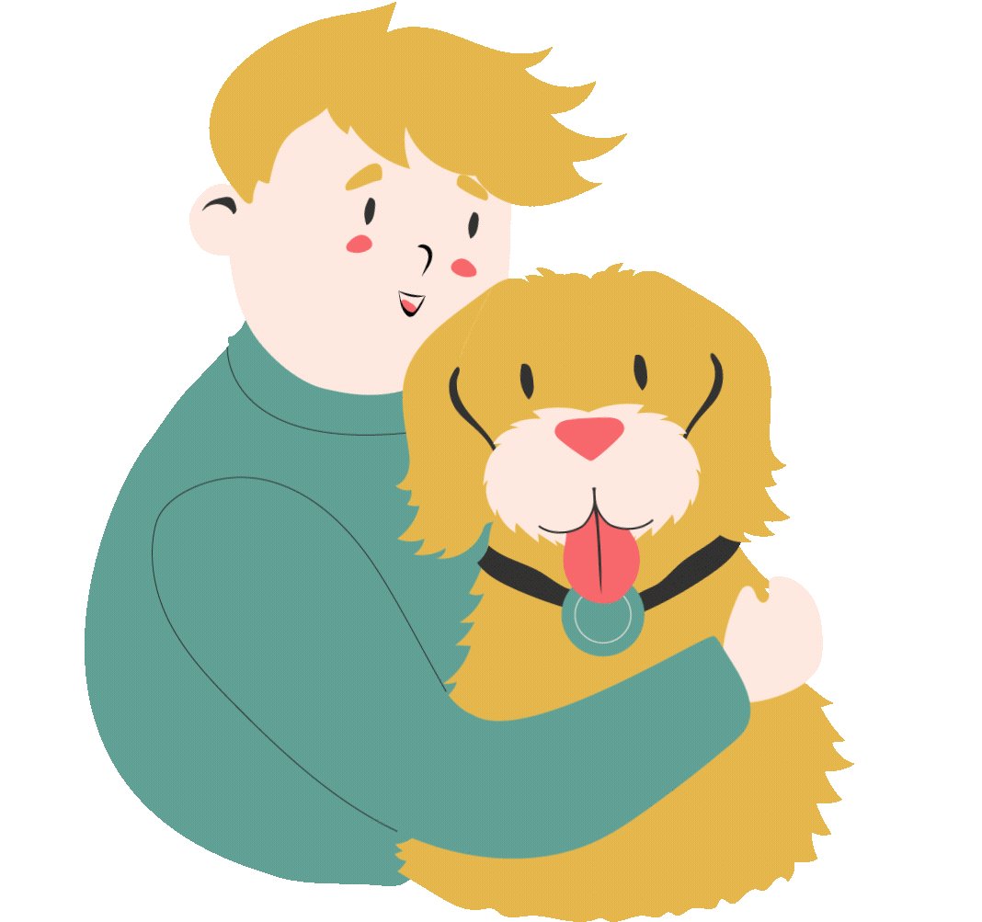
Features

Slide 9

Pet Adoption
Give a home for a homeless Pet

Slide 10
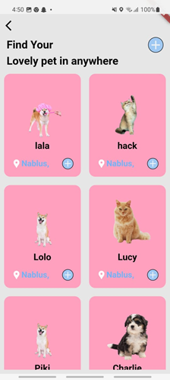

Slide 11
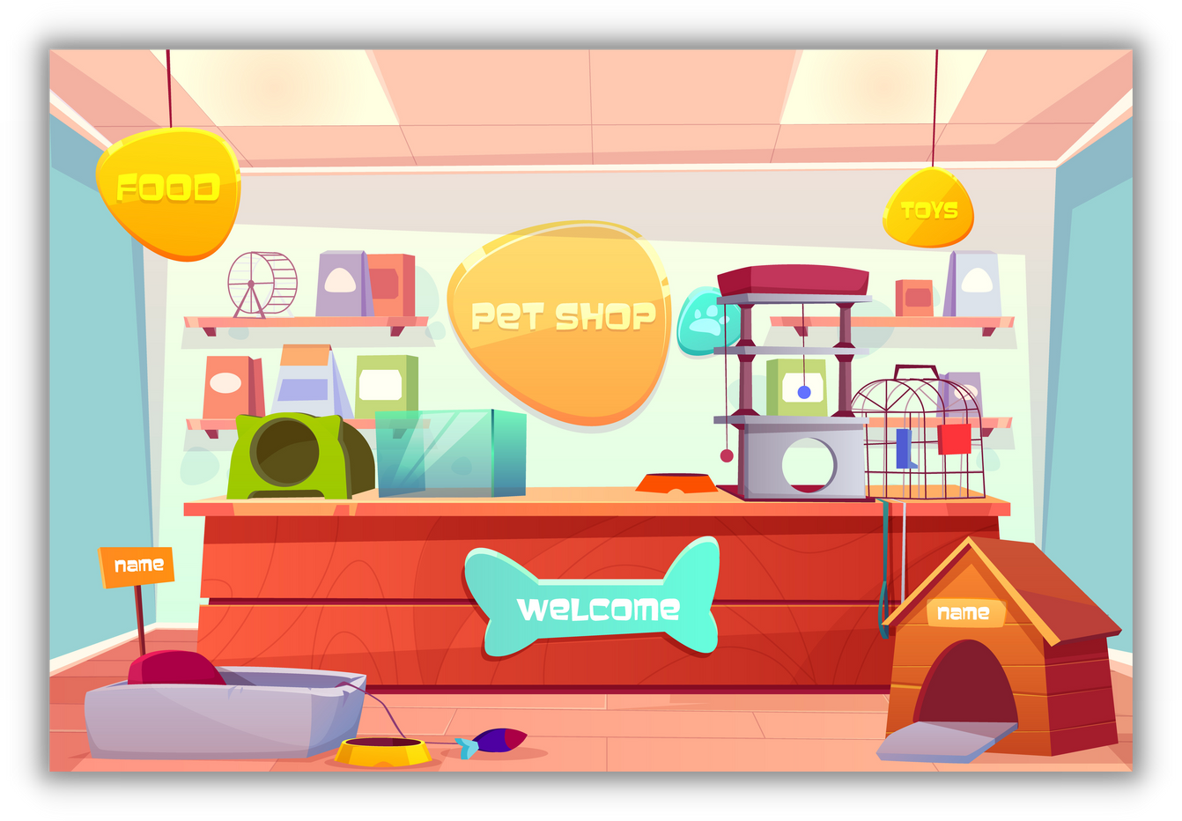
Shop
Order Food, Toys, Clothes, Tools for your Pet

Slide 12
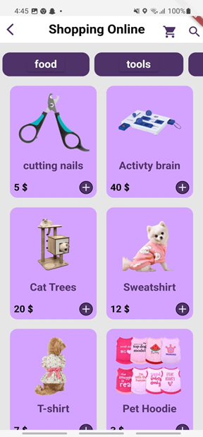

Slide 13

Social Network
Contact with other pets owners by sharing posts, comments, likes and chatting

Slide 14
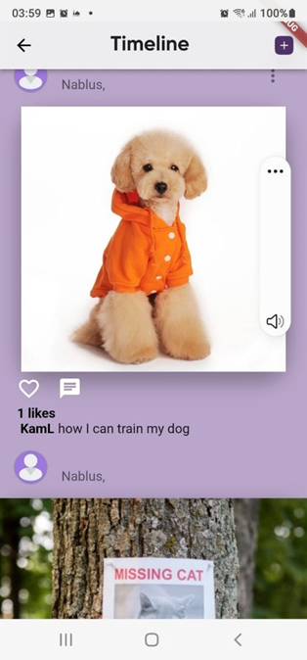

Slide 15
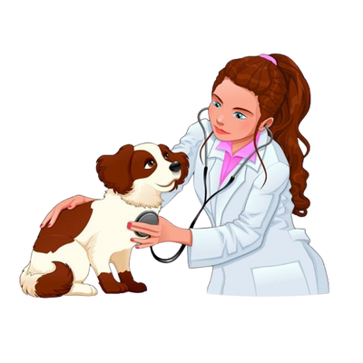
Veterinary Booking
Make an appointment with a veterinarian to have your pet's health checked.

Slide 16
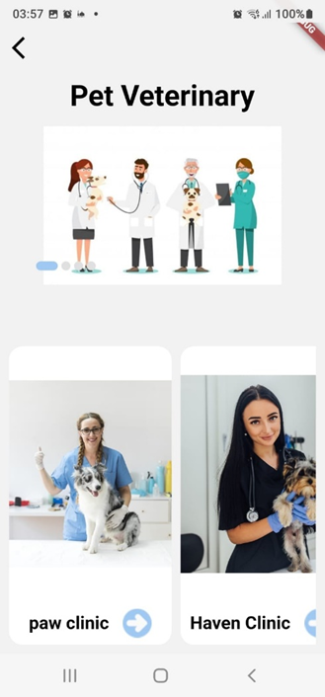

Slide 17
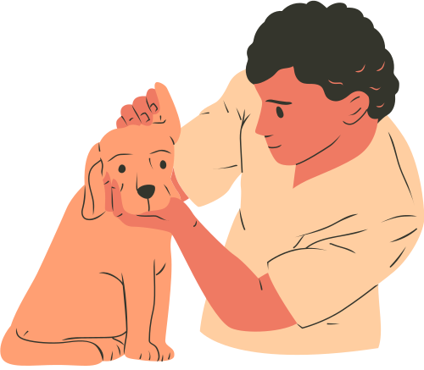
Grooming Booking
Make an appointment with a center which care about grooming, washing and other related services.

Slide 18
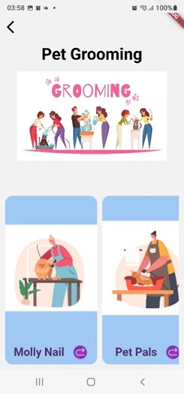

Slide 19
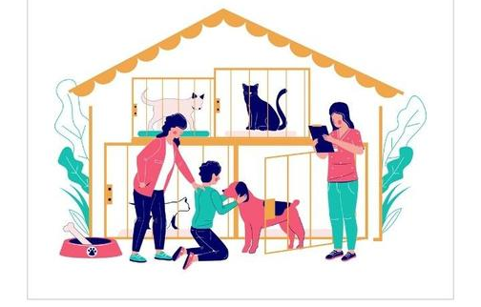
Hotel Booking
Make a reservation at the hotel and leave your pet there until you finish your work, and we'll take care for it.

Slide 20
Admin Website
In website we display the application data as Charts, statistics and tables.
when admin is logged in can monitor, modify or delete the data from tables.

Slide 21
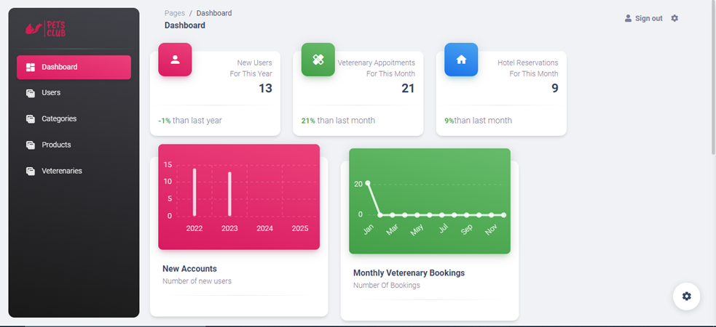
Admin Website

Slide 22
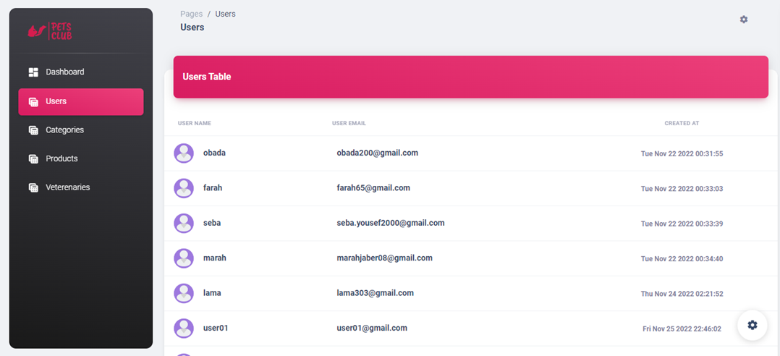
Admin Website

Slide 23
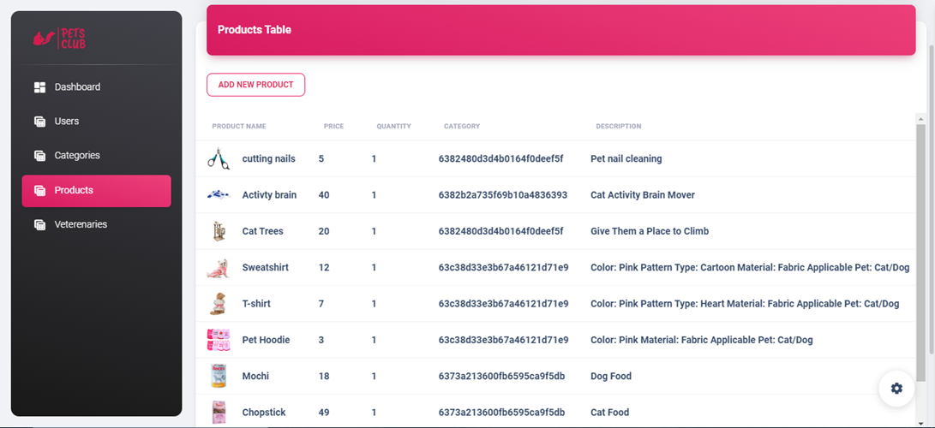
Admin Website

Slide 24
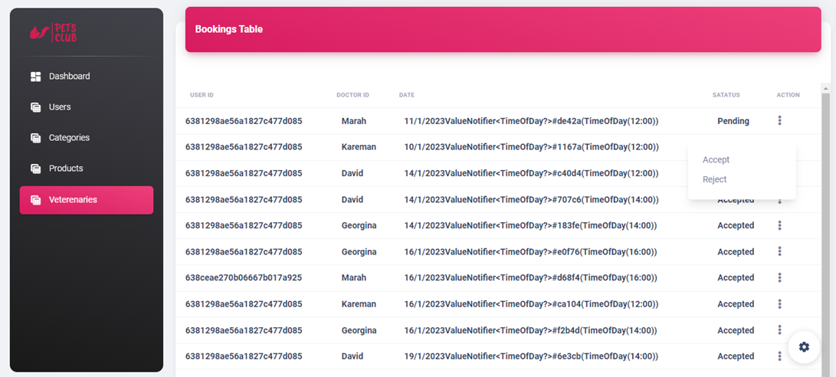
Admin Website

Slide 25

Software Development Process :
Waterfall model
Requirements
Design
Implementation
Testing

Slide 26


Tools and Technologies:
Frontend
Website: HTML, CSS, JavaScript
(Engines Template)
Application: Flutter (Dart)

Slide 27




Tools and Technologies:
Backend
Main Database
NodeJs
Postman
Test endpoint
Firebase
database for social network

Slide 28
Future Work:
Add story, following/ unfollowing functions to social network
Ability to reserve hours in pet hotel not only days
whiskers
Ability to share images and videos in chats
Make the payment process effective and real

Slide 29
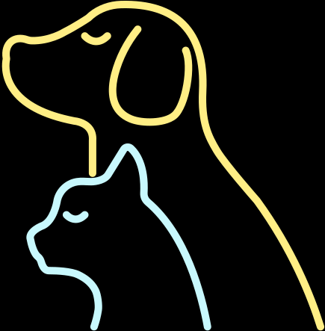
Challenges

Slide 30
Challenges :
  Using new frameworks and programming languages so, it was hard to implement.
  Heavy editors and simulations which caused problems in our laptops.
  Variety features from different fields delayed our work.
  Hard to work with two databases

Slide 31

Thank You
Any Questions?

