Slide 1
A GIS Model for the Assessment of Road
Closures & their Impacts on Travel Time ,Travel
Distance & Pollution in the West Bank
ANAS TOMEH, HAYTHAM MASHAQI, AHMAD ALLOOSH
Dr. EMAD DAWWAS

Slide 2
Introduction
Background
Objectives
Impotence of Project
Accessibility
Pollution in West Bank
Modes of Transportation in West Bank
What done in the first part

Slide 3
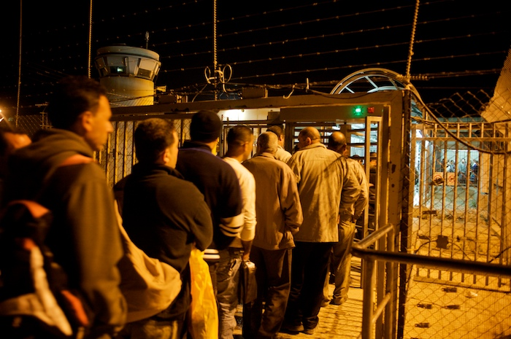
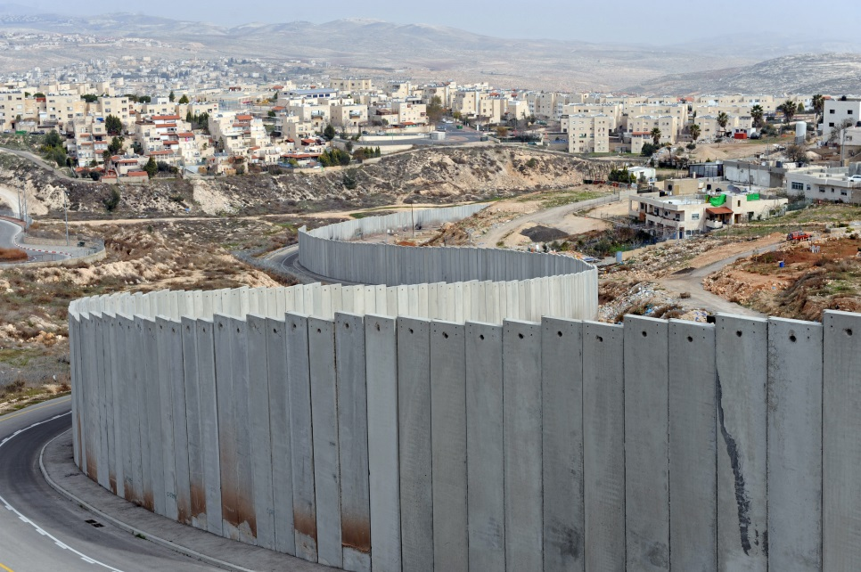
Background
Introduction
The second intifada (September 2000)
IOF procedures in West Bank:
Establish a network of checkpoints and closures.
Constructing the Separation Wall.
Forbidden Roads.

Slide 4
Objectives
Introduction
The main objectives of this study are:
• To develop tow GIS models of accessibility; one is a service area model and the other is a Travel Cost Simulator Model.
• To document and analyze the impact of the Israeli obstacles on the current transportation system in the West Bank and its effects on the accessibility to West Bank facility’s, changes in travel distance, travel time, and generating pollution because of these impacts.

Slide 5
Impotence of Project
Introduction
Design and use of a developed GIS models that is:
1. No need to be expert in Arcmap to use the models.
2. Provide flexibility to users to simulate any case for any study area that exposed to movement obstructing.
3. Obtaining reasonable results in a quick way and in a simple display form such as maps and graphs.

Slide 6
Accessibility
The ability to reach desired goods, services , activities and destinations (collectively called opportunities)
Accessibility in West Bank is divided into three categories:
Internal accessibility within the West Bank
International accessibility
Accessibility between West Bank and Gaza
The model will measure the Accessibility.

Slide 7
Pollution in West Bank
Pollutants | Sources
Suspended particulate Matter, SPM | Automobile, power plants, boilers, Industries requiring crushing and grinding such as quarry, cement.
Chlorine | Chlor-alkali plants.
Fluoride | Fertilizer, aluminum refining
Sulphur dioxide | Power plants, boilers, sulphuric acid manufacture, ore refining, Petroleum refining.
Lead | Ore refining, battery Manufacturing, automobiles.
Oxides of nitrogen, NO, NO2 (NOX) | Automobiles, power plants, nitric acid manufacture, also a secondary pollutant
Peroxyacetyl nitrate, PAN | Secondary pollutant
Formaldehyde | Secondary pollutant
Ozone | Secondary pollutant
Carbon monoxide | Automobiles
Hydrogen sulphide | Pulp and paper, petroleum Refining.
Hydrocarbons | Automobiles, petroleum refining
Ammonia | Fertilizer plant

Slide 8
Pollution in West Bank
Type of vehicle | Emission factors (g per vehicle km)
 | SO2 | SPM | NOx
Petrol-driven cars (61%) | 0.08 | 0.33 | 3.20
Diesel-driven cars (39%) | 0.39 | 2.00 | 0.99
Weighted mean | 0.20 | 0.98 | 2.33

Slide 9
Modes of Transportation in West Bank
The number of vehicles registered and operating in the West Bank, 2011 is 211268 vehicles
72.4% of licensed vehicles in the West Bank are private cars.
15% of all households in the West Bank have access to a car.
The bus is the cheapest mode of transport, while taxis are the most expensive types.

Slide 10
Modes of Transportation in West Bank
Type of public transport | Number of Vehicles
Number of external Service Taxis West Bank in 2010 | 4910
Number of internal Service Taxis West Bank in 2010 | 4910
Number of private taxis in the West Bank in 2010 | 4509
The number of buses in the West Bank in 2009 | 595

Slide 11
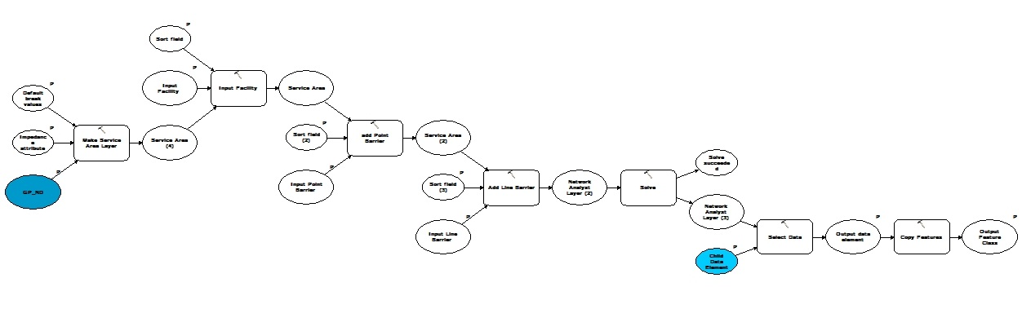
What done in the first part:
Introduction
A service area model was developed to determine areas that can reach facility in specific time.

Slide 12
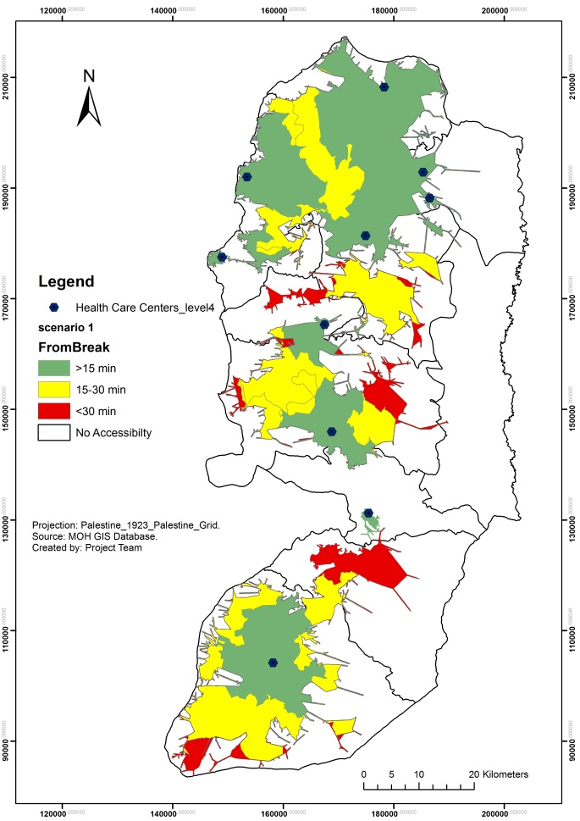
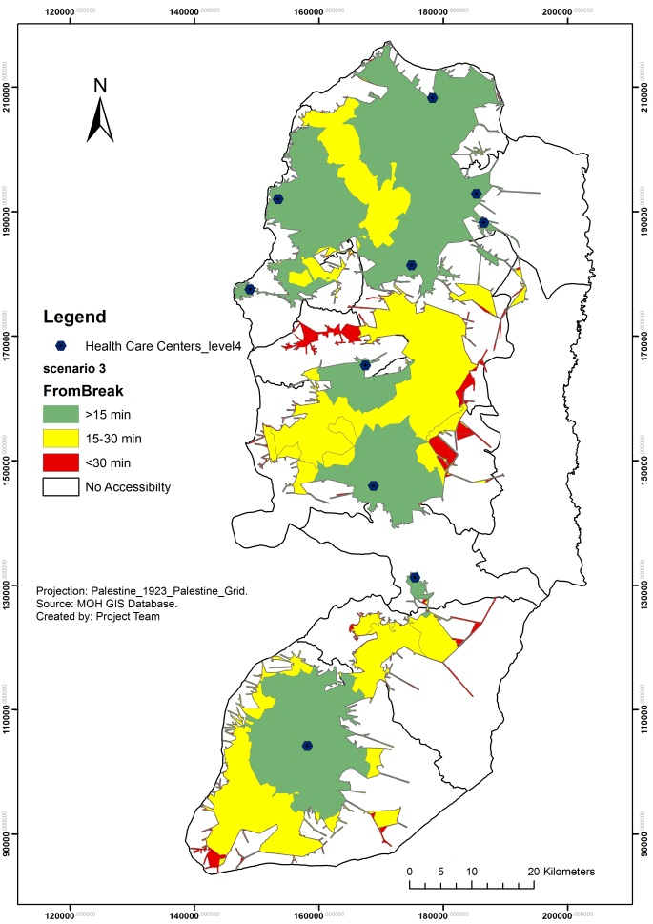
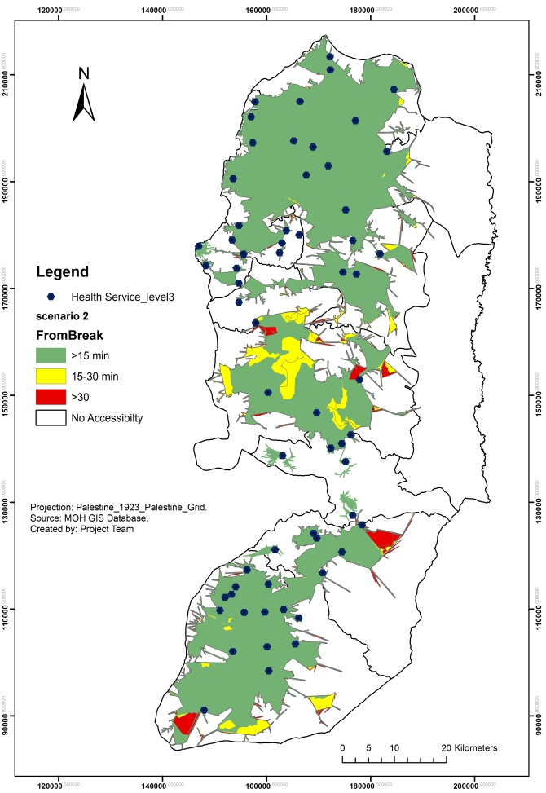
What done in the first part:
Introduction
A service area model was developed to determine areas that can reach facility in specific time.

Slide 13
Model Design and Implementation
Travel Cost Simulator Model was developed to:
Choose and draw the best route between any chosen origins and destinations.
Calculate travel cost based on: Travel Time, Travel Distance, and Pollution.

Slide 14
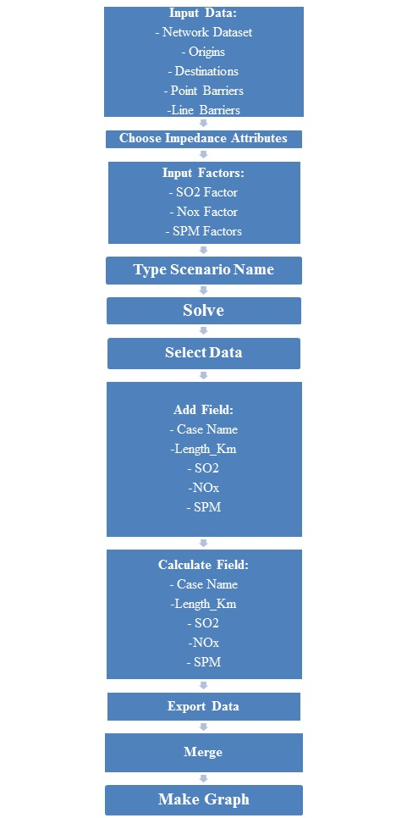
Model Design and Implementation
Travel Cost Simulator Model

Slide 15
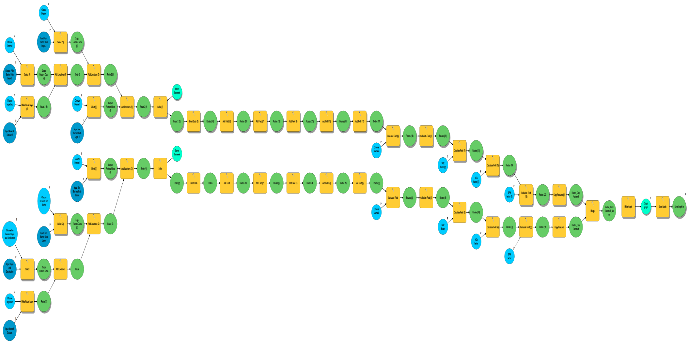
Model Design and Implementation
Travel Cost Simulator Model

Slide 16
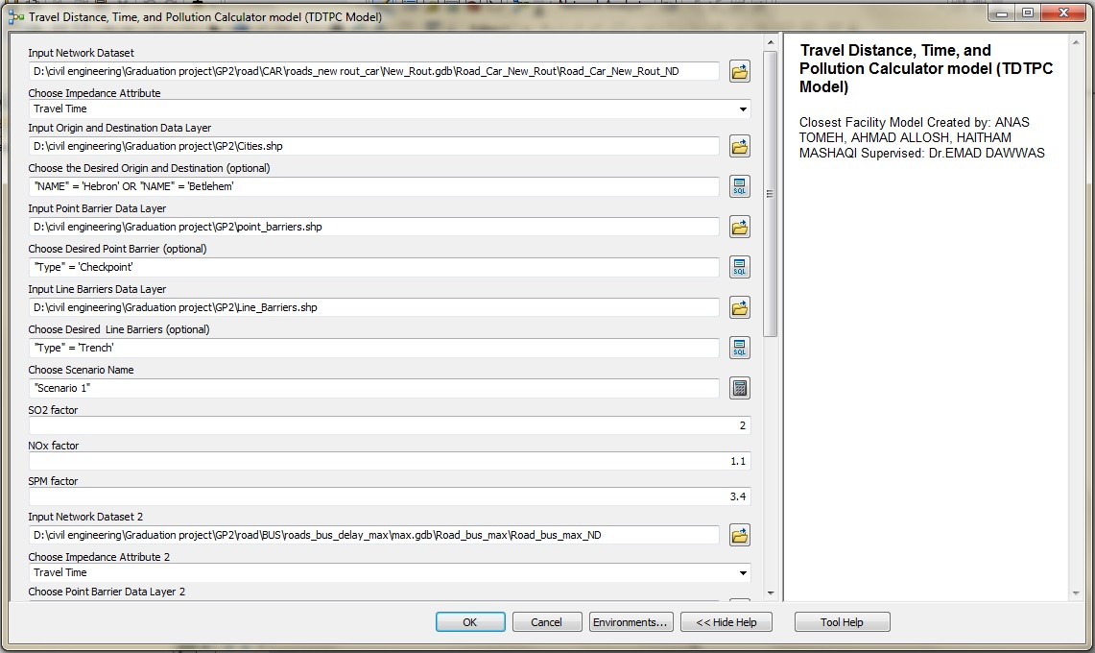
Model Design and Implementation

Slide 17
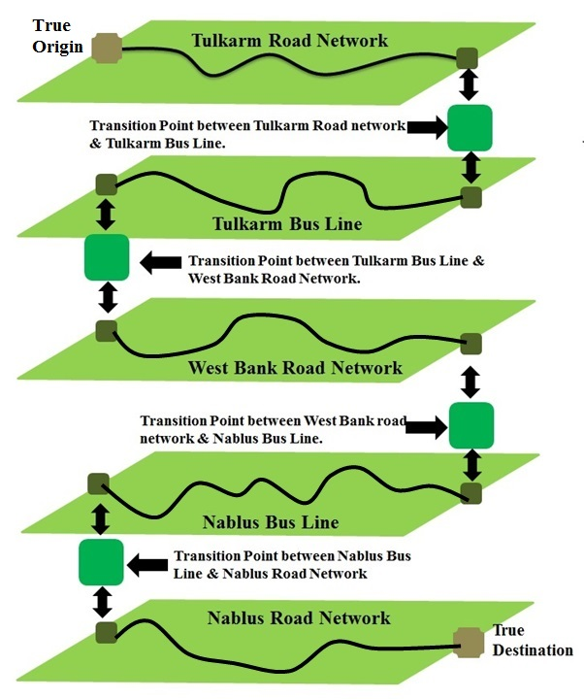
Multimodal Network Dataset
Multimodal Network Dataset is a group of network elements linked to the geographical nature (edges, intersections) which is derived from a network of sources.

Slide 18
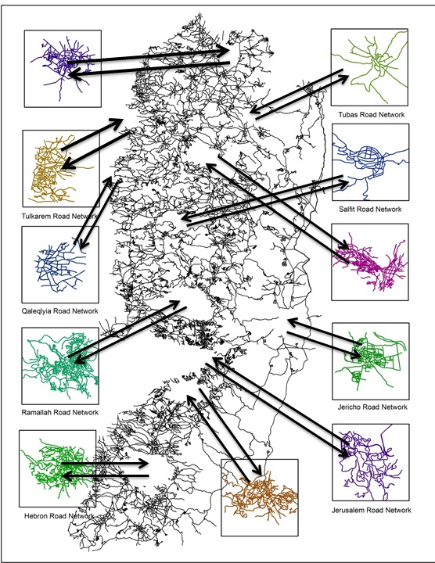
Multimodal Network Dataset

Slide 19
Model Design and Implementation
Network Dataset
Car
Bus
Normal Conitions
Crossable with longest Delay
Crossable with shortest Delay
All checkpoint are closed
Normal Conitions
Crossable with longest Delay
All checkpoint are closed
Crossable with shortest Delay

Slide 20
Model Design and Implementation
Road Network Name | Speed km/h | Source
West Bank using bus | 60 | Measured between Nablus and Tulkarem and used for all road in West Bank.
West Bank using Car | Main Roads = 85 Regional Roads = 80 | Eklund, L.2010 Accessibility to Health Services in the West Bank, Occupied Palestinian Territory. Measured by the researcher using GPS system.
Each one of the governorates road networks using Bus or Car | Main = 59 Local = 46 | Eklund, L.2010 Accessibility to Health Services in the West Bank, Occupied Palestinian Territory. Measured by the researcher using GPS system.

Slide 21
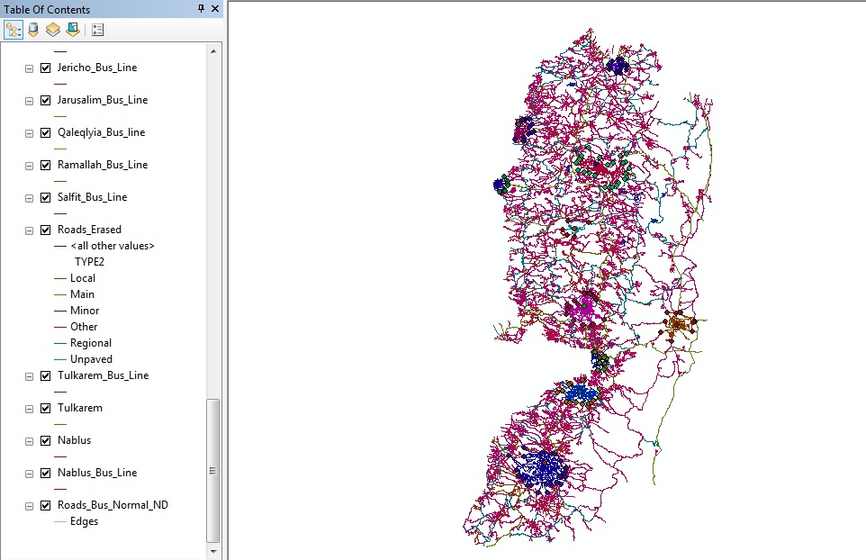
Model Design and Implementation

Slide 22
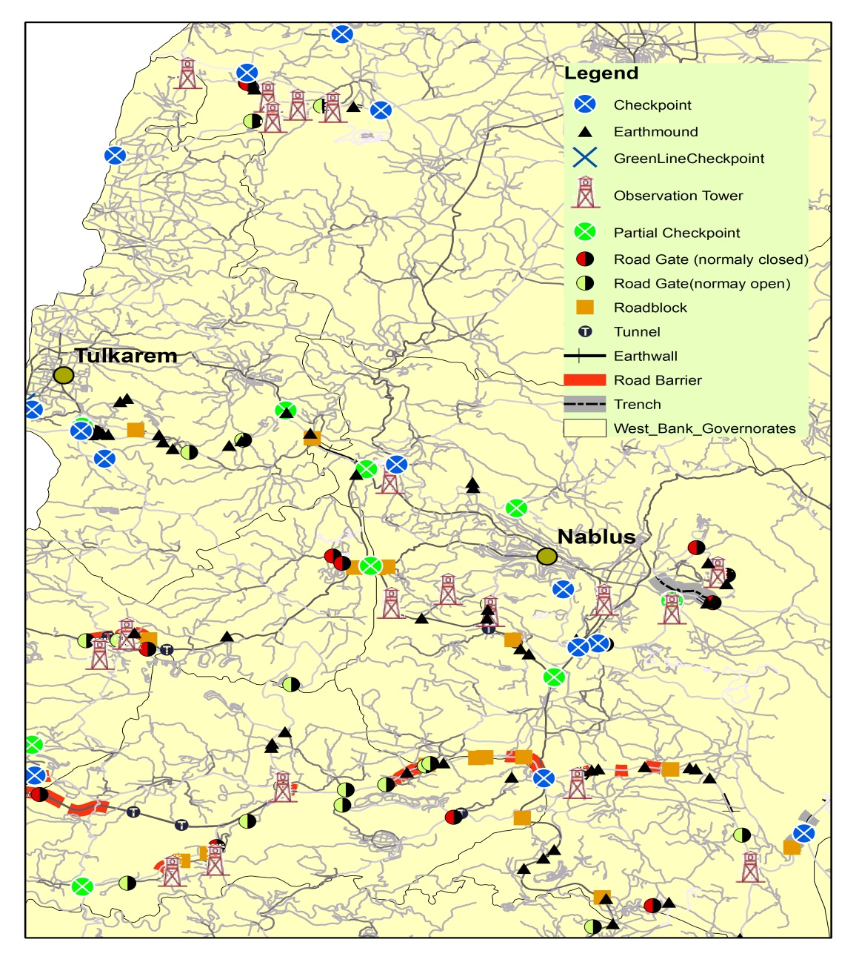
Application

Slide 23
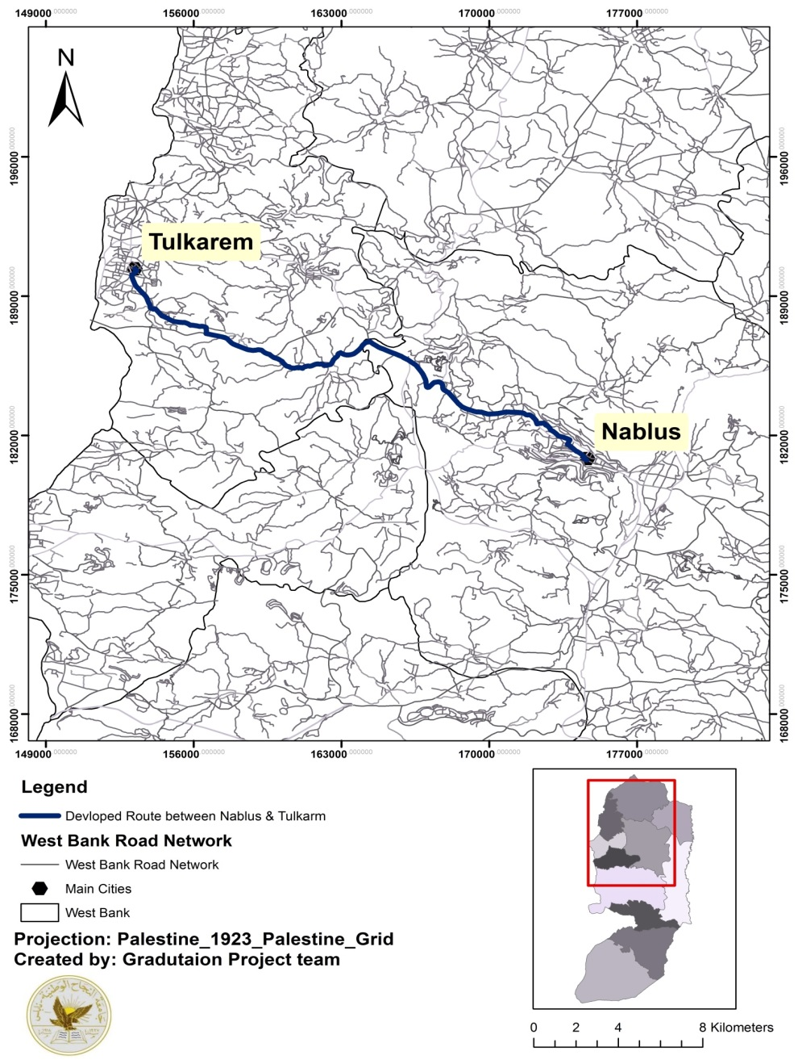
Application
Normal Route between Nablus & Tulkarm.

Slide 24
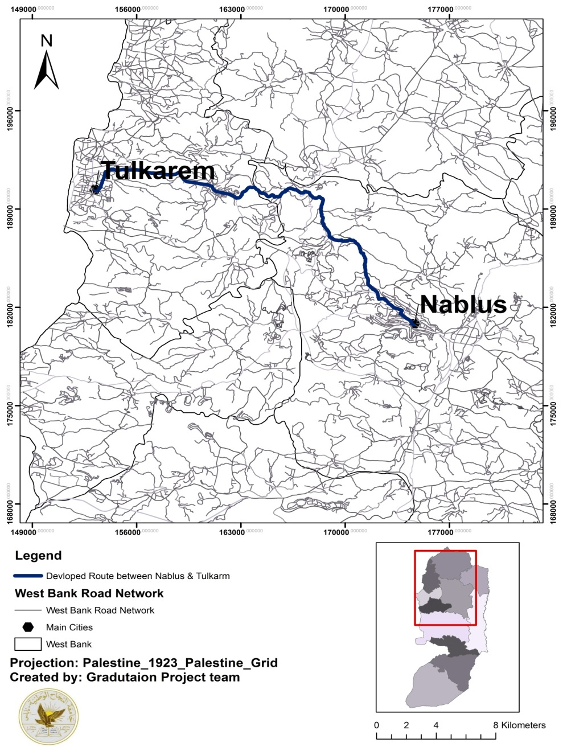
Application
Developed Route in closed conditions

Slide 25
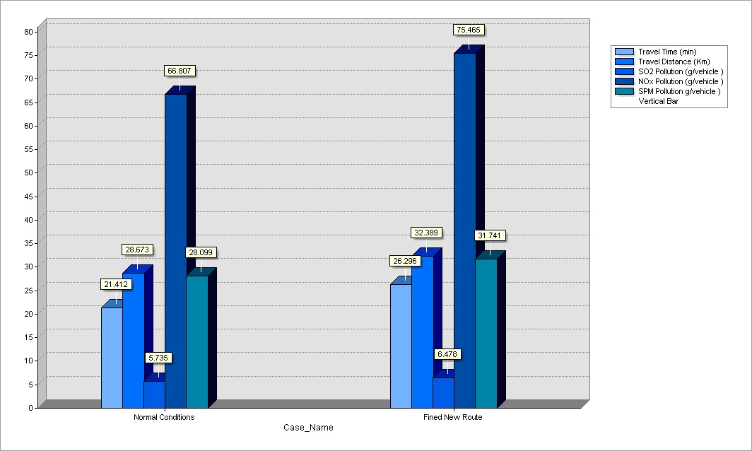
Application
Results
Normal travel conditions Vs. Checkpoints are closed when traveling using privet car:
-Travel Distance increased by about 120 %.
-Travel Time increased by about 130 %.
-SO2 increased by about 115 %.
-NOx increased by about 113 %.
-SPM increased by about 113 %.

Slide 26
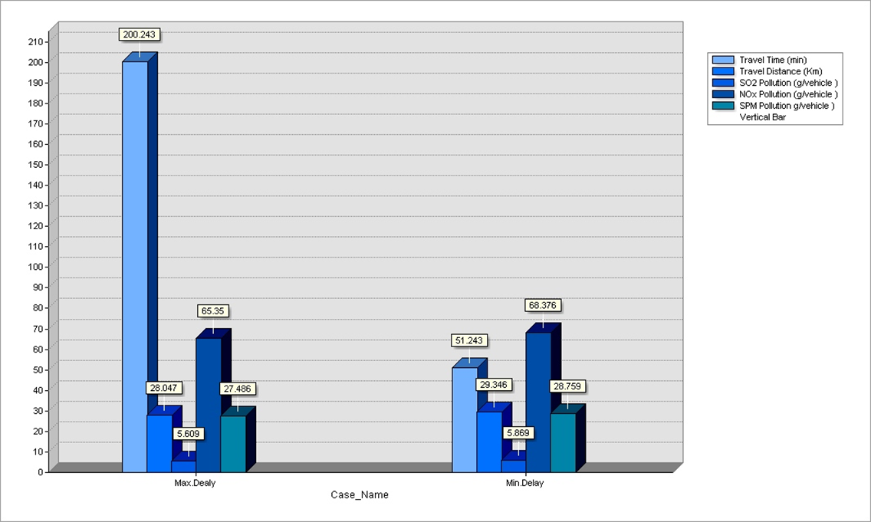
Application
Results
Maximum delay Vs. Minimum delay at checkpoints when traveling using car :
-Travel Time increased by about 400 % from minimum delay and 900 % from normal conditions.
-Travel Distance, Pollutions does not significantly affected.

Slide 27
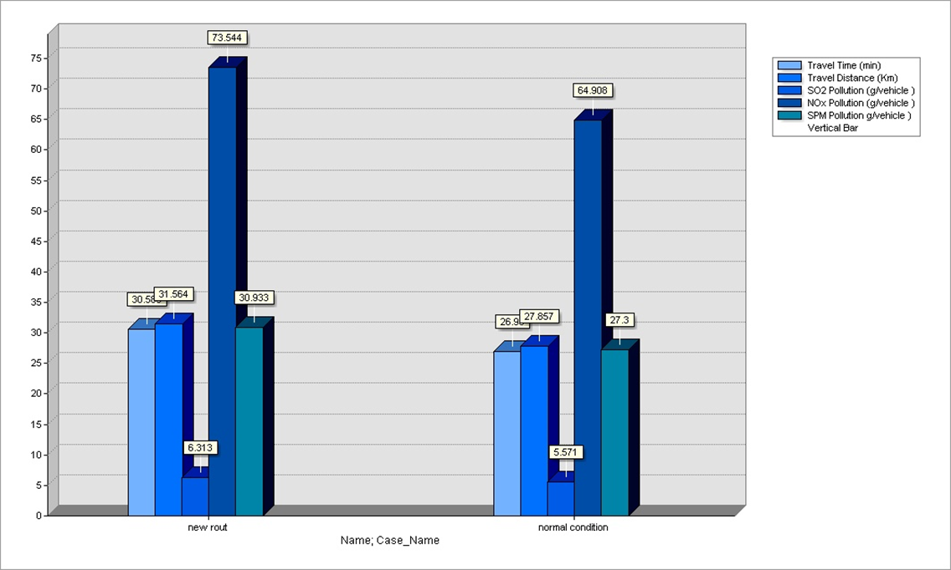
Application
Results
Normal travel conditions Vs. Checkpoints are closed when traveling using Bus:
-Travel Distance increased by about 115 %.
-Travel Time increased by about 115%.
-SO2 increased by about 113%%.
-NOx increased by about 113 %.
-SPM increased by about 114 %.

Slide 28
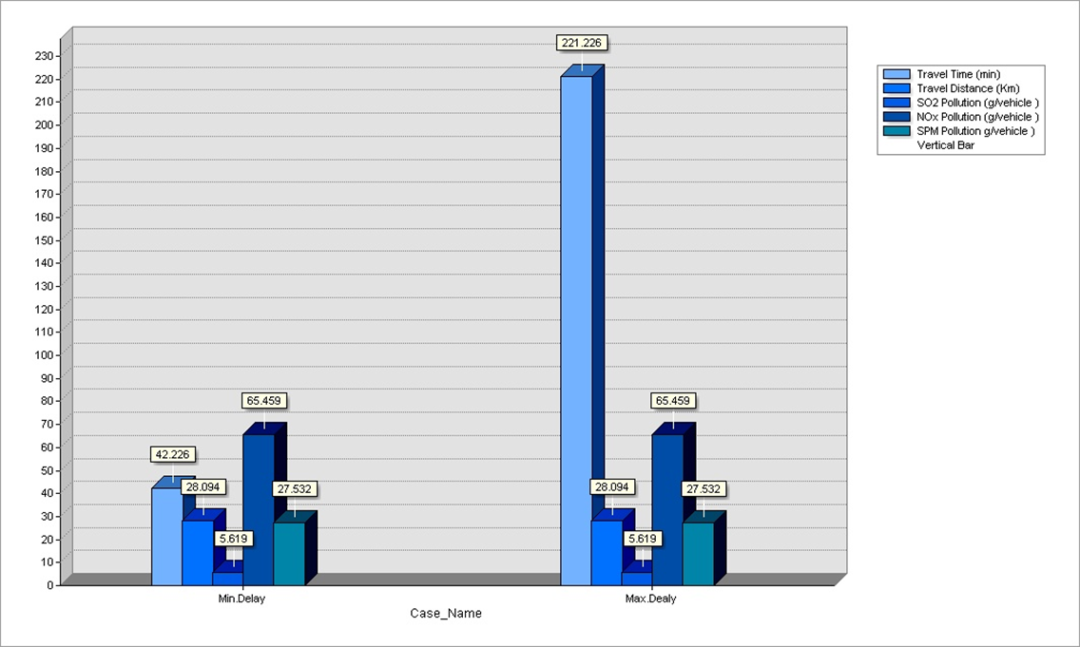
Application
Results
Maximum delay Vs. Minimum delay at checkpoints when traveling using Bus :
-Travel Time increased by about 500 % from minimum delay and 850 % from normal conditions.
-Travel Distance, Pollutions does not significantly affected.

Slide 29
Conclusion
The ability of the service area model creates reasonable service areas that can be used to assess accessibility in desired area.
The ability of Travel Cost Simulator Model to create graph that provide a simple display of comparison between any to desired and assumed scenarios
The models are applicable for any group of data set under any closure.
The final output of two models is reasonable.
If accurate data were available the models can provide accurate results about any situation under considering.

Slide 30
Further Works
The model can be further processed to suit other projects, some of them are done, and others still need more works. For example, it can be applied on a transit car line used to transfer Al-Najah National University students between the old and the new campus in Nablus, so it can evaluate the potential environmental impact on the atmosphere along the line of travel, and so precaution procedures can be made in the case of possible hazard that might happen.
These two models can measure the previous factors for any environment they applied in, so for example the Travel Cost Calculator can be applied inside main cities to predict trip time mainly and the other factors and provide alternative routes when the main routes are closed for any reasons.
Traffic Zone is an important study for Transportation engineering and urban planning engineering; Travel Cost Simulator model can be developed to help in commuting travel time, travel distance, and any needed factors between origins and destinations.

Slide 31
Recommendations
It’s recommended to developing the networks used in building the networks datasets to make the model produce accurate data as follow:
Providing accurate data layers for each road network contains all road network and its types.
Providing accurate values for travelling speeds for any mode of transportation in any road network.
Provide accurate data layers for modes of transportation travel lines, since some modes uses specific roads to travel from source to target such as Bus line, Street cars.
Provide accurate data layers for all parking in main cities, since these parking represent the transition points between roads network in the network datasets, these data layers should contain accurate information about what road network the parking connect.
Developing checkpoints walking routs data layers, the data layer represent the cases when Palestinians were had to walk around some checkpoints which is significantly impacts the travel time.

Slide 32
Recommendations
It’s recommended to develop the service area model to be able to extract information from its generated polygons, since the model in its current stage needs from users to extract the desired information from generated polygons manually.
It’s recommended to develop the Travel Cost Simulator Model to provide flexibility to user to choose any the five factors to be calculated and displayed separately without the need to calculate the other factors. This development makes the model executing process ending faster.
Its recommended to provide accurate input data layers, these data layer includes checkpoints, separation wall and others. Creating these data layer consumes time and effort to obtain their sources and treats it to be in form of data layers, usually these sources are relatively old and hard to reach. So providing continually sources update or providing new aerial photo will help in reducing time and effort.

Slide 33
Thank You For Attention.
Ready To Learn From You comments.

