Slide 1


An - Najah National University
“ Towards Zero Energy School
In Nablus City ”
Supervisor : Dr. Muhannad Haj Hussein
Prepared By :
Azza Natour
Mais Dalab
Sama Abu Shanab

Slide 2




Slide 3
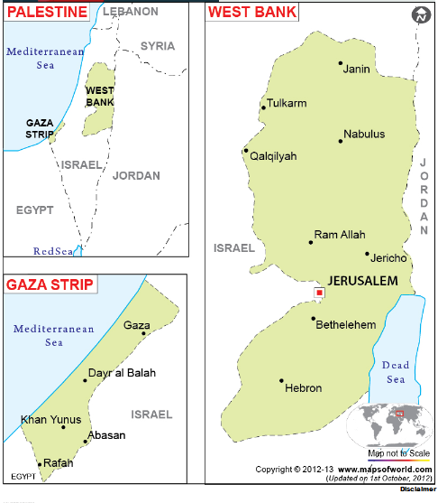

Slide 4
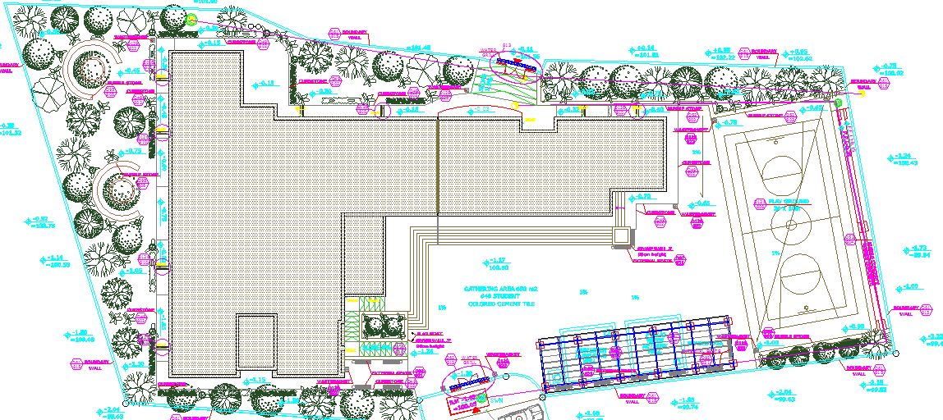

Slide 5
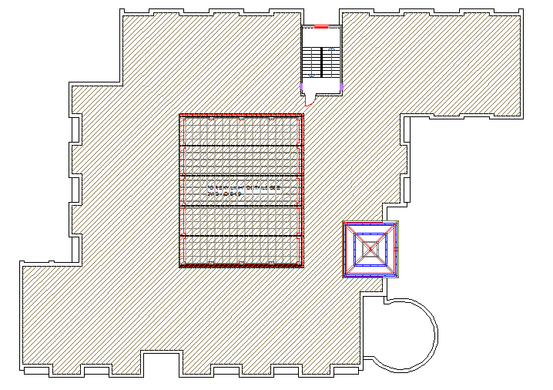

Slide 6
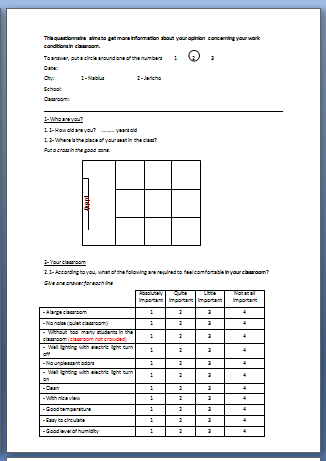
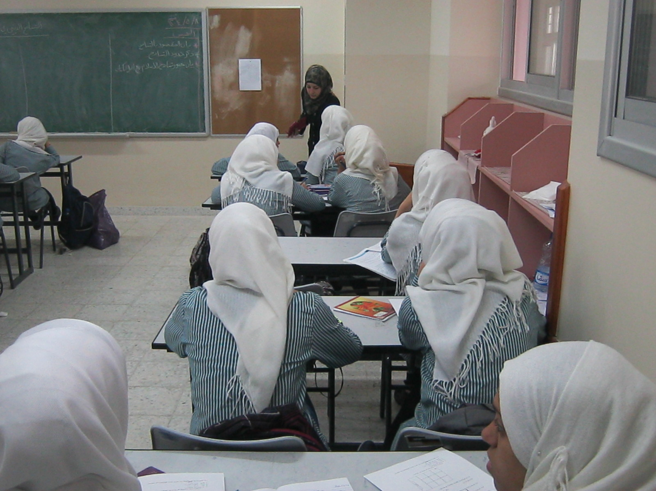

Slide 7
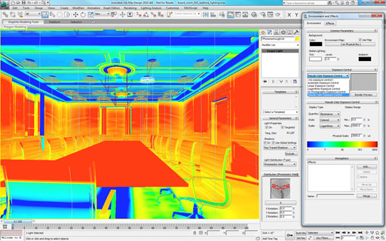

Slide 8


Slide 9

Architectural Design
9

Slide 10
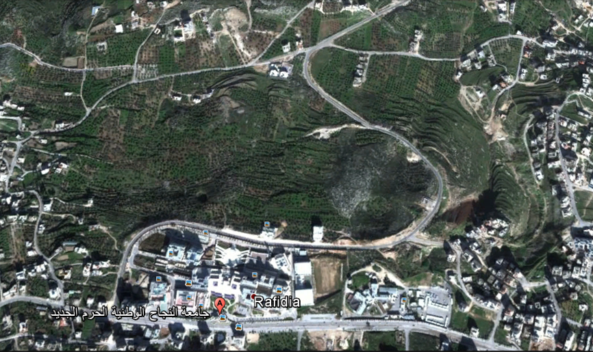
Site Description and Analysis:

Slide 11
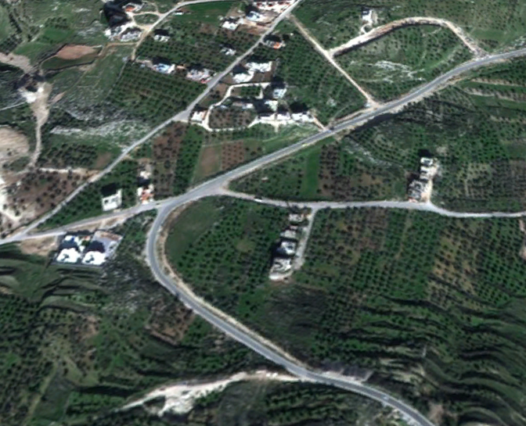

Slide 12
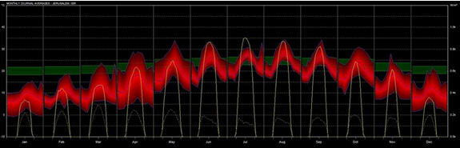
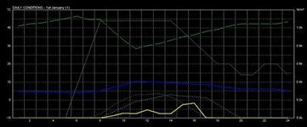
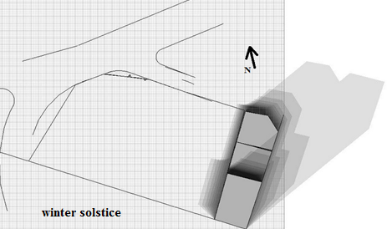
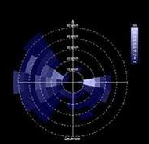
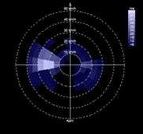
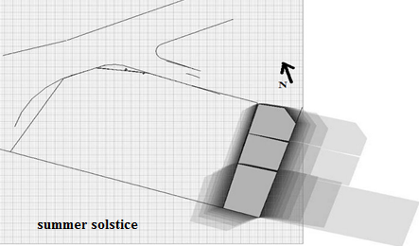
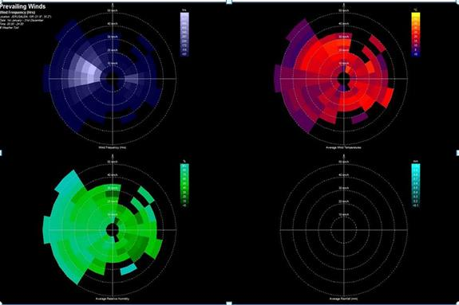

Slide 13
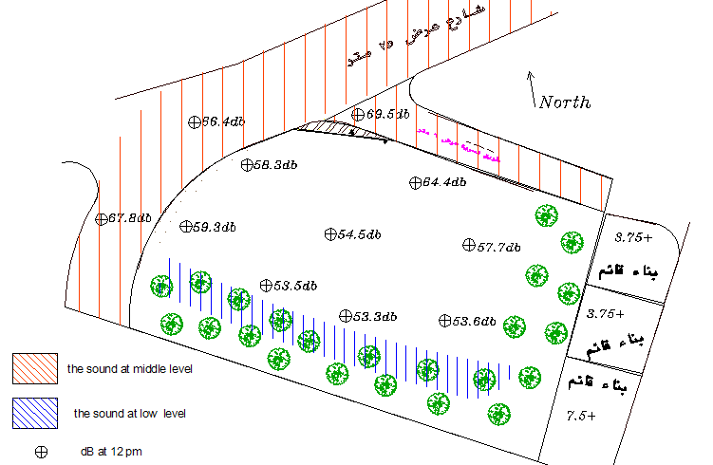

Slide 14
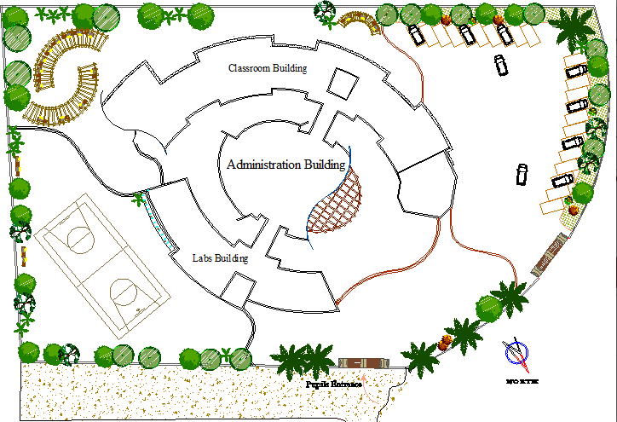
Design School Concept

Slide 15
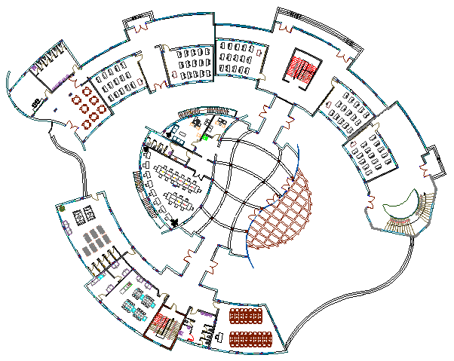

Slide 16
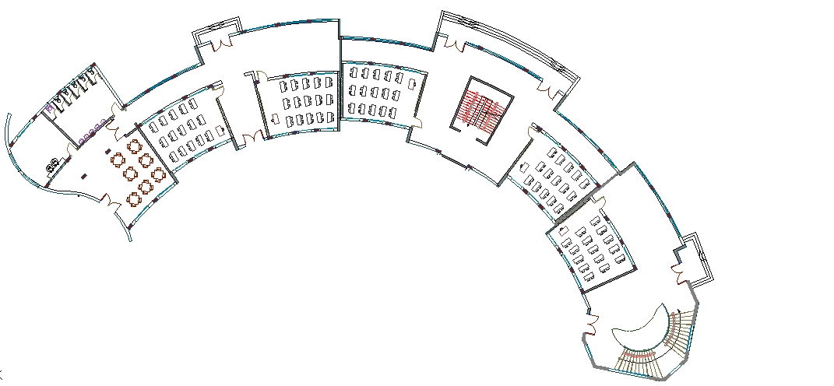

Slide 17
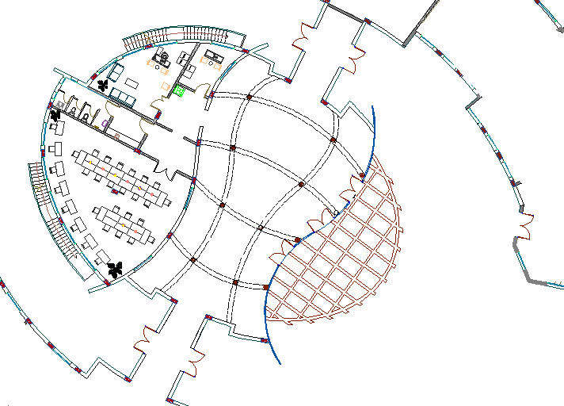

Slide 18
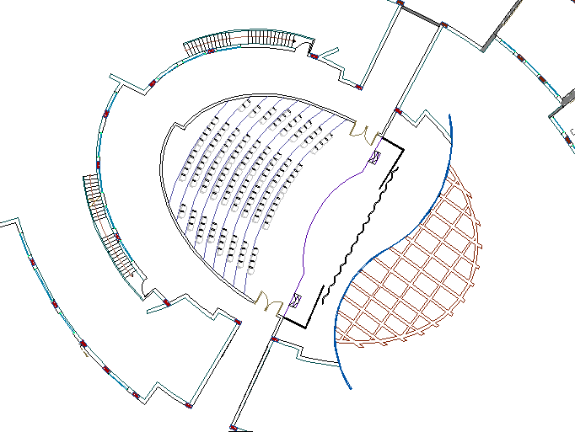

Slide 19
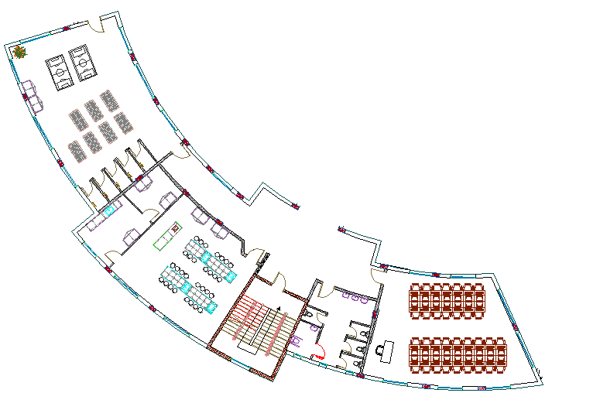

Slide 20
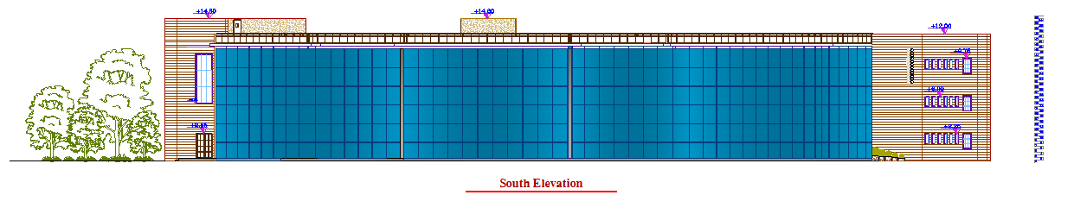
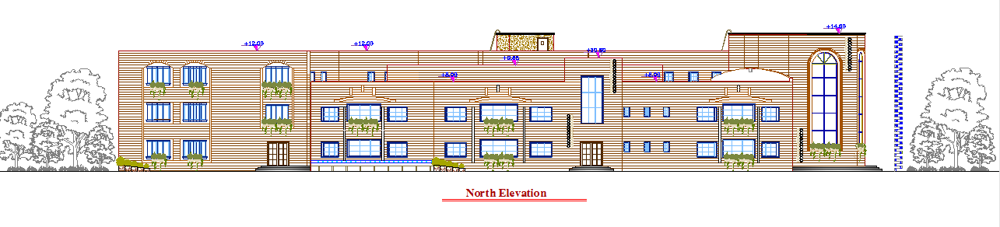

Slide 21
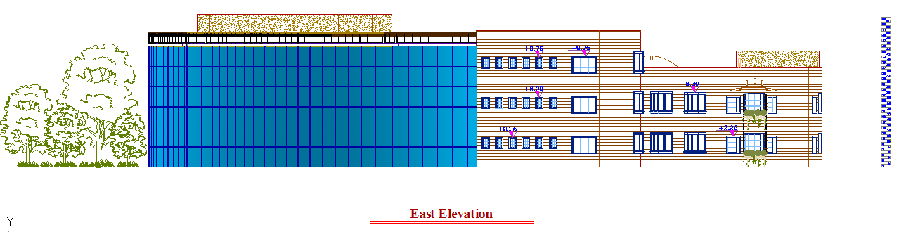
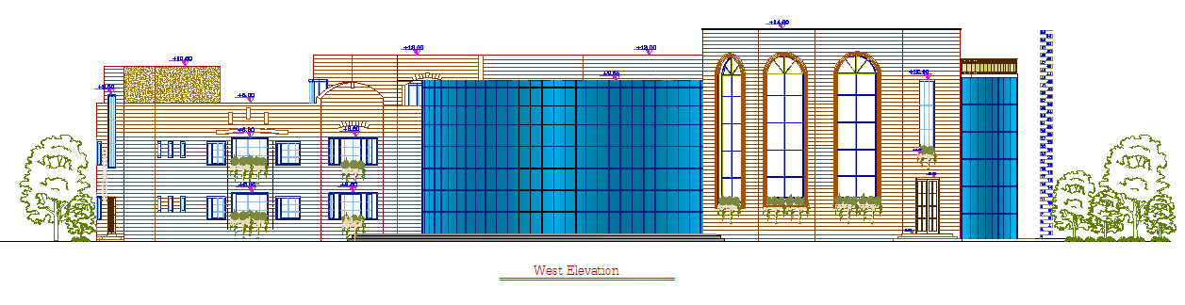

Slide 22
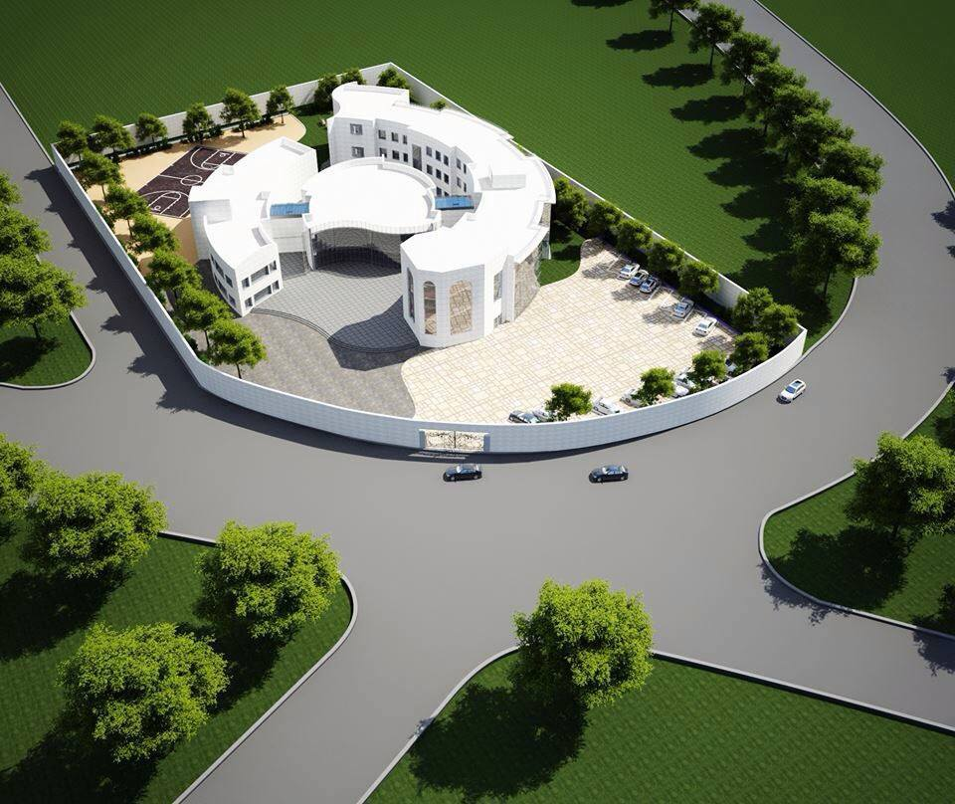

Slide 23
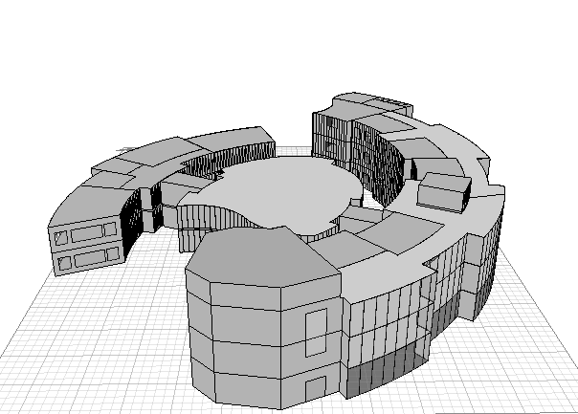
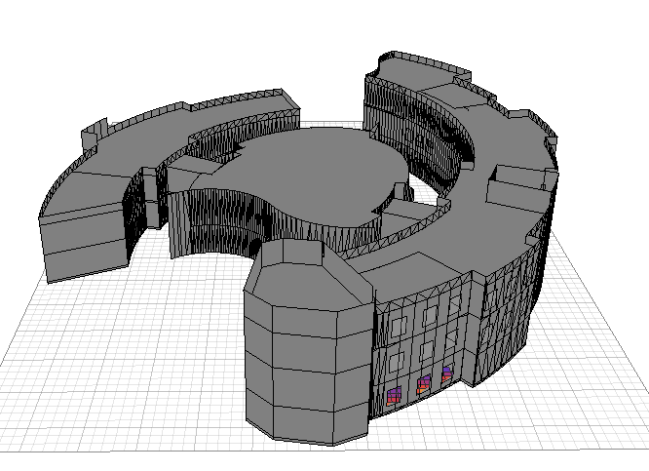
Environmental analysis

Slide 24
U value for each element :
 | U value (W/m².K)
External wall | 0.56
Ground floor | 0.4
Ceiling | 0.51
roof | 0.38
Partition | 2.65
Window | 2.41

Slide 25
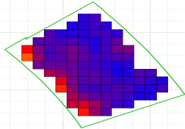
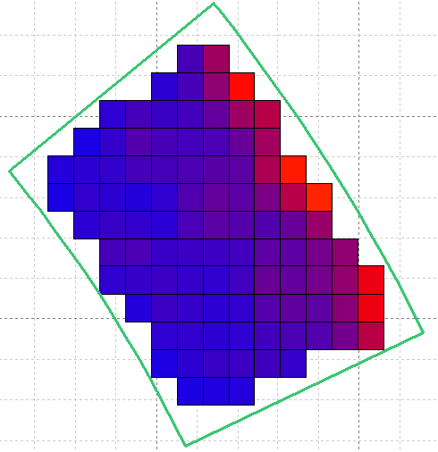
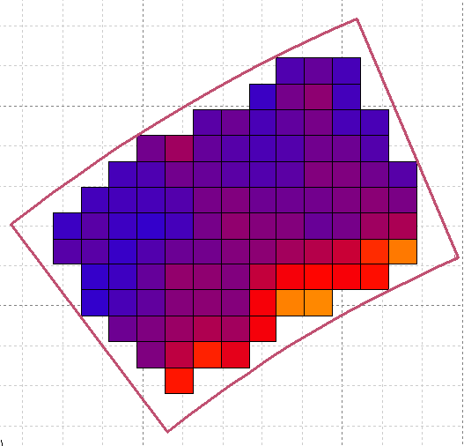
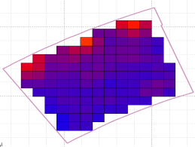
Natural Day light analysis
Activity | Floor | Orientation | Value |  | Picture
 |  |  | D.F | Lux
Classroom 1 | Ground | North | 3.94% | 354.8
Calssroom1 | Ground | South | 4.53% | 407.5
Classroom 5 | first | North | 4.17% | 374.9
Classroom 5 | first | South | 4.17% | 374.9

Slide 26
Thermal analysis and ventilation.
External wall material | Partition material | Too hot (deghrs) | Too cool (deghrs) | Total (deghrs)
External wall with 3cm insulation in the middle | Partition 15 cm block | 35422 | 414 | 35836
 | 10 cm block , 3cm insulation , 10 cm block | 35422 | 414 | 35836
 | 1.4 cm Gypsum board , 3cm insulation, 1.4 cm Gypsum board | 35634.5 | 391.4 | 36026
External wall with 4cm insulation in the middle | Partition 15 cm block | 35596.5 | 375.9 | 35972.4
 | 10 cm block , 3cm insulation , 10 cm block | 35500.5 | 385.1 | 35885.6
 | 1.4 cm Gypsum board , 3cm insulation, 1.4 cm Gypsum board | 35715.3 | 365 | 36080.3

Slide 27
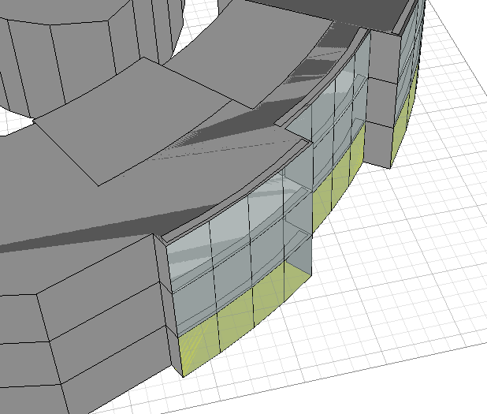
ventilation.

Slide 28
Heating and cooling results
 | HEATING | COOLING | TOTAL
MONTH | (Wh) | (Wh) | (Wh)
Jan | 1627698 | 1730338 | 3358036
Feb | 1465938 | 441613 | 1907552
Mar | 958045 | 2073898 | 3031943
Apr | 253416 | 3083734 | 3337150
May | 33986 | 5147326 | 5181312
Jun | 0 | 0 | 0
Jul | 0 | 0 | 0
Aug | 0 | 646524 | 646524
Sep | 0 | 4646448 | 4646448
Oct | 0 | 5010512 | 5010512
Nov | 386126 | 3042232 | 3428358
Dec | 331637 | 3038692 | 3370328
TOTAL | 5056847 | 28861316 | 33918164
PER M² | 1631 | 9308 | 10939

Slide 29
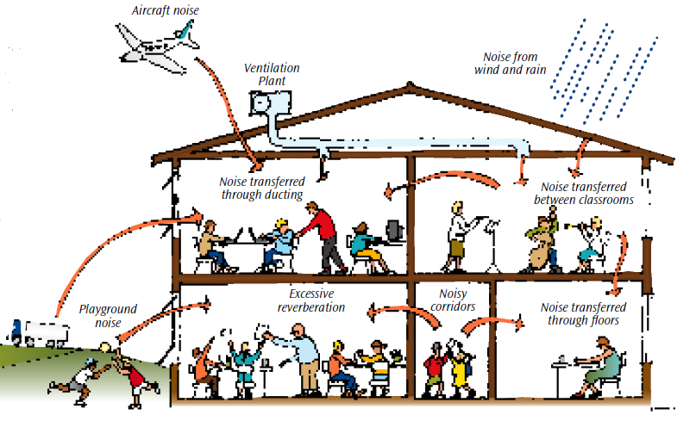
Acoustical analysis:

Slide 30
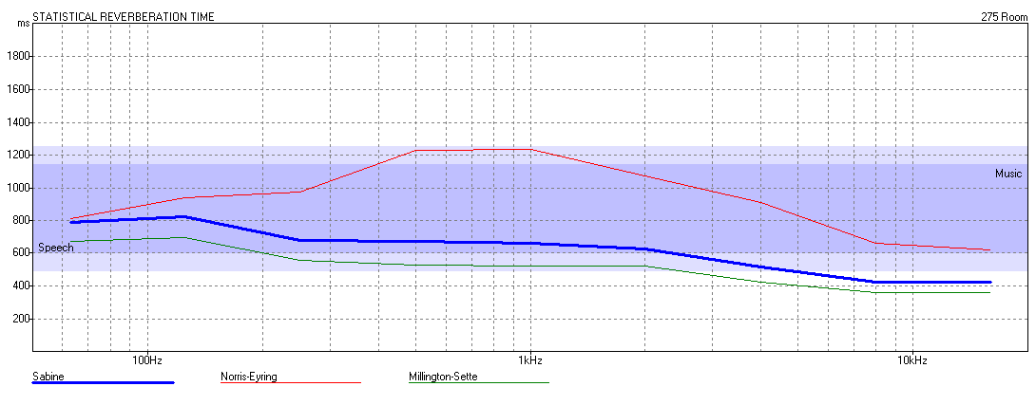
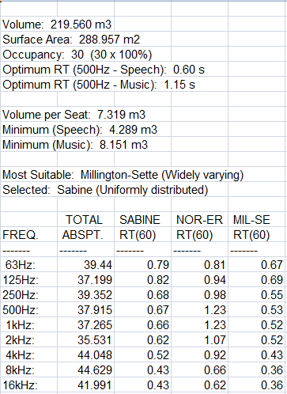
RT60 for classroom.
From previous figures and tables for RT60 we conclude that classroom are within range(0.6-0.8) .

Slide 31
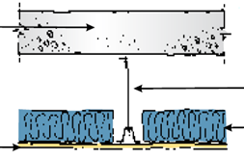
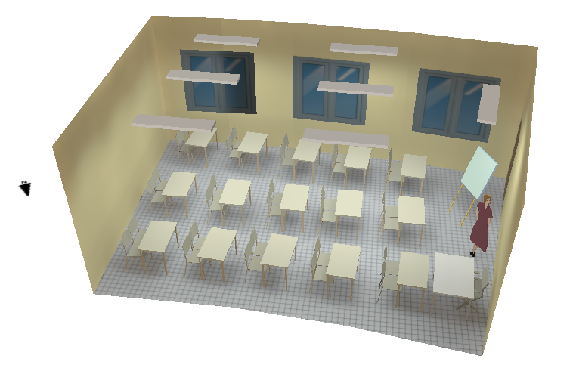
IIC & STC for rooms .
STC=59db
IIc = 49dB.
STC=45db

Slide 32
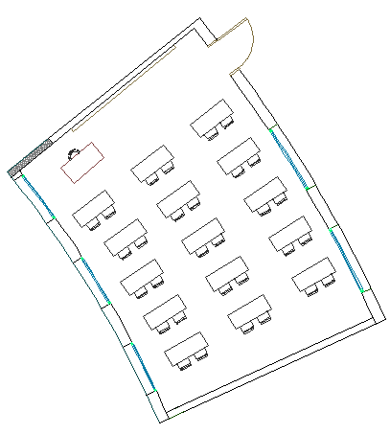
Background noise calculation.
Layers | STC
Masonry wall 40 cm with (23.13m^2) | 59
Window double glass with ( 8.1m^2) | 32
TLc | 38
Noted that the noise level in classroom shall be less than 25 , Thus the value calculated it is very good.
Noise =59db

Slide 33
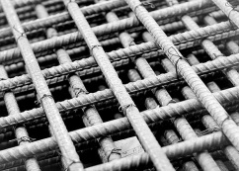
Structural Design

Slide 34
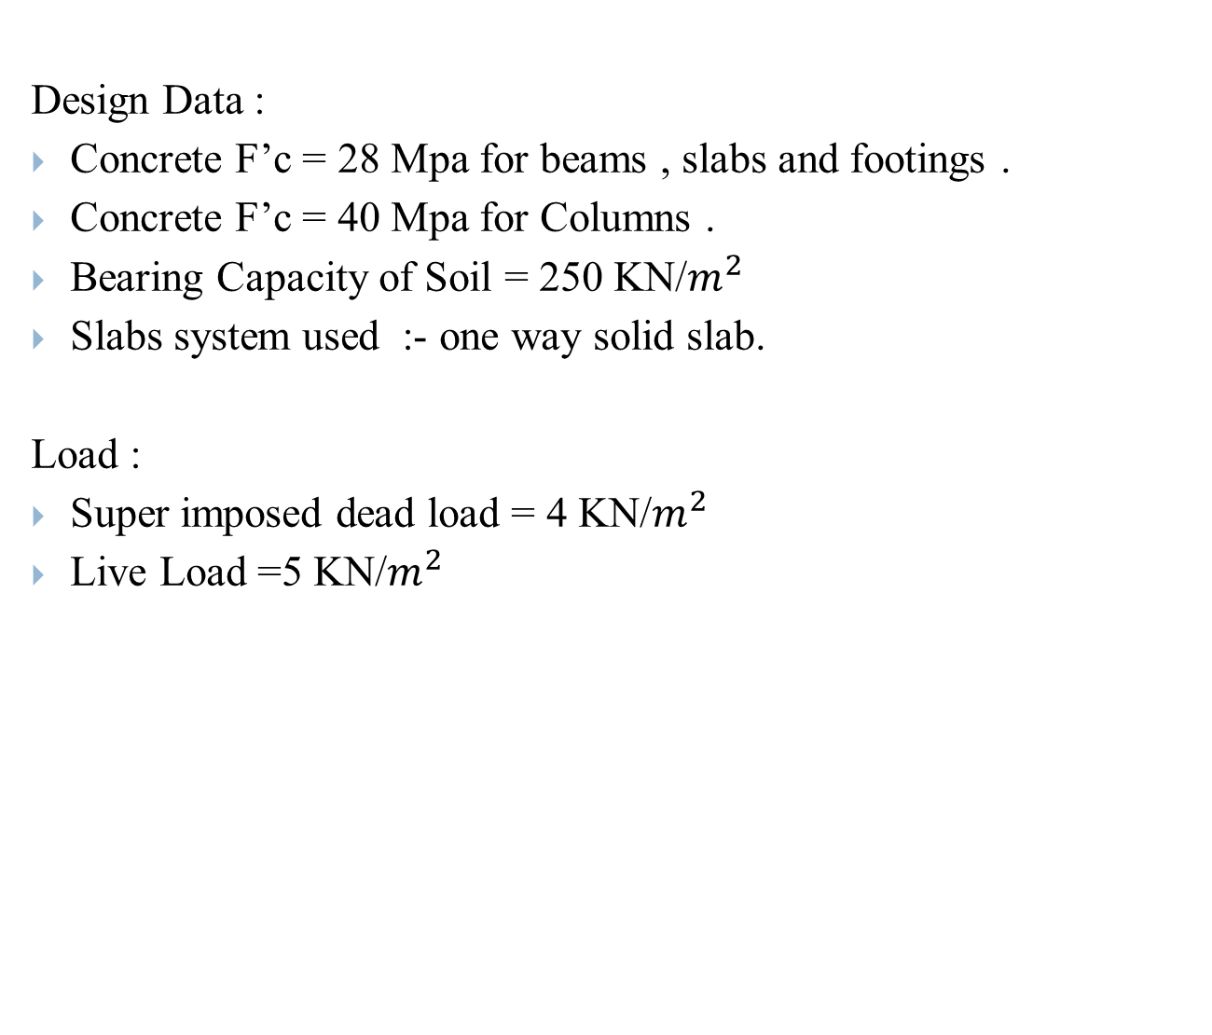
Structural Design
Design Data :
Concrete F’c= 28 Mpa for beams , slabs and footings .
Concrete F’c= 40 Mpa for Columns .
Bearing Capacity of Soil = 250 KN/$m^{2}$
Slabs system used :- one way solid slab.
Load :
Super imposed dead load = 4 KN/$m^{2}$
Live Load =5 KN/$m^{2}$

Slide 35
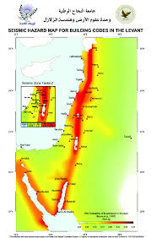
Seismic Design Data :
soil type S_{B}
Location → Nablus
zone =2B → Z=0.3
C_{V} = 0.45 , C_{a} = 0.36
I= 1.5 ( essential building )

Slide 36
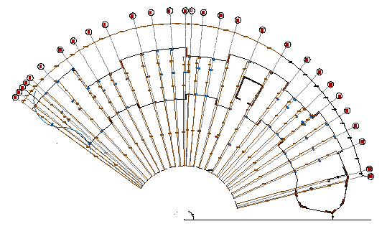
Column Center Lines Grid
Class Room Building

Slide 37
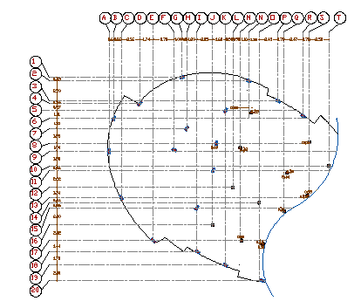
Administration Building

Slide 38
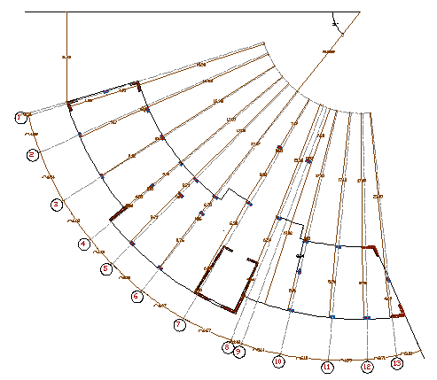
Laboratories Building

Slide 39

Class Room Building Structural Joints:
Block C
Block B
Block A

Slide 40
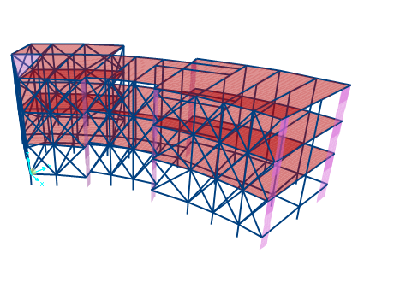
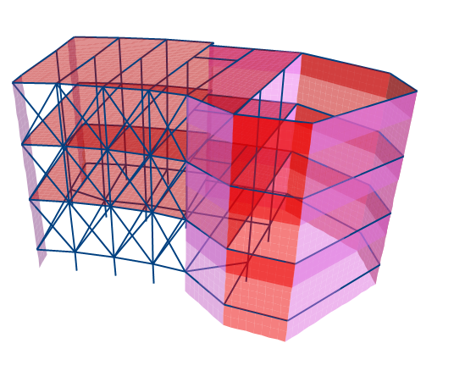
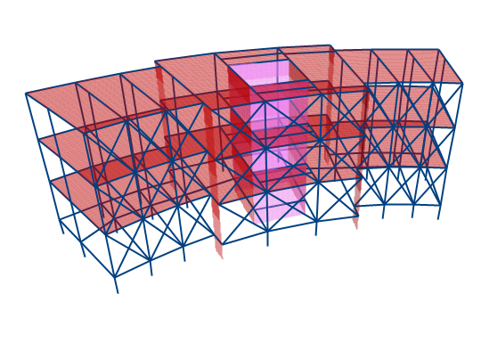

Slide 41
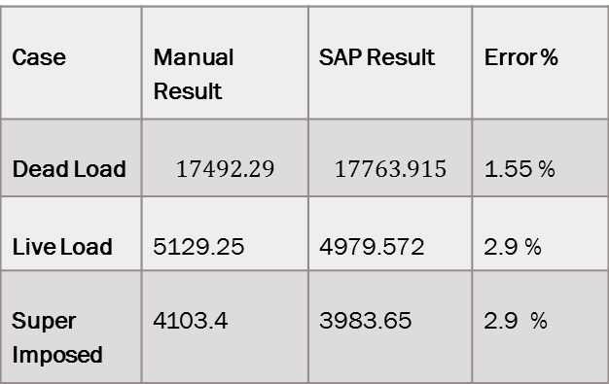
Beam | Manual Result (KN.m) | SAP Result (KN.m) | Error %
Beam 1 | 284 | 267.06 | 5.9 %
Beam 2 | 294.4 | 278.5 | 5.4 %
Beam 3 | 294.4 | 279.9 | 4.9 %
Beam 4 | 283.9 | 274.5 | 3.3 %
Beam 5 | 273.4 | 262.51 | 3.9 %
Case | Manual Result | SAP Result | Error %
Dead Load | $$17492.29$$ | $$17763.915$$ | 1.55 %
Live Load | 5129.25 | 4979.572 | 2.9 %
Super Imposed | 4103.4 | 3983.65 | 2.9 %

Slide 42

T SAP | T manual | %error
0.329 | 0.300 | 0.088 %

Slide 43

Footing Plan :

Slide 44


Three Types of footing :
Single Footing
Combined Footing

Slide 45


Shear Wall Footing

Slide 46

Tie Beam Plan

Slide 47

Column Design

Slide 48

Longitudinal Column Sections :

Slide 49


Slabs Reinforcement:
49

Slide 50



Beam Reinforcement :

Slide 51

Shear Wall Reinforcement

Slide 52

Stair Case Reinforcement

Slide 53

Reinforcement around windows

Slide 54

Mechanical Design

Slide 55
Mechanical design consists of :
Water Supplying System.
Drainage System.
Rain Water Drain System.

Slide 56

Water supplying for school
Water Demand (gpm) |  | Number of Fixture Units |  | Type of Supply Control | Zone A
Recycled | Clean | Recycled | Clean
20 | 8 | 30 | 10 | Flush tank | Ground Floor
20 | 8 | 30 | 10 | Flush tank | First Floor
20 | 8 | 30 | 10 | Flush tank | Second Floor

Slide 57



Slide 58

BLACK Water DRAINAGE

Slide 59

Rain Water harvesting

Slide 60

Gray water drain

Slide 61

FIRE Fighting system

Slide 62

Electrical Design

Slide 63

Socket Arrangement

Slide 64



Artificial Lighting

Slide 65


 | Value
Eavg. | 423
Uo | 0.606
UGR | 10-15

Slide 66



 | Value
Eavg. | 537
Uo | 0.689
UGR | 10-17

Slide 67

Photovoltaic System

Slide 68


Slide 69
Annual School Usage | -10126.8 KW.hr
Total Annual Price | -7595.1 NIS
Photovoltaic Annual Production | +14200 KW.hr
Total Annual Price | +10650 NIS
+3054.9 NIS

Slide 70


Slide 71

Quantity surveying

Slide 72
Quantity surveying calculation
Quantity | Unit | Work
792.88 | M3 | Earth work
2181.63 | M3 | Concrete work
103.122 | Ton | Steel work
12598.86 | M2 | Form work
14756.37 |  | Finishing work
490 | Unit | Electrical work

Slide 73


