Slide 1

X
FLOPPY
CLOUD
We are introducing
Backup System
Bahaa Tuffaha
Osama Alawwad
Dr: Othman Othman

Slide 2

INTRODUCTION
Information is everything, and the need for backups incresses everyday
Explaining our concept

Slide 3



LITERATURE REVIEW
Finding a system In the current marketplace similar to ours.
a
Windows recent files experiments.
c
b
How current backup systems lacks features.
d
Exploration the Psutil library.

Slide 4

MOTIVATION
Adding features
Automatic backup system.
Stepping Stone
Windows recent files is the first idea that inspired us to work in this project.
Marketplace
How current systems in marketplace needs more features.

Slide 5
GOALS & OBJECTIVES
12
11
1
Sorting and analyzing the data we acquired.
10
2
Collecting data on these opened files and folders.
9
3
Keep track of all currently opened
files in the system and folders.
8
4
7
5
6

Slide 6
GOALS & OBJECTIVES
12
11
1
Use machine learning to create a ranking for the files.
10
2
9
3
Encrypt and upload files to the cloud.
8
4
Optimize the resources usage.
7
5
6

Slide 7
Design
  Sending to Cloud
  Ranking
  Analyzer
  Collecting data
Encrypting, create md5 then send to database.
Using machine learning and other method
Sort, organize all sessions under its path.
Calculate Time
File observer
Folder observer

Slide 8
Design
Data collection – File bserver
Why we used python?
What is psutil library (process and system utilities)?
How this is actually working?
Here is a brief explanation on how file observer works
1
This psutil library will return a list of opened files.
Each file will have a timer using a thread.
2

Slide 9

Design
Each thread will take :
Path
Process name
Pid
User name
As parameters.
3
If the process associated with this file has been closed or the file-handle for that files has been shut , stop timer.
4
Then store the following in the pickle file as a session:
1-File name
2-Path
3-Start time
4-End time
5-Process name that opened this file
6-Pid of the process
7-Username
8-Last modified date from os
9-Creation date from os
10-Size file
5

Slide 10
Design
Data collection – folder bserver
We used a library called Win32 to help us communicate with windows explorer
Here is a brief explanation on how Folder observer works
1
This Win32 used within other functions to return a list of opened Directories.
Each Directory will have a timer.
2

Slide 11
Design
3
Each Directory will be checked if its still open
If a Directory is not open any more close the timer and store its data
4
5
Then store the following in the pickle file as a session:
1-File name
2-Path
3-Start time
4-End time
5-Creation date from os
6-Folder Size

Slide 12
Design
Folders data
Files data
File1 object
path
File(n) object
path
session1
Analyzer
The analyzer will process both files and folders
session1
session2
session2
session3
session3
session4
Session(n)
The Analyzer will do the following for files and folders:
Level 1:
Sort all sessions depending on the name of the file alphabetically.
Put every session with identical path under one bigger object represent that file.
Level 2:
Sort all sessions (for every file) depending on start-time in ascending order.
Adding other columns that relate to the folder and time functions.
Save all these columns for each file in CSV file

Slide 13

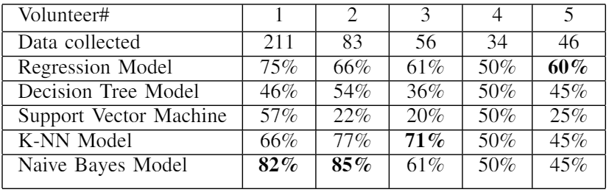
Design
Machine learning
Used machine learning models:
• Logistic Regression Model
• Decision Tree Model
• Support Vector Machine
• k-Nearest Neighbor Model
• Naive Bayes Model
F1 Score : is used to measure a test’s accuracy.
Notes:
Mention the Ranking if less than 75

Slide 14
Design
Machine learning
Due to having a small data, the results were inconclusive we tired to use Dummy data to get more results from the Machine learning algorithms and here is what we got …

Slide 15
Design
Machine learning
We tested out 2,000 dummy entry and the result as follow
25%
43%
50%
53%
62%
75%
77%
90%
100%
Logistic Regression
Decision Tree
SVM
K-NN
Naive Bayes

Slide 16


01
Problem
Config Files
Some text files are consuming a lot of time value in the data.
Machine Learning Problems
That cause confusion in the data
02
Problem
Problems
Temp Files
Some files get deleted after another file is closed like PowerPoint. e.g..($file.ppt)
03
Problem
OS related Files
Some files belong to the system, and some belong to other programs

Slide 17



01
Solution
Limit Files
Limit file selection to the preferred file size and specific type of extensions.
02
Solution
Machine Learning Solutions
That reduces the data confusion
Solution
Availability
Checking the existence of the file before uploading
03
Solution
Limit Paths
Limit path search in the
file observer

Slide 18

Uploading to Cloud Design
Cloud
01
Sorting
This phase consists of rearranging the data(files) depending on the ranking that has been calculated in the previous phase.
04
03
Commit
Upload encrypted files to document-oriented NoSQL database(CouchDB) as attachment under user email in that database.
Encrypt
Create hash code (MD5) for these files then encrypt each file using symmetric key encryption (AES)
02
Select files
Get top 5 most important files and check for existent and its within preferred size

Slide 19
Cloud System Process
Phase Two: Check and Upload
04
Commit
Send attachments to database and update the new calculated md5.
02
Re-calculate
File recalculate md5 to match the modified one.
03
Re-Encrypt
Encrypt the modified file.
01
Checking Files
Checking the md5 hash code for every file we have (to know if file changed or not).

Slide 20
EVALUATION & FINDINGS
Robust
Time analysis functions
Data gathering
We created a dummy data generator to stress test the analysis of the data. We tested with 100,000 dummy entries of files.
We had to test time
analysis functions that were created in the analysis phase using manual inserting data with pre-defined dates and duration time.
We had 5 volunteers to test our program and gather data as much as possible.
File handler
CPU usage
Machine-learning
We noticed that text and image file types cannot be seen by our program because of how these file types work while being read or written.
We used a couple of sleep commands to reduce the CPU stress. But that wasn’t enough, So we set the priority to low
Unfortunately, the data we collected was small due to some people concerning about their privacy, And anti malware program (Malwarebytes) for example detected our program (observer) as a malware (false positive).

Slide 21
Future work
Create a GUI
We can change adding manually in the future work to make the program take suggestion and recommendations from the user as popup windows.

Slide 22
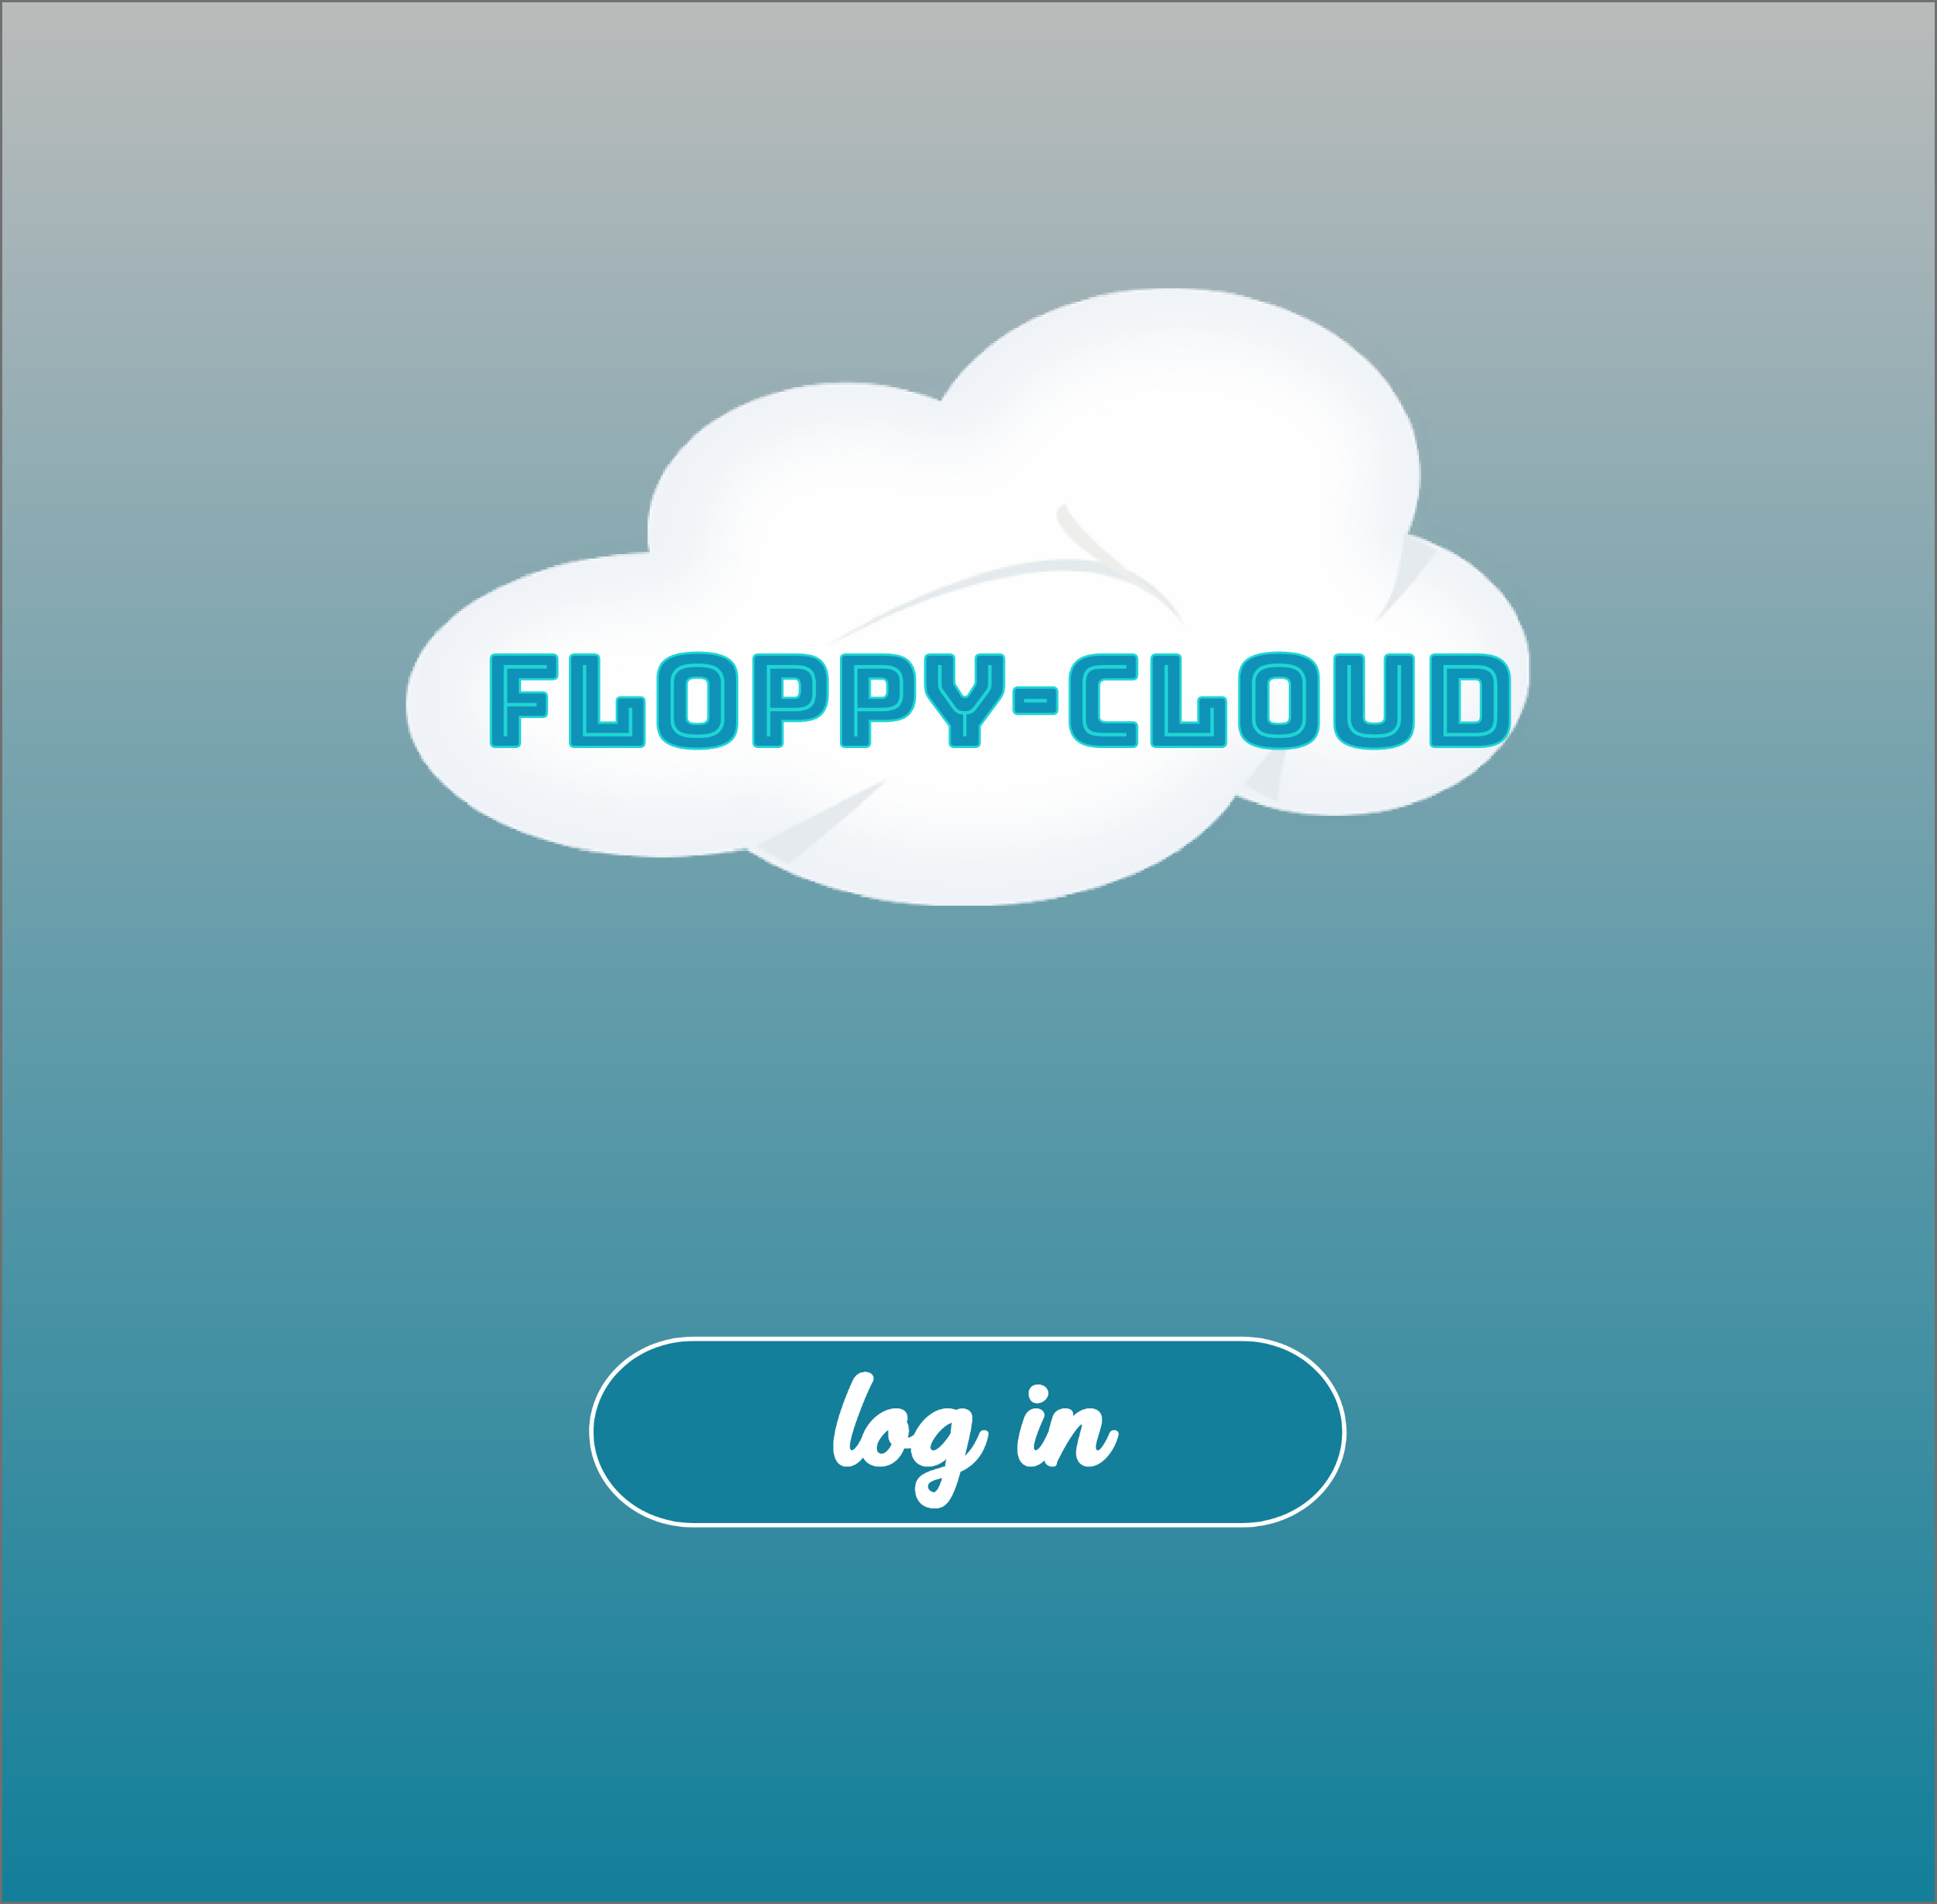
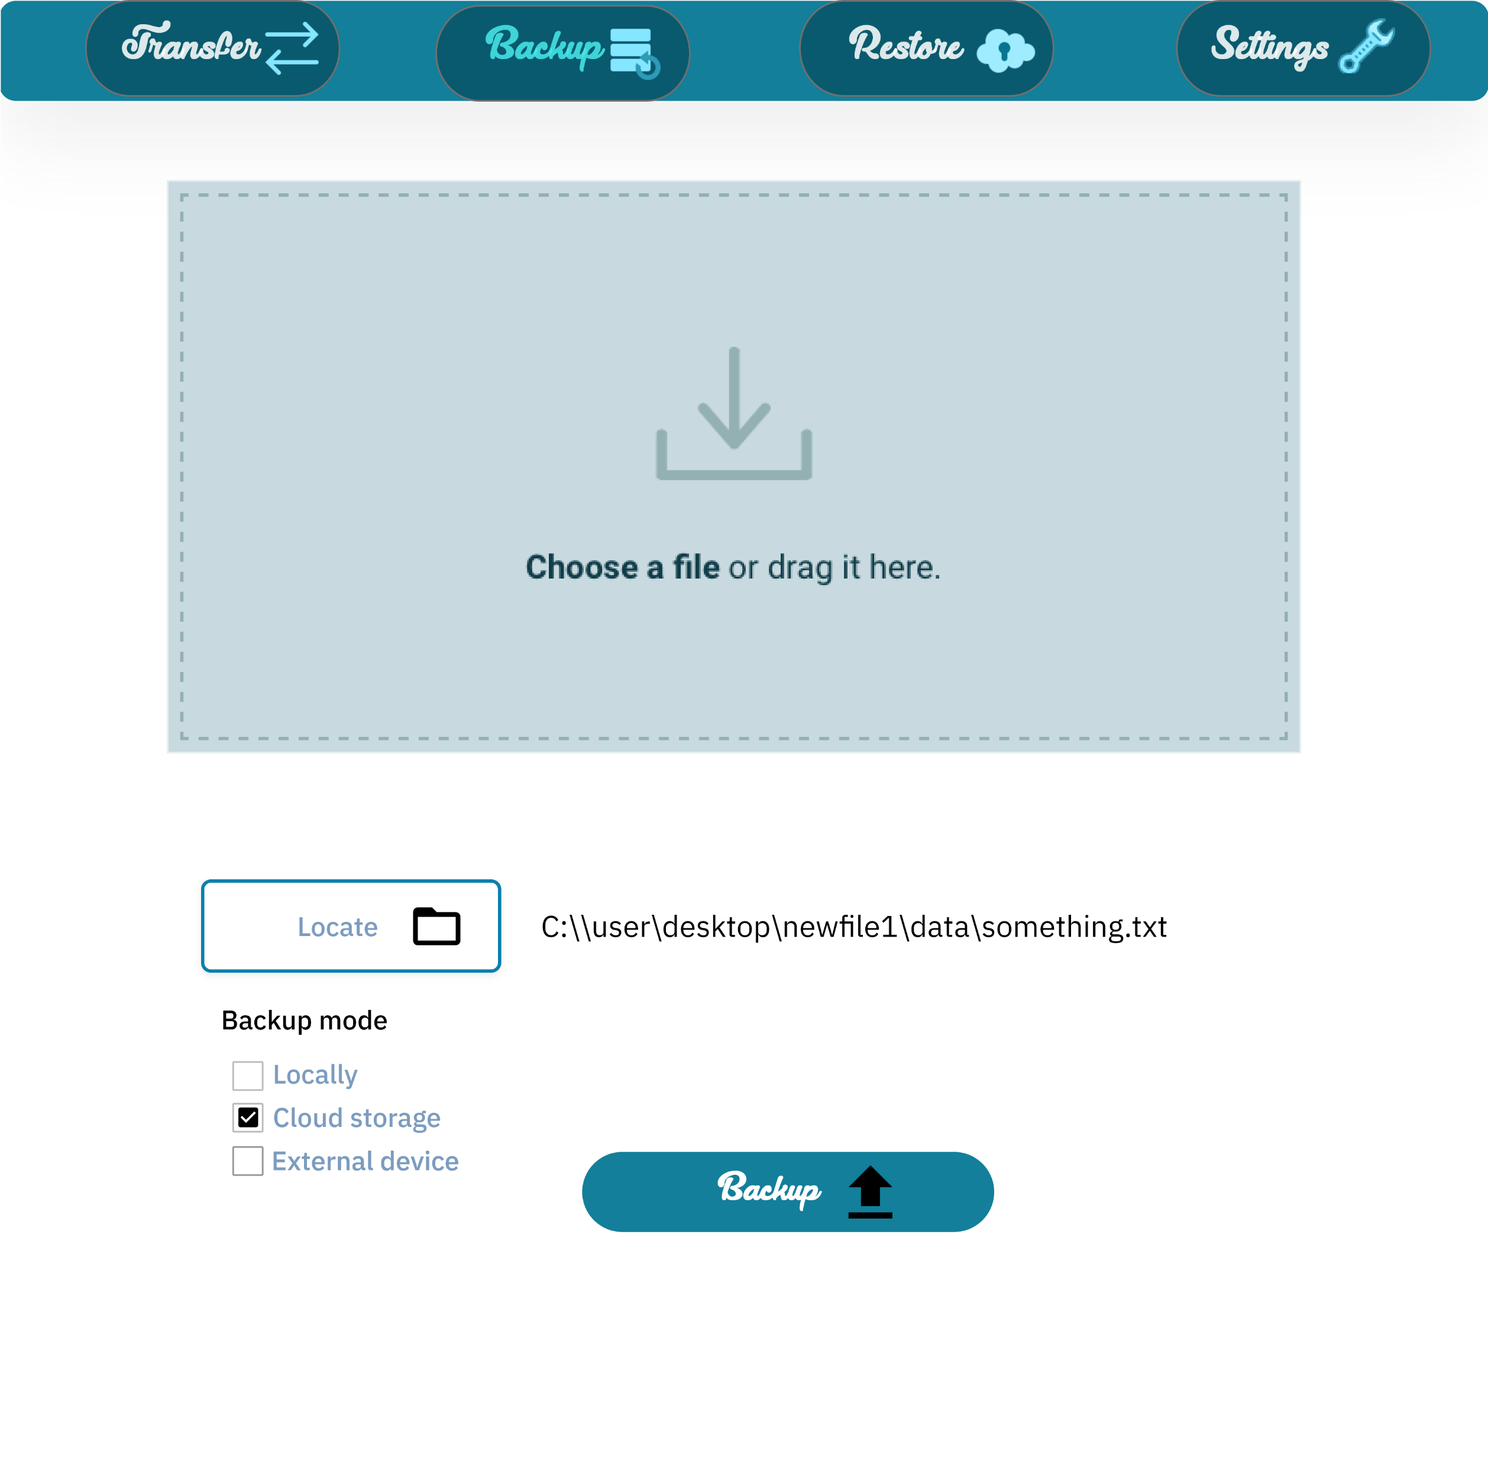
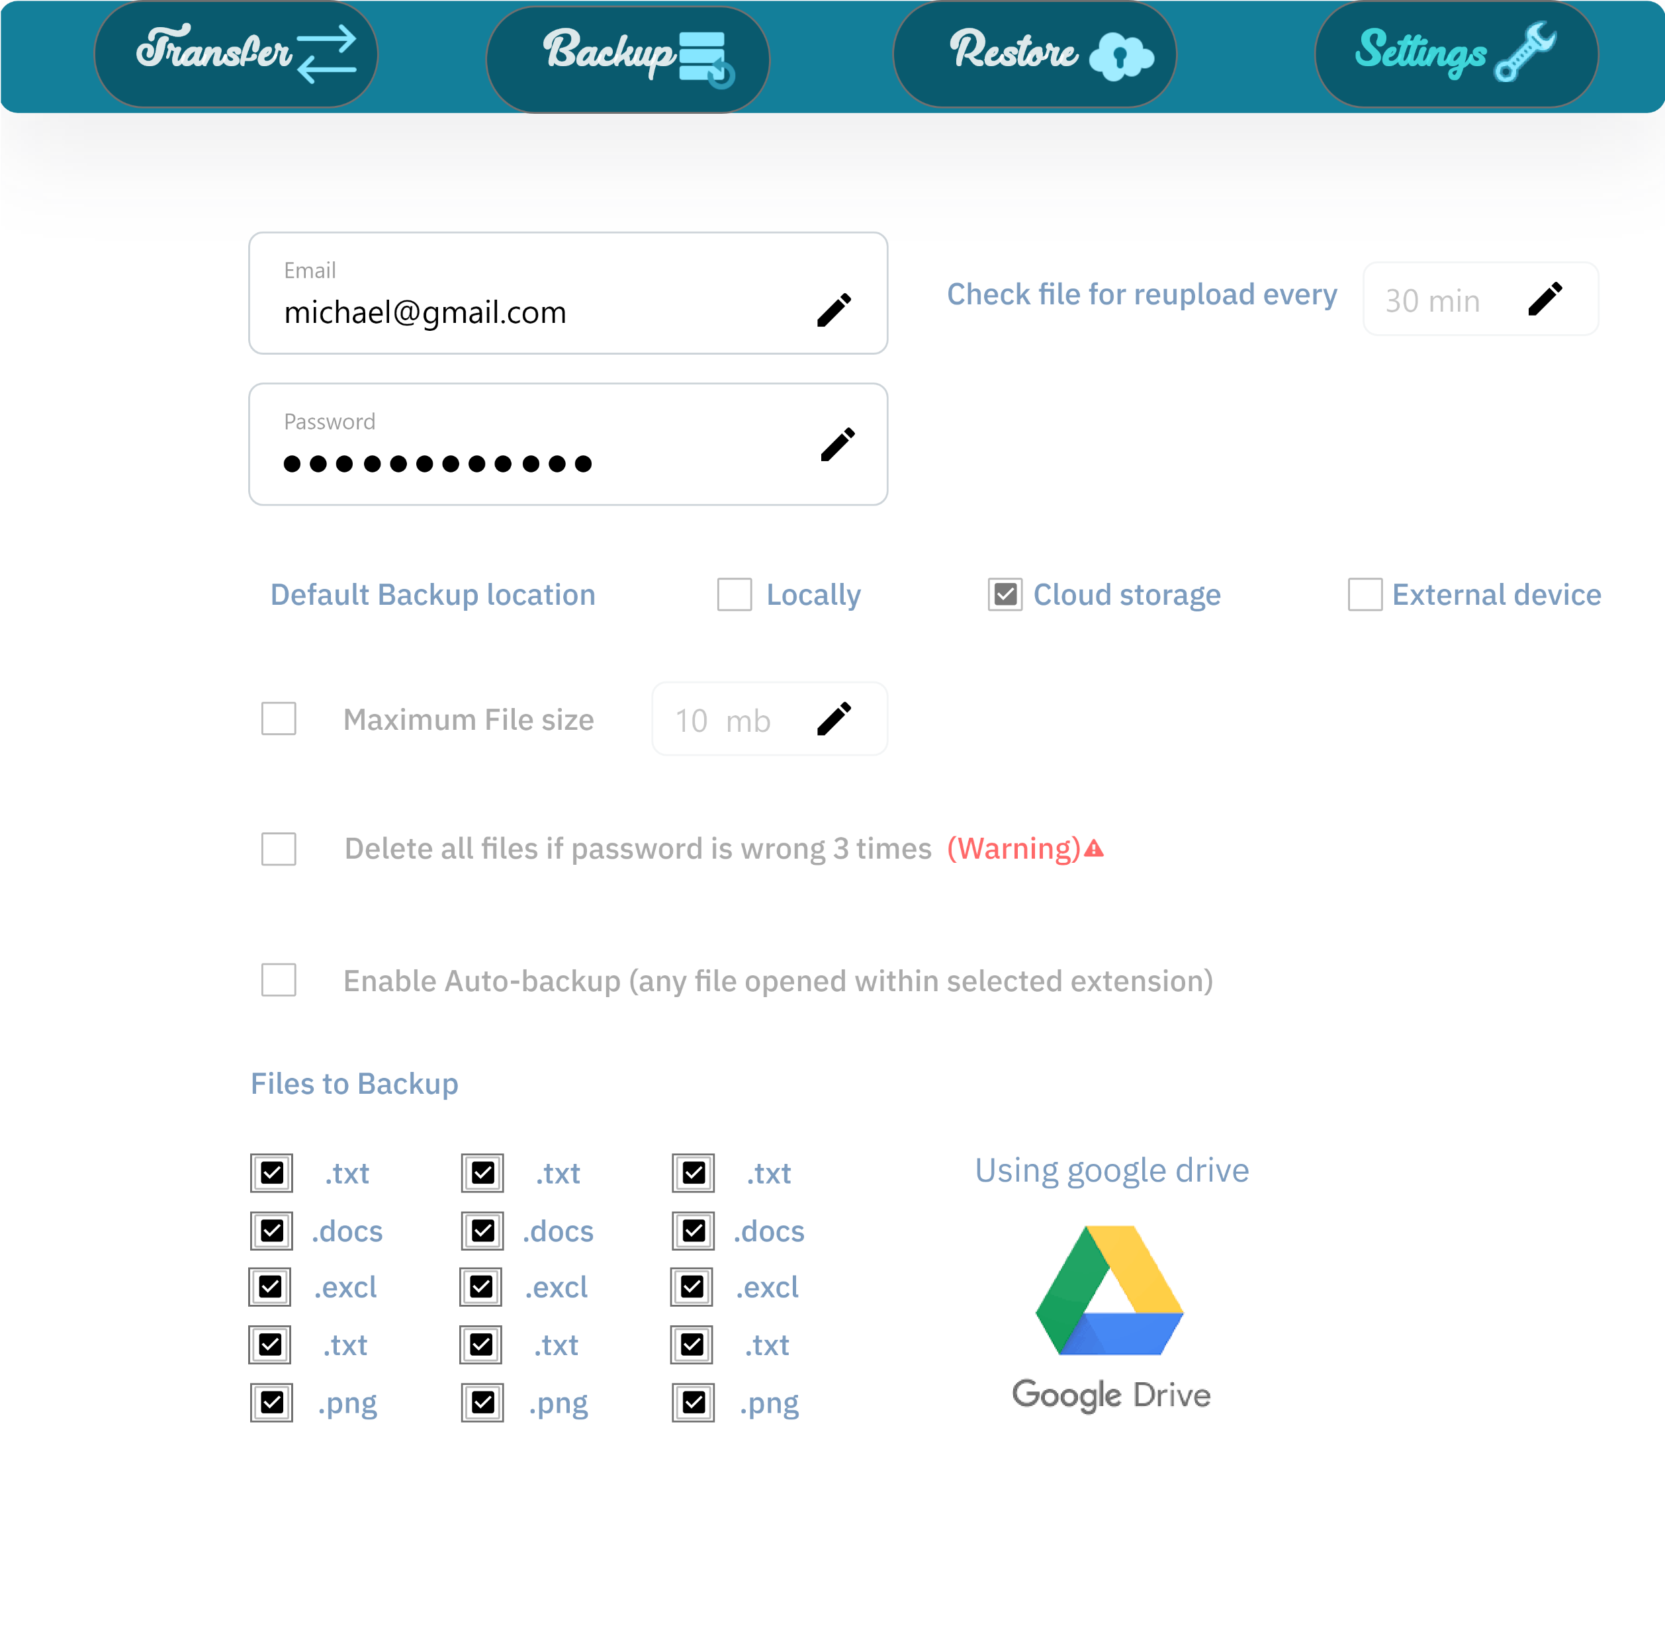
Future work

Slide 23
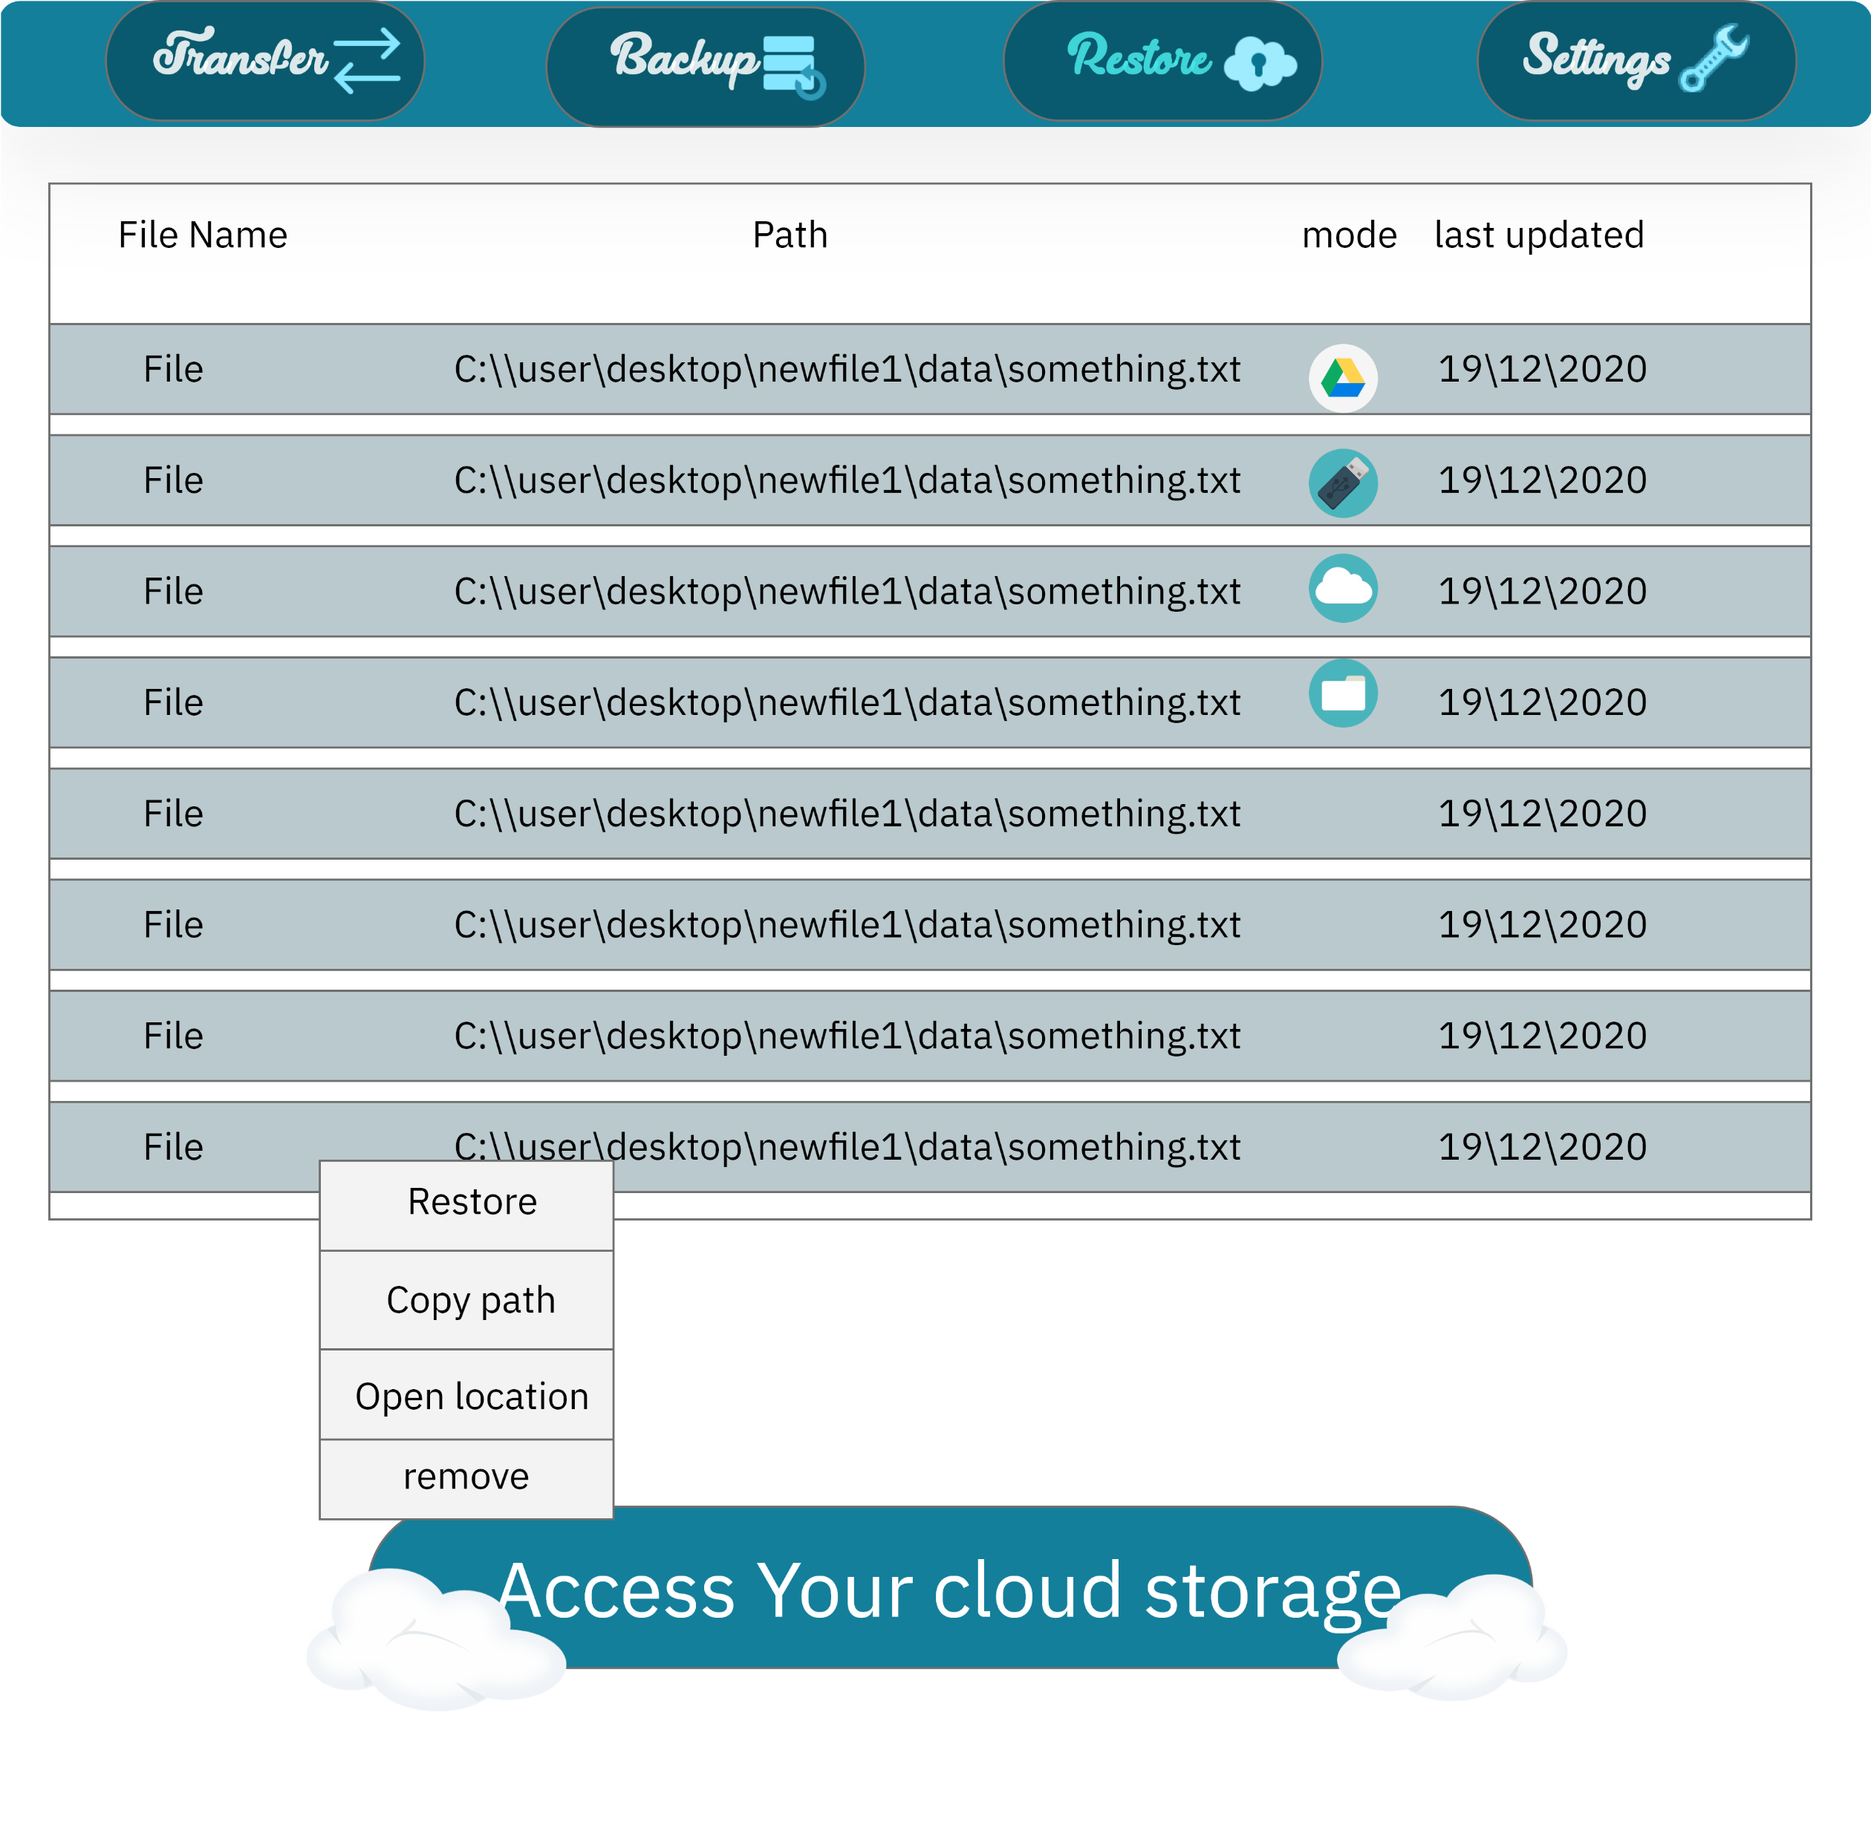
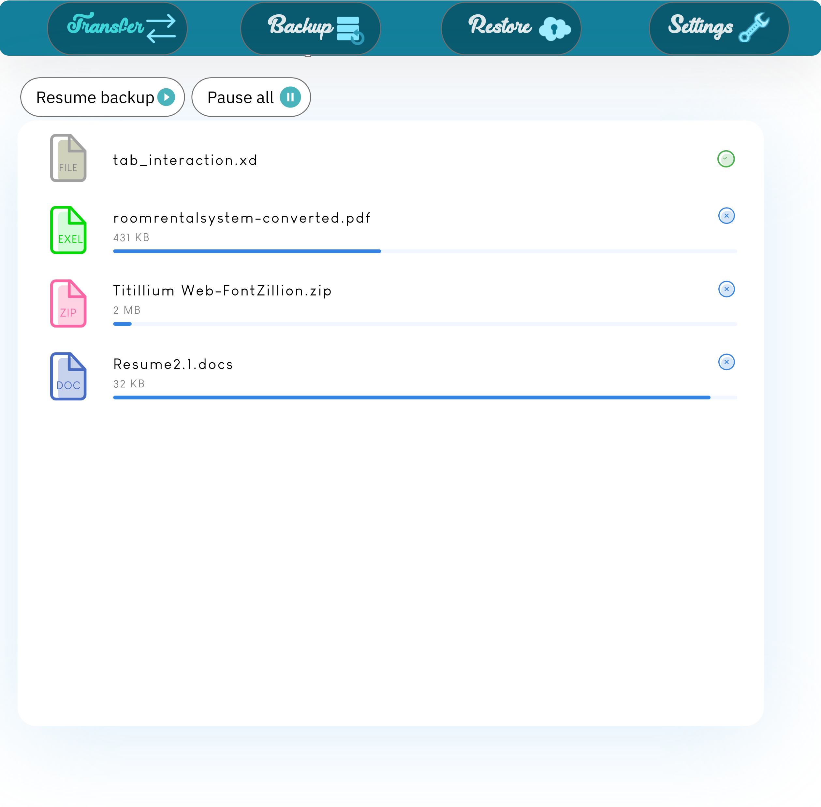
Future work

Slide 24
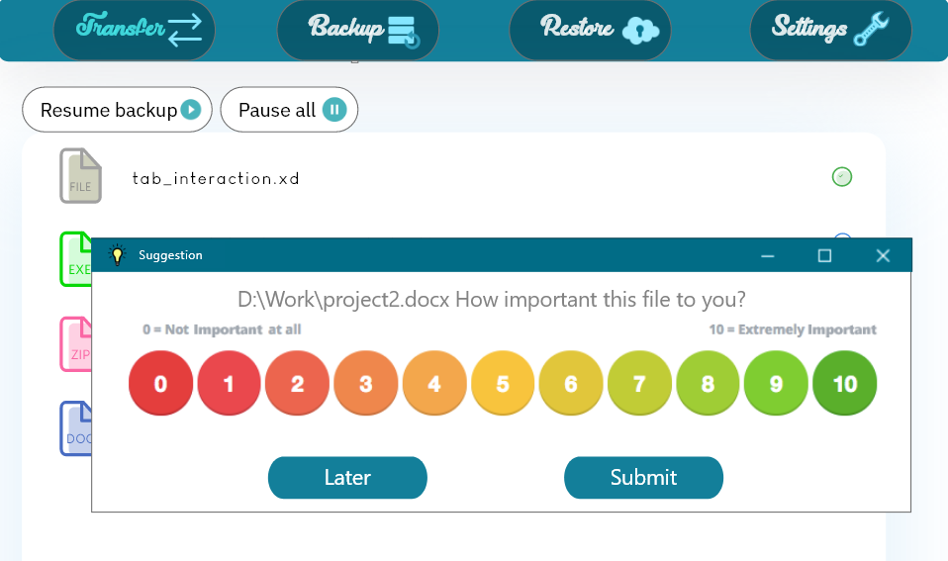
Future work

Slide 25

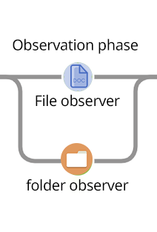
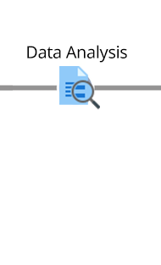
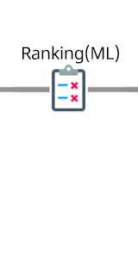

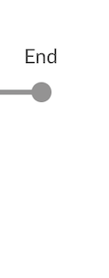
CONCLUSION
To sum up, We made multiple stages of pipelines, it starts with and goes as follow:
Observing opened docs and folders.
Then analysis collected sessions.
Machine learning to make decision of which file is important.
Encrypt and upload the file to the storage database (cloud).
Frequently check for file changes by hash-code:md5.

Slide 26
X
Q&A

