Slide 1
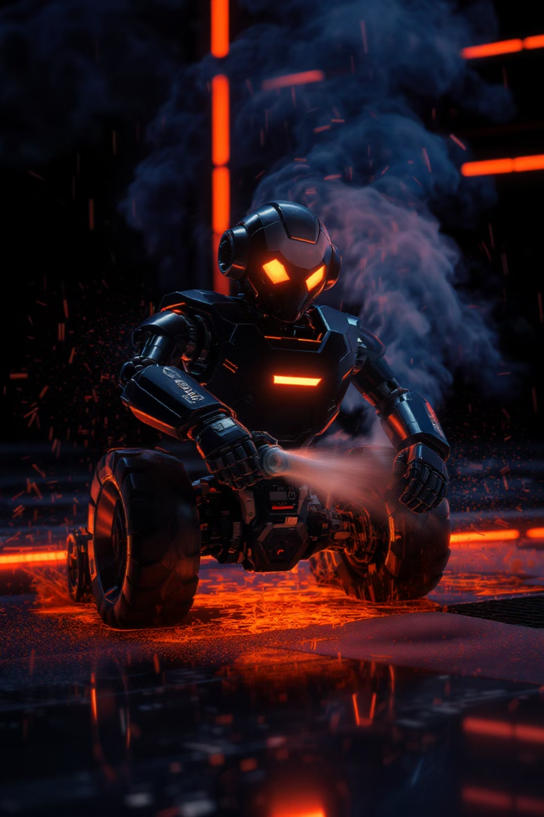
FIRE-X
Fire-Fighter Car Robot: Autonomous Flame Detection & Suppression
An autonomous fire-fighting robot designed to detect and extinguish flames using a hybrid architecture. The system combines an ESP32 microcontroller for real-time control with a Raspberry Pi 3 for computer vision-based flame detection using OpenCV.
By : Abd-Alhammed Mizher & Ezz-Aldeen Masre

Slide 2
Introduction & Motivation
Flame incidents pose significant risks to human lives and property, especially in indoor environments. Traditional firefighting methods often expose responders to dangerous conditions, highlighting a critical need for safer, more efficient alternatives. To address this, we developed a robot that can autonomously navigate, detect, and extinguish flames without human intervention.
We leveraged recent advancements in embedded systems and computer vision. The system uses an ESP32 microcontroller for hardware control and a Raspberry Pi 3 for advanced vision-based flame detection using OpenCV. This provides three key benefits:
Enhanced Safety
Rapid Response
Intelligent Detection
Reduces human exposure to dangerous fire conditions
Autonomous operation enables immediate action
Combines computer vision and infrared sensing for reliable flame detection

Slide 3
Evolution of Fire-Fighting Robots
The development of autonomous fire-fighting robots has evolved significantly over time, from simple microcontroller-based designs to sophisticated hybrid systems combining multiple technologies.
Early designs primarily used Arduino platforms for basic motor control and sensor integration but lacked computational power for advanced tasks. The introduction of single-board computers like Raspberry Pi enabled sophisticated algorithms such as OpenCV for visual flame detection.
Early Designs
Hybrid Approaches
Arduino-based robots with IR sensors and basic water nozzles (Adilshah et al., 2022)
Combined microcontroller and SBC systems for distributed computational loads
1
2
3
4
Advanced Processing
Current Project
Raspberry Pi-based systems combining thermal sensors with OpenCV (Sadiq et al., 2023)
Cost-effective ESP32/Raspberry Pi hybrid with mobile control capabilities
While advanced commercial robots like Thermite RS3 and Colossus exist, their prohibitive cost limits accessibility. This project aims to bridge this gap with a cost-effective prototype that replicates essential functionalities.

Slide 4

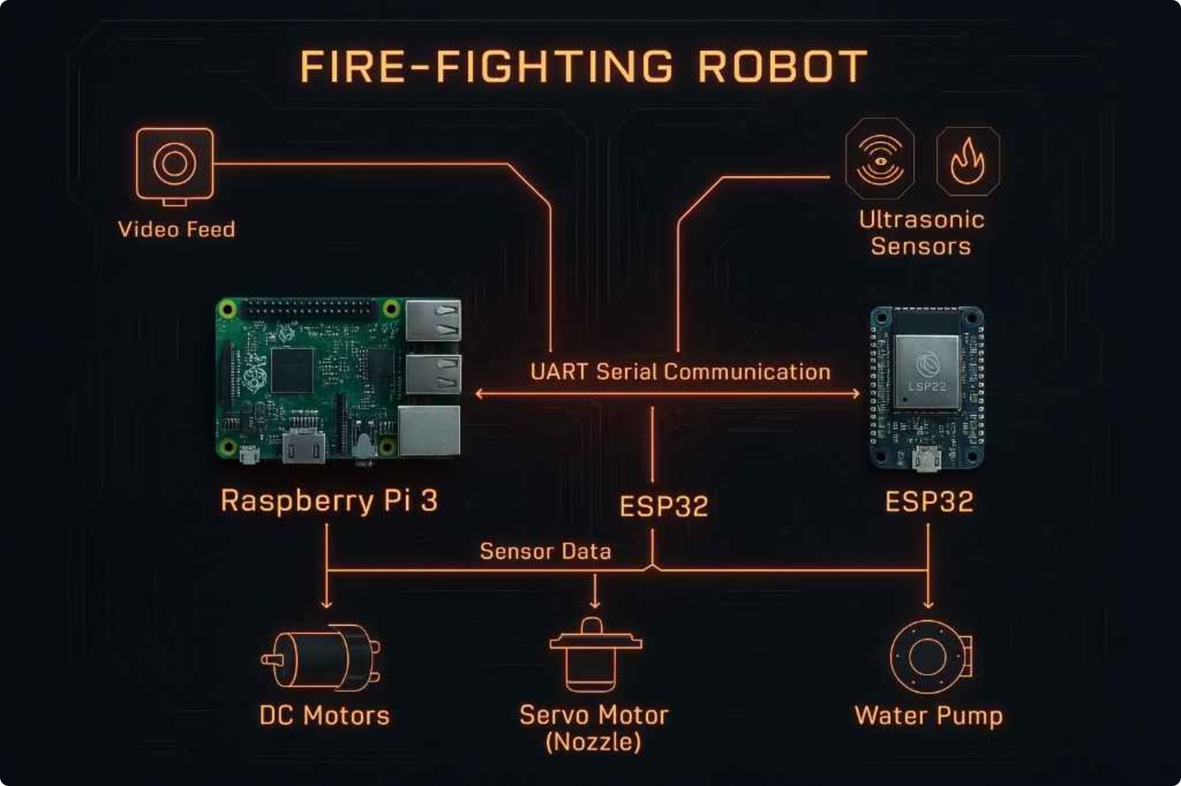




System Architecture Overview
Here is the core of our system: the hybrid architecture. As you can see in the diagram, it is based on two controllers working in tandem.
The Raspberry Pi 3 is our high-level brain, handling all the image processing and high-level decision-making. It communicates with the ESP32, which acts as our real-time controller, managing sensor readings, driving the motors, and activating the water suppression system. These two devices communicate seamlessly via UART serial communication.
The robot's operation can be broken down into four key stages:
Data Acquisition
Camera captures video feed while sensors collect environmental data like distance.
Processing
Raspberry Pi processes images using OpenCV while ESP32 handles sensor data
Decision Making
System determines optimal path and actions based on processed data
Execution
Motors drive robot to flame location and water pump activates to extinguish

Slide 5
Software Architecture & Methodology
The robot's functionality is governed by a sophisticated software architecture distributed across two primary processing units, complemented by a mobile application for flexible control.
ESP32 Responsibilities (Arduino C++)
Raspberry Pi Responsibilities (Python + OpenCV)
Real-time sensor data acquisition
Live video capture and processing
Precise control of motors and servo
Advanced flame detection using color filtering
Relay activation for water pump
Obstacle-free path calculation
Serial communication with Raspberry Pi
High-level command generation
Mobile app communication
Extinguish Mode
Engagement Mode
Upon reaching target proximity, servo aligns water nozzle towards flame and water pump activates to suppress the flame
Search Mode
Once a flame is detected, robot calculates and follows a path to approach the flame source, prioritizing direct line of sight
Robot autonomously navigates and scans the environment for flames using both IR sensors and camera, while avoiding obstacles

Slide 6



Performance Results
The Fire-Fighter Car Robot underwent extensive testing in a controlled laboratory environment to validate its core functionalities and performance capabilities.
90%
85%
Vision Detection
IR Detection
Accuracy in detecting flames within 2 meters using OpenCV-based vision system
Reliability in detecting open flames within 80cm radius using infrared sensors
90%
80%
Navigation
Extinguishing
Success rate in navigating environment and avoiding obstacles during Search Mode
Success rate in flame suppression, typically within 10 - 15 seconds of spray initiation
Communication latency between the Raspberry Pi and ESP32 via UART was consistently below 50ms, ensuring real-time responsiveness. The robot's hybrid approach to flame detection significantly enhanced reliability across various conditions and ranges.

Slide 7
Conclusion & Achievements
This project successfully demonstrates the implementation of an autonomous fire-fighting robot utilizing a robust hybrid architecture. By leveraging the Raspberry Pi's advanced computer vision capabilities and the ESP32's precise real-time control, the robot proved highly capable in real-world testing scenarios.
Hybrid Detection System
Responsive Control
Effective Suppression
The integrated approach of both vision-based and infrared sensor-based flame detection significantly enhanced detection reliability and range, achieving ~90% accuracy in camera-based detection.
Low-latency communication below 50ms between processing units enabled precise real-time control and actuation of the robot's systems.
The robot demonstrated consistent performance in autonomously detecting, approaching, and suppressing flames, achieving 8 out of 10 successful extinguishments in testing.

Slide 8






Future Development Opportunities
To further enhance the capabilities and applicability of the Fire-Fighter Car Robot, several key areas have been identified for future development and research.
Machine Learning
Implementing advanced ML models could enable classification of burning materials to adapt extinguishing strategies
Thermal Imaging
Incorporating thermal cameras would significantly improve flame localization in smoke-filled environments or low-light conditions
Outdoor Capability
Integrating GPS and developing robust navigation algorithms would enable operation in varied terrain
These enhancements would significantly expand the robot's capabilities, making it more versatile and effective in a wider range of firefighting scenarios while maintaining its core advantage of reducing human exposure to dangerous conditions.

Slide 9
So, in essence, What is FIRE-X:
It is more than just a prototype. It is a testament to the power of hybrid autonomy—a system where high-level vision meets real-time control to solve a critical problem. It is a machine engineered for precision and safety, capable of detecting fire with a vigilant eye, navigating autonomously, and extinguishing flames without ever putting a human life in danger.
It represents a cost-effective, intelligent step forward in fire safety, proving that innovative robotics can serve as a vital partner to human responders. It is our vision for a safer future.

